Slide 1



DR-STRaNGe: End-to-End System Design for DRAM-based True Random Number Generators
F. Nisa Bostancı
Ataberk Olgun Lois Orosa A. Giray Yağlıkçı
Jeremie S. Kim Hasan Hassan Oğuz Ergin Onur Mutlu
Notes:
Hello, my name is Nisa Bostancı
And I will be presenting our work
DR-STRANGE: End-to-End System Design for DRAM-based True Random Number Generators

Slide 2
DR-STRaNGe Summary
Motivation:
Random numbers are important for many applications
DRAM-based True Random Number Generators (TRNGs) can provide true random numbers at low cost on a wide range of systems
Problem: There is no end-to-end system design for DRAM-based TRNGs
Interference between regular memory requests and RNG requests significantly slows down concurrently running applications
Unfair prioritization of RNG applications degrades system fairness
High latency of DRAM-based TRNGs degrades the RNG applications’ performance
Goal: A low-cost and high-performance end-to-end system design for DRAM-based TRNGs
DR-STRaNGe: An end-to-end system design for DRAM-based TRNGs that
Reduces the interference between regular memory requests and RNG requests by separating them in the memory controller
Improves fairness across applications with an RNG-aware memory request scheduler
Hides the large TRNG latencies using a random number buffering mechanism combined with a new DRAM idleness predictor
Results: DR-STRaNGe
Improves the average performance of non-RNG (17.9%) and RNG (25.1%) applications
Improves the average system fairness (32.1%) when generating random numbers at a 5 Gb/s throughput
Reduces the average energy consumption (21%)
Notes:
I will first begin with a brief overview
[CLICK] Random numbers are important for many applications including security applications and DRAM-based true random number generators can provide true random numbers at low cost on a wide range of computing systems
[CLICK] However, no prior work on DRAM-based TRNGs provides an end-to-end system design to enable DRAM-based true random number generation in real systems.
We identify three key challenges for using DRAM-based TRNGs in current systems
[CLICK] as DRAM is used as main memory, random number generation in DRAM creates an interference between regular memory requests and RNG requests, which we call the RNG interference, this can degrade overall system performance by slowing down concurrently running applications
[CLICK]This RNG interference can cause unfair prioritization of applications that intensively use random numbers, which are called RNG applications, and degrade system fairness
[CLICK] And due to the high latency of DRAM-based TRNGs RNG applications can experience significant slowdowns.
[CLICK] Our goal is to design an end-to-end system for DRAM-based TRNGs with low cost and high performance.
[CLICK] To this end, we propose DR-STRANGE, An end-to-end system design for DRAM-based TRNGs that
[CLICK] reduces the RNG interference by separating RNG requests from regular requests in the memory controller,
[CLICK] improves fairness across applications with an RNG-aware memory request scheduler
[CLICK] hides the large TRNG latencies using a random number buffering mechanism combined with a new DRAM idleness predictor that accurately identifies idle DRAM periods
[CLICK] Based on our evaluations we Show that,
DR-STRaNGe improves the average performance of non-RNG and RNG applications by 17.9% and 25% respectively
It improves average system fairness by 32% when generating random numbers at a 5 Gb/s throughput
and it reduces average energy consumption by 21%.

Slide 3
Outline
Background
Motivation and Goal
DR-STRaNGe
Random Number Buffering Mechanism
RNG-Aware Scheduler
Application Interface
Evaluation
Conclusion
Notes:
I’ll start with a brief DRAM background

Slide 4
DRAM Organization
CPU
DRAM Module
Memory Controller
Chip
Channel
Chip
DRAM Bank
DRAM Bank
…
DRAM Bank
…
Memory Channel
Chip
Chip I/O
DRAM Bank
Row Decoder
Row Buffer
DRAM cell
Notes:
[CLICK] Here I Show a system with a CPU and a DRAM Module with several DRAM chips
[CLICK] Each DRAM chip consists of multiple DRAM banks, and these DRAM banks are accessed through one chip I/o
[CLICK] DRAM cells are organized as a two-dimensional array within each bank,
[CLICK] a DRAM cell stores a single bit of information as electrical charge
[CLICK] To Access a DRAM cell its row is activated by [CLICK] fetching the data stored in the cell to the row buffer
a request is serviced faster if the row is already in the row buffer

Slide 5
Memory Request Scheduling
Commonly used memory request schedulers aim to maximize throughput by leveraging the row buffer locality
Requests to open rows over all requests
Older requests over the younger ones
Request Scheduler
DRAM Module
Younger
Read (Row 5)
Row 1
Read (Row 1)
Row 2
App. A
Read (Row 2)
Row 3
App. B
…
Read (Row 1)
Memory Channel
Read (Row 3)
Row Buffer
Older
Read (Row 1)
Row 10
Notes:
The memory request scheduler decides which request will be scheduled based on the current status of the DRAM
Commonly used memory request schedulers aim to maximize throughput by leveraging the row buffer
[CLICK] They prioritize requests to open rows over all other requests
[CLICK] Then older requests over the younger ones
[CLICK] Here I Show a request scheduler with requests ordered in the age order from two applications. And in the beginning, None of the targeted rows are in the row buffer.

Slide 6
Memory Request Scheduling
Commonly used memory request schedulers aim to maximize throughput by leveraging the row buffer locality
Requests to open rows over all requests
Older requests over the younger ones
Request Scheduler
DRAM Module
Younger
Read (Row 5)
Row 1
Read (Row 1)
Row 2
App. A
Read (Row 2)
Row 3
App. B
…
Read (Row 1)
Memory Channel
Read (Row 3)
Row Buffer
Row 5
Row 10
Row 1
Row 3
Older
Read (Row 1)
Row 2
Notes:
[CLICK] The scheduler first schedules the oldest request and [CLICK] brings row one to the row buffer
[CLICK] Other read requests to row one can be served quickly since the row is already open, therefore the scheduler schedules them next
[CLICK] Then since there are no other requests to row one, it schedules the oldest request which is a read to row three
[CLICK] Then continues to Schedule in the same order

Slide 7
Outline
Background
Motivation and Goal
DR-STRaNGe
Random Number Buffering Mechanism
RNG-Aware Scheduler
Application Interface
Evaluation
Conclusion
Notes:
Let’s continue with the motivation

Slide 8

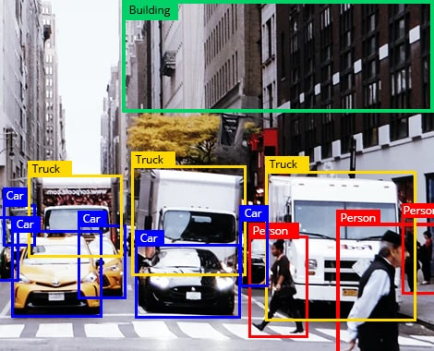
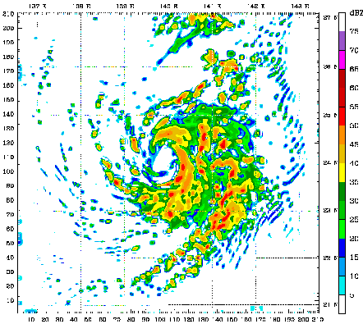
True Random Numbers (TRN)
True random numbers are widely used in real world
Security Applications:
Cryptographic key generation, authentication, countermeasures against hardware attacks, …
Emerging protocols require a very high TRNG throughput (~ Gb/s)
Other:
Randomized algorithms, scientific simulation, statistical sampling, blockchain applications, …
Notes:
[CLICK] True random numbers are used in many real-World applications
[CLICK] and the quality of the random number is especially important for a wide range of security applications such as cryptographic key generation, authentication and countermeasures against hardware attacks.
[CLICK] Emerging security protocols such as quantum key distribution protocols provide stronger security guarantees against attacks that target weak random numbers and these protocols require a very high true random number throughput in the order of several gigabits per second.
[CLICK] other use cases of true random numbers include randomized algorithms, scientific simulation and statistical sampling

Slide 9
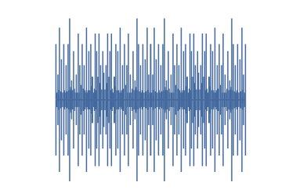
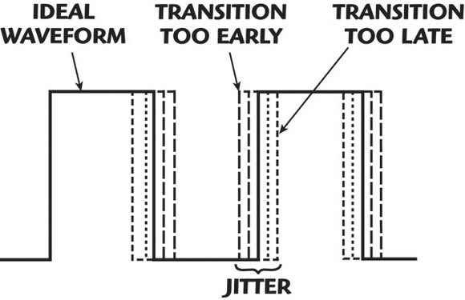
True Random Numbers (TRN)
True random numbers are generated by harnessing entropy resulting from random physical processes
Thermal Noise
Clock Jitter
Brownian Motion
Notes:
[CLICK} True random numbers are only generated by sampling random physical processes
such as
[CLICK] thermal noise,
clock jitter and
brownian motion

Slide 10
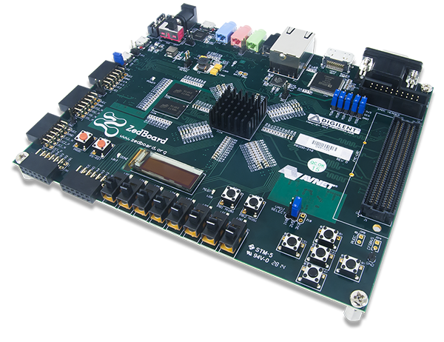

True Random Number Generators
Systems can generate true random numbers with dedicated hardware true random number generators (TRNGs)
Sample non-deterministic various physical phenomena
Not suitable for all systems
Notes:
[CLICK] Systems can generate true random numbers with dedicated hardware true random number generators
[CLICK] by sampling non deterministic various physical phenomena
[CLICK]However, dedicated hardware trngs cannot be easily used in all systems, for example embedded systems and processing in memory architectures

Slide 11
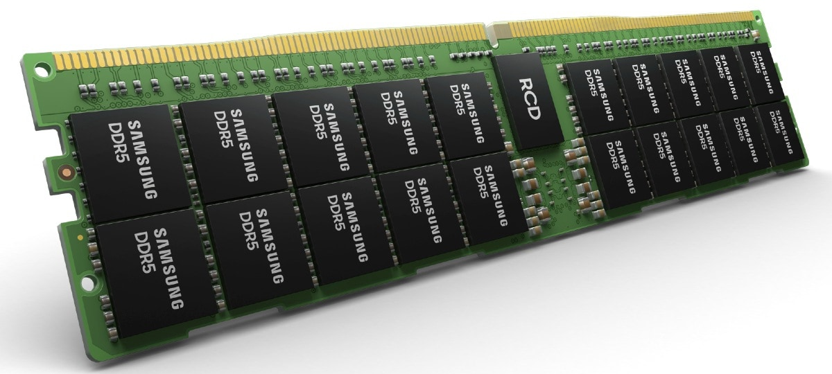
Why DRAM-based TRNGs?
DRAM is everywhere
DRAM-based TRNGs enable true random number generation within widely available DRAM chips
Notes:
In contrast, DRAM is widely available in most computer systems and can be integrated into mobile and IoT devices as main memory
Therefore, high-throughput DRAM-based TRNGs have the main advantage of availability over other TRNGs that typically require dedicated hardware
[CLICK]and they can enable true random number generation within widely available DRAM chips

Slide 12
DRAM-based TRNGs
1
Retention Failures
Fundamentally Slow: cells leak charge slowly
2
Start-up Values
Fundamentally Slow: requires power-cycle
3
Timing Failures
Fast: enabled by reducing DRAM command latencies
Notes:
Next, We will look at the entropy sources within DRAM that can be used to generate random numbers
Previous research proposes a set of DRAM-based TRNGs that leverage the randomness in
[CLICK] Retention failures, which uses random errors in DRAM cells due to charge leakage in the cells capacitor
[CLICK] Start-up values, that form after power-cycles
[CLICK] And timing failures that uses errors due to violating DRAM timing parameters [CLICK] ] Retention failure and start-up value based TRNGs have limited throughput Since charge leakage is fundamentally slow and power-cycles are expensive
[CLICK] However, Random DRAM timing failures can be induced quickly using carefully engineered and timed valid sequences of DRAM commands on commodity DRAM devices

Slide 13
DRAM-based TRNGs
1
Retention Failures
Fundamentally Slow: cells leak charge slowly
2
Start-up Values
Fundamentally Slow: requires power-cycle
3
Timing Failures
Fast: enabled by reducing DRAM command latencies
Notes:
Therefore they provide random numbers at high throughput with low latency and they can be used in a streaming manner unlike other mechanisms

Slide 14
Integration of DRAM-based TRNGs into Real Systems
No prior work provides an end-to-end system design to enable DRAM-based TRNGs in real systems
Notes:
However, none of the prior Work proposes an end-to-end system design to enable these mechanisms in real systems

Slide 15
Three Key Challenges
RNG Interference
significantly slows down concurrently-running applications
1.
Unfair Prioritization
degrades overall system fairness
2.
High TRNG Latency
degrades RNG applications’ performance
3.
Notes:
We identify three key challenges for integrating DRAM-based TRNGs into a baseline RNG-oblivious real system RNG interference, Unfair Prioritization, And high TRNG latency

Slide 16
Three Key Challenges
RNG Interference
significantly slows down concurrently-running applications
1.
Unfair Prioritization
degrades overall system fairness
2.
High TRNG Latency
degrades RNG applications’ performance
3.
Notes:
Lets talk about the RNG interference

Slide 17
RNG Interference
TRNG in DRAM can be intrusive in current systems that use DRAM as main memory and stall memory requests
t =
0
1
2
3
4
5
Memory Controller
(A) Non-RNG App.
1
2
3
Memory Controller
(B) RNG App.
RNG
RNG
Memory Controller
(C) Concurrently
running
RNG
1
RNG
2
1
2
memory request timeline
Notes:
True random number generation in DRAM is time-consuming and it can be very intrusive in a system that uses DRAM as main memory
[CLICK] Lets look at memory request scheduling timelines of non-RNG [CLICK] and RNG applications when executed alone and [CLICK] the timeline where they are executed concurrently on a system that uses DRAM-based TRNGs
[CLICK] This is the execution time of the non-RNG application
[CLICK] And when it runs concurrently with An RNG application you can see each memory request gets delayed and the applications execution time increases
[CLICK] And for the RNG application, the interference increases its execution time as well
This shows The RNG interference incurs significant slowdowns both for RNG and non-RNG applications

Slide 18
Three Key Challenges
RNG Interference
significantly slows down concurrently-running applications
RNG Interference
significantly slows down concurrently-running applications
1.
1.
Unfair Prioritization
degrades overall system fairness
Unfair Prioritization
degrades overall system fairness
2.
2.
High TRNG Latency
degrades RNG applications’ performance
High TRNG Latency
degrades RNG applications’ performance
3.
3.
Notes:
Next is unfair prioritization of RNG applications

Slide 19
Unfair Prioritization
Memory request schedulers can prioritize RNG applications to achieve high throughput
Stalls the non-RNG applications more and creates unfairness
t =
0
1
2
3
4
5
Memory Controller
(A) Non-RNG App.
1
2
3
1
Multiple DRAM accesses
2
High TRNG demand
Memory Controller
1
(B) RNG App.
2
3
4
RNG request
Memory Controller
(C) Concurrently
running
1
2
1
3
4
2
memory request timeline
Notes:
In a perfectly fair system no application experiences slowdown when it runs concurrently with another application
However, In a system that generates random numbers in DRAM Memory request schedulers can prioritize RNG applications to achieve *high throughput*
[CLICK]and by doing so the scheduler delays non-RNG applications’ memory requests more than the RNG requests and this creates unfairness
[CLICK] Here we Show the memory requests of two applications one [C] non-RNG and one [C] RNG application
The scheduler can prioritize RNG applications for two reasons
[CLICK] First, TRNG requires multiple DRAM accesses, so each random number request is translated into multiple memory requests
[CLICK] and second, RNG applications can have high required TRNG throughput and can create more memory requests
This results in RNG requests being scheduled more frequently to increase the overall throughput and [CLICK] higher memory stall times for regular memory requests
[CLICK] This can increase the memory stall time of non-RNG applications and degrade system fairness

Slide 20
Three Key Challenges
RNG Interference
significantly slows down concurrently-running applications
RNG Interference
significantly slows down concurrently-running applications
1.
1.
Unfair Prioritization
degrades overall system fairness
Unfair Prioritization
degrades overall system fairness
2.
2.
High TRNG Latency
degrades RNG applications’ performance
High TRNG Latency
degrades RNG applications’ performance
3.
3.
Notes:
And the third challenge is the high TRNG latency

Slide 21

High TRNG Latency
DRAM-based true random number generation has high latency and can degrade the performance of applications that use TRNGs
RNG application
1
...
t =
0
1
2
3
N
2
n : getRandom()
Memory Controller
1
2
3
4
{ /* code block * depending on the * random number n */ }
memory stall time
3
Notes:
DRAM-based true random number generation has high latency and can degrade the performance of applications that intensively use random numbers
[CLICK] Here I Show a code block from an RNG application and it consists of three main parts. [CLICK] The first one is the part of the code that does not depend on the random value
[CLICK] The Second is the part where the application requests a random number
[CLICK] And the third part is the code block that depends on the generated random number
[CLICK] Here is the memory request timeline of this application
[CLICK] After the unrelated code block DRAM generates a random number to serve the applications request [CLICK] and this takes some time, meanwhile requests that depend on the random value are delayed
after the RNG is completed [CLICK] DRAM serves the memory requests from the code block that depends on the random value.
[CLICK] As TRNG is time-consuming RNG applications suffer from long memory stall times due to the high TRNG latency

Slide 22
Our Goal
To develop a low-cost and high-performance end-to-end system design for DRAM-based TRNGs
Notes:
Our goal is to design an end-to-end system for DRAM- based
TRNGs with low cost and high performance that
(1) minimizes the slowdown of both RNG and non-RNG applications
(2) improves system fairness
and (3) mitigates the performance degradation
of RNG applications due to the high latency of DRAM
TRNG mechanisms.

Slide 23
Outline
Background
Motivation and Goal
DR-STRaNGe
Random Number Buffering Mechanism
RNG-Aware Scheduler
Application Interface
Evaluation
Conclusion
Notes:
Let’s look into our mechanism: DR-STRANGE

Slide 24
DR-STRaNGe: Overview
Random Number Buffering Mechanism
Predicts and utilizes idle DRAM channels to generate random numbers
Stores the generated random numbers in a buffer to be served to upcoming RNG requests
Serves RNG requests with low latency
RNG-Aware Memory Request Scheduler
Accumulates RNG and regular memory requests in separate queues
Schedules requests based on the priority levels set by the OS
Reduces the RNG interference and improves system fairness
Application Interface
Exposes a secure interface to applications that use random numbers
Completes the end-to-end system design and ensures security
Notes:
DR-STRANGE consists of three main components tackling three key challenges
[CLICK] The first component is the Random Number Buffering Mechanism,
[CLICK] it predicts and utilizes idle DRAM channles to generate random numbers
[CLICK] And stores the generated random numbers in a buffer to be served to upcoming random number requests
[CLICK] The random number buffering mechanism serves rng requests with low latency
[CLICK] The second component is the RNG-Aware memory request scheduler
[CLICK] It accumulates RNG and regular memory requests in separate memory scheduler queues
[CLICK] It schedules requests bassed on the priority levels set by the OS
[CLICK] RNG-aware scheduling reduces the RNG interference and improves system fairness
[CLICK] The third component is the Application interface
[CLICK] It exposes a secure interface to applications that use random numbers
[CLICK] And this completes the end-to-end system design and ensures security

Slide 25
Outline
Background
Motivation and Goal
DR-STRaNGe
Random Number Buffering Mechanism
RNG-Aware Scheduler
Application Interface
Evaluation
Conclusion
Notes:
I’ll explain how Random number buffering mechanism Works next

Slide 26
Random Number Buffering Mechanism
Generates and stores random numbers before they are requested, to be served in the future with low latency
Predicts DRAM idleness to generate random numbers with low overhead and stores them in a secure buffer
Memory Request Scheduler
Random Number Buffering Mechanism
DRAM
DRAM Idleness Predictor
Random Number Buffer
Notes:
Random number buffering mechanism generates and stores random numbers before they are requested, to be served in the future with low latency
[CLICK] It predicts DRAM idleness to generate random numbers with low overhead and stores the in a secure buffer

Slide 27
When to Generate Random Numbers
Before they are requested by an application
Two key metrics to determine when to generate random numbers:
Low DRAM Utilization
Low channel utilization due to the low rate of memory accesses
DRAM Idle Period Length
Number of idle DRAM cycles due to no memory accesses
Notes:
The key question is when do we generate random numbers? [CLICK] we need to generate random numbers before they are requested to hide the high TRNG latency and reduce the RNG interference
[CLICK] We propose a mechanism that takes two key metrics into account to decide when to generate random numbers for the random number buffer
[CLICK] The first one is the low DRAM utilization metric. It shows if a channel is not fully utilized due to the low rate of memory Accesses
[CLICK] And the second one is the DRAM Idle Period Length. This shows whether the channel will be idle long enough to generate random numbers with no overhead

Slide 28
Metric 1: Low DRAM Utilization
Determine if a channel has low utilization based on the number of queued memory requests in the memory request scheduler
Memory Request Scheduler
Random Number Buffering Mechanism
DRAM
1
Channel has low utilization?
DRAM Idleness Predictor
Low Util. Threshold
Random Number Buffer
2
Compare with The Low Utilization Threshold
Notes:
I’ll explain the first metric next:
[CLICK] We determine if a channel has low utilization based on the number of queued memory requests in the memory request scheduler.
[CLICK] This gives us an estimate of how busy the channel will be in the next cycles.
The random number buffering mechanism determines if a channel has low utilization by
[CLICK] checking the number of requests in the queue and
[CLICK] comparing it to a threshold called the low utilization threshold
After the channel is determined to have low utilization we use the second metric to decide whether to generate random numbers or to wait

Slide 29


Metric 2: DRAM Idle Period Length
Applications often do not fully utilize the DRAM bandwidth and this creates idle periods
Idle period lengths differ across applications based on the memory access pattern
Long Idle Period
t =
0
1
2
3
4
5
6
Memory Controller
1
IDLE TIME
2
DRAM
Application A
Memory Controller
DRAM
1
IDLE
2
IDLE
3
IDLE
Application B
memory request timeline
Short Idle Period
Notes:
For the second metric Let’s first talk about DRAM idleness
Applications often do not fully utilize the DRAM bandwidth and this creates
[CLICK] idle periods
[CLICK] Lengths of idle periods differ between applications based on the observed memory Access pattern [CLICK] and we can categorize idle periods into two classes based on their lengths
DRAM idle period length metric is used to determine if a channel will be IDLE
[CLICK] long enough to generate random numbers without any overhead in the near future and
[CLICK] it helps the mechanism to avoid short idle periods

Slide 30
DRAM Idleness Predictor
Key Idea: Use the last accessed memory address to predict the length of the idle period
READ #ADDRESS_1
(Followed by a long idle period)
t =
0
1
2
3
4
5
6
Memory Controller
#1
LONG IDLE PERIOD
…
DRAM
Multiple times
Memory Controller
DRAM
…
#1
RNG
RNG
RNG
RNG
RECALL THE LONG IDLE PERIOD
Notes:
At run time it is not possible to know the exact number of cycles that the channel will be idle for,
therefore we need to predict the future based on the observed memory Access pattern
[CLICK] The key idea of our DRAM idleness predictor is to use the last accessed memory addresses to predict the length of the idle periods
We propose correlating memory Access patterns with memory addresses that are followed by long idle periods
[CLICK] If a request to a certain memory address is
[CLICK] frequently followed by long idle periods this can point out to a certain memory Access pattern,
such as regular memory accesses leveraging the cache hierarchy.
[CLICK] And then, there is a good chance that in the future, the same address will be followed by a long idle period again.
[CLICK] So our predictor recalls the address that preceeds the long idle period and
[CLICK] starts to generate random numbers after that address is accessed again.

Slide 31
DRAM Idleness Predictor
Key Idea: Use the last accessed memory address to predict the length of the idle period
DRAM Idleness Predictor
2-bit saturating counter
0
Last Accessed Memory Address
0
1
Channel is idle
check the predictor table
1
3
2
2
3
Idle Period Length (CTR)
Prediction
increment the idle period length
Predictor Table
Notes:
DRAM Idleness Predictor is a lightweight predictor [CLICK] that is based on a predictor table of two-bit saturating counters.
It uses the last accessed memory addresses to predict idle period lengths, It also maintains a counter for the length of the current idle period
The prediction mechanism Works as follows
[CLICK] First, if a channel is idle [CLICK] it accesses the predictor counter with the last accessed memory address value.
[CLICK] Second, The prediction is determined as short or long idle period based on the counters state
[CLICK] And finally, we increment the idle period length counter as long as the channel stays idle

Slide 32
DRAM Idleness Predictor
Key Idea: Use the last accessed memory address to predict the length of the idle period
update
DRAM Idleness Predictor
4
2-bit saturating counter
1
Last Accessed Memory Address
new memory request
Check the period length
3
Update the predictor table
2
Idle Period Length (CTR)
5
reset
Predictor Table
Evaluation:
CTR < PeriodThreshold : short CTR ≥ PeriodThreshold : long
Notes:
The update process is as follows
[CLICK] First, when a new memory request is received the predictor gets the last accessed memory address value
[CLICK] It then checks the period length and compares it to a threshold that is called the Period Threshold, and determines whether the past idle period was short or long.
[CLICK] Third, it accesses the predictor table with the last accessed memory address, and updates the counter value based on the evaluation of the idle period length
[CLICK] After the entry is updated, the last accessed memory address is updated with the new memory request’s address
[CLICK] And the idle period length is reset to zero.

Slide 33
Random Number Buffering Mechanism
Memory Request Scheduler
Random Number Buffering Mechanism
DRAM
3
Long Idle Period
1
Channel has low utilization?
DRAM Idleness Predictor
Low Util. Threshold
get prediction
Random Number Buffer
4
2
Low utilization
Generates random numbers only if DRAM is not fully utilized and the idle period is predicted to be a long idle period
Notes:
To sum up these two metrics and how to use them, Our random number buffering mechanism Works as follows
[CLICK] the mechanism first determines if a channel has low utilization by observing the memory request scheduler.
[CLICK] Then if a channel has low utilization the mechanism gets a prediction from the idleness predictor.
[CLICK] If the predictor predicts idle period to be long enough to generate random numbers then the random number buffering mechanism starts to generate random numbers in DRAM
[CLICK] When enough bits are gathered it stores the generated random bits in the random number buffer

Slide 34
Outline
Background
Motivation and Goal
DR-STRaNGe
Random Number Buffering Mechanism
RNG-Aware Scheduler
Application Interface
Evaluation
Conclusion
Notes:
Now I will describe dr strange’s second major mechanism RNG-Aware memory request scheduler

Slide 35
RNG-Aware Scheduler
Goal: To schedule RNG requests without significantly stalling regular memory requests
Two main issues with prior RNG-oblivious schedulers:
RNG requests block regular memory requests due to the shared scheduler queue space
1.
Memory controller frequently switches between RNG and regular memory requests due to the RNG-oblivious scheduling decisions
2.
Notes:
[CLICK] The RNG-Aware schedulers goal is to schedule RNG requests without significantly stalling regular memory requests
[CLICK] there are two main issues with the prior RNG-oblivious scheduling mechanisms
[CLICK] First, RNG requests block regular memory requests due to the shared scheduler queue space
[CLICK] And second, the Memory controller frequently switches between serving RNG and regular memory requests due to the RNG-oblivious scheduling decisions

Slide 36
RNG-Aware Scheduler
Two key ideas:
Accumulate RNG requests in a separate scheduler queue to reduce contention for queue space
1.
Use application priority levels to schedule RNG and regular memory requests
2.
Notes:
[CLICK] We create our design based on two key ideas to solve these problems
[CLICK] The first idea is to accumulate RNG requests in a separate scheduler queue to reduce the contention for queue space between two types of requests
[CLICK] And the second idea is to use application priority levels to Schedule RNG and regular memory requests with switching in between less frequently

Slide 37
RNG-Aware Scheduler: Key Idea 1
Accumulate RNG requests in a separate scheduler queue to reduce contention for queue space
1.
Memory Request Scheduler
DRAM
contention
W
R
RNG
Notes:
Lets first talk about accumulating RNG requests in a separate scheduler queue
[CLICK] Without an RNG-aware design, the requests are enqueued either to the write request queue or the read request queue
[CLICK] Although RNG requests have different timing parameters they perform read operations and because of that [CLICK] they are enqueued to the read request queue
[CLICK] This can cause regular memory requests to be blocked by the RNG requests as they share the queue space
[CLICK] Our design creates a separate scheduler queue for RNG requests with the observation that they are essentially different types of requests
By creating a separate scheduler RNG-aware scheduler reduces the contention in the read request queue

Slide 38
RNG-Aware Scheduler: Key Idea 1
Accumulate RNG requests in a separate scheduler queue to reduce contention for queue space
1.
Memory Request Scheduler
DRAM
W
R
RNG
Notes:
[CLICK] This way more regular memory requests can be enqueued to the read request queue

Slide 39
RNG-Aware Scheduler: Key Idea 2
Use application priority levels to schedule RNG and regular memory requests
2.
The operating system manages hardware resources based on priority levels of applications
RNG-Aware scheduler
Can use these priority levels
Can identify applications that use TRNGs
Notes:
[CLICK] And the second idea of the RNG-Aware scheduler is to use application priority levels to Schedule RNG and regular memory requests
[CLICK] The operating system manages shared hardware resources using application priority levels
[CLICK] RNG aware scheduler [CLICK] can use these priority levels set by the OS and
{CLICK] It can identify applications that use TRNGs by observing the differences between RNG and regular memory requests
After that RNG-aware scheduler can prioritize different requests based on the priority levels

Slide 40
RNG-Aware Scheduler: Key Idea 2
Three possible cases:
R
RNG Prioritized.
RNG queue is prioritized to minimize the memory stall time of RNG application
RNG
Non-RNG Prioritized.
Regular read queue is prioritized to minimize non-RNG application’s memory stall time
R
RNG
Equal Priorities.
RNG queue is prioritized to quickly serve the RNG requests and minimize the RNG interference
R
RNG
Notes:
There are three possible cases regarding different priority levels
[CLICK] First, if an RNG application with an RNG request has higher priority than any other application
RNG-Aware scheduler prioritizes the RNG queue
This way it can minimize the memory stall time of RNG applications
[CLICK] Second, if a non-RNG application with a request has higher priority than other applications RNG-aware scheduler prioritizes the regular read queue
And it minimizes non-RNG applications’ memory stall time
[CLICK] And finally, if an RNG application with a request has the same priority as a non-RNG application with a request
Then, the RNG aware scheduler prioritizes the RNG queue to quickly serve the RNG requests
This way it can minimize the RNG interference and improve system performance
By employing these rules RNG-aware scheduler reduces the memory stall times of applications and improves system fairness

Slide 41
Outline
Background
Motivation and Goal
DR-STRaNGe
Random Number Buffering Mechanism
RNG-Aware Scheduler
Application Interface
Evaluation
Conclusion
Notes:
The third component of DR-STRaNGe is the application interface

Slide 42
Application Interface
Applications use a system call to request a random number
DR-STRaNGe serves the request from the random number buffer with low latency if enough random bits are present
DR-STRaNGe generates random numbers with low RNG interference and serve the request otherwise
Application
DR-STRaNGe
DRAM
1
Random Number Buffer
getrandom()
system call
2
Generate Random Number
Notes:
Applications use existing getrandom() system call which is modified to support DRAM-based TRNGs and communicate with DR-STRaNGe
[CLICK] If there are enough random bits in the random number buffer DR-STRaNGe serves the request from the buffer with low latency
[CLICK] Otherwise it will generate random numbers with low RNG interference and serve the request

Slide 43
Outline
Background
Motivation and Goal
DR-STRaNGe
Random Number Buffering Mechanism
RNG-Aware Scheduler
Application Interface
Evaluation
Conclusion
Notes:
I will share the key evaluation results next

Slide 44
Evaluation
Performance, fairness, energy efficiency, and area overhead
Cycle-level simulations using Ramulator [Kim+, CAL’16] and DRAMPower [Chandrasekar+]
System configuration:
D-RaNGe [Kim+, HPCA’19], and QUAC-TRNG [Olgun+, ISCA’21]
Processor | 1-,2-,4-,8-,16-core, 4 GHz clock frequency, 3-wide issue, 128-entry instruction window
DRAM | DDR3-1600, 800Mhz bus frequency, 4 channels, 1 rank/channel, 8 banks/rank, 64K rows/bank
Memory Controller | 32-entry read/write queues, FR-FCFS with a column cap of 16
DR-STRaNGe | 32-entry random read queue, RNG-aware scheduler, 256-entry predictor table/channel, 16-entry random number buffer
Notes:
[CLICK] We evaluate the performance, fairness, energy efficiency and area overhead of DR-STRaNGe
[CLICK] We conduct cycle-level simulations using Ramulator and DRAMPower
[CLICK] We simulate a realistic system with the configurations given in the slide
[CLICK] For DR-STRaNGe we use a thirty two-entry random read queue, an RNG-aware scheduler, a two hundred fifty six-entry predictor table per channel and sixteen entry random number buffer
[CLICK] We show DR-STRaNGe’s benefits using D-RaNGe and QUAC-TRNG as the RNG mechanism used in the system

Slide 45
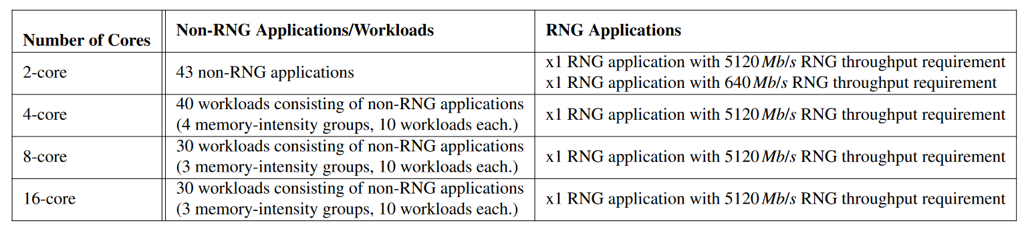
Evaluation
43 single-core applications from four benchmark suites:
SPEC CPU2006, TPC, MediaBench, YCSB
Synthetic RNG benchmarks with varying required TRNG throughputs
640 Mb/s, 1280 Mb/s, 2560 Mb/s, 5120 Mb/s
Multi-core workloads
Notes:
[CLICK] For our single core evaluations we yused 43 single core applications from four benchmark suites
[CLICK] We created synthetic RNG benchmarks with varying required TRNG throughputs
[CLICK] For multicore workloads we created 2-,4-,8 and 16-core workloads by randomly chosing multiple non-RNG applications and one RNG application

Slide 46
Comparison Points
System-level Comparison Points:
RNG-Oblivious Baseline Design
Greedy Idle Design
Perfect Idleness Predictor: predicts idle period lengths with 100% accuracy
Generates random numbers for the random number buffer without any overhead
Uses RNG-Aware scheduling
Memory Request Scheduler Comparison Points:
FR-FCFS + Column cap of 16 [Mutlu+, MICRO’07]
BLISS [Subramanian+, ICCD’14]
Notes:
We compare DR-STRaNGe to two system designs [CLICK] First We evaluate an RNG-oblivious Baseline Design
[CLICK] Second a greedy idle design. The Greedy Idle design is based on the idea of a design with a perfect DRAM Idleness Predictor. If an idle period reaches the PeriodThreshold we assume the design generates random bits without any overhead. However, it does not have a low utilization prediction mechanism
To simulate a fair comparison point, we also employ application-priority-based RNG-aware scheduling
[CLICK] To evaluate RNG-aware memory request scheduler we use two comparison points
[CLICK] First is a commonly employed memory request scheduler, FR-FCFS with column cap of sixteen
[CLICK] And the second comparison point is a state-of-the-art application aware memory request scheduler, BLISS, which uses a blacklisting method to improve fairness

Slide 47
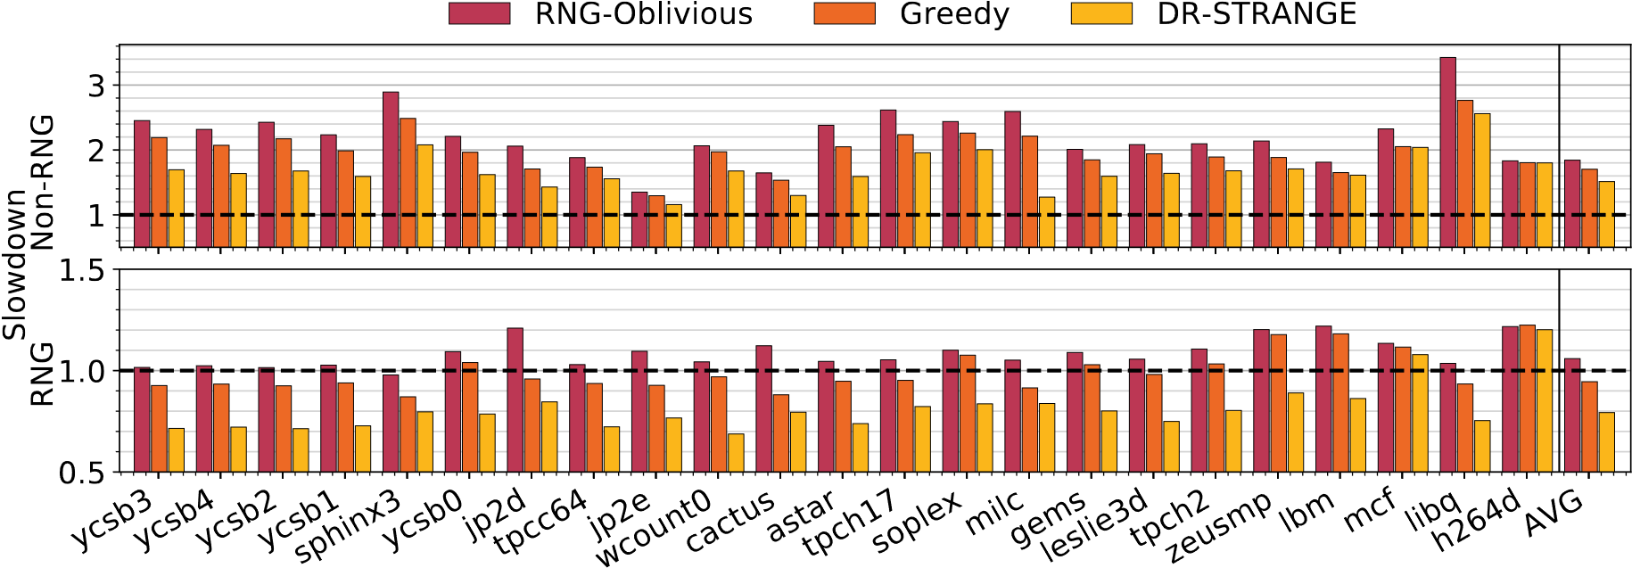
System Performance (Dual-Core)
Notes:
We compare the dual-core performance of RNG-oblivious baseline design, the Greedy Idle Design, and DR-STRaNGe
We Show the slowdown of results of [CLICK] nonRNG and [CLICK] RNG applications in workloads executed on a dual-core system, compared to the performance of each application when executed alone on a single core

Slide 48
System Performance (Dual-Core)
17.9%
25.1%
20.6%
DR-STRaNGe improves the performance of both non-RNG and RNG applications
DR-STRaNGe outperforms both baseline designs by leveraging the idle and low utilization periods to generate random numbers
Notes:
[CLICK] DR-STRANGE reduces the execution time of non-RNG applications by 17.9% [CLICK] and RNG applications by 25%
[CLICK] It also improves the average performance of RNG applications by 20% compared to the performance of RNG applications when executed alone on a single core, due to the lower TRNG latency
[CLICK] We conclude that DR-STRaNGe improves the performance of both non-RNG and RNG applications
[CLICK] It also outperforms both baseline designs by leveraging the idle and low utilization periods to generate random numbers

Slide 49
System Performance (Multi-Core)
4-, 8-, 16-core evaluation of system performance
DR-STRaNGe outperforms both baseline designs significantly
DR-STRaNGe’s performance improvement increases with the number of memory-intensive applications in the workload mix
Notes:
We evaluate DR-STRANGE with 4- 8- and sixteen cores and Show similar results to dual-core evaluation results
[CLICK] We conclude that DR-STRaNGe outperforms both RNG-oblivious and greedy idle designs significantly
[CLICK] and the performance improvement increases with the number of memory-intensive applications in the workload mix

Slide 50
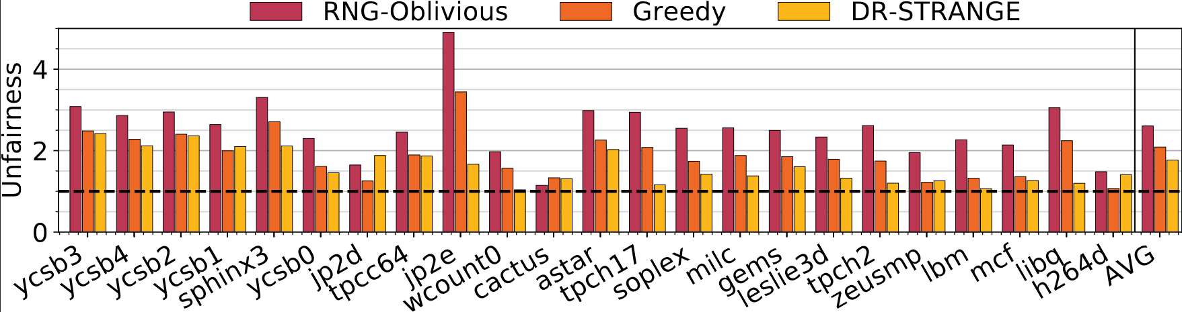
System Fairness
32.1%
DR-STRaNGe outperforms both designs by employing an RNG-aware scheduling policy and effectively reducing and controlling the RNG interference
Notes:
We compare the system fairness of the RNG-oblivious baseline, the greedy idle design and DR-STRaNGe
[CLICK] DR-STRANGE improves system fairness by thirty-two percent compared to the RNG-Oblivious design
[CLICK] We conclude that DR-STRaNGe outperforms both designs on average by employing an RNG-aware scheduling policy and effectively reducing and controlling the RNG interference

Slide 51
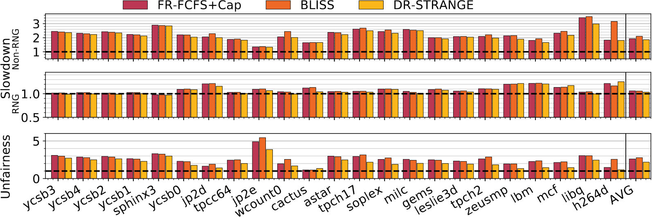
Impact of Memory Request Scheduling
RNG-Aware Scheduler
Notes:
To Show the impact of the memory requegst scheduling We compare FR-FCFS Cap, Bliss and the RNG-Aware Scheduler.
[CLICK] We Show the performance results of Non-RNG applications on top [CLICK] RNG applications in the middle and [CLICK] unfairness indices on the bottom subplot

Slide 52
Impact of Memory Request Scheduling
RNG-Aware Scheduler
RNG-Aware Scheduler outperforms both FR-FCFS+Cap [Mutlu+, MICRO’07] and BLISS [Subramanian+, ICCD’14]
RNG-Aware Scheduler improves average fairness by 16.1%
Notes:
[CLICK] We Show that RNG-aware scheduler outperforms both scheduler designs and
[CLICK] it improves average system fairness by sixteen percent

Slide 53
Area and Energy Analysis
Area:
CACTI [Muralimanohar+, HPL Tech. Report’09]
DR-STRaNGe incurs minor area overhead:
0.0022mm² (0.00048% of an Intel Cascade Lake CPU Core)
Energy:
DRAMPower [Chandrasekar+]
DR-STRaNGe reduces average energy consumption by 21%
Notes:
We evaluate area overhead of DR-STRaNGe
using CACTI and
Show that DR-STRanGE incurs minör area overhead compared to a Intel Cascade Lake CPU core
We also evalaute the energy consumption of the mechanism
using DRAMPower
and Show that DR-STRaNGe reduces the average energy consumption by 21%

Slide 54
More in the Paper
Security Analysis of DR-STRaNGe
Security of Random Numbers
Timing Side-Channel Attacks
Covert Channel Attacks
Denial of Service Attacks
Notes:
Here is the list of other analyses and results in our paper
[CLICK] We discuss the security of DR-STRaNGe and
[CLICK] Show that the random numbers stored in the Random number buffer are secure
because they can only be accessed with a system call and the bits are discarded after they are read
[CLICK] We discuss the random number buffer as a timing side-channel and conclude that DR-STRaNGe side channels are likely to be more difficult to exploit than timing side-channels from other shared hardware structures
because the buffer is constantly filled by the mechanism and if there are more than one RNG applications
it can be challenging to identify who is using the random numbers.
[CLICK] We discuss the random number buffer as a covert channel and conclude that
countermeasures against covert channels such as partitioning can be applied to the random number buffer.
[CLICK] We discuss denial of service attacks based on RNG requests, and conclude that
our RNG-aware scheduler’s rules can prevent such attacks. And in addition, it is also possible to mitigate such attacks with OS-level countermeasures.

Slide 55
More in the Paper
More Results
Impact of DRAM Idleness Predictor
Comparison to a Q-learning-based RL agent
Impact of the Random Number Buffer
Impact of Priority-based Scheduling
Impact of the Low Utilization Prediction
Experiments using QUAC-TRNG [Olgun+, ISCA’21]
Results of RNG Applications with Low RNG Demand
Notes:
[CLICK] And here is the list of results that you can find in our paper [CLICK] We evaluate the impact of the DRAM idleness predictor and compare the accuracy of different predictor mechanisms
We also used a q-learning-based reinforcement learning agent to predict the DRAM idleness by defining the DRAM idleness prediction problem as a reinforcement learning problem We conclude that our lightweight predictor achieves similar accuracy and performance results to the rl-based predictor with incurring less area overhead Our RL-based predictor design is described in the paper, please see the paper for more detail
[CLICK] We Show the performance impact of the random number buffer with different sizes, and conclude that a small buffer consisting of 16 entries can improve performance significantly
[CLICK] We evaluate the impact of priority-based scheduling and low utilization prediction
[CLICK] We evalaute DR-STRaNGe with a DRAM-based TRNG mechanims with higher throughput, QUAC-TRNG, and Show that DR-STRaNGe improves performance and fairness over the baseline regardless of the DRAM-based TRNG of the system.
[CLICK] We also evaluate workloads with RNG applications with low required TRNG throughput and Show that DR-STRANGE improves performance of these workloads as well.

Slide 56
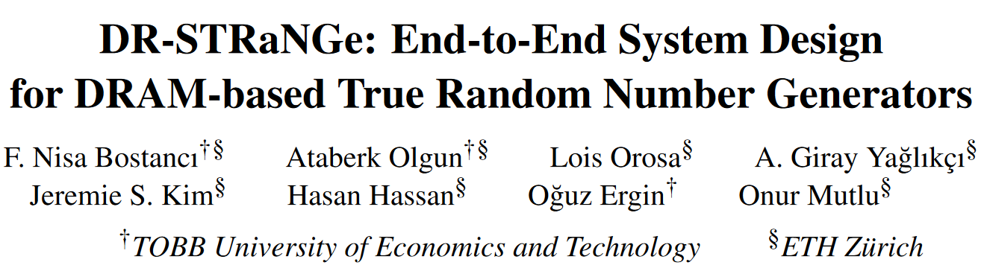
More in the Paper
Security Analysis of DR-STRaNGe
Security of Random Numbers
Timing Side-Channel Attacks
Covert Channel Attacks
Denial of Service Attacks
More Results
Impact of the Random Number Buffer
Impact of DRAM Idleness Predictor
Impact of Priority-based Scheduling
Impact of the Low Utilization Prediction
Experiments using QUAC-TRNG [Olgun+, ISCA’21]
Results of RNG Applications with Low RNG Demand
https://arxiv.org/abs/2201.01385
Notes:
For more analysis and results I invite you to read our paper

Slide 57
Outline
Background
Motivation and Goal
DR-STRaNGe
Random Number Buffering Mechanism
RNG-Aware Scheduler
Application Interface
Evaluation
Conclusion
Notes:
Now let me conclude

Slide 58
DR-STRaNGe Summary
Motivation:
Random numbers are important for many applications
DRAM-based True Random Number Generators (TRNGs) can provide true random numbers at low cost on a wide range of systems
Problem: There is no end-to-end system design for DRAM-based TRNGs
Interference between regular memory requests and RNG requests significantly slows down concurrently running applications
Unfair prioritization of RNG applications degrades system fairness
High latency of DRAM-based TRNGs degrades the RNG applications’ performance
Goal: A low-cost and high-performance end-to-end system design for DRAM-based TRNGs
DR-STRaNGe: An end-to-end system design for DRAM-based TRNGs that
Reduces the interference between regular memory requests and RNG requests by separating them in the memory controller
Improves fairness across applications with an RNG-aware memory request scheduler
Hides the large TRNG latencies using a random number buffering mechanism combined with a new DRAM idleness predictor
Results: DR-STRaNGe
Improves the average performance of non-RNG (17.9%) and RNG (25.1%) applications
Improves the average system fairness (32.1%) when generating random numbers at a 5 Gb/s throughput
Reduces the average energy consumption (21%)
Notes:
[CLICK] This paper tackles three key challenges for using DRAM-based TRNGs in real systems.
[CLICK] the RNG interference that significantly slows down concurrently running applications
[CLICK] unfair prioritization of RNG applications that degrades system fairness
[CLICK] And the high latency of DRAM-based TRNGs that degrades the performance of RNG applications
[CLICK] The goal of this work is to design an end-to-end system for DRAM-based TRNGs with low cost and high performance.
[CLICK] we propose DR-STRANGE, An end-to-end system design for DRAM-based TRNGs that
[CLICK] reduces the RNG interference by separating RNG requests from regular requests in the memory controller,
[CLICK] improves fairness across applications with an RNG-aware memory request scheduler
[CLICK] hides the large TRNG latencies using a random number buffering mechanism combined with a new DRAM idleness predictor that accurately identifies idle DRAM periods
[CLICK] Based on our evaluations we Show that,
DR-STRaNGe improves the average performance of non-RNG and RNG applications by seventeen point nine percent and twenty five percent respectively
İt improves average system fairness by thirty two percent when generating random numbers at a 5 Gb/s throughput
and it reduces average energy consumption by twenty one percent.

Slide 59
DR-STRaNGe: End-to-End System Design for DRAM-based True Random Number Generators
F. Nisa Bostancı
Ataberk Olgun Lois Orosa A. Giray Yağlıkçı
Jeremie S. Kim Hasan Hassan Oğuz Ergin Onur Mutlu
Notes:
And that concludes my talk. Thank you for your time and attention.

