Slide 1



DR-STRaNGe: End-to-End System Design for DRAM-based True Random Number Generators
F. Nisa Bostancı
Ataberk Olgun Lois Orosa A. Giray Yağlıkçı
Jeremie S. Kim Hasan Hassan Oğuz Ergin Onur Mutlu
Notes:
Hello, my name is Nisa Bostancı
And I will be presenting our work
DR-STRANGE: End-to-End System Design for DRAM-based True Random Number Generators

Slide 2
DR-STRaNGe Summary
Motivation:
Random numbers are important for many applications
DRAM-based True Random Number Generators (TRNGs) can provide true random numbers at low cost on a wide range of systems
Problem: There is no end-to-end system design for DRAM-based TRNGs
Interference between regular memory requests and RNG requests significantly slows down concurrently running applications
Unfair prioritization of RNG applications degrades system fairness
High latency of DRAM-based TRNGs degrades the RNG applications’ performance
Goal: A low-cost and high-performance end-to-end system design for DRAM-based TRNGs
DR-STRaNGe: An end-to-end system design for DRAM-based TRNGs that
Reduces the interference between regular memory requests and RNG requests by separating them in the memory controller
Improves fairness across applications with an RNG-aware memory request scheduler
Hides the large TRNG latencies using a random number buffering mechanism combined with a new DRAM idleness predictor
Results: DR-STRaNGe
Improves the average performance of non-RNG (17.9%) and RNG (25.1%) applications
Improves the average system fairness (32.1%) when generating random numbers at a 5 Gb/s throughput
Reduces the average energy consumption (21%)
Notes:
I will first begin with a brief overview
[CLICK] Random numbers are important for many applications including security applications and DRAM-based true random number generators can provide true random numbers at low cost on a wide range of computing systems
[CLICK] However, no prior work on DRAM-based TRNGs provides an end-to-end system design to enable DRAM-based true random number generation in real systems.
We identify three key challenges for using DRAM-based TRNGs in current systems
[CLICK] as DRAM is used as main memory, random number generation in DRAM creates an interference between regular memory requests and RNG requests, which we call the RNG interference, this can degrade overall system performance by slowing down concurrently running applications
[CLICK]This RNG interference can cause unfair prioritization of applications that intensively use random numbers, which are called RNG applications, and degrade system fairness
[CLICK] And due to the high latency of DRAM-based TRNGs RNG applications can experience significant slowdowns.
[CLICK] Our goal is to design an end-to-end system for DRAM-based TRNGs with low cost and high performance.
[CLICK] To this end, we propose DR-STRANGE, An end-to-end system design for DRAM-based TRNGs that
[CLICK] reduces the RNG interference by separating RNG requests from regular requests in the memory controller,
[CLICK] improves fairness across applications with an RNG-aware memory request scheduler
[CLICK] hides the large TRNG latencies using a random number buffering mechanism combined with a new DRAM idleness predictor that accurately identifies idle DRAM periods
[CLICK] Based on our evaluations we Show that,
DR-STRaNGe improves the average performance of non-RNG and RNG applications by 17.9% and 25% respectively
İt improves average system fairness by 32% when generating random numbers at a 5 Gb/s throughput
and it reduces average energy consumption by 21%.

Slide 3

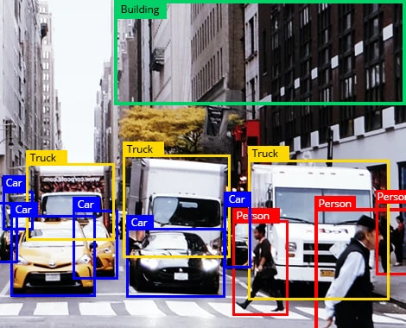
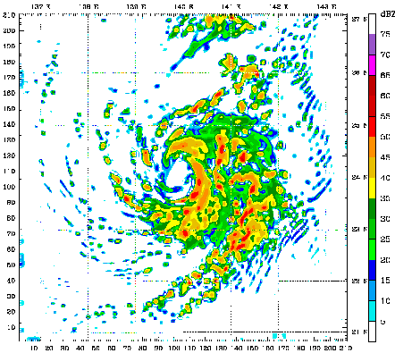
True Random Numbers (TRN)
True random numbers are critical for many real-world applications
True random numbers are generated by harnessing entropy resulting from random physical processes
Dedicated hardware true random number generators (TRNGs) cannot be easily used in all systems
Notes:
Let me motivate our work first
[CLICK] True random numbers are critical for many real-World applications
[CLICK] Such as security applications, randomized algorithms and scientific simulations.
[CLICK} and they can be only generated by sampling random physical processes Systems can generate true random numbers with dedicated hardware true random number generators
[CLICK]However, dedicated hardware trngs cannot be easily used in all systems, for example embedded systems and processing in memory architectures

Slide 4
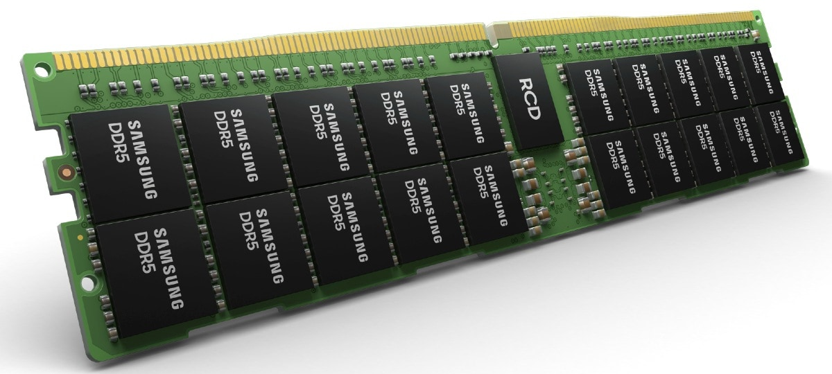
Why DRAM-based TRNGs?
DRAM is widely available in most computer systems and can be integrated into mobile and IoT devices as main memory
DRAM-based TRNGs enable true random number generation within widely available DRAM chips
Notes:
In contrast, DRAM is widely available in most computer systems and can be integrated into mobile and IoT devices as main memory
[CLICK]and they can enable low-cost and high throughput true random number generation within widely available DRAM chips

Slide 5
Integration of DRAM-based TRNGs into Real Systems
No prior work provides an end-to-end system design to enable DRAM-based TRNGs in real systems
Notes:
However, none of the prior Work proposes an end-to-end system design to enable these mechanisms in real systems

Slide 6
Three Key Challenges
RNG Interference
significantly slows down concurrently-running applications
1.
Unfair Prioritization
degrades overall system fairness
2.
High TRNG Latency
degrades RNG applications’ performance
3.
Notes:
We identify three key challenges for integrating DRAM-based TRNGs into a baseline RNG-oblivious real system The first challenge is the RNG interference,
True random number generation in DRAM is time-consuming and it can be very intrusive in a system that uses DRAM as main memory. It can stall memory requests and the interference between RNG and regular memory requests can significantly slow down both RNG and non-RNG applications
[C] The second challenge is the Unfair Prioritization of RNG applications
, In a system that generates random numbers in DRAM, Memory request schedulers can prioritize RNG applications to achieve high throughput because RNG applications can create more memory requests based on the true random number throughput they require. this slows down nonRNG applications and degrades system fairness
[C] And the third challenge is the high TRNG latency, DRAM-based true random number generation has high latency and can degrade the performance of applications that intensively use random numbers

Slide 7
Our Goal
To develop a low-cost and high-performance end-to-end system design for DRAM-based TRNGs
Notes:
Our goal is to design an end-to-end system for DRAM- based
TRNGs with low cost and high performance that
(1) minimizes the slowdown of both RNG and non-RNG applications
(2) improves system fairness
and (3) mitigates the performance degradation
of RNG applications due to the high latency of DRAM
TRNG mechanisms.

Slide 8
DR-STRaNGe: Overview
DR-STRaNGe
DRAM
Application Interface
Random Number Buffering Mechanism
RNG-Aware Scheduler
Notes:
DR-STRANGE consists of three main components tackling three key challenges
Random Number Buffering Mechanism
RNG-aware scheduler
And the application interface

Slide 9
DR-STRaNGe: Overview
DR-STRaNGe
DRAM
Application Interface
RN Buffering Mechanism
RNG-Aware Scheduler
DRAM Idleness Predictor
Key Idea: Use the last accessed memory addresses to predict the length of the idle periods
Last Accessed Memory Address
Predictor Table
2-bit saturating counter
Random Number Buffer
Predicts and utilizes idle DRAM channels to generate random numbers
Stores the generated random numbers in a buffer to be served to upcoming RNG requests
Serves RNG requests with low latency
Notes:
[CLICK] The first component is the Random Number Buffering Mechanism,
[CLICK] it predicts and utilizes idle DRAM channels to generate random numbers
[CLICK] And stores the generated random numbers in a buffer to be served to upcoming random number requests
[CLICK] The key idea of our DRAM idleness predictor is to use the last accessed memory addresses to predict the length of the idle periods
Our lightweight predictor uses the last accessed memory address to Access the predictor table that consists of two bit saturating counters and predicts the length of the idle period as long or short compared to the time it takes to generate random numbers,
this way the mechanism avoids short idle periods that increases the RNG interference and generates random numbers only in long idle periods
[CLICK] Combining these two components the random number buffering mechanism generates random numbers with low RNG interference and serves the RNG requests with low latency

Slide 10
DR-STRaNGe: Overview
DR-STRaNGe
DRAM
Application Interface
RN Buffering Mechanism
RNG-Aware Scheduler
Write Queue
Read Queue
RNG Queue
PRIORITY
Accumulates RNG and regular memory requests in separate queues
Schedules requests based on the priority levels set by the operating system
Reduces the RNG interference and improves system fairness
Notes:
[CLICK] The second component is the RNG-Aware memory request scheduler
[CLICK] It accumulates RNG and regular memory requests in [CLICK] separate memory scheduler queues to reduce the contention for queue space
[CLICK] And It schedules requests based on the priority levels set by the operating system
The operating system uses application priority levels to manage hardware resources, and the rng-aware scheduler can also use these priority levels and Schedule RNG and regular memory requests
[CLICK] This way it reduces the RNG interference and improves the system fairness

Slide 11
DR-STRaNGe: Overview
DR-STRaNGe
DRAM
Application Interface
RN Buffering Mechanism
RNG-Aware Scheduler
Exposes a secure interface to applications that use random numbers
Completes the end-to-end system design and ensures security
Notes:
The third component is the application interface
It exposes a secure interface to applications that use random numbers
And limits the Access to security-critical components such as the random number buffer
And this completes the end-to-end system design and ensures security

Slide 12
Evaluation
Performance, fairness, energy efficiency, and area overhead
Cycle-level simulations using Ramulator [Kim+, CAL’16] and DRAMPower [Chandrasekar+]
System configuration:
Processor | 1-,2-,4-,8-,16-core, 4 GHz clock frequency, 3-wide issue, 128-entry instruction window
DRAM | DDR3-1600, 800Mhz bus frequency, 4 channels, 1 rank/channel, 8 banks/rank, 64K rows/bank
Memory Controller | 32-entry read/write queues, FR-FCFS with a column cap of 16
DR-STRaNGe | 32-entry random read queue, RNG-aware scheduler, 256-entry predictor table/channel, 16-entry random number buffer
Notes:
[CLICK] We evaluate the performance, fairness, energy efficiency and area overhead of DR-STRaNGe
[CLICK] We conduct cycle-level simulations using Ramulator and DRAMPower
[CLICK] We simulate a realistic system and model DR-STRaNGe, using the configurations given in the slide

Slide 13
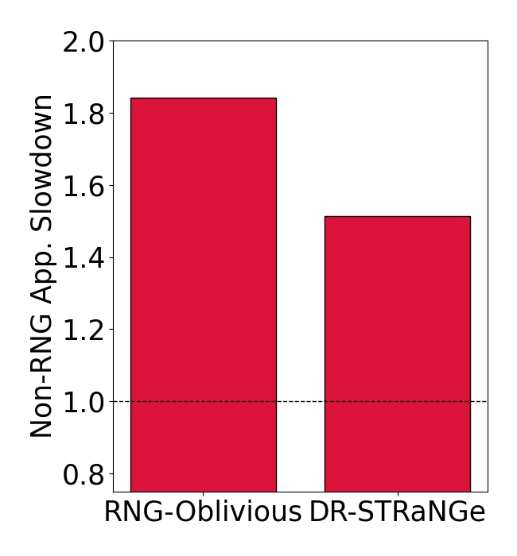
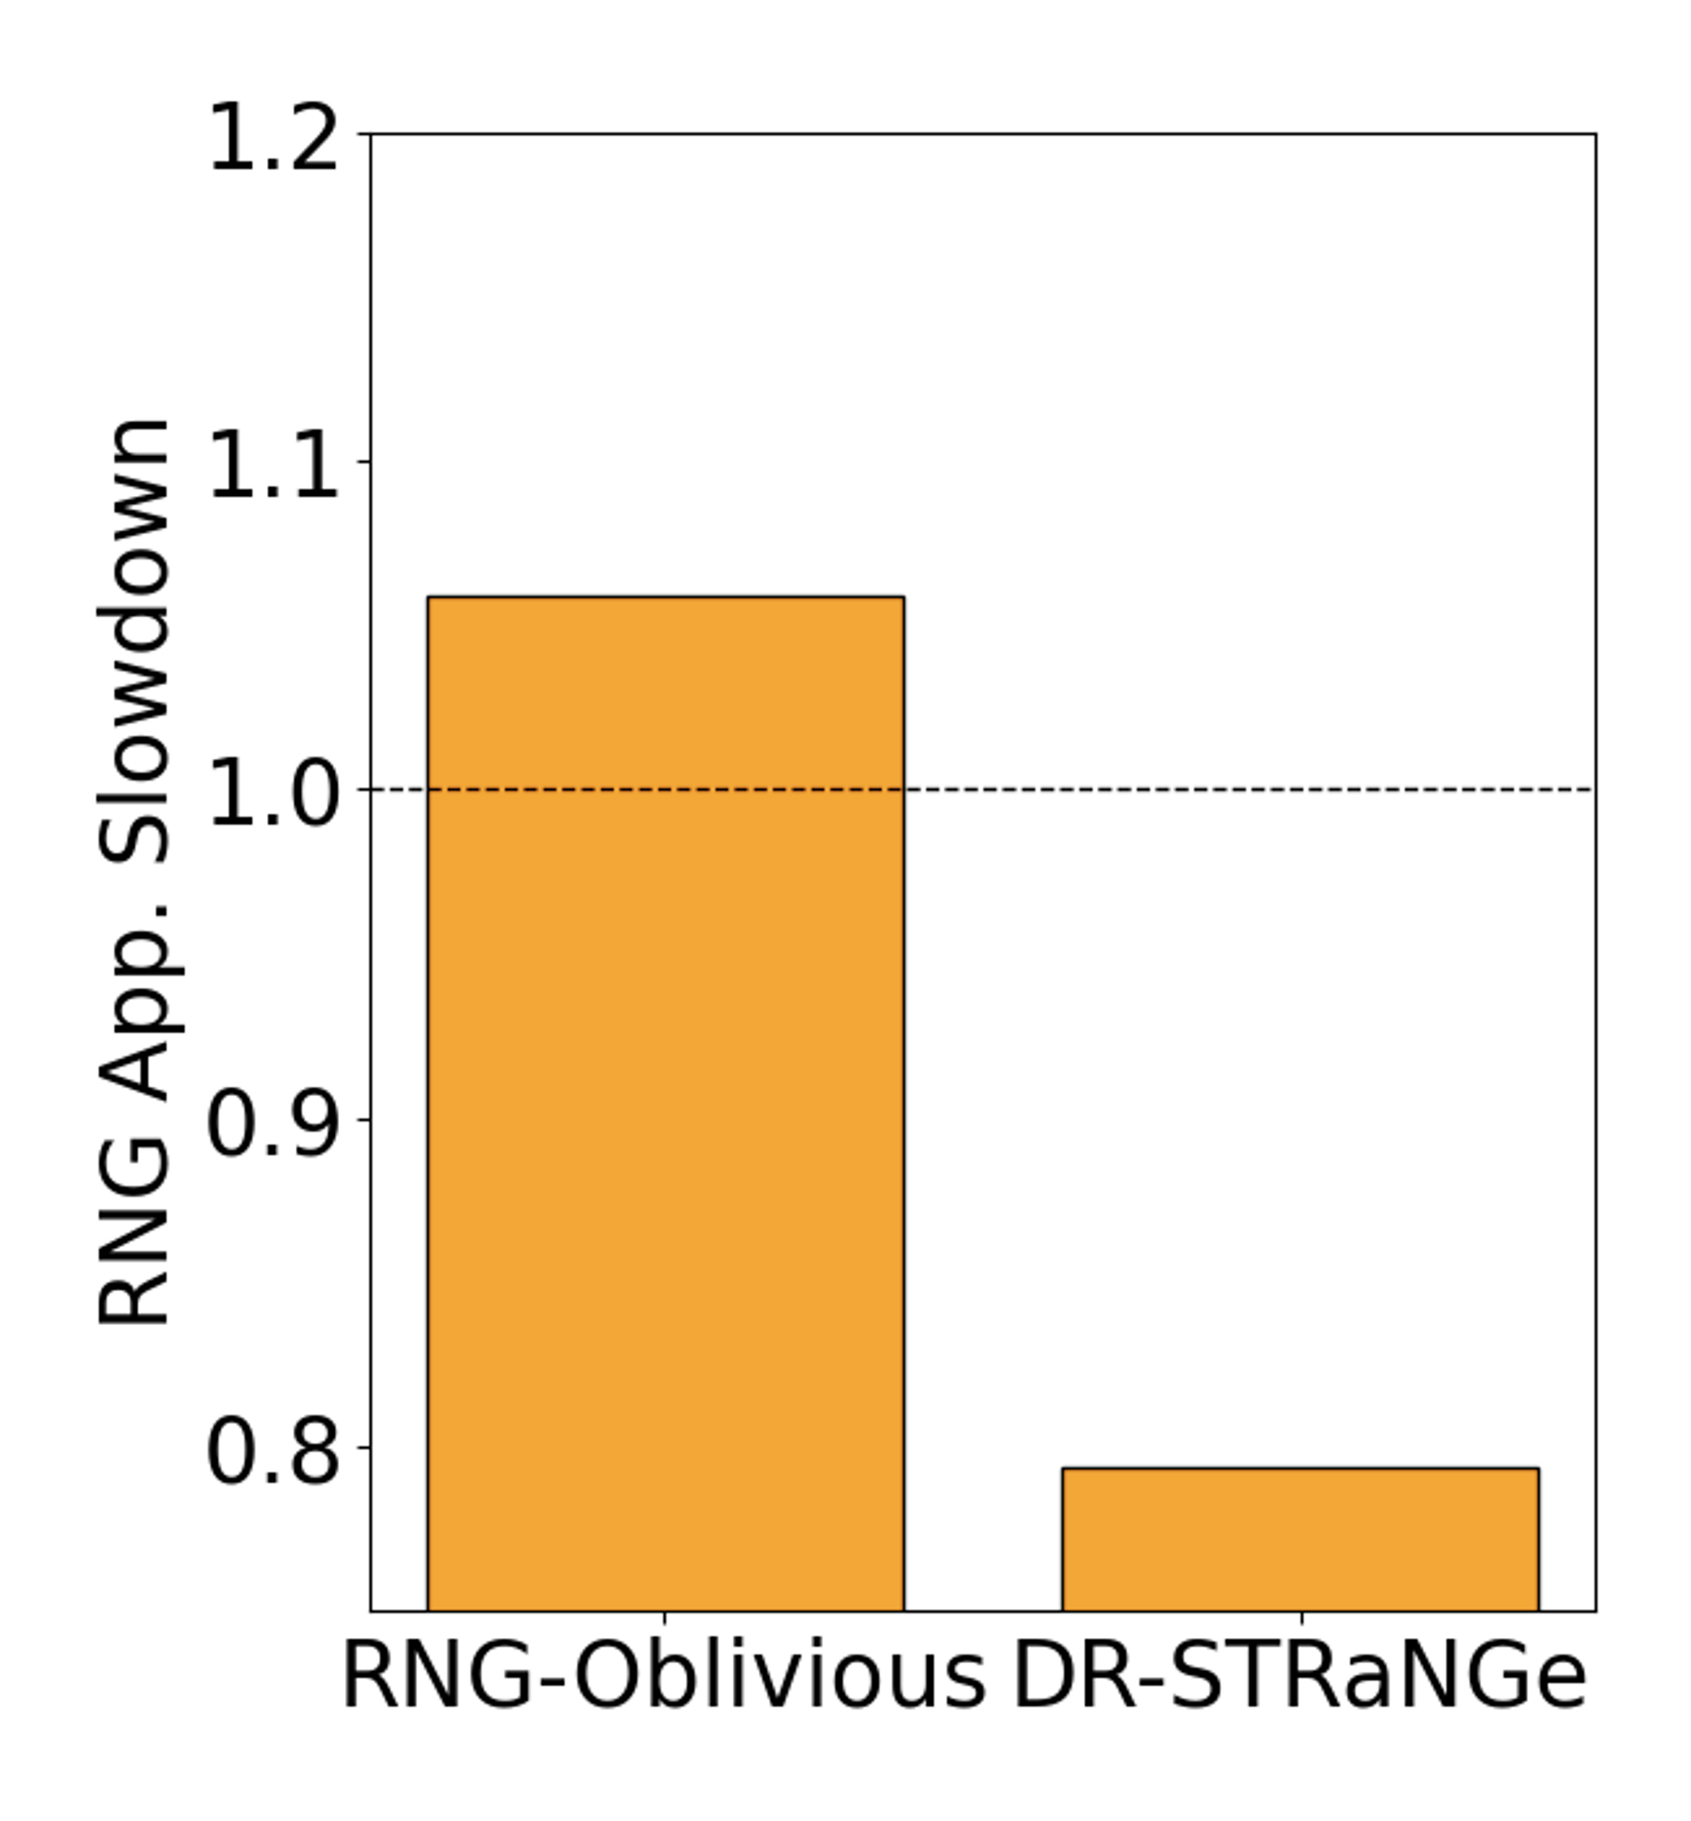
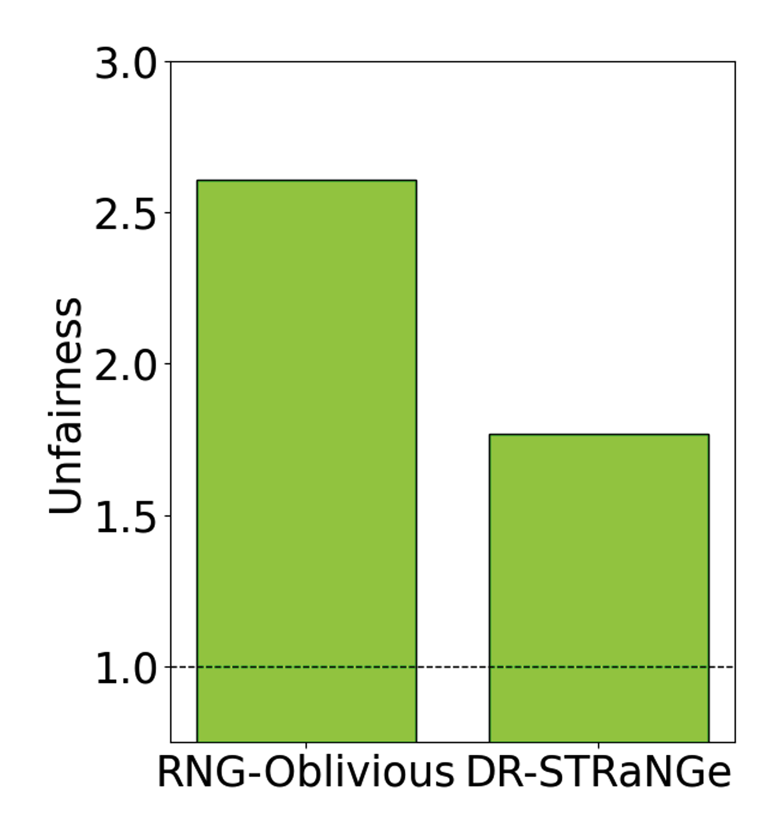
Key Results: Performance and Fairness
17.9%
25.1%
32.1%
20.6%
Improves the performance of both non-RNG (17.9%) and RNG (25.1%) applications compared to the RNG-oblivious baseline design
Improves the performance of RNG applications (20.6%) over the RNG application’s single-core performance
Improves the system fairness (32.1%)
Notes:
I’ll share the key results next,[CLICK]
[CLICK] We conclude that DR-STRANGE improves the performance of both non-RNG and RNG applications compared to the RNG-oblivious baseline design
[CLICK] It improves the average performance of RNG applications By reducing the TRNG latency compared to the performance of RNG applications when executed alone on a single core
[CLICK] and lastly, DR-STRANGE improves the system fairness by thirty two percent
We evaluate DR-STRANGE with four, eight and sixteen core workloads and Show similar results,
[CLICK]We conclude that the performance improvement of DR-STRANGE increases with the number of memory intensive applications in the workload mix
We evaluate the area overhead and energy consumption of DR-STRaNGe and conclude that
[CLICK] It incurs minör area overhead and
[CLICK] reduces the average energy consumption

Slide 14
Key Results: Scalability, Area, Energy
Performance improvement increases with the number of memory-intensive applications in the workload mix
Incurs minor area overhead (0.0022mm², 0.00048% of an Intel Cascade Lake CPU Core)
Reduces the average energy consumption (21%)
Notes:
We evaluate DR-STRANGE with four, eight and sixteen core workloads and Show similar results,
[CLICK]We conclude that the performance improvement of DR-STRANGE increases with the number of memory intensive applications in the workload mix
We evaluate the area overhead and energy consumption of DR-STRaNGe and conclude that
[CLICK] It incurs minör area overhead and
[CLICK] reduces the average energy consumption

Slide 15
More in the Paper
Security Analysis of DR-STRaNGe
Security of Random Numbers
Timing Side-Channel Attacks
Covert Channel Attacks
Denial of Service Attacks
More Results
Impact of DRAM Idleness Predictor
Comparison to a Q-learning-based RL agent
Impact of the Random Number Buffer
Impact of RNG-Aware Scheduling
Impact of the Low Utilization Prediction
Experiments using QUAC-TRNG [Olgun+, ISCA’21]
Results of RNG Applications with Low RNG Demand
Notes:
Here is the list of other analyses in our paper
[CLICK] We discuss the security of DR-STRaNGe and Show that our random numbers are secure and we discuss the timing side channel, covert channel and denial of service attacks and countermeasures against them
[CLICK] And we have many more results in the paper
İncluding the impact of each component and comparisons with other memory request schedulers and a second reinforcement learning based DRAM idleness predictor
I invite you to read the paper in full to see a comprehensive evaluation of DR-STRaNGe

Slide 16
DR-STRaNGe: End-to-End System Design for DRAM-based True Random Number Generators
F. Nisa Bostancı
Ataberk Olgun Lois Orosa A. Giray Yağlıkçı
Jeremie S. Kim Hasan Hassan Oğuz Ergin Onur Mutlu
Notes:
And this concludes my talk. Thank you for your time and attention.

