Slide 1


EDEN
Session 2A: Accelerators for Machine Learning 2 (Monday 1:30PM)
Enabling Energy-Efficient, High-Performance
Deep Neural Network Inference
Using Approximate DRAM
Skanda Koppula Lois Orosa A. Giray Yaglikci
Roknoddin Azizi Taha Shahroodi Konstantinos Kanellopoulos Onur Mutlu

Slide 2
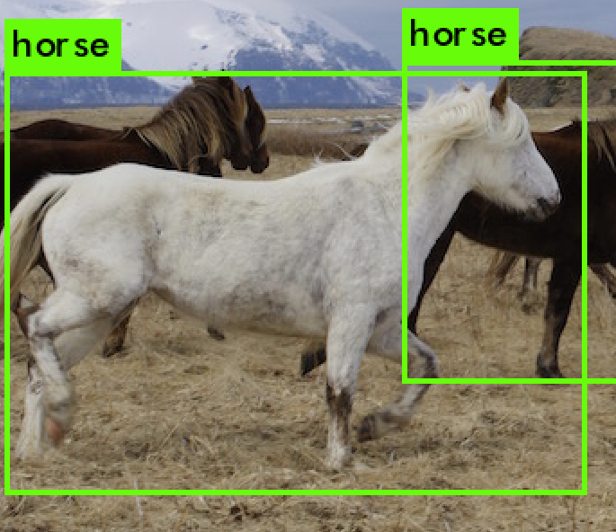
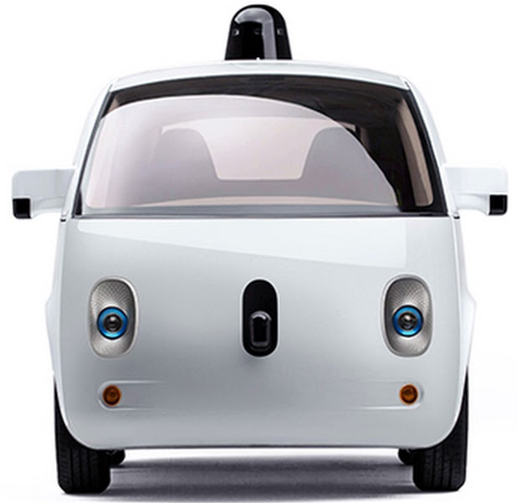

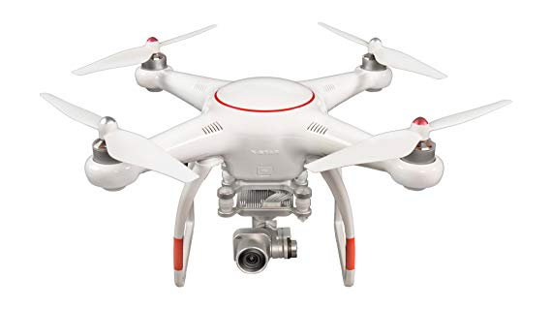

Motivation
Deep neural networks (DNNs) are critical
in computer vision, robotics, and many other domains

Slide 3
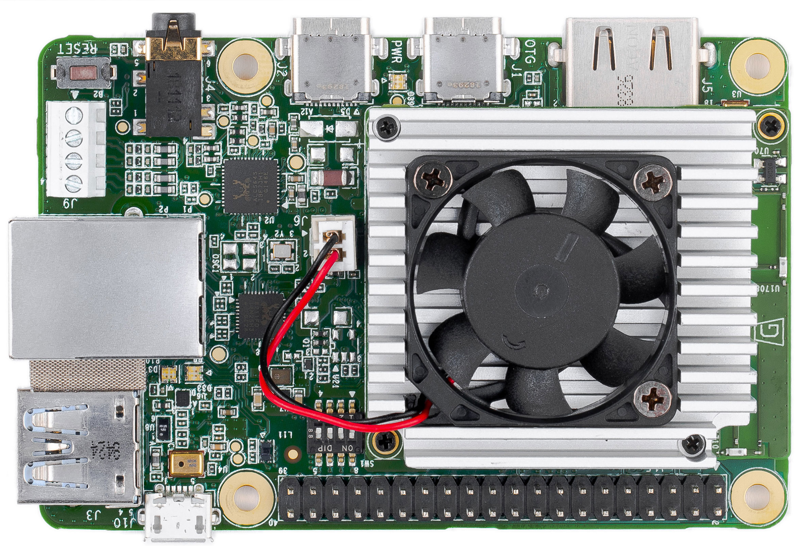
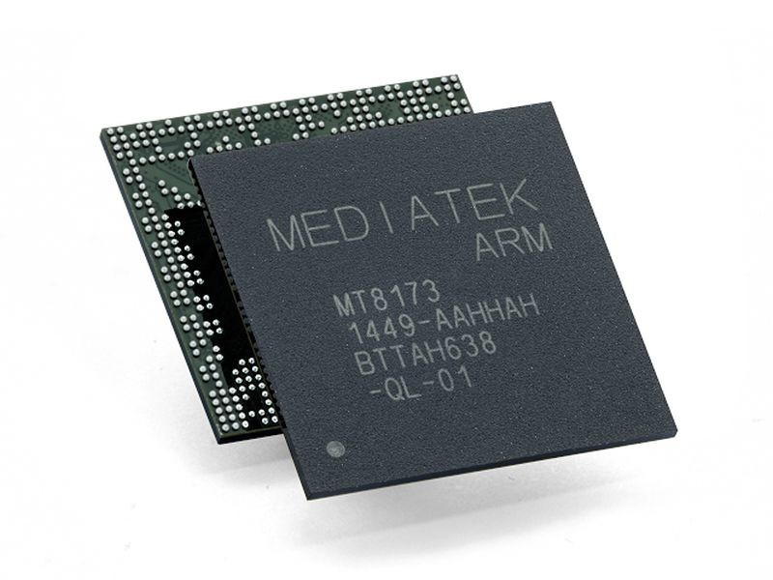
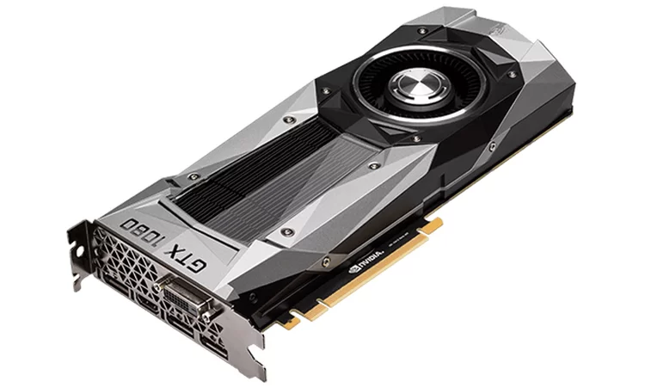
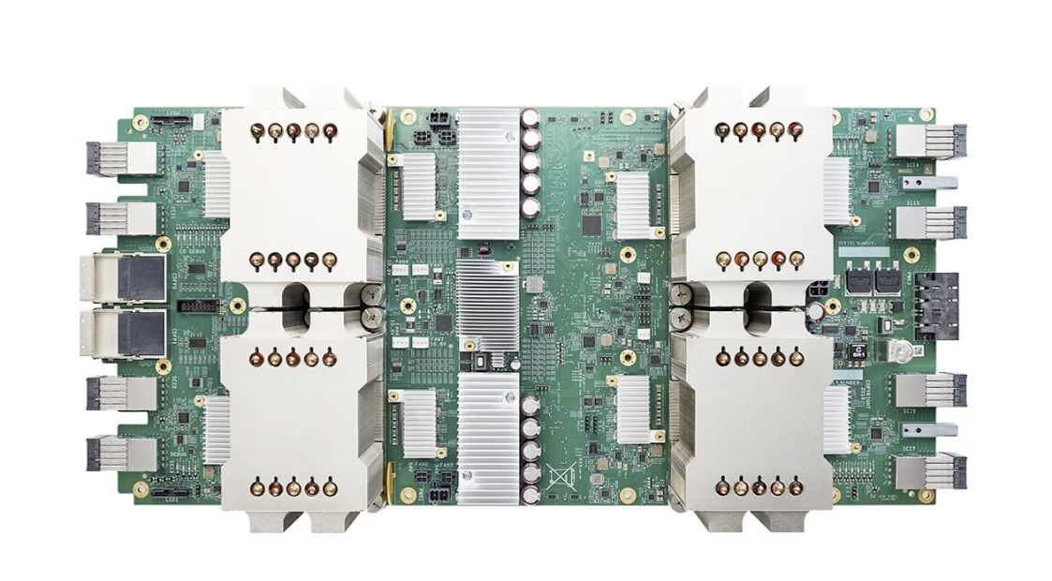
Motivation
Deep neural networks (DNNs) are critical
in computer vision, robotics, and many other domains
Modern DNN inference platforms use DRAM
Mobile CPUs
GPUs
Data Center Accelerators
Edge-device Accelerators

Slide 4
Challenges of DNN Inference
DRAM has high energy consumption
25% to 70% of system energy is consumed by DRAM in common DNN inference accelerators
DRAM can bottleneck performance
Potential 19% speedup by reducing DRAM latency on CPU
for some DNNs

Slide 5
Observations
DNNs have an intrinsic robustness to errors
in the input, weight, and output data types
2. We can reduce DRAM energy consumption and latency if we tolerate more bit errors

Slide 6
Insight
DNNs have an intrinsic robustness to errors
in input, weight, and output data types
Approximate DRAM (voltage and latency-scaled DRAM)
can provide higher energy-efficiency and performance
for error-tolerant DNN inference workloads
2. DRAM can be more energy-efficient and lower latency if we tolerate low bit reliability

Slide 7
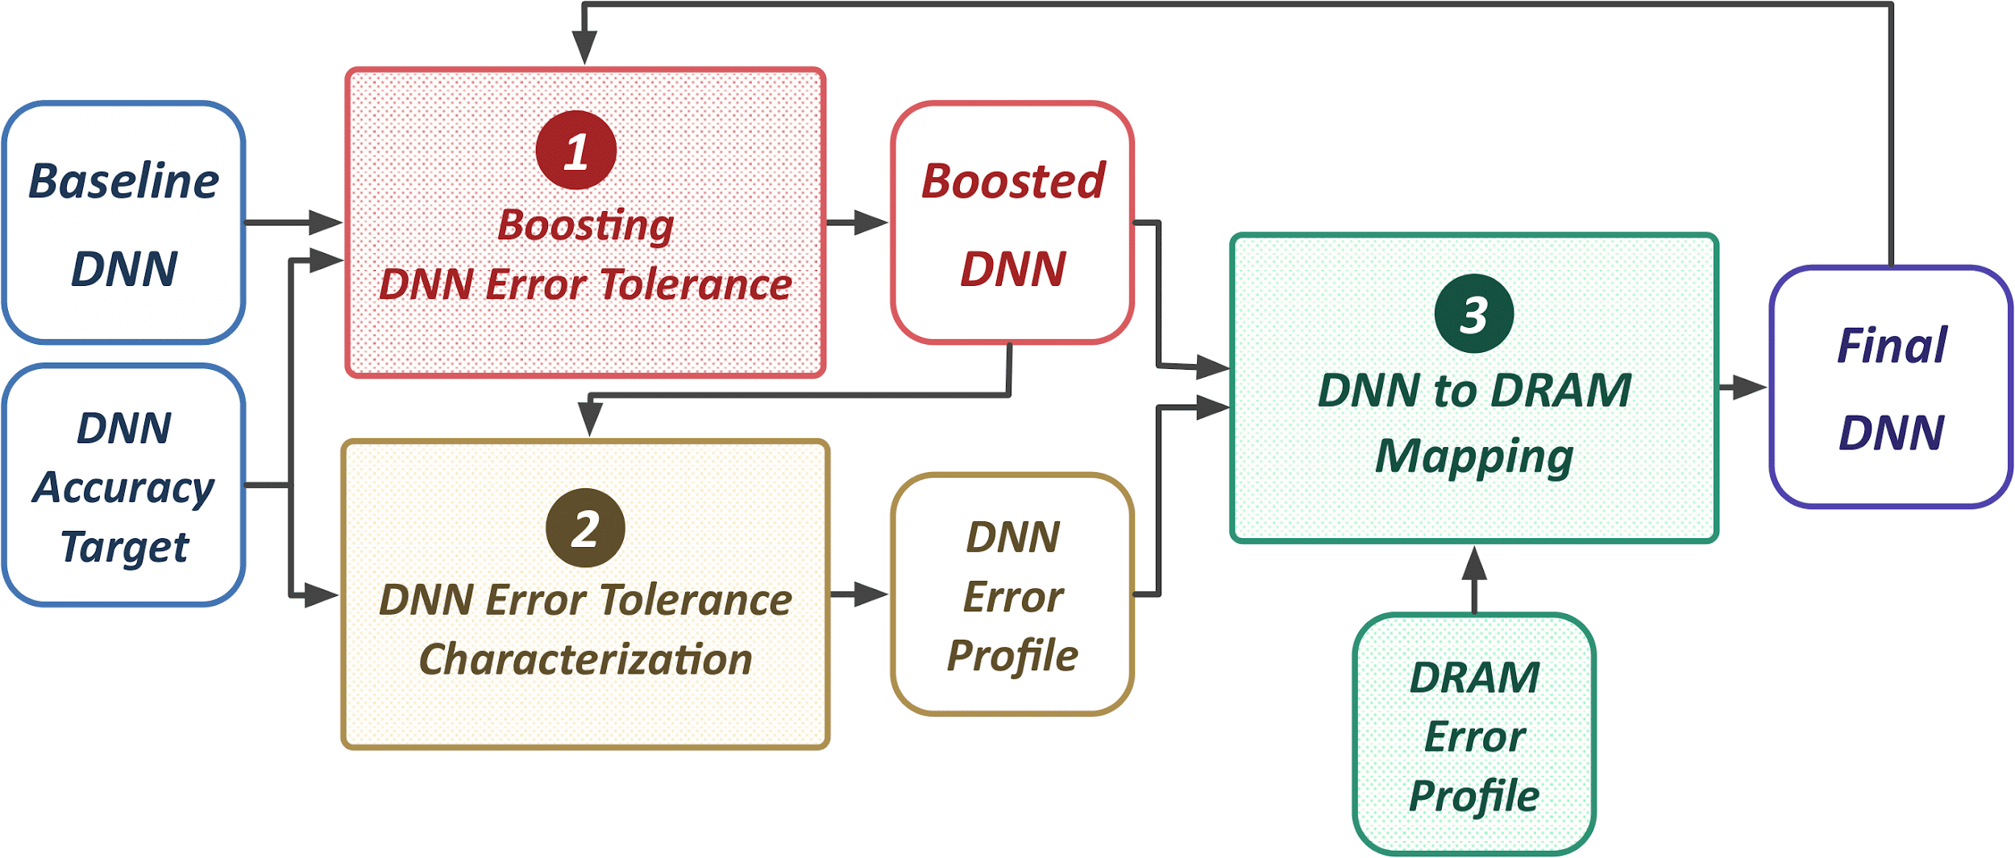
We propose EDEN, a mechanism to enable
accurate DNN inference on approximate DRAM

Slide 8
Key Results
CPU: 21% DRAM energy reduction, 8% speedup
GPU: 37% DRAM energy reduction
DNN Accelerators: 31% DRAM energy reduction
While maintaining a user-specified accuracy target
within 1% of the original DNN accuracy

Slide 9
EDEN
Session 2A: Accelerators for Machine Learning 2 (Monday 1:30PM)
Enabling Energy-Efficient, High-Performance
Deep Neural Network Inference
Using Approximate DRAM
Skanda Koppula Lois Orosa A. Giray Yaglikci
Roknoddin Azizi Taha Shahroodi Konstantinos Kanellopoulos Onur Mutlu

