Slide 1


EDEN
Enabling Energy-Efficient, High-Performance
Deep Neural Network Inference
Using Approximate DRAM
Skanda Koppula Lois Orosa A. Giray Yaglikci
Roknoddin Azizi Taha Shahroodi Konstantinos Kanellopoulos Onur Mutlu
Notes:
Hi, I’m Skanda and I’m excited to be sharing our work today on EDEN: enabling energy-efficient, high performance DNN inference using approximate DRAM. This work is done in collaboration with colleagues from ETH Zurich.

Slide 2

Summary
Motivation: Deep Neural Networks (DNNs) are important in many domains (vision, robotics, ...)
Notes:
First, we’ll dive into a brief summary of the work.
DNNs are widely used in a number of different applications, ranging from robotics to robotics.

Slide 3
Summary
Motivation: Deep Neural Networks (DNNs) are important in many domains (vision, robotics, ...)
Problem: Challenges of DNN Inference:
High DRAM energy consumption → high energy cost of DNN inference
High DRAM latency → DNN inference slowdowns
Notes:
Most modern systems for evaluating DNNs use DRAM, which has high DRAM energy consumption and imposes high access latency. This imposes energy and performance challenges for DNN inference.

Slide 4
Summary
Motivation: Deep Neural Networks (DNNs) are important in many domains (vision, robotics, ...)
Problem: Challenges of DNN Inference:
High DRAM energy consumption → high energy cost of DNN inference
High DRAM latency → DNN inference slowdowns
Goal: Reduce DRAM voltage and timing for error tolerant DNN inference workloads, exploiting the trade-off between bit error rate and energy/performance
Notes:
The goal of this work is to improve the energy efficiency and performance for DNN inference by using approximate DRAM -- that is DRAM that operates at reduced DRAM voltage and latency. Approximate DRAM operates with with increased bit error rates, but offers lower energy consumption and higher performance

Slide 5
Summary
Motivation: Deep Neural Networks (DNNs) are important in many domains (vision, robotics, ...)
Problem: Challenges of DNN Inference:
High DRAM energy consumption → high energy cost of DNN inference
High DRAM latency → DNN inference slowdowns
Goal: Reduce DRAM voltage and timing for error tolerant DNN inference workloads, exploiting the trade-off between bit error rate and energy/performance
EDEN: Deep Neural Network Inference Using Approximate DRAM
Techniques to maintain accuracy through (1) error tolerance boosting, (2) DNN characterization, (3) DNN to DRAM mapping, and DRAM error modeling
Notes:
EDEN is our proposal for a mechanism that enables users to achieve a user-specified target DNN accuracy on approximate DRAM. EDEN uses four main techniques to maintain DNN accuracy in spite of bit errors: error tolerance boosting through re-training, DNN error characterization, and effective mapping onto DRAM. To handle implementation challenges, EDEN also uses DRAM error modeling.

Slide 6
Summary
Motivation: Deep Neural Networks (DNNs) are important in many domains (vision, robotics, ...)
Problem: Challenges of DNN Inference:
High DRAM energy consumption → high energy cost of DNN inference
High DRAM latency → DNN inference slowdowns
Goal: Reduce DRAM voltage and timing for error tolerant DNN inference workloads, exploiting the trade-off between bit error rate and energy/performance
EDEN: Deep Neural Network Inference Using Approximate DRAM
Techniques to maintain accuracy through (1) error tolerance boosting, (2) DNN characterization, (3) DNN to DRAM mapping, and DRAM error modeling
Results: Energy savings and performance improvements on 12 DNN benchmarks
Average 21% DRAM energy savings and 8% speedup on CPU
Average 37% DRAM energy savings on GPU
Average 31% DRAM energy savings on DNN accelerators (Eyeriss and TPU)
Notes:
We emphasize that the core ideas of EDEN are applicable to other memory technologies and scaling of other DRAM parameters such as refresh

Slide 7
Summary
Motivation: Deep Neural Networks (DNNs) are important in many domains (vision, robotics, ...)
Problem: Challenges of DNN Inference:
High DRAM energy consumption → high energy cost of DNN inference
High DRAM latency → DNN inference slowdowns
Goal: Reduce DRAM voltage and timing for error tolerant DNN inference workloads, exploiting the trade-off between bit error rate and energy/performance
EDEN: Deep Neural Network Inference Using Approximate DRAM
Techniques to maintain accuracy through (1) error tolerance boosting, (2) DNN characterization, (3) DNN to DRAM mapping, and DRAM error modeling
Results: Energy savings and performance improvements on 12 DNN benchmarks
Average 21% DRAM energy savings and 8% speedup on CPU
Average 37% DRAM energy savings on GPU
Average 31% DRAM energy savings on DNN accelerators (Eyeriss and TPU)
EDEN is applicable to other DRAM parameters and memory technologies
Notes:
We emphasize that the core ideas of EDEN are applicable to other memory technologies and scaling of other DRAM parameters such as refresh

Slide 8
Outline
Motivation and Problem
2. DNN Basics and DRAM Parameters
3. EDEN Mechanism
i. Boosting DNN Error Tolerance
ii. DNN Error Tolerance Characterization
iii. DNN to DRAM Mapping
Enabling EDEN Using Error Models
4. Evaluation
5. Conclusion
Notes:
In this talk, we will first discuss the motivation behind our work. Then we’ll cover a little background on DNN and DRAM operation, then dive into the core EDEN mechanism. Finally, we will discuss evaluation of EDEN’s performance. Let’s dive into motivation first.

Slide 9
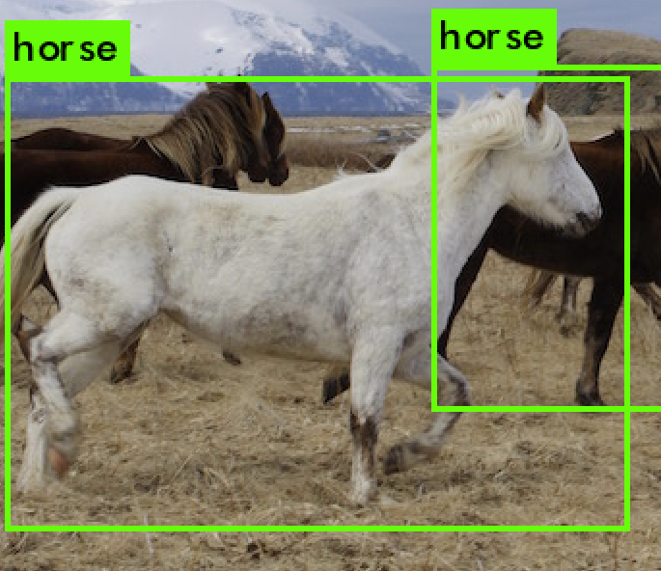
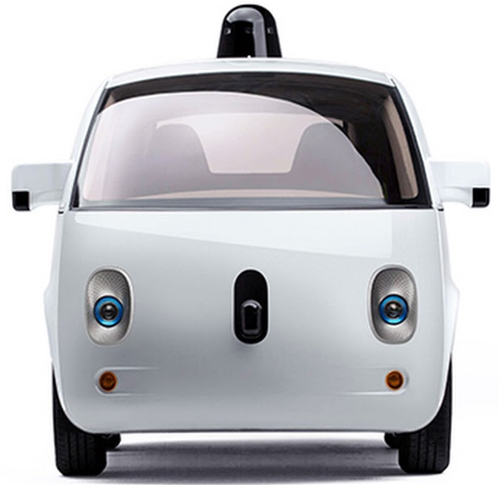
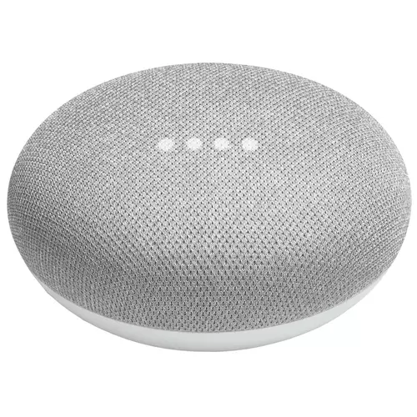
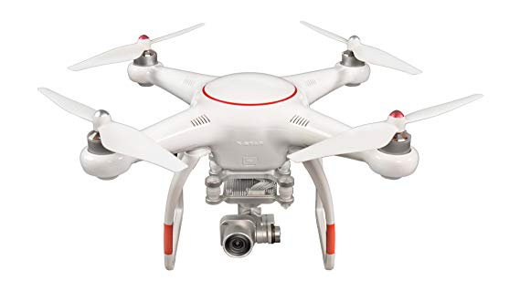
Motivation
Deep neural networks (DNNs) are critical
in computer vision, robotics, and many other domains
Notes:
Deep neural networks, or DNNs, are widely used in many domains, from computer vision to robotics

Slide 10
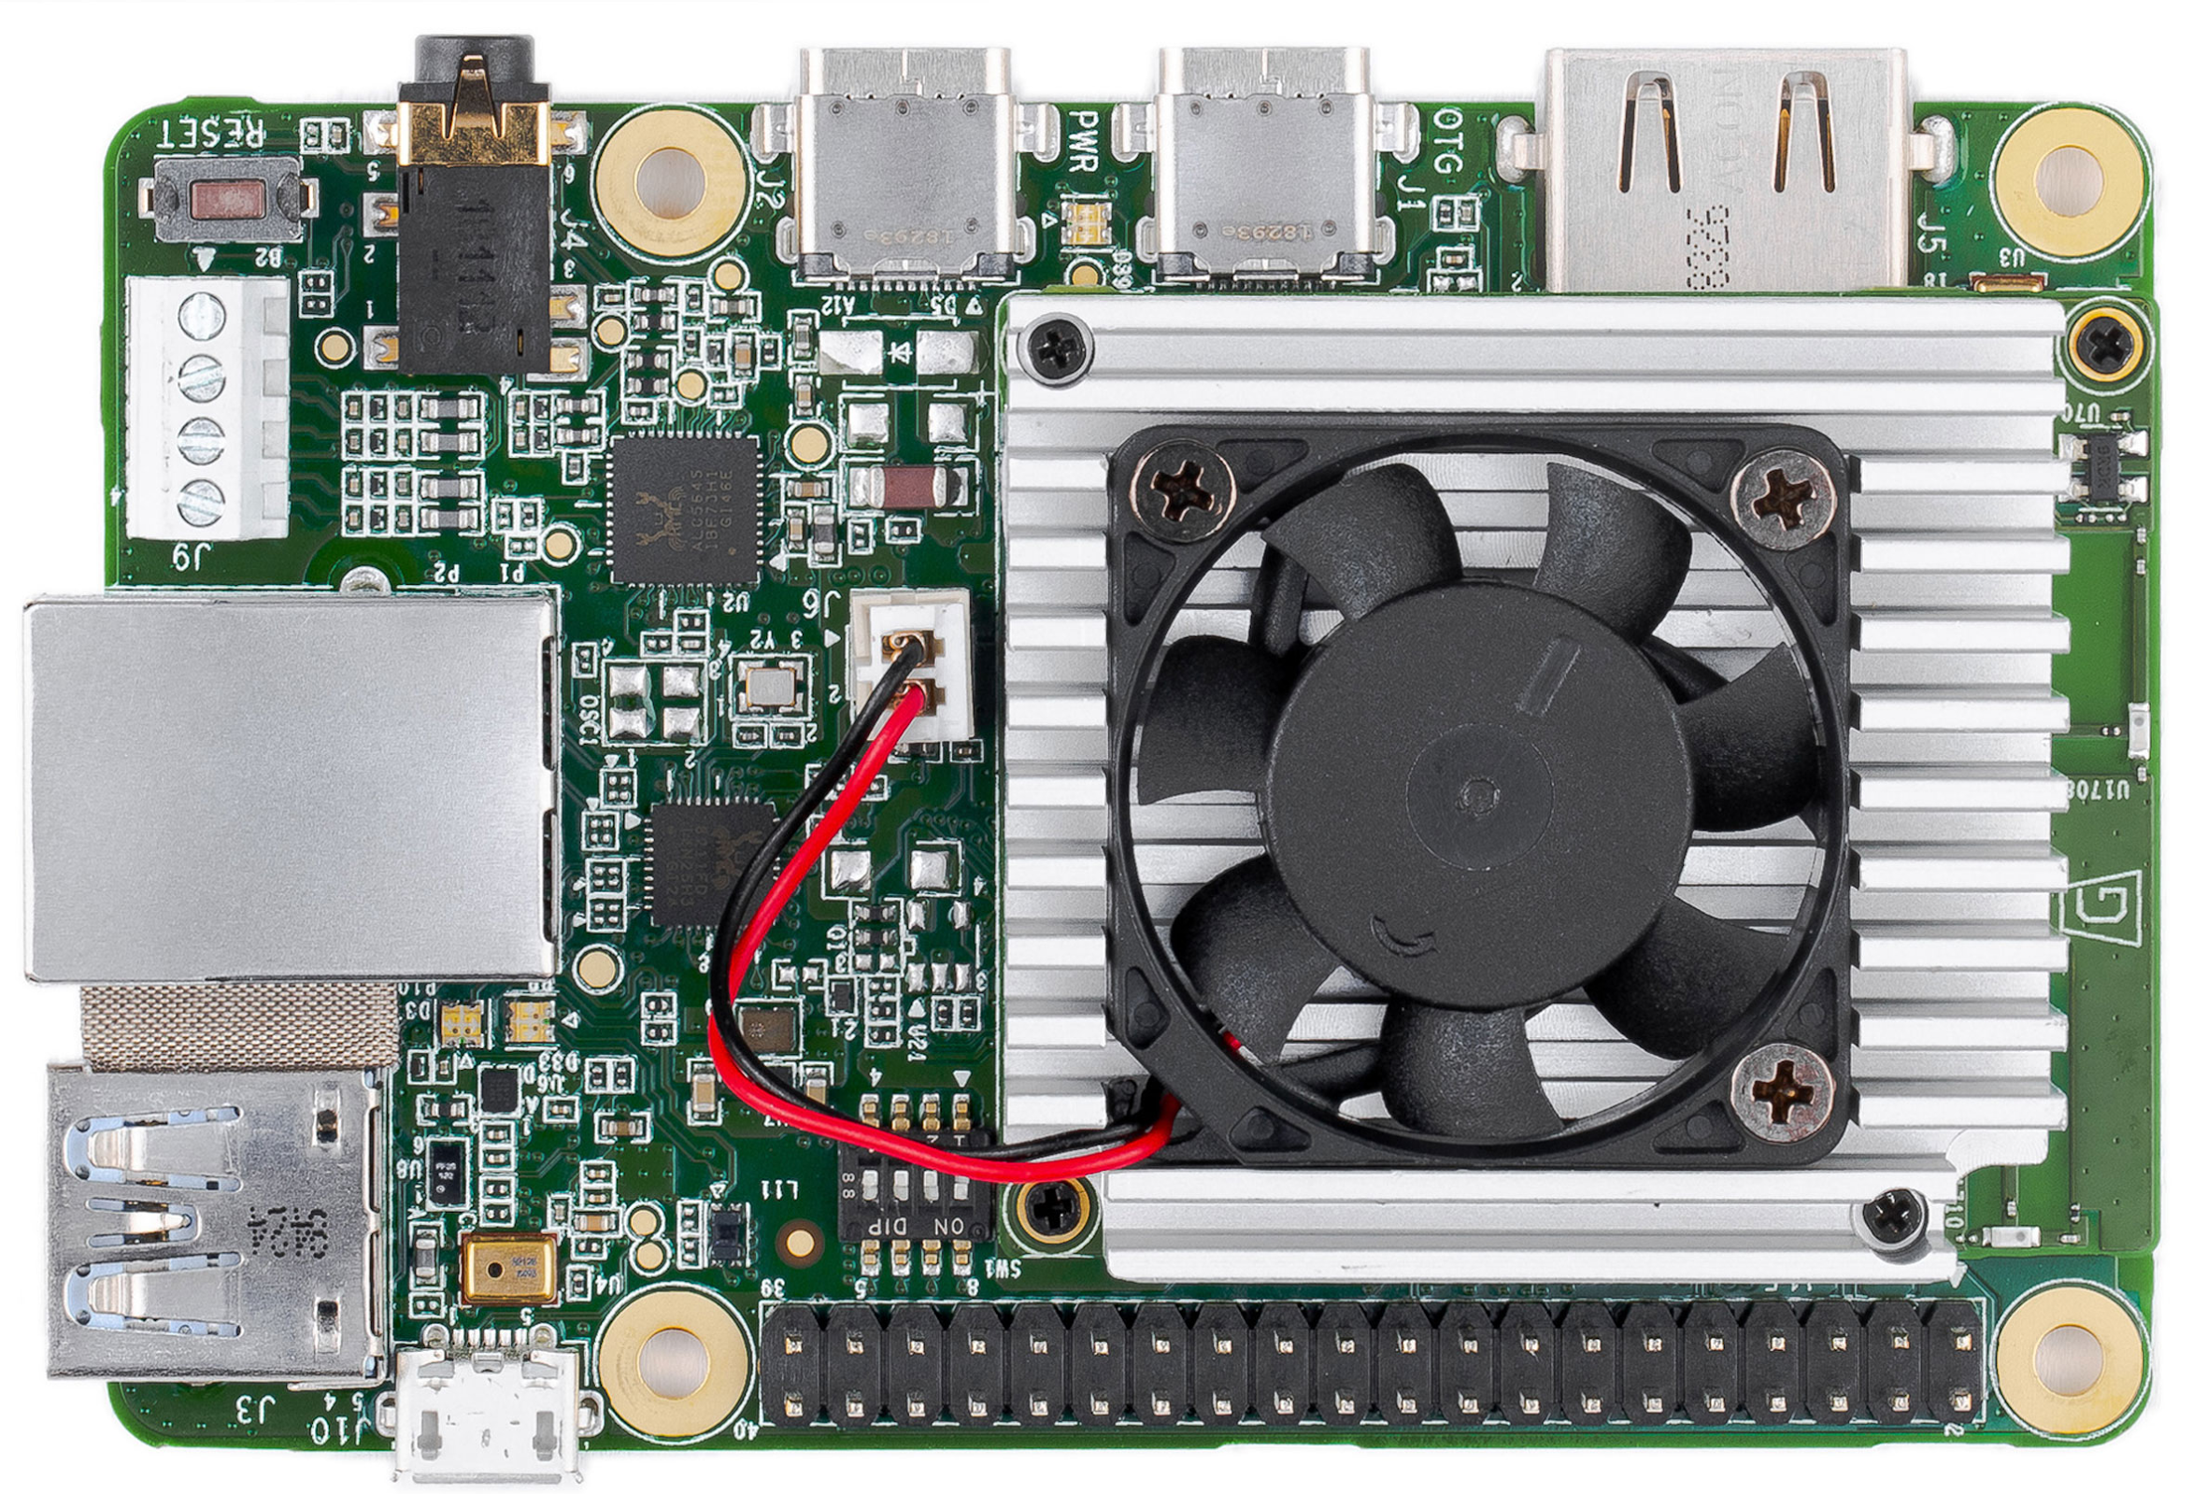
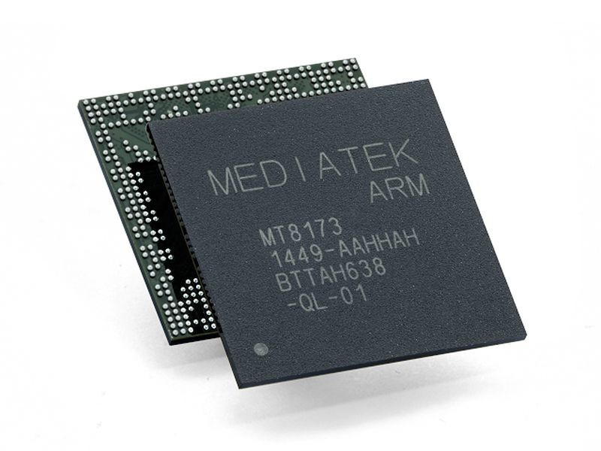
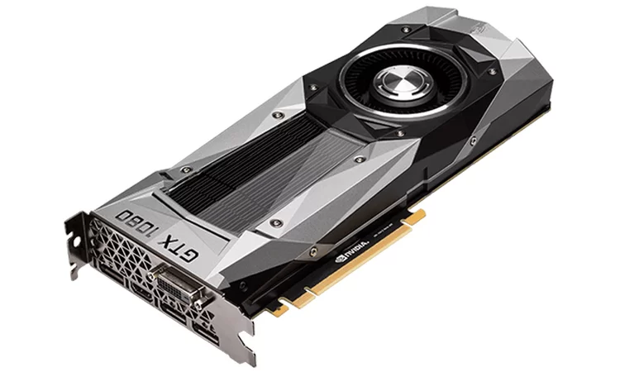
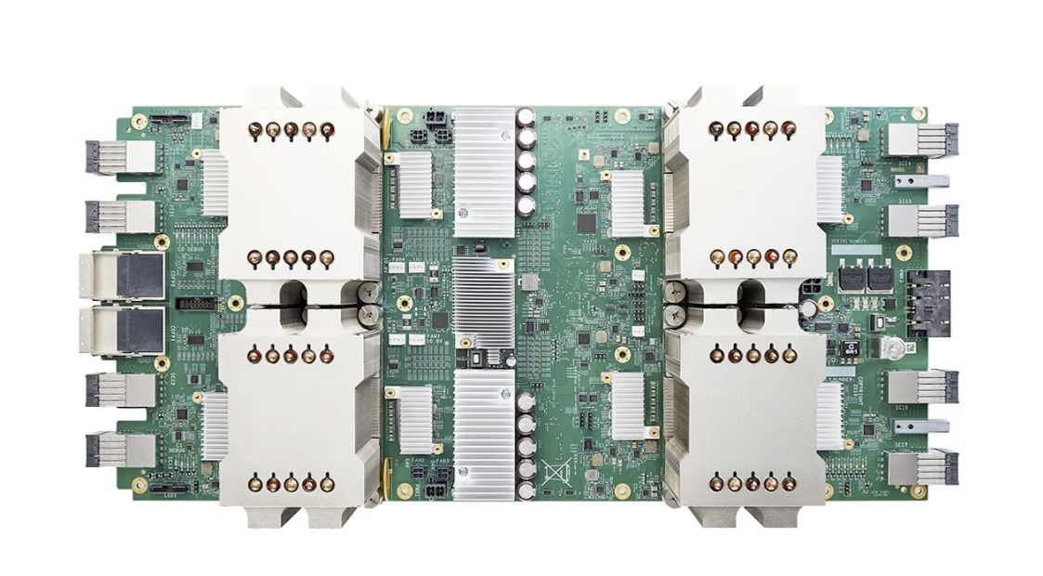
Motivation
Deep neural networks (DNNs) are critical
in computer vision, robotics, and many other domains
Modern platforms for DNN inference use DRAM
Mobile CPUs
GPUs
Data Center Accelerators
Edge-device Accelerators
Notes:
DNN inference occurs on many architectures today, most of which use DRAM.

Slide 11
Challenges of DNN Inference
DRAM has high energy consumption
25% to 70% of system energy is consumed by DRAM in common DNN inference accelerators
Notes:
This introduces two main challenges. First, DRAM exhibits high energy consumption. In commonly referenced specialized architectures, between 25 to 70% of system energy is consumed by DRAM.

Slide 12
Challenges of DNN Inference
DRAM has high energy consumption
25% to 70% of system energy is consumed by DRAM in common DNN inference accelerators
DRAM can bottleneck performance
Potential 19% speedup by reducing DRAM latency on CPU
for some DNNs
Notes:
Second, DRAM can present performance bottlenecks for some workloads on CPU-based inference systems because of DRAM’s high latency.

Slide 13
Challenges of DNN Inference
DRAM has high energy consumption
25% to 70% of system energy is consumed by DRAM in common DNN inference accelerators
DRAM can bottleneck performance
Potential 19% speedup by reducing DRAM latency on CPU
for some DNNs
How can we reduce DRAM energy and improve DRAM performance for DNN inference?

Slide 14
Outline
Motivation and Problem
2. DNN Basics and DRAM Parameters
3. EDEN Mechanism
i. Boosting DNN Error Tolerance
ii. DNN Error Tolerance Characterization
iii. DNN to DRAM Mapping
Enabling EDEN Using Error Models
4. Evaluation
5. Conclusion

Slide 15
Deep Neural Network Inference
Modern DNNs can have hundreds of layers and between 10⁵ and 10⁹ weights
Notes:
Modern DNNs are large and deep, having hundreds of layers and up to a billion parameters.

Slide 16
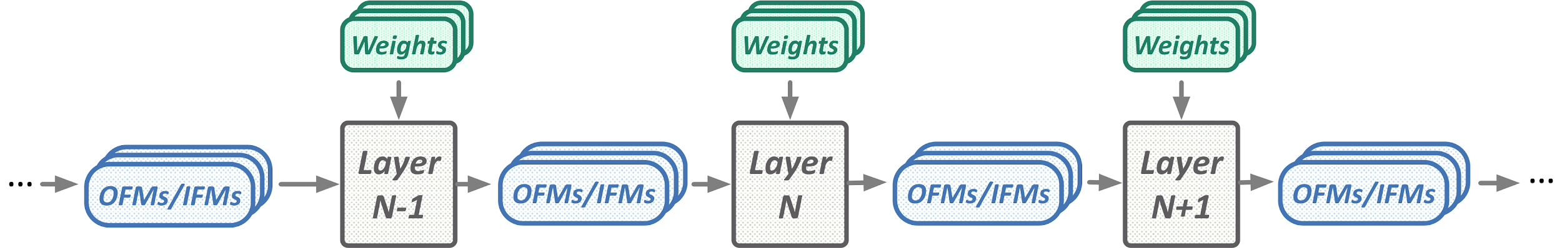
Deep Neural Network Inference
Modern DNNs can have hundreds of layers and between 10⁵ and 10⁹ weights
Three main data types compose a DNN layer:
Weights
Notes:
Each layer in a DNN is composed of three main data types:
-- Weights

Slide 17
Deep Neural Network Inference
Modern DNNs can have hundreds of layers and between 10⁵ and 10⁹ weights
Three main data types compose a DNN layer:
Weights
Input Feature Maps (IFMs)
Notes:
-- which operate on input feature maps

Slide 18
Deep Neural Network Inference
Modern DNNs can have hundreds of layers and between 10⁵ and 10⁹ weights
Three main data types compose a DNN layer:
Weights
Input Feature Maps (IFMs)
Output Feature Maps (OFMs)
Notes:
-- to produce output feature maps

Slide 19
Deep Neural Network Inference
Modern DNNs can have hundreds of layers and between 10⁵ and 10⁹ weights
Three main data types compose a DNN layer:
Weights
Input Feature Maps (IFMs)
Output Feature Maps (OFMs)
Large DNN weight/IFM counts enable high learning capacity
Notes:
Large parameter counts in the DNN enable it to generalize well across varied inputs.

Slide 20
Deep Neural Network Inference
Modern DNNs can have hundreds of layers and between 10⁵ and 10⁹ weights
Three main data types compose a DNN layer:
Weights
Input Feature Maps (IFMs)
Output Feature Maps (OFMs)
Large DNN weight/IFM counts enable high learning capacity
If the weights/IFMs have small bit errors, a DNN can still maintain accuracy
Notes:
Additionally, small bit errors in these weights and IFMs can often be tolerated to some extent by the DNN during inference

Slide 21
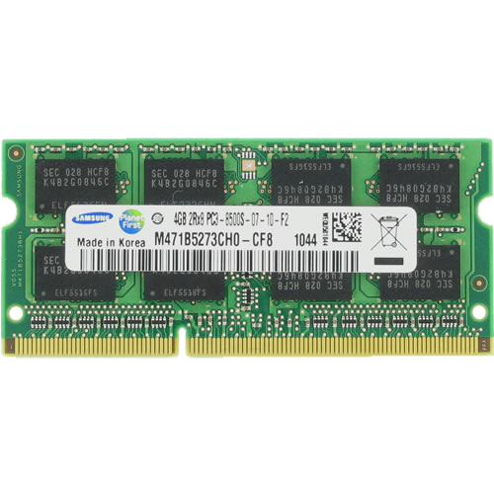
DNN Inference Using DRAM
Memory
Bus
CPU, GPU, or DNN Accelerator
Memory Controller
Notes:
DNN inference today occurs on a variety of platforms. These architectures share their technology for main memory, DRAM.

Slide 22
DRAM Parameters
DRAM operates at a standard voltage
(e.g., DDR3 at 1.35V)
Memory
Bus
Compute Unit
Memory Controller
Notes:
The DRAM used is governed by a set of operating parameters. For example, DDR3 DRAM is often run at a voltage of 1.35V. Lower than that and you might induce bit errors.

Slide 23
DRAM Parameters
Accessing data follows a sequence of MC commands with standard timing parameters
Memory
Bus
Compute Unit
Memory Controller
Notes:
Similarly, fixed timings define how the controller is allowed to communicate with the DRAM module.

Slide 24
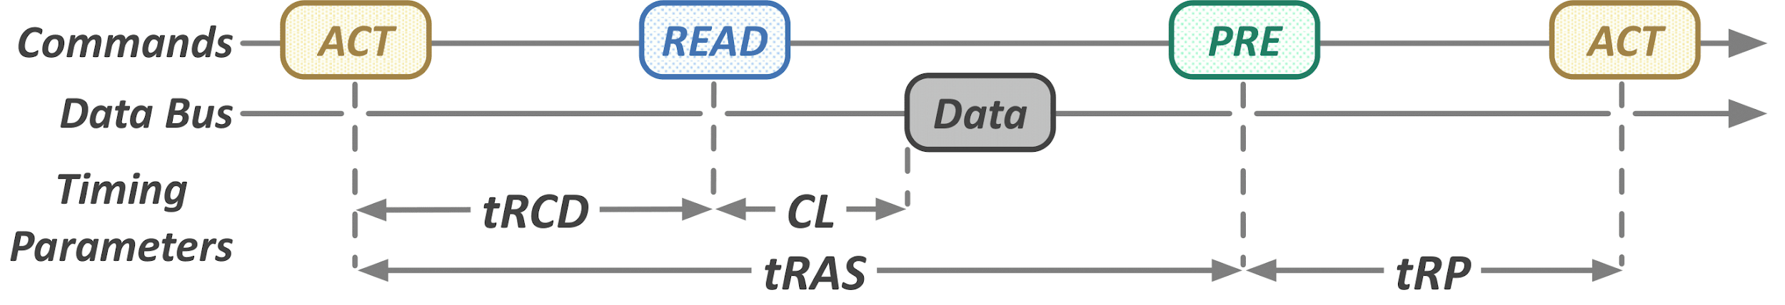
DRAM Parameters
Accessing data follows a sequence of MC commands with standard timing parameters
Memory
Bus
Compute Unit
Memory Controller
Notes:
This work focuses on reducing one such timing parameter called tRCD, the time between row activation and reading values from the bitlines.

Slide 25
Outline
Motivation and Problem
2. DNN Basics and DRAM Parameters
3. EDEN Mechanism
i. Boosting DNN Error Tolerance
ii. DNN Error Tolerance Characterization
iii. DNN to DRAM Mapping
Enabling EDEN Using Error Models
4. Evaluation
Notes:
Now that we have some background, let’s dive into the idea, goal, and mechanism behind EDEN.

Slide 26
Observations
DNNs have an intrinsic robustness to errors
in the weight and feature map data types
Notes:
EDEN is based on two key observations: First, DNNs demonstrate a robustness to errors introduced in input, weight, and output data types. This error tolerance can allow DNN evaluation on unreliable hardware if the error tolerance is accurately characterized and bit error rates are controlled.

Slide 27
Observations
DNNs have an intrinsic robustness to errors
in the weight and feature map data types
2. DNN inference systems can reduce DRAM energy consumption and latency if they tolerate more bit errors
Notes:
Second, DRAM exhibits a trade-off between performance for bit reliability. Reducing supply voltage and timing parameters can decrease energy consumption and latency while increasing bit errors

Slide 28
Insight
DNNs have an intrinsic robustness to errors
in input, weight, and output data types
Approximate DRAM (voltage and latency-scaled DRAM)
can provide higher energy-efficiency and performance
for error-tolerant DNN inference workloads
2. DRAM can be more energy-efficient and lower latency if we tolerate low bit reliability
Notes:
In this work, we focus on running DNN workloads on voltage and latency scaled approximate DRAM offering potential energy and performance improvements.

Slide 29
EDEN: Key Idea
Enable accurate, efficient DNN inference using approximate DRAM through 3 key steps:
1. DNN error tolerance boosting
2. DNN and DRAM characterization
3. DNN to DRAM mapping
Notes:
To exploit these two insights, we propose EDEN: a framework to enable accurate DNN inference on approximate DRAM through three key steps;
1) boosting DNN error tolerance, 2) DNN and DRAM error tolerance characterization, and 3) DNN-DRAM mapping.
These steps are repeated iteratively until EDEN finds the most aggressive configuration that meets the target accuracy requirements

Slide 30
EDEN: Inputs
Inputs to EDEN:
(1) user-specified DNN accuracy goal
(2) pre-trained model
(3) target DRAM device
Notes:
EDEN takes in three inputs: the pre-trained model, the accuracy target, and the target DRAM device being used for inference

Slide 31
Step 1: Boosting DNN Error Tolerance
Goal: Better maintain accuracy when the DNN is exposed to bit errors
Notes:
First, let’s jump into the first step of EDEN: boosting DNN error tolerance.
According to our evaluations, the error tolerance intrinsic to most common DNNs is not sufficient to enable significant DRAM voltage and timing parameter reductions.
As such, the goal of the section is to reduce accuracy reductions when the DNN is exposed to bit errors.

Slide 32
Step 1: Boosting DNN Error Tolerance
Goal: Maintain accuracy when the DNN is exposed to bit errors
Mechanism: Retrain the DNN with approximate memory to adapt the DNN to unreliable cells
Forward Pass using Approximate DRAM
Output
and Loss
Input
Notes:
For this, we retrain the DNN on the approximate device to adapt the DNN to particularly unreliable cells and parameter values.

Slide 33

Step 1: Boosting DNN Error Tolerance
Goal: Maintain accuracy when the DNN is exposed to bit errors
Mechanism: Retrain the DNN with approximate memory to adapt the DNN to unreliable cells
Forward Pass using Approximate DRAM
Output
and Loss
Input
Gradient
Update
Backward Pass using Reliable DRAM
Notes:
The backward pass during retraining is performed on reliable DRAM and outputs a gradient update reducing reliance on weak cells

Slide 34
Step 1: Failures during Boosting
For high error rates, accuracy collapses at the start of retraining.
Backward pass becomes polluted with zero-information updates
Bad/Zero
Gradient
Output
and High Loss
Backward Pass using Reliable DRAM
Notes:
In our first iteration of the mechanism, we observed that introducing high DRAM error rates immediately at the beginning of retraining process sometimes caused accuracy collapse due to non-informative gradients from a high-variance loss.

Slide 35
Step 1: Mitigating Failures
Goal: Avoid early retraining collapse
Notes:
To avoid this, we found that slow stepwise increases the error rate of the approximate DRAM, largely mitigated this early accuracy collapse. This enabled the DNN to gradually prune reliance on unreliable cells.

Slide 36

Step 1: Mitigating Failures
Goal: Avoid early retraining collapse
Mechanism: Gradually increase the error rate of the approximate DRAM during retraining to build error tolerance
Forward Pass using Approximate DRAM
with increasing BER
Output
and Loss
Input
Notes:
To avoid this, we found that slow stepwise increases the error rate of the approximate DRAM, largely mitigated this early accuracy collapse. This enabled the DNN to gradually prune reliance on unreliable cells.

Slide 37
Step 1: Mitigating Failures
Goal: Avoid early retraining collapse
Mechanism: Gradually increase the error rate of the approximate DRAM during retraining to build error tolerance
Filter out-of-range values (e.g., >10¹⁵) based on knowledge of the DNN weight and IFM distribution
Notes:
Additionally, we implemented an in-memory controller filtering mechanism that zeros out of range values, based on priors collected on distribution of weights and IFMs.

Slide 38
Outline
Motivation and Problem
2. DNN Basics and DRAM Parameters
3. EDEN Mechanism
i. Boosting DNN Error Tolerance
ii. DNN Error Tolerance Characterization
iii. DNN to DRAM Mapping
Enabling EDEN Using Error Models
4. Evaluation
Notes:
At this point, we have a boosted DNN that demonstrates higher tolerance to DRAM bit errors from step 1. This is used in the second step of EDEN: error tolerance characterization.

Slide 39
Step 2: Error Tolerance Characterization
Goal: Find the highest tolerable error rates of the DNN
and the corresponding DRAM parameters
Notes:
In order to achieve aggressive DRAM parameter reductions, we must determine information about the error rates tolerable by our boosted DNN. We do this through a characterization step in which the DRAM error rate by progressively increased and the accuracy is measured.

Slide 40
Step 2: Error Tolerance Characterization
Goal: Find the highest tolerable error rates of the DNN
and the corresponding DRAM parameters
Mechanism: Systematically measure error resilience of each DNN data type on the approximate DRAM
Notes:
In order to achieve aggressive DRAM parameter reductions, we must determine information about the error rates tolerable by our boosted DNN. We do this through a characterization step in which the DRAM error rate by progressively increased and the accuracy is measured.

Slide 41
Step 2: Error Tolerance Characterization
Goal: Find the highest tolerable error rates of the DNN
and the corresponding DRAM parameters
Mechanism: Systematically measure error resilience of each DNN data type on the approximate DRAM
Two ways to perform this testing:
Coarse-grained characterization
Fine-grained characterization
Notes:
This characterization is done in one of two ways: either a coarse-grained or a fine-grained error characterization.

Slide 42
Step 2: Coarse-Grained Characterization
Reduce voltage/latency of all DNN data types equally
Notes:
In coarse-grained characterization, EDEN determines the most aggressively voltage or latency that can be applied uniformly to the entire DNN, while still meeting the accuracy requirements
of the user.

Slide 43
Step 2: Coarse-Grained Characterization
Reduce voltage/latency of all DNN data types equally
Easy to perform on commodity DRAM
Notes:
In practice, this is easier to achieve in commodity DRAM and what we used for our evaluation.

Slide 44
Step 2: Coarse-Grained Characterization
Reduce voltage/latency of all DNN data types equally
Easy to perform on commodity DRAM
Voltage and latency reduction is limited by the most error sensitive data in the DNN
Notes:
This however, means that less aggressive scaling is possible as the scale is limited by the most sensitive components in the DNN.

Slide 45
Step 2: Fine-Grained Characterization
Scale voltage and latency differently for each individual DNN data type and layer
Notes:
In the alternative, fine-grained scaling, we seek the individual maximum tolerable error rate for each individual DNN data component.

Slide 46
Step 2: Fine-Grained Characterization
Different reductions for each DNN data type and layer
More aggressive voltage/latency reduction is possible
Notes:
This means that more aggressive voltage and latency reductions are possible

Slide 47
Step 2: Fine-Grained Characterization
Different reductions for each DNN data type and layer
More aggressive voltage/latency reduction is possible
Requires non-commodity DRAM to reduce some parameters (e.g., V_{dd})
Takes more time than coarse-grained characterization
Notes:
But often requires non-commodity DRAM (for example, to scale the individual DRAM chips holding the DNN components to different voltage levels). Additionally, it takes significantly longer than coarse-grained characterization.

Slide 48
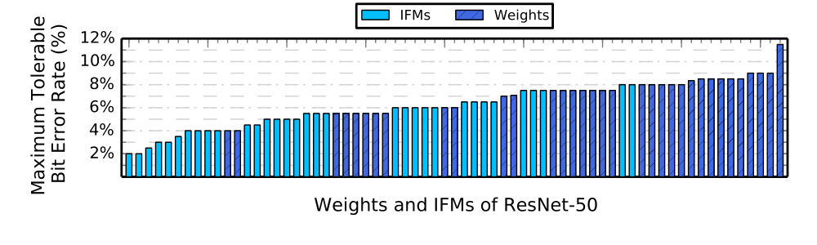
Example ResNet-50 Characterization
Notes:
In this example characterization, we determined the maximum tolerable bit error rate of each individual weight and IFM of ResNet-50, that yielded a DNN that maintained accuracy within 1% of original on a held-out CIFAR10 validation set.

Slide 49
Example ResNet-50 Characterization
Error tolerance of DNN layers varies greatly
Weights exhibit greater error tolerance than IFMs
Notes:
Two possible takeaways we gather from this is that error tolerance varies widely between DNN data types and layers, and weights exhibit greater error tolerance than IFMs.

Slide 50
Outline
Motivation and Problem
2. DNN Basics and DRAM Parameters
3. EDEN Mechanism
i. Boosting DNN Error Tolerance
ii. DNN Error Tolerance Characterization
iii. DNN to DRAM Mapping
Enabling EDEN Using Error Models
4. Evaluation
Notes:
Now we have our error tolerance DNN from Step 1 and an understanding of its error tolerance from step 2. Now in step 3, we determine the DRAM operating parameters.

Slide 51
Step 3: Mapping
Goal: match error tolerance of DNN with DRAM error rates
Notes:
The goal of this short step is to match the error tolerance of the DNN with the DRAM error rates in order to meet the target DNN accuracy.

Slide 52
Step 3: Mapping
Goal: match error tolerance of DNN with DRAM error rates
Mechanism:
Coarse-grained: assign the single best voltage/latency value
that meets the target DNN accuracy
Notes:
Based on the chosen characterization procedure, this is done in one of two ways. Either, we simply assign the single best voltage/latency value that reaches the DNN accuracy, or we use a greedy matching algorithm that pairs the most error sensitive DNN data to the most reliable DRAM partitions.

Slide 53
Step 3: Mapping
Goal: match error tolerance of DNN with DRAM error rates
Mechanism:
Coarse-grained: assign the single best voltage/latency value
that meets the target DNN accuracy
Fine-grained: a greedy algorithm that matches first
the most error sensitive DNN data
to the most reliable DRAM partitions
Notes:
Based on the chosen characterization procedure, this is done in one of two ways. Either, we simply assign the single best voltage/latency value that reaches the DNN accuracy, or we use a greedy matching algorithm that pairs the most error sensitive DNN data to the most reliable DRAM partitions.

Slide 54
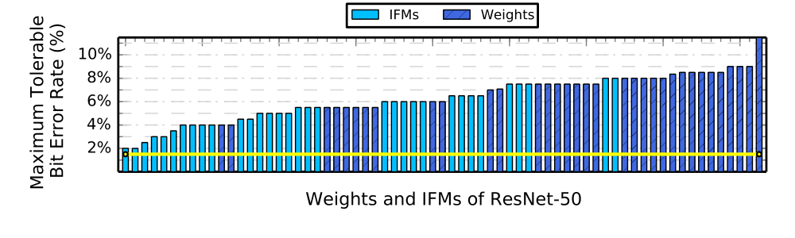
Example Coarse-Grained Mapping
Mapping of ResNet-50:
Single DRAM partition with error rate in yellow
Notes:
In our example from before, if we were to use a coarse-grained mapping, we’d choose the voltage value that yields a bit error rate tolerated by the most sensitive DNN data, denoted in yellow.

Slide 55
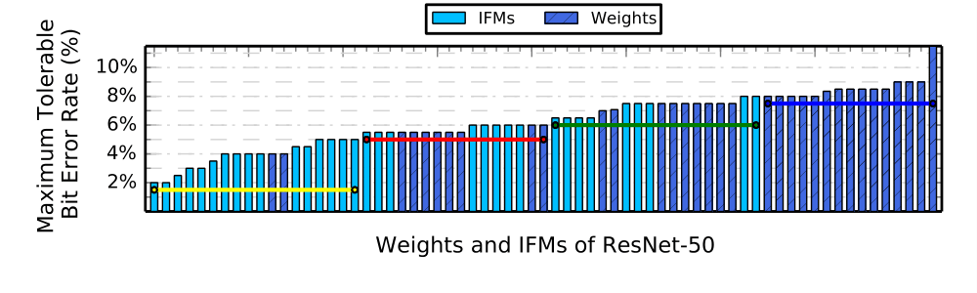
Example Fine-Grained Mapping
Mapping of ResNet-50:
4 DRAM partitions with error rates in yellow, red, green, blue
Notes:
In contrast, using a DRAM chip partitioned into four voltage domains can use a many-to-four DNN to DRAM mapping, using four different voltage values with error rates indicated by the yellow, red, green, and blue lines

Slide 56
Outline
Motivation and Problem
2. DNN Basics and DRAM Parameters
3. EDEN Mechanism
i. Boosting DNN Error Tolerance
ii. DNN Error Tolerance Characterization
iii. DNN to DRAM Mapping
Enabling EDEN Using Error Models
4. Evaluation
Notes:
Finally, we dive into an implementation solution we found necessary to evaluate EDEN on real DRAM devices

Slide 57
Enabling EDEN Using Error Models
Problem: Retraining is not always feasible on the approximate DRAM device
Goal: Perform retraining and error characterization without use of the approximate DRAM device
Notes:
An implementation problem we faced, with the testing devices we had available to use, was that re-training is not always feasible on the approximate DRAM device due to performance or availability reasons. For this reason, we investigated use of DRAM error models in order perform re-training and DRAM error characterization without the use of the approximate DRAM device.

Slide 58
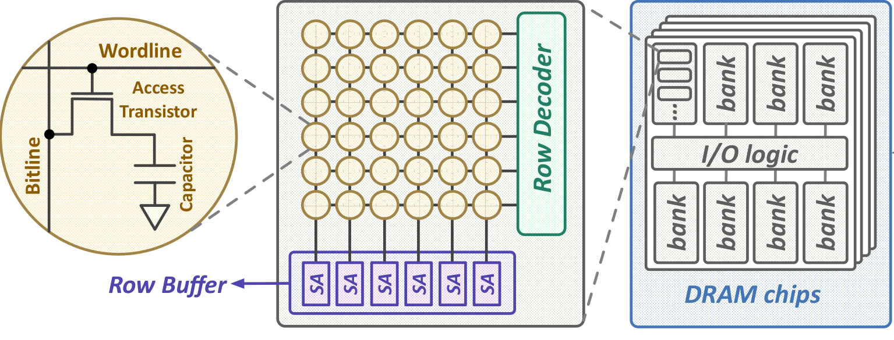

DRAM Error Models
We use the closest fit of four probabilistic error models
1
1
1
Model 0:
Uniform Random
Model 1:
Wordline Correlated
Model 2:
Bitline Correlated
Model 3:
Bit Value Dependent
Notes:
We used four candidate probabilistic DRAM error models. After collecting data in a profiling stage, we selected the error model that most closely fit the characteristics of the target DRAM device.

Slide 59
Use of a DRAM Error Model
Forward Pass using an Error Model in lieu of the Approximate DRAM
Output
and Loss
Input
Gradient
Update
Backward Pass using Regular DRAM
Notes:
We used each DRAM error model in place of the approximate DRAM during re-training. In our case, re-training using the error model enabled us to shave hours from re-training, compared to re-training on our the approximate DRAM testing infrastructure.

Slide 60
Outline
Motivation and Problem
2. DNN Basics and DRAM Parameters
3. EDEN Mechanism
i. Boosting DNN Error Tolerance
ii. DNN Error Tolerance Characterization
iii. DNN to DRAM Mapping
Enabling EDEN Using Error Models
4. Evaluation
5. Conclusion
Notes:
In our next section, we will look into evaluating the accuracy, energy, and latency of multiple DNN workloads.

Slide 61
DNN Accuracy Evaluation: Methodology
8 DNN workloads across four quantization levels
int4, int8, int16, FP32
YOLO YOLO-Tiny MobileNetV2 SqueezeNet1.1
VGG-16 DenseNet201 ResNet-101 AlexNet
Notes:
In our accuracy evaluation, we use 8 DNN workloads across four quantization levels.

Slide 62
DNN Accuracy Evaluation: Methodology
8 DNN workloads across four quantization levels
int4, int8, int16, FP32
YOLO YOLO-Tiny MobileNetV2 SqueezeNet1.1
VGG-16 DenseNet201 ResNet-101 AlexNet
Custom PyTorch-based DNN framework to run DNN inference with error models
SoftMC framework to run inference data accesses
on real DDR3 DRAM modules
Notes:
We use a PyTorch based re-training setup to run DNN inference and our learnt error models. We use an FPGA-based instructure called SoftMC to run inference data accesses through real DDR3 DRAM modules.

Slide 63
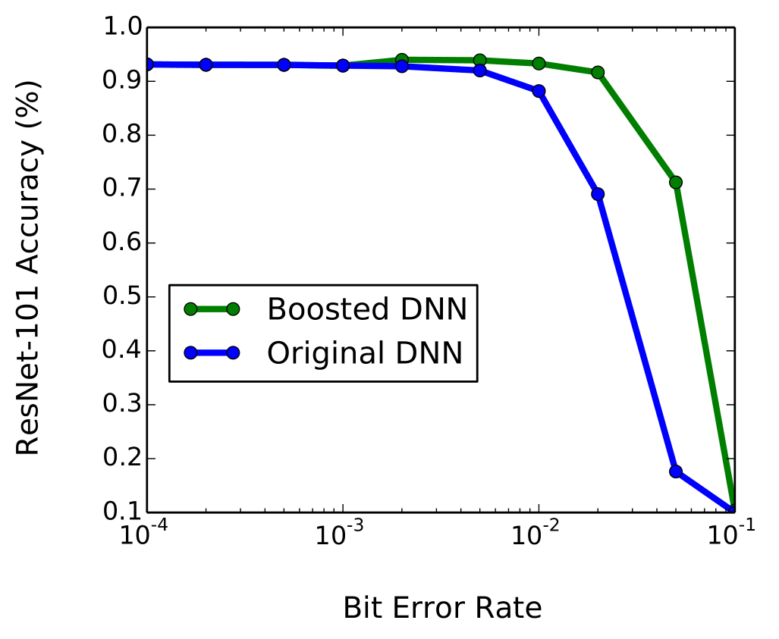
Example: Boosting Error Tolerance of ResNet101
Tolerance Boost
Notes:
In this example evaluation, we illustrates the effects of EDEN’s step 1: DNN boosting. In this graph, accuracy across different bit error rates is shifted right, yielding a DNN that is more error tolerant.

Slide 64
Example: Boosting Error Tolerance of ResNet101
Tolerance Boost
DNN tolerance boosting can
improve a DNN’s bit error tolerance by 5-10x
Notes:
Across our DNN workloads, we find that the tolerated bit error rates can be boosted by 5-10x through re-training.

Slide 65
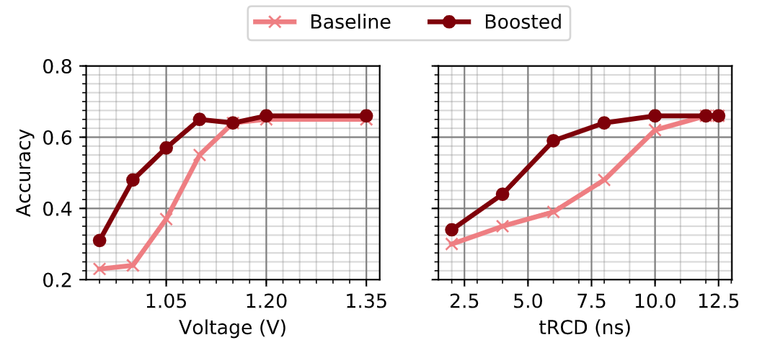
DNN Accuracy of LeNeT on SoftMC
Boosting with error models helps maintain accuracy while reducing voltage and latency
on real DRAM modules
Notes:
We also evaluated micro-benchmarks and a set of smaller DNNs on voltage and latency scaled DDR3 DRAM modules using our SoftMC infrastructure. We find that we can enable up to 6ns reduction in tRCD and up to 30% reduction in supply voltage.

Slide 66
Energy and Performance Evaluation
6 DNN workloads with int8 and FP32 quantizations
Inference libraries from DarkNet, Intel OpenVINO, TVM
Notes:
Our next

Slide 67
Energy and Performance Evaluation
6 DNN workloads with int8 and FP32 quantizations
Inference libraries from DarkNet, Intel OpenVINO, TVM
Ramulator, ZSim, GPGPUSim, and SCALE-Sim used for DRAM, CPU, GPU, Eyeriss, and TPU simulation
CPU: 4 Core @ 4.0 GHz, 8MB L3, 8GB DDR4 DRAM
GPU: 28 SMs, 12GB GDDR5 @ 2.5 GHz
Eyeriss: 12 x 18 PEs, 4GB LPDDR4 @ 1600MHz
TPU: 256 x 256 PEs, 4GB LPDDR4 @ 1600MHz
Full configuration can be found in the paper

Slide 68
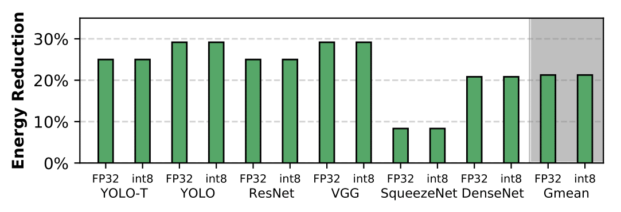
CPU Energy Evaluation
Average 21% DRAM energy reduction
maintaining accuracy within 1% of original

Slide 69
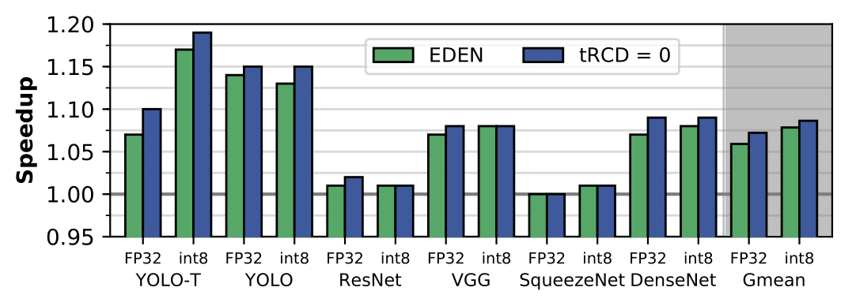
CPU Performance Evaluation
Average 8% system speedup
with some workloads achieving 17% speedup

Slide 70
CPU Evaluation
EDEN achieves close to the ideal speedup
possible via tRCD scaling

Slide 71
GPU, Eyeriss, and TPU Energy Evaluation
Using the previous DNN benchmarks:
Average 31% DDR4 energy reduction on Eyeriss
Average 32% DDR4 energy reduction on TPU
Average 37% GDDR5 energy reduction on Titan X

Slide 72
GPU, Eyeriss, and TPU Energy Evaluation
Using the previous DNN benchmarks:
Average 31% DRAM energy reduction on Eyeriss
Average 32% DRAM energy reduction on TPU
Average 37% DRAM energy reduction on GPU
GPUs and accelerators are effective at hiding DRAM latency due to (1) effective pre-fetching and (2) large register banks and SRAM buffers (exploiting the fixed memory access patterns on DNN inference)

Slide 73
Other Results in the Paper
Error resiliencies across different DNNs and quantizations
Validation of the boosting mechanism
Supporting data for error models using real DRAM modules
Comparison of different DRAM error models
Breakdown of energy savings on different workloads for GPU and TPU

Slide 74
Summary
Motivation: Deep Neural Networks (DNNs) are important in many domains (vision, robotics, ...)
Problem: Challenges of DNN Inference:
High DRAM energy consumption → high energy cost of DNN inference
High DRAM latency → DNN inference slowdowns
Goal: Use voltage/timing scaled DRAM for DNN inference to exploit error tolerant DNN workloads, enabling a trade-off between bit error rate and energy/performance
EDEN: Deep Neural Network Inference Using Approximate DRAM
Techniques to maintain accuracy through error tolerance boosting, DNN characterization, DNN to DRAM mapping, and DRAM error modeling
Results: Energy savings and performance improvements on 12 DNN benchmarks
Average 21% energy savings and 8% speedup on CPU
Average 37% energy savings on GPU
Average 31% energy savings on DNN accelerators (Eyeriss and TPU)
EDEN is applicable to other DRAM parameters and memory technologies

Slide 75
EDEN
Enabling Energy-Efficient, High-Performance
Deep Neural Network Inference
Using Approximate DRAM
Skanda Koppula Lois Orosa A. Giray Yaglikci
Roknoddin Azizi Taha Shahroodi Konstantinos Kanellopoulos Onur Mutlu

Slide 76
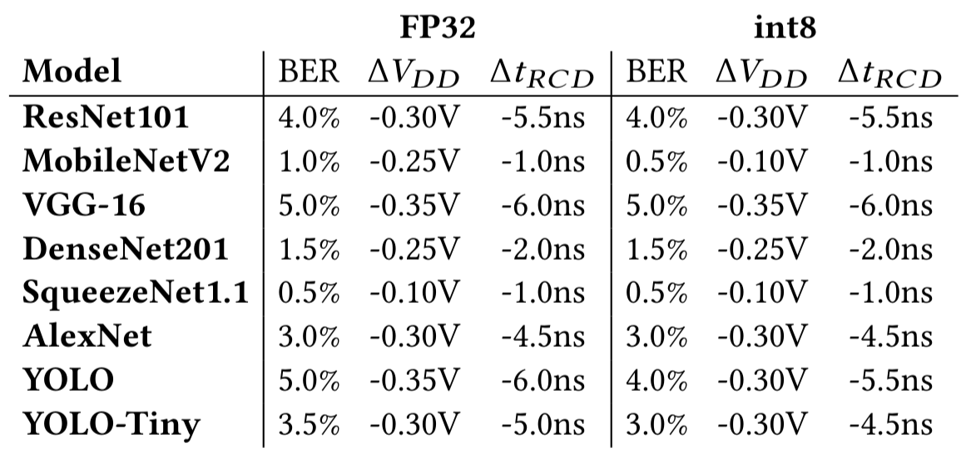
Coarse-Grained Scaling
tRCD or voltage scaling that yields <1% accuracy degradation on a target DDR3 module

Slide 77
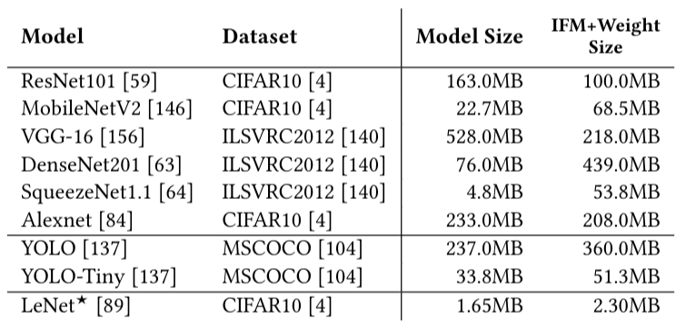
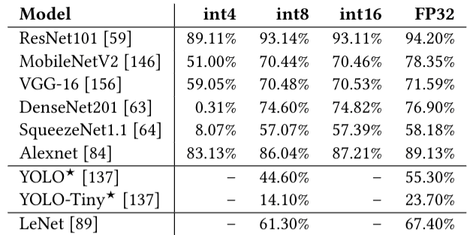
DNN Workload List and Baseline Accuracies

Slide 78
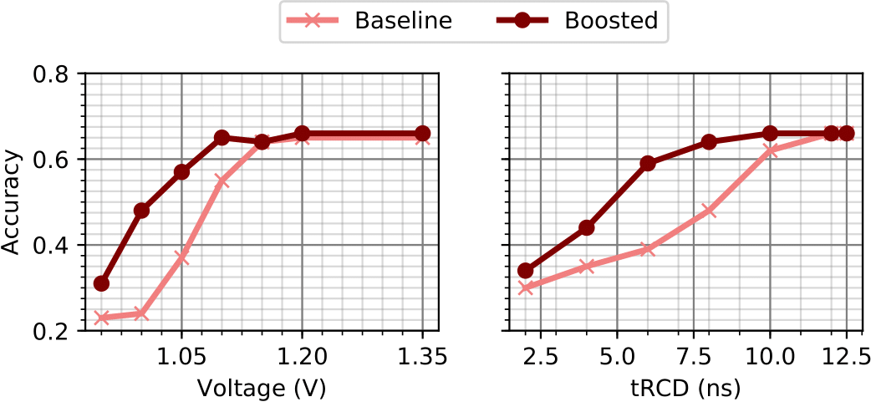
Coarse-Grained Characterization Algorithm
Key Steps:
Decrease tRCD/V_{dd} of DRAM module
Run DNN inference
Measure accuracy on validation dataset
If accuracy < target: terminate.
Decreasing voltage and DNN accuracy

Slide 79
Fine-Grained Characterization Algorithm
Key Steps:
Decrease parameter of DRAM/DNN partition
Run DNN inference
Measure accuracy on validation dataset
If accuracy < target: roll-back parameter decrease
Repeat for all DNN partitions, parameter levels

