Slide 1






FLIN: Enabling Fairness and Enhancing Performance in Modern NVMe Solid State Drives
Arash Tavakkol, Mohammad Sadrosadati, Saugata Ghose,
Jeremie S. Kim, Yixin Luo, Yaohua Wang, Nika Mansouri Ghiasi,
Lois Orosa, Juan Gómez-Luna, Onur Mutlu
Notes:
Hello, my name is Arash Tavakkol and I will be talking about FLIN a new device-level I/O scheduler for modern SSDs.

Slide 2
Motivation
SSDs are widely used as a storage medium
SSDs initially adopted conventional host interface protocols (e.g., SATA)
Designed for magnetic hard disk drives: only thousands of IOPS per device
Process 1
Process 2
Process 3
OS Block Layer
In-DRAM
I/O Request
Queue
I/O Scheduler
Fairness Control
Hardware dispatch queue
SSD Device
Notes:
SSDs are widely used as a storage medium today due to their performance and power consumption benefits. [CLICK] SSDs initially adopted existing host–interface protocols that were originally designed for lower-performance HDDs. [CLICK] These protocols rely on the OS [CLICK] to manage I/O requests and data transfers between the host system and the SSD. [CLICK] [CLICK] and the OS block layer is responsible for fairness control to equalize the effects of interference across applications.

Slide 3

Motivation
Modern SSDs use high-performance host interface protocols (e.g., NVMe)
Takes advantage of SSD throughput: enables millions of IOPS per device
Bypasses OS intervention: SSD must perform scheduling, ensure fairness
Process 1
Process 2
Process 3
In-DRAM
I/O Request
Queue
Fairness should be provided by the SSD itself. Do modern SSDs provide fairness?
SSD Device
Notes:
Modern SSDs, on the other hand, use new host–interface protocols to provide applications with fast access to storage. [CLICK] In these protocols the overheads of the OS software stack is eliminated and the SSD has direct access to the application-level I/O request queues. However, these protocols require the SSD device itself to provide fairness. [CLICK] Our fundamental question in this paper is: do modern SSDs provide fairness? And if not, how can we solve this issue.

Slide 4
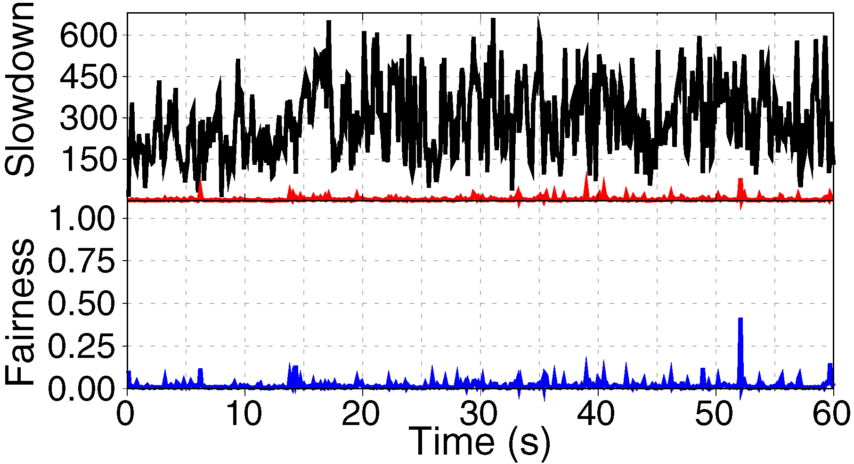
Motivation
We study fairness control in real state-of-the-art SSDs
An example of two datacenter workloads running concurrently
tpce
tpcc
Modern NVMe SSDs focus on providing high performance
at the expense of large amounts of unfairness
Notes:
We study fairness control in real state-of-the-art SSDs. [CLICK] Here is an example where two datacenter workloads, namely tpce and tpcc, are executed on a modern SSD. The upper plot shows the slowdown of [CLICK] tpce and [CLICK] tpcc in concurrent execution with respect to their alone execution. [CLICK] As the plot shows, tpce is highly slowed down in concurrent execution while the effects of concurrent execution on tpcc is very modest, which leads to very low fairness as shown in the lower plot. [CLICK] We conclude that NVMe SSDs focus on providing high performance at the expense of large amounts of unfairness.

Slide 5
Our First Contribution
We perform a comprehensive analysis of inter-application interference in state-of-the-art SSDs
The intensity of requests sent by each application
Differences in request access patterns
The ratio of reads to writes
Garbage collection
Notes:
Our first contribution in this paper is that, [CLICK] we perform a comprehensive analysis of inter-application interference in modern SSDs, and we find four major sources of interferences, i.e., the difference in, [CLICK] the I/O intensity, [CLICK] access pattern, [CLICK] ratio of reads to writes, and [CLICK] garbage collection demands of the concurrent applications.

Slide 6
Our Second Contribution
We propose the Flash-Level INterference-aware scheduler (FLIN)
FLIN is a lightweight device-level I/O request scheduling mechanism that provides fairness among requests from different applications
FLIN carefully reorders transactions within the SSD controller to balance the slowdowns incurred by concurrent applications
Notes:
Our second contribution is that, [CLICK] we propose a new device-level I/O scheduler, called FLIN, [CLICK] which provides fairness among requests from different applications. [CLICK] FLIN carefully reorders transactions within the SSD controller to balance the slowdowns incurred by concurrent applications.

Slide 7
Our Third Contribution
We comprehensively evaluate FLIN using a wide variety of enterprise and datacenter storage workloads
On average, 70% fairness and 47% performance improvement over a state-of-the-art device-level I/O request scheduler
FLIN is implemented fully within the SSD firmware with a very modest DRAM overhead (< 0.06%)
Notes:
As our third contribution, [CLICK] we comprehensively evaluate FLIN using a wide variety of storage workloads. [CLICK] FLIN, on average, improves fairness by 70% and performance by 47% over a state-of-the-art device-level I/O request scheduler. [CLICK] FLIN is implemented fully within the SSD firmware with a very modest DRAM overhead, i.e., less than 0.06%.

Slide 8
FLIN: Enabling Fairness and Enhancing Performance in Modern NVMe Solid State Drives
Arash Tavakkol, Mohammad Sadrosadati, Saugata Ghose,
Jeremie S. Kim, Yixin Luo, Yaohua Wang, Nika Mansouri Ghiasi,
Lois Orosa, Juan Gómez-Luna, Onur Mutlu
Notes:
Please come to my talk at ISCA 2018, if you would like to learn more or have any questions. Thank you very much.

