Slide 1
FLIN: Enabling Fairness and Enhancing Performance in Modern NVMe Solid State Drives
Arash Tavakkol, Mohammad Sadrosadati, Saugata Ghose,
Jeremie S. Kim, Yixin Luo, Yaohua Wang, Nika Mansouri Ghiasi,
Lois Orosa, Juan Gómez-Luna, Onur Mutlu
June 5, 2018

Slide 2
Executive Summary
Modern solid-state drives (SSDs) use new storage protocols (e.g., NVMe) that eliminate the OS software stack
I/O requests are now scheduled inside the SSD
Enables high throughput: millions of IOPS
OS software stack elimination removes existing fairness mechanisms
We experimentally characterize fairness on four real state-of-the-art SSDs
Highly unfair slowdowns: large difference across concurrently-running applications
We find and analyze four sources of inter-application interference that lead to slowdowns in state-of-the-art SSDs
FLIN: a new I/O request scheduler for modern SSDs designed to provide both fairness and high performance
Mitigates all four sources of inter-application interference
Implemented fully in the SSD controller firmware, uses < 0.06% of DRAM space
FLIN improves fairness by 70% and performance by 47% compared to a state-of-the-art I/O scheduler

Slide 3
Background: Modern SSD Design Unfairness Across Multiple Applications in Modern SSDs FLIN: Flash-Level INterference-aware SSD Scheduler Experimental Evaluation Conclusion
Outline

Slide 4
Internal Components of a Modern SSD
Back End: data storage
Memory chips (e.g., NAND flash memory, PCM, MRAM, 3D XPoint)

Slide 5
Internal Components of a Modern SSD
Back End: data storage
Memory chips (e.g., NAND flash memory, PCM, MRAM, 3D XPoint)
Front End: management and control units

Slide 6
Internal Components of a Modern SSD
Back End: data storage
Memory chips (e.g., NAND flash memory, PCM, MRAM, 3D XPoint)
Front End: management and control units
Host–Interface Logic (HIL): protocol used to communicate with host

Slide 7
Internal Components of a Modern SSD
Back End: data storage
Memory chips (e.g., NAND flash memory, PCM, MRAM, 3D XPoint)
Front End: management and control units
Host–Interface Logic (HIL): protocol used to communicate with host
Flash Translation Layer (FTL): manages resources, processes I/O requests

Slide 8
Internal Components of a Modern SSD
Back End: data storage
Memory chips (e.g., NAND flash memory, PCM, MRAM, 3D XPoint)
Front End: management and control units
Host–Interface Logic (HIL): protocol used to communicate with host
Flash Translation Layer (FTL): manages resources, processes I/O requests
Flash Channel Controllers (FCCs): sends commands to, transfers data with memory chips in back end

Slide 9
Conventional Host–Interface Protocols for SSDs
SSDs initially adopted conventional host–interface protocols (e.g., SATA)
Designed for magnetic hard disk drives
Maximum of only thousands of IOPS per device
Process 1
Process 2
Process 3
OS Software Stack
In-DRAM
I/O Request
Queue
I/O Scheduler
Hardware dispatch queue
SSD Device

Slide 10

Host–Interface Protocols in Modern SSDs
Modern SSDs use high-performance host–interface protocols (e.g., NVMe)
Bypass OS intervention: SSD must perform scheduling
Take advantage of SSD throughput: enables millions of IOPS per device
Process 1
Process 2
Process 3
OS Software Stack
In-DRAM
I/O Request
Queue
I/O Scheduler
Fairness mechanisms in OS software stack are also eliminated
Do modern SSDs need to handle fairness control?
Hardware dispatch queue
SSD Device

Slide 11
Background: Modern SSD Design Unfairness Across Multiple Applications in Modern SSDs FLIN: Flash-Level INterference-aware SSD Scheduler Experimental Evaluation Conclusion
Outline

Slide 12
Measuring Unfairness in Real, Modern SSDs
We measure fairness using four real state-of-the-art SSDs
NVMe protocol
Designed for datacenters
Flow: a series of I/O requests generated by an application
Slowdown = (lower is better)
Unfairness = (lower is better)
Fairness = (higher is better)
shared flow response time
alone flow response time
max slowdown
min slowdown
1
unfairness

Slide 13
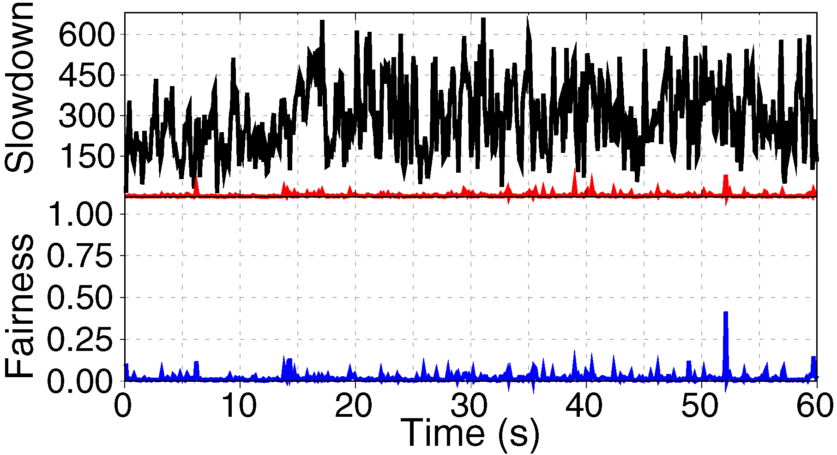
Representative Example: tpcc and tpce
tpce
tpcc
very low fairness
average slowdown of tpce: 2x to 106x across our four real SSDs
SSDs do not provide fairness among concurrently-running flows

Slide 14
What Causes This Unfairness?
Interference among concurrently-running flows
We perform a detailed study of interference
MQSim: detailed, open-source modern SSD simulator [FAST 2018] https://github.com/CMU-SAFARI/MQSim
Run flows that are designed to demonstrate each source of interference
Detailed experimental characterization results in the paper
We uncover four sources of interference among flows

Slide 15
Source 1: Different I/O Intensities
The I/O intensity of a flow affects the average queue wait time of flash transactions
Similar to memory scheduling for bandwidth-sensitive threads vs. latency-sensitive threads
The average response time of a low-intensity flow substantially increases due to
interference from a high-intensity flow

Slide 16
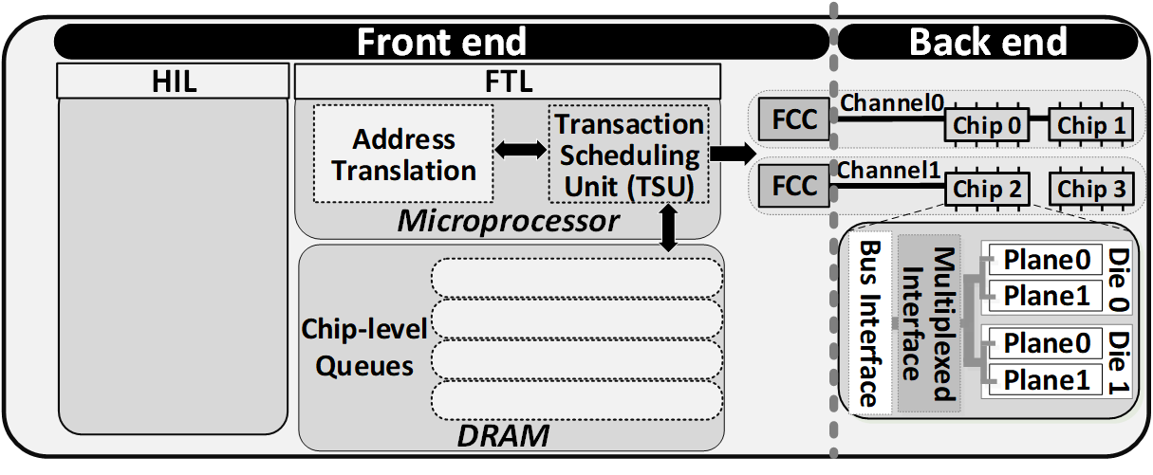
Source 2: Different Access Patterns
Some flows take advantage of chip-level parallelism in back end
Leads to a low queue wait time
Even distribution of transactions in chip-level queues

Slide 17
Source 2: Different Request Access Patterns
Other flows have access patterns that do not exploit parallelism
Flows with parallelism-friendly access patterns are susceptible to interference from flows whose access patterns do not exploit parallelism

Slide 18
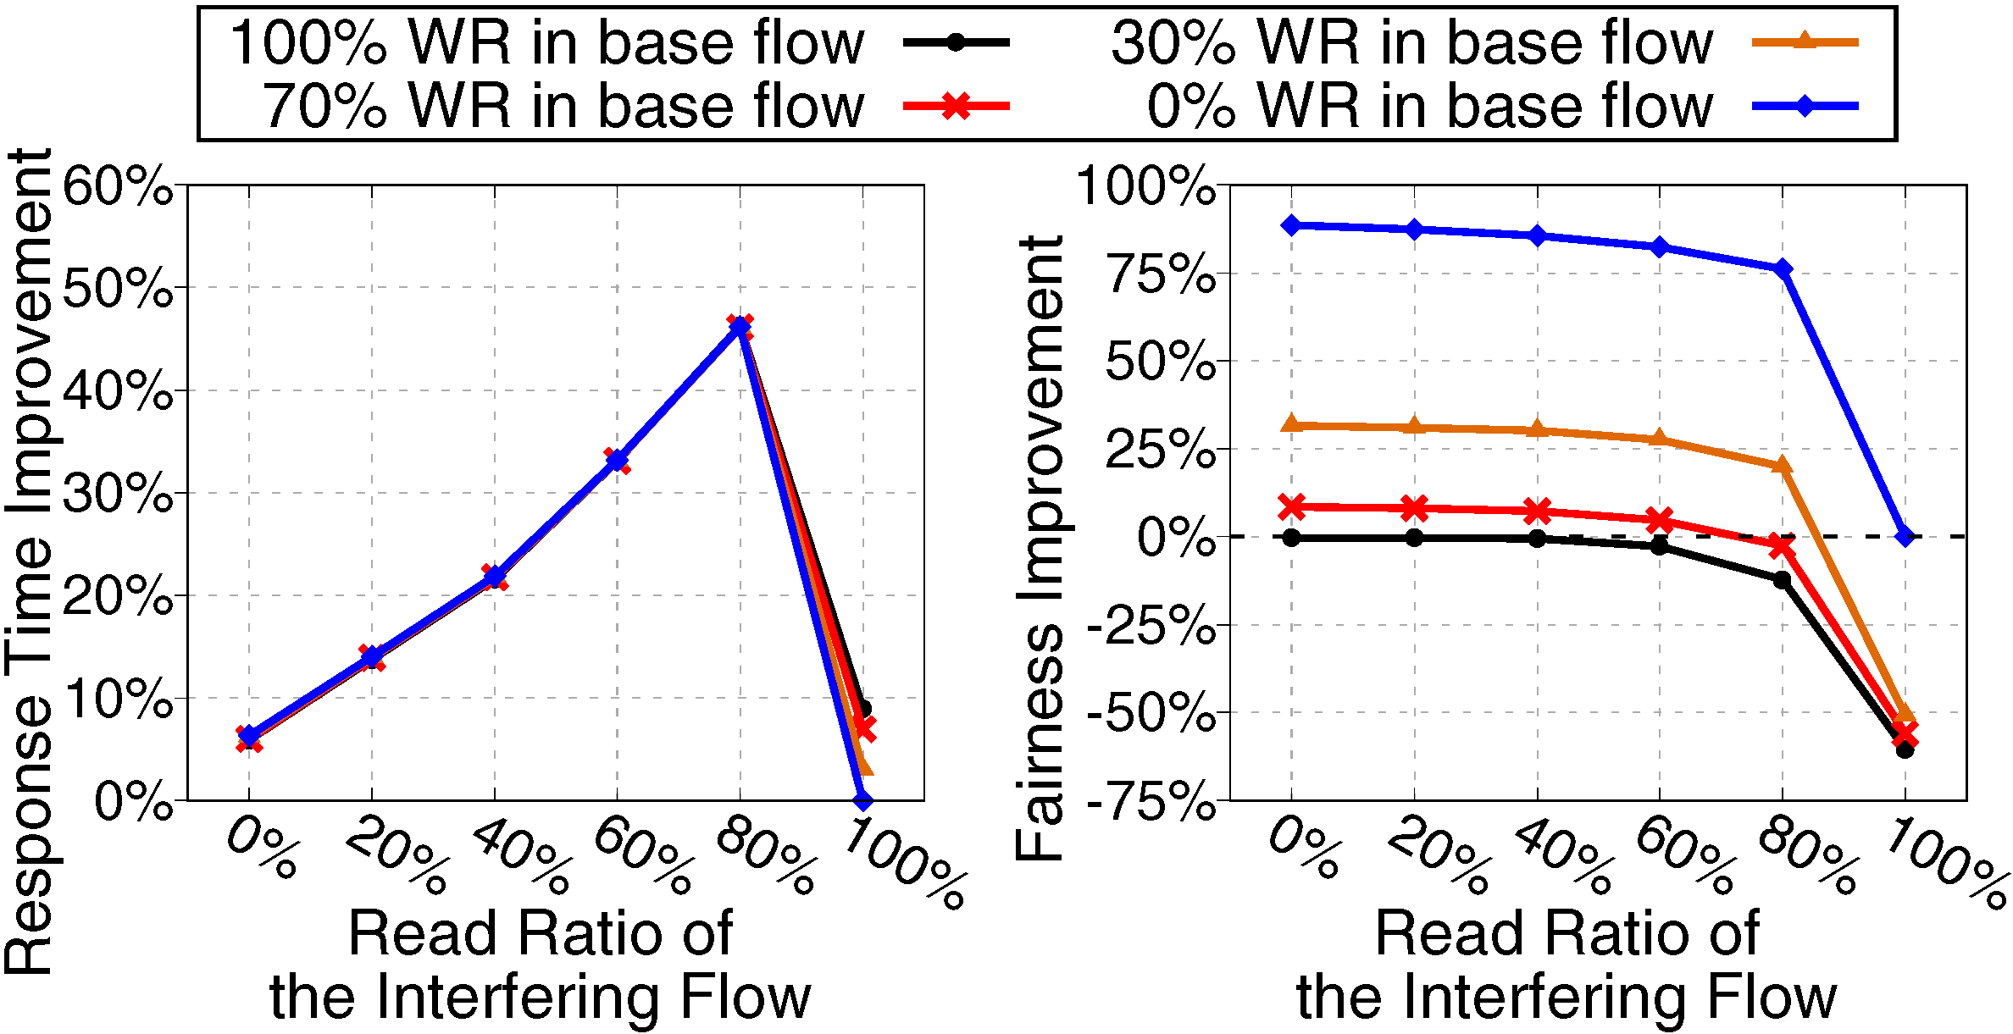
Source 3: Different Read/Write Ratios
State-of-the-art SSD I/O schedulers prioritize reads over writes
Effect of read prioritization on fairness (vs. first-come, first-serve)
When flows have different read/write ratios, existing schedulers do not effectively provide fairness

Slide 19
Source 4: Different Garbage Collection Demands
NAND flash memory performs writes out of place
Erases can only happen on an entire flash block (hundreds of flash pages)
Pages marked invalid during write
Garbage collection (GC)
Selects a block with mostly-invalid pages
Moves any remaining valid pages
Erases blocks with mostly-invalid pages
High-GC flow: flows with a higher write intensity induce more garbage collection activities
The GC activities of a high-GC flow can
unfairly block flash transactions of a low-GC flow

Slide 20
Summary: Source of Unfairness in SSDs
Four major sources of unfairness in modern SSDs
I/O intensity
Request access patterns
Read/write ratio
Garbage collection demands
OUR GOAL
Design an I/O request scheduler for SSDs that (1) provides fairness among flows by mitigating all four sources of interference, and (2) maximizes performance and throughput
Notes:
New goal, link to sources

Slide 21
Background: Modern SSD Design Unfairness Across Multiple Applications in Modern SSDs FLIN: Flash-Level INterference-aware SSD Scheduler Experimental Evaluation Conclusion
Outline

Slide 22
FLIN: Flash-Level INterference-aware Scheduler
FLIN is a three-stage I/O request scheduler
Replaces existing transaction scheduling unit
Takes in flash transactions, reorders them, sends them to flash channel
Identical throughput to state-of-the-art schedulers
Fully implemented in the SSD controller firmware
No hardware modifications
Requires < 0.06% of the DRAM available within the SSD
Notes:
Fix animation

Slide 23
Three Stages of FLIN
Stage 1: Fairness-aware Queue Insertion relieves I/O intensity and access pattern interference
Tail
Head
9
8
7
6
5
4
3
2
1
0
From high-intensity flows
From low-intensity flows

Slide 24
Three Stages of FLIN
Stage 1: Fairness-aware Queue Insertion relieves I/O intensity and access pattern interference
Stage 2: Priority-aware Queue Arbitration enforces priority levels that are assigned to each flow by the host

Slide 25
Three Stages of FLIN
Stage 1: Fairness-aware Queue Insertion relieves I/O intensity and access pattern interference
Stage 2: Priority-aware Queue Arbitration enforces priority levels that are assigned to each flow by the host
Stage 3: Wait-balancing Transaction Selection relieves read/write ratio and garbage collection demand interference

Slide 26
Background: Modern SSD Design Unfairness Across Multiple Applications in Modern SSDs FLIN: Flash-Level INterference-aware SSD Scheduler Experimental Evaluation Conclusion
Outline

Slide 27
Evaluation Methodology
MQSim: https://github.com/CMU-SAFARI/MQSim [FAST 2018]
Protocol: NVMe 1.2 over PCIe
User capacity: 480GB
Organization: 8 channels, 2 planes per die, 4096 blocks per plane, 256 pages per block, 8kB page size
40 workloads containing four randomly-selected storage traces
Each storage trace is collected from real enterprise/datacenter applications: UMass, Microsoft production/enterprise
Each application classified as low-interference or high-interference

Slide 28
Two Baseline Schedulers
Sprinkler [Jung+ HPCA 2014] a state-of-the-art device-level high-performance scheduler
Sprinkler+Fairness [Jung+ HPCA 2014, Jun+ NVMSA 2015] we add a state-of-the-art fairness mechanism to Sprinkler that was previously proposed for OS-level I/O scheduling
Does not have direct information about the internal resources and mechanisms of the SSD
Does not mitigate all four sources of interference

Slide 29
FLIN Improves Fairness Over the Baselines
FLIN improves fairness by an average of 70%, by mitigating all four major sources of interference

Slide 30
FLIN Improves Performance Over the Baselines
FLIN improves performance by an average of 47%, by making use of idle resources in the SSD and improving the performance of low-interference flows

Slide 31
Other Results in the Paper
Fairness and weighted speedup for each workload
FLIN improves fairness and performance for all workloads
Maximum slowdown
Sprinkler/Sprinkler+Fairness: several applications with maximum slowdown over 500x
FLIN: no flow with a maximum slowdown over 80x
Effect of each stage of FLIN on fairness and performance
Sensitivity study to FLIN and SSD parameters
Effect of write caching

Slide 32
Background: Modern SSD Design Unfairness Across Multiple Applications in Modern SSDs FLIN: Flash-Level INterference-aware SSD Scheduler Experimental Evaluation Conclusion
Outline

Slide 33
Conclusion
Modern solid-state drives (SSDs) use new storage protocols (e.g., NVMe) that eliminate the OS software stack
Enables high throughput: millions of IOPS
OS software stack elimination removes existing fairness mechanisms
Highly unfair slowdowns on real state-of-the-art SSDs
FLIN: a new I/O request scheduler for modern SSDs designed to provide both fairness and high performance
Mitigates all four sources of inter-application interference
Different I/O intensities
Different request access patterns
Different read/write ratios
Different garbage collection demands
Implemented fully in the SSD controller firmware, uses < 0.06% of DRAM
FLIN improves fairness by 70% and performance by 47% compared to a state-of-the-art I/O scheduler (Sprinkler+Fairness)

Slide 34
FLIN: Enabling Fairness and Enhancing Performance in Modern NVMe Solid State Drives
Arash Tavakkol, Mohammad Sadrosadati, Saugata Ghose,
Jeremie S. Kim, Yixin Luo, Yaohua Wang, Nika Mansouri Ghiasi,
Lois Orosa, Juan Gómez-Luna, Onur Mutlu
June 5, 2018

Slide 35
Backup Slides

Slide 36
Executive Summary
Modern NVMe solid-state drives (SSDs) eliminate the OS software stack to improve the performance of storage accesses
Take advantage of SSD throughput: enables millions of IOPS per device
The SSD device itself should provide fairness
Modern SSDs focus on providing high performance at the expense of large amounts of unfairness
We perform experiments on four real state-of-the-art SSDs
Large difference in the slowdown of concurrently-running flows
We comprehensively analyze the major sources of inter-application interference in state-of-the-art SSDs
There are four major sources of interference
We propose FLIN, a new device-level I/O scheduler that protects against all sources of unfairness and provides fairness and high performance
Compared to a state-of-the-art I/O scheduler, FLIN, on average, improves fairness and performance by 70% and 47%, respectively
Implemented fully within the SSD controller firmware with a modest DRAM cost

Slide 37


Enabling Higher SSD Performance and Capacity
Solid-state drives (SSDs) are widely used in today’s computer systems
Data centers
Enterprise servers
Consumer devices
I/O demand of both enterprise and consumer applications continues to grow
SSDs are rapidly evolving to deliver improved performance
Host
NAND Flash
SATA
Host Interface
3D XPoint
New NVM

Slide 38
Defining Slowdown and Fairness for I/O Flows
RT_{fi}: response time of Flow f_{i}
S_{fi}: slowdown of Flow f_{i}
F: fairness of slowdowns across multiple flows
0 < F < 1
Higher F means that system is more fair
WS: weighted speedup

Slide 39
Host–Interface Protocols in Modern SSDs
Modern SSDs use high-performance host–interface protocols (e.g., NVMe)
Take advantage of SSD throughput: enables millions of IOPS per device
Bypass OS intervention: SSD must perform scheduling, ensure fairness
Process 1
Process 2
Process 3
In-DRAM
I/O Request
Queue
Fairness should be provided by the SSD itself. Do modern SSDs provide fairness?
SSD Device

Slide 40
FTL: Managing the SSD’s Resources
Flash writes can take place only to pages that are erased
Perform out-of-place updates (i.e., write data to a different, free page), mark old page as invalid
Update logical-to-physical mapping (makes use of cached mapping table)
Some time later: garbage collection reclaims invalid physical pages off the critical path of latency

Slide 41
FTL: Managing the SSD’s Resources
Flash writes can take place only to pages that are erased
Perform out-of-place updates (i.e., write data to a different, free page), mark old page as invalid
Update logical-to-physical mapping (makes use of cached mapping table)
Some time later: garbage collection reclaims invalid physical pages off the critical path of latency
Transaction Scheduling Unit: resolves resource contention

Slide 42
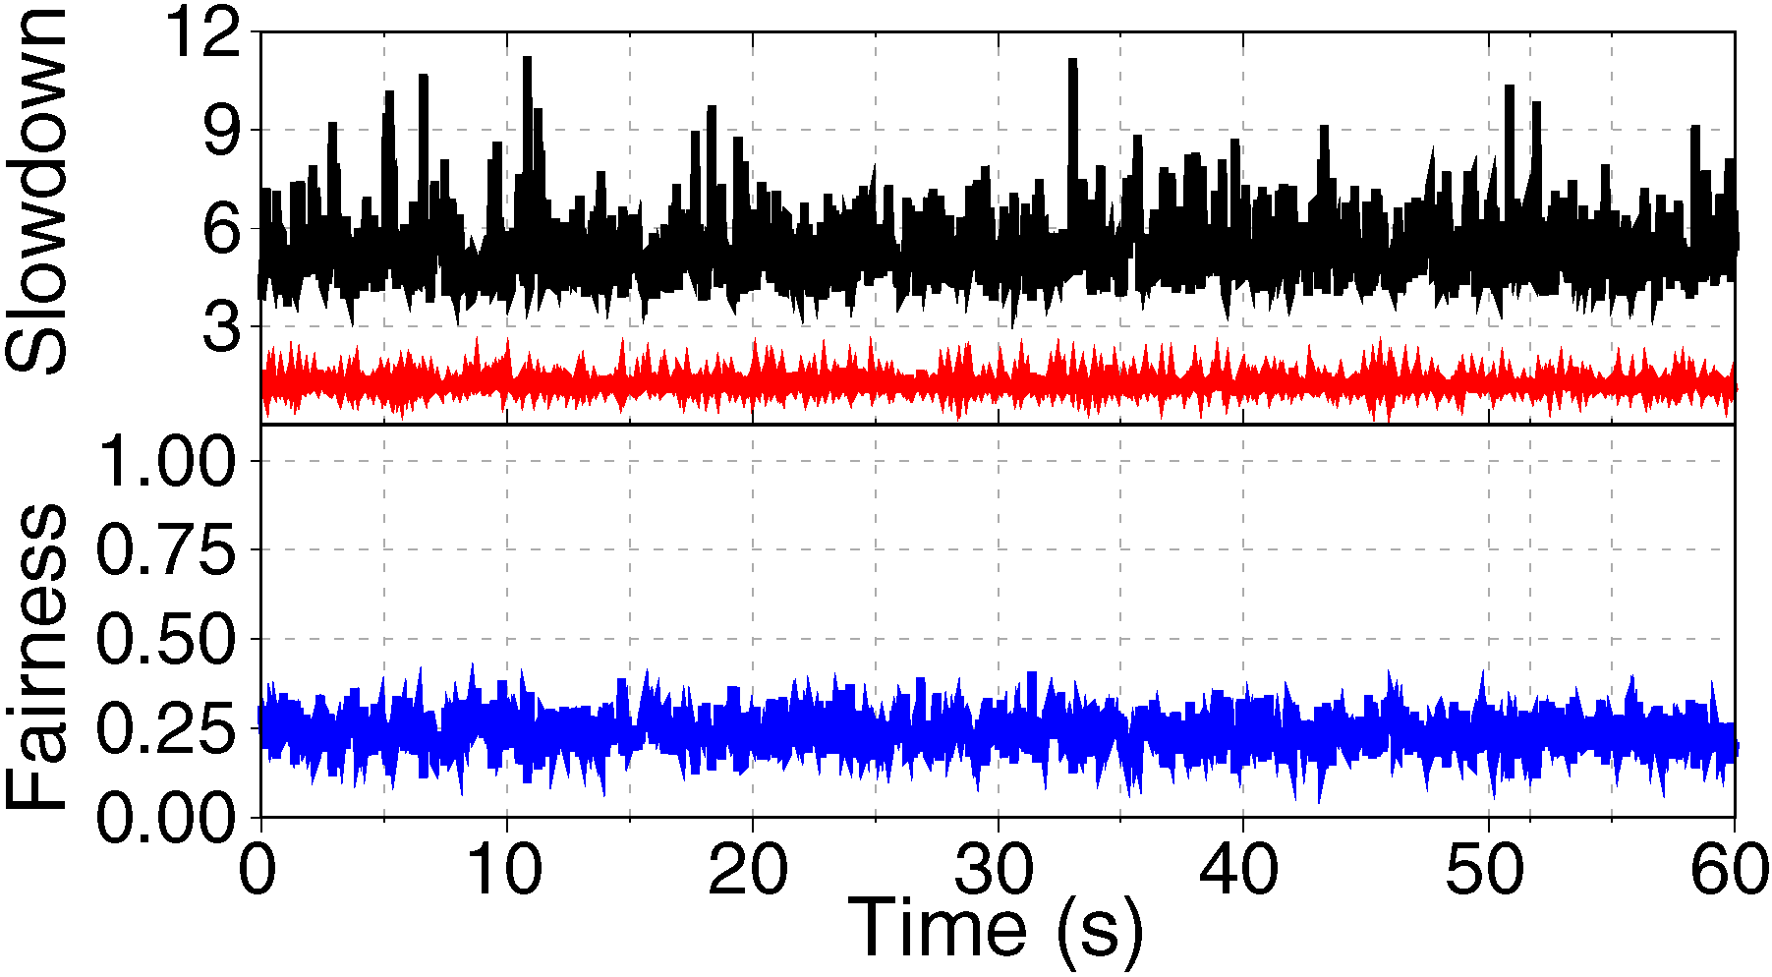
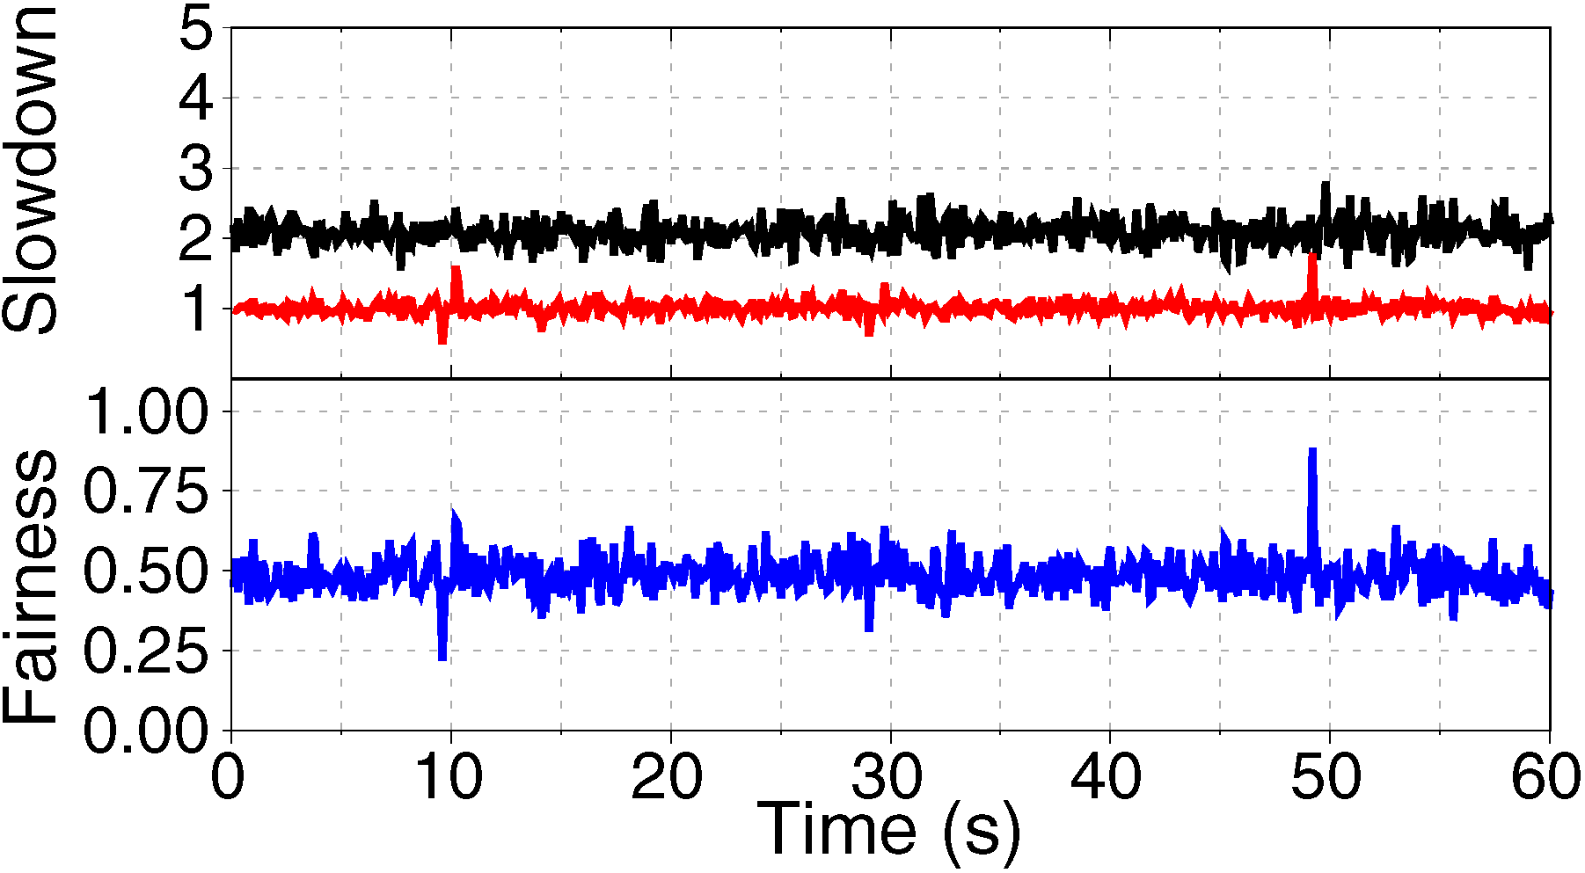
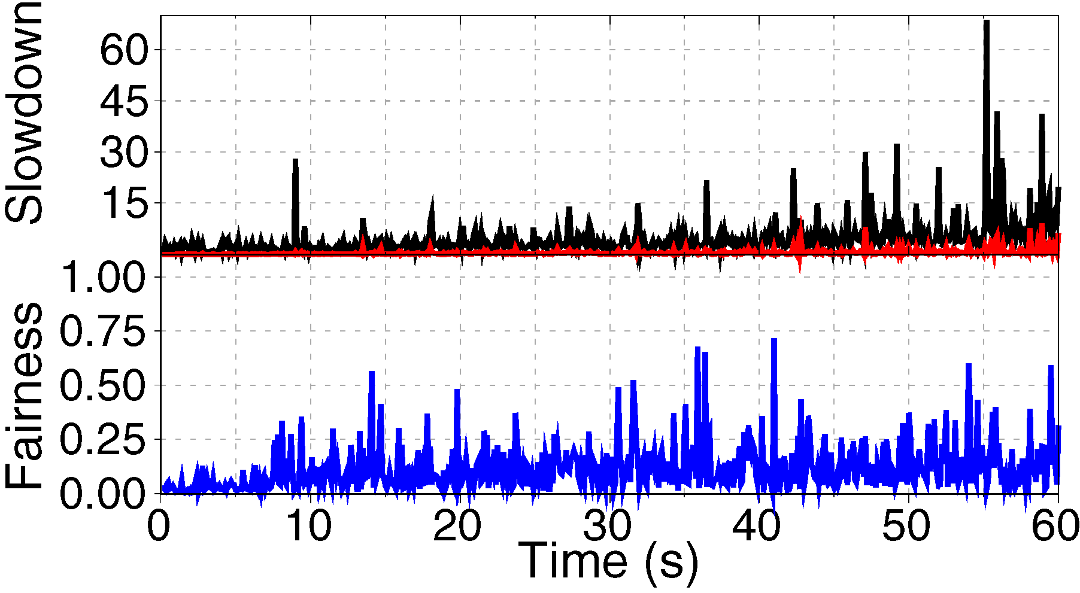
Motivation
The study experimental results on our four SSDs
An example of two datacenter workloads running concurrently
tpcc
tpce
SSD-A
SSD-B
SSD-C
SSD-D
tpce on average experiences 2x to 106x
higher slowdown compared to tpcc

Slide 43
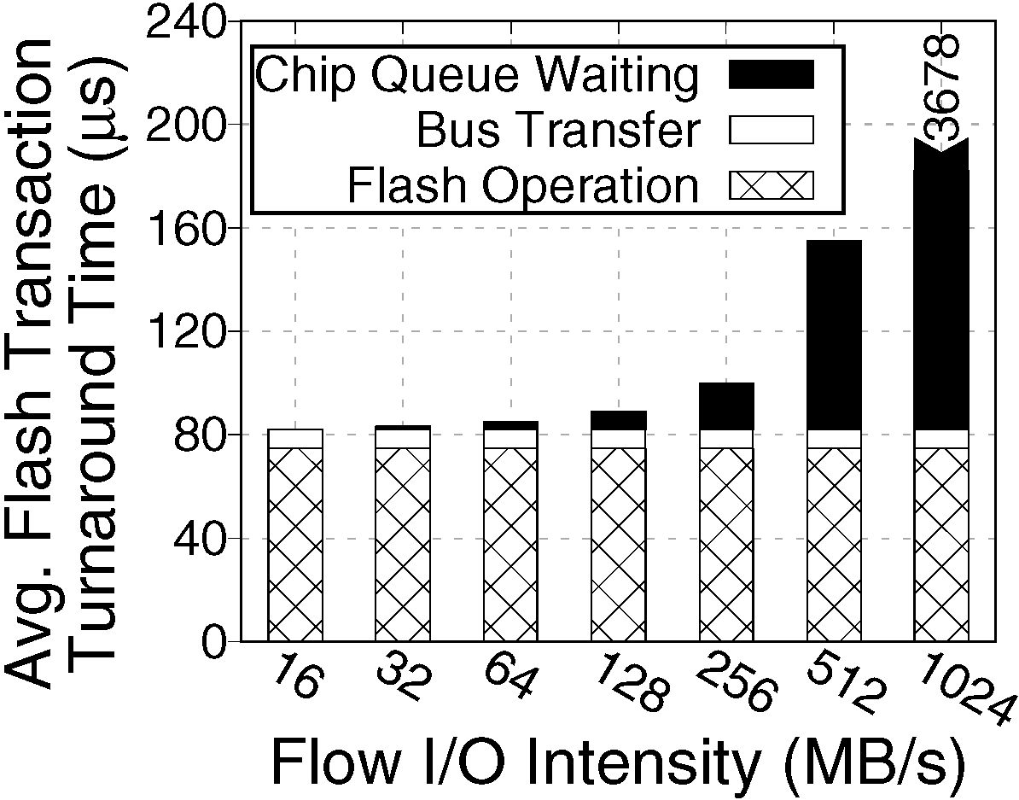
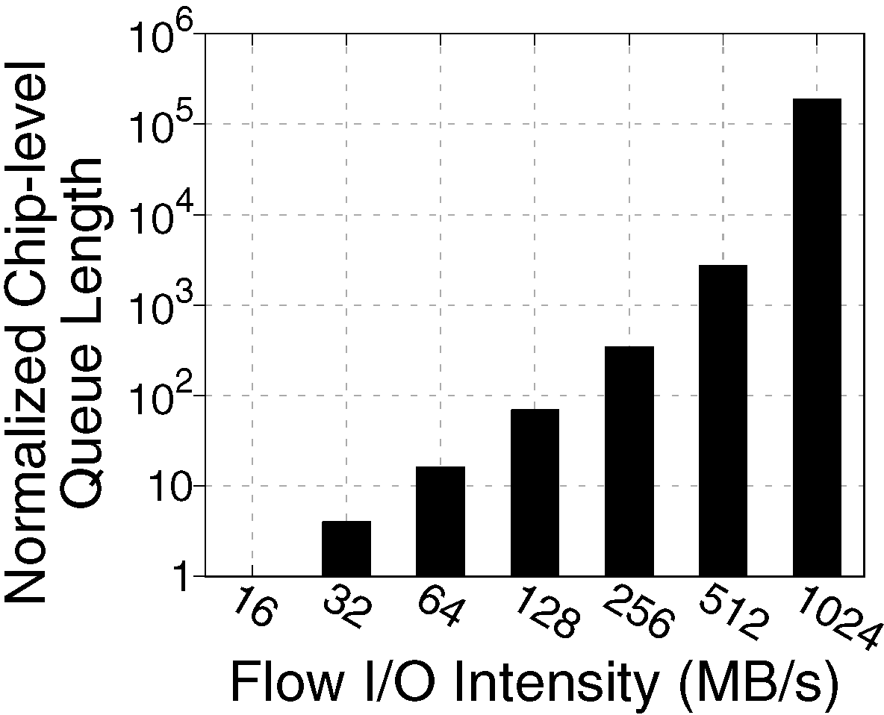
Reason 1: Difference in the I/O Intensities
The I/O intensity of a flow affects the average queue wait time of flash transactions
The queue wait time
highly increases with I/O intensity

Slide 44
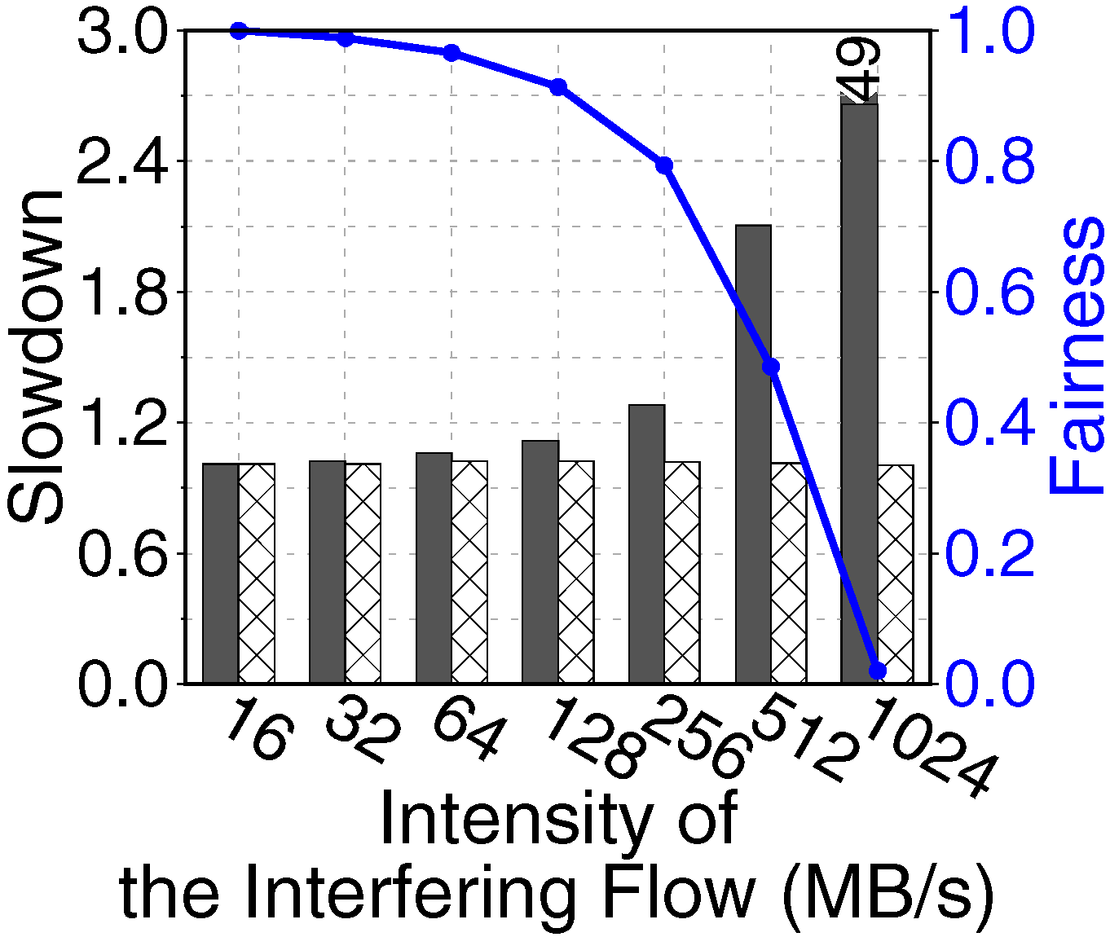
Reason 1: Difference in the I/O Intensities
An experiment to analyze the effect of concurrently executing two flows with different I/O intensities on fairness
Base flow: low intensity (16 MB/s) and low average chip-level queue length
Interfering flow: varying I/O intensities from low to very high
Base flow experiences a drastic increase
in the average length of the chip-level queue
The average response time of a low-intensity flow substantially increases due to
interference from a high-intensity flow

Slide 45
Reason 2: Difference in the Access Pattern
The access pattern of a flow determines how its transactions are distributed across the chip-level queues
The running flow benefits from parallelism in the back end
Leads to a low transaction queue wait time
Even distribution of transactions in chip-level queues

Slide 46
Reason 2: Difference in the Access Pattern
The access pattern of a flow determines how its transactions are distributed across the chip-level queues
Higher transaction wait time in the chip-level queues
Uneven distribution of flash transactions

Slide 47
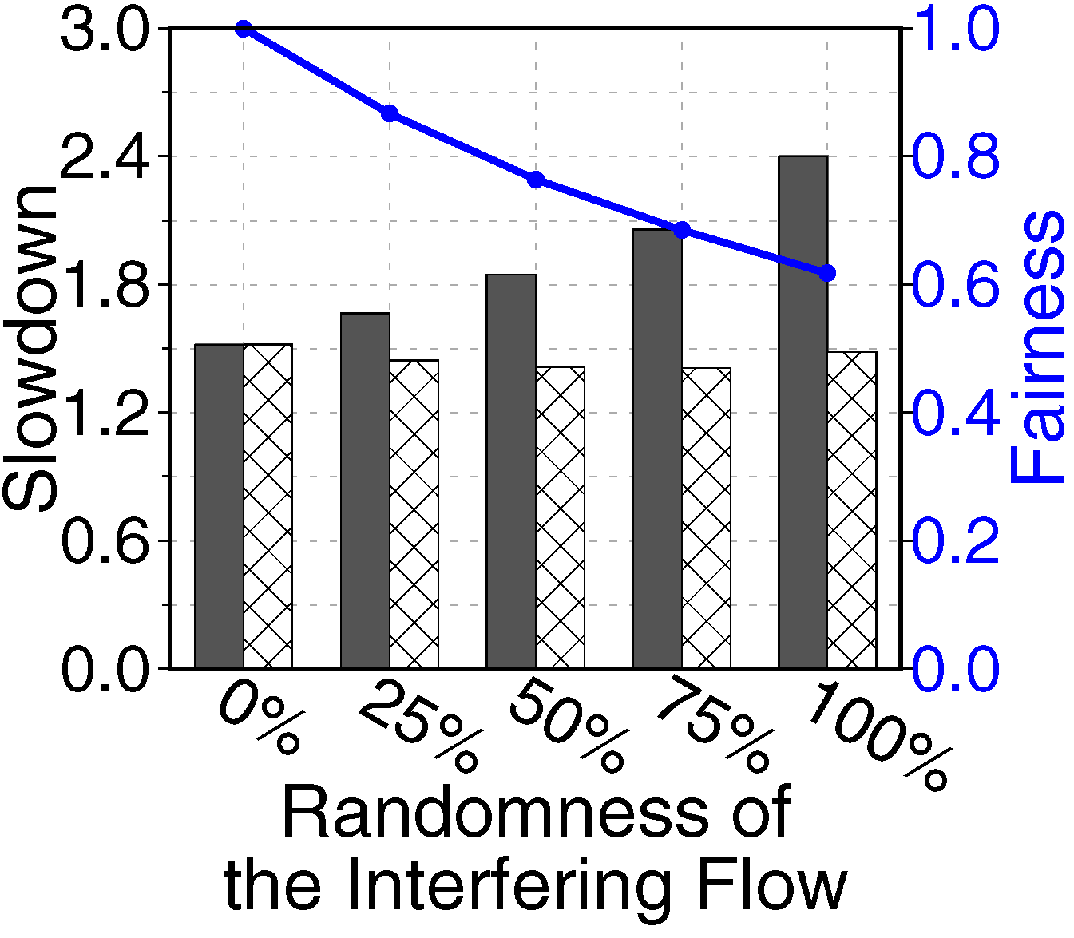
Reason 2: Difference in the Access Pattern
An experiment to analyze the interference between concurrent flows with different access patterns
Base flow: streaming access pattern (parallelism friendly)
Interfering flow: mixed streaming and random access pattern
Flows with parallelism-friendly access patterns are susceptible to interference from flows
with access patterns that do not exploit parallelism

Slide 48
Reason 3: Difference in the Read/Write Ratios
State-of-the-art SSD I/O schedulers tend to prioritize reads over writes
Reads are 10-40x faster than writes
Reads are more likely to fall on the critical path of program execution
The effect of read prioritization on fairness
Compare a first-come first-serve scheduler with a read-prioritized scheduler
Existing scheduling policies are not effective
at providing fairness, when
concurrent flows have different read/write ratios

Slide 49
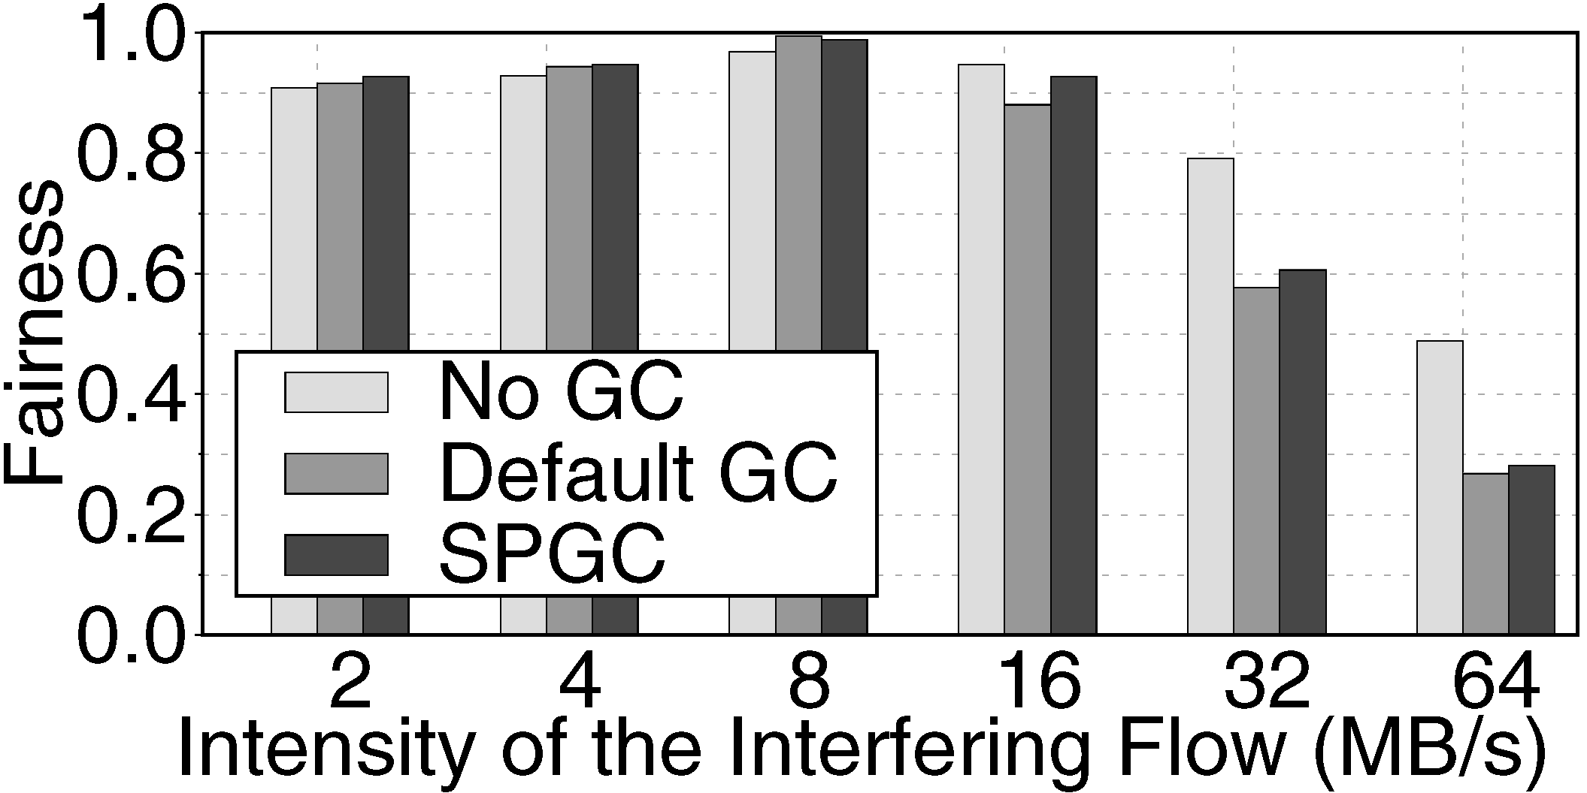
Reason 4: Difference in the GC Demands
Garbage collection may block user I/O requests
Primarily depends on the write intensity of the workload
An experiment with two 100%-write flows with different intensities
Base flow: low intensity and moderate GC demand
Interfering flow: different write intensities from low-GC to high-GC
Lower fairness
due to GC execution
Tries to
preempt GC
The GC activities of a high-GC flow can
unfairly block flash transactions of a low-GC flow

Slide 50
Stage 1: Fairness-Aware Queue Insertion
Relieves the interference that occurs due to the intensity and access pattern of concurrently-running flows
In concurrent execution of two flows
Flash transactions of one flow experience a higher increase in the chip-level queue wait time
Stage 1 performs reordering of transactions within the chip-level queues to reduce the queue wait
Intensity
Access pattern

Slide 51
Stage 1: Fairness-Aware Queue Insertion
Tail
Head
New transaction arrives
9
8
7
6
5
4
3
2
1
0
From high-intensity flows
From low-intensity flows
1. If source of the new transaction is high-intensity
9
8
7
6
5
4
3
2
1
0
If source of the new transaction is low-intensity
9
8
7
6
5
4
3
2
1
0
2a. Estimate slowdown of each transaction and reorder transactions to improve fairness in low-intensity part
9
8
7
6
5
4
3
2
1
0
2b. Estimate slowdown of each transaction and reorder transactions to improve fairness in high-intensity part
9
8
7
6
5
4
3
2
1
0
Notes:
Simplify to two queues

Slide 52
Stage 2: Priority-Aware Queue Arbitration
Many host–interface protocols, such as NVMe, allow the host to assign different priority levels to each flow
FLIN maintains a read and a write queue for each priority level at Stage 1
Totally 2×P read and write queues in DRAM for P priority classes
Stage 2
Selects one ready read/write transaction from the transactions at the head of the P read/write queues and moves it to Stage 3
It uses a weighted round-robin policy
An example
0
1
To stage 3
2
Read Slot
Notes:
simpler

Slide 53

Stage 3: Wait-Balancing Transaction Selection
Minimizes interference resulted from the read/write ratios and garbage collection demands of concurrently-running flows
Attempts to distribute stall times evenly across read and write transactions
Stage 3 considers proportional wait time of the transactions
Reads are still prioritized over writes
Reads are only prioritized when their proportional wait time is greater than write transaction’s proportional wait time
$$PW=\frac{T_{wait}}{T_{memory}+T_{transfer}}$$
Waiting time before
the transaction is dispatched
to the flash controller
Smaller for reads
Notes:
Fix completely, add estimation logic

Slide 54
Stage 3: Wait-Balancing Transaction Selection
Read Slot
Write Slot
GC Read Queue
GC Write Queue
1. Estimate proportional wait times for the transactions in the read slot and write slot
2. If the read-slot transaction has a higher proportional wait time, then dispatch it to channel
3. If the write-slot transaction has a higher proportional wait time
The number of GC activities is estimated
based on 1) relative write intensity, and
2) relative usage of the storage space
3a. If GC queues are not empty then execute some GC requests ahead of write
3b. Dispatch the transaction in the write slot to the FCC

Slide 55
Implementation Overheads and Cost
FLIN can be implemented in the firmware of a modern SSD, and does not require specialized hardware
FLIN has to keep track of
flow intensities to classify flows into and low-intensity categories,
slowdowns of individual flash transactions in the queues,
the average slowdown of each flow, and
the GC cost estimation data
Our worst-case estimation shows that the DRAM overhead of FLIN would be very modest (< 0.06%)
The maximum throughput of FLIN is identical to the baseline
All the processings are performed off the critical path of transaction processing

Slide 56
Methodology: SSD Configuration
MQSim, an open-source, accurate modern SSD simulator: https://github.com/CMU-SAFARI/MQSim [FAST’18]

Slide 57
Methodology: Workloads
We categorize workloads as low-interference or high-interference
A workload is high-interference if it keeps all of the flash chips busy for more than 8% of the total execution time
We form workloads using randomly-selected combinations of four low- and high-interference traces
Experiments are done in groups of workloads with 25%, 50%, 75%, and 100% high-intensity workloads

Slide 58
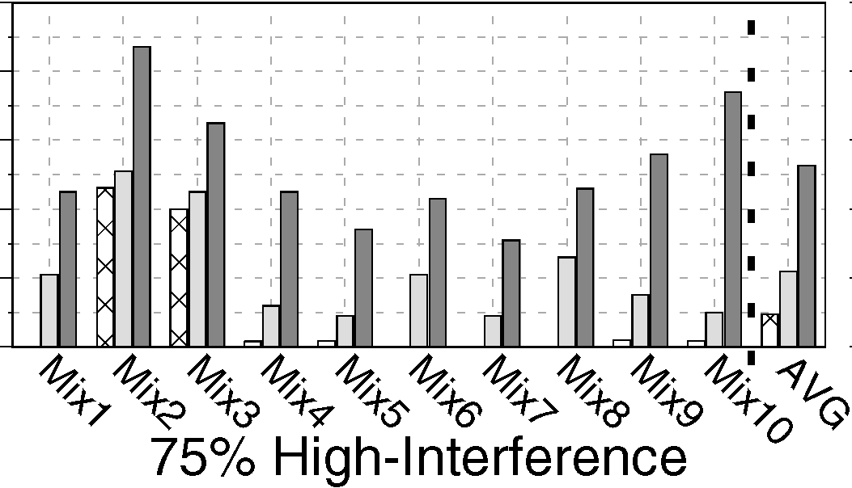
Experimental Results: Fairness
For workload mixes 25%, 50%, 75%, and 100%, FLIN improves average fairness by
1.8x, 2.5x, 5.6x, and 54x over Sprinkler, and
1.3x, 1.6x, 2.4x, and 3.2x over Sprinkler+Fairness
Sprinkler+Fairness improves fairness over Sprinkler
Due to its inclusion of fairness control
1.0
0.8
0.6
0.4
0.2
0.0
Sprinkler+Fairness does not consider all sources of interference, and therefore has a much lower fairness than FLIN
Notes:
Keep heterogeneity
Backup slides – review questions

Slide 59
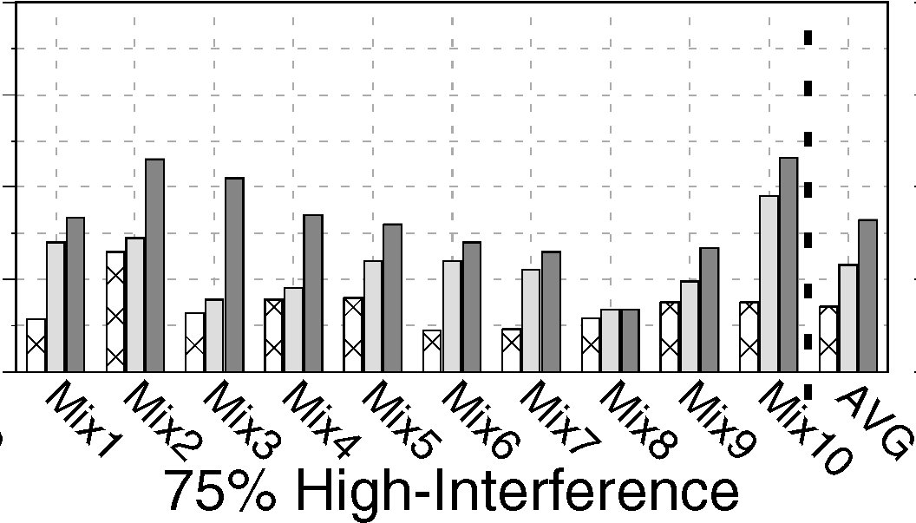
Experimental Results: Weighted Speedup
4
3
2
1
0
Across the four workload categories, FLIN on average improves the weighted speedup by
38%, 74%, 132%, 156% over Sprinkler, and
21%, 32%, 41%, 76% over Sprinkler+Fairness
FLIN’s fairness control mechanism improves the performance of low-interference flows
Weighted-speedup remains low for Sprinkler+Fairness as its throughput control mechanism leaves many resources idle

Slide 60
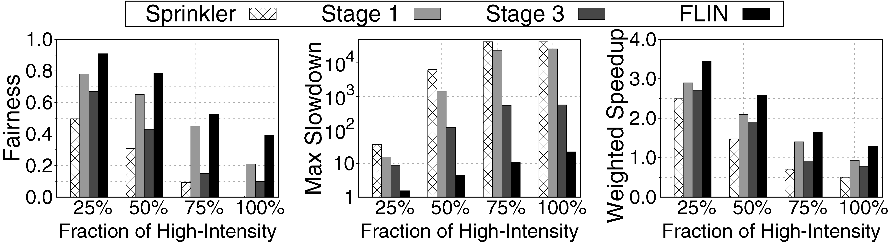
Effect of Different FLIN Stages
The individual stages of FLIN improve both fairness and performance over Sprinkler, as each stage works to reduce some sources of interference
The fairness and performance improvements of Stage 1 are much higher than those of Stage 3
I/O intensity is the most dominant source of interference
Stage 3 reduces the maximum slowdown by a greater amount than Stage 1
GC operations can significantly increase the stall time of transactions

Slide 61
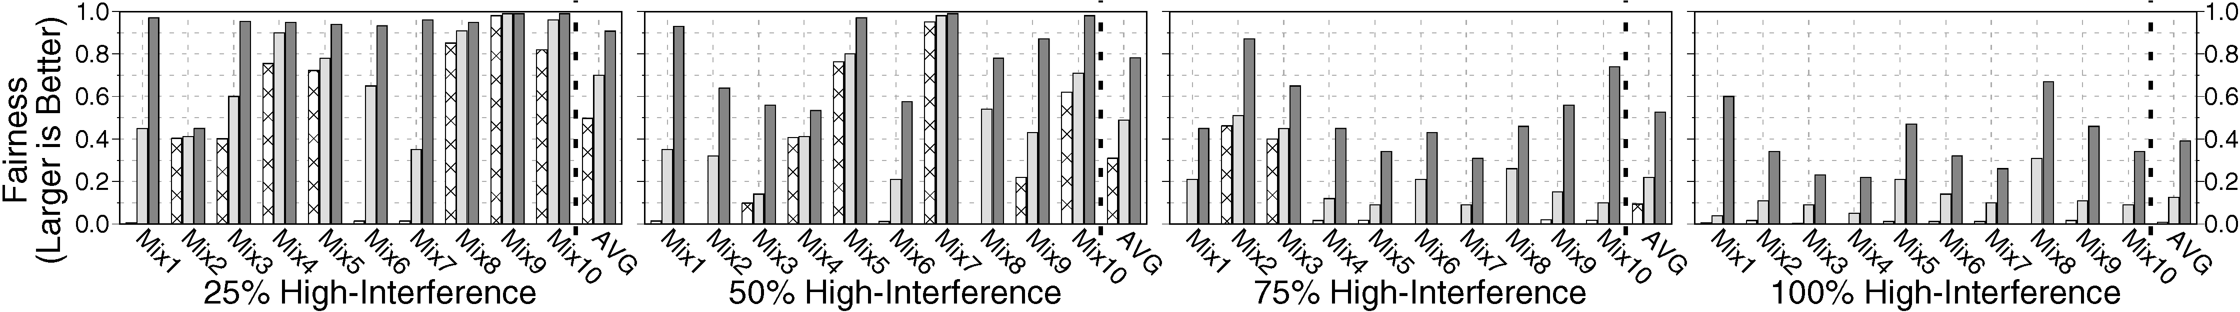
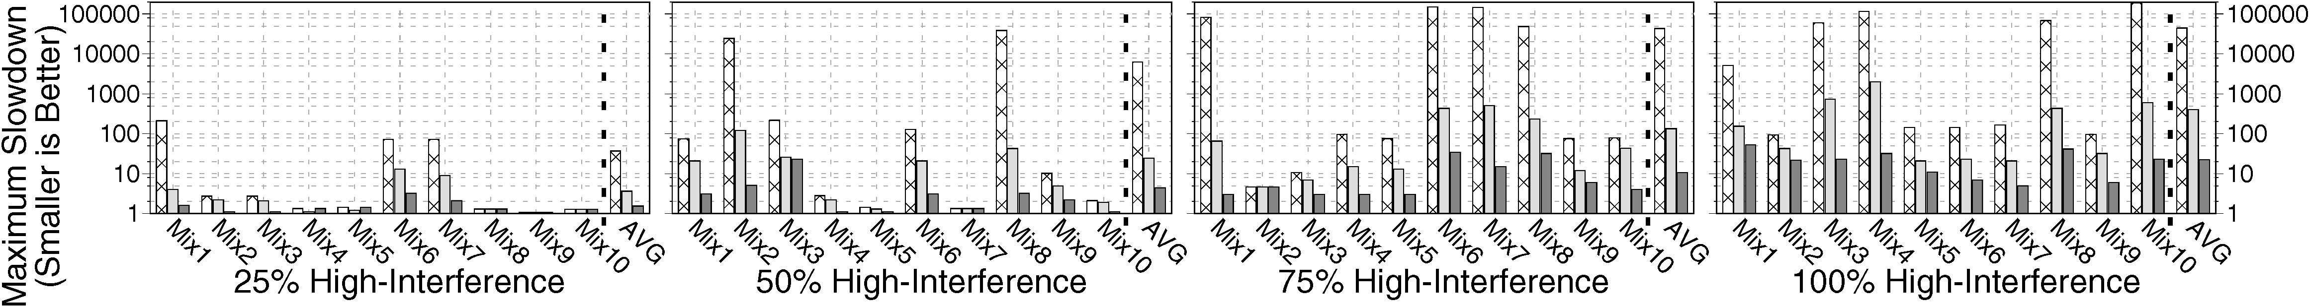
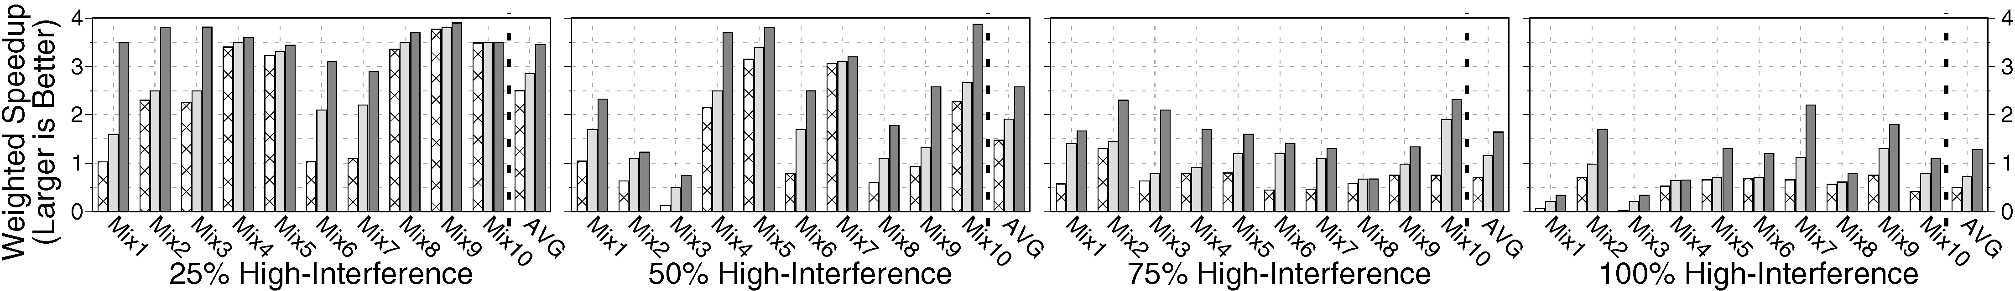
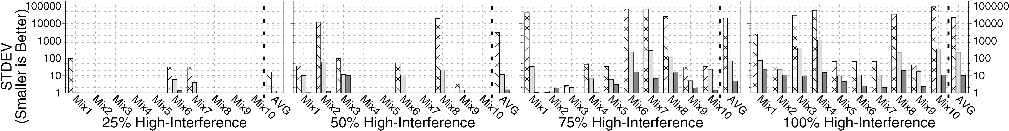
Fairness and Performance of FLIN

Slide 62
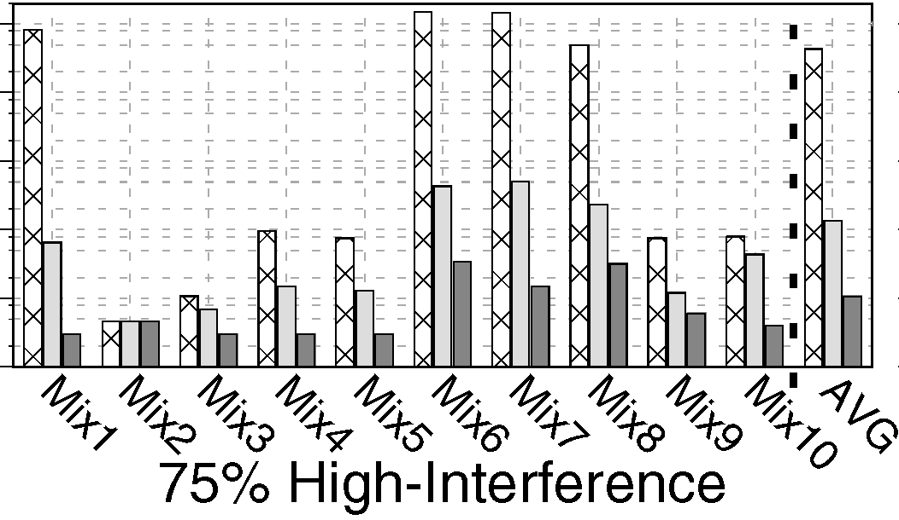
Experimental Results: Maximum Slowdown
100000
10000
1000
100
10
1
Across the four workload categories, FLIN reduces the average maximum slowdown by
24x, 1400x, 3231x, and 1597x over Sprinkler, and
2.3x, 5.5x, 12x, and 18x over Sprinkler+Fairness
Across all of the workloads, no flow has a maximum slowdown greater than 80x under FLIN
There are several flows that have maximum slowdowns over 500x with Sprinkler and Sprinkler+Fairness

Slide 63
Conclusion & Future Work
FLIN is a lightweight transaction scheduler for modern multi-queue SSDs (MQ-SSDs), which provides fairness among concurrently-running flows
FLIN uses a three-stage design to protect against all four major sources of interference that exist in real MQ-SSDs
FLIN effectively improves both fairness and system performance compared to state-of-the-art device-level schedulers
FLIN is implemented fully within the SSD firmware with a very modest DRAM overhead (<0.06%)
Future Work
Coordinated OS/FLIN mechanisms

