Slide 1




FlexWatts: A Power- and Workload-Aware Hybrid Power Delivery Network for
Energy-Efficient Microprocessors
Jawad Haj-Yahya¹ Mohammed Alser¹ Jeremie S. Kim¹ Lois Orosa¹ Efraim Rotem²
Avi Mendelson^{3,4} Anupam Chattopadhyay ⁴ Onur Mutlu¹
1
1
2
3
4
Notes:
My name is Jawad Haj-Yahya and I will present FlexWatts [END]

Slide 2

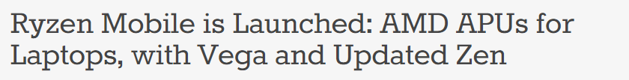
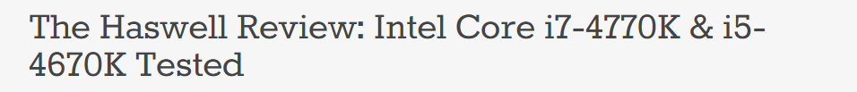
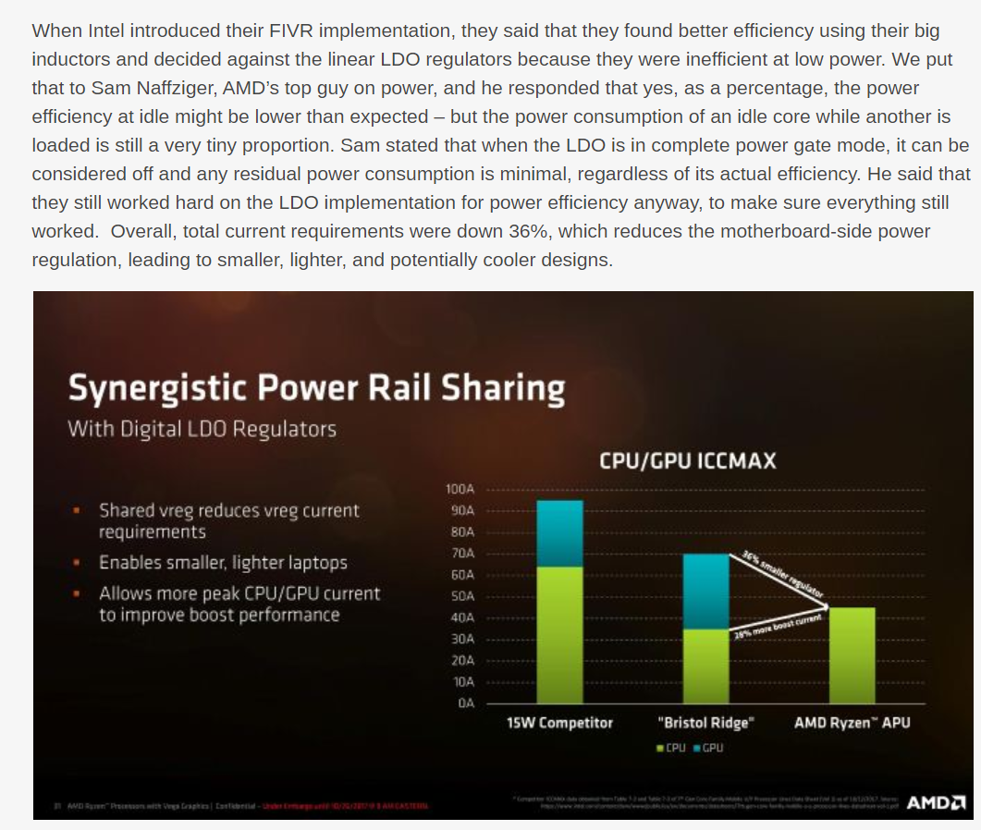
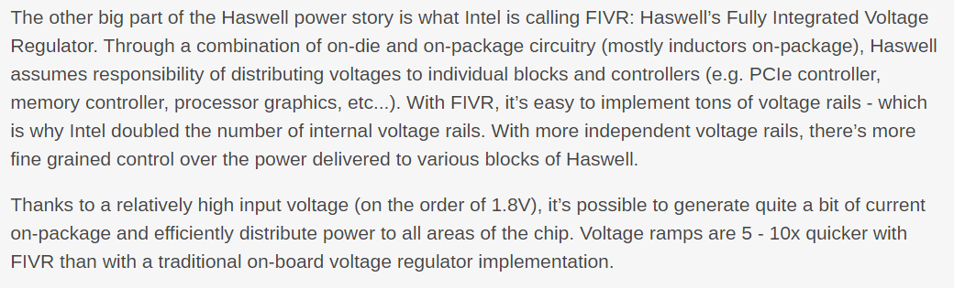
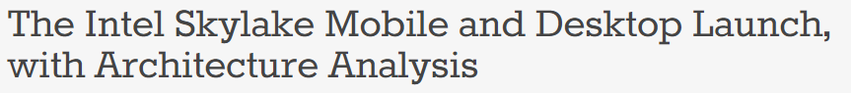
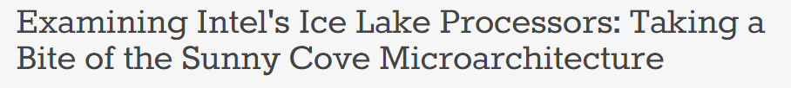
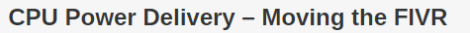
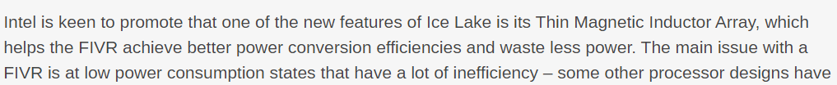

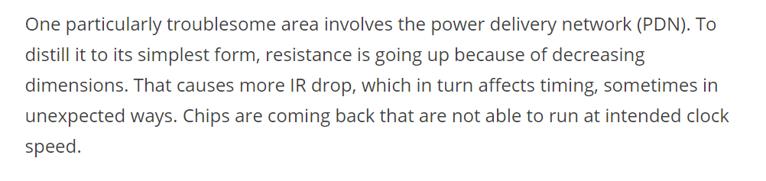
The Power Delivery Network (PDN) Debate
2013
Intel Haswell Uses IVR PDN (FIVR)
2017
AMD Ryzen Uses LDO PDN
2015
Intel Skylake Uses MBVR PDN
2019
Intel Icelake Uses IVR PDN (FIVR)
https://semiengineering.com/power-delivery-affecting-performance-at-7nm/
Notes:
In recent years there is a hot debate in industry and academia on power delivery networks. [CLICK]
PDN issues are becoming even worse as process technology scales down [END]

Slide 3
Our Goal: A Hybrid and Adaptive PDN
A client processor operates across a wide range of power consumption and executes a wide variety of workloads
We find that there is no single PDN for modern client processors that provides a high energy-efficiency across the wide range of power consumption and wide variety of workloads
Our Goal is to propose a new PDN architecture that overcomes the inefficiencies of prior PDN architectures
To this end, we propose a hybrid and adaptive PDN that provides the advantages of each one of the three commonly-used PDNs
by dynamically adapting the hybrid PDN based on processor power consumption and workload characteristics
Notes:
[CLICK]
A client processor operates across a wide range of power consumption and executes a wide variety of workloads [CLICK]
We find that there is no single PDN for modern client processors that provides a high energy-efficiency across the wide range of power consumption and wide variety of workloads [CLICK]
Our Goal is to propose a new PDN architecture that overcomes the inefficiencies of prior PDN architectures [CLICK]
To this end, we propose a hybrid and adaptive PDN that provides the advantages of each one of the three commonly-used PDNs [CLICK]
by dynamically adapting the hybrid PDN based on processor power consumption and workload characteristics [END]

Slide 4
FlexWatts: Key Results
FlexWatts is the first hybrid PDN to use two types of on-chip voltage regulators (IVR and LDO) to leverage the advantages of both
FlexWatts efficiently chooses the processor PDN based on the power demands and workload characteristics
We evaluate FlexWatts using our new open-sourced PDNspot model
FlexWatts improves the performance of CPU and graphics workloads (by up to 22% and 25%, respectively, for 4W thermal design power (TDP))
FlexWatts reduces the average power consumption of battery life workloads (by up to 11%) across all TDPs
We show that FlexWatts is an effective approach:
To provide high efficiency and high performance in metrics of interest
In client processors across a wide spectrum of TDPs and workloads with minimal overhead
https://github.com/CMU-SAFARI/PDNspot
Notes:
We propose FlexWatts [CLICK]
FlexWatts is the first hybrid PDN to use two types of on-chip voltage regulators (IVR and LDO) to leverage the advantages of both [CLICK]
FlexWatts efficiently chooses the processor PDN based on the power demands and workload characteristics [CLICK]
We evaluate FlexWatts using our new open-sourced PDNspot model [CLICK]
FlexWatts improves the performance of CPU and graphics workloads by up to 22% and 25%, respectively, for 4W thermal design power [CLICK]
FlexWatts reduces the average power consumption of battery life workloads by up to 11% across all TDPs [CLICK]
We show that FlexWatts is an effective approach to maintain high efficiency and high performance in metrics of interest in client processors across a wide spectrum of TDPs and workloads with minimal overhead [END]

Slide 5
FlexWatts: A Power- and Workload-Aware Hybrid Power Delivery Network for
Energy-Efficient Microprocessors
Jawad Haj-Yahya¹ Mohammed Alser¹ Jeremie S. Kim¹ Lois Orosa¹ Efraim Rotem²
Avi Mendelson^{3,4} Anupam Chattopadhyay ⁴ Onur Mutlu¹
1
1
2
3
4
Notes:
To learn more about FlexWatts, please attend my full talk and read our paper at MICRO 2020..
[END]

