Slide 1




FlexWatts: A Power- and Workload-Aware Hybrid Power Delivery Network for
Energy-Efficient Microprocessors
Jawad Haj-Yahya¹ Mohammed Alser¹ Jeremie S. Kim¹ Lois Orosa¹ Efraim Rotem²
Avi Mendelson^{3,4} Anupam Chattopadhyay ⁴ Onur Mutlu¹
1
1
2
3
4
MICRO 2020, session 6B Mobile & Embedded Architectures
Wednesday, October 21, 2020
Notes:
My name is Jawad Haj-Yahya and I will present our work FlexWatts [END]

Slide 2
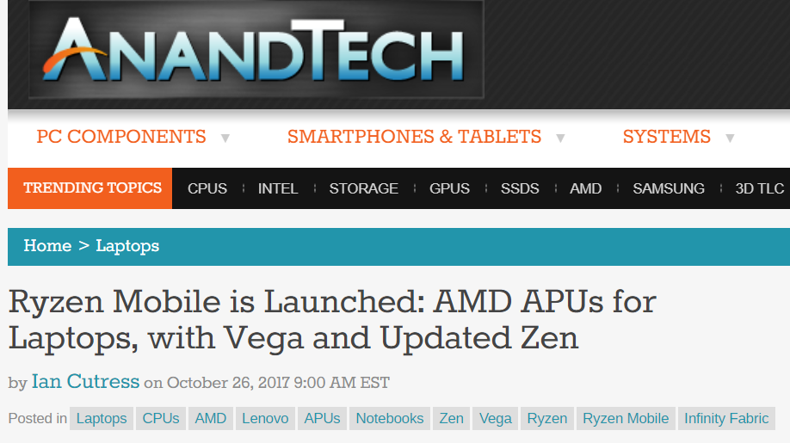
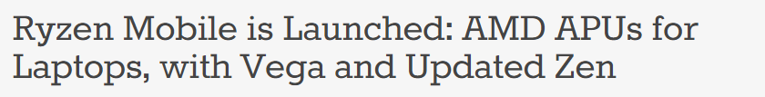
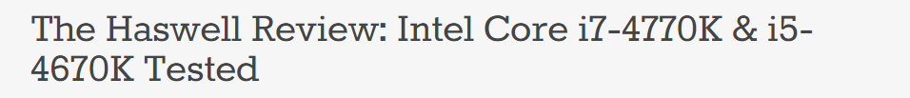
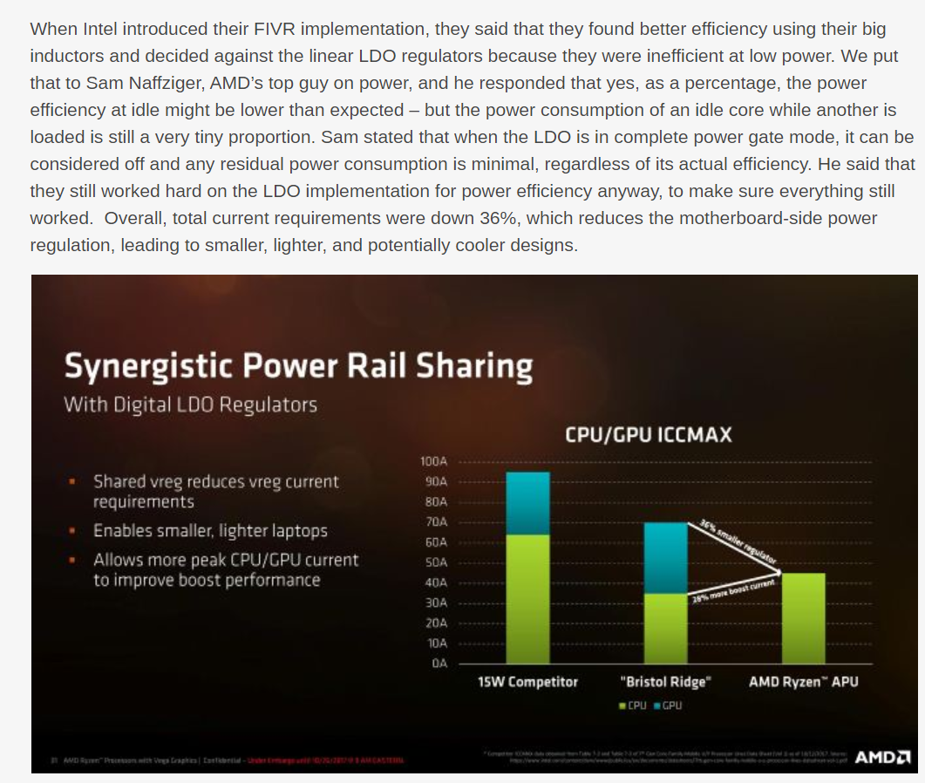
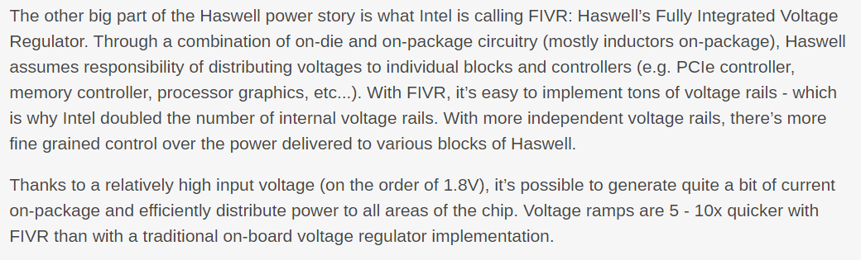
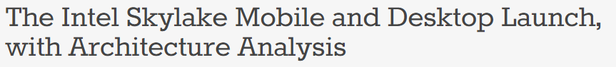
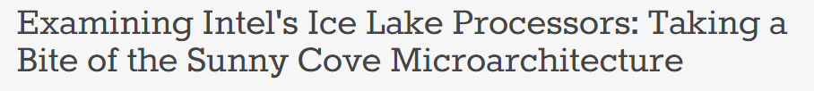
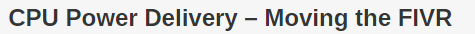
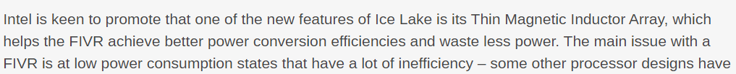

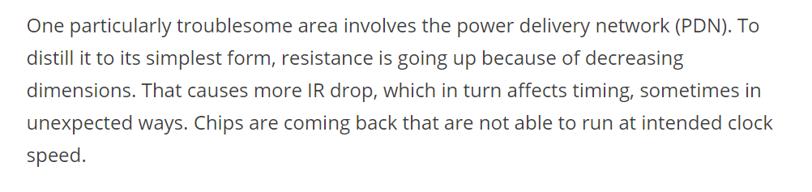
The Power Delivery Network (PDN) Debate
2013
Intel Haswell Uses IVR PDN (FIVR)
2017
AMD Ryzen Uses LDO PDN
2015
Intel Skylake Uses MBVR PDN
2019
Intel Icelake Uses IVR PDN (FIVR)
https://semiengineering.com/power-delivery-affecting-performance-at-7nm/
Notes:
In recent years there is a hot debate in industry and academia on power delivery networks. [CLICK]
PDN issues are becoming even worse as process technology scales down [END]

Slide 3
Executive Summary
Problem: Client processors typically use one of three commonly-used power delivery network (PDN) architectures: 1) MBVR, 2) IVR, and 3) LDO. The energy-efficiency of each of these PDNs varies with the processor power and workload characteristics.
Goal: Provide high energy-efficiency and high performance PDN architecture by leveraging the advantages of each one of the three PDN architectures across the processor’s wide range of power consumption and workloads.
Mechanism: FlexWatts, a new hybrid adaptive PDN for client processors that introduces
New hybrid voltage regulators (VRs) that are allocated for processor domains with a wide power consumption range (e.g., CPU cores and graphics engines) that dynamically switch between two modes: IVR-Mode and LDO-Mode.
Static allocation of off-chip VRs, which have high energy-efficiency for low and narrow power ranges, for the rest of the domains (e.g., IO domain).
A novel prediction algorithm that switches the hybrid PDN to the mode (IVR-Mode/LDO-Mode) that is the most beneficial based on processor power and workload characteristics.
Evaluation: We evaluate FlexWatts using our new architectural PDN model (PDNspot):
Improves the average performance of the SPEC CPU2006 and 3DMark06 workloads by 22% and 25%, respectively, for 4W thermal design power (TDP) system.
Reduces the average power consumption of video playback workload by 11% across all tested TDPs (4W-50W).
https://github.com/CMU-SAFARI/PDNspot
Notes:
First, I will give a high-level overview of the talk [CLICK]
Client processors typically use one of three commonly-used power delivery network architectures: 1) Motherboard voltage regulators, 2) Integrated voltage regulators , and 3) Low dropout voltage regulators. The energy-efficiency of each of these PDNs varies with the processor power and workload characteristics. [CLICK]
Our goals is to provide high energy-efficiency and high performance PDN architecture by leveraging the advantages of each one of the three PDN architectures across the processor’s wide range of power consumption and workloads. [CLICK]
To this end we propose FlexWatts, a new hybrid adaptive PDN for client processors that introduces three mechanisms [CLICK]
First, New hybrid voltage regulators that are allocated for processor domains with a wide power consumption range that dynamically switches between two modes: IVR-Mode and LDO-Mode. [CLICK]
Secondly, Static allocation of off-chip VRs, which have high energy-efficiency for low and narrow power ranges, for the rest of the domains. [CLICK]
And finally, A novel prediction algorithm that switches the hybrid PDN to the mode that is the most beneficial based on processor power and workload characteristics. [CLICK]
We evaluate FlexWatts using our new architectural PDN model, PDNspot [CLICK]
FlexWatts Improves the average performance of the SPEC CPU2006 and 3DMark workloads by 22% and 25%, respectively, for 4W thermal design power system. [CLICK]
and FlexWatts Reduces the average power consumption of video playback workload by 11% across all tested TDPs
[END]

Slide 4
Overview of Modern Client PDN Architectures
The Power Delivery Network (PDN) is the electrical system that provides supply voltage to the processor’s domains
A PDN consists of 1) a power supply, 2) voltage regulators (VRs), 3) network of interconnections, 4) decoupling capacitors (not graphed), and 5) power-gates
There are 3 different commonly-used PDNs
Use Switching VRs (SVRs) and/or Low dropout VRs (LDO VRs)
An SVR can be placed into the motherboard (MBVR) or integrated on-chip (IVR)
The PDNs perform differently based on the processor power and workload characteristics
MBVR and LDO PDNs are more energy-efficient at low thermal design power (TDP) and light workloads compared to IVR
IVR PDN is more energy-efficient at high TDP and heavy workloads than LDO and MBVR
MBVR is more energy-efficient than LDO in graphics workloads
MBVRs
Motherboard voltage regulators (MBVR)
IVRs
Integrated voltage regulators (IVR)
LDOs
Low dropout voltage regulators (LDO)
Notes:
I will give a brief overview on Client Processor PDN Architectures
[CLICK]
The Power Delivery Network is the electrical system that provides supply voltage to the processor’s domains [CLICK]
A PDN consists of:
a power supply,
voltage regulators,
network of interconnections,
decoupling capacitors,
and power-gates [CLICK]
There are 3 different commonly-used PDNs [CLICK]
These PDNs normally Use Switching VRs and/or Low dropout VRs [CLICK]
An SVR can be placed into the motherboard, which called MBVR, or integrated on-chip, which known as IVR [CLICK]
The PDNs perform differently based on the processor power and workload characteristics [CLICK]
For example, MBVR and LDO PDNs are more energy-efficient at low thermal design power and light workloads compared to IVR [CLICK]
While IVR PDN is more energy-efficient at high TDP and heavy workloads than LDO and MBVR [CLICK]
And MBVR is more energy-efficient than LDO in graphics workloads [END]

Slide 5
Overview of Modern Client PDN Architectures
The Power Delivery Network (PDN) is the electrical system that provides supply voltage to the processor’s domains
A PDN consists of 1) a power supply, 2) voltage regulators (VRs), 3) network of interconnections, 4) decoupling capacitors (not graphed), and 5) power-gates
There are 3 different commonly-used PDNs
Use Switching VRs (SVRs) and/or Low dropout VRs (LDO VRs)
An SVR can be placed into the motherboard (MBVR) or integrated on-chip (IVR).
The PDNs perform differently based on the processor power and workload characteristics
MBVR and LDO PDNs are more energy-efficient at low thermal design power (TDP) and light workloads compared to IVR
IVR PDN is more energy-efficient at high TDP and heavy workloads than LDO and MBVR
MBVR is more energy-efficient than LDO in graphics workloads
MBVRs
Motherboard voltage regulators (MBVR)
IVRs
Integrated voltage regulators (IVR)
A single PDN architecture cannot provide high energy-efficiency across
a wide power consumption range and wide variety of workloads
LDOs
Low dropout voltage regulators (LDO)
Notes:
We conclude that a single PDN architecture cannot provide high energy-efficiency across
a wide power consumption range and wide variety of workloads

Slide 6
Our Goal: A Hybrid and Adaptive PDN
Our goal is to provide a PDN architecture that provides high energy-efficiency across the wide range of power consumption and variety of workloads
To this end, we propose a hybrid and adaptive PDN that provides the advantages of each one of the three commonly-used PDNs
by dynamically adapting the hybrid PDN based on processor power consumption and workload characteristics
Notes:
[CLICK]
Our goal is to provide a PDN architecture that provides high energy-efficiency across the wide range of power consumption and variety of workloads [CLICK]
To this end, we propose a hybrid and adaptive PDN that utilizes the advantages of each one of the three commonly-used PDNs [CLICK]
by dynamically adapting the hybrid PDN based on processor power consumption and workload characteristics [END]

Slide 7
FlexWatts: Key Results
FlexWatts is the first hybrid PDN to use two types of on-chip voltage regulators (IVR and LDO) to leverage the advantages of both
FlexWatts efficiently chooses the processor PDN based on the power demands and workload characteristics
We evaluate FlexWatts using our new open-sourced PDNspot model
FlexWatts improves the performance of CPU and graphics workloads (by up to 22% and 25%, respectively, for 4W thermal design power (TDP))
FlexWatts reduces the average power consumption of battery life workloads (by up to 11%) across all TDPs
We show that FlexWatts is an effective approach to maintain high efficiency and high performance in metrics of interest in client processors across a wide spectrum of TDPs and workloads with minimal overhead
https://github.com/CMU-SAFARI/PDNspot
Notes:
We propose FlexWatts [CLICK]
FlexWatts is the first hybrid PDN to use two types of on-chip voltage regulators (IVR and LDO) to leverage the advantages of both [CLICK]
FlexWatts efficiently chooses the processor PDN based on the power demands and workload characteristics [CLICK]
We evaluate FlexWatts using our new open-sourced PDNspot model [CLICK]
FlexWatts improves the performance of CPU and graphics workloads by up to 22% and 25%, respectively, for 4W thermal design power [CLICK]
FlexWatts reduces the average power consumption of battery life workloads by up to 11% across all TDPs [CLICK]
We show that FlexWatts is an effective approach to maintain
high efficiency and high performance in metrics of interest in client processors
across a wide spectrum of power consumption and workloads with minimal overhead
[END]

Slide 8
FlexWatts: A Power- and Workload-Aware Hybrid Power Delivery Network for
Energy-Efficient Microprocessors
Jawad Haj-Yahya¹ Mohammed Alser¹ Jeremie S. Kim¹ Lois Orosa¹ Efraim Rotem²
Avi Mendelson^{3,4} Anupam Chattopadhyay ⁴ Onur Mutlu¹
1
1
2
3
4
MICRO 2020, session 6B Mobile & Embedded Architectures
Wednesday, October 21, 2020
Notes:
Thank you for your attention. I will be happy to take questions [END]

Slide 9
Component 1: Hybrid Adaptive PDN
Off-chip VRs allocated to each system domain with a low and narrow power consumption range (i.e., SA and IO domains).
Hybrid VRs allocated to system domains with a wide power consumption range (e.g., CPU cores and graphics engines)
This hybrid PDN can dynamically switch between two modes, IVR-Mode and LDO-Mode, based on the expected ETEE benefits of each mode for the current workload and power consumption
The hybrid PDN shares multiple die, package, and board resources
Notes:
Now I will talk about each component in more detail.
The first component is a Hybrid Adaptive PDN [CLICK] FlexWatts PDN consists of two key components:
Off-chip VRs allocated to each system domain with a low and narrow power consumption range [CLICK]
A hybrid VRs allocated to system domains with a wide power consumption range [CLICK]
This hybrid PDN can dynamically switch between two modes, IVR-Mode and LDO-Mode, based on the expected ETEE benefits of each mode for the current workload and power consumption [CLICK]
The hybrid PDN shares multiple die, package and board resources [END]

Slide 10
Component 2: Voltage Noise-Free Mode-Switching
FlexWatts performs mode-switching using 3 steps, while the compute domains are idle to prevent any voltage noise
Place the processor in an idle power-state for a short period of time
Configure the hybrid PDN and update the on-chip and off-chip VR levels
Exit the idle power-state and resume the processor with the new PDN mode
Notes:
The second component is a Voltage Noise-free Mode-Switching mechanism [CLICK]
FlexWatts performs mode-switching using 3 steps, while the compute domains are idle to prevent any voltage noise
First, We Place the processor in an idle power-state for a short period of time [CLICK]
Secondly, We Configure the hybrid PDN and update the on-chip and off-chip VR levels, and [CLICK]
And finally, We Exit the idle power-state and resume the processor with the new PDN mode [END]

Slide 11
Component 3: Runtime Mode Prediction Algorithm
A new runtime mode-prediction algorithm predicts which PDN mode, among the two modes (IVR-Mode and LDO-Mode), provides the best end-to-end power conversion efficiency (ETEE). ETEE is a function of:
The AR and the workload type (i.e., single-thread, multi-thread, and graphics)
The TDP and the power-state of the system
We store two sets of ETEE curves inside the power management unit (PMU) firmware, one set for the IVR PDN and the other set for the LDO PDN
The PMU firmware estimates each of the input parameters at runtime
TDP
Application Ratio
Workload Type
Power state
Estimate IVR ETEE
Estimate LDO ETEE
IVR_Mode
Yes
IVR_ETEE> LDO_ETEE
No
LDO_Mode
Notes:
The final component is Runtime Mode Prediction Algorithm [CLICK]
A new runtime mode-prediction algorithm predicts which PDN mode, among the two modes (IVR-Mode and LDO-Mode), provides the best end-to-end power conversion efficiency (ETEE). ETEE is a function:
The AR and the workload type, i.e., single-thread, multi-thread, and graphics [CLICK]
The TDP and the power-state of the system [CLICK]
We store two sets of ETEE curves inside the power management unit firmware, one set for the IVR PDN and the other set for the LDO PDN [CLICK]
The PMU firmware estimates each of the input parameters at runtime [END]

Slide 12
Motivational Experiment
We evaluate the potential benefits of the 3 PDNs (IVR, MBVR, LDO) across different TDPs, application ratios (ARs) and workloads
AR is the switching rate of a component (e.g., CPU core) for a workload when compared to the highest possible power (power-virus)
We use our validated model, PDNspot, to evaluate the efficiency of the three PDNs
We use the Metric end-to-end power conversion efficiency (ETEE)
ETEE of a PDN is the ratio between total output power consumption to total input power consumption of the PDN
We use multiple workload traces from SPEC CPU2006, 3DMark06, and video playback workloads
Power Supply
Input
power
PDN
Output
power
Loads
https://github.com/CMU-SAFARI/PDNspot
Notes:
[CLICK]
We evaluate the potential benefits of the 3 PDNs :IVR, MBVR and LDO, across different TDPs, application ratios and workloads [CLICK]
application ratio is the switching rate of a component for a workload when compared to the highest possible power (power-virus) [CLICK]
We use our validated model, PDNspot, to evaluate the efficiency of the three PDNs [CLICK]
We use the Metric end-to-end power conversion efficiency [CLICK]
end-to-end efficiency of a PDN is the ratio between total output power consumption to total input power consumption of the PDN [CLICK]
We use multiple workload traces from SPEC CPU2006, 3DMark06, and video playback workloads [END]

Slide 13
Observation 1: TDP Effect on PDN’s Efficiency (1)
Executing CPU- and graphics-intensive workloads, with different ARs
IVR PDN has a lower ETEE at the 4W TDP compared to MBVR and LDO PDNs
IVR PDN has a higher ETEE at the 50W TDP compared to MBVR and LDO PDNs
The ETEE crossover point, at which the IVR ETEE becomes higher than the MBVR/LDO ETEE, exists at some TDP between 4W and 50W.
Single-Thread
Multi-Thread
Graphics
4W
50W
Notes:
Our first observation is about the TDP Effect on PDNs’ Efficiency [CLICK]
When Executing CPU- and graphics-intensive workloads, with different Ars [CLICK]
We observe that IVR PDN has a lower end-to-end efficiency at the 4W TDP compared to MBVR and LDO PDNs [CLICK]
And We observe that IVR PDN has a higher end-to-end efficiency at the 50W TDP compared to MBVR and LDO PDNs [CLICK]
The end-to-end efficiency crossover point, at which the IVR end-to-end efficiency becomes higher than the MBVR/LDO end-to-end efficiency, exists at some TDP between 4W and 50W [END]

Slide 14
Observation 1: TDP Effect on PDN Efficiency (2)
A breakdown of PDN power conversion loss:
At low-TDP (e.g., 4W ), the on-chip and off-chip VRs’ power conversion inefficiencies are higher for the IVR PDN than that of the MBVR and LDO.
At high-TDP (e.g., 50W), the I²R loss in core and graphics domains is higher for the MBVR and LDO PDNs than for IVR. The high I²R loss is due to:
A 2× higher chip input current in the MBVR and LDO PDNs compared to the IVR PDN, and
A 2.5×/1.3× higher load-line impedance (RLL) in the MBVR/LDO PDNs compared to the IVR PDN
6%
Notes:
[CLICK]
A breakdown of PDN power conversion loss: [CLICK]
At low-TDP (e.g., 4W ), the on-chip and off-chip VRs’ power conversion inefficiencies are higher for the IVR PDN than that of the MBVR and LDO. [CLICK]
At high-TDP (e.g., 50W), the I²R loss in core and graphics domains is higher for the MBVR and LDO PDNs than that of the IVR. The high I²R loss is due to: [CLICK]
A 2× higher chip input current in the MBVR and LDO PDNs compared to the IVR PDN, and [CLICK]
A 2.5×/1.3× higher load-line impedance (RLL) in the MBVR/LDO PDNs compared to the IVR PDN [END]

Slide 15
Observation 1: TDP Effect on PDN’s Efficiency
Executing CPU- and graphics-intensive workloads, with different ARs
IVR PDN has a lower ETEE at the 4W TDP compared to MBVR and LDO PDNs
IVR PDN has a higher ETEE at the 50W TDP compared to MBVR and LDO PDNs
The ETEE crossover point, at which the IVR ETEE becomes higher than the MBVR/LDO ETEE, exists at some TDP between 4W and 50W.
TDP affects the ETEE of a PDN.
Single-Thread
Multi-Thread
Graphics
At low-TDP, the MBVR and LDO PDNs are more efficient.
4W
At high-TDP, the IVR PDN is more efficient.
50W
Notes:
We conclude that a TDP affects the end-to-end efficiency of a PDN. [CLICK]
At low-TDP, the MBVR and LDO PDNs are more efficient. [CLICK]
at high-TDP, the IVR PDN is more efficient. [END]

Slide 16
Observation 2: Workload Effect on PDN’s Efficiency
Workload’s AR and the workload type (e.g., single-threaded, multi-threaded, graphics) affects PDN ETEE
The ETEEs of the MBVR & LDO PDNs increase with AR due to load-line effect
Different workload types have different ETEE curves
The LDO ETEE is higher than the MBVR ETEE for CPU-intensive (single- and multi-threaded) workloads, but is lower than the MBVR ETEE for graphics-intensive workloads
LDO inefficiency is more dominant in graphics workloads, due to the high voltage difference between the core and graphics domains (graphics’ voltage is significantly higher than cores’)
Single-Thread
Multi-Thread
Graphics
50W
Notes:
Our second observation is about the Workload Effect on PDN’s Efficiency [CLICK]
Workload’s application ratio and the workload type affects PDN end-to-end efficiency [CLICK]
The end-to-end efficiencies of the MBVR & LDO PDNs increase with AR due to load-line effect [CLICK]
Different workload types have different end-to-end efficiency curves [CLICK]
For example: The LDO end-to-end efficiency is higher than the MBVR end-to-end efficiency for CPU-intensive workloads, but is lower than the MBVR end-to-end efficiency for graphics intensive workloads [CLICK]
LDO inefficiency is more dominant in graphics workloads, due to the high voltage difference between the core and graphics domains [END]

Slide 17
Observation 2: Workload Effect on PDN’s Efficiency
Workload’s AR and the workload type (e.g., single-threaded, multi-threaded, graphics) affects PDN ETEE
The ETEEs of the MBVR & LDO PDNs increase with AR due to load-line effect
Different workload types have different ETEE curves
The LDO ETEE is higher than the MBVR ETEE for CPU-intensive (single- and multi-threaded) workloads, but is lower than the MBVR ETEE for graphics-intensive workloads
LDO inefficiency is more dominant in graphics workloads, due to the high voltage difference between the core and graphics domains (graphics’ voltage is significantly higher than cores’)
Application ratio and workload type
have significant effects on each PDN’s ETEE.
MBVR and LDO PDNs have lower ETEE
with low application ratios.
LDO PDN has lower ETEE
on graphics workloads.
Single-Thread
Multi-Thread
Graphics
50W
Notes:
We conclude that Application ratio and workload type have significant effects on each PDN’s end-to-end efficiency [CLICK]
MBVR and LDO PDNs have lower ETEE with low application ratios [CLICK]
LDO PDN has lower ETEE on graphics workloads [CLICK]

Slide 18
Observation 3: Power-State Effect on PDN’s Efficiency
The ETEE of the IVR PDN is lower than that of MBVR and LDO PDNs for computationally light workloads and low power states across all TDPs
A video playback workload spends 10%, and 90% of its execution time in light workload (C0_{MIN}) and low power states (C2 and C8) respectively
MBVR and LDO PDNs have 12% and 11% lower average power consumption, respectively, than the IVR PDN due to the higher ETEE of MBVR and LDO PDNs
12%
11%
Notes:
Our last observation is about the Power-state Effect on PDN’s Efficiency [CLICK]
The end-to-end efficiency of the IVR PDN is lower than that of MBVR and LDO PDNs for computationally light workloads and low power states across all TDPs [CLICK]
A video playback workload spends 10%, and 90% of its execution time in light workload and low power states respectively [CLICK]
MBVR and LDO PDNs have 12% and 11% lower average power consumption, respectively, than the IVR PDN due to the higher end-to-end efficiency of MBVR and LDO PDNs [END]

Slide 19
Observation 3: Power-State Effect on PDN’s Efficiency
The ETEE of the IVR PDN is lower than that of MBVR and LDO PDNs for computationally light workloads and low power states across all TDPs
A video playback workload spends 10%, and 90% of its execution time in light workload (C0_{MIN}) and low power states (C2 and C8) respectively
MBVR and LDO PDNs have 12% and 11% lower average power consumption, respectively, than the IVR PDN due to the higher ETEE of MBVR and LDO PDNs
The IVR PDN is energy-inefficient
for computationally-light workloads.
This negatively impacts both energy consumption and battery life.
12%
11%
Notes:
We conclude that the IVR PDN is energy-inefficient for computationally-light workloads.
This negatively impacts both energy consumption and battery life [END]

Slide 20
Our Goal: A Hybrid and Adaptive PDN
We conclude that there is no single PDN for modern client processors that provides a high ETEE across all TDPs, workload types and application ratios (ARs)
Notes:
Based on our three key observations [CLICK]
We conclude that there is no single PDN for modern client processors that provides a high end-to-end efficiency across all TDPs, workload types and application ratios [CLICK]

Slide 21
Our Goal: A Hybrid and Adaptive PDN
We conclude that there is no single PDN for modern client processors that provides a high ETEE across all TDPs, workload types and application ratios (ARs)
Our goal is to provide a PDN architecture that provides
high energy-efficiency across the wide range of
power consumption and variety of workloads.
Notes:
Our goal is to provide a PDN architecture that provides
high energy-efficiency across the wide range of
power consumption and variety of workloads.

Slide 22
Presentation Outline
Overview of Client Processor PDN Architectures
Motivation and Goal
FlexWatts
Hybrid Adaptive PDN
Voltage Noise-Free Mode-Switching
Runtime Mode Prediction Algorithm
Evaluation
Conclusion
Notes:
Now I will explain the technique to achieve our goal
[END]

Slide 23
FlexWatts
FlexWatts is a new hybrid adaptive PDN that provides a high ETEE for the wide power consumption range and workload diversity of client processors
FlexWatts is based on three key ideas:
New hybrid voltage regulators (VRs) that are allocated for processor domains with a wide power consumption range that dynamically switch between two modes (IVR-Mode and LDO-Mode) to maintain high energy-efficiency across the wide range
Static allocation of off-chip VRs, which have high energy-efficiency for low and narrow power ranges, for the rest of the domains (e.g., IO domain)
A novel prediction algorithm that switches the hybrid PDN to the mode (IVR-Mode/LDO-Mode) that is the most beneficial based on processor power and workload characteristics
Notes:
We propose FlexWatts [CLICK] FlexWatts is a new hybrid adaptive PDN that provides a high ETEE for the wide power consumption range and workload diversity of client processors [CLICK]
FlexWatts is based on three key ideas: [CLICK]
First, New hybrid voltage regulators (VRs) that are allocated for processor domains with a wide power consumption range that dynamically switch between two modes (IVR-Mode and LDO-Mode) to maintain high energy-efficiency across the wide range [CLICK]
Secondly, Static allocation of off-chip VRs, which have high energy-efficiency for low and narrow power ranges, for the rest of the domains [CLICK]
And Finaly, A novel prediction algorithm that switches the hybrid PDN to the mode that is the most beneficial based on processor power and workload characteristics [END]

Slide 24
FlexWatts Architecture: 3 Components
Hybrid adaptive PDN: includes hybrid VRs and off-chip VRs
Voltage Noise-Free Mode-Switching: transitions the hybrid PDN between two modes (IVR-Mode and LDO-Mode)
A new mode prediction algorithm: automatically determines, which PDN mode would be the most beneficial based on system and workload characteristics
Notes:
[CLICK] FlexWatts has three key components: [CLICK]
A hybrid adaptive PDN that includes hybrid VRs and off-chip VRs [CLICK]
A Voltage Noise-Free Mode-Switching that transitions the hybrid PDN between two modes, IVR-Mode and LDO-Mode
A new mode prediction algorithm that automatically determines which PDN mode would be the most beneficial based on system and workload characteristics [END]

Slide 25
Presentation Outline
Overview of Client Processor PDN Architectures
Motivation and Goal
FlexWatts
Hybrid Adaptive PDN
Voltage Noise-Free Mode-Switching
Runtime Mode Prediction Algorithm
Evaluation
Conclusion
Notes:
I will next present our evaluation of FlexWatts
[END]

Slide 26
Methodology
Framework: We evaluate the PDNs using our new open-sourced PDNspot model
Workloads: We evaluate FlexWatts with three classes of workloads
CPU: SPEC CPU2006 benchmarks
Graphics: 3DMARK06 benchmarks
Battery life: web browsing, light gaming, video conferencing, and video playback benchmarks
Comparison Points: We compare FlexWatts to the three commonly-used (IVR, MBVR, LDO) PDNs of client processors
https://github.com/CMU-SAFARI/PDNspot
Notes:
First, I will present our methodology [CLICK]
We evaluate the PDNs using our new open-sourced PDNspot model [CLICK]
We evaluate FlexWatts with three classes of workloads [CLICK]
For CPU:SPEC CPU2006 benchmarks [CLICK]
For Graphics: 3DMARK06 benchmarks [CLICK]
And For Battery life: web browsing, light gaming, video conferencing, and video playback benchmarks [CLICK]
We compare FlexWatts to the three commonly-used PDNs of client processors [END]

Slide 27
Results – CPU Workloads (TDPs 4-50W)
22%
7%
4%
At TDPs lower than 18W, FlexWatts provides up to 22% higher performance over the IVR PDN
by operating mainly in LDO-Mode
At TDPs higher than 18W, FlexWatts provides up to 7%/4% higher performance over the MBVR/LDO PDNs
by operating in IVR-Mode
Notes:
Let me start with showing the result for the CPU workloads [CLICK]
[CLICK]
At TDPs lower than 18W, FlexWatts provides up to 22% higher performance over the IVR PDN
by operating mainly in LDO-Mode [CLICK]
At TDPs higher than 18W, FlexWatts provides up to 7%/4% higher performance over the MBVR/LDO PDNs
by operating in IVR-Mode [CLICK]

Slide 28
Results – CPU Workloads (TDPs 4-50W)
22%
7%
4%
At TDPs lower than 18W, FlexWatts provides up to 22% higher performance over the IVR PDN by operating mainly in LDO-Mode, which has a higher ETEE than the IVR PDN at low TDPs
At TDPs higher than 18W, FlexWatts provides up to 7%/4% higher performance over the MBVR/LDO PDNs by operating at IVR-Mode, which has a higher ETEE than the MBVR/LDO PDNs at high TDPs
FlexWatts significantly improves CPU performance compared to IVR at low TDPs by operating in LDO-Mode.
FlexWatts provides higher CPU performance compared
to MBVR/LDO at high TDPs by operating in IVR-Mode.
Notes:
FlexWatts significantly improves CPU performance compared to IVR at low TDPs by operating in LDO-Mode. [CLICK]
FlexWatts provides higher CPU performance compared to MBVR/LDO at high TDPs by operating in IVR-Mode. [CLICK]

Slide 29
Results – Graphics Workloads
2%
25%
6%
3%
At TDPs lower than 25W, FlexWatts provides up to 25% higher performance over the IVR PDN
by operating mainly in LDO-Mode
At TDPs higher than 25W, FlexWatts provides up to 3%/6% higher performance over the MBVR/LDO PDNs
by operating mainly in IVR-Mode
At TDPs lower than 25W, FlexWatts performs slightly worse (up to 2%) than MBVR/LDO PDNs due to
The higher load-line of FlexWatts
The large difference in operating voltages across the cores/LLC/graphics domains
Notes:
Now let us see the result for the Graphics workloads [CLICK]
At TDPs lower than 25W, FlexWatts provides up to 25% higher performance over the IVR PDN
by operating mainly in LDO-Mode
At TDPs higher than 25W, FlexWatts provides up to 3% and 6% higher performance over the MBVR and LDO PDNs
by operating mainly in IVR-Mode
At TDPs lower than 25W, FlexWatts performs slightly worse (up to 2%) than MBVR/LDO PDNs due to
The higher load-line of FlexWatts
The large difference in operating voltages across the cores/LLC/graphics domains
[END]

Slide 30
Results – Graphics Workloads
2%
25%
7%
3%
At TDPs lower than 25W, FlexWatts provides up to 25% higher performance over the IVR PDN
by operating mainly in LDO-Mode
At TDPs higher than 25W, FlexWatts provides up to 3%/6% higher performance over the MBVR/LDO PDNs
by operating mainly in IVR-Mode
At TDPs lower than 25W, FlexWatts performs slightly worse (up to 2%) than MBVR/LDO PDNs due to
The higher load-line of FlexWatts
The large difference in operating voltages across the cores/LLC/graphics domains
FlexWatts significantly improves graphics performance compared to IVR at low TDPs by operating in LDO-Mode.
FlexWatts provides higher graphics performance compared
to MBVR/LDO at high TDPs by operating in IVR-Mode.
Notes:
We conclude that FlexWatts significantly improves graphics performance compared to IVR at low TDPs by operating in LDO-Mode. [CLICK]
FlexWatts provides higher graphics performance compared to MBVR/LDO at high TDPs by operating in IVR-Mode.

Slide 31
Results – Battery Life Workloads
Battery life workloads have fixed performance requirements
they consume the same power at all TDPs
11%
8%
1%
FlexWatts reduces average power consumption (8%-11%) on battery life workloads compared to IVR PDN
FlexWatts consumes up to 1% more power than MBVR PDN
Notes:
Now I will present the results for Battery Life Workloads [CLICK]
Battery life workloads have fixed performance requirements
they consumes the same power at all TDPs [CLICK]
FlexWatts reduces average power consumption between 8% to 11% on a battery life workloads compared to IVR PDN [CLICK]
FlexWatts consumes up to 1% more power than MBVR PDN [CLICK]

Slide 32
Results – Battery Life Workloads
Battery life workloads have fixed performance requirements
they consume the same power at all TDPs
11%
8%
1%
FlexWatts is almost as energy-efficient as both MBVR and LDO
and up to 11% more energy-efficient than IVR.
FlexWatts reduces average power consumption (8%-11%) on battery life workloads compared to IVR PDN
FlexWatts consumes up to 1% more power than MBVR PDN
Notes:
We conclude that FlexWatts is almost as energy-efficient as both MBVR and LDO
and up to 11% more energy-efficient than IVR,
for battery life workloads.

Slide 33
Other Results in the Paper
FlexWatts board area and bill of materials (BOM) compared to other PDNs:
FlexWatts PDN has comparable BOM cost and board area to IVR PDN
FlexWatts PDN has significantly lower BOM cost and board area compared to MBVR and LDO PDNs
Comparison to the PDN used in Intel Skylake-X processors that combines IVR and MBVR PDNs
Intel Skylake-X PDN provides higher performance and lower energy consumption than the IVR PDN
FlexWatts provides significantly higher performance and lower energy consumption than the Intel Skylake-X PDN
Notes:
We have more results in the paper. For example [CLICK]
FlexWatts board area and bill of materials (BOM) compared to other PDNs:
FlexWatts PDN has comparable BOM cost and board area to IVR PDN
FlexWatts PDN has significantly lower BOM cost and board area compared to MBVR and LDO PDNs
Comparison to the PDN used in Intel Skylake-X processors that combines IVR and MBVR PDNs
Intel Skylake-X PDN Provides higher performance and lower energy consumption than the IVR PDN
FlexWatts provides significantly higher performance and lower energy consumption than the Intel Skylake-X PDN
[END]

