Slide 1

IChannels
Exploiting Current Management Mechanisms
to Create Covert Channels in Modern Processors
Jawad Haj-Yahya Jeremie S. Kim A. Giray Yağlıkçı Ivan Puddu Lois Orosa
Juan Gómez Luna Mohammed Alser Onur Mutlu
Notes:
My name is Jawad Haj-Yahya and I will present our work IChannels [END]

Slide 2
Executive Summary
Problem: Current management mechanisms throttle instruction execution and adjust voltage/frequency to accommodate power-hungry instructions (PHIs).
These mechanisms may compromise a system’s confidentiality guarantees
Goal:
Understand the throttling side-effects of current management mechanisms
Build high-capacity covert channels between otherwise isolated execution contexts
Practically and effectively mitigate each covert channel
Characterization: Variable execution times and frequency changes due to running PHIs
We observe five different levels of throttling in real Intel systems
IChannels: New covert channels that exploit side-effects of current management mechanisms
On the same hardware thread
Across co-located Simultaneous Multi-Threading (SMT) threads
Across different physical cores
Evaluation: On three generations of Intel processors, IChannels provides a channel capacity
2× that of PHIs’ variable latency-based covert channels
24× that of power management-based covert channels
Notes:
First, I will give a high-level overview of the talk [CLICK]
Current management mechanisms throttle instruction execution and adjust voltage/frequency to accommodate power-hungry instructions (PHIs).
These mechanisms may compromise a system’s confidentiality guarantees [CLICK]
Our Goal is [CLICK]
First to Understand the throttling side-effects of current management mechanisms [CLICK]
Secondly to Build high-capacity covert channels between otherwise isolated execution contexts [CLICK]
Finally to Practically and effectively mitigate each covert channel [CLICK]
We Characterize the Variable execution times and frequency changes due to running PHIs
We observe five different levels of throttling in real Intel systems [CLICK]
We propose Ichannels, a New covert channels that exploit side-effects of current management mechanisms [CLICK]
On the same hardware thread [CLICK]
Across co-located Simultaneous Multi-Threading (SMT) threads [CLICK]
Across different physical cores [CLICK]
On three generations of Intel processors, IChannels provides a channel capacity [CLICK]
2× that of PHIs’ variable latency-based covert channels [CLICK]
24× that of power management-based covert channels [CLICK]
[END]

Slide 3
Presentation Outline
Overview of Client Processor Architectures
Motivation and Goal
Throttling Characterization
IChannels Covert Channels
Evaluation
Conclusion
Notes:
Here is the outline for the talk today.
I will begin with a brief overview on Client Processor Architectures [END]
[END]

Slide 4
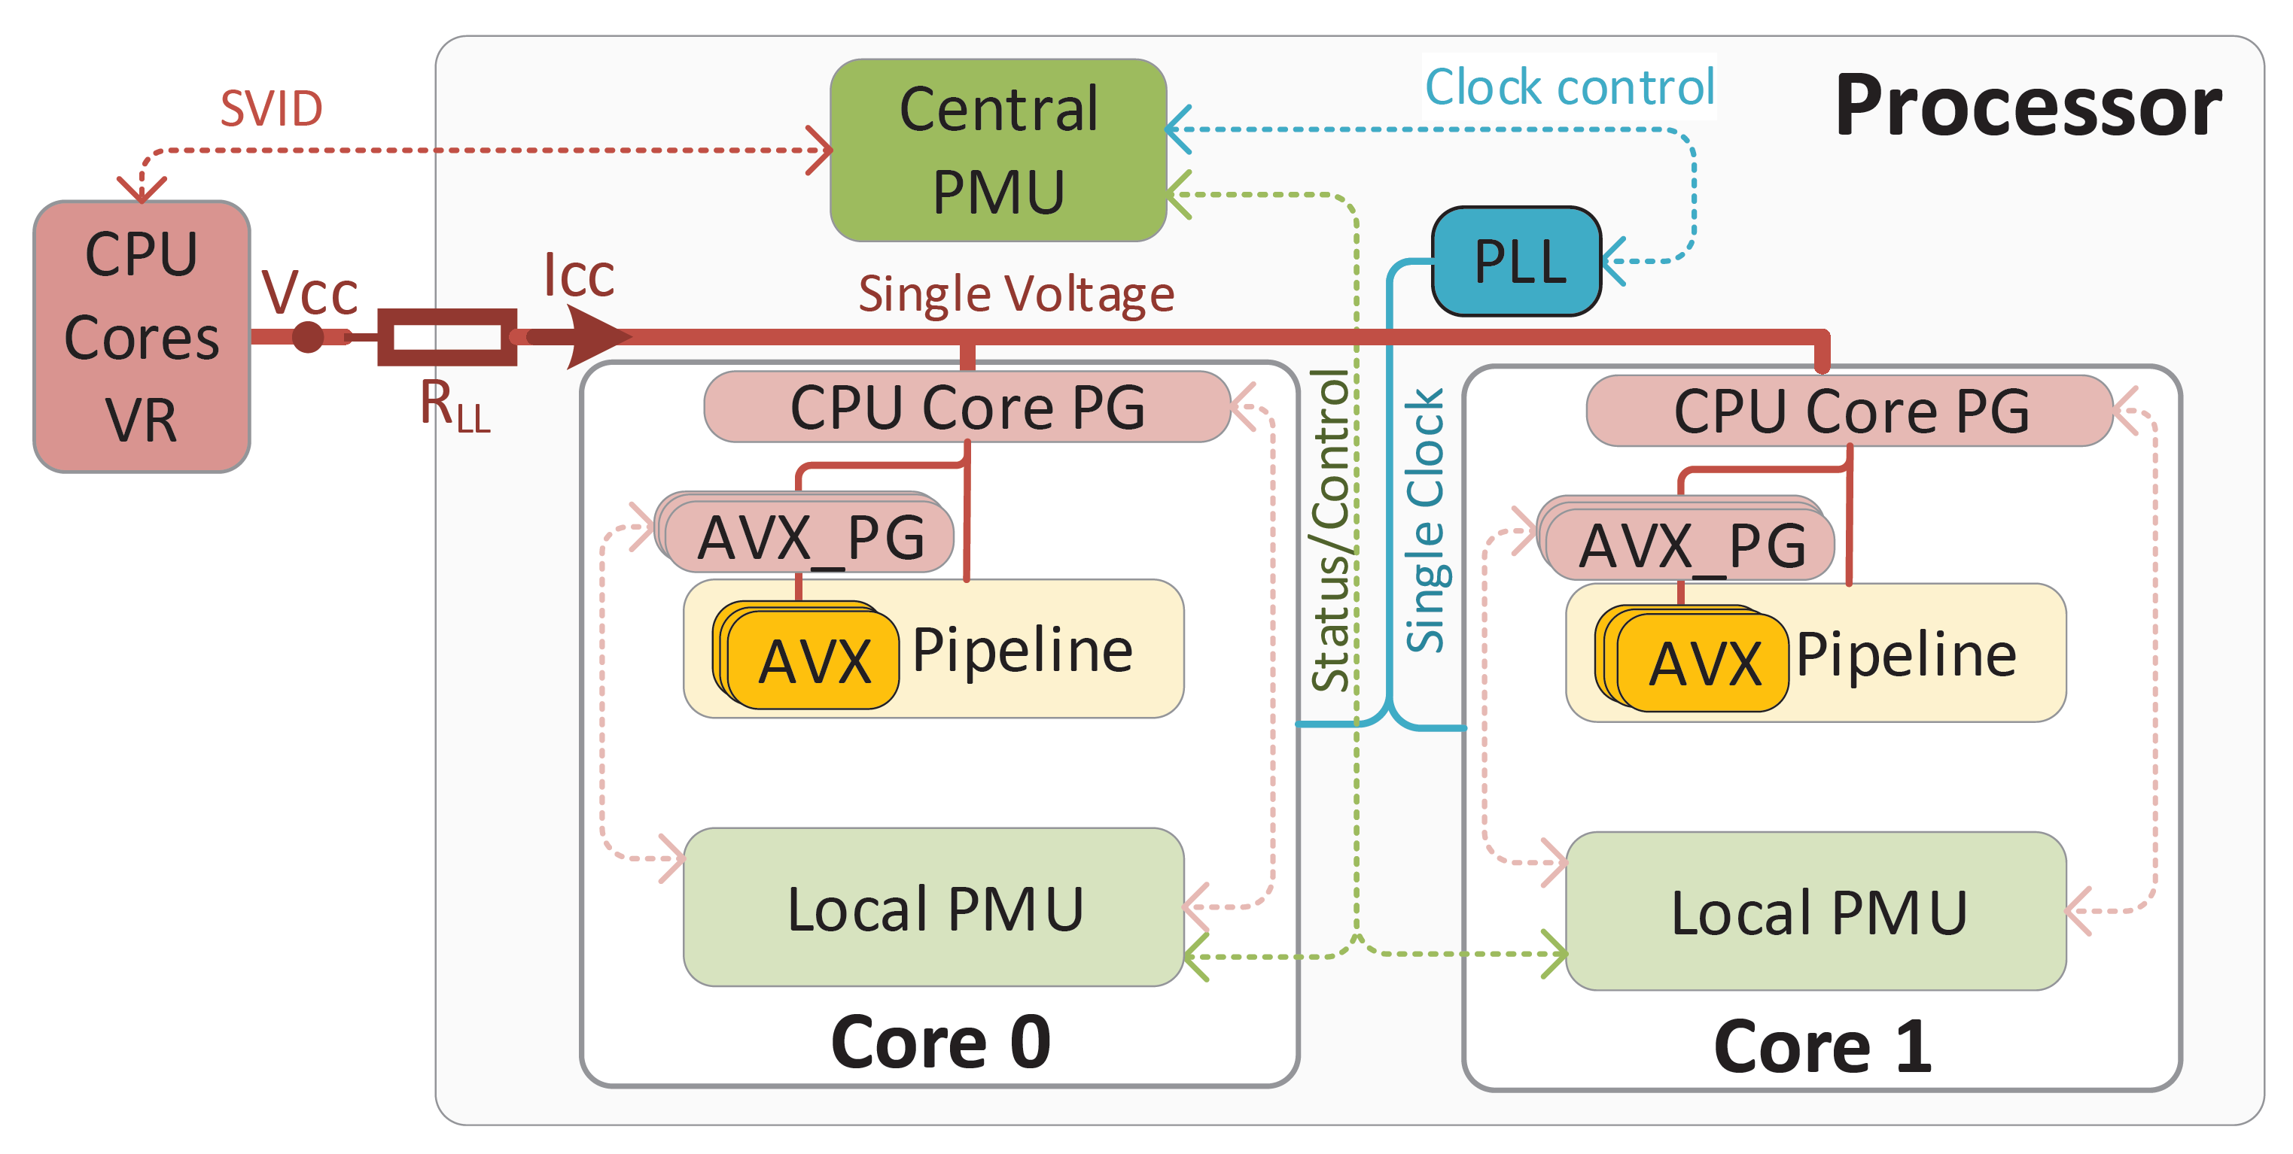
Overview of Client Processor Architectures
In many recent processors (e.g., Intel Coffee Lake, Cannon Lake), CPU cores:
Share the same voltage regulator (VR) and clock domain
Controlled by a central power management unit (PMU)
Notes:
[CLICK]
In many recent processors (e.g., Intel Coffee Lake, Cannon Lake), CPU cores: [CLICK]
Share the same voltage regulator (VR) and clock domain [CLICK]
Controlled by a central power management unit (PMU) [END]

Slide 5
Load Voltage and Voltage Guardband
Below the maximum operational voltage (Vcc_{max}) under the lightest load (leakage, Icc_{lkg})
×
= Vcc – Icc × R_{LL}
Above the minimum functional voltage (Vcc_{min}) under the most intensive load (power-virus, Icc_{virus})
The relationship between load voltage (Vcc_{load}), supply voltage (Vcc) and current (Icc) under a given system impedance (R_{LL}) is : Vcc_{load} = Vcc – Icc × R_{LL}
The PMU adds voltage guardband to Vcc to a level that keeps Vcc_{load} within limits
Notes:
[CLICK]
The relationship between load voltage, Vcc_{load,} supply voltage, Vcc, and current, Icc, under a given system impedance,R_{LL,} is : Vcc_{load} = Vcc – Icc × R_{LL} [CLICK]
[CLICK] as also show in the following figure [CLICK]
The PMU adds voltage guardband to Vcc to a level that keeps Vcc_{load} within limits [CLICK]
Above the minimum functional voltage (Vcc_{min}) under the most intensive load, power-virus, with a current of Icc_{virus} [CLICK]
And below the maximum operational voltage, Vcc_{max,} under the lightest load, leakage with a current of Icc_{lkg} [END]

Slide 6
Presentation Outline
Overview of Client Processor Architectures
Motivation and Goal
Throttling Characterization
IChannels Covert Channels
Evaluation
Conclusion
Notes:
I will now discuss the motivation and the goal of our work [END]

Slide 7
Motivation and Goal
Prior works propose covert channels that exploit some of the throttling side-effects of executing power-hungry instructions (PHIs)
These works are limited and use inaccurate observations
Our goal in this work is to:
Experimentally understand the throttling side-effects of current management mechanisms in modern processors to gain several deep insights into how these mechanisms can be abused by attackers
Build high-capacity covert channels, IChannels, between otherwise isolated execution contexts
Practically and effectively mitigate covert channels caused by current management mechanisms
Notes:
[CLICK]
Prior works propose covert channels that exploit some of the throttling side-effects of executing power-hungry instructions (PHIs) [CLICK]
These works are limited and use inaccurate observations [CLICK]
Our goal in this work is to:
Experimentally understand the throttling side-effects of current management mechanisms in modern processors to gain several deep insights into how these mechanisms can be abused by attackers [CLICK]
Build high-capacity covert channels, IChannels, between otherwise isolated execution contexts [CLICK]
Practically and effectively mitigate covert channels caused by current management mechanisms
[END]

Slide 8
Presentation Outline
Overview of Client Processor Architectures
Motivation and Goal
Throttling Characterization
IChannels Covert Channels
Evaluation
Conclusion
Notes:
Now I will preset the Throttling Characterization [END]

Slide 9
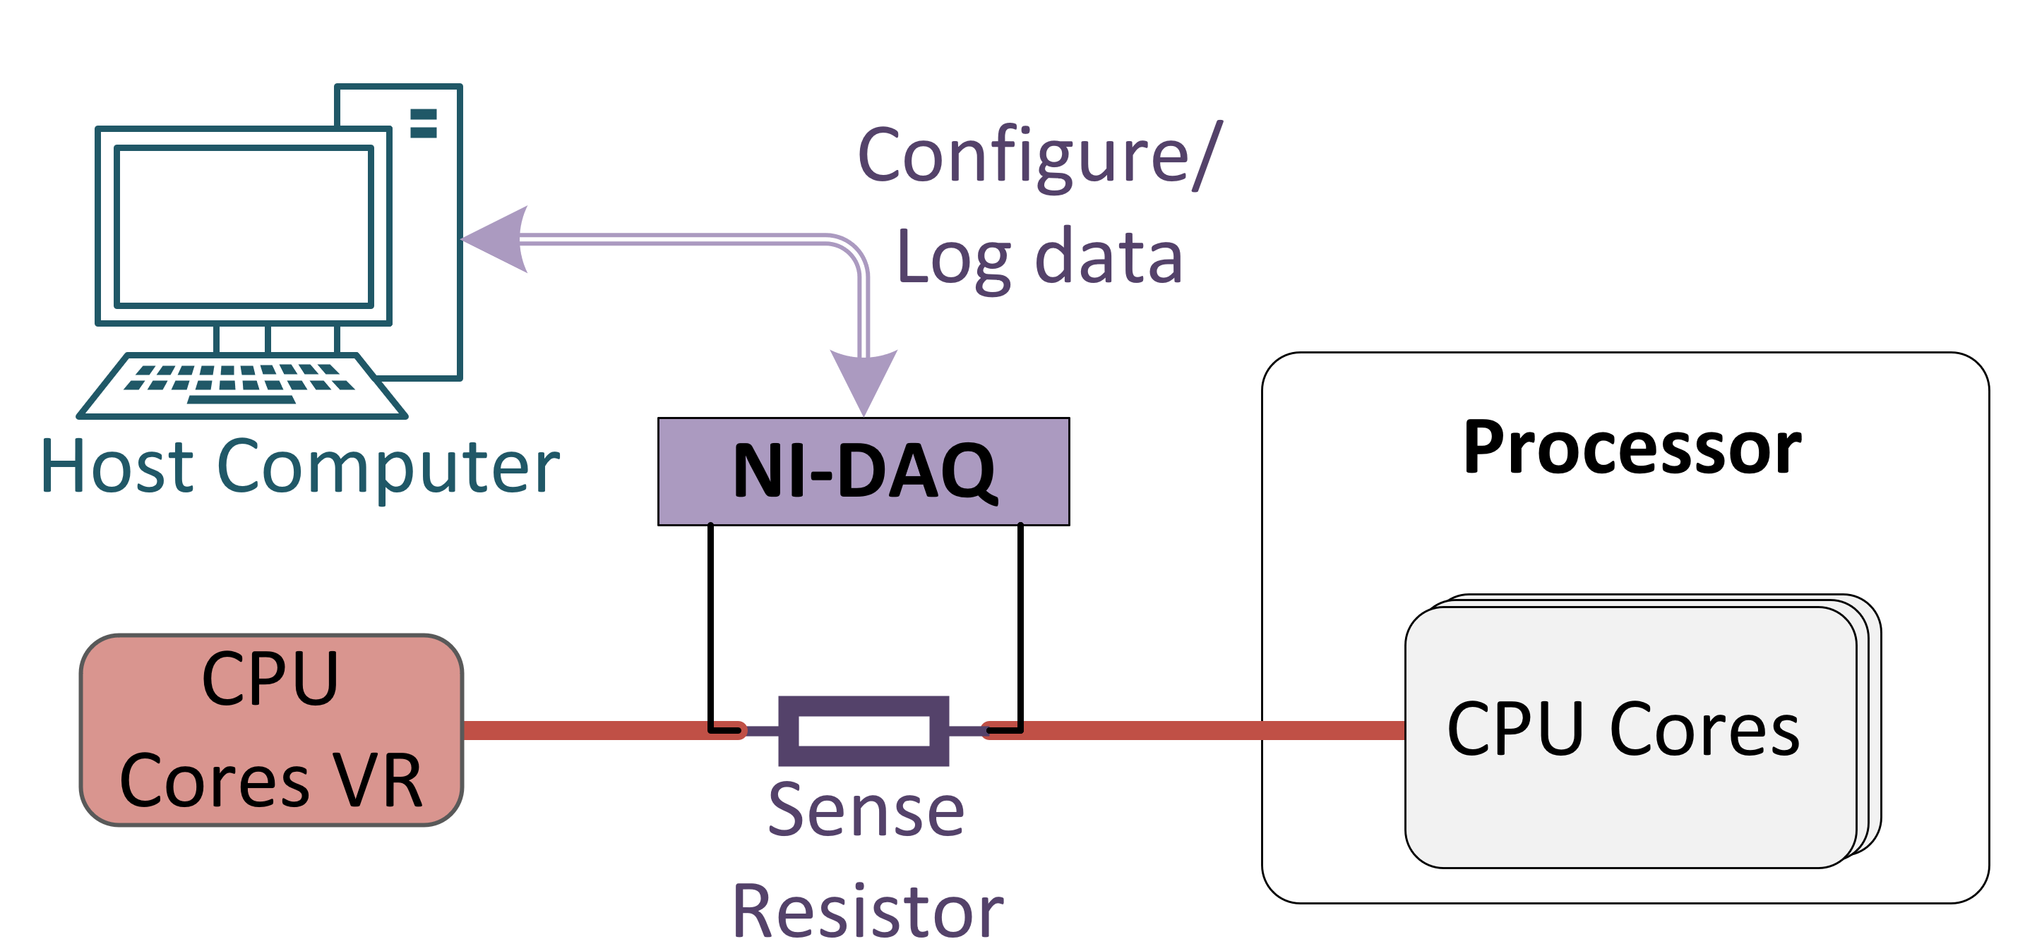
Experimental Methodology
We experimentally study three modern Intel processors
Haswell, Coffee Lake, and Cannon Lake
We measure voltage and current using a Data Acquisition card (NI-DAQ)
Notes:
[CLICK] We experimentally study three modern Intel processors
Haswell, Coffee Lake, and Cannon Lake [CLICK]
We measure voltage and current using a Data Acquisition card (NI-DAQ) [CLICK]
Here is a picture of our system [END]

Slide 10
Characterization Insights
Our rigorous characterization or real system provide deep insights on current management mechanisms
We find that
The core frequency reduction that directly follows the execution of PHIs at the Turbo frequency is due to maximum instantaneous current limit (Icc_{max}) and maximum voltage limit (Vcc_{max}) protection mechanisms
Power-gating AVX execution units accounts for only ~0.1% of the total throttling time observed when executing PHIs. Most of the throttling time is due to voltage transitions
Current management mechanisms result in a multi-level throttling period depending on the computational intensity of the PHIs
The 4× core IPC reduction that directly follows the execution of PHIs because the core blocks the front-end to back-end uop delivery during 75% of the time for both threads in an SMT Core
Notes:
[CLICK]
Our rigorous characterization or real system provide deep insights on current management mechanisms [CLICK]
We find that the core frequency reduction that directly follows the execution of PHIs at the Turbo frequency is due to maximum instantaneous current limit (Icc_{max}) and maximum voltage limit (Vcc_{max}) protection mechanisms [CLICK]
Secondly, Power-gating AVX execution units accounts for only ~0.1% of the total throttling time observed when executing PHIs. Most of the throttling time is due to voltage transitions [CLICK]
Thirdly, Current management mechanisms result in a multi-level throttling period depending on the computational intensity of the PHIs [CLICK]
Finally, The 4× core IPC reduction that directly follows the execution of PHIs because the core blocks the front-end to back-end uop delivery during 75% of the time for both threads in an SMT Core [END]

Slide 11
Presentation Outline
Overview of Client Processor Architectures
Motivation and Goal
Throttling Characterization
IChannels Covert Channels
Evaluation
Conclusion
Notes:
Now I will explain the Covert Channels of IChannels
[END]

Slide 12
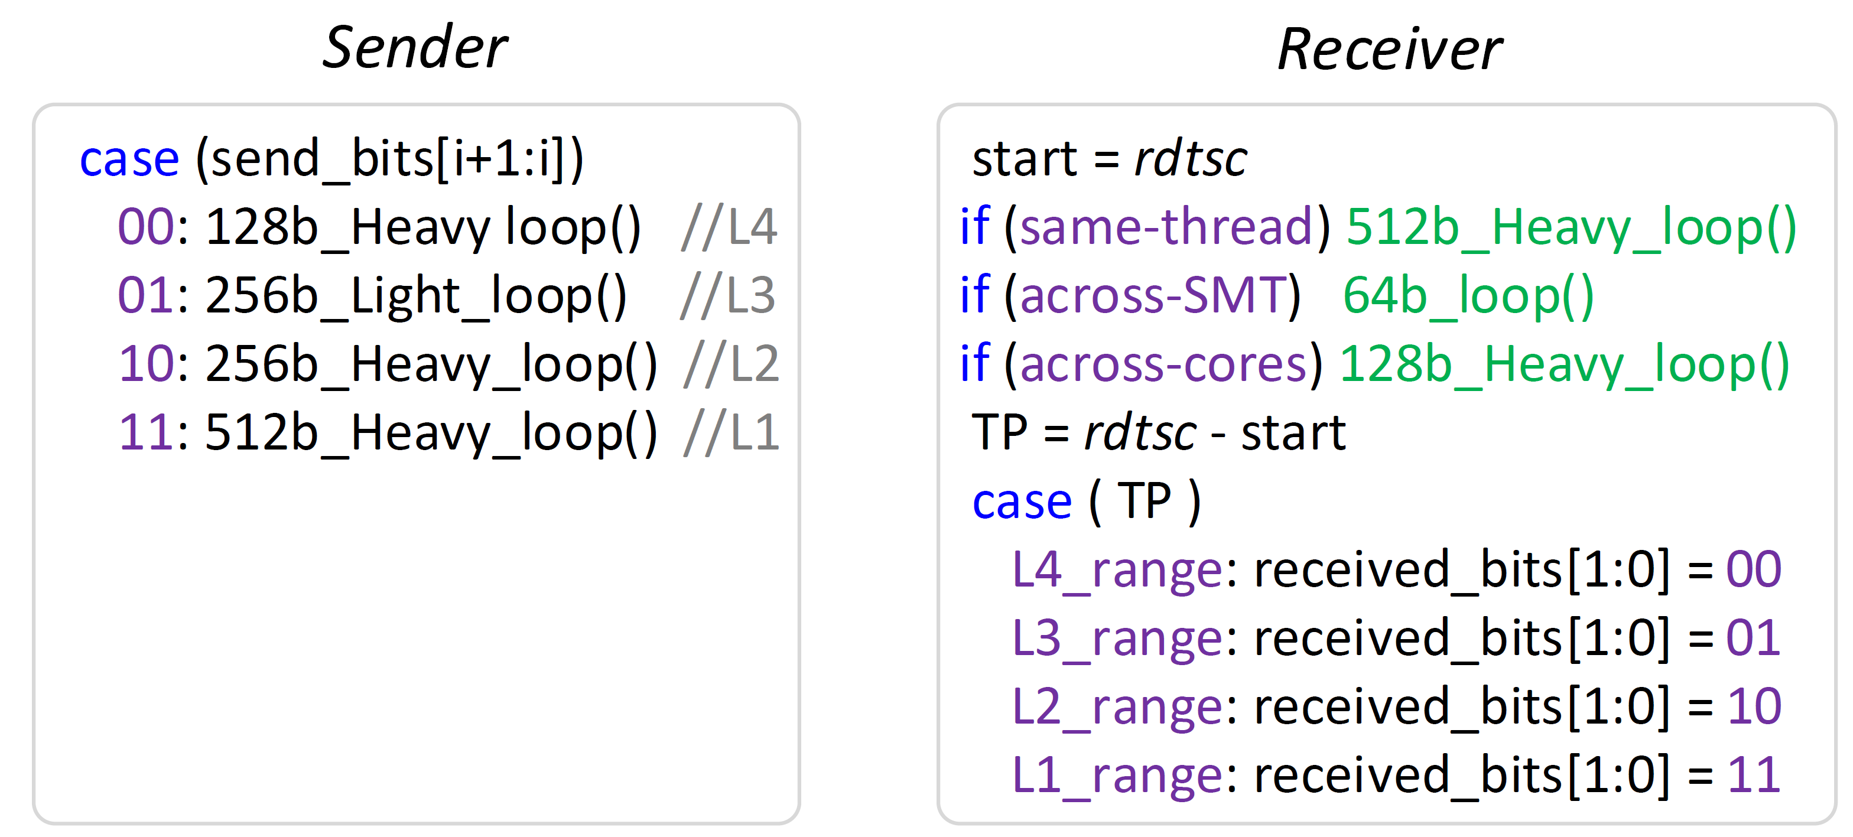
IChannels Covert Channels
Threat model consists of two malicious user-level attacker applications, sender and receiver, which cannot communicate through overt channels
We build three high-throughput covert channels between sender and receiver that exploit throttling side-effects of current management mechanisms
On the same hardware thread
Across SMT threads, and
Across cores
Each covert channel sends 2 bits from Sender to Receiver in every transaction
Each covert channel should wait for reset-time (~650us) before starting a new transaction
We demonstrate the covert channels on real Intel Coffee Lake and Cannon Lake systems
Sender
Receiver
Notes:
[CLICK]
The threat model consists of two malicious user-level attacker applications, sender and receiver, which cannot communicate through overt channels [CLICK]
We build three high-throughput covert channels between sender and receiver that exploit throttling side-effects of current management mechanisms [CLICK]
On the same hardware thread
Across SMT threads, and
Across cores [CLICK]
Each covert channel sends 2 bits from Sender to Receiver in every transaction.
Each covert channel should wait for reset-time before starting a new transaction
We demonstrate the covert channels on Intel Cannon Lake real system [END]

Slide 13
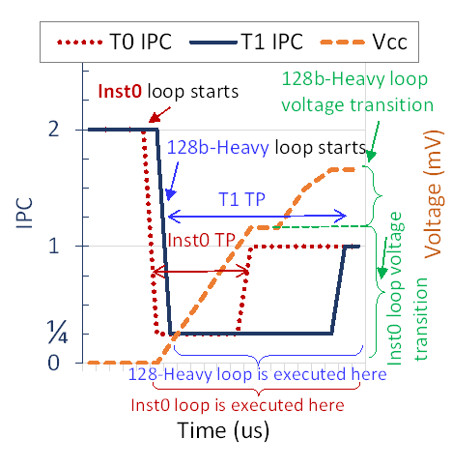
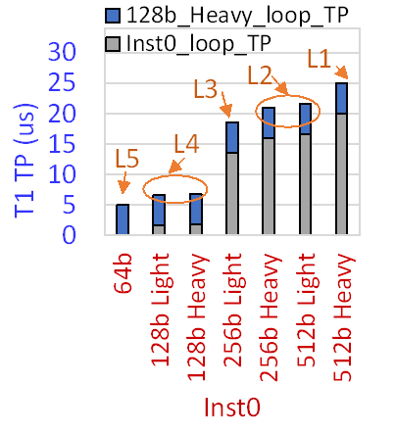
Across Cores Covert Channel: IccCoresCovert (1/2)
IccCoresCovert covert channel exploits the Multi-Throttling-Cores side effect
Multi-Throttling-Cores: when two cores execute PHIs at similar times, the throttling periods (TP) are exacerbated proportionally to the computational intensity of each PHI executed in each core
This increase in the TP is because the power management unit (PMU) waits until the voltage transition for core A to complete before starting the voltage transition for core B
T1 TP depends on the computational intensity of Inst0, which determines Vcc level to which the PMU needs to increase the supply voltage before handling T1 voltage transition
T0 and T1 loops are throttled (IPC=1/4)
T1 continues to be throttled since the PMU will not handle T1 voltage transition until T0 voltage target is reached
T0/T1 in core0/1 starts executing Inst0/128b-Heavy loop with IPC=1
Once the T0 target Vcc is reached, T0 throttling is stopped (IPC = 1)
Notes:
I’ll present only the Third covert channel, IccCoresCovert established across different physical cores [CLICK]
IccCoresCovert covert channel utilizes the side effect of Multi-Throttling-Cores [CLICK]
In this side effect, when two cores execute PHIs at similar times, the throttling periods are exacerbated proportionally to the computational intensity of each PHI executed in each core.
This increase in the throttling period is because the power management unit (PMU) waits until the voltage transition for core A to complete before starting the voltage transition for core B [CLICK]
As illustrated here: [CLICK]
T0 and T1 in core0 and 1 starts executing Inst0 and 128b-Heavy loop both with IPC of 1 [CLICK]
T0 and T1 loops are throttled [CLICK]
Once the T0 target Vcc is reached, T0 throttling is stopped [CLICK]
T1 continues to be throttled since the PMU will not handle T1 voltage transition until T0 voltage target is reached [CLICK]
T1 TP depends on the computational intensity of Inst0, which determines Vcc level to which the PMU needs to increase the supply voltage before handling T1 voltage transition [END]

Slide 14
Across Cores Covert Channel: IccCoresCovert (2/2)
Sender
Receiver
IccCoresCovert exploits the Multi-Throttling-Cores side-effect to build a covert channel between Sender and Receiver:
The Sender executes a PHI loop with a computational intensity level (L1–L4) depending on the values of two secret bits it wants to send
The Receiver can infer the two bits sent by the Sender based on the measured TP of the 128b_Heavy loop
The higher the power required by the PHI loop executed by the Sender, the higher the TP experienced by the Receiver will be
Notes:
[CLICK]
IccCoresCovert exploits the Multi-Throttling-Cores side-effect to build a covert channel between Sender and Receiver: [CLICK]
The Sender executes a PHI loop with a computational intensity level depending on the values of two secret bits it wants to send [CLICK]
The Receiver can infer the two bits sent by the Sender based on the measured throttling period of the 128b_Heavy loop [CLICK]
The higher the power required by the PHI loop executed by the Sender, the higher the TP experienced by the Receiver will be [END]

Slide 15
Presentation Outline
Overview of Client Processor Architectures
Motivation and Goal
Throttling Characterization
IChannels Covert Channels
Evaluation
Conclusion
Notes:
I will next present our evaluation of IChannels [END]

Slide 16
Methodology
Framework: We evaluate IChannels on Coffee Lake and Cannon Lake
Workloads: Proof-of-concept codes of the covert channels
Comparison Points: We compare IChannels to four recent works
Mitigation Mechanisms: We propose three mitigation mechanisms
Notes:
First, I will present our methodology [CLICK]
We evaluate IChannels on Coffee Lake and Cannon Lake
Our main workloads are Proof-of-concept codes of the covert channels [CLICK]
We compare IChannels to four recent works [CLICK]
We proposed three mitigation mechanisms. Please see our paper [END]

Slide 17
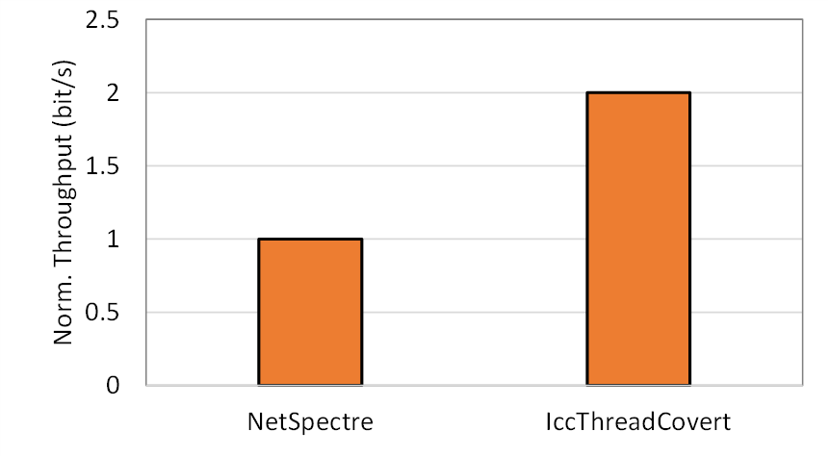
Results – IccThreadCovert
Normalized
Throughput (bits/s)
2X
We compare IccThreadCovert against NetSpectre
The state-of-the-art work that exploits the variable latency of PHIs to create a covert channel between two execution contexts running on the same hardware thread
The NetSpectre covert channel can send one bit per transaction
IccThreadCovert covert channel can send two bits per transaction
Notes:
[CLICK]
We compare IccThreadCovert against NetSpectre
The state-of-the-art work that exploits the variable latency of PHIs to create a covert channel between two execution contexts running on the same hardware thread [CLICK]
The NetSpectre covert channel can send one bit per transaction, [CLICK]
While our IccThreadCovert covert channel can send two bits per transaction [END]

Slide 18
Results – IccSMTcovert & IccCoresCovert
145X
47X
24X
Throughput (bits/s)
We compare IccSMTcovert and IccCoresCovert against DFScovert, TurboCC and PowerT
The state-of-the-art works that exploit different power management mechanisms of modern processors to build covert channels across cores and SMT threads
IccSMTcovert/IccCoresCovert throughput is 145×, 47×, and 24×
The throughput of DFScovert, TurboCC, and PowerT, respectively
The three works exploit slow mechanisms (e.g., frequency/thermal changes)
Compared to the current management side-effects that our IChannels exploits
Notes:
[CLICK]
We compare IccSMTcovert and IccCoresCovert against DFScovert, TurboCC and PowerT
The state-of-the-art works that exploit different power management mechanisms of modern processors to build covert channels across cores and SMT threads [CLICK]
IccSMTcovert/IccCoresCovert throughput is
145 times,
47 time , and
24 time
The throughput of DFScovert,
TurboCC, and
PowerT, respectively [CLICK]
The three works exploit slow mechanisms Compared to the current management side-effects that our IChannels exploits [END]

Slide 19
Presentation Outline
Overview of Client Processor Architectures
Motivation and Goal
Throttling Characterization
IChannels Covert Channels
Evaluation
Conclusion
Notes:
Let me quickly conclude my talk [END]

Slide 20
Conclusion
We introduced IChannels, new covert channels we can exploit based on current management mechanisms in modern processors
We showed that the multi-level throttling effects of current management mechanisms can be exploited for malicious information leakage on real systems (Intel Cannon Lake & Intel Coffee Lake)
IChannels is 2× and 24× higher throughput than existing state-of-the-art covert channels
We propose multiple practical mitigations to protect against IChannels in modern processors
We hope our work paves the way for eliminating the confidentiality breaches such current management mechanisms lead to
Notes:
[CLICK]
We introduced IChannels, new covert channels we can exploit based on current management mechanisms in modern processors [CLICK]
We showed that the multi-level throttling effects of current management mechanisms can be exploited for malicious information leakage on real systems (Intel Cannon Lake & Intel Coffee Lake) [CLICK]
IChannels is 2× and 24× higher throughput than existing state-of-the-art covert channels [CLICK]
We propose multiple practical mitigations to protect against IChannels in modern processors [CLICK]
We hope our work paves the way for eliminating the confidentiality breaches such current management mechanisms lead to [END]

Slide 21
IChannels
Exploiting Current Management Mechanisms
to Create Covert Channels in Modern Processors
Jawad Haj-Yahya Jeremie S. Kim A. Giray Yağlıkçı Ivan Puddu Lois Orosa
Juan Gómez Luna Mohammed Alser Onur Mutlu
Notes:
Thank you for your attention. For many more details, I invite you to read our ISCA 2021 paper [END]

