Slide 1

IChannels
Exploiting Current Management Mechanisms
to Create Covert Channels in Modern Processors
Jawad Haj-Yahya Jeremie S. Kim A. Giray Yağlıkçı Ivan Puddu Lois Orosa
Juan Gómez Luna Mohammed Alser Onur Mutlu
Notes:
My name is Jawad Haj-Yahya and I will present our work IChannels [END]

Slide 2
Executive Summary
Problem: Current management mechanisms throttle instruction execution and adjust voltage/frequency to accommodate power-hungry instructions (PHIs).
These mechanisms may compromise a system’s confidentiality guarantees
Goal:
Understand the throttling side-effects of current management mechanisms
Build high-capacity covert channels between otherwise isolated execution contexts
Practically and effectively mitigate each covert channel
Characterization: Variable execution times and frequency changes due to running PHIs
We observe five different levels of throttling in real Intel systems
IChannels: New covert channels that exploit side-effects of current management mechanisms
On the same hardware thread
Across co-located Simultaneous Multi-Threading (SMT) threads
Across different physical cores
Evaluation: On three generations of Intel processors, IChannels provides a channel capacity
2× that of PHIs’ variable latency-based covert channels
24× that of power management-based covert channels
Notes:
First, I will give a high-level overview of the talk [CLICK]
Current management mechanisms throttle instruction execution and adjust voltage/frequency to accommodate power-hungry instructions (PHIs).
These mechanisms may compromise a system’s confidentiality guarantees [CLICK]
Our Goal is [CLICK]
First to Understand the throttling side-effects of current management mechanisms [CLICK]
Secondly to Build high-capacity covert channels between otherwise isolated execution contexts [CLICK]
Finally to Practically and effectively mitigate each covert channel [CLICK]
We Characterize the Variable execution times and frequency changes due to running PHIs
We observe five different levels of throttling in real Intel systems [CLICK]
We propose Ichannels, a New covert channels that exploit side-effects of current management mechanisms [CLICK]
On the same hardware thread [CLICK]
Across co-located Simultaneous Multi-Threading (SMT) threads [CLICK]
Across different physical cores [CLICK]
On three generations of Intel processors, IChannels provides a channel capacity [CLICK]
2× that of PHIs’ variable latency-based covert channels [CLICK]
24× that of power management-based covert channels [CLICK]
[END]

Slide 3
Presentation Outline
Overview of Client Processor Architectures
Motivation and Goal
Throttling Characterization
IChannels Covert Channels
IccThreadCovert – on the same hardware thread
IccSMTcovert – across co-located SMT threads
IccCoresCovert – across different physical cores
Evaluation
Conclusion
Notes:
Here is the outline for the talk today.
I will begin with a brief overview on Client Processor Architectures [END]
[END]

Slide 4
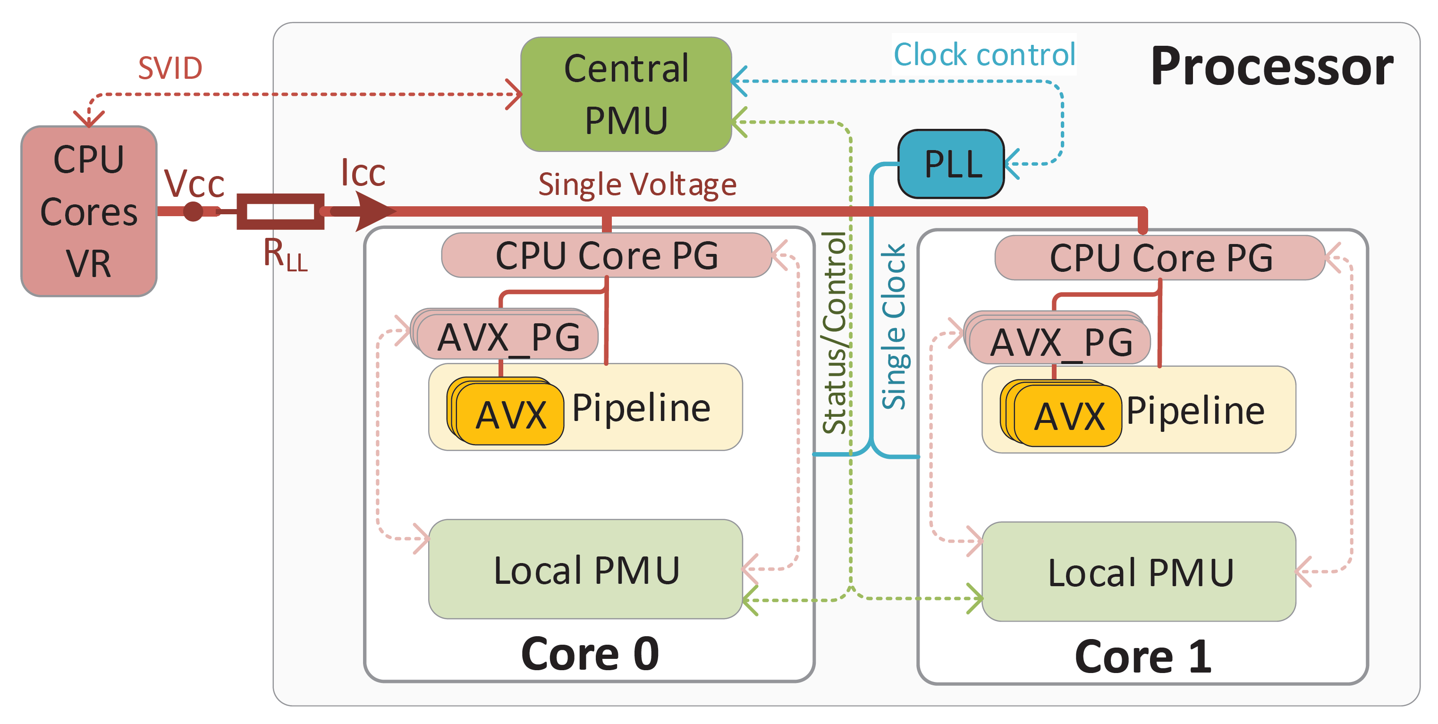
Overview of Client Processor Architectures
Clock Control
In many recent processors (e.g., Intel Coffee Lake, Cannon Lake), CPU cores:
Share the same voltage regulator (VR) and clock domain
A central power management unit (PMU) controls:
The VR using an off-chip serial voltage identification (SVID) interface
The clock phase-locked loop (PLL) using an on-chip interface
Each CPU core has a power-gate (PG) for the entire core
Each SIMD unit (e.g., AVX-256, AVX-512) has a separate PG
Notes:
[CLICK]
In many recent processors, CPU cores: [CLICK]
Share the same voltage regulator and clock domain [CLICK]
A central power management unit controls: [CLICK]
The voltage regulator using an off-chip serial voltage identification interface [CLICK]
The clock phase-locked loop using an on-chip interface [CLICK]
Each CPU core has a power-gate for the entire core [CLICK]
Each SIMD unit has a separate power-gate [END]

Slide 5
Load Voltage and Voltage Guardband
Below the maximum operational voltage (Vcc_{max}) under the lightest load (leakage, Icc_{lkg})
×
= Vcc – Icc × R_{LL}
Above the minimum functional voltage (Vcc_{min}) under the most intensive load (power-virus, Icc_{virus})
The relationship between load voltage (Vcc_{load}), supply voltage (Vcc) and current (Icc) under a given system impedance (R_{LL}) is : Vcc_{load} = Vcc – Icc × R_{LL}
The PMU adds voltage guardband to Vcc to a level that keeps Vcc_{load} within limits
For loads with current lower than Icc_{virus}, the voltage drop (Icc × R_{LL}) is smaller than when running a power-virus
Results in a higher load voltage Vcc_{load} than necessary
Leading to a power loss that increases quadratically with the voltage level
Notes:
[CLICK]
The relationship between load voltage, Vcc_{load,} supply voltage, Vcc, and current, Icc, under a given system impedance,R_{LL,} is : Vcc_{load} = Vcc – Icc × R_{LL} [CLICK]
[CLICK] as also show in the following figure [CLICK]
The power management unit adds voltage guardband to Vcc to a level that keeps Vcc_{load} within limits [CLICK]
Above the minimum functional voltage (Vcc_{min}) under the most intensive load, power-virus, with a current of Icc_{virus} [CLICK]
And below the maximum operational voltage, Vcc_{max,} under the lightest load, leakage with a current of Icc_{lkg}) [CLICK]
For loads with current lower than Icc_{virus}, the voltage drop is smaller than when running a power-virus [CLICK]
Results in a higher load voltage than necessary [CLICK]
Leading to a power loss that increases quadratically with the voltage level [END]

Slide 6
Presentation Outline
Overview of Client Processor Architectures
Motivation and Goal
Throttling Characterization
IChannels Covert Channels
IccThreadCovert – on the same hardware thread
IccSMTcovert – across co-located SMT threads
IccCoresCovert – across different physical cores
Evaluation
Conclusion
Notes:
I will now discuss the motivation and the goal of our work
[END]

Slide 7
Motivation: Limitations of Prior Work
NetSpectre [Schwarz+, ESORICS 2019] exploits the variable execution times of PHIs to create a covert channel. NetSpectre has three limitations:
Established only between two execution contexts on the same hardware thread
Uses only a single-level throttling side-effect (thread is throttled/unthrottled)
Does not identify the true source of throttling
Hypothesizes that the throttling is due power-gating of the PHI execution units
TurboCC [Kalmbach+, arXiv 2020] exploits the core frequency throttling when executing PHIs to create cross-core covert channel. TurboCC has two limitations:
Focuses only on the slow (milliseconds) side-effect of frequency throttling that happens when executing PHIs at only Turbo frequencies
Does not uncover the real reason behind the vulnerability
Hypothesizes that the frequency throttling is due to thermal management
Notes:
Prior Works have multiple limitations [CLICK]
NetSpectre exploits the variable execution times of PHIs to create a covert channel.
NetSpectre has three limitations: [CLICK]
First, it is Established only between two execution contexts on the same hardware thread [CLICK]
Secondly, it Uses only a single-level throttling side-effect (thread is throttled/unthrottled) [CLICK]
And Finally, it Does not identify the true source of throttling. NetSpectre Hypothesizes that the throttling is due power-gating of the PHI execution units [CLICK]
TurboCC exploits the core frequency throttling when executing PHIs to create cross-core covert channel.
TurboCC has two limitations: [CLICK]
First, it Focuses only on the slow (milliseconds) side-effect of frequency throttling that happens when executing PHIs at only Turbo frequencies [CLICK]
And Secondly, it Does not uncover the real reason behind the vulnerability. TurboCC Hypothesizes that the frequency throttling is due to thermal management [END]

Slide 8
Motivation: Limitations of Prior Work
NetSpectre [Schwarz+, ESORICS 2019] exploits the variable execution times of PHIs to create a covert channel. NetSpectre has three limitations:
Established only between two execution contexts on the same hardware thread
Uses only a single-level throttling side-effect (thread is throttled/unthrottled)
Does not identify the true source of throttling
Hypothesizes that the throttling is due power-gating of the PHI execution units
TurboCC [Kalmbach+, arXiv 2020] exploits the core frequency throttling when executing PHIs to create cross-core covert channel. TurboCC has two limitations:
Focuses only on the slow (milliseconds) side-effect of frequency throttling that happens when executing PHIs at Turbo frequencies
Does not uncover the real reason behind the vulnerability
Hypothesizes that the frequency throttling is due to thermal management
Recent works propose limited covert channels
and use inaccurate observations
Notes:
Recent works propose limited covert channels and use inaccurate observations [END]

Slide 9
Goal
Our goal in this work is to:
Experimentally understand the throttling side-effects of current management mechanisms in modern processors to gain several deep insights into how these mechanisms can be abused by attackers
Build high-capacity covert channels, IChannels, between otherwise isolated execution contexts located
On the same hardware thread
Across co-located Simultaneous Multi-Threading (SMT) threads
Across different physical cores
Practically and effectively mitigate covert channels caused by current management mechanisms
Notes:
[CLICK]
Our goal in this work is to:
Experimentally understand the throttling side-effects of current management mechanisms in modern processors to gain several deep insights into how these mechanisms can be abused by attackers [CLICK]
Build high-capacity covert channels, IChannels, between otherwise isolated execution contexts located
On the same hardware thread
Across co-located Simultaneous Multi-Threading (SMT) threads
Across different physical cores [CLICK]
Practically and effectively mitigate covert channels caused by current management mechanisms
[END]

Slide 10
Presentation Outline
Overview of Client Processor Architectures
Motivation and Goal
Throttling Characterization
IChannels Covert Channels
IccThreadCovert – on the same hardware thread
IccSMTcovert – across co-located SMT threads
IccCoresCovert – across different physical cores
Evaluation
Conclusion
Notes:
Now I will preset the Throttling Characterization [END]

Slide 11
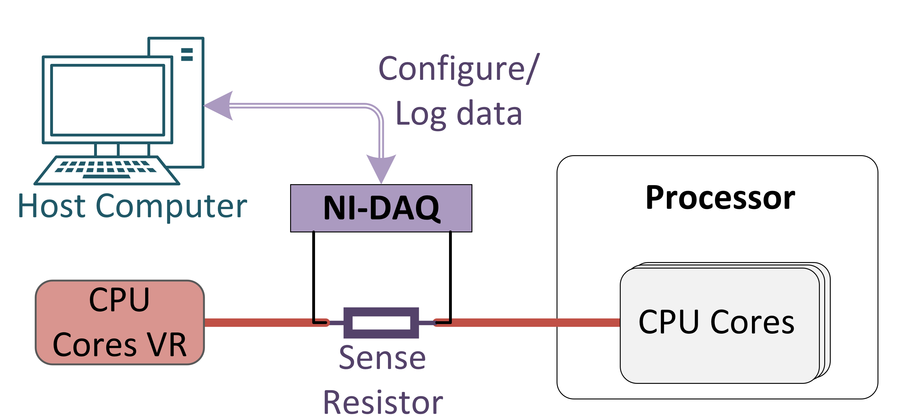
Experimental Methodology
We experimentally study three modern Intel processors
Haswell, Coffee Lake, and Cannon Lake
We measure voltage and current using a Data Acquisition card (NI-DAQ)
Configuration /
Log data
Notes:
[CLICK] We experimentally study three modern Intel processors
Haswell, Coffee Lake, and Cannon Lake [CLICK]
We measure voltage and current using a Data Acquisition card (NI-DAQ) [CLICK]
Here is a picture of our system [END]

Slide 12
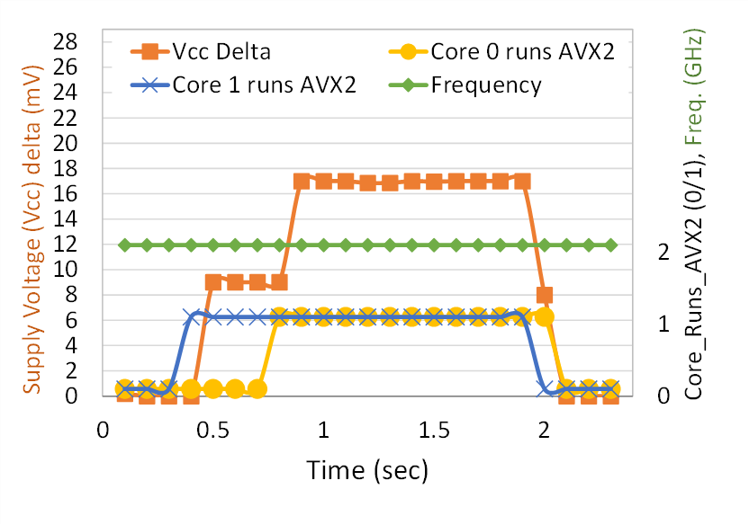
Voltage Emergency Avoidance Mechanism
We study the impact of Power-Hungry Instructions (PHIs) on the CPU core supply voltage (Vcc)
We track the Vcc change during an experiment on a two-core Coffee Lake system executing code that includes PHI (AVX2) phases
Vcc increases once a CPU core begins executing AVX2 instructions
The more cores executing AVX2 instructions, the higher the Vcc
Supply Voltage (Vcc) Delta (mV)
Notes:
[CLICK] We study the impact of Power-Hungry Instructions (PHIs) on the CPU core supply voltage, Vcc [CLICK]
We track the Vcc change during an experiment on a two-core Coffee Lake system executing code that includes AVX2 phases [CLICK]
Vcc increases once a CPU core begins executing AVX2 instructions [CLICK]
The more cores executing AVX2 instructions, the higher the Vcc [END]

Slide 13
Voltage Emergency Avoidance Mechanism
We study the impact of Power-Hungry Instructions (PHIs) on the CPU core supply voltage (Vcc)
We track the Vcc change during an experiment on a two-core Coffee Lake system executing code that includes PHI (AVX2) phases
Vcc increases once a CPU core begins executing AVX2 instructions
The more cores executing AVX2 instructions, the higher the Vcc
Voltage emergency avoidance mechanism
prevents the core voltage from dropping below the
minimum operational voltage limit when executing PHIs
Supply Voltage (Vcc) Delta (mV)
Notes:
Voltage emergency avoidance mechanism
prevents the core voltage from dropping below the
minimum operational voltage limit when executing PHIs [END]

Slide 14
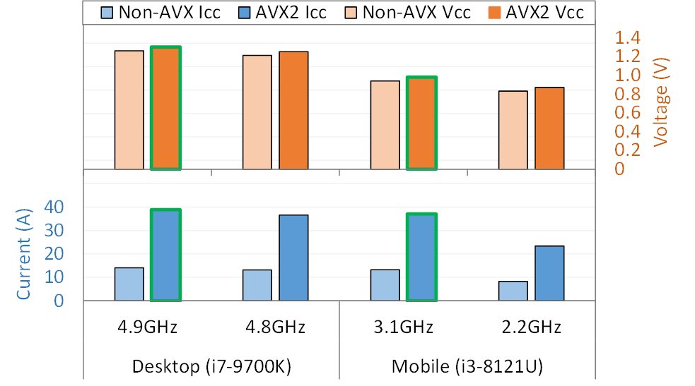

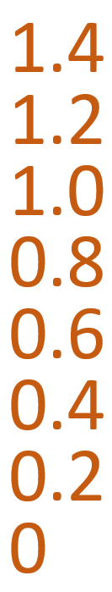
Icc_{max} and Vcc_{max} Limit Protection Mechanisms
Systems:
A single-core Coffee Lake desktop CPU operating at Turbo frequencies (4.9 GHz and 4.8 GHz)
A two-core Cannon Lake mobile CPU operating at Turbo frequencies (3.1 GHz and 2.2 GHz)
Workloads (Non-AVX and AVX2) while measuring current and voltage
For both desktop frequencies, current (Icc) is below the system limit (Icc_{max})
Vcc will exceed the voltage limit (Vcc_{max}) when executing AVX2 code at a frequency of 4.9 GHz
For both mobile frequencies, the voltage (Vcc) is below the system limit (Vcc_{max})
Icc will exceed the current limit (Icc_{max}) when executing AVX2 code at a frequency of 3.1 GHz
Vcc_{max} (1.27V)
Vcc_{max} (1.15V)
The bars with green borders are projected
Icc_{max} (100A)
Icc_{max} (29A)
Notes:
[CLICK]
We use the following Systems:
A single-core Coffee Lake desktop CPU operating at Turbo frequencies 4.9 and 4.8GHz
A two-core Cannon Lake mobile CPU operating at Turbo frequencies 3.1 and 2.2GHz [CLICK]
We execute and Non-AVX and AVX2 Workloads while measuring current and voltage [CLICK]
The bars with green borders are projected [CLICK]
Here are the Vccmax and Iccmax of each system [CLICK]
For both desktop frequencies, Icc is below the Icc_{max} limit [CLICK]
Vcc will exceed the Vcc_{max} limit () when executing AVX2 code at a frequency of 4.9 GHz [CLICK]
For both mobile frequencies, Vcc is below the Vcc_{max} limit [CLICK]
Icc will exceed the Icc_{max} limit when executing AVX2 code at a frequency of 3.1 GHz [END]

Slide 15
Icc_{max} and Vcc_{max} Limit Protection Mechanisms
Systems:
A single-core Coffee Lake desktop CPU operating at Turbo frequencies (4.9GHz and 4.8GHz)
A two-core Cannon Lake mobile CPU operating at Turbo frequencies (3.1GHz and 2.2GHz)
Workloads (Non-AVX and AVX2) while measuring current and voltage
Contrary to the state-of-the-art work’s hypothesis:
The core frequency reduction that directly follows the execution of PHIs at the Turbo frequency is not due to thermal management
For both desktop frequencies, Icc is below the system limit (Icc_{max})
Vcc will exceed the voltage limit (Vcc_{max}) when executing AVX2 code at a frequency of 4.9 GHz
For both mobile frequencies, the voltage (Vcc) is below the system limit (Vcc_{max})
Icc will exceed the current limit (Icc_{max}) when executing AVX2 code at a frequency of 3.1 GHz
Vcc_{max} (1.27V)
It is due to maximum instantaneous current limit (Icc_{max}) and maximum voltage limit (Vcc_{max}) protection mechanisms
Vcc_{max} (1.15V)
The bars with green borders are projected
Icc_{max} (100A)
Icc_{max} (29A)
Notes:
[CLICK]
Contrary to the state-of-the-art work’s hypothesis:
The core frequency reduction that directly follows the execution of PHIs at the Turbo frequency is not due to Thermal management [CLICK]
It is due to maximum instantaneous current limit (Icc_{max}) and maximum voltage limit (Vcc_{max}) protection mechanisms

Slide 16
AVX Throttling is Not Due to Power Gating
We study the time it takes to open the AVX power-gate of Coffee Lake
By comparing it to Haswell system, which doesn’t have an AVX power-gate
When running AVX2 instructions in a loop
Consisting of 300 AVX (VMULPD) instructions that use registers
The first iteration of the loop running on Coffee Lake is > 8ns longer than the other two iterations
For the Haswell processor all iterations have nearly the same latency
AVX power-gating feature has approximately 8–15 ns of wake-up latency
About 1% of the total throttling time when executing PHIs (>10us)
>10us
>8ns
8-15 ns
Notes:
[CLICK]
We study the time it takes to open the AVX power-gate of Coffee Lake By comparing it to Haswell system, which doesn’t have an AVX power-gate [CLICK]
When running AVX2 instructions in a loop Consisting of 300 AVX (VMULPD) instructions that use registers [CLICK]
The first iteration of the loop running on Coffee Lake is more than 8ns longer than the other two iterations [CLICK]
For the Haswell processor all iterations have nearly the same latency [CLICK]
The following graph shows AVX throttling with zoom in into power gating in the right side [CLICK]
AVX power-gating feature has approximately 8–15 ns of wake-up latency [CLICK]
About 1% of the total throttling time when executing PHIs, which is greater then10us [END]

Slide 17
AVX Throttling is Not Due to Power Gating
We study the time it takes to open the AVX power-gate of Coffee Lake
By comparing it to Haswell system, which doesn’t have an AVX power-gate
When running AVX2 instructions in a loop
Consisting of 300 AVX (VMULPD) instructions that use registers
Contrary to the state-of-the-art work’s hypothesis:
Power-gating AVX execution units accounts for only ~0.1% of the total throttling time observed when executing PHIs
The first iteration of the loop running on Coffee Lake is > 8ns longer than the other two iterations
For the Haswell processor all iterations have nearly the same latency
AVX power-gating feature has approximately 8–15 ns of wake-up latency
About 1% of the total throttling time when executing PHIs (>10us)
The majority of the throttling time is due to voltage transitions
>10us
>8ns
8-15 ns
Notes:
Contrary to the state-of-the-art work’s hypothesis:
Power-gating AVX execution units accounts for only ~0.1% of the total throttling time observed when executing PHIs
[CLICK]
The majority of the throttling time is due to voltage transitions

Slide 18
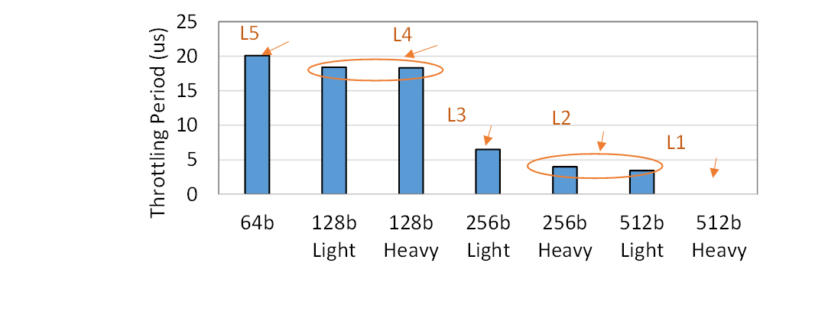
Multi-level Throttling
We execute one of 7 instruction types in a loop followed by a 512b_Heavy loop
Inst0: 64b, 128b_Light, 128b_Heavy, 256b_Light, 256b_Heavy, 512b_Light, and 512b_Heavy
Heavy instructions: require the floating-point unit or any multiplication
The throttling period of the 512b_Heavy loop increases when
The computational intensity of the instructions executed in the preceding loop decreases
The lower the instructions’ computational intensity in the preceding loop, the lower the applied voltage guardband to this instruction
Hence, the 512b_Heavy loop requires more time to increase the voltage to the required level
We observe at least five throttling levels (L1–L5) corresponding to the computational intensity of instruction types
Throttling period of a 512b_Heavy loop
Notes:
[CLICK]
We execute one of 7 instruction types in a loop followed by a 512b_Heavy loop
Heavy instructions are instructions that require the floating-point unit or any multiplication [CLICK]
The throttling period of the 512b_Heavy loop increases when The computational intensity of the instructions executed in the preceding loop decreases [CLICK]
The lower the instructions’ computational intensity in the preceding loop, the lower the applied voltage guardband to this instruction
Hence, the 512b_Heavy loop requires more time to increase the voltage to the required level [CLICK]
We observe at least five throttling levels (L1–L5) corresponding to the computational intensity of instruction types [END]

Slide 19
Multi-level Throttling
We execute one of 7 instruction types in a loop followed by a 512b_Heavy loop
Inst0: 64b, 128b_Light, 128b_Heavy, 256b_Light, 256b_Heavy, 512b_Light, and 512b_Heavy
Heavy instructions: require the floating-point unit or any multiplication
The throttling period of the 512b_Heavy loop increases when
The computational intensity of the instructions executed in the preceding loop decreases
The lower the instructions’ computational intensity in the preceding loop the lower the applied to voltage guardband to this instruction
Hence, the 512b_Heavy loop requires more time to increase the voltage to the required level
We observe at least five throttling levels (L1–L5) corresponding to the computational intensity of instruction types
Current management mechanisms result in
a multi-level throttling period
depending on the computational intensity of the PHIs
Throttling period of a 512b_Heavy loop
Notes:
[CLICK]
Current management mechanisms result in a multi-level throttling period depending on the computational intensity of the PHIs [END]

Slide 20
Throttling Affects SMT Threads
We study the source of throttling and its microarchitectural impact
We track the number of micro-operations (uops) that the core pipeline delivers from the front-end to the back-end during throttled and non-throttled AVX2 loops
The front-end does not deliver any uop in approximately three-quarters (~75%) of the core cycles even though the back-end is not stalled
The core uses a throttling mechanism that limits the number of uops delivered from the front-end to the back-end during a certain time window
We found that this throttling mechanism affects both threads in Simultaneous Multi-Threading (SMT)
Cannon Lake
Notes:
[CLICK]
We study the source of throttling and its microarchitectural impact [CLICK]
We track the number of micro-operations (uops) that the core pipeline delivers from the front-end to the back-end during throttled and non-throttled AVX2 loop [CLICK]
The front-end does not deliver any uop in approximately three-quarters of the core cycles even though the back-end is not stalled [CLICK]
The core uses a throttling mechanism that limits the number of uops delivered from the front-end to the back-end during a certain time window [CLICK]
We found that this throttling mechanism affects both threads in SMT [END]

Slide 21
Throttling Affects SMT Threads
We study the source of throttling and its microarchitectural impact
We track the number of micro-operations (uops) that the core pipeline delivers from the front-end to the back-end during throttled and non-throttled AVX2 loop
The front-end does not deliver any uop in approximately three-quarters (~75%) of the core cycles even though the back-end is not stalled
The core uses a throttling mechanism that limits the number of uops delivered from the front-end to the back-end during a certain time window
We found that this throttling mechanism affects both threads in Simultaneous Multi-Threading (SMT)
Contrary to the state-of-the-art work’s hypothesis:
The 4× core IPC reduction that directly follows the execution of PHIs is not due to reduced core clock frequency of 4×
It is rather because the core blocks the
front-end to back-end uop delivery during 75% of the time
This throttling mechanism affects both threads in an SMT Core
Cannon Lake
Notes:
Contrary to the state-of-the-art work’s hypothesis:
The 4× core IPC reduction that directly follows the execution of PHIs is not due to reduced core clock frequency of 4× [CLICK]
It is rather because the core blocks the
front-end to back-end uop delivery during 75% of the time [CLICK]
This throttling mechanism affects both threads in an SMT Core

Slide 22
Presentation Outline
Overview of Client Processor Architectures
Motivation and Goal
Throttling Characterization
IChannels Covert Channels
IccThreadCovert – on the same hardware thread
IccSMTcovert – across co-located SMT threads
IccCoresCovert – across different physical cores
Evaluation
Conclusion
Notes:
Now I will explain the Covert Channels of IChannels
[END]

Slide 23
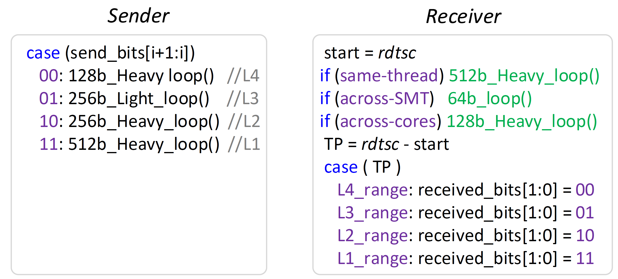
IChannels Covert Channels
Threat model consists of two malicious user-level attacker applications, sender and receiver, which cannot communicate through overt channels
We build three high-throughput covert channels between sender and receiver that exploit throttling side-effects of current management mechanisms
On the same hardware thread
Across SMT threads, and
Across cores
Each covert channel sends 2 bits from Sender to Receiver in every transaction
Each covert channel should wait for reset-time (~650us) before starting a new transaction
We demonstrate the covert channels on real Intel Coffee Lake and Cannon Lake system
Sender
Receiver
Notes:
[CLICK]
The threat model consists of two malicious user-level attacker applications, sender and receiver, which cannot communicate through overt channels [CLICK]
We build three high-throughput covert channels between sender and receiver that exploit throttling side-effects of current management mechanisms [CLICK]
On the same hardware thread
Across SMT threads, and
Across cores [CLICK]
Each covert channel sends 2 bits from Sender to Receiver in every transaction.
Each covert channel should wait for reset-time before starting a new transaction
We demonstrate the covert channels on Intel Cannon Lake real system [END]

Slide 24
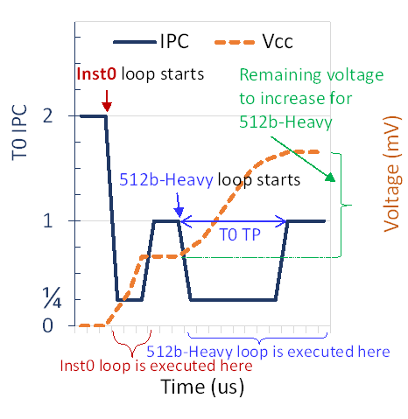
Covert Channel 1: IccThreadCovert (1/2)
IccThreadCovert covert channel exploits the side effect of Multi-Throttling-Thread
Multi-Throttling-Thread: Executing an instruction with high computational intensity results in a throttling period proportional to the difference in voltage requirements of
The currently and previously executing instructions
When 512b_Heavy loop is executed, it is first throttled (IPC = 1/4) while ramping the Vcc to accommodate 512b_Heavy
T0 throttling period (TP) dependent on the computational intensity of Inst0 loop
Inst0 loop is throttled (IPC=1/4) while ramping the voltage (Vcc)
Once the target Vcc is reached, the throttling is stopped (IPC=1)
Inst0 loop starts executing with IPC=1
Executes scalar instruction with IPC=2
The remaining voltage required to execute a 512b_Heavy instruction depends on the previous Vcc level that was reached when Inst0 loop was executed
Notes:
Now I will talk about each of the three covert channels in more detail.
The first covert channel is IccThreadCovert established on the same hardware thread[CLICK]
IccThreadCovert covert channel exploits the side effect of Multi-Throttling-Thread [CLICK]
In this side-effect, Executing an instruction with high computational intensity results in a throttling period proportional to the difference in voltage requirements of
The currently and previously executing instructions [CLICK]
As illustrated here: [CLICK]
The thread Executes scalar instruction with IPC of 2 [CLICK]
Inst0 loop starts executing with IPC of 1 [CLICK]
Inst0 loop is throttled while ramping the voltage, Vcc [CLICK]
Once the target Vcc is reached, the throttling is stopped [CLICK]
When 512b_Heavy loop is executed, it is first throttled while ramping the Vcc to accommodate 512b_Heavy [CLICK]
T0 throttling period dependent on the computational intensity of Inst0 loop [CLICK]
The remaining voltage required to execute a 512b_Heavy instruction depends on the previous Vcc level that was reached when Inst0 loop was executed [END]

Slide 25
Covert Channel 1: IccThreadCovert (2/2)
Sender
Receiver
IccThreadCovert exploits the Multi-Throttling-Thread side-effect to build a covert channel between Sender and Receiver:
The Sender executes a PHI loop with a computational intensity level (L1–L4) depending on the values of two secret bits it wants to send
The Receiver can infer the two bits sent by the Sender based on the measured TP of the 512b_Heavy loop
The higher the power required by the PHI loop executed by the Sender, the shorter the TP experienced by the Receiver will be
Notes:
[CLICK]
IccThreadCovert exploits the Multi-Throttling-Thread side-effect to build a covert channel between Sender and Receiver: [CLICK]
The Sender executes a PHI loop with a computational intensity level (L1–L4) depending on the values of two secret bits it wants to send [CLICK]
The Receiver can infer the two bits sent by the Sender based on the measured TP of the 512b_Heavy loop [CLICK]
The higher the power required by the PHI loop executed by the Sender, the shorter the TP experienced by the Receiver will be [END]

Slide 26
Covert Channel 2: IccSMTcovert (1/2)
IccSMTcovert covert channel exploits the side effect of Multi-Throttling-SMT
Multi-Throttling-SMT: when a thread is throttled due to executing PHIs, the co-located SMT thread is also throttled
We discover that co-located hardware threads are throttled together because the throttling mechanism in the core pipeline blocks the front-end to back-end interface during three-quarters of the TP for the entire core
T1 throttling period (TP) depends on the computational intensity of Inst0 (executed by T0), which determines Vcc level to which the processor needs to increase the supply voltage
T0 starts executing Inst0 loop with IPC=1
T1 starts executing 64b loop with IPC=1
Once the target Vcc is reached, the throttling is stopped (IPC = 1)
Threads Execute scalar instructions with IPC=2
T0 and T1 loops are throttled (IPC=1/4) while ramping the voltage (Vcc)
Notes:
The second covert channel is IccSMTcovert established across co-located SMT threads [CLICK]
IccSMTcovert covert channel exploits the side effect of Multi-Throttling-SMT [CLICK]
Multi-Throttling-SMT: when a thread is throttled due to executing PHIs, the co-located SMT thread is also throttled
We discover that co-located hardware threads are throttled together because the throttling mechanism in the core pipeline blocks the front-end to back-end interface during three-quarters of the TP for the entire core [CLICK]
As illustrated here: [CLICK]
The threads Executes scalar instruction with IPC of 2 [CLICK]
T0 starts executing Inst0 loop with IPC of 1 and T1 starts executing 64b loop with IPC of 1 [CLICK]
T0 and T1 loops are throttled while ramping the voltage (Vcc) [CLICK]
Once the target Vcc is reached, the throttling is stopped [CLICK]
T1 throttling period depends on the computational intensity of Inst0 executed by T0, which determines Vcc level to which the processor needs to increase the supply voltage [END]

Slide 27
Covert Channel 2: IccSMTcovert (2/2)
Sender
Receiver
IccSMTcovert exploits the Multi-Throttling-SMT side-effect to build a covert channel between Sender and Receiver:
The Sender executes a PHI loop with a computational intensity level (L1–L4) depending on the values of two secret bits it wants to send
The Receiver can infer the two bits sent by the Sender based on the measured TP of the 64b loop
The higher the power required by the PHI loop executed by the Sender, the higher the TP experienced by the Receiver will be
Notes:
[CLICK]
IccSMTcovert exploits the Multi-Throttling-SMT side-effect to build a covert channel between Sender and Receiver: [CLICK]
The Sender executes a PHI loop with a computational intensity level (L1–L4) depending on the values of two secret bits it wants to send [CLICK]
The Receiver can infer the two bits sent by the Sender based on the measured TP of the 64b loop[CLICK]
The higher the power required by the PHI loop executed by the Sender, the higher the TP experienced by the Receiver will be[END]

Slide 28
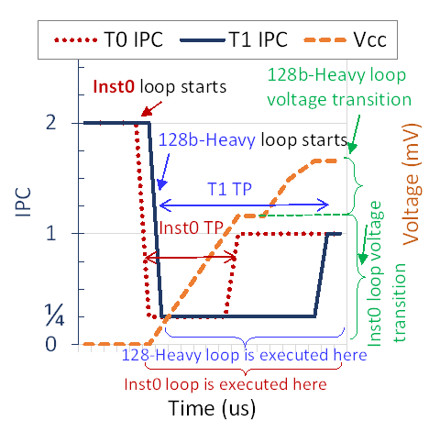
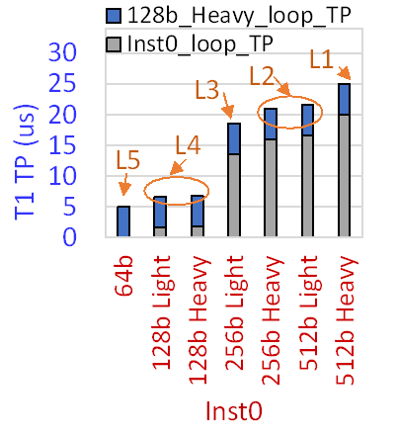
Covert Channel 3: IccCoresCovert (1/2)
IccCoresCovert covert channel exploits the side effect of Multi-Throttling-Cores
Multi-Throttling-Cores: when two cores execute PHIs at similar times, the throttling periods (TP) are exacerbated proportionally to the computational intensity of each PHI executed in each core
This increase in the TP is because the power management unit (PMU) waits until the voltage transition for core A to complete before starting the voltage transition for core B
T1 TP depends on the computational intensity of Inst0, which determines Vcc level to which the PMU needs to increase the supply voltage before handling T1 voltage transition
T0 and T1 loops are throttled (IPC=1/4)
T1 continues to be throttled since the PMU will not handle T1 voltage transition until T0 voltage target is reached
T0/T1 in core0/1 starts executing Inst0/128b-Heavy loop with IPC=1
Once the T0 target Vcc is reached, T0 throttling is stopped (IPC = 1)
Notes:
The Third covert channel is IccCoresCovert established across different physical cores [CLICK]
IccCoresCovert covert channel exploits the side effect of Multi-Throttling-Cores [CLICK]
In this side effect, when two cores execute PHIs at similar times, the throttling periods are exacerbated proportionally to the computational intensity of each PHI executed in each core.
This increase in the throttling period is because the power management unit (PMU) waits until the voltage transition for core A to complete before starting the voltage transition for core B [CLICK]
As illustrated here: [CLICK]
T0 and T1 in core0 and 1 starts executing Inst0 and 128b-Heavy loop both with IPC of 1 [CLICK]
T0 and T1 loops are throttled [CLICK]
Once the T0 target Vcc is reached, T0 throttling is stopped [CLICK]
T1 continues to be throttled since the PMU will not handle T1 voltage transition until T0 voltage target is reached [CLICK]
T1 TP depends on the computational intensity of Inst0, which determines Vcc level to which the PMU needs to increase the supply voltage before handling T1 voltage transition [END]

Slide 29
Covert Channel 3: IccCoresCovert (2/2)
Sender
Receiver
IccCoresCovert exploits the Multi-Throttling-Cores side-effect to build a covert channel between Sender and Receiver:
The Sender executes a PHI loop with a computational intensity level (L1–L4) depending on the values of two secret bits it wants to send
The Receiver can infer the two bits sent by the Sender based on the measured TP of the 128b_Heavy loop
The higher the power required by the PHI loop executed by the Sender, the higher the TP experienced by the Receiver will be
Notes:
[CLICK]
IccCoresCovert exploits the Multi-Throttling-Cores side-effect to build a covert channel between Sender and Receiver: [CLICK]
The Sender executes a PHI loop with a computational intensity level depending on the values of two secret bits it wants to send [CLICK]
The Receiver can infer the two bits sent by the Sender based on the measured throttling period of the 128b_Heavy loop [CLICK]
The higher the power required by the PHI loop executed by the Sender, the higher the TP experienced by the Receiver will be [END]

Slide 30
Presentation Outline
Overview of Client Processor Architectures
Motivation and Goal
Throttling Characterization
IChannels Covert Channels
IccThreadCovert – on the same hardware thread
IccSMTcovert – across co-located SMT threads
IccCoresCovert – across different physical cores
Evaluation
Conclusion
Notes:
I will next present our evaluation of IChannels [END]

Slide 31
Methodology
Framework: We evaluate IChannels on Coffee Lake and Cannon Lake
We test IccThreadCovert and IccCoresCovert on both processors, but we test IccSMTcovert only on Cannon Lake as Coffee Lake does not support SMT
Workloads: Proof-of-concept codes of each of the three IChannels covert channels
Comparison Points: We compare IChannels to four recent works
That exploit different power management mechanisms of modern processors to build covert channels
Notes:
First, I will present our methodology [CLICK]
We evaluate IChannels on Coffee Lake and Cannon Lake
We test IccThreadCovert and IccCoresCovert on both processors, but we test IccSMTcovert only on Cannon Lake as Coffee Lake does not support SMT[CLICK]
Our main workloads are Proof-of-concept codes of each of the three IChannels covert channels[CLICK]
We compare IChannels to four recent works that exploit different power management mechanisms of modern processors to build covert channels [END]

Slide 32
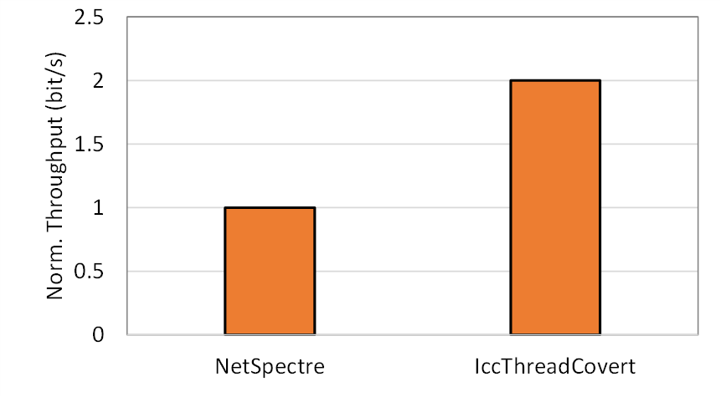
Results – IccThreadCovert
Normalized
Throughput (bits/s)
2X
We compare IccThreadCovert against NetSpectre
The state-of-the-art work that exploits the variable latency of PHIs to create a covert channel between two execution contexts running on the same hardware thread
The NetSpectre covert channel can send one bit per transaction,
IccThreadCovert covert channel can send two bits per transaction
Notes:
[CLICK]
We compare IccThreadCovert against NetSpectre
The state-of-the-art work that exploits the variable latency of PHIs to create a covert channel between two execution contexts running on the same hardware thread [CLICK]
The NetSpectre covert channel can send one bit per transaction, [CLICK]
While our IccThreadCovert covert channel can send two bits per transaction [END]

Slide 33
Results – IccSMTcovert & IccCoresCovert
145X
47X
24X
Throughput (bits/s)
We compare IccSMTcovert and IccCoresCovert against DFScovert, TurboCC and PowerT
The state-of-the-art works that exploit different power management mechanisms of modern processors to build covert channels across cores and SMT threads
IccSMTcovert/IccCoresCovert throughput is 145×, 47×, and 24×
The throughput of DFScovert, TurboCC, and PowerT, respectively
The three works exploit slow mechanisms (e.g., frequency/thermal changes)
Compared to the current management side-effects that our IChannels exploits
Notes:
[CLICK]
We compare IccSMTcovert and IccCoresCovert against DFScovert, TurboCC and PowerT
The state-of-the-art works that exploit different power management mechanisms of modern processors to build covert channels across cores and SMT threads [CLICK]
IccSMTcovert/IccCoresCovert throughput is
145 times,
47 time , and
24 time
The throughput of DFScovert,
TurboCC, and
PowerT, respectively [CLICK]
The three works exploit slow mechanisms Compared to the current management side-effects that our IChannels exploits [END]

Slide 34
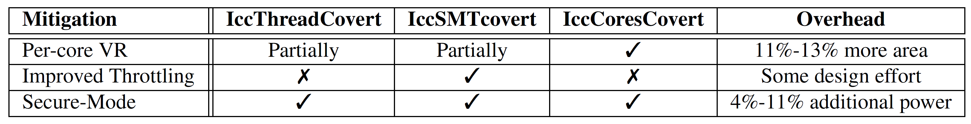
Other Results in the Paper
We propose practical hardware or software techniques for the mitigation of IChannels covert channels:
Fast Per-core Voltage Regulators
Improved Core Throttling
New Secure Mode of Operation
Notes:
We have more results in the paper. For example [CLICK]
We propose practical hardware or software techniques for the mitigation of IChannels covert channels: [CLICK]
Fast Per-core Voltage Regulators
Improved Core Throttling
And New Secure Mode of Operation
This table shows the effectiveness and overhead of each proposed mitigation technique

Slide 35
Presentation Outline
Overview of Client Processor Architectures
Motivation and Goal
Throttling Characterization
IChannels Covert Channels
IccThreadCovert – on the same hardware thread
IccSMTcovert – across co-located SMT threads
IccCoresCovert – across different physical cores
Evaluation
Conclusion
Notes:
Let me quickly conclude my talk.
[END]

Slide 36
Conclusion
Problem: Current management mechanisms throttle instruction execution and adjust voltage/frequency to accommodate power-hungry instructions (PHIs).
These mechanisms may compromise a system’s confidentiality guarantees
Goal:
Understand the throttling side-effects of current management mechanisms
Build high-capacity covert channels between otherwise isolated execution contexts
Practically and effectively mitigate each covert channel
Characterization: Variable execution times and frequency changes due to running PHIs
We observe five different levels of throttling in real Intel systems
IChannels: New covert channels that exploit side-effects of current management mechanisms
On the same hardware thread
Across co-located Simultaneous Multi-Threading (SMT) threads
Across different physical cores
Evaluation: On three generations of Intel processors, IChannels provides a channel capacity
2× that of PHIs’ variable latency-based covert channels
24× that of power management-based covert channels
Notes:
[CLICK]
Current management mechanisms throttle instruction execution and adjust voltage/frequency to accommodate power-hungry instructions (PHIs).
These mechanisms may compromise a system’s confidentiality guarantees [CLICK]
Our Goal is to: [CLICK]
Understand the throttling side-effects of current management mechanisms [CLICK]
Build high-capacity covert channels between otherwise isolated execution contexts [CLICK]
Practically and effectively mitigate each covert channel [CLICK]
We Characterize the Variable execution times and frequency changes due to running PHIs
We observe five different levels of throttling in real Intel systems [CLICK]
We propose Ichannels, a New covert channels that exploit side-effects of current management mechanisms
On the same hardware thread [CLICK]
Across co-located Simultaneous Multi-Threading (SMT) threads [CLICK]
Across different physical cores [CLICK]
On three generations of Intel processors, IChannels provides a channel capacity [CLICK]
2× that of PHIs’ variable latency-based covert channels [CLICK]
24× that of power management-based covert channels [CLICK]
[END]

Slide 37
IChannels
Exploiting Current Management Mechanisms
to Create Covert Channels in Modern Processors
Jawad Haj-Yahya Jeremie S. Kim A. Giray Yağlıkçı Ivan Puddu Lois Orosa
Juan Gómez Luna Mohammed Alser Onur Mutlu
Notes:
Thank you for your attention. For many more details, I invite you to read our ISCA 2021 paper. [END]

