Slide 1




Optically Connected Memory for Disaggregated Data Centers
Jorge Gonzalez¹ Alexander Gazman² Maarten Hattink² Mauricio G.Palma¹
Meisam Bahadori³ Ruth Rubio-Noriega⁴ Lois Orosa⁵
Madeleine Glick² Onur Mutlu⁵ Keren Bergman² Rodolfo Azevedo¹
1
2
3
4
5
LSC
SAFARI

Slide 2
Executive Summary
Motivation: Off-chip memory bandwidth is limited to short distances, being challenging to disaggregate the main memory.
Problem: Current memory interconnects does not scale for disaggregation in datacenters.
Contributions:
- New optical point-to-point disaggregated main memory system for current DDR standards.
- Study how a processor interacts with the disaggregated memory subsystem.
- Evaluates a SiP link with state-of-the-art optical devices.
Results:
- OCM is 5.5x faster than 40G NIC-based disaggregated memory.
- OCM has10.7% energy overhead compared to the DDR DRAM energy consumption for data movement.
Conclusion: OCM is a promising step towards future data centers with disaggregated main memory.
Notes:
This is the summary of our work.
Our motivation is the limitation in bandwidth and energy efficiency of current interconnects to disaggregate main memory,
This represents a problem for scaling memory for future datacenters.
Our work OCM proposes a new optical disaggregated memory to overcome that problem, by studying processor performance when memory is disaggregated and the design of a Silicon Photonic link to sustain DDR memory.
Our work show promising results with 5.5x better performance compared to 40G NIC-based disaggregated system, and low energy overhead of 10.7 %.
We conclude that our work is a promising step toward main memory disaggregation.

Slide 3
Outline
Introduction
Background
Motivation and Goal
Optically Connected Memory (OCM)
Evaluation
Conclusion
Notes:
In today agenda:
First we will introduce the disaggregation concepts
Second, we will give some background of the memory interface
Then we discuss our work motivation and goals to present our Optically Connected Memory proposal.
Finally we show the evaluation, discuss results and conclusions of our work.

Slide 4
Outline
Introduction
Background
Motivation and Goal
Optically Connected Memory (OCM)
Evaluation
Conclusion

Slide 5
Disaggregated Data Centers
Growing gap between computing power and communication.
#1 Top500 2019 (Summit) has ratio communication/computing (Bytes/FLOP) 8X lower than #1 Top500 2017.
Data Centers maintain most data inside the node.
Improve performance by increasing the available resources.
Underutilization of resources still occurs.
Disaggregated systems:
Approach: a network of resources,
rather than a network of servers.
Efficient allocation of resources
Memory is a critical resource.
High-bandwidth interconnection
at rack distance (<10m).
Notes:
In HPC Datacenters, the gap between computing power and communication is increasing. For example, with Summit the rank #1 supercomputer in 2019, the Communication per Computation or Bytes/Flops ratio decreases 8 times compared to 2017.
This shows that data centers require maintaining most of data inside the node for computation.
To improve the compute power and efficiency, we increase the resources.
However, the existing underutilization of resources and operation costs motivates to develop
new architectures and new interconnect technologies efficient data movement to reduce this gap.
One solution is the disaggregated approach, where instead of having a server-centric data center, we have a network of resources. The figure shows a pool of resources in different racks: CPU, GPU, storage, memory. Those resources can be allocated according to the dynamic workload to compose a disaggregated server. If we consider memory as a critical resource for computing, To disaggregate memory from the processor remains a challenge, because we need a high-bandwidth and reconfigurable interconnect that enables up to 10m distances considering its actual limit of few cm.
If we compare Summit energy efficiency of 0.36 pJ/bit to the data movement energy of a DDR3 off-chip which is around 100pJ/bit and consider the Bytes per Flop ratio; we observe that most of the computation occurs inside the node.

Slide 6
Outline
Introduction
Background
Motivation and Goal
Optically Connected Memory (OCM)
Evaluation
Conclusion

Slide 7
Electrical Memory Interface
Single channel:
Shared data bus.
Only 1 DRAM DIMM can be accessed.
1 memory access = 8 transactions of 8B (e.g.: 64B cache line).
DIMM0
DIMM1
CPU
MEM
CTRL
8B
DATA BUS
CMD/ADDR
Single Channel
DIMM0
DIMM1
Multichannel:
Add physical channels to access data in parallel.
Electrical constraints: wiring, pins and short distances (few cm).
CPU
MEM
CTRL
8B
DATA BUS
CMD/ADDR
DIMM0
DIMM1
8B
DATA BUS
CMD/ADDR
Dual Channel
How can we disaggregate main memory?
Notes:
The conventional memory interface establish a communication channel communication between processor and memory
As we can see in the single channel figure from the left, it uses a shared data bus to access one DRAM DIMM per time.
Its physical constraints limit the number of transaction required, for example a 64B cache line performs 8 transactions.
In case we need more channels, we need to add more channes. For example, double the previous interface for a dual channel configuration.
We need to consider the electrical constraints such as pin count, the associate wiring and in datacenter scenarios (rack distance).
How can we disaggregate main memory?

Slide 8
Outline
Introduction
Background
Motivation and Goal
Optically Connected Memory (OCM)
Evaluation
Conclusion

Slide 9
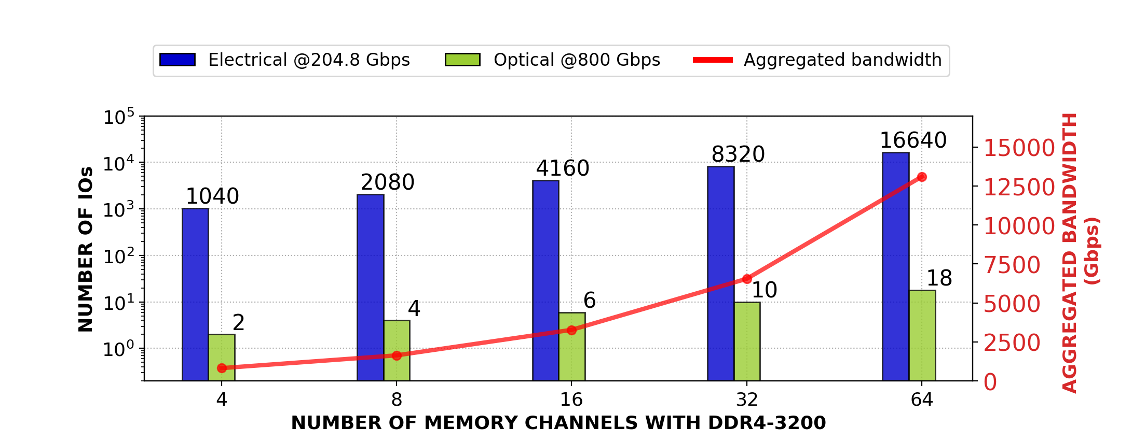
Motivation: Approaching the Memory Wall
Memory off-chip bandwidth is limited.
Photonics characteristics: a) high-bandwidth, b) low-energy, c) distance independent.
We can scale the number of memory channels with photonics.
Notes:
If memory off-chip bandwidth is limited to a few cm. We need a new technology as photonics that provides high-bandwidth, low-energy and large distances.
In this Figure we estimate the number IO count of the memory channels for DDR4. In the blue bar we can see, that electrical interconnects require 1040 IOs to sustain the DDR4 aggregated bandwidth, while a photonic interconnect will require only 2 IOs.
We can scale the number of memory channels using photonics.

Slide 10
Motivation: Photonics for Memory Disaggregation
Prior works show that photonics is a promising solution for scalability [Bahadori+, JLT’16], [Anderson+ OFC’18 ], [Brunina+, JSTQE’13]
No comprehensive analysis that evaluates both:
- How a processor interacts with a disaggregated memory subsystem executing real applications.
- SiP link design to estimate the number of optical devices and energy consumption for DDR standards.
Notes:
Prior works show that photonics is a promising solution for main memory disaggregation.
However, there is no comprehensive analysis that evaluates both:
How a processor interact with a disaggregated mem subsystem executing With real applications, and at the same time evaluates
The sip link design, to obtain relevant metrics such as energy and the number of required optical devices.

Slide 11
Goal
Propose an Optically Connected Memory (OCM) architecture and study how photonics can enable disaggregation for memory systems.
Study how a processor interacts with a disaggregated memory subsystem while executing real applications.
Design and evaluate a SiP link to estimate the number of optical devices and energy consumption for current DDR standards.
Notes:
Our goal in this work is to propose the Optically Connected Memory architecture and study both:
Processor performance with OCM
And the SiP link analysis for memory disaggregation.

Slide 12
Outline
Introduction
Background
Motivation and Goal
Optically Connected Memory (OCM)
Evaluation
Conclusion

Slide 13
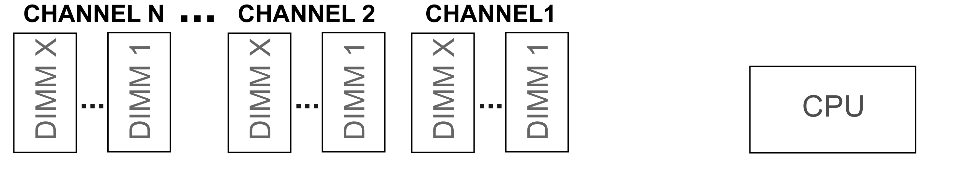
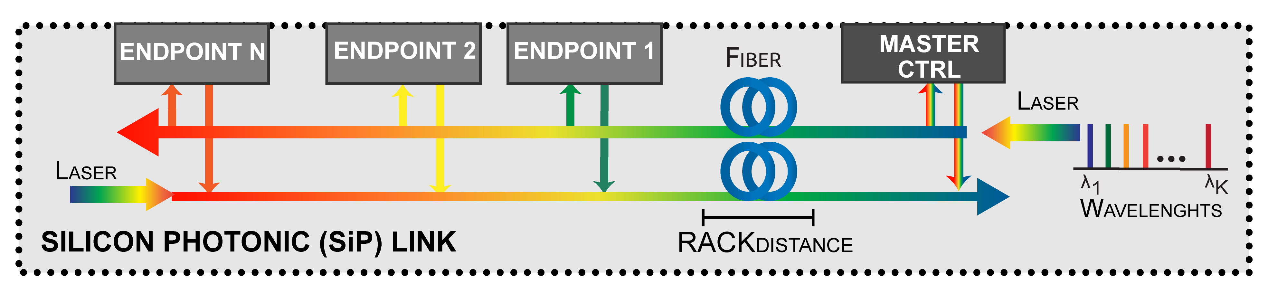
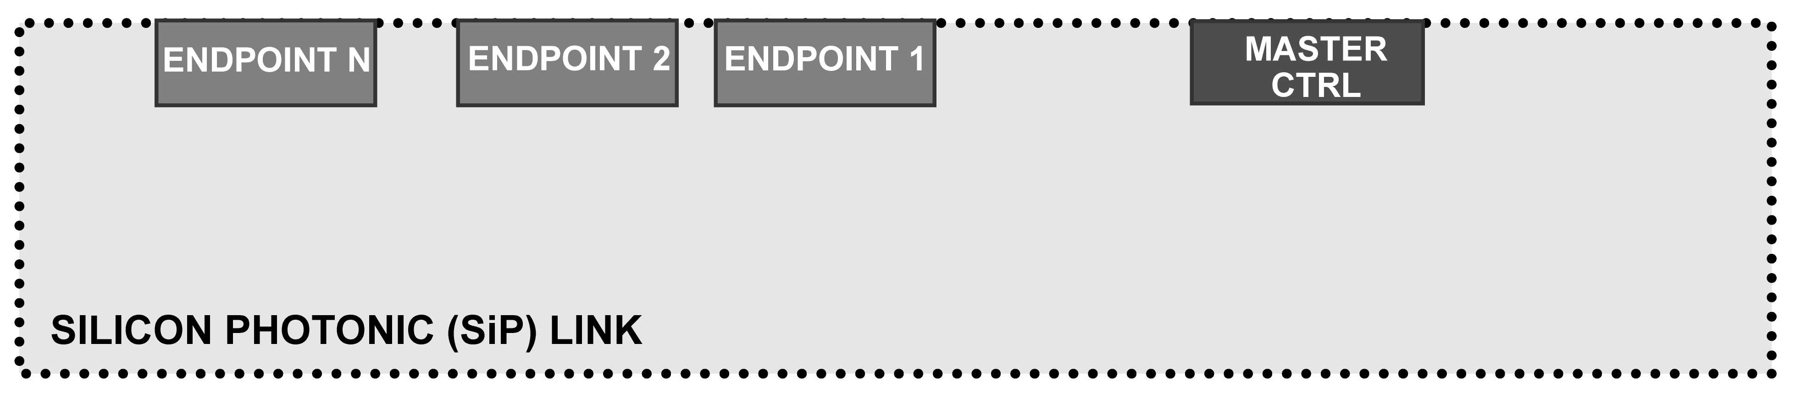
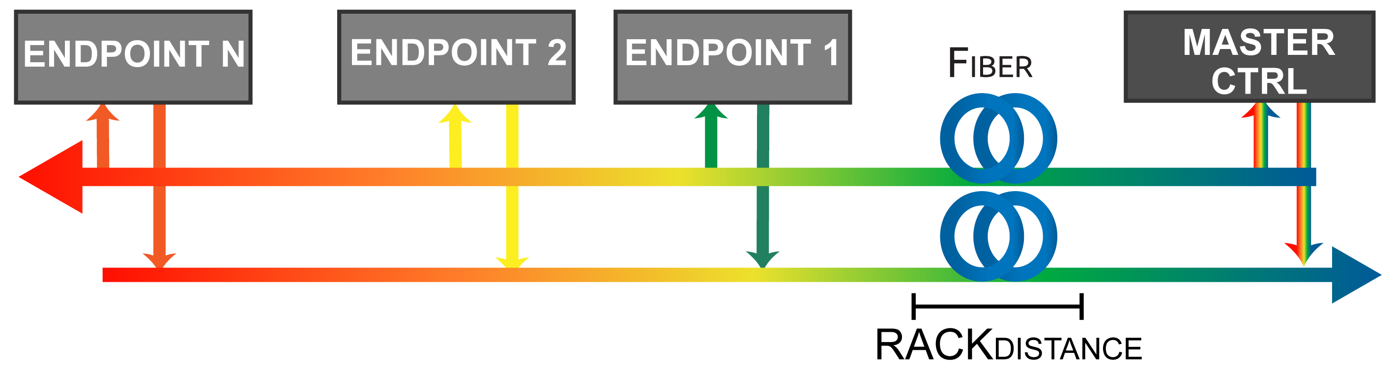
Optically Connected Memory (OCM)
Laser source generates light in multiple wavelengths (λs) simultaneously.
SiP link is bidirectional and composed of sublinks, e.g.: two unidirectional sublinks.
OCM uses a fiber (waveguide) to connect processor and memory, because they are placed at rack distance.
OCM has a SiP link based on state-of-the-art photonic devices.
It has a master controller on the processor side, and enpoint controllers on the DRAM DIMM side.
Each controller is based on Microring Resonators (MRRs)
OCM connects a processor to N-memory channels.
Each channel has a set of DRAM DIMMs, e.g.: two DRAM DIMMs per channel.
Notes:
To Introduce our Optically Connected memory architecture, first we need a processor and DRAM DIMMs grouped in channels. For example, two DIMMs per channel.
OCM uses state of the art optical devices in its Silicon photonic link. The Sip link has a master controller on the processor side and endpoint controllers on the memory side. .
The SiP link is based on Micro ring resonators or MRRs to obtain low energy and area consumption.
It also is bidirectional, and composed of sublinks. The physical connection at rack distances is established with optical fibers.
In addition it is required a Laser source, to produce multiple wavelengths for communication.

Slide 14
Optically Connected Memory (OCM)
OCM uses DWDM to achieve high aggregated bandwidth using multiple wavelength (λs):
- Same λs for all DRAM DIMMs in a memory channel.
- A single fiber can carry multiple λs (requires less wires than an electrical bus).
Notes:
OCM uses the Dense Wavelength Division Multiplexing or DWDM to use the wavelengths and achieve high aggregated bandwidth.
In OCM we use the same wavelengths for all DRAM DIMMs in the same memory channel.
Notice, that with DWDM a single fiber can carry multiple wavelengths at the same time.

Slide 15
oCM Read/Write Operation
Example: CPU to Channel 1
5
1
4
2
3
OCM operation steps:
WR: Store data in DRAM DIMM. RD: Load data and repeat steps 1 to 4 (from DIMM to CPU)
Processor request of Read or Write operation.
Electrical signals to optical domain conversion for TX (Modulation).
Signal propagation through the optical fiber.
1
Optical to electrical conversion at RX (Demodulation).
2
3
4
5

Slide 16
OCM Timing
OCM DDR latency and memory controller latency is the same as conventional DDR.
OCM latency overhead: SERDES latency + Distance propagation
OCM incurs in latency overhead because of:
Signal conversion electrical to/from optical.
Signal propagation latency at rack distance.
Lockstep operation:
Parallel access to DRAM DIMMs in the same memory channel.
Larger cache line size, e.g.: 128B, split into the DRAM DIMMs on the same channel.
Allow to reduce the latency overhead.
Notes:
The memory access latency on a conventional system results of sum up the (read or write latency) inside the module and the controller latency.
In a disaggregation system with OCM we need to consider the time of Serialization and Deserialization , this is the conversion from different domain …. electrical to optical or viceversa .
We also consider the signal propagation delay at rack distances.
To alleviate those latencies, OCM performs parallel access to the DRAM DIMMs in the same channel and increase the SiP link usage
OCM works in lockstep operation by splitting the cache line in all the DIMMs con the same channel.
For example a 128B line can be divided in two DIMMs.

Slide 17
Outline
Introduction
Background
Motivation and Goal
Optically Connected Memory (OCM)
Evaluation
Conclusion

Slide 18
Experimental Setup
System-level performance: modified version of ZSIM simulator.
Benchmarks: SPEC06, SPEC17, Parsec, Splash, GAPS
Baseline | Processor | 3 GHz, 8 cores, 128B cache lines
 | Cache | 32KB L1(D+I), 256KB L2, 8MB L3
MemConf1 | Mem | 4 channels, 2 DIMMs/channel, DDR4-2400
MemConf2 | Mem | 1 channel, 2 DIMMs/channel, DDR4-2400
 | DRAM cache | 4GB stacked, 4-way, 4K pages, FBR, DDR4-2400
OCM | SERDES | latency: 10 - 340 cycles
 | Fiber | latency: 30/60/90 cycles (2/4/6 meters roundtrip)
NIC | 40G PCIe | latency: 1050 cycles
Setup Parameters
CPU
DRAM
MemConf1
without
DRAM Cache
Interconnect
MemConf2
with
DRAM Cache
CPU
Interconnect
DRAM
DRAM CACHE
SiP link evaluation: custom model in our PhoenixSim simulator [Rumley+, AISTECS’16].
Modified to sustain current DDR4-2400 memory systems.
Notes:
We evaluate the system level performance of our OCM architecture, using a modified ZSIM simulator, and execute: two versions of SPEC, parsec, and a graph benchmark suite.
We crate two memory scenarios, one without a DRAM cache, and the other with a 4GB in package DRAM cache (to the processor).
We use a multicore processor and we compared performance with three types of interconnect:
The baseline interconnect, which represents the conventional memory bus - not disaggregated
The OCM interconnect for disaggregation
A NIC-based interconnect for disaggregation

Slide 19
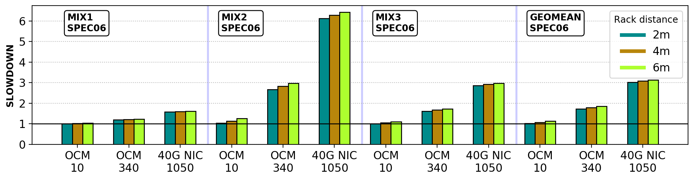
Results MemConf1 w/out DRAM Cache
SPEC06
Lower delay is close to baseline performance
Latency
(Cycles)
As expected higher OCM latency degrades performance.
Average slowdown is 1.07x with the optimistic scenario.
Average slowdown is 1.78x with the worst-case scenario.
OCM is up to 5.5x faster than 40G NIC.
Notes:
Our results without DRAM cache, as expected show that higher OCM latency and larger distances desgrades performance. Each bar inside a group represents a different latency, where the light green at the right is 6m.
On average OCM is 5.5x faster than 40G Nic based disaggregation.
OCM showed an Average slowdown is 1.07x with with minimum latency of 10 cycles.
Average slowdown is 1.78x with with maximum latency of 340 cycles.

Slide 20
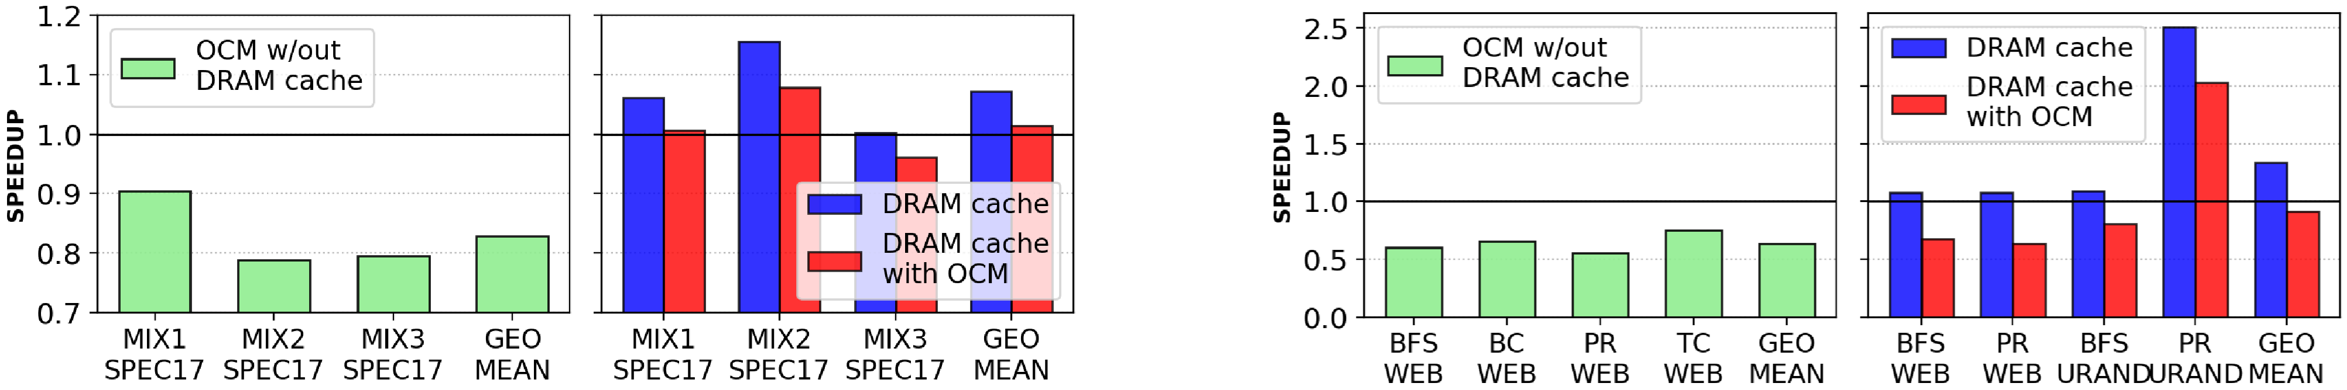
Results MemConf2 with DRAM Cache
GAPS
20% higher
10% Average
slowdown
For most of the benchmarks, OCM has less than 38% slowdown.
PR with Urand input graph exhibits > x2 speedup on both OCM and non-disaggregated scenario.
Notes:
In this figure we can observe the results of a disaggregated system with OCM with DRAM cache. It shows an average slowdown of 10%, and for most oof the benchmarks, OCM has less than 38% slowdown.
We also observe an application (pagerank with the urand input graph) that exhibits speedup on both non and disaggregated scneharios, with a 20% slowdown with OCM.

Slide 21
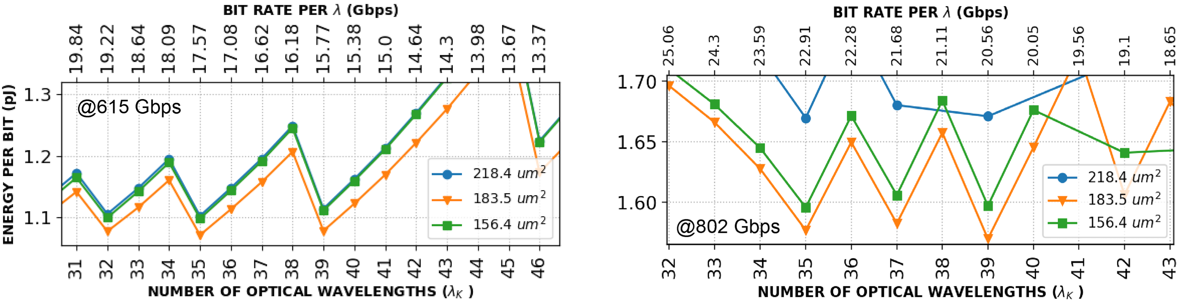
SiP Link Results
Lowest energy
consumption
1.07 pj/bit @ 615 Gbps
For both Gbps rates, 183.5 um² rings have the lowest energy consumption.
DDR4-2400 bandwidth: 2x615 Gbps link: 35 wavelengths (MRRs) @ 17.57 Gbps.
Notes:
This figure shows the energy-per-bit results of the SiP link operating at 615 Gbps, which is the DDR4 standard.
We evaluated three MRRs sizes represented in three colors blue orange and green.
We observe that the the lowest energy consumption was obtained with the 183.5 squared micrometer rings (the orange one). This results allow to determine the number of MRRs and the maximum bit rate per wavelength with DWDM.
For DDR4 technology standards we need two SiP links. Each with 35 wavelengths with a bit rate per wavelength of 17.6

Slide 22
Additional details in the paper:
More OCM architecture details in the paper:
Timing diagram and operation.
More results in the paper:
Measured memory footprint.
Multithreaded results.
Multiprogrammed results.
Additional SiP link configuration.
Notes:
Please refer to our paper for additional details.
We included ….

Slide 23
Outline
Introduction
Background
Motivation and Goal
Optically Connected Memory (OCM)
Evaluation
Conclusion

Slide 24
Conclusion
We proposed and evaluated Optically Connected Memory (OCM), a new optical architecture for disaggregated main memory systems, compatible with current DDR DRAM technology.
We made three key observations:
OCM has low energy overhead of only 10.7% compared to DDR DRAM data movement energy consumption.
OCM performs x5.5 faster than a 40G NIC- based disaggregated memory.
OCM can fit the bandwidth requirements of commodity DDR4 DRAM modules.
We conclude that OCM is a promising step towards future data centers with disaggregated main memory.

Slide 25
Optically Connected Memory for Disaggregated Data Centers
Jorge Gonzalez¹ Alexander Gazman² Maarten Hattink² Mauricio G.Palma¹
Meisam Bahadori³ Ruth Rubio-Noriega⁴ Lois Orosa⁵
Madeleine Glick² Onur Mutlu⁵ Keren Bergman² Rodolfo Azevedo¹
1
2
3
4
5
LSC
SAFARI

Slide 26
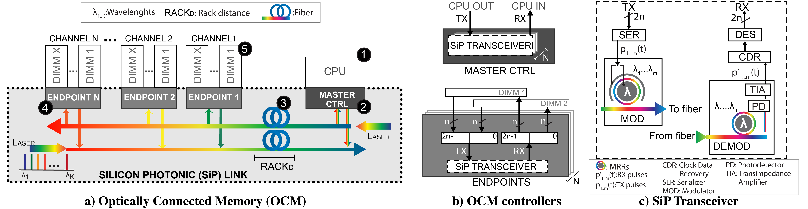
Sip Link Controllers and Transceivers
SiP link design based on state-of-the art devices [Bahadori+, JLT’16], [Bahadori+, JLT’18], [Bahadori+, OI’16] , [Polster+, TVLSI’16]
Controllers have transceivers:
- Master, on the processor side.
- Endpoint, on the DRAM DIMM
A transceiver is a microring resonator (MRR) array for TX (modulators) and RX (demodulators).

Slide 27
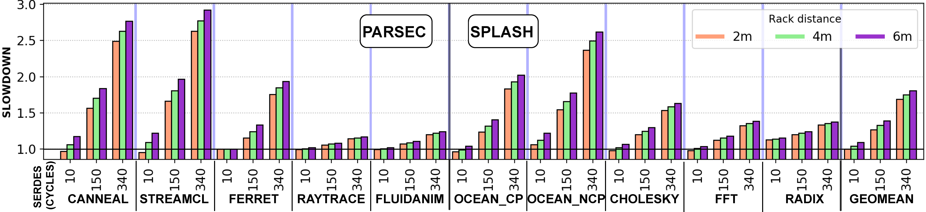
Results MemConf1 w/out DRAM Cache
Average slowdown is 1.3x for Splash2x and 1.4x for Parsec.
Computing bound applications
x2.97 Highest slowdown
Memory bound applications

Slide 28
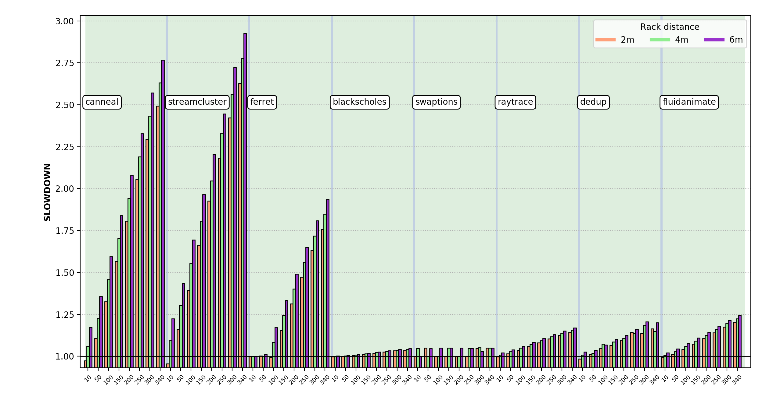
PARSEC with OCM
Memory bound applications
Computing bound applications
SERDES (cycles)
Lower delay is close to baseline performance
Latency
(Cycles)
10 - 340

Slide 29
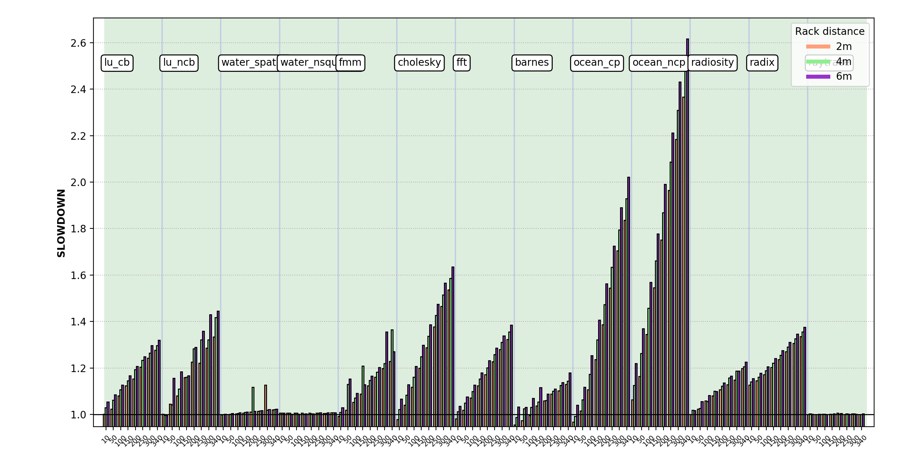
SPLASH with OCM
Memory bound applications
Computing bound applications
Lower delay is close to
baseline performance
SERDES (cycles)
Latency
(Cycles)
10 - 340

Slide 30
Results MemConf2 with DRAM Cache
SPEC17
50% lower
Max slowdown
GAPS
For most of the benchmarks, OCM has less than 38% slowdown.
PR with Urand input graph exhibits > x2 speedup on both OCM and non-disaggregated scenario.

Slide 31
Results MemConf2 with DRAM Cache
GAPS
20% lower
Max slowdown
For most of the benchmarks, OCM has less than 38% slowdown.
PR with Urand input graph exhibits > x2 speedup on both OCM and non-disaggregated scenario.
Notes:
In the left figure we can observe the results of a disaggregated system with OCM and without DRAM cache. All results show slowdown.
In the figure to the right we can observe the results of a disaggregated system with OCM with DRAM cache. With a DRAM Cache the slowdown is lower than the results of the left. With a max slowdown of 45 % as marked with an arrow in the second group of bars.
We also observe an application (pagerank with the urand input graph) that exhibits speedup on both non and disaggregated scneharios, with a 20% slowdown with OCM.

Slide 32
SiP Link Results
1.07 pj/bit @ 615 Gbps
Lowest energy
consumption
1.57 pj/bit @ 802 Gbps
For both Gbps rates, 183.5 um² rings consume the lowest energy.
615 Gbps link: 35 wavelengths (MRRs) @ 17.57 Gbps. Area overhead: 51.4E-3 mm²
802 Gbps link: 39 wavelengths (MRRs) @ 20.56 Gbps. Area overhead: 57.3E-3 mm²

