Slide 1



AVPP:
Address-first Value-next Predictor
with Value Prefetching for Improving the Efficiency of Load Value Prediction
Lois Orosa, Rodolfo Azevedo and Onur Mutlu

Slide 2
Executive Summary
Motivation: single-thread performance is critical for many applications
Problem: improving single-thread performance in modern processors requires techniques that significantly increase the hardware cost
Goal: revisit Load Value Prediction as an efficient way to improve single-thread performance
Contributions:
We propose optimizations for reducing the hardware cost of load value prediction
We propose a new taxonomy of Value Prediction Policies
AVPP:
New load value predictor that predicts the address first and the value next.
Increases the coverage of the predictor by prefetching the value of a future instance of the load instruction
Results:
AVPP outperforms all state-of-the-art value predictors in the context of load value prediction, and it is less complex than predicting all instructions
AVPP provides 11.2% system performance improvement and 3.7% energy savings compared to no value prediction.
Notes:
To begin, I will give a brief overview. [CLICK] many applications are limited by the single thread performance. [CLICK] The problem is that achieving performance benefits require significant hardware cost [CLICK] The goal is to revisit load value prediction as a low cost alternative to improve single-thread performance. We propose [CLICK] AVPP, a mechanism

Slide 3
AVPP Outline
Motivation and Goal
Motivation and Goal
Background
Reducing Hardware Complexity
Taxonomy of Value Prediction
Mechanism: AVPP
Evaluation and Results
Conclusion
Notes:
Here is the outline for the talk today [CLICK]

Slide 4
AVPP Outline
Motivation and Goal
Motivation and Goal
Background
Reducing Hardware Complexity
Taxonomy of Value Prediction
Mechanism: AVPP
Evaluation and Results
Conclusion
Notes:
Here is the outline for the talk today [CLICK]

Slide 5
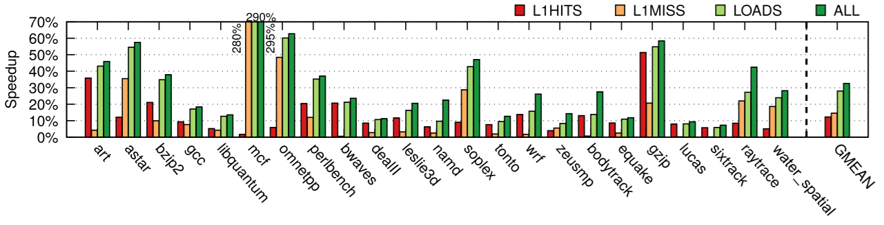
Motivation and Goal
True data dependencies limit single-thread performance significantly
We simulate an oracle predictor that predicts the output of instructions correctly:
We observe that an oracle predictor achieves almost the same performance predicting load instructions as predicting all instructions
Predicting all instructions requires large predictors
Our goal is revisit Load Value Prediction as a low-cost alternative to improve single-thread performance
28%
32%

Slide 6
AVPP Outline
Motivation and Goal
Motivation and Goal
Background
Reducing Hardware Complexity
Taxonomy of Value Prediction
Mechanism: AVPP
Evaluation and Results
Conclusion
Notes:
Here is the outline for the talk today [CLICK]

Slide 7
Background: Value Prediction
True Data Dependency:
instr_0: A = B + 1
instr_1: C = A + 3
Read-After-Write (RAW)
Depends on the result of the previous instruction
Value Prediction breaks true data dependencies by predicting values and performing speculative execution
Prediction: the output value of instr_0 (A)
Speculation: executes instr_1 using the predicted value of A
instr_0 and instr_1 are executed in parallel
Requires a Rollback mechanism to recover from mispredictions

Slide 8
State-of-the-art Value Predictors
Last Value Predictor (LVP) [Lipasti+ MICRO’96]
The predicted value is the last value
Stride Predictor (Stride) [Mendelson+ TR’96]
The predicted value is the last value + stride
2D-Stride [Eickemeyer+ IBM Journal’93]: variant that improves performance in loops
Finite Context Method (FCM) predictor [Sazeides+ TR’97]
Context based predictor
Large prediction tables
D-FCM [Goeman+ HPCA’01]: variant that uses strides
VTAGE [Perais+ HPCA’14]
Uses global branch history
D-VTAGE [Perais+ HPCA’15]: variant that uses strides
Notes:
Add figure to explain one of then

Slide 9
AVPP Outline
Motivation and Goal
Motivation and Goal
Background
Reducing Hardware Complexity
Taxonomy of Value Prediction
Mechanism: AVPP
Evaluation and Results
Conclusion
Notes:
Here is the outline for the talk today [CLICK]

Slide 10
Reducing Hardware Complexity
Predicting only load instructions instead of predicting all instructions has some advantages:
Decrease the hardware cost: we show that load value predictors have a smaller area footprint
Less pressure over shared resources (e.g., Physical Register File): we show how to reduce the number of ports in the paper
We leverage the Load Queue for implementing load value prediction
Load Instructions are 25% of all instructions on average
Small modifications to support Load Value Prediction
Notes:
Add figure to explain one of then

Slide 11
Previous Works on Reducing Complexity of Value Prediction
Value prediction for all instructions:
Work
[Perais+ HPCA’14]
EOLE [Perais+ ISCA’14]
BeBOP
[Perais+ HPCA’15]
[Perais+ MICRO’16]
Predictor Entries
8192
8192
2048
2048
Speedup
~10%
~10%
11.2%
5%
Main contribution for reducing complexity
- Introduces Confidence
-
Reduces the extra ports
Single predictor entry for a
-
Register reuse
Counters
required on the PRF
cache line
-
Low hardware cost
- Simple mechanism to
-
Increases the
recover from
complexity of the in-order
value mispredictions
front-end and back-end
AVPP
512
11.2%
Minimal hardware Modifications to an OoO processor
Load Value Prediction:
Notes:
Add figure to explain one of then

Slide 12
AVPP Outline
Motivation and Goal
Motivation and Goal
Background
Reducing Hardware Complexity
Taxonomy of Value Prediction
Mechanism: AVPP
Evaluation and Results
Conclusion
Notes:
Here is the outline for the talk today [CLICK]

Slide 13
Taxonomy of Value Prediction Policies
We propose a new taxonomy for analyzing value prediction design choices
Predictor update
Prediction availability
In-flight pending updates

Slide 14
Taxonomy: Predictor Update Policies
Where is the predictor updated in the pipeline?
Correct update:
The predictor is updated at the commit stage
Speculative update:
The predictor is updated at the fetch stage

Slide 15
Taxonomy: Prediction Availability Policies
What happens when the prediction is not ready at dispatch time?
Delay dispatch
The pipeline is stalled waiting for the prediction
Not-delay dispatch
The prediction is discarded

Slide 16
Taxonomy: In-flight Pending Update Policies
What happens with back-to-back predictions?
In-flight ignore
The predictor ignores previous in-flight instructions
In-flight wait
The predictor waits for previous in-flight instructions to update the predictor

Slide 17
Taxonomy
We evaluate different combinations of these policies for all predictors we evaluate

Slide 18
AVPP Outline
Motivation and Goal
Motivation and Goal
Background
Reducing Hardware Complexity
Taxonomy of Value Prediction
Mechanism: AVPP
Evaluation and Results
Conclusion
Notes:
Here is the outline for the talk today [CLICK]

Slide 19
AVPP: Address-first Value-next Value Predictor
with Data Prefetching
Observations:
Predicting load instructions has almost the same potential performance benefits as predicting all instructions
Addresses are usually more predictable than values
Key Ideas:
Predict only load instructions to reduce hardware cost
Leverage the better predictability of addresses on load instructions to improve performance

Slide 20
AVPP: Predictor Overview
Two main hardware structures:
Address Table (AT):
Implemented with any predictor
Indexed by the load instruction address
Calculates the predicted address
2. Value Table (VT):
Indexed by the predicted address
Returns the predicted value
1
2
3
LD instruction
address
Predicted
address
Predicted
value
AT
VT
AT entry
VT entry
AT predictor entry
Confidence
pdis
d
tag
value
3bits
3bits
1bit

Slide 21
AVPP: Prediction Overview (II)
AVPP predicts the output of every load instruction
The prediction happens in the front-end of the pipeline
Confidence mechanism to improve accuracy [Perais+ HPCA’14]
If the prediction is confident, write the result in the target register
Speculatively execute all the dependent instructions
1
2
3
LD Instruction
address
Predicted
address
Predicted
value
AT
VT
1
2
3
Load
Front-end
Exec. (OoO)
Commit
3
4
1
2
3
TIME
Dependent
instruction
4
Front-end
Exec. (OoO)
Commit

Slide 22
AVPP: Update Overview
Update the AT at commit of every load instruction
Update the VT:
At the commit of every store instruction. Keeps the VT coherent with memory
At the commit of every load instruction?
7
Should we update the VT
at the commit of every load instruction ?
9
Load
Front-end
Exec. (OoO)
Commit
Load Address
LD instruction
address
Value
Store Address
5
6
7
AT
VT
TIME
7
9
Store
Front-end
Exec. (OoO)
Commit
Load Address
Store Value
Store Address
8
9
TIME

Slide 23
AVPP: Updating the VT at Each Load Instruction
Correct
predictions :
40: LD [4]
40: LD [8]
40: LD [12]
40: LD [16]
Predictor stage: updating
PC
Instruction
Predictor stage: predicting
0
tag
Last value
Stride
Last addr
addr
value
16
40
8
4
4
-
12
Stride
Predictor
4
10
8+4=12
8
3
12+4=16
12
9
AT
16
13
MISS
VT
HIT
MISS
HIT
MISS
HIT
VT always misses
No valid predictions
tag
val
4
10
8
3
12
9
16
13
L1 Cache

Slide 24
AVPP: Prefetching Overview
Idea: Prefetch values from the memory hierarchy into VT to increase the VT hit ratio
The prefetch address is calculated at each address prediction
Generated when the prediction is confident
Predicted to be accessed by future instances of the same load instruction
Dynamic prefetch distance (details in the paper)
The VT is updated with the prefetched values
3
4
The goal of prefetching is to increase the predictor coverage, not to hide memory latency
1
2
Prefetch
address
LD Instruction
address
Predicted
address
VT
AT
4
Prefetch
Value
3
Prefetch
address

Slide 25
AVPP: Updating the VT with Prefetching
40: LD [4]
40: LD [8]
40: LD [12]
40: LD [16]
Predictor stage: updating
PC
Instruction
Predictor stage: predicting
tag
Last value
Stride
Last addr
addr
value
16
40
8
4
4
-
12
Stride
Predictor
12+4=16
8+4=12
Correct
predictions :
12
9
0
1
2
16
13
20
2
HIT
HIT
HIT
AT
VT
HIT
HIT
MISS
Valid Predictions
VT hits because we prefetch the right values into it
tag
val
4
10
8
3
12
9
16
13
20
2
L1 Cache

Slide 26
AVPP: Putting All Together
Leverages the better predictability of addresses on load instructions to improve performance
Two basic hardware structures:
AT: predicts the address first
VT: predicts the value next
Prefetches future instances of the load instruction to improve the VT hit rate

Slide 27
AVPP Outline
Motivation and Goal
Motivation and Goal
Background
Reducing Hardware Complexity
Taxonomy of Value Prediction
Mechanism: AVPP
Evaluation and Results
Conclusion
27
Notes:
Here is the outline for the talk today [CLICK]

Slide 28
Experimental Setup
Simulation platform:
ZSIM [Sanchez+ ISCA’13] : 4-issue OoO cores, TAGE branch predictor, 128-entry ROB, 32KB L1 caches, 256KB L2s, Stream prefetchers
McPAT [Li+ MICRO’09] for estimating the energy consumption
Predictors evaluated:
LVP, 2D-Stride, DFCM, VTAGE, DVTAGE, AVPP-DVTAGE, AVPP-Stride
512 entries
23 selected benchmarks from
SPEC2000
SPEC2006
PARSEC/SPLASH2

Slide 29
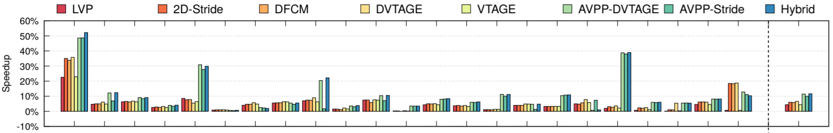
Evaluation: Speedup
5.9%
11.2%
AVPP outperforms the state-of-the-art predictors
11.2% speedup over no value prediction

Slide 30
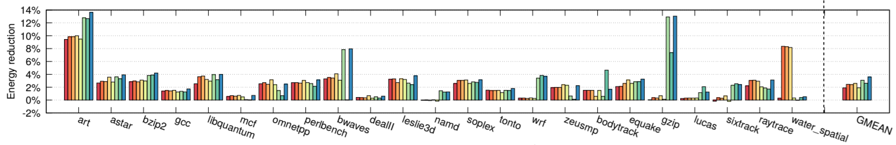
Evaluation: Energy
2.6%
3.7%
AVPP outperforms the state-of-the-art predictors
3.7% energy savings over no value prediction

Slide 31
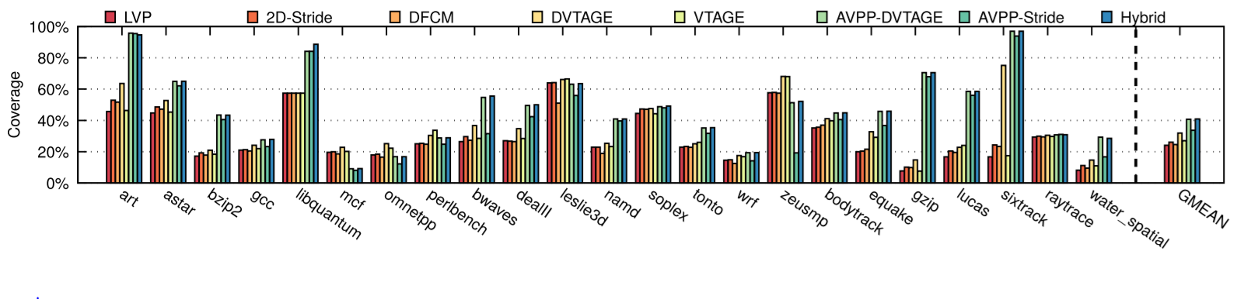
Coverage of the Load Value Predictors
36%
44%
AVPP covers more load instructions than the state-of-the-art
AVPP covers 44% of the load instructions
Coverage of a predictor: percentage of loads for which a prediction is used for speculation

Slide 32
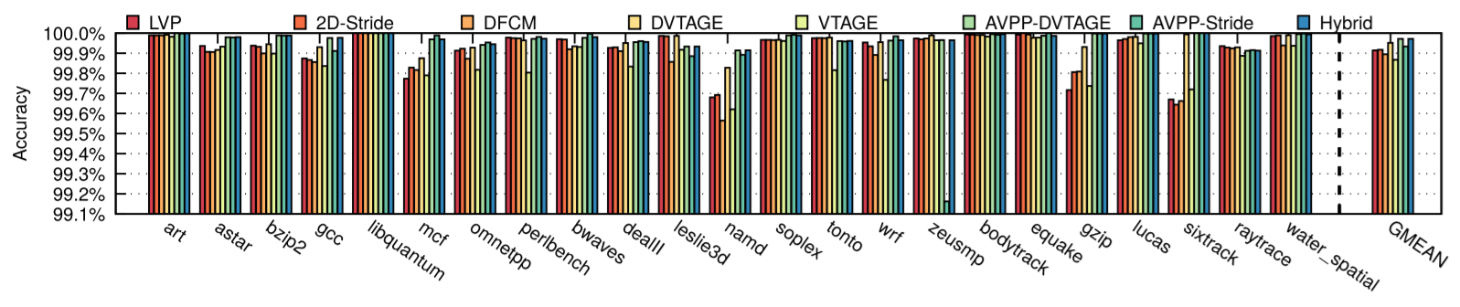
Evaluation: Accuracy
Accuracy is higher than 99.8% in all predictors
because of the use of the confidence counters

Slide 33
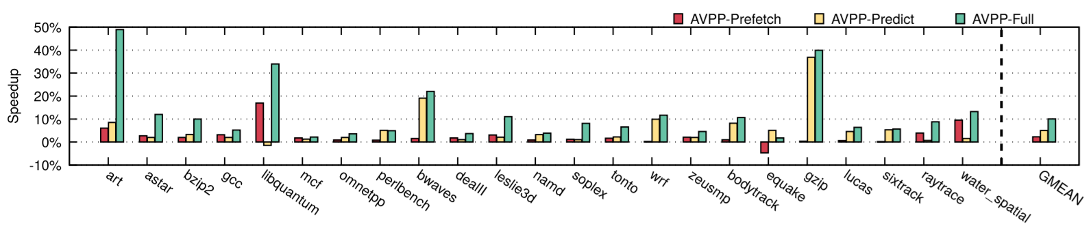
Where are the Benefits Coming from?
1.8%
4.8%
10.6%
AVPP prefetching alone does not provide significant performance improvement
AVPP prediction alone provides only 4.8% speedup
The full AVPP achieves 10.6% speedup

Slide 34
More Results in the Paper
Multi-core simulations
Cache hit distribution
Distribution of the prefetch request that hits in L1, L2 and main memory
Sensitivity studies on
Memory hierarchy (larger caches)
Load Queue size
Impact of different load value prediction implementation policies

Slide 35
AVPP Outline
Motivation and Goal
Motivation and Goal
Background
Reducing Hardware Complexity
Taxonomy of Value Prediction
Mechanism: AVPP
Evaluation and Results
Conclusion
Notes:
Here is the outline for the talk today [CLICK]

Slide 36
Executive Summary
Motivation: single-thread performance is critical for many applications
Problem: improving single-thread performance in modern processors requires techniques that significantly increase the hardware cost
Goal: revisit Load Value Prediction as an efficient way to improve single-thread performance
Contributions:
We propose optimizations for reducing the hardware cost of load value prediction
We propose a new taxonomy of Value Prediction Policies
AVPP:
New load value predictor that predicts the address first and the value next.
Increases the coverage of the predictor by prefetching the value of a future instance of the load instruction
Results:
AVPP outperforms all state-of-the-art value predictors in the context of load value prediction, and it is less complex than predicting all instructions
AVPP provides 11.2% system performance improvement and 3.7% energy savings compared to no value prediction.
Notes:
To begin, I will give a brief overview. [CLICK] many applications are limited by the single thread performance. [CLICK] The problem is that achieving performance benefits require significant hardware cost [CLICK] The goal is to revisit load value prediction as a low cost alternative to improve single-thread performance. We propose [CLICK] AVPP, a mechanism

Slide 37
AVPP:
Address-first Value-next Predictor
with Value Prefetching for Improving the Efficiency of Load Value Prediction
Lois Orosa, Rodolfo Azevedo and Onur Mutlu

Slide 38
BACKUP

Slide 39
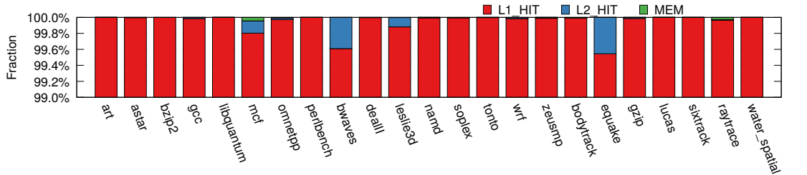
Cache Hit Distribution
of the predicted load instructions
Most of the predicted load instructions
hit into L1 cache

Slide 40
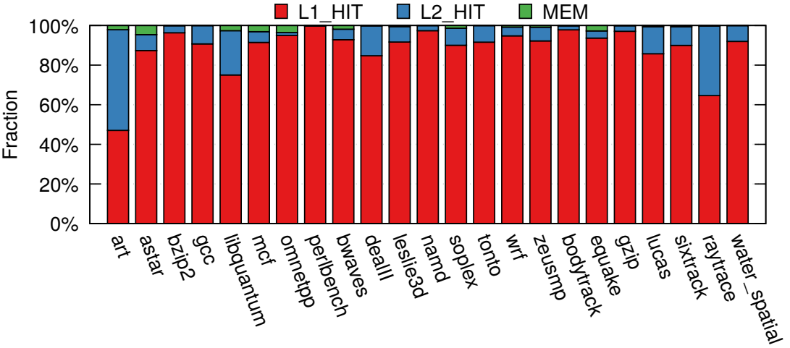
Cache Hit Distribution
of AVPP-DVTAGE prefetch requests
Most of the AVPP prefetch requests hit into L1 cache

Slide 41
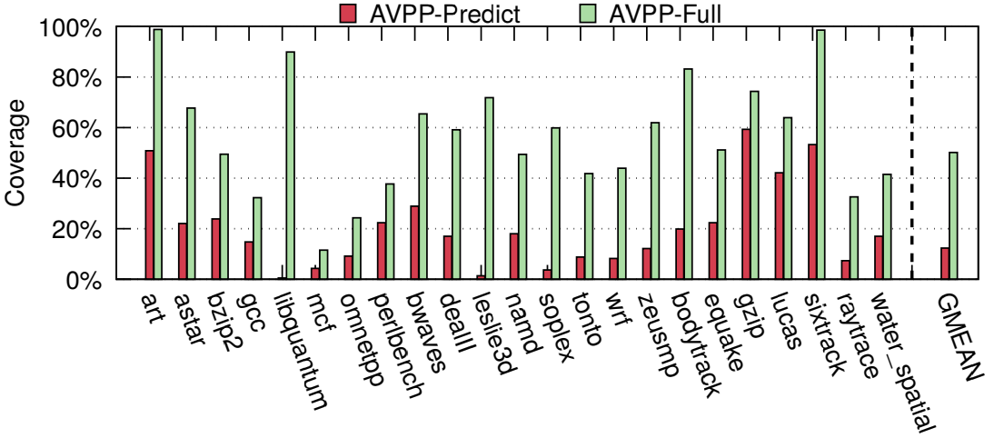
Coverage of AVPP-DVTAGE
with and without prefetching
The coverage of the predictor
largely improves with prefetching

Slide 42
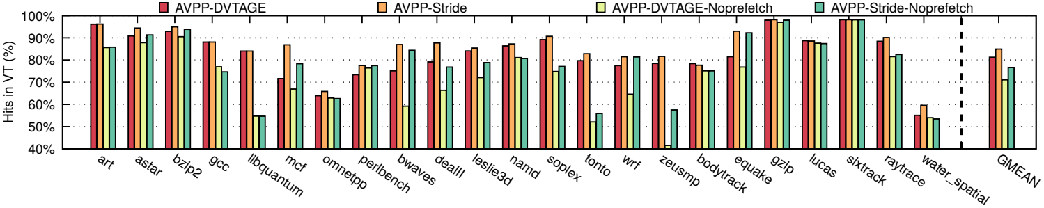
VT hit rate with and without prefetching
Prefetching increases the VT hit rate

Slide 43
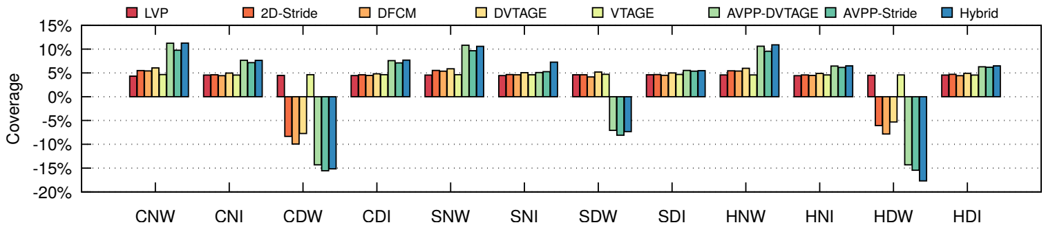
Impact of the Prediction Policies
The best policy depends on the microarchitecture

Slide 44
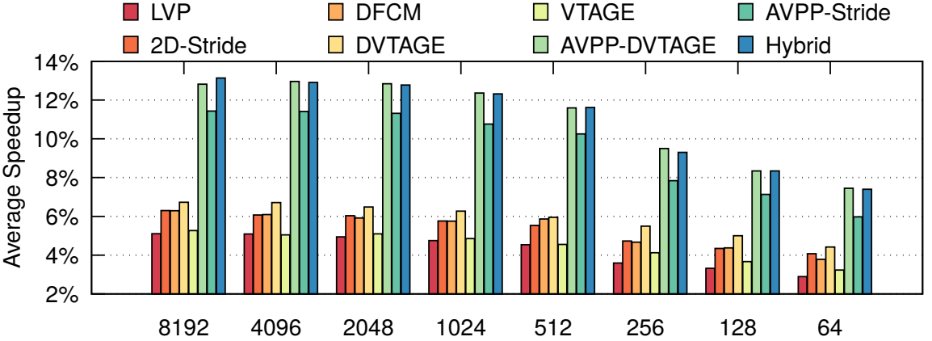
Impact of the Predictor Size
512 entries is a sweet spot

Slide 45
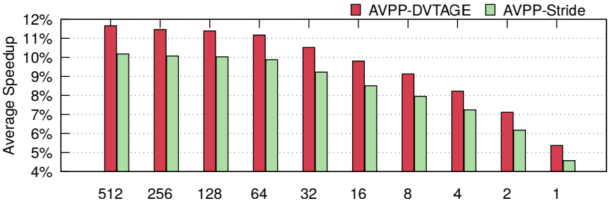
Impact of the VT Table Size
64 VT entries is a sweet spot

Slide 46
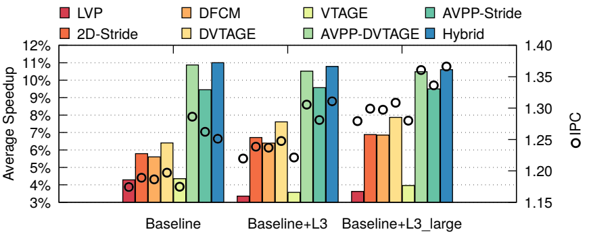
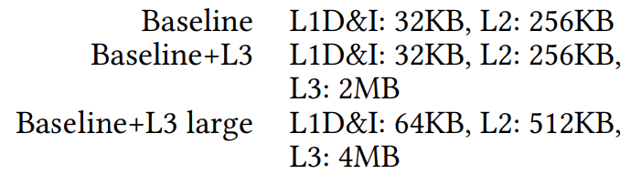
Impact of Cache Configurations
The speedup of load value prediction does not depend much on the cache configuration

Slide 47
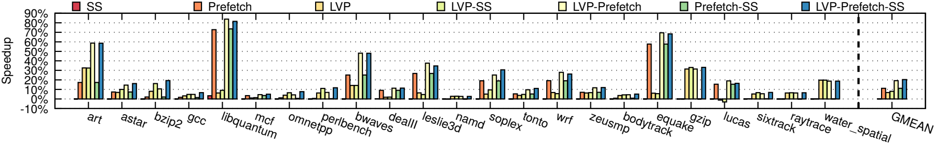
Store Set Prediction
and L2 Prefetching
The L2 Prefetcher and Load Value Prediction (LVP) are complementary

Slide 48
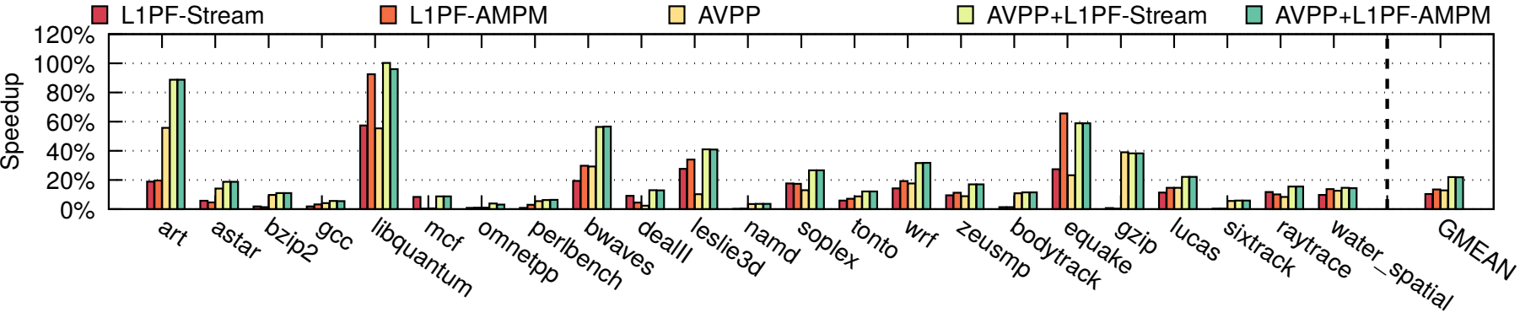
L1 prefetching VS AVPP
When AVPP and L1 prefetcher are used together
the performance is additive in many benchmarks

Slide 49
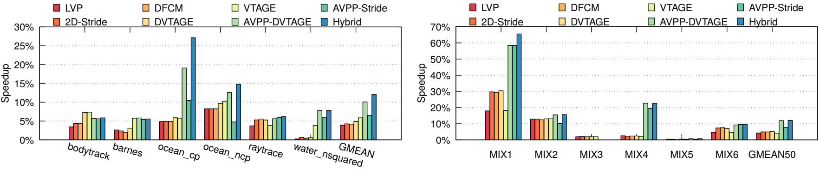
Multithreaded and Multiprogram Mixes
AVPP outperforms previous predictors

