Slide 1



D-RaNGe: Using Commodity DRAM Devices to Generate True Random Numbers with Low Latency and High Throughput
Jeremie S. Kim Minesh Patel
Hasan Hassan Lois Orosa Onur Mutlu
Notes:
20 Minute talk 5 minute questions
Hello, my name is Jeremie Kim and I will be presenting D-RaNGe: a mechanism that uses commodity DRAM devices to generate true random numbers with low latency and high throughput

Slide 2
Executive Summary
Motivation: High-throughput true random numbers enable system security and various randomized algorithms.
Many systems (e.g., IoT, mobile, embedded) do not have dedicated True Random Number Generator (TRNG) hardware but have DRAM devices
Problem: Current DRAM-based TRNGs either
do not sample a fundamentally non-deterministic entropy source
are too slow for continuous high-throughput operation
Goal: A novel and effective TRNG that uses existing commodity DRAM to provide random values with 1) high-throughput, 2) low latency and 3) no adverse effect on concurrently running applications
D-RaNGe: Reduce DRAM access latency below reliable values and exploit DRAM cells’ failure probabilities to generate random values
Evaluation:
Experimentally characterize 282 real LPDDR4 DRAM devices
D-RaNGe (717.4 Mb/s) has significantly higher throughput (211x)
D-RaNGe (100ns) has significantly lower latency (180x)
Notes:
To begin, I will give a brief overview. [CLICK] Our motivation is that high throughput true random numbers enable system security, and various randomized algorithms.
[CLICK] Unfortunately, many systems like IoT, mobile, and embedded systems do not have dedicated true random number generator (TRNG) hardware. However, they do have DRAM devices, on which a few recent papers have proposed generating true random numbers on.
[CLICK] The problem is that current DRAM-based TRNGs either [CLICK] do not sample a fundamentally non-deterministic entropy source, which may not result in true random numbers, or [CLICK] they are too slow for continuous high-throughput operation
[CLICK] Our goal is to develop a novel and effective TRNG for existing commodity DRAM devices that can provide continuous high-throughput random values at low latency while minimally affecting concurrently running applications.
[CLICK] We propose D-RaNGe, a high-throughput TRNG that reduces DRAM access latency below reliable values and exploits DRAM cell failure probabilities to quickly generate random values
[CLICK] In our evaluation
[CLICK] we experimentally characterize 282 real LPDDR4 DRAM devices and [CLICK] find that D-RaNGe provides random values at over 700 Mb/s which is orders of magnitude over prior DRAM-based TRNGs [CLICK] In addition, D-RaNGe can provide 64 bits of random data in 100 ns which is 180x faster than prior proposals

Slide 3
D-RaNGe Outline
Motivation
Effective True Random Number Generators
D-RaNGe
DRAM Operation
Key Idea
Methodology
Results
Prior work on DRAM-based TRNGs
Command scheduling
Cell charge retention
Start-up values
Summary
Notes:
Here is the outline for the talk today

Slide 4
D-RaNGe Outline
Motivation
Effective True Random Number Generators
D-RaNGe
DRAM Operation
Key Idea
Methodology
Results
Prior work on DRAM-based TRNGs
Command scheduling
Cell charge retention
Start-up values
Summary
Notes:
I will first discuss the Motivation of the work

Slide 5
Motivation and Goal
High throughput True Random Numbers are required for many real-world applications
Importantly cryptography for securely encrypting file systems, network packets, data in standard protocols (TLS/SSL/RSA…)
Others include randomized algorithms, scientific simulation, statistical sampling, recreational entertainment
True random numbers can only be generated via physical processes
e.g., radioactive decay, thermal noise, shot noise
Systems rely on dedicated TRNG Hardware that samples non-deterministic various physical phenomena
Notes:
[CLICK] high throughput True random numbers are required for many real world applications
[CLICK] These applications include cryptography for securely encrypting file systems, network packets, data in standard protocols such as TLS, SSL, RSA, etc.
[CLICK] others include randomized algorithms, scientific simulation, statistical sampling, industrial testing, recreational entertainment, etc.
[CLICK] True random numbers can only be generated from physical processes [CLICK] such as shot noise, electrical noise, thermal noise, radioactive decay, Brownian motion, etc.
[CLICK] For this reason, systems generally rely on dedicated TRNG Hardware that samples non-deterministic random variables that are inherent in various physical phenomena

Slide 6
Motivation and Goal
Smaller devices (e.g., IoT, mobile, embedded) require, but often lack, a high throughput True Random Number Generator (TRNG)
DRAM devices are available on most systems
Mechanism that generates TRN using DRAM enables:
applications that require true random numbers to now run on most systems
other use-cases, e.g., processing-in-memory applications to generate true random numbers within memory itself
Our Goal: to provide a TRNG using DRAM devices that satisfies the characteristics of an effective TRNG
Notes:
[CLICK] Unfortunately, smaller devices such as IoT, mobile or embedded devices that may not have the provisions for dedicated True random number generator or TRNG hardware, require a high-throughput TRNG to enable the previously mentioned applications
[CLICK] However, DRAM devices are available on most systems
[CLICK] A TRNG that generates true random numbers using DRAM, would enable
[CLICK] applications that require true random numbers to now run on most systems and
[CLICK] other applications and use cases. One example would be PIM applications generating true random numbers within memory itself
[CLICK] Our goal is to therefore provide a TRNG that uses DRAM devices and satisfies the characteristics of an effective TRNG.

Slide 7
D-RaNGe Outline
Motivation
Effective True Random Number Generators
D-RaNGe
DRAM Operation
Key Idea
Methodology
Results
Prior work on DRAM-based TRNGs
Command scheduling
Cell charge retention
Start-up values
Summary
Notes:
I will discuss these characteritstics next.

Slide 8
Effective TRNG Characteristics
Low implementation cost
Fully non-deterministic
impossible to predict the next output given complete information about how the mechanism operates
Provide a continuous stream of true random numbers with high throughput
Provide true random numbers with low latency
Exhibit low system interference
not significantly slow down concurrently-running applications
Generate random values with low energy overhead
Notes:
We identify 6 effective TRNG characteristics that we want our proposal to satisfy.
[CLICK] it should have a Low implementation cost. A mechanism that requires little or no changes to current systems and minimal additional area overhead.
[CLICK] it should be Fully non-deterministic which can be guaranteed by sampling a truly random physical phenomena, so it is impossible to predict the next output given complete information about how the mechanism operates.
[CLICK] It should provide a continuous stream of true random numbers with high throughput
[CLICK] it should provide true random numbers with low latency such that applications do not have to stall when requesting random values.
[CLICK] it should exhibit low system interference, which means that it should not significantly slow down concurrently-running applications
Finally, [CLICK] it should generate random values with low energy overhead

Slide 9
D-RaNGe Outline
Motivation
Effective True Random Number Generators
D-RaNGe
DRAM Operation
Key Idea
Methodology
Results
Prior work on DRAM-based TRNGs
Command scheduling
Cell charge retention
Start-up values
Summary
Notes:
I will now discuss our mechanism D-RaNGe, after providing the necessary background on DRAM

Slide 10
DRAM Organization
A DRAM bank is hierarchically organized into subarrays
local
bitline
DRAM cell
wordline
DRAM Bank
DRAM row
Columns of cells in subarrays share a local bitline
Rows of cells in a subarray share a wordline
Notes:
[CLICK] Each DRAM bank is hierarchically organized into subarrays. [CLICK] Each circle in the cartoon represents a single DRAM cell. [CLICK] columns of DRAM cells in a subarray are connected with a wire referred to as a local bitline. [CLICK] and rows of DRAM cells are connected with a wire referred to as a wordline, and [CLICK] a row of DRAM cells is called a DRAM row. [CLICK] at the peripherals of the core cell arrays are a local row decoder, which selects the row to read and write to, and a local row-buffer which amplifies the data that is stored in the cell to an I/O readable value. [CLICK] DRAM is comprised of many subarrays which are often composed of 512 to 1024 rows. Further peripherals exist containing groups of subarrays called [CLICK] a bank. The global row decoder selects the local row decoder that will drive the wordline, and global row buffer aids in the transfer of data to and from the CPU. A DRAM device is comprised of several banks, and each bank can be accessed independently [CLICK]

Slide 11
DRAM Operation
Cache line
…
Row Decoder
…
…
…
…
…
Local Row Buffer
Local Row Buffer
Local Row Buffer
READ
READ
READ
READ
READ
READ
ACT R0
RD
RD
RD
PRE R0
ACT R1
RD
RD
RD
Notes:
Let’s take a look at how DRAM operates in the scope of a single subarray. [CLICK] Because memory controllers typically access DRAM at the granularity of a cache line, we combine consecutive, aligned DRAM cells as cache lines in our diagram. [CLICK] First, we activate the first row, which [CLICK] copies the entire rows' data into the row buffer. At this point, we can [CLICK] read our data at the granularity [CLICK] of cache lines within the [CLICK] activated or opened row. When we want to access data on another row, we must precharge [CLICK] the currently opened row, which prepares the row buffer for copying data from another row. We can now [CLICK] activate the second row, before reading data from it [CLICK][CLICK][CLICK]

Slide 12
DRAM Accesses and Failures
wordline
Guardband
Strong
V_{dd}
access
transistor
V_{min}
Weak
Ready to Access
Voltage Level
Process variation during manufacturing results in cells having unique behavior
bitline
Bitline Voltage
Bitline Charge Sharing
capacitor
Sense Amplifier
0.5 V_{dd}
Time
ACTIVATE
SA Enable
READ
t_{RCD}
Notes:
Now Lets take a deeper look at the circuitry to understand access latency failures.
[CLICK] A DRAM cell holds its data as charge in a capacitor and and the access transistor gates reads and writes to the cell data. The data gets read out by the sense amplifier via the bitline when the access transistor is enabled. [CLICK][CLICK] Initially the bitline is kept at Vdd/2. [CLICK] When the wordline is driven high or activated, [CLICK] the capacitor begins to share charge with the bitline. The sense amplifier is then enabled and [CLICK] the voltage differential on the bitline is amplified to an I/O readable value. [CLICK] In order to ensure correctness of operation, the memory controller can only read data tRCD time after the activation. [CLICK] We could read this data earlier, when it reaches a readable voltage threshold (Vmin), [CLICK] but we want to make sure that there is enough guardband such that other cells that may be [CLICK] weaker due to process variation will not fail when accessed tRCD time after activation. [CLICK] We highlight and refer to varying degrees of strengths of cells in terms of how early they reach the readable voltage threshold.

Slide 13
DRAM Accesses and Failures
wordline
Strong
V_{dd}
access
transistor
V_{min}
Weak
Ready to Access
Voltage Level
bitline
Weaker cells have
a higher probability
to fail
Bitline Voltage
capacitor
SA
0.5 V_{dd}
Time
ACTIVATE
SA Enable
READ
t_{RCD}
Notes:
If we are to read with a [CLICK] tRCD reduced below manufacturer-recommended values, we begin to induce latency failures in the weaker cell. Cells that are read when their bitline’s voltage is lower than Vmin, have a probability of failure. And this probability increases as you read further below the voltage threshold.

Slide 14
D-RaNGe Outline
Motivation
Effective True Random Number Generators
D-RaNGe
DRAM Operation
Key Idea
Methodology
Results
Prior work on DRAM-based TRNGs
Command scheduling
Cell charge retention
Start-up values
Summary
Notes:
This leads to our key idea.

Slide 15
D-RaNGe Key Idea
A cell’s latency failure probability is inherently related to random process variation from manufacturing
We can extract random values by observing DRAM cells’ latency failure probabilities
High % chance to fail with reduced t_{RCD}
Low % chance to fail with reduced t_{RCD}
Row Decoder
SA
SA
SA
SA
SA
SA
SA
Notes:
Our key idea is to reduce DRAM read access latency below the reliable datasheet specification values using software-only system calls in order to exploit the resulting error patterns as true random numbers
[CLICK] We find that the probability that a cell will result in a latency failure due to a reduced-tRCD access, is inherently related to random process variation from manufacturing [CLICK] This knowledge enables us to provide random values by observing DRAM cells’ latency failure probabilities.
[CLICK] Here is a cartoon showing the manufacturing variation across a region of DRAM. When accessed with a reduced timing parameter, [CLICK] some cells have a high percentage chance of failing, while others [CLICK] have a low percentage chance of failing.

Slide 16
D-RaNGe Key Idea
A cell’s latency failure probability is inherently related to random process variation from manufacturing
We can extract random values by observing DRAM cells’ latency failure probabilities
The key idea is to extract random values
by sampling DRAM cells that fail
truly randomly
High % chance to fail with reduced t_{RCD}
Low % chance to fail with reduced t_{RCD}
Row Decoder
SA
SA
SA
SA
SA
SA
SA
Notes:
The Key Idea is to extract random values by sampling those DRAM cells that fail truly randomly and using the resulting data as random data.

Slide 17
D-RaNGe: Extracting Random Values
Identify all DRAM cells that fail randomly when accessed with a reduced t_{RCD} (RNG Cell)
When accessing an RNG Cell with a reduced t_{RCD}, the values read will be truly random values
RNG Cell
1
Random values when accessed with t_{RCD} reduced by 45%
1 0010110100110011101000110101
SA
1 0 1 0 1 0 0 1 0 0
Notes:
[CLICK] we first identify all DRAM cells that fail randomly when accessed with a reduced tRCD, and we refer to these as RNG cells. [CLICK]
[CLICK] When accessing an RNG cell with a reduced tRCD, the values read will be truly random values and we can directly use the output as such

Slide 18
D-RaNGe: Identifying RNG Cells
To identify RNG Cells, extract 1M values (bitstream) from each DRAM cell
An RNG Cell is a DRAM cell whose output passes the NIST statistical test suite for randomness
NIST tests [Rukhin+, Tech report, 2001] include tests for:
Unbiased output of 1’s and 0’s across entire bitstream
Unbiased output within smaller segments of the bitstream
Limited number of uninterrupted sequence of identical bits
Peak heights in the discrete fourier transform of bitstream
Even distribution of short sequences within bitstream
Cumulative sum always stays close to zero
…
1 0 1 0 1 0 0 1 0 0
Notes:
[CLICK] to identify RNG cells, we first extract one million values that we will refer to as a bitstream from each DRAM cell.
[CLICK] We then classify each DRAM cell whose output passes the NIST statistical test suite for randomness as RNG cells
[CLICK] the NIST test suite includes tests for:
[CLICK] unbiased output of 1’s and 0’s across the entire bitstream
[CLICK] unbiased output within smaller segments of the bitstream
[CLICK] a limited number of uninterrupted sequences of identical bits
[CLICK] etc. [CLICK][CLICK][CLICK]

Slide 19
D-RaNGe: Access Pattern
To maximize the bits that are accessed immediately following activation, we alternate accesses to distinct rows in each bank
quickly generate tRCD failures within cache lines in two rows
maximizes tRCD failures when using reduced tRCD
Cache line
…
Row Decoder
…
…
…
…
…
Local Row Buffer
Local Row Buffer
Local Row Buffer
READ
READ
READ
READ
Notes:
[CLICK] To maximize the bits that are accessed immediately following an activation, we alternate accesses to distinct rows in a bank.
[CLICK] This access pattern quickly generates tRCD failures within cache lines in two rows
[CLICK] this maximizes tRCD failures when accessing with a reduced tRCD
[CLICK]
[CLICK] we activate the first wordline
[CLICK] and immediately read the cache line from the first row
[CLICK]
[CLICK] we then activate the second wordline
[CLICK]
[CLICK] we then immediately read the cacheline from the second row
[CLICK] [CLICK].... We keep alternating accesses to different rows

Slide 20
D-RaNGe: Access Pattern
To maximize the bits that are accessed immediately following activation, we alternate accesses to distinct rows in each bank
quickly generate tRCD failures within cache lines in two rows
maximizes tRCD failures when using reduced tRCD
Accessing cache lines containing
more RNG cells will result
in more random values
Cache line
…
Row Decoder
…
…
…
…
…
Local Row Buffer
Local Row Buffer
Local Row Buffer
READ
READ
READ
READ
Notes:
[CLICK] Because only cache lines immediately read after activation result in failures, Cache lines containing more RNG cells provide more random bits of data per access

Slide 21
D-RaNGe: Exclusive Access
To minimize system interference, D-RaNGe has exclusive access to RNG cells
In a bank, find the two cache lines in distinct rows with the most number of RNG cells
Cache line
…
Row Decoder
…
…
…
…
Local Row Buffer
Notes:
To minimize the system interference of D-RaNGe, we give D-RaNGe exclusive access to RNG cells, such that data must not be migrated before starting to generate random values.
[CLICK] here we show a DRAM array of cache lines
[CLICK] We highlight the two cache lines in distinct rows with the most number of RNG cells in this bank.

Slide 22
D-RaNGe: Exclusive Access
Reserve rows containing selected cache lines
exclusively for D-RaNGe accesses
to minimize interference
Cache lines containing more RNG cells provide more random bits of data per access
In a bank, find the two cache lines in distinct rows with the most number of RNG cells
Cache line
…
Row Decoder
…
…
…
…
Local Row Buffer
Notes:
In order to minimize interference, we reserve these rows such that D-RaNGe can exclusively access the cache lines containing the most RNG cells.

Slide 23
D-RaNGe: Exclusive Access
Cache lines containing more RNG cells provide more random bits of data per access
In a bank, find the two cache lines in distinct rows with the most number of RNG cells
Reserve neighboring rows to minimize
DRAM data pattern/read interference
Cache line
…
Row Decoder
…
…
…
…
Local Row Buffer
Notes:
we also reserve the surrounding rows such that DRAM data pattern or read/write interference does not occur.
[CLICK]

Slide 24
D-RaNGe: Exclusive Access
Cache lines containing more RNG cells provide more random bits of data per access
In a bank, find the two cache lines in distinct rows with the most number of RNG cells
We can parallelize accesses
across all available DRAM banks
for higher throughput of random values
Cache line
…
Row Decoder
…
…
…
…
Local Row Buffer
Notes:
We can parallelize accesses across all available DRAM banks for higher throughput of random values. [CLICK]

Slide 25
D-RaNGe: Example Implementation
Memory controller reserves rows containing selected RNG cells and neighboring rows
When system not accessing a bank, memory controller runs D-RaNGe firmware to generate random values in the bank
Memory controller has buffer of random data
Stores random values in memory controller buffer
Expose API for returning random values from the buffer when requested by the user
Notes:
[CLICK] one such example implementation of D-RaNGe is that:
[CLICK] The memory controller reserves rows containing the selected RNG cells and neighboring rows in each bank to avoid DRAM read/write interference
[CLICK] When the system is not accessing memory , the memory controller runs firmware that generates random values using the D-RaNGe methodology
[CLICK] the memory controller maintains a buffer of random data.
[CLICK] and D-RaNGe stores the random numbers in the memory buffer at the memory controller
[CLICK] We then expose an API for returning random values from the buffer whenever requested by the user

Slide 26
D-RaNGe Outline
Motivation
Effective True Random Number Generators
D-RaNGe
DRAM Operation
Key Idea
Methodology
Results
Prior work on DRAM-based TRNGs
Command scheduling
Cell charge retention
Start-up values
Summary
Notes:
I will next discuss the methodology for testing DRAM and evaluating our mechanism

Slide 27
Methodology
282 2y-nm LPDDR4 DRAM devices
2GB device size from 3 major DRAM manufacturers
Thermally controlled testing chamber
Ambient temperature range: {40°C – 55°C} ± 0.25°C
DRAM temperature is held at 15°C above ambient
Control over DRAM commands/timing parameters
Test reduced latency effects by reducing t_{RCD} parameter
Cycle-level simulator: Ramulator [Kim+, CAL’15] https://github.com/CMU-SAFARI/ramulator
SPEC CPU2006 workloads, 4-core
DRAM Energy: DRAMPower [Chandrasekar+, ‘12] http://www.es.ele.tue.nl/drampower/
Using output from Ramulator
Notes:
[CLICK] The infrastructure we developed can test 282 state-of-the-art LPDDR4 DRAM chips.
Each device is [CLICK] 2 gigabytes in size, and we have chips from across three major DRAM manufacturers.
[CLICK] We test within a thermally controlled chamber with an [CLICK] ambient temperature range of 40 to 55 degrees C with a tolerance of 0.25 degrees.
[CLICK] DRAM temperature is always held at 15 degrees C above ambient using a local heat source
[CLICK] We had precise control over DRAM commands and timing parameters
[CLICK] we test reduced latency effects by reducing the tRCD parameter
[CLICK] We use a cycle-level simulator called Ramulator using SPEC CPU2006 workloads simulating a 4-core system to evaluate the throughput, latency, and system interference of D-RaNGe
[CLICK] We also use DRAMPower to estimate the DRAM energy consumption of D-RaNGe using the output from Ramulator
[CLICK]

Slide 28
D-RaNGe Outline
Motivation
Effective True Random Number Generators
D-RaNGe
DRAM Operation
Key Idea
Methodology
Results
Prior work on DRAM-based TRNGs
Command scheduling
Cell charge retention
Start-up values
Summary
Notes:
I will now go into our results

Slide 29
Results – NIST Randomness Tests
How do we know whether D-RaNGe is truly random?
[Rukhin+, Tech report, 2001]
Passes all tests in NIST test suite for randomness!
More details in the paper
Notes:
How do we know whether D-RaNGe provides truly random values?
We test many bitstreams with the NIST Statistical Test Suite for Randomness and show that the RNG cells that we sample pass the test
[CLICK] There are more details in the paper.

Slide 30
Results – 64-bit TRN Latency
Latency is related to density of available RNG cells per cache line
Outlier
Whisker
Q3: 75% point
Median: 50%
Q1: 25% point
Whisker
Across our devices, we analyze availability of RNG cells per cache line in a bank. Each point is the number of occurrences in a bank.
We plot the distribution across many banks as box-and-whisker plot
Notes:
I will now discuss our latency results
[CLICK] Latency is related to the density of available RNG cells per cache lines
[CLICK] This plot shows the number of cache lines that we find in each bank containing a certain number of RNG cells which is on the x-axis. The most we ever observe is 4 RNG cells per cache line.
[CLICK] Each point here is represents the number of cachelines containing x RNG cells in a single bank. Note that the y-axis has a logarithmic scale.
[CLICK] We plot the distribution of points for each x value across many banks as a box-and-whisker plot. The median is the red line inside the box and represents the 50 percentile point. The box is bounded by Quartile 3 or the 75 percentile point and Quartile 1 or the 25 percentile point. The outliers are shown with x's.

Slide 31
Results – 64-bit TRN Latency
Latency is related to density of available RNG cells per cache line
Maximum latency: 960 ns
assuming 1 RNG cell / cache line from a single bank
Minimum empirical latency: 100 ns
assuming 4 RNG cell / cache line in all 32 banks in 4-channels
Notes:
We plot the latency distributions for each of the three DRAM manufacturers that we test. The manufacturers are labeled A, B, and C.
We use these distributions to determine the latency of generating 64 bits of random data.
[CLICK] As a maximum latency, we assume that we are accessing cache lines containing only one single RNG cell and also using only using cache lines within a single bank. We find the maximum latency to be 960 ns.
[CLICK] To find the minimum empirical latency, we assume that we are accessing cache lines that contain 4 RNG cells and that we parallelize accesses across all available banks. We find the minimum empirical latency to be 100 ns.

Slide 32
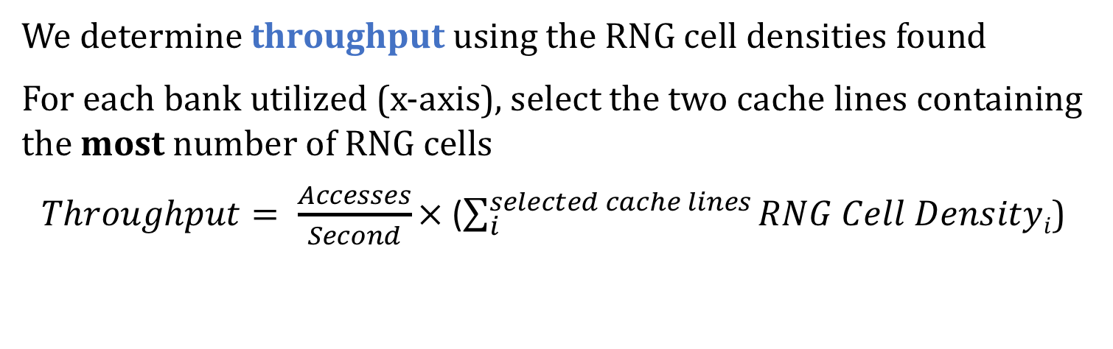
Results – Single Channel Throughput
We determine throughput using the RNG cell densities found
For each bank utilized (x-axis), select the two cache lines containing the most number of RNG cells
$Throughput= \frac{Accesses}{Second}×$ ($\sum_{i}^{selected cache lines}{RNG Cell Densityi}$)
Notes:
I will now present the single channel TRNG throughput evaluation results.
[CLICK] we plot a box and whisker plot again for the throughput. The x-axis sweeps the number of banks that we parallelize D-RaNGe accesses on, and the y-axis plots the TRNG throughput in terms of Mb/s.
[CLICK] we determine the throughput using the RNG cell densities found.
[CLICK] for each bank that we use, we select the two cache lines containing the most number of RNG cells
[CLICK] The throughput is calculated by taking the number of accesses we can make per second to a cache line when generating random numbers and multiplying that value, by the sum of all RNG cells in our selected cache lines.

Slide 33
Results – Single Channel Throughput
Since there are only between 1 and 4 RNG cells per cache line, there are a limited number of possible throughputs
At least 40 Mb/s when using all 8 banks in a single channel
Maximum throughput for A/B/C: 179.4/179.4/134.5 Mb/s
4-channel max (avg) throughput: 717.4 Mb/s (435.7 Mb/s)
Notes:
We plot the distributions for all three DRAM manufacturers
[CLICK] Because we have only observed between 1 and 4 RNG cells per cache line, there are a limited number of possible throughputs.
[CLICK] We find that we can generate true random numbers at at least 40 Mb/s when parallelizing D-RaNGe access across all banks.
[CLICK] We find that the maximum throughputs for manufacturers A,B, and C, are around 180, 180, and 130 Mb/s
[CLICK] When we parallelize across 4 Channels of DRAM which is often available on systems, D-RaNGe can produce random numbers at a maximum of 717 Mb/s and an average of 435 Mb/s
[CLICK]

Slide 34
Results
System Interference
Capacity overhead: 6 DRAM rows per DRAM bank (~0.018%)
D-RaNGe is flexible and can adjust its level of interference
D-RaNGe throughput with SPEC CPU2006 workloads in the pessimistic case where D-RaNGe only issues accesses to a DRAM bank when it is idle (no interference)
Average throughput of 83.1 Mb/s
Energy Consumption
4.4 nJ/bit
Determined by Ramulator + DRAMPower
https://github.com/CMU-SAFARI/ramulator
http://www.es.ele.tue.nl/drampower/
Notes:
Let’s now look at the system interference results.
[CLICK] We find that the capacity overhead of D-RaNGe is the 6 DRAM rows per DRAM bank that we must reserve. This includes the 2 rows containing the selected cachelines and the 4 rows surrounding each side of the two rows. This is an insignificant capacity overhead of less than 0.1%
[CLICK] D-RaNGe is inherently a flexible mechanism and can adjust its level of interference in a number of ways. One way would be to change the priority at which D-RaNGe accesses are issued compared to regular application DRAM accesses.
[CLICK] In trying to show the flexibility of D-RaNGe, we study the SPEC CPU2006 workloads in the pessimistic case where D-RaNGe only issues accesses to a DRAM bank when it is idle such that D-RaNGe has no interference with concurrently running applications. We find that in this case, D-RaNGe can still provide on average 83.1 Mb/s of random data.
[CLICK] Next we will look into the energy consumption of D-RaNGe
[CLICK] We find that D-RaNGe can provide random data at the rate of 4.4 nJ per bit, and [CLICK] this was determined by Ramulator and DRAMPower.

Slide 35
Other Results in the Paper
LPDDR4 DRAM Activation Failure Characterization
Spatial distribution, data pattern dependence, temperature effects, variation over time
A detailed analysis on:
Devices of the three major DRAM manufacturers
D-RaNGe energy consumption, 64-bit latency, throughput
Further discussion on:
Algorithm for D-RaNGe to effectively generate random values
Design considerations for D-RaNGe
D-RaNGe overhead analysis
Analysis of NIST statistical test suite results
Detailed comparison against prior work
Notes:
Let me briefly talk about othlller results that are included in the paper before presenting our comparison of D-RaNGe against prior work. These include the following:
[CLICK] LPDDR4 DRAM Activation failure characterization, including [CLICK] the spatial distribution, data pattern dependence, temperature effects, and variation over time
[CLICK] How D-RaNGe meets the basic requirements for an effective TRNG
[CLICK] a detailed analysis on [CLICK] devices of the three major DRAM manufacturers and [CLICK] D-RaNGe energy consumption, 64 bit latency, and throughput
[CLICK] Further discussion on [CLICK] the algorithm for D-RaNGe to effectively generate random values,
[CLICK] design considerations for D-RaNGe
[CLICK] D-RaNGe overhead analysis
[CLICK] detailed comparison against prior work
[CLICK] analysis of NIST statistical test suite results

Slide 36
D-RaNGe Outline
Motivation
Effective True Random Number Generators
D-RaNGe
DRAM Operation
Key Idea
Methodology
Results
Prior work on DRAM-based TRNGs
Command scheduling
Cell charge retention
Start-up values
Summary
Notes:
I will now discuss the three classes of existing prior work on DRAM-based TRNGs. The first class is DRAM command-scheduling based, the second is DRAM cell charge retention based, and the third is DRAM start-up value based. I will start by comparing against the command-scheduling based TRNG.

Slide 37
Prior Work: Command Scheduling
[Pyo+, IET, 2009]
Randomness source: time it takes to run a code segment of many DRAM accesses
Since time to access DRAM is unpredictable due to memory conflicts, refresh operations, calibration, etc.
Lower bits of the cycle timer used as random values
Can produce random numbers at 3.4 Mb/s
D-RaNGe can produce TRNs at >700Mb/s (211x higher)
Downsides of DRAM Command Scheduling based TRNGs
Randomness source is not truly random: depends on memory controller implementation and concurrently running applications
Much lower TRN throughput than D-RaNGe
Notes:
[CLICK] In DRAM Command-scheduling based TRNGs, the randomness source is the time it takes to run a code segment containing many DRAM accesses.
[CLICK] The authors claim the time to complete this code segment is random because the time to access DRAM is unpredictable due to memory conflicts, refresh operations, calibration, etc.
[CLICK] The time to complete this code segment is measured and the lower bits of the timer are extracted as random values,
[CLICK] The authors show that this proposal can generate random numbers at 3.4 Mb/s
[CLICK] On the other hand, D-RaNGe produces true random numbers at over 700 Mb/s which is orders of magnitude higher
[CLICK] Unfortunately, we claim that the randomness source is not truly random as it does not rely on a physical non-deterministic phenomena
[CLICK] In fact, it heavily depends on the memory controller implementation as we ll as concurrently running applications.
[CLICK] it also can only provide a very small throughput of True random numbers compared to D-RaNGe

Slide 38
D-RaNGe Outline
Motivation
Effective True Random Number Generators
D-RaNGe
DRAM Operation
Key Idea
Methodology
Results
Prior work on DRAM-based TRNGs
Command scheduling
Cell charge retention
Start-up values
Summary
Notes:
The next prior work I will discuss is the DRAM cell charge retention based TRNGs along with some background information

Slide 39
DRAM Cell Leakage
DRAM encodes information in leaky capacitors
wordline
access
transistor
charge
leakage
paths
capacitor
bitline
Stored data is corrupted if too much charge leaks (i.e., the capacitor voltage degrades too much)
[Patel et al., REAPER, ISCA’17]
Notes:
DRAM encodes data in fundamentally leaky capacitors [CLICK] Here is a simplified diagram of a DRAM cell.
[CLICK]
There are a number of leakage paths by which charge can enter or exit the capacitor.
[CLICK]
The important thing to note is that stored data can be corrupted if too much charge leaks
Which is the same as saying if the capacitor voltage degrades too much
[END]

Slide 40
DRAM Cell Retention
100%
Retention Success
Vmin
Retention Failure
Capacitor voltage (Vdd)
0%
Retention time
time
Retention failure – when leakage corrupts stored data
Retention time – how long a cell holds its value
[Patel et al., REAPER, ISCA’17]
Notes:
Here, we have a simplified diagram of the capacitor voltage over time
We see that the voltage decreases over time in an exponential decay.
[CLICK]
Again we have our voltage, Vmin, under which we can no longer guarantee that we will correctly read the data that was originally stored in the cell.
[CLICK]
As long as a cell’s voltage remains above this line, we consider this a retention success.
[CLICK]
However, as soon as the voltage drops below Vmin, we consider this a retention failure
[CLICK]
We define the length of time that must elapse before a cell experiences a retention failure as the ‘retention time’ of a cell.
[END]

Slide 41
Retention-based TRNGs
[Keller+, ISCAS, 2014] [Hashemian, DATE, 2015] [Sutar+, TECS, 2018]
Generate random values using data from cells that fail randomly with a refresh interval N
Can handle a longer refresh interval
Row Decoder
Fails with refresh interval N
SA
SA
SA
SA
SA
SA
SA
SA
SA
SA
After time N, some cells leak close to Vmin.
These RNG cells fail randomly
Notes:
[CLICK] Retention-based TRNGs generate random values using data from cells that fail randomly with a refresh interval N. We induce retention failures by disabling refresh for a time longer than the standard 64ms.
[CLICK] Here is a cartoon showing the variation of cell retention times in different colors.
[CLICK] When we disable refresh for a time interval N, we see that the charge in different cells leak over time.
[CLICK] some cells leak charge below Vmin which results in retention failures, but
[CLICK] other cells can handle a longer refresh interval without failing.
[CLICK] After time N, some cells leak close to Vmin and it is these cells that fail randomly. We refer to these as RNG cells in this context.

Slide 42
Retention-based TRNGs
[Keller+, ISCAS, 2014] [Hashemian, DATE, 2015] [Sutar+, TECS, 2018]
Generate random values using data from cells that fail randomly with a refresh interval N
The key idea is to extract random values
by aggregating values from RNG cells after every increased refresh interval N
Can handle a longer refresh interval
Row Decoder
Fails with refresh interval N
SA
SA
SA
SA
SA
SA
SA
SA
SA
SA
After time N, some cells leak close to Vmin.
These RNG cells fail randomly
Notes:
[CLICK] Retention-based TRNGs generate random values using data from cells that fail randomly with a refresh interval N. We induce retention failures by disabling refresh for a time longer than the standard 64ms.
[CLICK] Here is a cartoon showing the variation of cell retention times in different colors.
[CLICK] When we disable refresh for a time interval N, we see that the charge in different cells leak over time.
[CLICK] some cells leak charge below Vmin which results in retention failures, but
[CLICK] other cells can handle a longer refresh interval without failing.
[CLICK] After time N, some cells leak close to Vmin and it is these cells that fail randomly. We refer to these as RNG cells in this context.

Slide 43
DRAM Retention TRNG Weaknesses
High latency
Prior work shows that 40 sec refresh interval results in 256 random bits of data per 4MiB DRAM block
D-RaNGe’s latency is 100ns (>9 orders of magnitude faster)
Low Throughput / High DRAM capacity overhead
Requires more capacity for higher throughput
Fully reserving a 32GB DRAM device results in 0.05 Mb/s
D-RaNGe has 14,000x higher throughput with a fixed capacity overhead (384 KB)
High energy consumption
6.8mJ/bit mainly due to long idle periods
D-RaNGe: 4.4 nJ/bit (>7 orders of magnitude lower)
Notes:
Unfortunately, DRAM retention-baed TRNGs have weaknesses
[CLICK] They generate random values with a low throughput and high latency
[CLICK] Prior work shows that 40 second refresh intervals result in 256 random bits of data per 4MB DRAM blocks. This means that fully using a 32GB DRAM device would result in 0.05 Mb/s. This is significantly lower than D-RaNGe and [CLICK] has a much higher capacity overhead. [CLICK] Requiring reserving large region of DRAM during random number generation, since a whole 4MB DRAM block only produces 256 bits.
[CLICK] They have high energy consumption.
[CLICK] They consume 6.8milliJ per bit since they have a very long idle time for waiting for retention failure to occur.

Slide 44
D-RaNGe Outline
Motivation
Effective True Random Number Generators
D-RaNGe
DRAM Operation
Key Idea
Methodology
Results
Prior work on DRAM-based TRNGs
Command scheduling
Cell charge retention
Start-up values
Summary
Notes:
Lastly, I will discuss the third class of DRAM-based TRNGs: DRAM start-up value based TRNGs.

Slide 45
Start-up Values as Random Numbers
[Tehranipoor, HOST, 2016]
When a device is powered up, some DRAM cells have random values due to interaction between
precharge logic
row decoder logic
column select lines
Prior works propose power cycling DRAM to extract the random data resident in those cells
Downsides of DRAM Start-up value based TRNGs
Must power cycle DRAM to generate random values:
High latency: based on power cycle time and data migration
High storage cost: all data must be migrated or will be lost
Notes:
[CLICK] Prior work exploit the interaction of precharge and row decoder logic, and column select lines when a device is powered up to produce random values in some DRAM cells.
[CLICK] Prior works propose power cycling DRAM to extract the random data resident in those cells.
[CLICK] unfortunately, these TRNGs come with their own constraints as well.
[CLICK] The latency of generating random values depends on a long DRAM power cycle time. While the authors do not evaluate this, there is oftentime a high latency in power cycling DRAM due to all the initialization and calibration required for reading and writing from DRAM.
[CLICK] this mechanism also has a high storage cost since all data will be lost during the power cycle,

Slide 46
D-RaNGe Comparison against Prior Work
Compared to Command Scheduling, D-RaNGe:
samples a truly random entropy source
211x higher throughput
180x lower latency
Compared to Retention Time, D-RaNGe:
>5 orders of magnitude higher throughput
>9 orders of magnitude lower latency
>7 orders of magnitude more energy efficient
Compared to Startup Values, D-RaNGe:
continuously produces random values
does not require a system restart
Notes:
Compared to all prior work, D-RaNGe performs better in terms of all the identified characteristics of an effective TRNG.
[CLICK] Compared to Command Scheduling, D-RaNGe actually samples a truly random entropy source, and provides random values at significantly higher throughput and lower latency.
[CLICK] compared to retention time, D-RaNGe provides random values at orders of magnitude higher throughput, less energy, and lower latency.
[CLICK] Compared to startup values, D-RaNGe can continuously produce random values, and likely generate random values with much lower latency and higher throughput.

Slide 47
D-RaNGe Outline
Motivation
Effective True Random Number Generators
D-RaNGe
DRAM Operation
Key Idea
Methodology
Results
Prior work on DRAM-based TRNGs
Command scheduling
Cell charge retention
Start-up values
Summary
Notes:
now let me conclude by giving the summary

Slide 48
Summary and Conclusion
Motivation: High-throughput true random numbers enable system security and various randomized algorithms.
Many systems (e.g., IoT, mobile, embedded) do not have dedicated True Random Number Generator (TRNG) hardware but have DRAM devices
Problem: Current DRAM-based TRNGs either
do not sample a fundamentally non-deterministic entropy source
are too slow for continuous high-throughput operation
Goal: A novel and effective TRNG that uses existing commodity DRAM to provide random values with 1) high-throughput, 2) low latency and 3) no adverse effect on concurrently running applications
D-RaNGe: Reduce DRAM access latency below reliable values and exploit DRAM cells’ failure probabilities to generate random values
Evaluation:
Experimentally characterize 282 real LPDDR4 DRAM devices
D-RaNGe (717.4 Mb/s) has significantly higher throughput (211x)
D-RaNGe (100ns) has significantly lower latency (180x)
Notes:
To begin, I will give a brief overview. [CLICK] Our motivation is that high throughput true random numbers enable system security, and various randomized algorithms.
[CLICK] Unfortunately, many systems like IoT, mobile, and embedded systems do not have dedicated true random number generator (TRNG) hardware. However, they do have DRAM devices, on which a few recent papers have proposed generating true random numbers on.
[CLICK] The problem is that current DRAM-based TRNGs either [CLICK] do not sample a fundamentally non-deterministic entropy source, which may not result in true random numbers, or [CLICK] they are too slow for continuous high-throughput operation
[CLICK] Our goal is to develop a novel and effective TRNG for existing commodity DRAM devices that can provide continuous high-throughput random values at low latency while minimally affecting concurrently running applications.
[CLICK] We propose D-RaNGe, a high-throughput TRNG that reduces DRAM access latency below reliable values and exploits DRAM cell failure probabilities to quickly generate random values
[CLICK] In our evaluation
[CLICK] we experimentally characterize 282 real LPDDR4 DRAM devices and [CLICK] find that D-RaNGe provides random values at over 700 Mb/s which is orders of magnitude over prior DRAM-based TRNGs [CLICK] In addition, D-RaNGe can provide 64 bits of random data in 100 ns which is 180x faster than prior proposals

Slide 49
D-RaNGe: Using Commodity DRAM Devices to Generate True Random Numbers with Low Latency and High Throughput
Jeremie S. Kim Minesh Patel
Hasan Hassan Lois Orosa Onur Mutlu
Notes:
20 Minute talk 5 minute questions
Hello, my name is Jeremie Kim and I will be presenting D-RaNGe: a mechanism that uses commodity DRAM devices to generate true random numbers with low latency and high throughput

Slide 51
Results - System Interference
Capacity overhead: 6 DRAM rows per DRAM bank (~0.018%)
D-RaNGe is flexible and can adjust its level of interference
D-RaNGe throughput with SPEC CPU2006 workloads in the pessimistic case where D-RaNGe only issues accesses to a DRAM bank when it is idle (no interference): Average of 83.1 Mb/s
Results – Energy Consumption
4.4 nJ/bit
Determined by Ramulator + DRAMPower
https://github.com/CMU-SAFARI/ramulator
http://www.es.ele.tue.nl/drampower/
Notes:
Let’s now look at the system interference results.
[CLICK] We find that the capacity overhead of D-RaNGe is the 6 DRAM rows per DRAM bank that we must reserve. This includes the 2 rows containing the selected cachelines and the 4 rows surrounding each side of the two rows. This is an insignificant capacity overhead of less than 0.1%
[CLICK] D-RaNGe is inherently a flexible mechanism and can adjust its level of interference in a number of ways. One way would be to change the priority at which D-RaNGe accesses are issued compared to regular application DRAM accesses.
[CLICK] In trying to show the flexibility of D-RaNGe, we study the SPEC CPU2006 workloads in the pessimistic case where D-RaNGe only issues accesses to a DRAM bank when it is idle such that D-RaNGe has no interference with concurrently running applications. We find that in this case, D-RaNGe can still provide on average 83.1 Mb/s of random data.
[CLICK] Next we will look into the energy consumption of D-RaNGe
[CLICK] We find that D-RaNGe can provide random data at the rate of 4.4 nJ per bit, and [CLICK] this was determined by Ramulator and DRAMPower.

Slide 52
DRAM Organization + Operation

Slide 53
DRAM Activation Failure Testing

Slide 54
Activation Failure Spatial Distribution

Slide 55
Activation Failure Temperature Dependence

Slide 56
Full D-RaNGe Algorithm

Slide 57
Summary Comparison Table

Slide 58
DRAM Data Pattern Dependence

Slide 59
Each Cell has a Different Retention Time
Row Decoder
wordline
access
transistor
capacitor
Row Buffer
bitline
8GB DRAM = 6.4e10 cells
[Patel et al., REAPER, ISCA’17]
Notes:
DRAM is comprised of [CLICK] many of these small cells to have a large capacity. [CLICK] For an example 8GB DRAM device, there are 64 billion of these cells.
In correct operation, every one of these cells are restored every 64 ms, so there are no retention failures during program execution.
However, prior work has shown that cells of a given retention time are uniform randomly distributed across the DRAM array

Slide 60
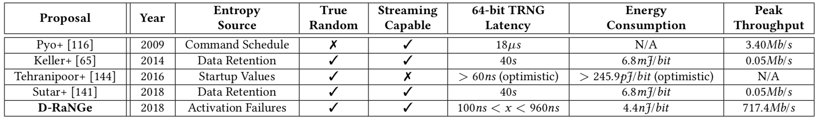
D-RaNGe Compared to Prior Work
Proposal | Pyo+ | Keller+ | Tehranipoor+ | Sutar+ | D-RaNGe
Year | 2009 | 2014 | 2016 | 2018 | 2019
Entropy Source | Command Schedule | Data Retention | Startup Values | Data Retention | Activation Failures
True Random
Streaming Capable
64-bit TRNG Latency | 18us | 40s | >60ns (optimistic) | 40s | 100ns < x < 960ns
Energy Consumption | N/A | 6.8mJ/bit | 245.9pJ/bit (optimistic) | 6.8mJ/bit | 4.4nJ/bit
Peak Throughput | 3.4Mb/s | 0.05Mb/s | N/A | 0.05Mb/s | 717.4Mb/s

Slide 61
DRAM Architecture Background

Slide 62
Sources of Retention Time Variation
Process/voltage/temperature
Data pattern dependence (DPD)
Retention times change with data in cells/neighbors
e.g., all 1’s vs. all 0’s
Variable retention time (VRT)
Retention time changes randomly (unpredictably)
Due to a combination of various circuit effects
Notes:
Let’s take a look at some of the sources of this variation.
[CLICK]
First, cell retention times depend on process variation and vary dynamically with changes in voltage and temeperature.
[CLICK]
Second, data pattern dependence effects mean that the retention time of a cell depends on the value programmed into the cell and its neighbors.
For example, a DRAM containing all 1’s would have a different set of failures than if it contained all 0’s
[CLICK]
Third, variable retention time effects mean that the retention times of cells change randomly, and more importantly, unpredictably, over time
This is due to a combination of various circuit level effects
And prior work has shown that VRT effects make ECC necessary to operate at a longer refresh interval.
[END]

Slide 63
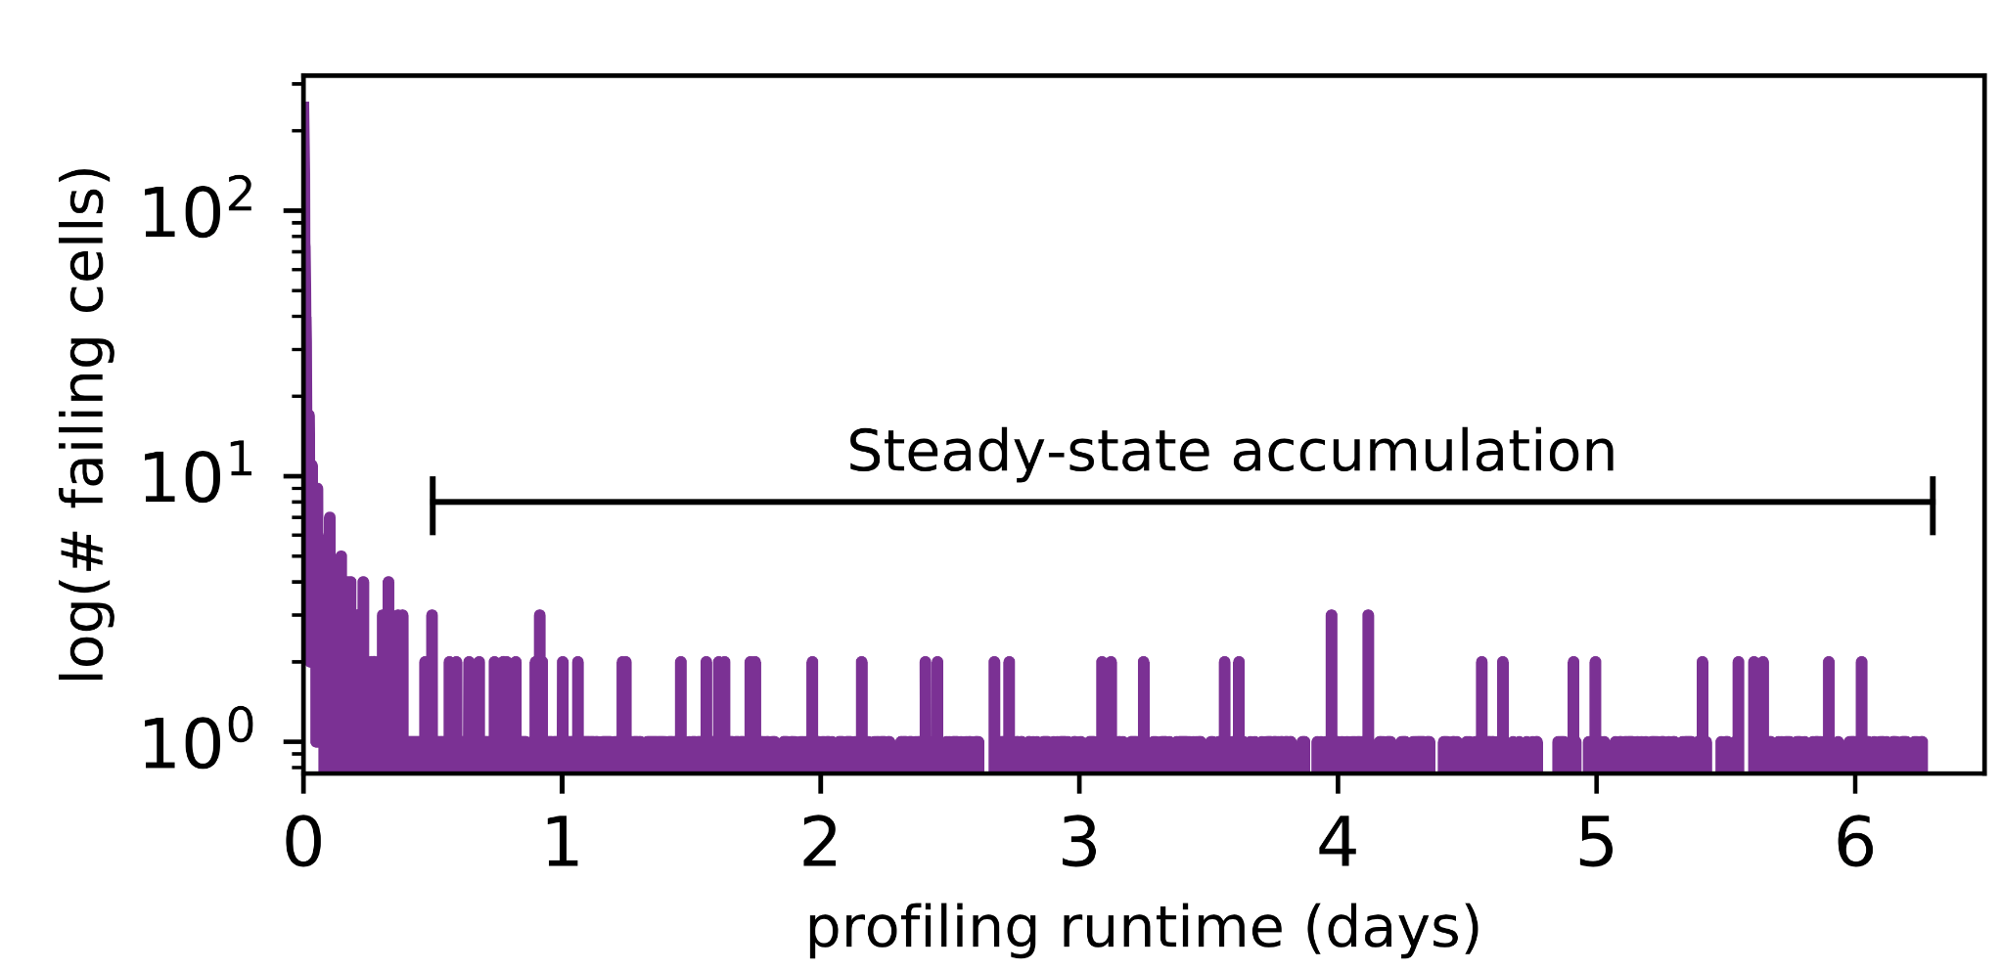
Long-term Continuous Profiling
Representative chip from Vendor B, 2048ms, 45°C
# New Failing Cells
Error correction codes (ECC)
and online profiling are necessary
to manage new failing cells
Time (days)
New failing cells continue to appear over time
Attributed to variable retention time (VRT)
The set of failing cells changes over time
Notes:
Here is some data we collected from a representative chip at a fixed refresh interval of 2048ms.
We show the number of new failing cells discovered by continuously profiling over 6 days.
[CLICK]
We see that new failing cells continue to appear over time.
We attribute these to variable retention time effects, which mean that cells can randomly change retention times at any point.
[CLICK]
This shows that the set of failing cells we find at 2048ms changes over time
[CLICK]
This means that error correction codes and online profiling are necessary to manage new failing cells that continue to appear
[END]

Slide 64
Single-cell Failure Probability (Cartoon)
idealized cell
(retention time = 3s)
actual cell
N(μ, σ) | μ = 3s
Notes:
In another study, we analyzed the failure probability of individual cells.
Here we show the probability of read failure for a single cell over different refresh intervals
We show an idealized cell, with never fails below 3.5 seconds, but always fails above 3.5s
We can say that this cell has a retention time of 3.5s.
[CLICK]
However, we find that real cells look more like the blue cartoon, which follows a normal distribution with a mean at 3.5s.
Note that even below 3.5s, there is a nonzero probability of the cell failing.
[END]

Slide 65
Single-cell Failure Probability (Real)
operate here
profile here
easy
Any cell is more likely to fail
at a longer refresh interval
OR a higher temperature
to find
failed 9 times out of 16 trials
hard
false
to find
positives
Notes:
TEMPERATURE TEMPERATURE TEMPERATURE TEMPERATURE TEMPERATURE TEMPERATURE TEMPERATURE
Here we show real data from a real chip, [CLICK] which we collected by testing how often the cell failed out of 16 trials for different refresh intervals.
[CLICK]
We now show 8 different cells from the same chip.
[CLICK]
Suppose we are interested in operating at a refresh interval of 1.7 seconds.
[CLICK]
We will find 6 cells with a non-negligible probability of failing
[CLICK]
However, the bottom two cells will be hard to find since they have a low probability of failure at this refresh interval
[CLICK]
Instead, if we profile at an increased refresh interval, [CLICK] the same cells will be much easier to find since they will have a high probability of failure.
[CLICK]
However, we will also identify some additional cells as failing, which can end up being false positives.
[CLICK]
We repeat the same analysis for temperature variation and find that cells behave similarly. We show details of this analysis in the paper.
[CLICK]
The takeaway here is that any given cell is more likely to fail at a longer refresh interval or a higher temperature.
[END]

Slide 66
Temperature Relationship
Well-fitting exponential relationship:
E.g., 10°C ~ 10x more failures

Slide 67
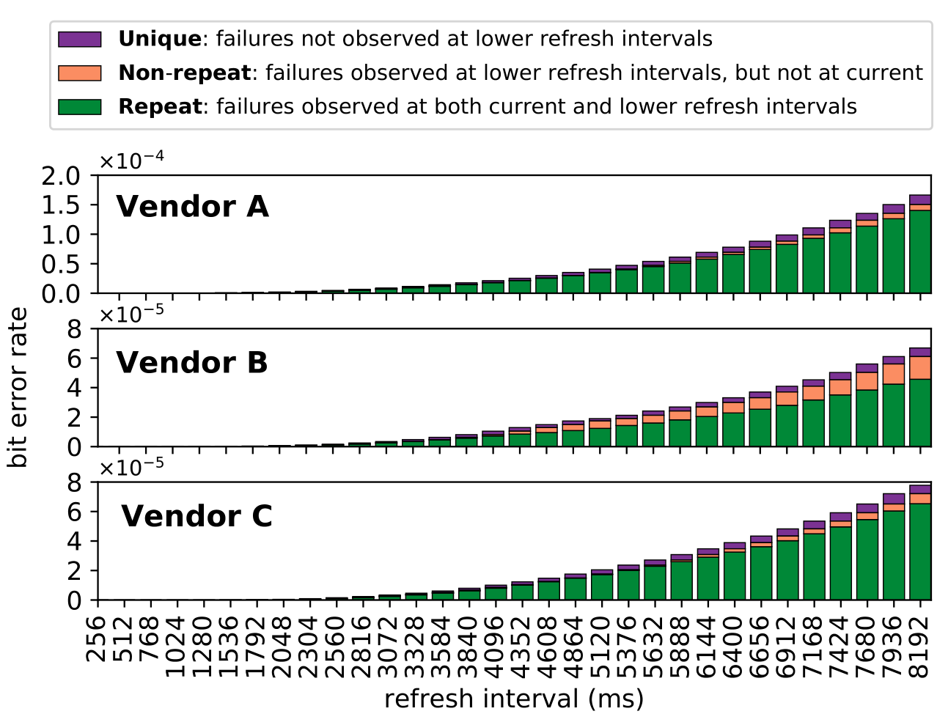
Retention Failures @ 45°C

Slide 68
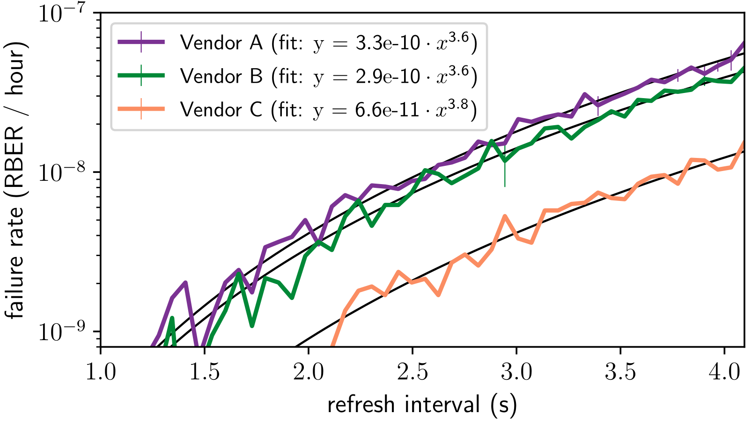
VRT Failure Accumulation Rate
Notes:
BACKUP!!!

Slide 69
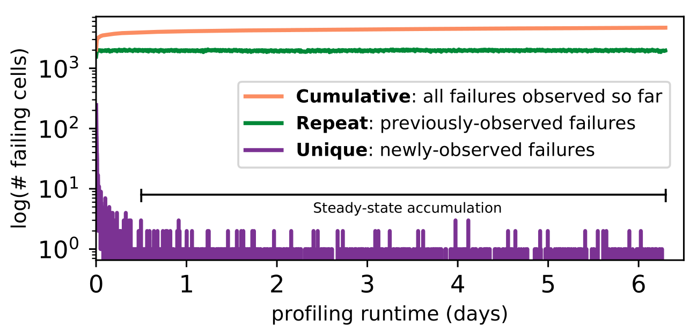
800 Rounds of Profiling @ 2048ms, 45°C

Slide 70
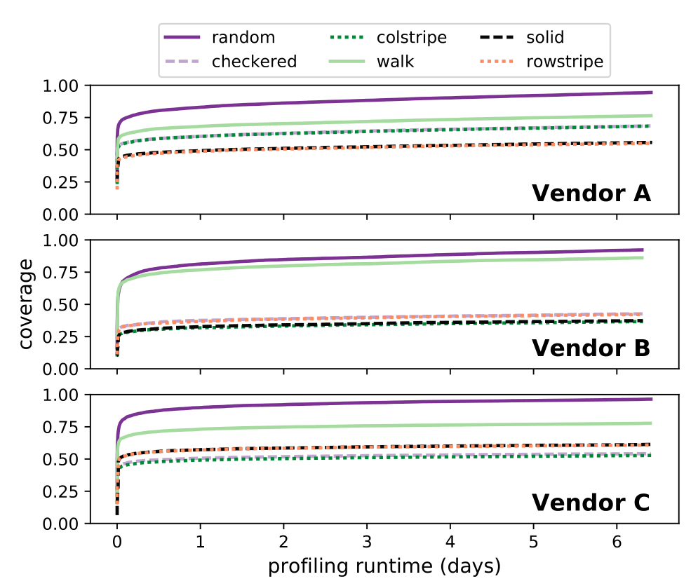
800 Rounds of Profiling @ 2048ms, 45°C

Slide 71
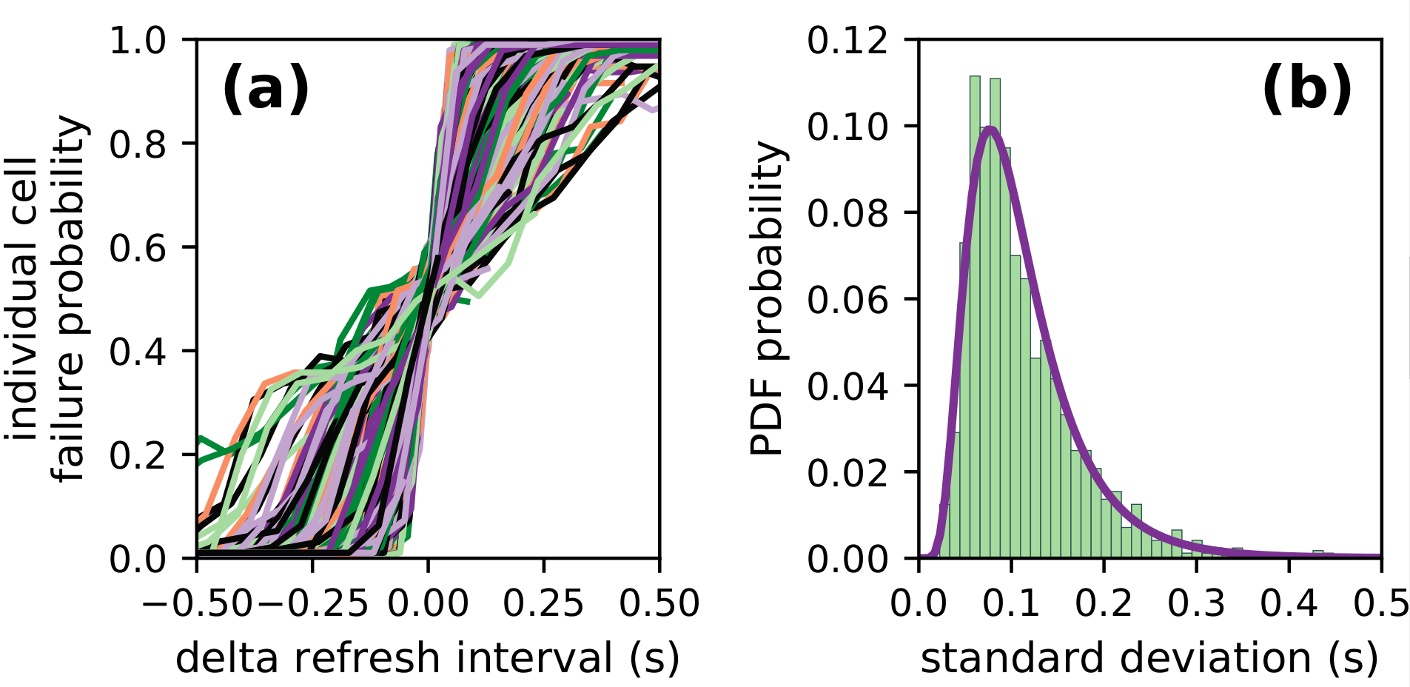
Individual Cell Failure Probabilities
Single representative chip of Vendor B at 40° C
Refresh intervals ranging from 64ms to 4096ms

Slide 72
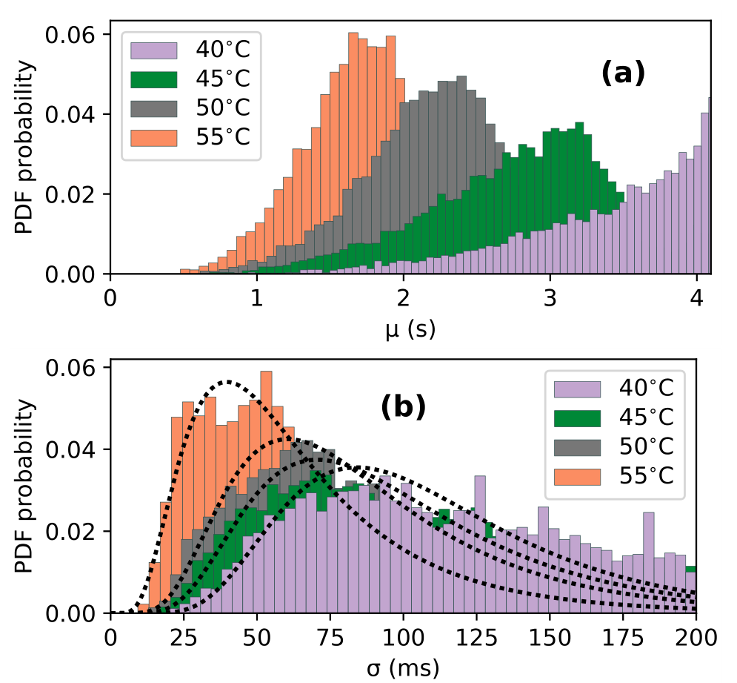
Individual Cell Failure Distributions

Slide 73
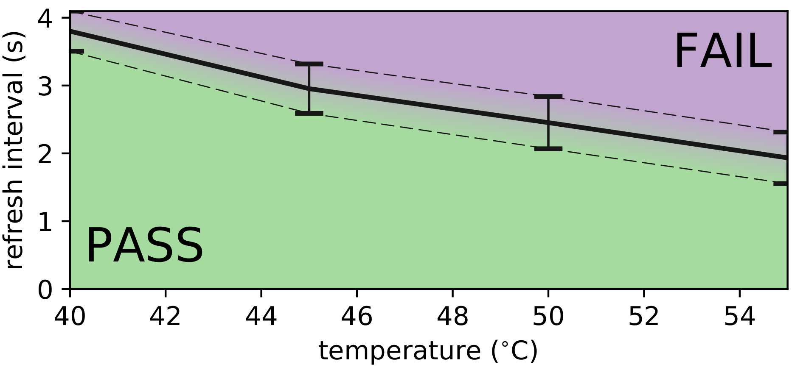
Single-cell Failures With Temperature
Single representative chip of Vendor B
{mean, std} for cells between 64ms and 4096ms

