Slide 1


HiRA: Hidden Row Activation for Reducing Refresh Latency of Off-the-Shelf DRAM Chips
Abdullah Giray Yağlıkçı
Ataberk Olgun Minesh Patel Haocong Luo Hasan Hassan
Lois Orosa Oğuz Ergin Onur Mutlu
Notes:
Hello, I am Giray, and I will present our new paper HiRA: Hidden Row Activation

Slide 2
Executive Summary
Problem: DRAM Refresh
is a fundamental operation to avoid bit flips due to leakage and RowHammer
incurs increasingly large performance overhead with DRAM chip density scaling
Goal: Reduce the performance overhead of DRAM Refresh
Key Idea: Hide refresh latency by refreshing a DRAM row concurrently with activating another row in a different subarray of the same bank
HiRA: Hidden Row Activation – a new DRAM operation that
Issues DRAM commands in quick succession to concurrently open two rows in different subarrays
Works on real off-the-shelf DRAM chips by violating timing constraints
Significantly reduces (51.4%) the time spent for refresh operations
HiRA-MC: HiRA Memory Controller – a new mechanism
Leverages HiRA to perform refresh requests concurrently with DRAM accesses and other refresh requests
Significantly improves system performance by hiding refresh latency for both regular periodic and RowHammer-preventive refreshes
Notes:
In this paper, we tackle the performance overhead of DRAM refresh – a fundamental maintenance operation – that incurs increasingly large performance overhead with DRAM chip density scaling
[CLICK] Our goal is to reduce DRAM refresh’s performance overhead
[CLICK] Our key idea is to hide refresh latency by concurrently performing refreshes and row activations on rows in different subarrays of the same bank.
[CLICK] To achieve this, we propose a new operation called Hidden Row Activation or HiRA that issues dram commands inn quick succession to concurrently open two rows inn different subarrays
[CLICK] We experimentally demonstrate that HiRA works on real off-the-shelf DRAM chips and
[CLICK] provides 51.4% reduction in time spent for refresh operations
[CLICK] To effectively leverage HiRA, we propose a new mechanism called HiRA Memory Controller which buffers each refresh request for a time slack and performs concurrently with DRAM accesses and other refresh requests.
[CLICK] By doing so, it provides significant system performance improvements by hiding the latency of both regular periodic and RowHammer-preventive refresh operations.

Slide 3
Outline
Background and Problem
Motivation and Goal
Experimental Methodology
Temperature Analysis
Aggressor Row Active Time Analysis
Spatial Variation Analysis
Implications on Attacks and Defenses
Conclusions
Goal and Key Idea
HiRA: Hidden Row Activation
HiRA in Real DRAM Chips
HiRA-MC: HiRA Memory Controller
Performance Evaluation
Conclusion
Notes:
This is the outline of the talk. Let me quickly introduce background and problem

Slide 4
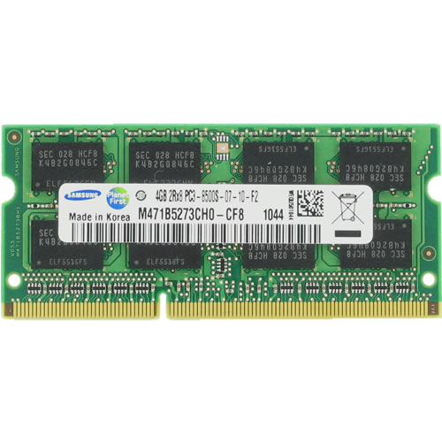
DRAM Organization
DRAM Rank
Subarray
Bitline
DRAM Cell
Bank
Wordline
Chip I/O
. . .
…
DRAM Row
…
…
…
…
…
Row Buffer
DRAM Chip
DRAM Bank
DRAM Subarray
Notes:
This is a DRAM module, used as the main memory in many computing systems. [CLICK]
Multiple chips in a DRAM module form a DRAM rank [CLICK]
Each chip contains multiple banks [CLICK]
Each bank is composed of multiple subarrays [CLICK]
And within each subarray, there is a two dimensional array of DRAM cells. [CLICK]
These cells are organized into rows that are selected using wordlines [CLICK]
And the cells are connected to a row buffer via bitlines [CLICK]

Slide 5
DRAM Operations
DRAM Subarray
ACTIVATE (ACT):
Fetch the row’s content into the row buffer
1
1
1
1
1
Column Access (RD/WR): Read/Write the target column and drive to I/O
2
Row
Buffer
PRECHARGE (PRE): Prepare the array for a new ACTIVATE
3
I/O Circuitry
Notes:
Data is internally accessed in a row granularity. To access data, [CLICK]
the memory controller first needs to activate the row that contains the data and fetch the row’s content into the row buffer [CLICK]
Then, column accesses are serviced from the row buffer [CLICK]
Finally, the subarray needs to be precharged to get ready for the next row activation [CLICK]

Slide 6
DRAM Refresh
DRAM Subarray
DRAM cells leak charge over time
Fully charged
1
1
1
1
time
DRAM Refresh
Row
Buffer
DRAM Refresh is the key maintenance operation to avoid bit flips due to charge leakage
DRAM Refresh activates a row and precharges the bank
Problem: DRAM Refresh blocks accesses to the whole bank / rank
Notes:
DRAM cells leak charge over time [CLICK]
And need to be refreshed to avoid bit flips due to leakage [CLICK]
DRAM Refresh essentially activates a row [CLIcK] and precharges the bank after the cell charges are restored [CLICK]
Unfortunately, the whole DRAM bank or rank becomes unavailable during a refresh operation [CLICK]

Slide 7




Two Main Types of DRAM Refresh
Periodic Refresh: Periodically restores the charge DRAM cells leak over time
1
RowHammer: Repeatedly accessing a DRAM row can cause bit flips in other physically nearby rows
2
Preventive Refresh
DRAM Row
Preventive Refresh
Preventive Refresh: Mitigates RowHammer by refreshing physically nearby rows of a repeatedly accessed row
Notes:
DRAM Refresh is mainly used for two purposes [CLICK]
The first one is called: Periodic Refresh to periodically restore the charge that DRAM cells leak over time [CLICK]
The second one is relevant to a read-disturb error mechanism called RowHammer, where repeatedly accessing a DRAM row can cause bit flips in other physically near by rows [CLICK]
A common method of mitigating RowHammer is refreshing potentially affected rows, called preventive refresh [CLICK]

Slide 8
Periodic Refresh with Increasing DRAM Chip Density
A larger capacity chip has more rows to be refreshed
A smaller cell stores less charge
26% Slowdown
More periodic refresh operations incur larger performance overhead as DRAM chip density increases
Significant performance and energy overhead
Notes:
With increasing DRAM chip density, [CLICK]
More rows need to be refreshed [CLICK]
And cells can store smaller charge leading to more periodic refresh operations[CLICK]
In this plot, we sweep DRAM chip capacity on the x-axis and investigate how the performance overhead of DRAM refresh operations change[CLICK]
We observe 26% slowdown in system performance caused by periodic refreshes [CLICK]

Slide 9
RowHammer and Preventive Refresh with Increasing DRAM Chip Density
RowHammer vulnerability worsens as DRAM chip density increases
96% Slowdown
Preventive refresh operations need to be performed more aggressively as DRAM chip density increases
Significant performance and energy overhead
Notes:
Again with increasing DRAM chip density, [CLICK]
RowHammer vulnerability worsens such that [CLICK] RowHammer threshold, which is the minimum activation count needed to induce RowHammer bit flips, is reduced by more than an order of magnitude in less than a decade, requiring more aggressive preventive refresh operations [CLICK]
We observe as large as 96% slowdown in system performance with reducing RowHammer threshold [CLICK]

Slide 10
Outline
Background and Problem
Motivation and Goal
Experimental Methodology
Temperature Analysis
Aggressor Row Active Time Analysis
Spatial Variation Analysis
Implications on Attacks and Defenses
Conclusions
Goal and Key Idea
HiRA: Hidden Row Activation
HiRA in Real DRAM Chips
HiRA-MC: HiRA Memory Controller
Performance Evaluation
Conclusion
Notes:
Based on these observations our goal

Slide 11
Our Goal
Reduce the performance overhead of DRAM Refresh (both periodic and preventive)
Notes:
Is to reduce the performance overhead of both periodic and preventive refresh operations

Slide 12
Key Idea
Hide refresh latency by refreshing a DRAM row concurrently with activating another row in a different subarray of the same bank
Notes:
To achieve this goal our key idea is to hide refresh latency by refreshing a DRAM row concurrently with activating another row in a different subarray of the same bank

Slide 13
Outline
Background and Problem
Motivation and Goal
Experimental Methodology
Temperature Analysis
Aggressor Row Active Time Analysis
Spatial Variation Analysis
Implications on Attacks and Defenses
Conclusions
Goal and Key Idea
HiRA: Hidden Row Activation
HiRA in Real DRAM Chips
HiRA-MC: HiRA Memory Controller
Performance Evaluation
Conclusion
Notes:
We achieve this with a nnew operation called HiRA: Hidden Row Activation

Slide 14
HiRA: Hidden Row Activation – Key Insight
Activating two rows in quick succession that are in different subarrays in the same bank can refresh one row concurrently with activating the other row
Subarray X
ACT
Row A
Refreshes RowA
concurrently with
Subarray Y
ACT
Row B
Activating RowB
DRAM Bank
Notes:
HiRA is based on the key insight that [CLICK]
activating two rows in quick succession [CLICK]
That are in different subarrays in the same bank[CLICK]
Can refresh one row [CLICK]
Concurrently with activating the other row [CLICK]

Slide 15
HiRA: Hidden Row Activation – Key Benefit
Refresh RowA concurrently with Activating RowB
RowA’s
refresh
Precharge
RowB’s activation
Without HiRA
time
ACT
RowA
PRE
ACT
RowB
RD
RD
PRE
HiRA
PRE
With HiRA
time
ACT
RowA
ACT
RowB
RD
RD
PRE
RowB’s activation
Saved time using HiRA
Reduction in the time spent for two refreshes
RowA’s
refresh
Notes:
Here is an example of how HiRA refreshes a RowA concurrently with activating a RowB [CLICK]
Without HiRA, only one row can be activated in a bank at a given time [CLICK]
Therefore, we activate RowA, wait until the row is refreshed [CLICK]
Precharge the bank [CLICK]
And activate RowB to read data from RowB [CLICK]
With HiRA, [CLICK]
We issue ACT-PRE-ACT command sequence [CLICK]
Which starts RowA’s refresh with the first ACT [CLICK]
And RowB’s activation with the second ACT [CLICK]
With this parallelization, we can perform the column access earlier [CLICK]

Slide 16
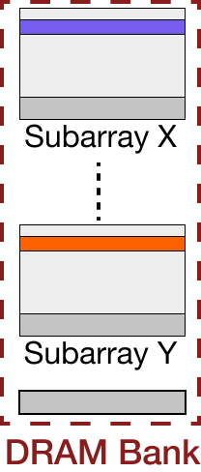
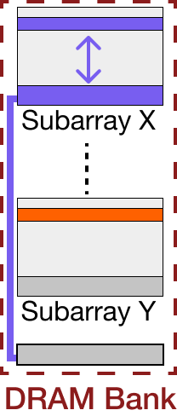
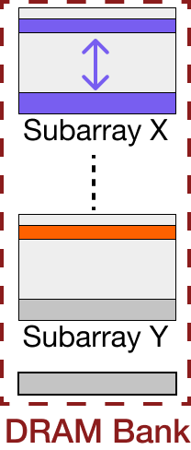
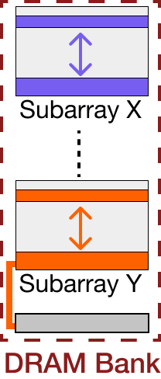
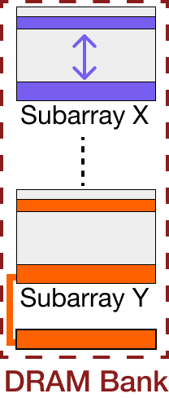
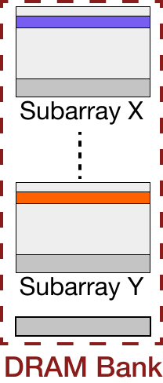
HiRA: Hidden Row Activation – Closer Look
RowA
Local Row
Buffer X
RowB
Local Row
Buffer Y
Bank I/O
time
HiRA
ACT RowA
PRE
ACT RowB
RD
RD
RD
PRE
ACT
t₁
t₂
t_{RCD}
t_{RP}
t_{RestoreA}
t_{RestoreB}
Overlapped
HiRA refreshes RowA concurrently with activating RowB by issuing ACT-PRE-ACT commands in quick succession
Notes:
ACT RowA : Connencts RowA to its Local Row Buffer, starting the refresh of RowA
PRE: Interrupts row activation before the local row buffer X is connnected to the bank i/o
ACT RowB: Interrupts the PRE operation before it closes the rowB

Slide 17
Outline
Background and Problem
Motivation and Goal
Experimental Methodology
Temperature Analysis
Aggressor Row Active Time Analysis
Spatial Variation Analysis
Implications on Attacks and Defenses
Conclusions
Goal and Key Idea
HiRA: Hidden Row Activation
HiRA in Real DRAM Chips
HiRA-MC: HiRA Memory Controller
Performance Evaluation
Conclusion
Notes:
Next we experimentally demonstrate that HiRA works on real DRAM chips

Slide 18
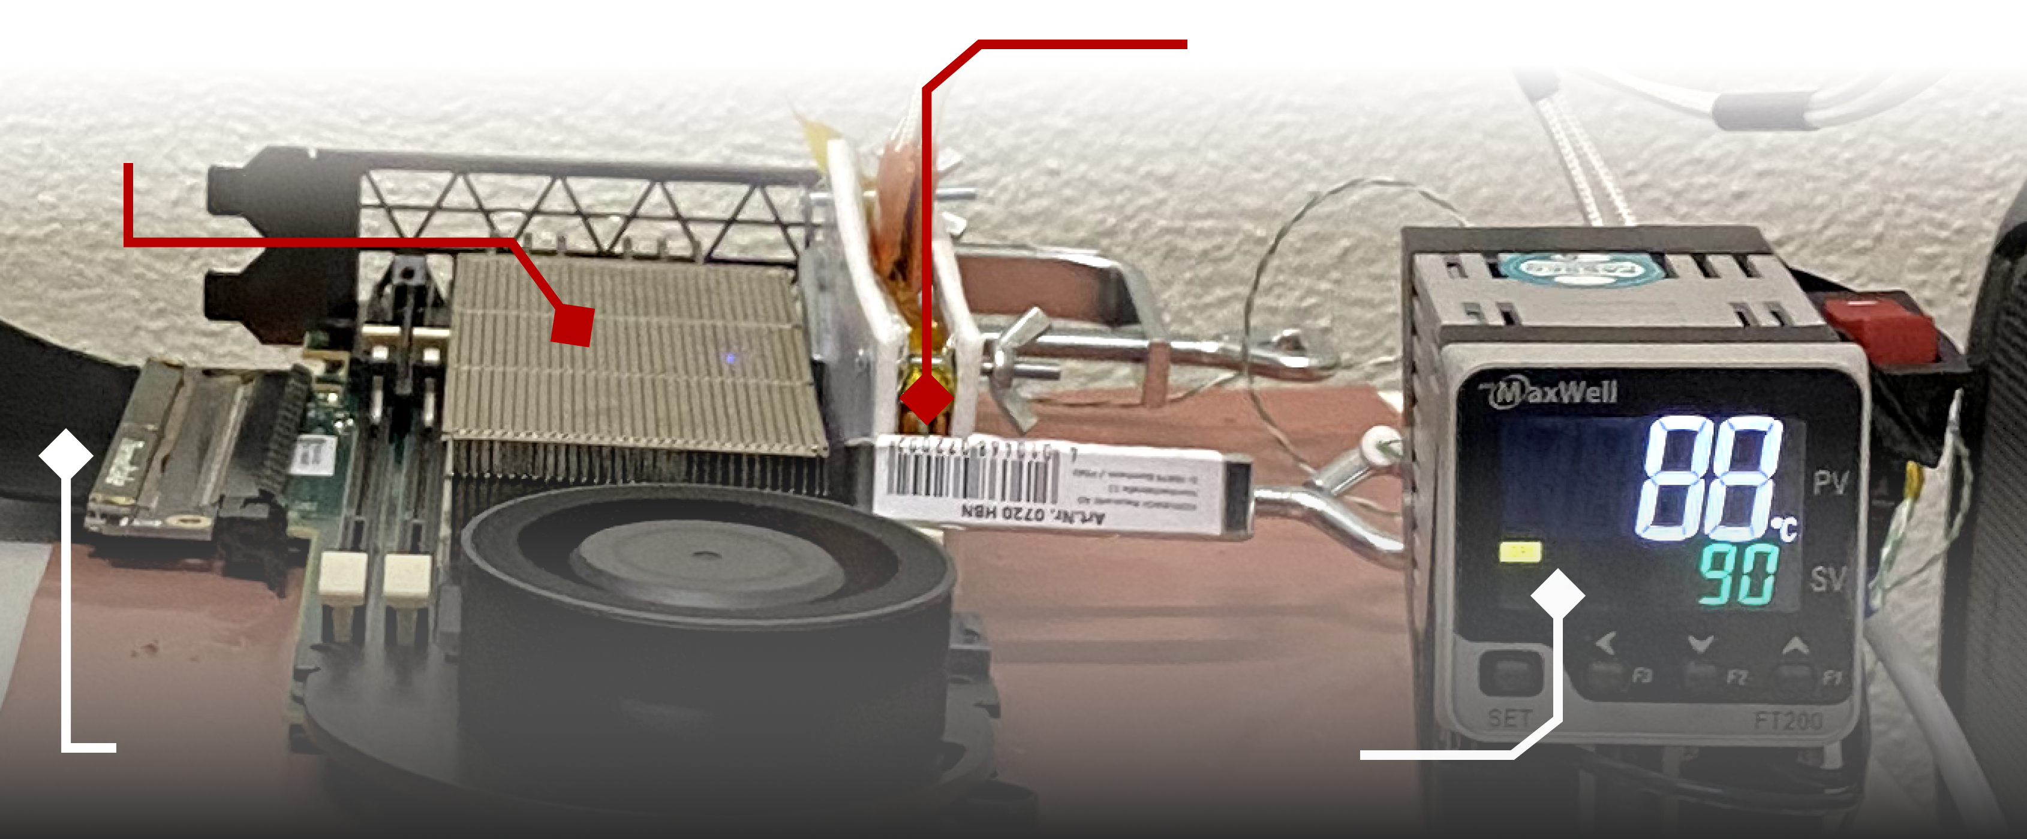
DRAM Testing Infrastructure
FPGA-based SoftMC (Xilinx Virtex UltraScale+ XCU200)
Xilinx Alveo U200 FPGA Board (programmed with SoftMC*)
DRAM Module with Heaters
PCIe
Host Interface
MaxWell FT200 Temperature Controller
Fine-grained control over DRAM commands,
timing parameters (±1.5ns), and temperature (±0.1°C )
*Hassan et al., "SoftMC: A Flexible and Practical Open-Source Infrastructure for Enabling Experimental DRAM Studies," in HPCA, 2017. [Available on GitHub: https://github.com/CMU-SAFARI/SoftMC]
Notes:
We use an FPGA-based experimental setup programmed with a modified version of SoftMC [CLICK]
This infrastructure provides us with a fine-grained control over DRAM commands, timing parameters, and temperature [CLICK]
=======

Slide 19
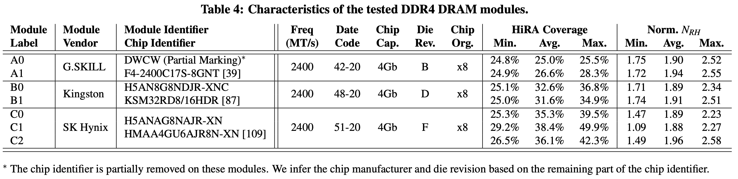
HiRA in Off-the-Shelf DRAM Chips: Key Result 1
HiRA works in 56 off-the-shelf DRAM chips from SK Hynix
HiRA performs a given row’s refresh concurrently with activating any of the 32% of the rows in the same bank
Refresh RowA
HiRA(RowA, RowB)
ACT RowB
32%
DRAM Bank
Notes:
We observe that HiRA works in 56 off-the-shelf dRAM chips from SK-Hynix, which we specify in the full paper [CLICK]
To leverage HiRA [CLICK]
for a given DRAM row's refresh, [CLICK]
we can choose any of the 32% of the rows in the same bank to activate concurently with the refresh [CLICK]

Slide 20
HiRA in Off-the-Shelf DRAM Chips: Key Result 2
HiRA works in 56 off-the-shelf DRAM chips from SK Hynix
51.4% reduction in the time spent for refresh operations
HiRA effectively reduces the time spent for refresh operations in off-the-shelf DRAM chips
Notes:
And we observe that HiRA reduces time spent for refresh operations by 51.4% [CLICK]
Therefore, we conclude that HiRA effectively reduces the time spent for refresh operation in off-the-shelf DRAM chips [CLICK]

Slide 21
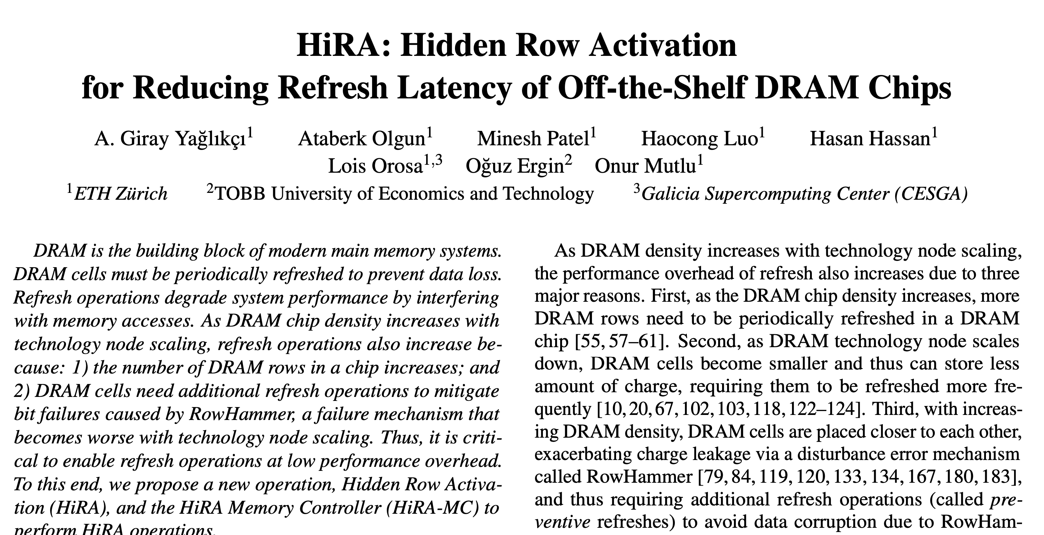

HiRA in Off-the-Shelf DRAM Chips: Key Results
HiRA works in 56 off-the-shelf DRAM chips from SK Hynix
51.4% reduction in the time spent for refresh operations
HiRA performs a given row’s refresh concurrently with activating any of the 32% of the rows in the same bank
Refresh RowA
ACT RowB
32%
HiRA(RowA, RowB)
https://arxiv.org/pdf/2209.10198.pdf
DRAM Bank
HiRA effectively reduces the time spent for refresh operations in off-the-shelf DRAM chips
Notes:
The full paper contains more experimental results [CLICK]

Slide 22
Outline
Background and Problem
Motivation and Goal
Experimental Methodology
Temperature Analysis
Aggressor Row Active Time Analysis
Spatial Variation Analysis
Implications on Attacks and Defenses
Conclusions
Goal and Key Idea
HiRA: Hidden Row Activation
HiRA in Real DRAM Chips
HiRA-MC: HiRA Memory Controller
Performance Evaluation
Conclusion
Notes:
We propose a new mechanism called hiRA Memory Controller to leverage HiRA’s parallelism

Slide 23
HiRA-MC: HiRA Memory Controller
Goal: Leverage HiRA’s parallelism as much as possible
Key Insight: A time slack is needed to find a row activation and a refresh to perform HiRA
RowA and RowZ are in two electrically disconnected subarrays
time slack
time
Ref(RowA) is generated
ACT
RowX
ACT
RowY
ACT
RowZ
ACT
RowT
Ref(RowA)
deadline
time slack
time
Ref(RowA) is generated
ACT
RowX
ACT
RowY
HiRA
RowA,RowZ
ACT
RowT
Ref(RowA) deadline
Notes:
HiRA-MC’s goal is to leverage HiRA’s parallelism as much as possible [CLICK]
It is based on the key insight that a time slack is needed to find a row activation and a refresh that we can perform HiRA on [CLICK]
Here is an example on a timeline [CLICK]
HiRA-MC generates a refresh request [CLICK]
With a time slack before it needs to be performed [CLICK]
During this time slack, the memory controller can perform row activations [CLICK]
Assuming that RowZ and RowA are in two electrically disconnected subarrays, [CLICK]
HiRA-MC replaces rowZ’s activation with a hiRA operation targeting both RowA and RowZ. [CLICK]

Slide 24
HiRA-MC: HiRA Memory Controller
Generates each periodic refresh and RowHammer-preventive refresh with a deadline
Buffers each refresh request and performs the refresh request until the deadline
Finds if it can refresh a DRAM row concurrently with a DRAM access or another refresh
1
2
3
Notes:
HiRA-MC contains the necessary components to timely generate each periodic and RowHammer-preventive refresh request with a deadline [CLICK]
To buffer each refresh request until its deadline [CLICK]
And to find if it can refresh a row concurrently with a DRAM access or another refresh request [CLICK]

Slide 25
HiRA-MC: HiRA Memory Controller
Generates each periodic refresh and RowHammer-preventive refresh with a deadline
Buffers each refresh request and ensures to perform the refresh request until the deadline
Finds if it can refresh a DRAM row concurrently with a DRAM access or another refresh
1
2
3
https://arxiv.org/pdf/2209.10198.pdf
Notes:
Please refer to the full paper for the mechanism's details [CLICK]

Slide 26
Outline
Background and Problem
Motivation and Goal
Experimental Methodology
Temperature Analysis
Aggressor Row Active Time Analysis
Spatial Variation Analysis
Implications on Attacks and Defenses
Conclusions
Goal and Key Idea
HiRA: Hidden Row Activation
HiRA in Real DRAM Chips
HiRA-MC: HiRA Memory Controller
Performance Evaluation
Conclusion
Notes:
Let me quickly go over the performance evaluation

Slide 27
Performance Evaluation
Cycle-level simulations using Ramulator [Kim+, CAL 2015]
System Configuration:
Workloads: 125 different 8-core multiprogrammed workloads from the SPEC2006 benchmark suite
DRAM Chip Capacity: {2, 4, 8, 16, 32, 64, 128} Gb
RowHammer Threshold: {1024, 512, 256, 128, 64} activations The minimum number of row activations needed to induce the first RowHammer bit flip
Processor | 3.2 GHz, 8 core, 4-wide issue, 128-entry instr. window
Last-Level Cache | 64-byte cache line, 8-way set-associative, 8 MB
Memory Scheduler | FR-FCFS
Address Mapping | Minimalistic Open Pages
Main Memory | DDR4, 4 bank group, 4 banks per bank group (16 banks per rank)
Timing Parameters | t₁=t₂=3ns, t_{RC}= 46.25ns, t_{FAW}=16ns
Notes:
We use Ramulator for cycle-level simulations in our performance evaluation [CLICK]
We simulate a realistic system with the shown parameters that I will not explain in detail [CLICK]
We simulate 125 different 8-core multiprogrammed workloads [CLICK]
We sweep DRAM chip capacity from 2Gb to 128Gb [CLICK]
And RowHammer threshold: the minimum number of activations needed to induce the first RowHammer bit flip from 1K to 64 [CLICK]

Slide 28
HiRA for Periodic Refreshes
No-Refresh: No periodic refresh is performed (Ideal case)
Baseline: Auto-Refresh (using conventional REF commands)
26%
slowdown
12.6% speedup
Periodic refreshes cause significant (26%) performance overhead
HiRA improves system performance by 12.6% over the baseline
Notes:
This plot shows DRAM chip capacity on the x-axis and system performance on the y-axis [CLICK]
System performance is normalized to an ideal system with no periodic refresh [CLICK]
Baseline system uses conventional REF commands [CLICK]
We observe that periodic refreshes cause significant slow down as DRAM chip capacity increases [CLICK]
And HiRA improves system performance by 12.6% compared to the baseline [CLICK]

Slide 29
HiRA for Preventive Refreshes
No Defense: No RowHammer mitigation employed (i.e., no preventive refresh)
PARA [Kim+, ISCA’14]: the RowHammer defense with the lowest hardware overhead
96%
slowdown
3.7x speedup
PARA significantly reduces (by 96%) system performance
HiRA improves system performance by 3.7x over PARA
Notes:
This plot shows RowHammer threshold on the x-axis and system performance on the y-axis [CLICK]
System performance is normalized to a system with no RowHammer defense and thus no preventive refreshes [CLICK]
As the baseline, we choose PARA the RowHammer defense with the lowest hardware overhead for this analysis [CLICK]
We observe that preventive refreshes cause significant slow down as RowHammer threshold reduces[CLICK]
And HiRA improves system performance by 3.7x compared to PARA [CLICK]
Proof of concept

Slide 30
More in the Full Paper
Real DRAM Chip Experiments
Verification of HiRA’s functionality
Variation in HiRA’s characteristics across banks
Sensitivity to
length of time slack for refreshes
number of channels
number of ranks
Hardware Complexity Analysis
Chip area cost of 0.0023% of a processor die per DRAM rank
No additional latency overhead
Experimental Methodology
Detailed algorithms for each set of real chip experiments
Extensive security analysis for RowHammer-preventive refreshes
Detailed Algorithm of Finding Concurrent Refreshes
Notes:
Please refer to the full paper for more
Real DRAM chip experiments on verification of HiRA and HiRA’s variation across banks [CLICK]
Sensitivity to the time slack and the number of channels and ranks [CLICK]
The hardware complexity analysis where we show that HiRA-MC is a low cost mechanism [CLICK]
Details about the experimental methodology, including detailed algorithms of real chip experiments and an extensive security analysis for preventive refreshes [clICK]
And detailed algorithm of finding concurrent refreshes [CLICK]

Slide 31
More in the Full Paper
Real DRAM Chip Experiments
verify that HiRA’s second row activation is performed
analyze the variation across banks
Sensitivity to
the length of time slack for refreshes
the number of channels
the number of ranks
Hardware Complexity Analysis
Chip area cost of 0.0023% of a processor die per DRAM rank
No additional latency overhead
Experimental methodology
provide detailed algorithms for each set of real chip experiments
an extensive security analysis for the RowHammer defense
Detailed Algorithm of Finding Concurrent Refreshes
https://arxiv.org/pdf/2209.10198.pdf
Notes:
The full paper is available on arxiv

Slide 32
Outline
Background and Problem
Motivation and Goal
Experimental Methodology
Temperature Analysis
Aggressor Row Active Time Analysis
Spatial Variation Analysis
Implications on Attacks and Defenses
Conclusions
Goal and Key Idea
HiRA: Hidden Row Activation
HiRA in Real DRAM Chips
HiRA-MC: HiRA Memory Controller
Performance Evaluation
Conclusion
Notes:
In conclusion

Slide 33
Conclusion
HiRA: Hidden Row Activation – a new DRAM operation
First technique that refreshes a DRAM row concurrently with activating another row in the same bank in off-the-shelf DRAM chips
Real DRAM chip experiments:
HiRA works on 56 real off-the-shelf DRAM chips
51.4% reduction in the time spent for refresh operations
HiRA-MC: HiRA Memory Controller – a new mechanism
Leverages HiRA to perform refresh requests concurrently with DRAM accesses and other refresh requests
HiRA-MC provides:
12.6% speedup by hiding periodic refresh latency
3.7x speedup by hiding RowHammer-preventive refresh latency
Notes:
We propose HiRA the first DRAM operation that refreshes a DRAM row concurrently with activating another row in the same bank in off-the-shelf DRAM chips [CLICK]
We experimentally demonstrate on 56 real DRAM chips that [CLICK]
HiRA significantly reduces time spent for refresh operations [CLiCK]
We propose a new mechanism called HiRA-MC that leverages HiRA’s parallelism as much as possible [CLICK]
And significantly improves system performance by hiding the latency of both periodic and preventive refreshes
COLOR CHANGE IN RESULTS

Slide 34
HiRA: Hidden Row Activation for Reducing Refresh Latency of Off-the-Shelf DRAM Chips
Abdullah Giray Yağlıkçı
Ataberk Olgun Minesh Patel Haocong Luo Hasan Hassan
Lois Orosa Oğuz Ergin Onur Mutlu
Notes:
This concludes my talk. Thanks for listening. I’m happy to answer your questions.

Slide 35
HiRA: Hidden Row Activation for Reducing Refresh Latency of Off-the-Shelf DRAM Chips
Backup Slides
Abdullah Giray Yağlıkçı
Ataberk Olgun Minesh Patel Haocong Luo Hasan Hassan
Lois Orosa Oğuz Ergin Onur Mutlu
Notes:
This concludes my talk. Thanks for listening. I’m happy to receive your questions.

Slide 36
The RowHammer Vulnerability
DRAM Subarray
Row 0
Row 1
Row 1
Row 1
open (high voltage)
open (high voltage)
open (high voltage)
closed (low voltage)
closed (low voltage)
Row 2
Row 2
Row 2
Row 2
Row 2
Row 2
Row 3
Row 3
Row 3
Aggressor Row
Row 2
closed
Row 4
Repeatedly opening (activating) and closing (precharging) a DRAM row in real DRAM chips causes RowHammer bit flips in nearby cells
Notes:
Due to an increase in cell-to-cell interference, as a result of aggressive technology node scaling in real DRAM chips, repeatedly activating [CLICK] and precharging
[FORTH & BACK] a DRAM row can result in bit flips in physically adjacent rows [CLICK]
[FORTH & BACK] Continuing to access the same row results in even more failures in nearby rows. This phenomenon is known as RowHammer. [CLICK]
We refer to the rapidly accessed row as an aggressor row and the rows containing bit flips as victim rows.

Slide 37
Preventive Refresh
DRAM Subarray
Row 0
Row 0
Row 0
ACT
Victim Row
Row 1
Row 1
Row 1
Row 1
ACT
Victim Row
open (high voltage)
open (high voltage)
open (high voltage)
closed (low voltage)
closed (low voltage)
Row 2
Row 2
Row 2
Row 2
Row 2
Row 2
Aggressor Row
Aggressor Row
Row 3
Row 3
Row 3
Row 3
ACT
Victim Row
Row 2
closed
Row 4
Row 4
Row 4
ACT
Victim Row
Activating a DRAM row refreshes the row and prevents RowHammer bit flips
Notes:
Due to an increase in cell-to-cell interference, as a result of aggressive technology node scaling in real DRAM chips, repeatedly activating [CLICK] and precharging
[FORTH & BACK] a DRAM row can result in bit flips in physically adjacent rows [CLICK]
[FORTH & BACK] Continuing to access the same row results in even more failures in nearby rows. This phenomenon is known as RowHammer. [CLICK]
We refer to the rapidly accessed row as an aggressor row and the rows containing bit flips as victim rows.

Slide 38


Mitigating RowHammer
Row 0
ACT
Row 1
Row 2 is being hammered
open
closed
Row 2
ACT
Refresh neighbor rows
Row 3
Row 4
Preventive Refresh
Activating potential victim rows mitigate RowHammer by refreshing them
Notes:
To protect their DRAM chips against RowHammer, DRAM vendors currently implement proprietary RowHammer mitigation mechanisms typically called Target Row Refresh or (TRR)
[CLICK] The key idea of TRR is to refresh nearby rows upon detecting an aggressor row
[CLICK] We demonstrate how TRR operates at a high-level.
[CLICK] The TRR mechanism detects [CLICK] an aggressor row as a result of [CLICK] repeatedly activating and precharging the same row. [CLICK]
[CLICK] To protect the neighbor victim rows from experiencing RowHammer bit flips, [CLICK] TRR refreshes the victim rows by performing TRR-induced refresh operations. TRR refreshes victim rows by piggybacking TRR-induced refreshes to the REFRESH commands that the memory controller periodically issues.

Slide 39
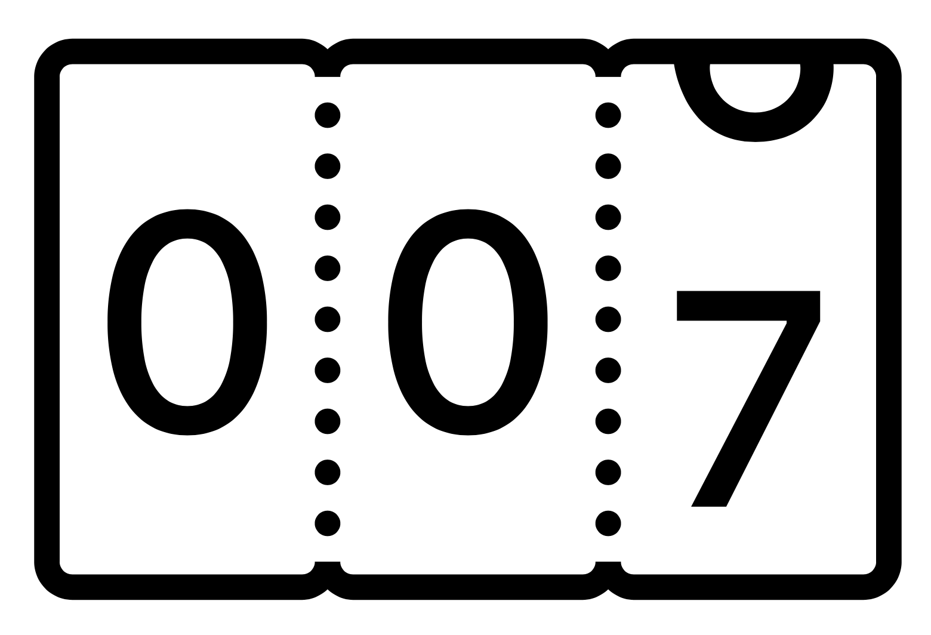

RowHammer and Preventive Refresh
RowHammer: Repeatedly accessing a DRAM row can cause bit flips in other physically nearby rows
Preventive Refresh: Refresh a DRAM row when a physically nearby row is activated based on activation counts or probabilistic processes
Preventive
Refresh
Preventive refresh mitigates RowHammer bit flips
Significant performance and energy overhead

Slide 40
HiRA: Hidden Row Activation
HiRA concurrently activates two rows in a DRAM bank
Challenge 1 : Only one row can be activated in a DRAM bank at a given time
Solution 1 : HiRA violates timing constraints for concurrent row activations
HiRA issues two row activation (ACT) commands in quick succession
Challenge 2 : DRAM chips ignore the second activation before precharge
Solution 2 : HiRA issues a precharge (PRE) command between two ACTs
HiRA activates two DRAM rows in the same bank
Challenge 3: The two rows can override each other’s data via shared bitlines
Solution 3 : HiRA uses rows from two electrically disconnected subarrays
HiRA violates DRAM timing constraints by issuing a sequence of ACT-PRE-ACT commands that target two rows in two electrically disconnected subarrays
Notes:
To make HiRA work, we overcome three challenges: [CLICK]
First, HiRA concurrently activates two rows in the same bank [CLICK]
But row activations in a bank are not performed concurrently [CLICK]
HiRA overcomes this challenge by violating certain timing constraints that leads to concurrent row activations in a bank [CLICK]
Second, HiRA needs to issue two row activation commands in quick succession [CLICK]
But DRAM chips ignore a. second row activation before a DRAM bank is precharged [CLICK]
HiRA overcomes this challenge by issuing a precharge command in between two row activations [CLICK]
Third, HiRA activates two DRAM rows in the same bank [CLICK]
But concurrently activating two rows in the same bank can lead the two rows to override each other’s data over shared bitlines [CLICK]
HiRa overcomes this challenge by choosing two rows from electrically disconnected subarrays [CLICK]
Therefore, hiRA violates DRAM timing constraints in issuing a sequence of Act-PRE-ACT commands that target two rows in two electrically disconnected subarrays []CLICK

Slide 41
HiRA: Hidden Row Activation
Refreshing RowA concurrently with Activating RowB
RowB’s refresh
RowA’s refresh
Precharge
RowB’s activation
Without HiRA
time
ACT
RowA
PRE
ACT
RowB
RD
RD
PRE
The time saved using HiRA
HiRA
PRE
With HiRA
time
ACT
RowA
ACT
RowB
RD
RD
PRE
RowA’s refresh
Reduction in the time spent for two refreshes
RowB’s activation
RowB’s refresh

Slide 42
HiRA Operation
RowA
Local Row
Buffer X
RowB
Local Row
Buffer Y
Bank I/O
time
HiRA
ACT RowA
PRE
ACT RowB
RD
RD
RD
PRE
ACT
t₁
t₂
t_{RCD}
t_{RP}
t_{RestoreA}
t_{RestoreB}
Overlapped
HiRA refreshes RowA concurrently with activating RowB by issuing ACT-PRE-ACT commands in quick succession
Notes:
ACT RowA : Connencts RowA to its Local Row Buffer, starting the refresh of RowA
PRE: Interrupts row activation before the local row buffer X is connnected to the bank i/o
ACT RowB: Interrupts the PRE operation before it closes the rowB

Slide 43
HiRA in Off-the-Shelf DRAM Chips: Key Results
HiRA works in 56 off-the-shelf DRAM chips from SK Hynix
51.4% reduction in the time spent for refresh operations
HiRA performs a given row’s refresh concurrently with activating any of the 32% of the rows in the same bank
Refresh RowA
ACT RowB
32%
HiRA(RowA, RowB)
DRAM Bank
HiRA effectively reduces the time spent for refresh operations in off-the-shelf DRAM chips
Notes:
To leverage HiRA [CLICK]
for a given DRAM row's refresh, [CLICK]
we can choose any of the 32% of the rows in the same bank to concurrently activate [CLICK]
Therefore, HiRA effectively reduces the time spent for refresh operations in off-the-shelf DRAM chips [CLICK]
KEEP THE TABLE HERE

Slide 44
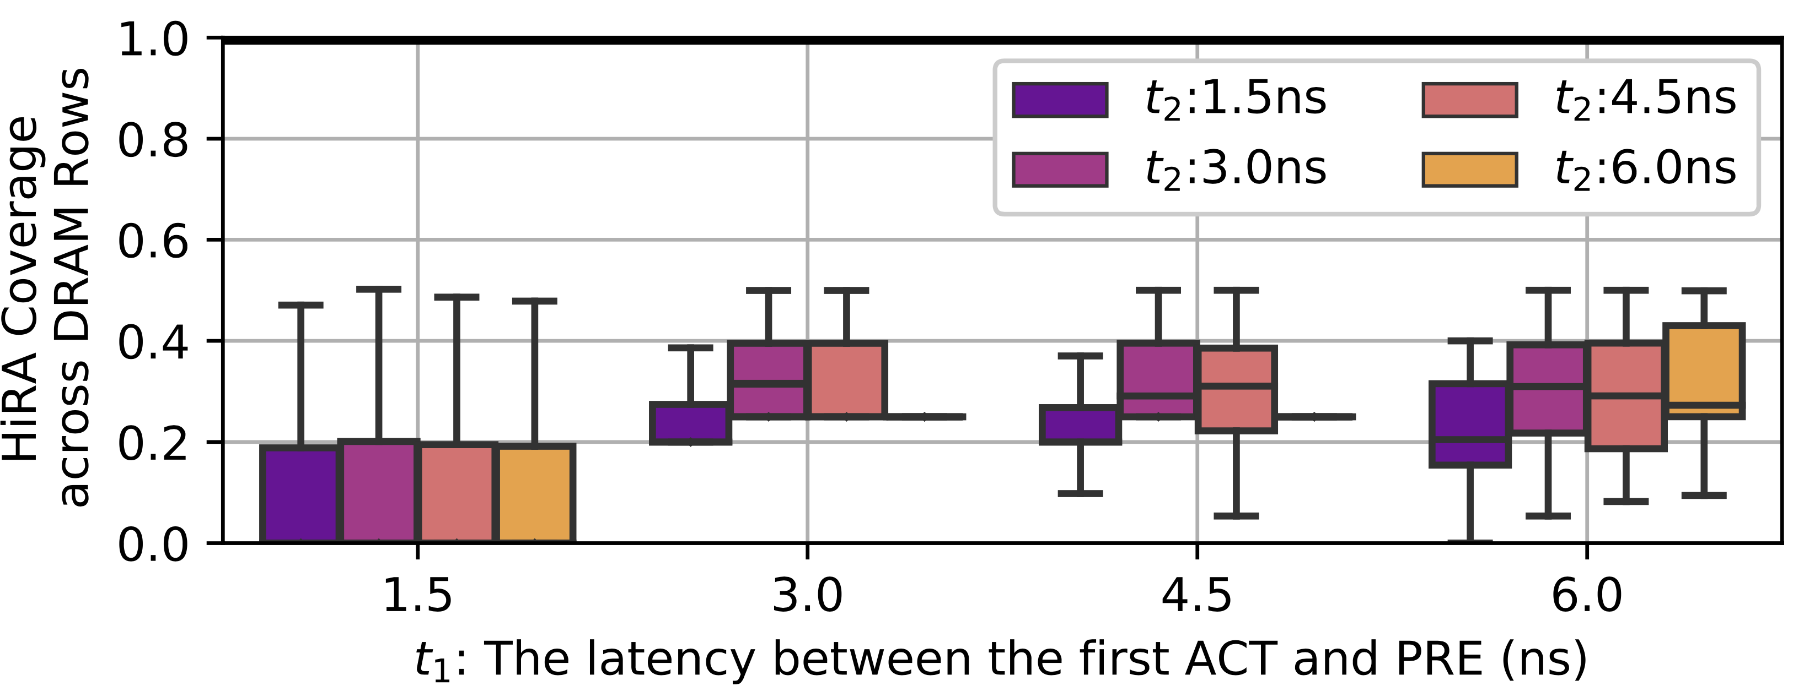
HiRA Support in Off-the-Shelf DRAM Chips
56 off-the-shelf DDR4 DRAM chips support HiRA (from SK Hynix)
HiRA Coverage of a given DRAM row:
Refresh a given DRAM row while activating other rows in the same bank
We sweep two timing parameters: t₁ and t₂
HiRA
ACT RowA
PRE
ACT RowB
t₁
t₂
t₁ and t₂ can be as small as 3ns
HiRA can refresh a DRAM row concurrently with 32% of any of the other DRAM rows in the same bank

Slide 45
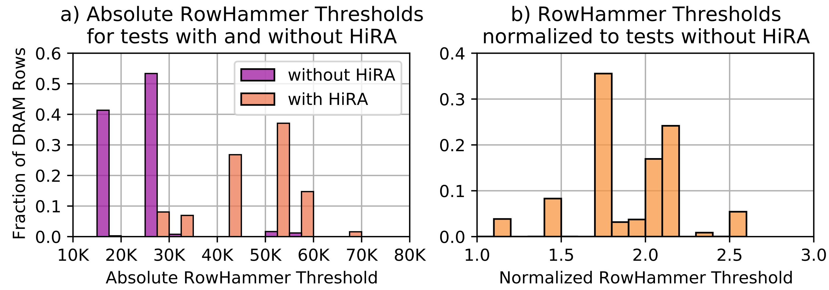
HiRA’s Second Row Activation
Hammer N/2 times
NOP
Hammer N/2 times
Hammer N/2 times
HiRA
Hammer N/2 times
Does performing HiRA in between refresh the victim row?
If HiRA’s second row activation is performed, more activations are needed to induce RowHammer bit flips
If HiRA’s second row activation is ignored, RowHammer threshold should not change

Slide 46
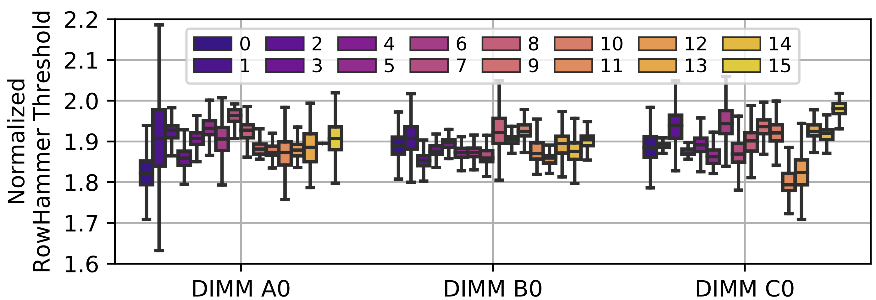
Variation across DRAM Banks
Coverage: Identical across banks
The effect of second row activation

Slide 47
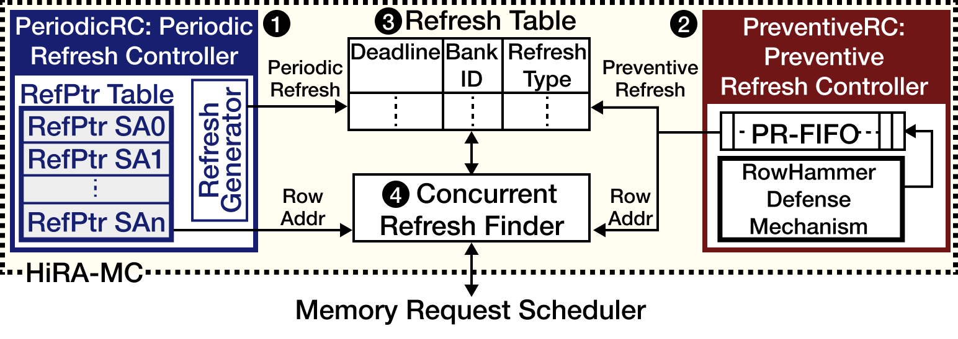
HiRA-MC: HiRA Memory Controller
Goal: Leverage HiRA’s parallelism as much as possible
Periodic and preventive refresh controllers generate each refresh request with a deadline
Refresh Table buffers a refresh request until its deadline
Concurrent Refresh Finder finds if HiRA can refresh a row
Concurrently with a memory request
Concurrently with another refresh request
Periodic Refresh Controller
Refresh Table
Preventive Refresh Controller
RefPtr Table
PR FIFO
RefPtr SA0
Refresh Generator
RefPtr SA1
RowHammer
Defense Mechanism
RefPtr SAn
Concurrent Refresh Finder
Memory Request Scheduler

Slide 48
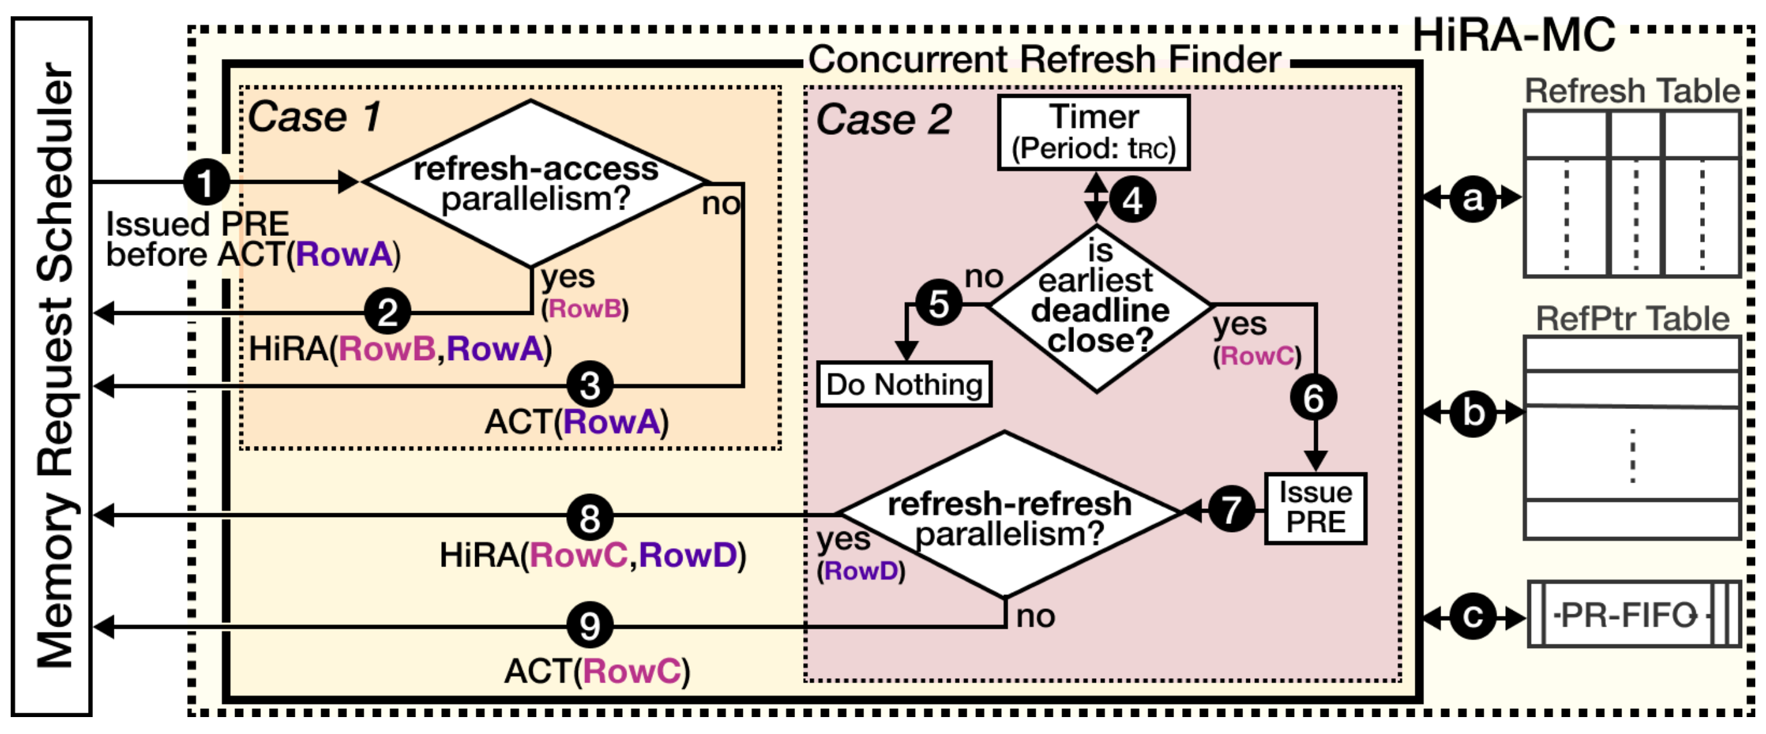
The Concurrent Refresh Finder
Case 1: Executes when a precharge is issued (completes before the precharge completes)
Case 2: Periodically executes after every t_{RC} (completes before t_{RC})

Slide 49
HiRA-MC Example
Case 1: Refresh – Access Parallelism
Case 2: Refresh – Refresh Parallelism
Memory Request Queue
Refresh Table
HiRA(Row SA:B Row:6, SA:A Row:0)
ACT SA:B Row:6
ACT SA:A Row:0
REF SA:C Row:2
time
RD SA:B Row:0
REF SA:B Row:1
PRE
Head
RD SA:A Row:0
REF SA:B Row:6
6ns
Memory Request Queue
Refresh Table
HiRA(Row SA:B Row:1, SA:C Row:2)
ACT SA:B Row:1
ACT SA:C Row:2
REF SA:C Row:2
time
PRE
Head
RD SA:B Row:0
REF SA:B Row:1
6ns
HiRA-MC provides refresh-access and refresh-refresh parallelism

Slide 50
HiRA-MC Hardware Complexity
We use CACTI with 22nm technology node
HiRA-MC Component | Area (mm²) | Area (% of Chip Area) | Access Latency
Refresh Table | 0.00031 | <0.0001% | 0.07ns
RefPtr Table | 0.00683 | 0.0017% | 0.12ns
PR-FIFO | 0.00029 | <0.0001% | 0.07ns
Subarray Pairs Table | 0.00180 | 0.0005% | 0.09ns
Overall | 0.00923 | 0.0023% | 6.31ns
HiRA-MC consumes only 0.0023% of CPU chip area per DRAM rank
Precharge latency: ~14.5ns
time
PRE
HiRA-MC Overall Latency: 6.31ns
ACT
HiRA-MC does not increase memory access latency

Slide 51
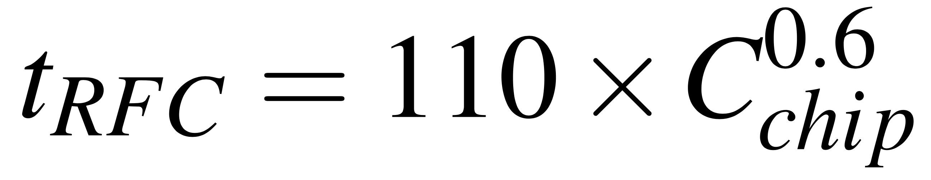
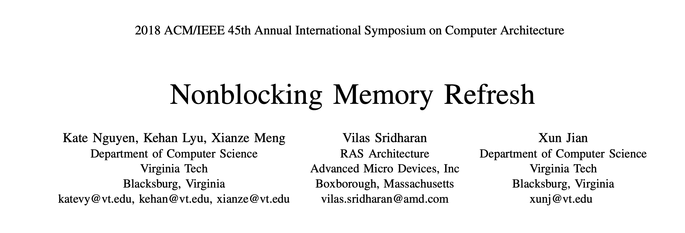
Estimating Periodic Refresh Overhead
Latency of a REF command
DRAM Chip
Capacity

Slide 52
Reducing Overall Latency of Two Refreshes
Refreshing two rows using nominal timing parameters:
Using HiRA:
t_{RAS}: 32ns
t_{RP}: 14.25ns
t_{RAS}: 32ns
time
ACT RowA
PRE
ACT RowB
PRE
51.4% reduction
t₁: 3ns
t₂: 3ns
t_{RAS}: 32ns
time
ACT RowA
PRE
ACT RowB
PRE
Overall latency of refreshing two rows reduces by 51.4%
from 78.25ns down to 38ns

Slide 53
Tested DRAM Chips
https://arxiv.org/pdf/2209.10198.pdf

Slide 54
HiRA-MC: HiRA Memory Controller
Periodic and preventive refresh controllers generate each refresh request with a deadline
Refresh Table buffers a refresh request until its deadline
Concurrent Refresh Finder finds if HiRA can refresh a row
Concurrently with a DRAM access
Concurrently with another refresh request
Refresh Table
Periodic Refresh Controller
Preventive Refresh Controller
Concurrent Refresh Finder
RowHammer
Defense Mechanism
Memory Request Scheduler

Slide 55
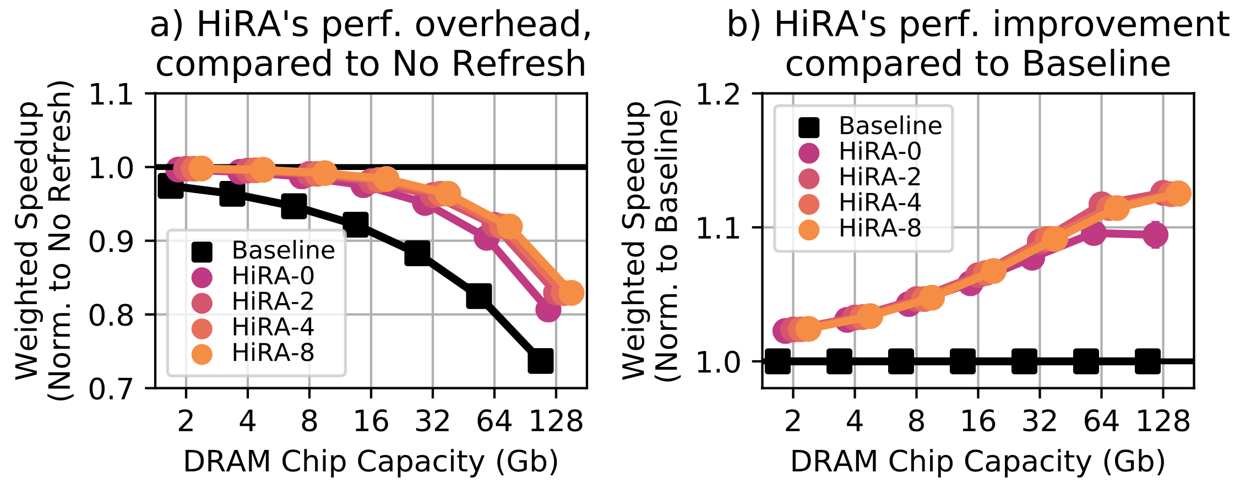
HiRA for Periodic Refreshes

Slide 56
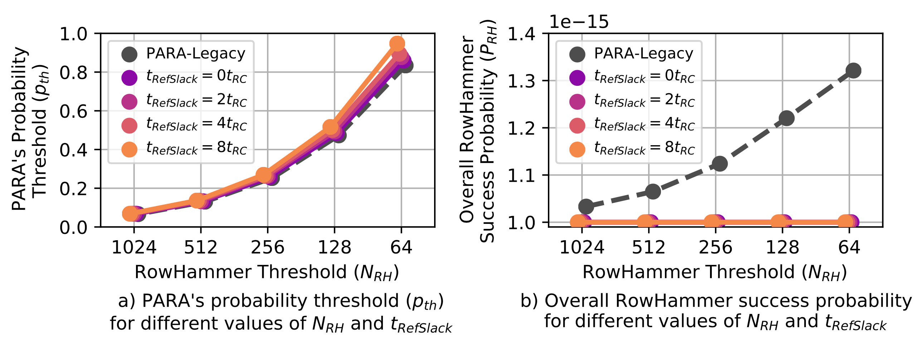
RowHammer Thresholds

Slide 57
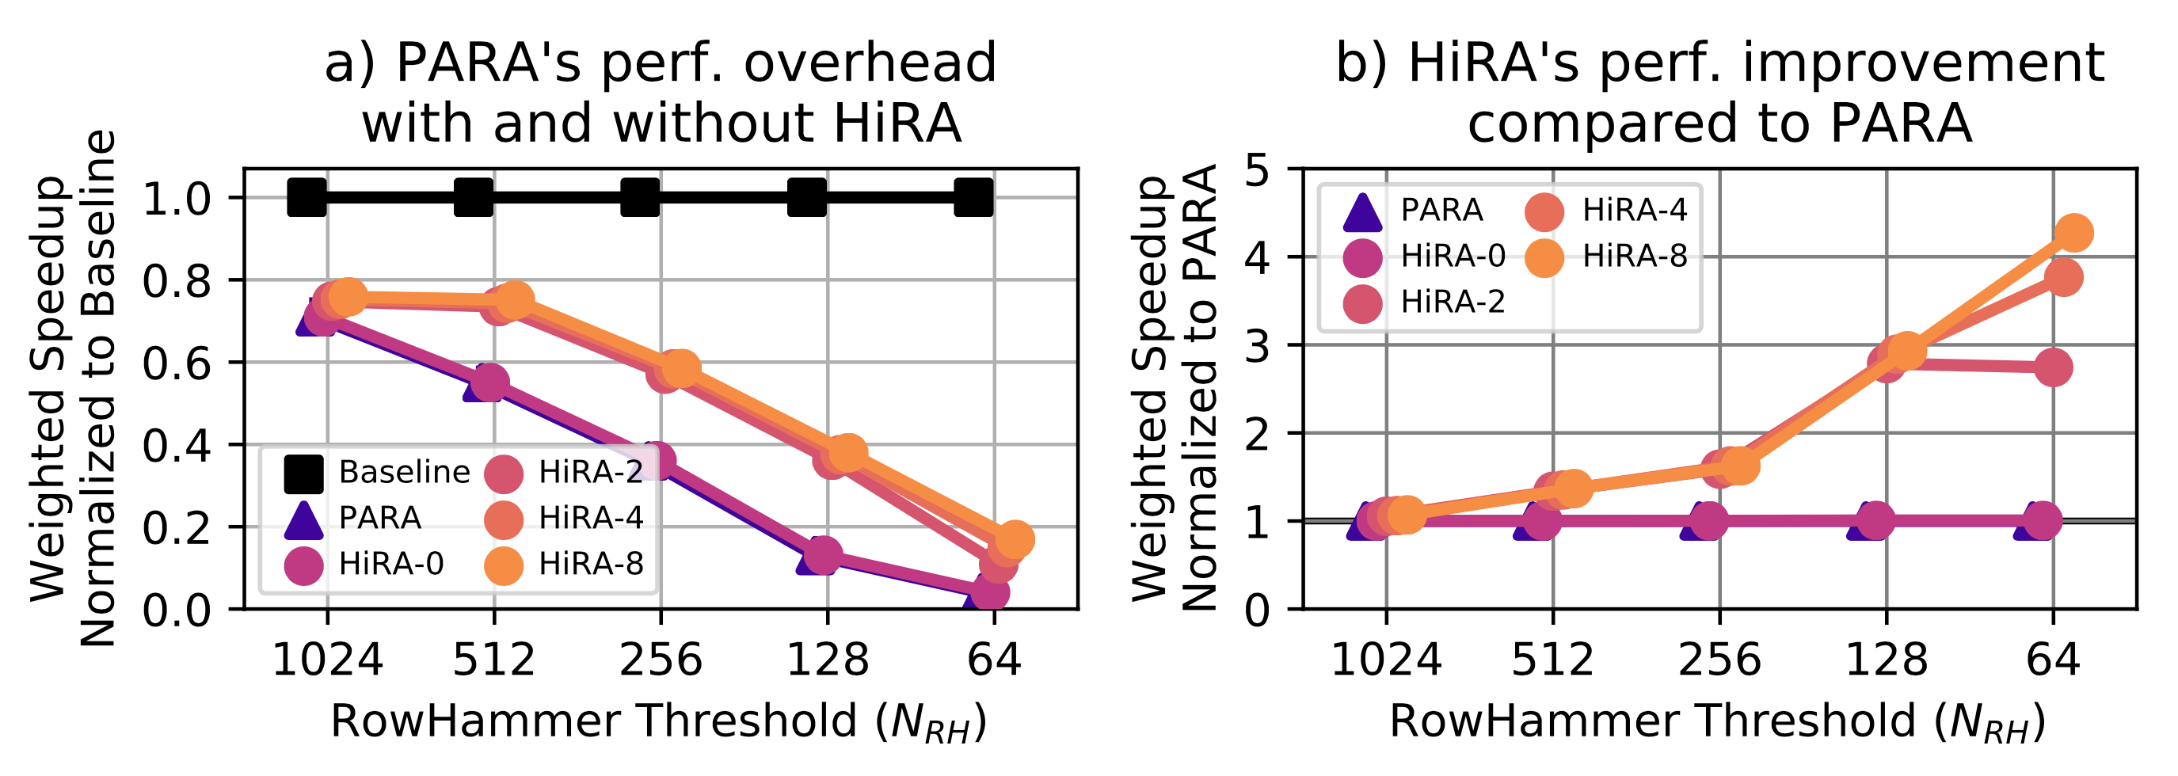
HiRA for Preventive Refreshes

Slide 58
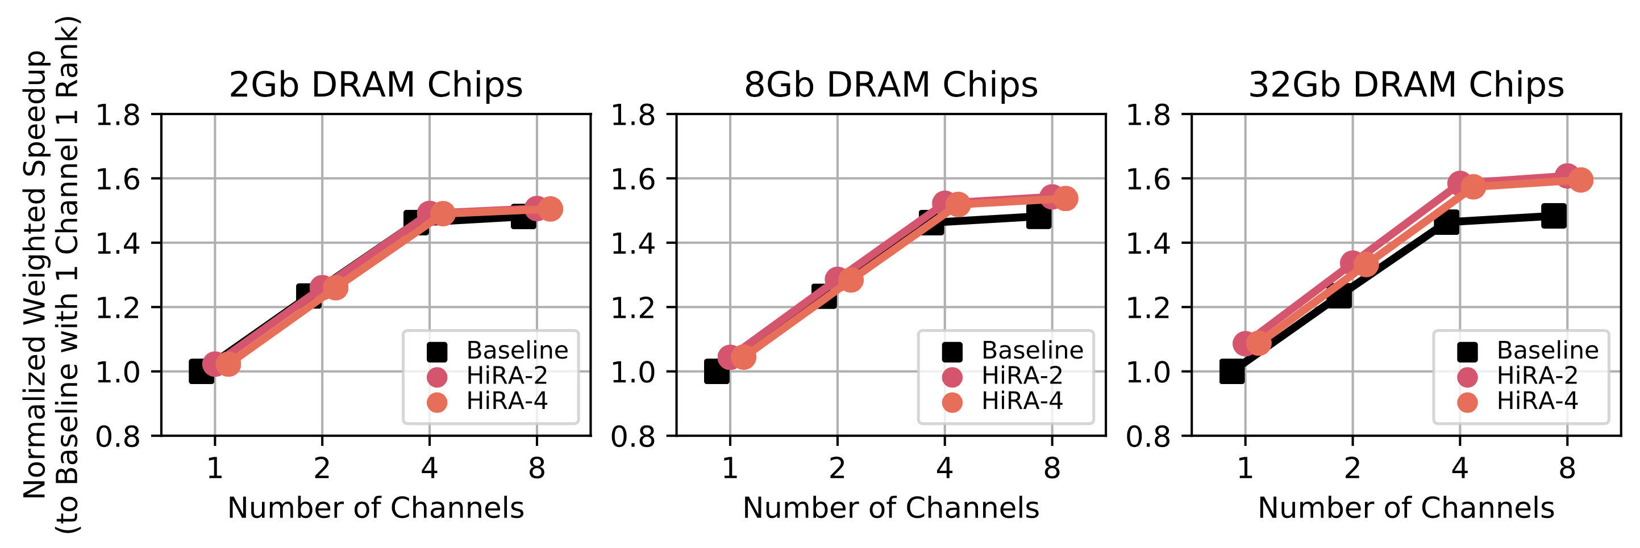
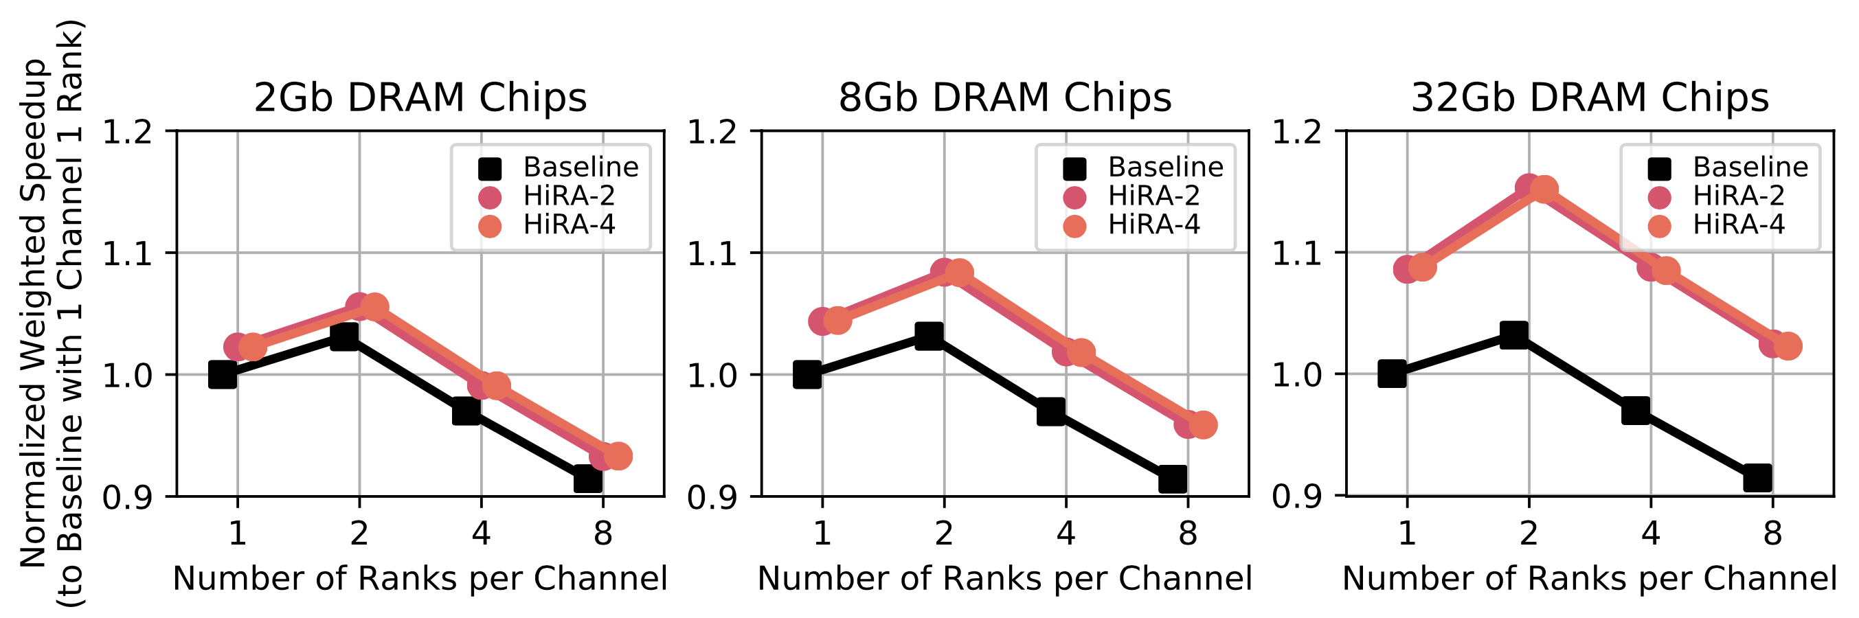
HiRA for Periodic Refresh Sensitivity to Number of Channels and Ranks

Slide 59
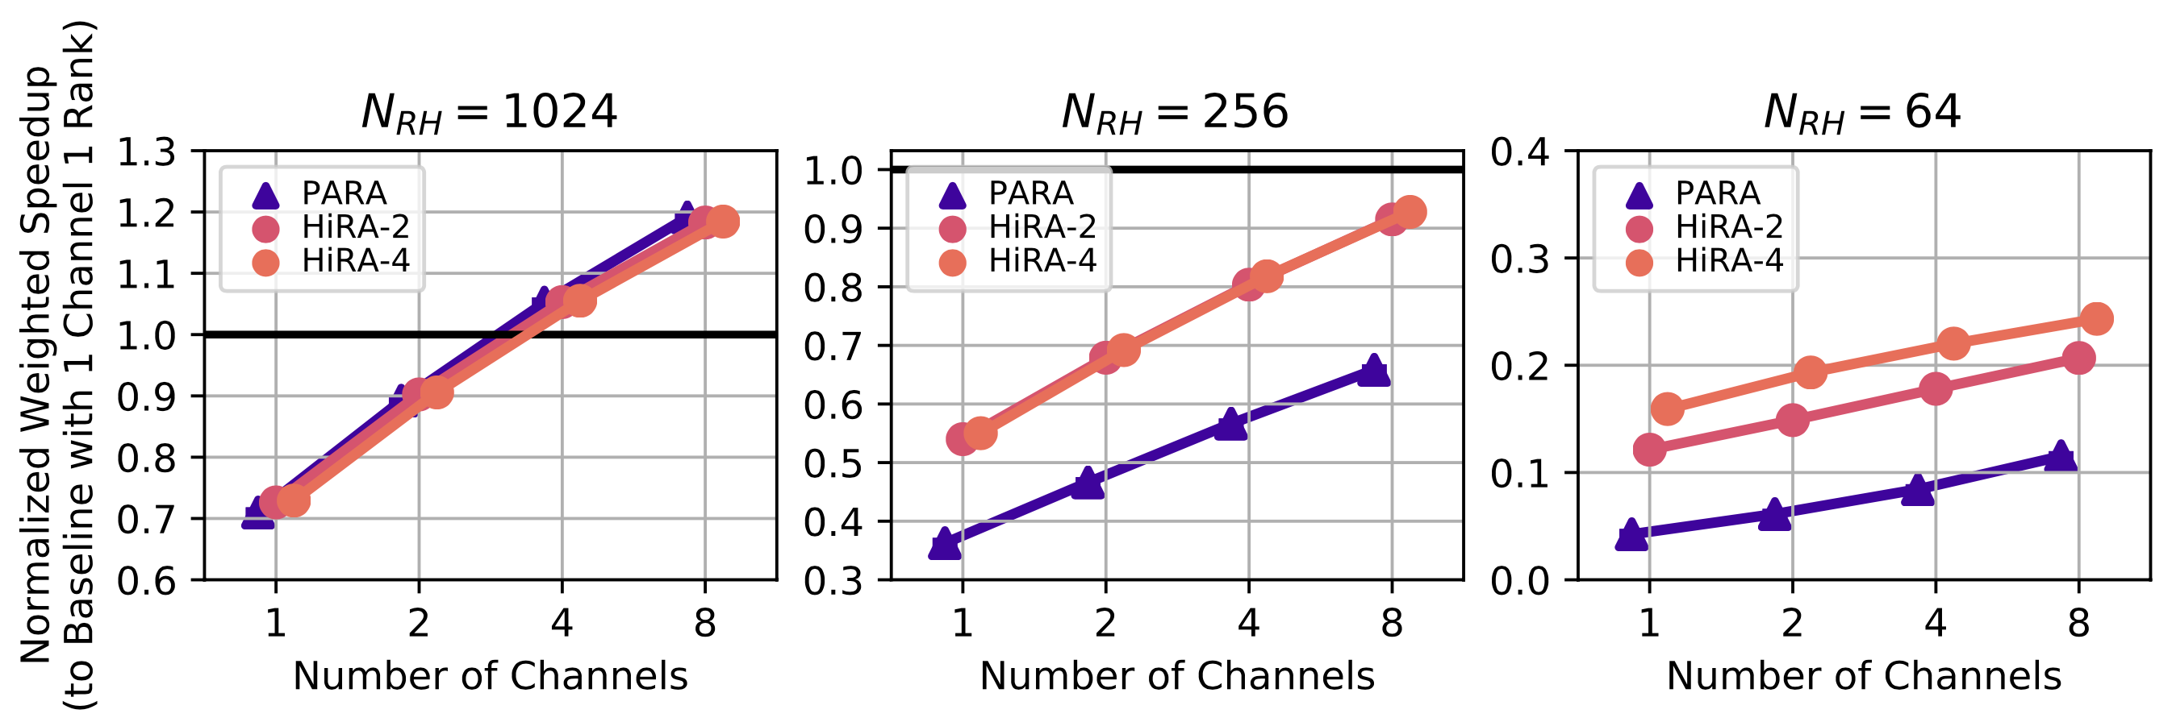
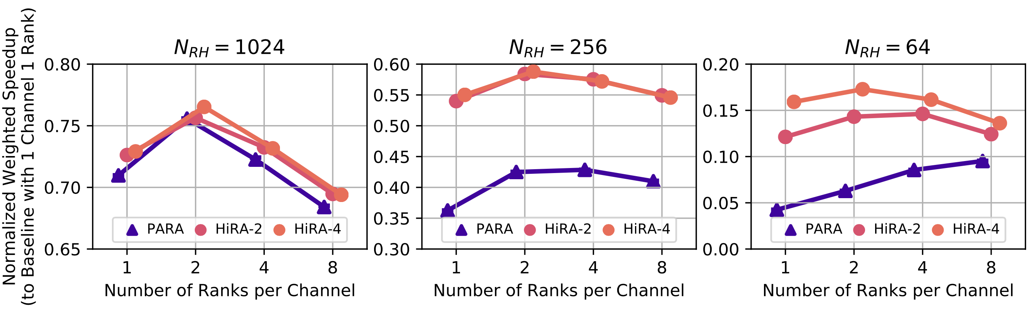
HiRA for Preventive Refresh Sensitivity to Number of Channels and Ranks

Slide 60
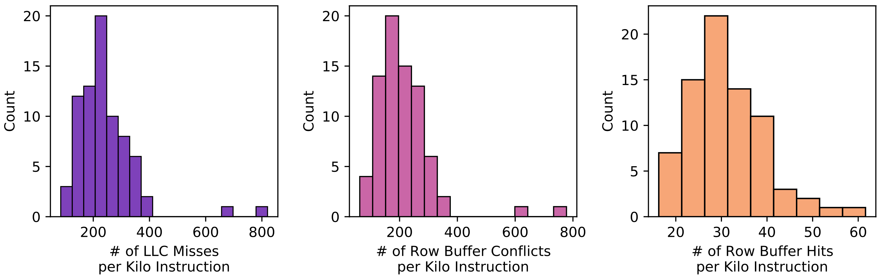
Workload Memory Access Characteristics
125 different 8-core multiprogrammed workloads
Three histograms showing MPKI, RBCPKI, and RBHPKI respectively
Notes:
ADD THIS TO ARXIV VERSION

Slide 61
RowHammer Mitigation across Generations
10⁵
10⁴
10³
10²
Ideal
14%
TWiCe-ideal
PARA
LPDDR4-1x
LPDDR4-1y
DDR3-old
DDR3-new
DDR4-new
DDR4-old
10⁵
10⁴
10³
10²
HC_{first} (number of hammers required to induce first RowHammer bit flip)
J. S. Kim, M. Patel, A. G. Yaglikci, H. Hassan, R. Azizi, L. Orosa, and O. Mutlu, "Revisiting RowHammer: An Experimental Analysis of Modern Devices and Mitigation Techniques,” in ISCA, 2020.

Slide 62
Refresh Delay
DDRx protocols allow a REF command to be postponed for ~70us
HiRA-MC’s current design does not leverage this flexibility
A longer time slack allows
the baseline to better utilize DRAM idle time to perform refresh operations
HiRA to find more opportunities to perform a refresh operation concurrently with a DRAM access
Future sensitivity study: the effect of long refresh delays
REF
7.8us
REF
7.8us
REF
7.8us
REF
7.8us
REF
REF
~70us
REF
REF
REF
REF
REF
7.8us
REF
7.8us
REF
7.8us
REF
7.8us
REF
REF
7.8us
REF
7.8us
REF
7.8us
REF
7.8us
REF
time slack
longer time slack

Slide 63
Energy
HiRA does not change the number of refresh operations at a given time window
Overall energy consumed for refresh operations is the same
HiRA improves system performance
Reduces the background energy consumption
Evaluation requires an accurate power model based on real system measurements, similar to VAMPIRE [Ghose+ SIGMETRICS’17], but for HiRA operations

Slide 64
HiRA: Hidden Row Activation for Reducing Refresh Latency of Off-the-Shelf DRAM Chips
Abdullah Giray Yağlıkçı
Ataberk Olgun Minesh Patel Haocong Luo Hasan Hassan
Lois Orosa Oğuz Ergin Onur Mutlu
Notes:
This concludes my talk. Thanks for listening. I’m happy to receive your questions.

Slide 65
HiRA in Off-the-Shelf DRAM Chips: Key Results
HiRA works in 56 off-the-shelf DRAM chips from SK Hynix
51.4% reduction in the time spent for refresh operations
A given row’s refresh can be performed concurrently with the activation of any of the 32% of the rows in the same bank
Refresh RowA
ACT RowB
32%
HiRA(RowA, RowB)
DRAM Bank
HiRA effectively reduces the time spent for refresh operations in off-the-shelf DRAM chips
Notes:
We observe that HiRA works in 56 off-the-shelf dRAM chips from SK-Hynix [CLICK]
To leverage HiRA for a given DRAM row's refresh, [CLICK]
we can choose any of the 32% of the rows in the same bank to activate [CLICK]
We observe that HiRA reduces time spent for refresh operations by 51.4% [CLICK]
Therefore, HiRA effectively reduces the time spent for refresh operations in off-the-shelf DRAM chips [CLICK]

Slide 66
HiRA in Off-the-Shelf DRAM Chips: Key Results
HiRA works in 56 off-the-shelf DRAM chips from SK Hynix
51.4% reduction in the time spent for refresh operations
A given row’s refresh can be performed concurrently with the activation of any of the 32% of the rows in the same bank
Refresh RowA
ACT RowB
32%
HiRA(RowA, RowB)
DRAM Bank
HiRA effectively reduces the time spent for refresh operations in off-the-shelf DRAM chips
Notes:
We observe that HiRA works in 56 off-the-shelf dRAM chips from SK-Hynix [CLICK]
To leverage HiRA for a given DRAM row's refresh, [CLICK]
we can choose any of the 32% of the rows in the same bank to activate [CLICK]
We observe that HiRA reduces time spent for refresh operations by 51.4% [CLICK]
Therefore, HiRA effectively reduces the time spent for refresh operations in off-the-shelf DRAM chips [CLICK]

