Slide 1





ITAP: Idle-Time-Aware Power Management for GPU Execution Units
Mohammad Sadrosadati | Seyed Borna Ehsani
Hajar Falahati | Rachata Ausavarungnirun
Arash Tavakkol | Mojtaba Abaee
Lois Orosa Hamid Sarbazi-Azad | Yaohua Wang Onur Mutlu

Slide 2
Executive Summary
Motivation: GPU execution units are frequently idle
Full-lane and partial-lane idleness
High static power
Problem: static energy represents a high percentage of the energy consumption on execution units
Key idea: Employ the most efficient power management mode for each idle period
Mechanism: Predict the idle period length and apply power-gating and different levels of voltage-scaling
Results:
27.6% more static energy savings than the state-of-the-art mechanisms
Less than 2.1% performance overhead

Slide 3
Outline
ion and Goal
Background
Motivation
Inefficiency of Prior Works
ITAP
Evaluation
Conclusion
Notes:
Here is the outline for the talk today [CLICK]

Slide 4
Outline
ion and Goal
Background
Motivation
Inefficiency of Prior Works
ITAP
Evaluation
Conclusion
Notes:
Here is the outline for the talk today [CLICK]

Slide 5
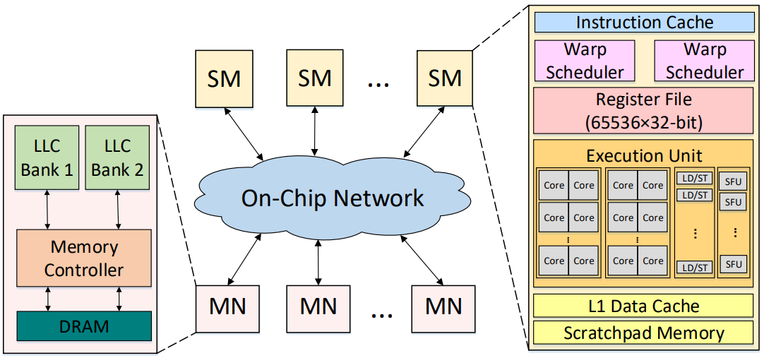
GPU Background
Groups of threads are assigned to a Streaming Multiprocessor (SM)
Single Instruction Multiple Data (SIMD) execution units
Threads within the SMs are divided into warps
Threads inside a warp are executed in parallel lock-step manner
All threads execute the same instruction
SIMD units are time-multiplexed between different warps
A SIMD lane executes the instructions of a thread

Slide 6
Static Power Reduction Techniques
The contribution of the static power to total power consumption is significant (e.g. 20% on an NVIDIA GTX 480 [Leng+ ISCA’13])
Sleep mode: reduces the power supply
The execution units do not function properly
Wake-up: the power supply is switched back to full in order to gain functionality
T_{wake_up} : wake-up time
E_{wake_up} : wake-up energy
T_{break_even} : minimum idle time for that the energy savings can break even with the energy overhead of wake-up

Slide 7
Sleep Modes
Two main sleep modes:
Power-gating (PG)
Cuts off the supply voltage entirely
Sleep transistor between the voltage supply line and the pull up network
T_{break_even} = 14 cycles
Voltage-scaling (VS)
Uses voltage regulators
T_{break_even} = 1-2 cycles (VS_{0.3}-VS_{0.5})

Slide 8
Outline
ion and Goal
Background
Motivation
Inefficiency of Prior Works
ITAP
Evaluation
Conclusion
Notes:
Here is the outline for the talk today [CLICK]

Slide 9
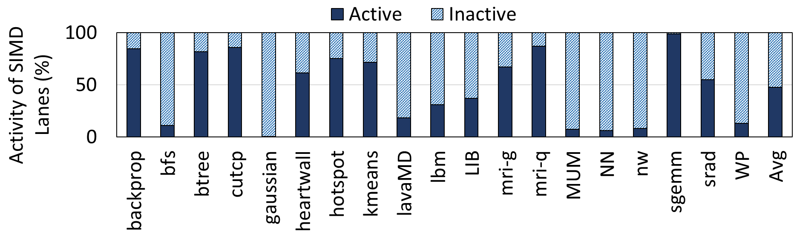
GPU Execution Units Are Frequently Idle
Around 53%
Why?
Partial-lane idleness
Branch divergence: when threads on a warp take different control flow paths
Full-lane idleness
There are no active warps to be scheduled for execution (e.g., memory accesses)

Slide 10
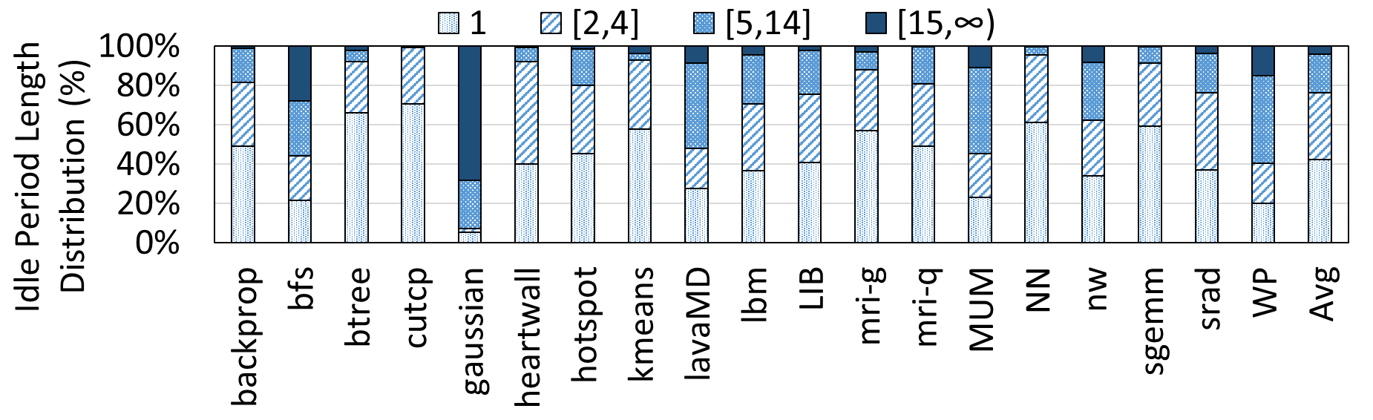
What Is The Main Challenge?
Dealing with different idle period lengths
95.9%
PG is not effective:
The length of the idle periods is shorter than T_{break_even} in most of the cases
Prior works do not cover all idle period sizes
Goal: cover 100% of idle periods
in an efficient way

Slide 11
Outline
ion and Goal
Background
Motivation
Inefficiency of Prior Works
ITAP
Evaluation
Conclusion
Notes:
Here is the outline for the talk today [CLICK]

Slide 12
Prior Works
We will show the inefficiency of prior works
in two cases:
Partial-lane idleness
Full-lane idleness

Slide 13
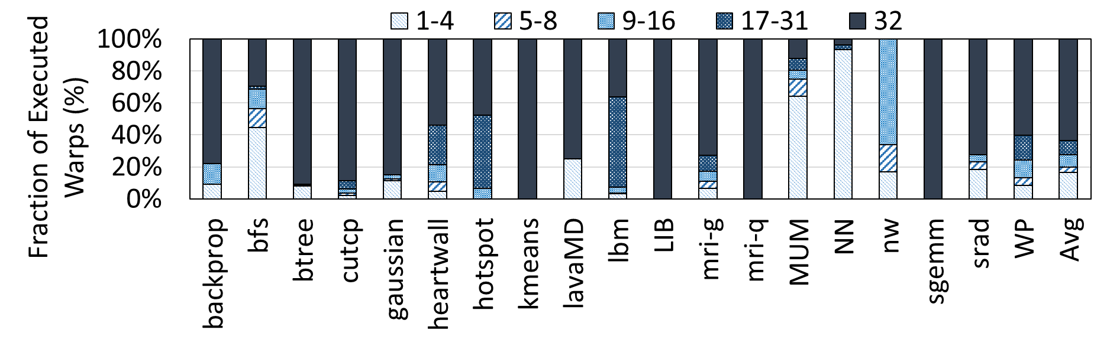
Partial-Lane Idleness
Active threads in a warp
35%
35% of warps are under-utilized
NN & MUM usually have 1-4 active threads
Prior solutions
Reducing lane size [Vaidya+ ISCA’13] → performance overhead
Thread block compaction [Fung+ HPCA’11]→ limited opportunity

Slide 14
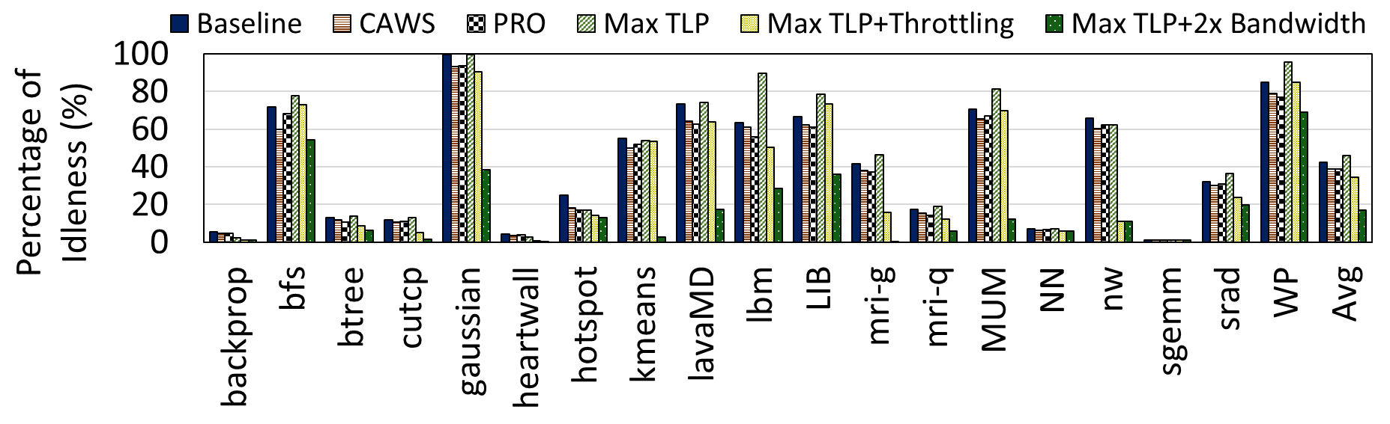
Full-Lane Idleness
42% full-lane idleness for the baseline GPU
35% full-lane idleness even after using state-of-the-art warp schedulers (CAWS & PRO)
Criticality-Aware Warp Scheduler (CAWS) [Lee+ PACT’14]: prioritize slower warps
Progress-Aware Warp Scheduler (PRO) [Anantpur+ IPDPS’15]: prioritize warps based on their progress
Max TLP: maximum (ideal) Thread Level Parallelism
Max TLP+Throttling: Max TLP + a state-of-the-art throttling mechanism to mitigate the contention caused by higher TLP
Max TLP+2x Bandwidth: double on/off-chip bandwidth
Even the ideal techniques have
significant full-lane idleness
Reducing leakage power of idle execution lanes is very important

Slide 15
Outline
ion and Goal
Background
Motivation
Inefficiency of Prior Works
ITAP
Evaluation
Conclusion
Notes:
Here is the outline for the talk today [CLICK]

Slide 16
ITAP: Idle-Time-Aware Power Management
Observation:
The best static power reduction technique depends on the length of the idle period
Key ideas:
Classify the idle periods on types (i.e., short, medium, or long periods)
Assign each type to the most effective power reduction technique
Short idle periods → Voltage-scaling to 0.5VDD
Medium idle periods → Voltage-scaling to 0.3VDD
Long idle periods → Power-gating
Predict idle period types
Use a peek-ahead approach for improving performance

Slide 17
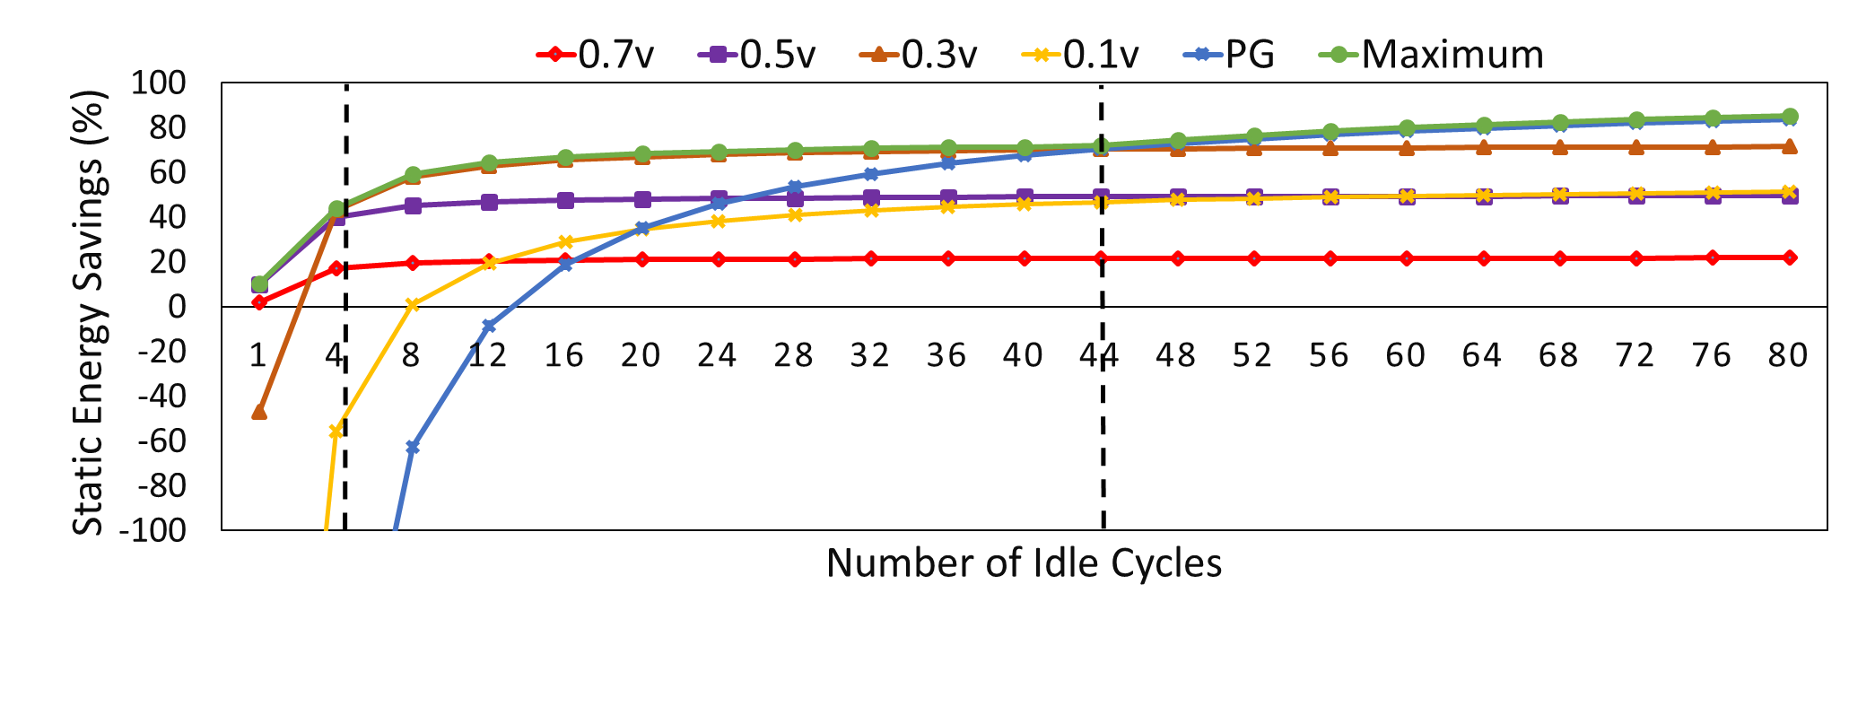
Power Reduction Techniques
0.5v is the best for idle periods “<=4”
0.3v is the best for idle periods “5-44”
PG is the best for idle periods “>44”

Slide 18
Predicting Idle Period Type
Finite State Machine (FSM) with four states to predict the idle period type
One active state
Three sleep mode states
Two counters:
Mode-change counter (counter_{mode}):
Keeps or changes the mode
Thr_{switch} is the threshold for switching the mode
Incremented when the idle time is > 8 cycles
Confidence Counter (counter_{conf}):
Differentiates between medium and long periods
Thr_{long} is the threshold for switching to a long period
Decremented if the idle time is < 48 cycles
ON
VS
VS
PG
0.5
0.3

Slide 19
ITAP’s FSM
T8
VS
PG
T10
0.3
T8: The lane is idle
T10: The lane is idle
T4: lane idle for less than 4 cycles or counter_{mode} < Thr_{switch}
T5:
lane idle for more than 4 cycles
counter_{mode} > Thr_{switch}
counter_{conf} < Thr_{long}
T6:
lane idle for more than 4 cycles
counter_{mode} > Thr_{switch}
counter_{conf} > Thr_{long}
T6
T5
T7
T9
T4
VS
T2
ON
T1
0.5
T3
T1: The lane is active
T2: The lane is idle
T3: The lane is active
T7: The lane is active
T9: The lane is active
VS_{0.3} and PG remain
while the lane is idle
If the lane is idle, VS_{0.5} remains or changes depending on the counters
When a lane changes from idle to active,
ITAP always exits the sleep modes
ON remains while the lane is active
When a lane changes from active to idle,
ITAP always applies VS_{0.5}

Slide 20
ITAP Issues
Our mechanism has two issues
ITAP always selects VS_{0.5} mode first, no matter the length of the idle period
Room for optimization
ITAP can not figure out when an execution lane should be woken up ahead of time
Performance overhead due to T_{wake_up}
To solve these issues, we propose a peek-ahead technique

Slide 21
Peek-Ahead Window
Goal: know the state of the lane in the near future
Implementation:
A 3-cycle peek-ahead window
Slightly modify the round-robin warp scheduler
Determine two future warps to schedule in addition to the currently-selected warp
Result: hides the wake-up latency of each power reduction technique
One cycle for 0.5v
Two cycles for 0.3v
Three cycles for PG
More details in the paper

Slide 22
ITAP Granularity
ITAP can be applied to each lane individually or use the same reduction mode for all of idle lanes
Fine-grain implementation
Apply power reduction technique for each idle lane individually
Different lanes can be in different power reduction modes
Higher accuracy
Larger overhead (due to per-lane voltage regulators)
Coarse-grain implementation
Apply one power reduction for all idle lanes
Lower accuracy
Lower overhead
How to select the power reduction mode for all idle lanes?

Slide 23
ITAP Coarse-grain implementation
The ITAP algorithm to select the power mode is applied to every single lane
If any idle execution lane is selected to be in VS_{0.5} mode
then the selected power mode for all idle lanes is VS_{0.5}
0.5
If no idle execution lane in VS_{0.5} and at least one idle execution lane in VS_{0.3}
then the selected power mode for all idle lanes is VS_{0.3}
If all lanes are selected to be in PG mode
then the selected power mode for all idle lanes is PG

Slide 24
Outline
ion and Goal
Background
Motivation
Inefficiency of Prior Works
ITAP
Evaluation
Conclusion
Notes:
Here is the outline for the talk today [CLICK]

Slide 25
Evaluation Methodology
Simulator: GPGPU-Sim [Bakhoda+ ISPASS’09] modeling NVIDIA Pascal
Energy: GPUWattch [Leng+ ISCA’13] and HSPICE
19 Workloads from Rodinia, Parboil and ISPASS benchmark suites
Comparison points:
Conventional Power-Gating (CPG)
Pattern-aware warp scheduling (PATS) [Xu+ PACT’14]
State-of-the-art scheduler-aware PG technique
Variants of ITAP
Ideal
With and without peek-ahead
Power aggressive and performance aggressive
ITAP+PATS

Slide 26
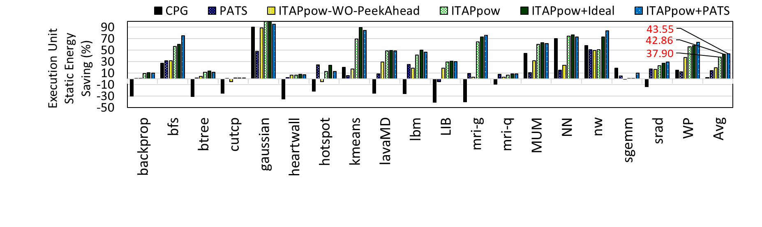
Static Energy Savings
2.4%
14.2%
19.4%
37.9%
42.9%
43.6%
ITAP reduces the static energy by 36.3% compared to CPG and by 27.6% compared to PATS
Peek-ahead improves the ITAP energy savings
by 24.3%
PATS defragments the idle periods and improves the opportunity of applying more powerful power reduction modes in ITAP
ITAP+PATS: additional 9.1% compared to ITAP

Slide 27
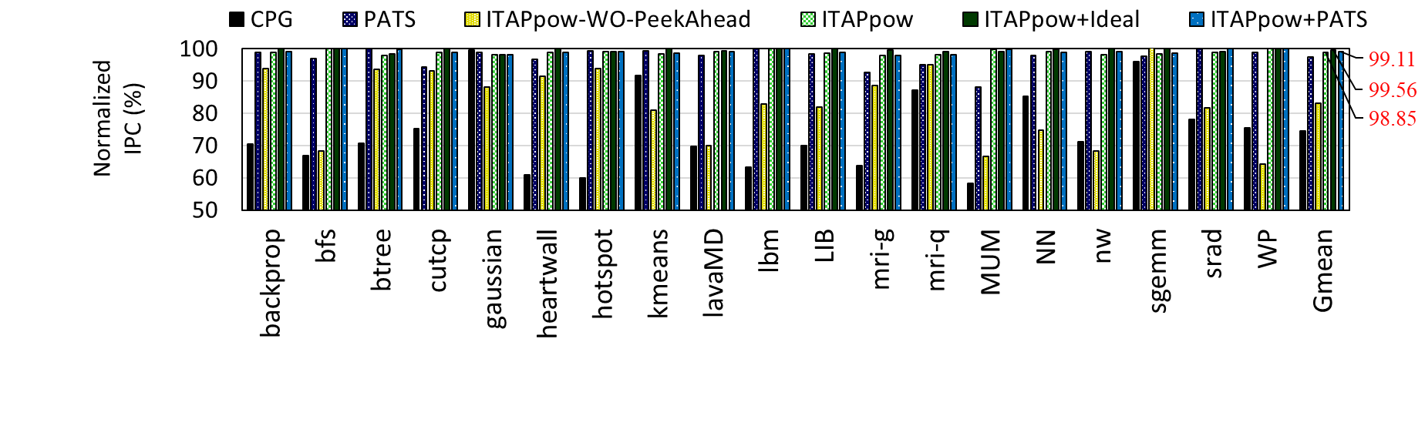
Performance Overhead
74.4%
97.4%
83.1%
98.8%
99.6%
99.1%
ITAP has low performance overhead compared to CPG and PATS
ITAP has up to 2% performance overhead compared to no static power reduction
CPG has up to 41% performance overhead
PATS has up to 12% performance overhead

Slide 28
Also in the paper…
Different optimization goals of ITAP
Power-aggressive
Performance-aggressive
Detailed analysis of hardware overheads
Sensitivity analysis on
ITAP’s prediction parameters
SIMD lane size
ITAP granularity
Effect of T_{wake_up} and T_{break_even}

Slide 29
Outline
ion and Goal
Background
Motivation
Inefficiency of Prior Works
ITAP
Evaluation
Conclusion
Notes:
Here is the outline for the talk today [CLICK]

Slide 30
Executive Summary
Motivation: GPU execution units are frequently idle
Full-lane and partial-lane idleness
High static power
Problem: static energy represents a high percentage of the energy consumption on execution units
Key idea: Employ the most efficient power management mode for each idle period
Mechanism: Predict the idle period length and apply power-gating and different levels of voltage-scaling
Results:
27.6% more static energy savings than the state-of-the-art mechanisms
Less than 2.1% performance overhead

Slide 31
ITAP: Idle-Time-Aware Power Management for GPU Execution Units
Mohammad Sadrosadati | Seyed Borna Ehsani
Hajar Falahati | Rachata Ausavarungnirun
Arash Tavakkol | Mojtaba Abaee
Lois Orosa Hamid Sarbazi-Azad | Yaohua Wang Onur Mutlu

