Slide 1
GIT WORKSHOP
ARFAOUI Nidhal

Slide 2
What is Git ?
Git is a free and open source distributed Version Control system designed to handle everything from small to very large projects with speed and efficiency.
What is Version Control ?
Version control is a system that records changes to a file or set of files over time so that you can recall specific versions later.

Slide 3
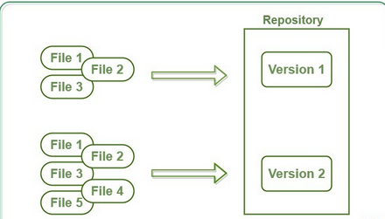
What is a GIT Repository?
Repositories in GIT contain a collection of files of various different versions of a Project. These files are imported from the repository into the local server of the user for further updations and modifications in the content of the file.
What is GIT Clone ?
The git clone command is used to create a copy of a specific repository or branch within a repository. Git is a distributed version control system. Maximize the advantages of a full repository on your own machine by cloning.

Slide 4
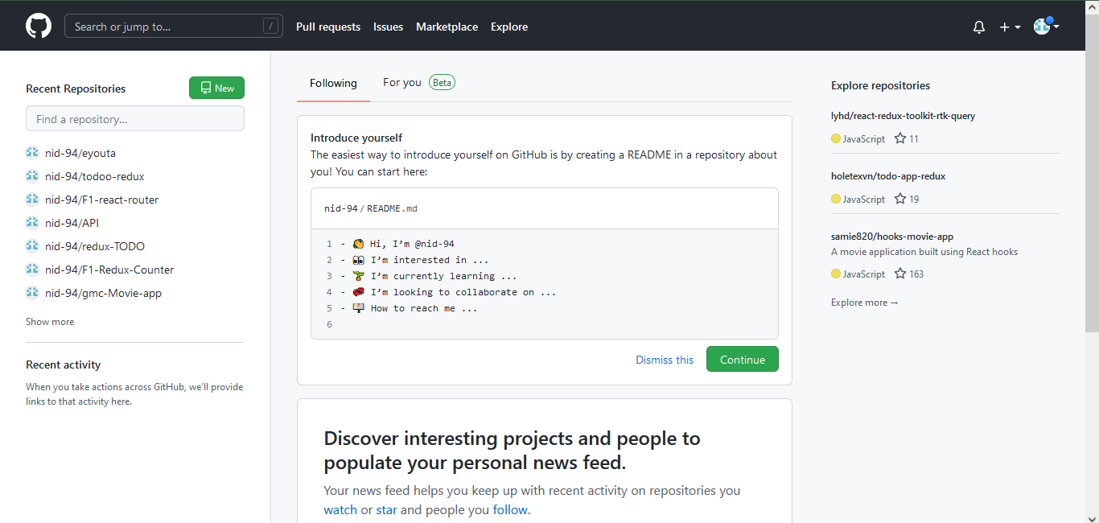
What is a GITHub?
GitHub is a Git repository hosting service that provides a web-based graphical interface. It is the world’s largest coding community.
Programmers can find source codes in many different languages and use the command-line interface, Git, to make and keep track of any changes.
Advantages?
Easy Project Management
Effective Team Management
Increased Safety With Packages
Increased Code Safety

Slide 5
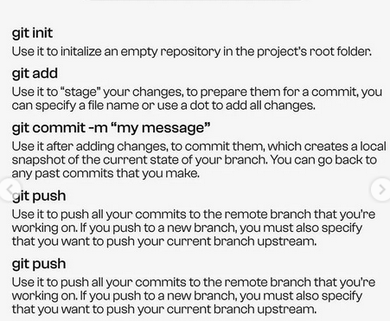
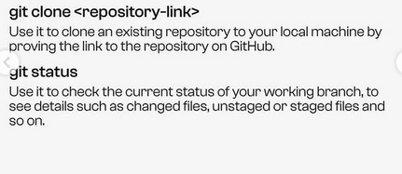
Git commands ?

Slide 6
How To Use ?
1- Install git in your pc “https://git-scm.com/downloads”
2-Create account in GitHub
3- Link git to GitHub using
git config --global user.name "<your_name_here>"
git config --global user.email "<your_email@email.com>"

Slide 7
Happy coding !

