Slide 1
The Lojikil School for Kids who can’t compile good
And wanna learn to do other stuff good too

Slide 2
OMFG STEFAN ANOTHER LANGUAGE TALK?
The last talk was types
This talk is compilation strategies

Slide 3
What is a compiler?
Takes some language
Mungs it
Outputs to another language

Slide 4
What is a compiler? Take a language…
Example: a function that sums all the values > 10
(define (foo x y)
(if (> x 10)
(foo (- x 1) (+ y x))
y))

Slide 5
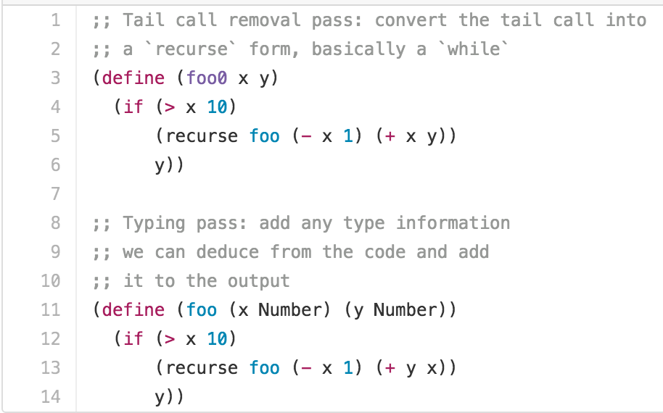
What is a compiler? Mung it…
Input source => Intermediate Representation (IR) => C

Slide 6
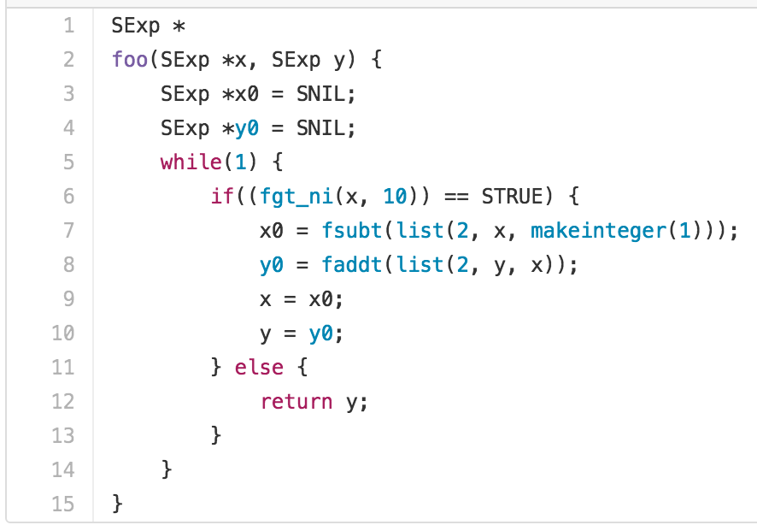
What is a compiler? Output it…
Spit out some nice C…

Slide 7
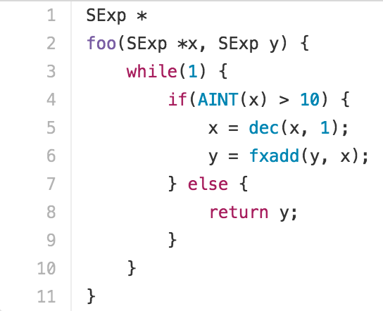
What is a compiler? Mung it more?
The compiler knows more than that tho… can it do better?

Slide 8
OMFG who cares?
Well, let’s see if we can add in something extra to help
Goal: write less code
Goal: get better performant & secure code

Slide 9
Compilers as compilation aid
Types + Algorithms + Data Structures = Awesome
Wirth, probably
Let’s think about Access Control:
Admin
Regular User
Unauth’d
Error

Slide 10
Access Control As Compiler
(define-variant
DocumentAccess
(AdminAccess int)
(UserAccess int)
(Unauthenticated int)
(AccessError int))

Slide 11
Output
typedef struct _DocumentAccess {
union {
struct _AdminAccess {
int member 0;
} AdminAccess;
…
} DocumentAccess;

Slide 12
Here’s where we care
(define fetch-document =>
(case (document-system $1)
(UserDocument x) => …
_ => (DocumentError “cannot retrieve document…”)))

Slide 13
Here’s where we care
(let (tmpbind349 (document-system ##args#1))
(match tmpbind349
UserDocument => …
_ => (DocumentError …)))

Slide 14
You probably still don’t care
But we can combine match/case forms with guards
Encode even more of our logic
Write Less code => more performant code
Rile Tim up cuz you made a compiler talk in a jiffy

Slide 15

Questions?

