Slide 1
A Mobile Heraclitus Seminar
Understanding security via inscrutable philosophers
For philosophical people must be well versed in many things…

Slide 2
Overview
Your Brave Speaker
What are we doing & why?
A Mobile Top 10 5
TLS Communications
Non-TLS Encryption & Hashing
Lifetime of data
Mobile Registration
Entropy Sources

Slide 3
Your Brave Speaker, Sextus Empiricus
Stefan Edwards (Github/Twitter: @lojikil)
Principal Security Consultant
Father (1 human, 1 doge), future husband, applied philosopher
Education: Dual majored CS & Philo
Interests
Computing: Programming Language Theory, LangSec, Secure environments, Discoverable Computing, Constructivist/Democratic/Accessible Computing
Philosophy: ethics, history of philosophy, absurdism/nihilism, political philosophy, Stoicism/Cynicism, Phenomenology

Slide 4
nVisium
Information Security
Penetration Testing (Web/Net/Mobile)
Adversarial Assessments
Training
Threat Modeling & Design Review
DFIR
Secure Development/Infrastructure
AWS/Cloud
Code Remediation

Slide 5

Note: Hearing Impaired

Slide 6
Heraclitus Seminar?
Famous talk by Heidegger & Fink
Approached Heraclitus’ work on Freiburg Phenomenological grounds
… and?

Slide 7
My Talks have themes
“On being Eeyore in InfoSec, or, how I learnt to hate everything & love Winnie the Pooh”
Everything is broken and we all die, but Winnie the Pooh is neat
“A Midsummer night’s Scheme: on Dancing for Oberon with Types”
Talk about LangSec, Types, Formal verification, and Shakespear
“A Mobile Heraclitus Seminar”
This talk, on my Mobile Top 5

Slide 8
What are we doing and why?
Of this account which holds forever men prove uncomprehending, both before hearing it and when they have first heard it.
Heraclitus, as quoted by Sextus Empiricus in “Against the Mathematicians”

Slide 9
What are we doing?
Take away:
What the problems are.
What the solutions are.
And why we are bothering.

Slide 10
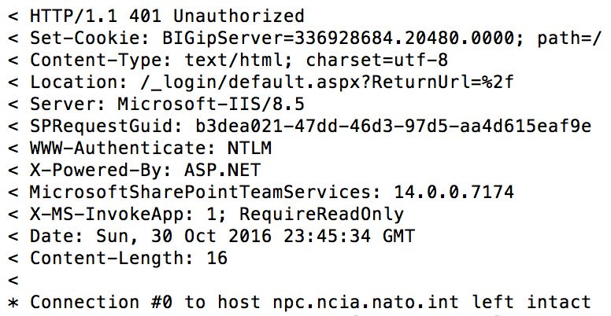
An Example – ad petitionem
Notes:
Here’s the background
I was looking around NATO, and one of the things I always do is look at the jobs page. It tells you a great deal about an organization (tech used, paradigms, &c &c &c).
Well, NATO linked to one of the sub organzations

Slide 11
An Example
From 1 request
BigIP F5 usage (BigIP cookie)
Specific version of SharePoint (14.0.0.7174), rough version of IIS (8.5)
Your Individual Request (SPRequestGuid)
Page is meant read from another App(X-MS-InvokeApp)
If we issued another request…
We could find internal DNS/NTLM/Host info

Slide 12
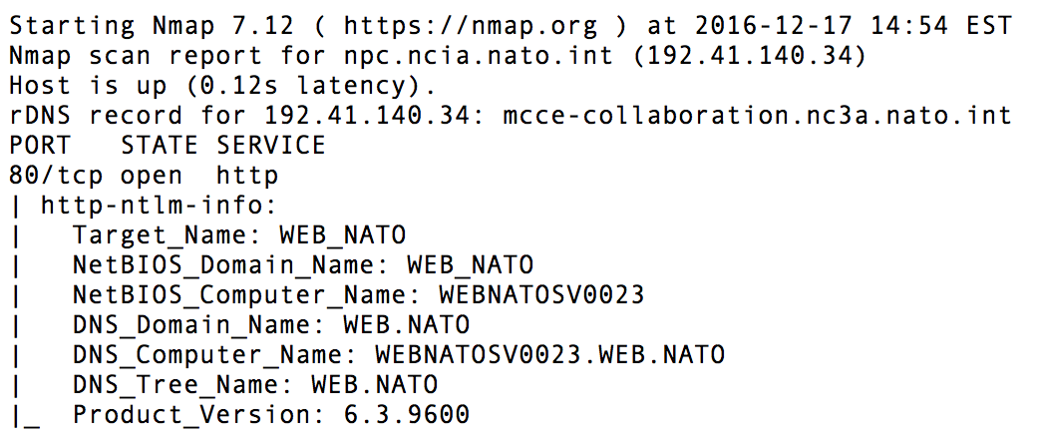
Not that anyone would issue such a request…

Slide 13
… and that’s the why
You have to be right all the time
Attackers only have to be right once

Slide 14
Attackers only have to be right once
2 HTTP Requests => great recon
Operating System Version
Host Names
Internal Domain Names
Technology Stack Information
No real attack has begun, just recon
Total time? < 5 minute, including silly browsing

Slide 15
A Mobile Top 10 5
For the sun will not overstep its boundaries, lest the Furies, ministers of justice, find it out.
Plutarch, On Exile

Slide 16
Top N, for N != 10
Top 5?
Top things seen in apps over and over
Mobile developer focused
Why not OWASP Mobile Top 10 (2014)?
Too server focused: M1, M5, M9
Client injection isn’t common or terribly dangerous (M7)
Maaaaaybe XSS in webviews, but… still not common
Binary protections is a vendor grab (M10)
And honestly not something a dev can fix anway
2016 is equally silly

Slide 17
Top N, for N != 10
TLS Communications
Data in transit
Non-TLS Encryption & Hashing
Data at rest
Lifetime of data
Where data lives
Mobile Registration
Knowing who owns data
Entropy Sources
How random is that data

Slide 18
TLS Communications
We step and do not step into the same rivers, we are and we are not.
Heraclitus, Homeric Questions
Notes:
TLS for all comms, TLS Version, Check things that matter (not name), Cert pinning, Public Key Pinning

Slide 19
TLS
Transport Layer Security
Derived from SSL v3
The “S” in https://…
Basically a collection of algorithms to secure data in transit

Slide 20
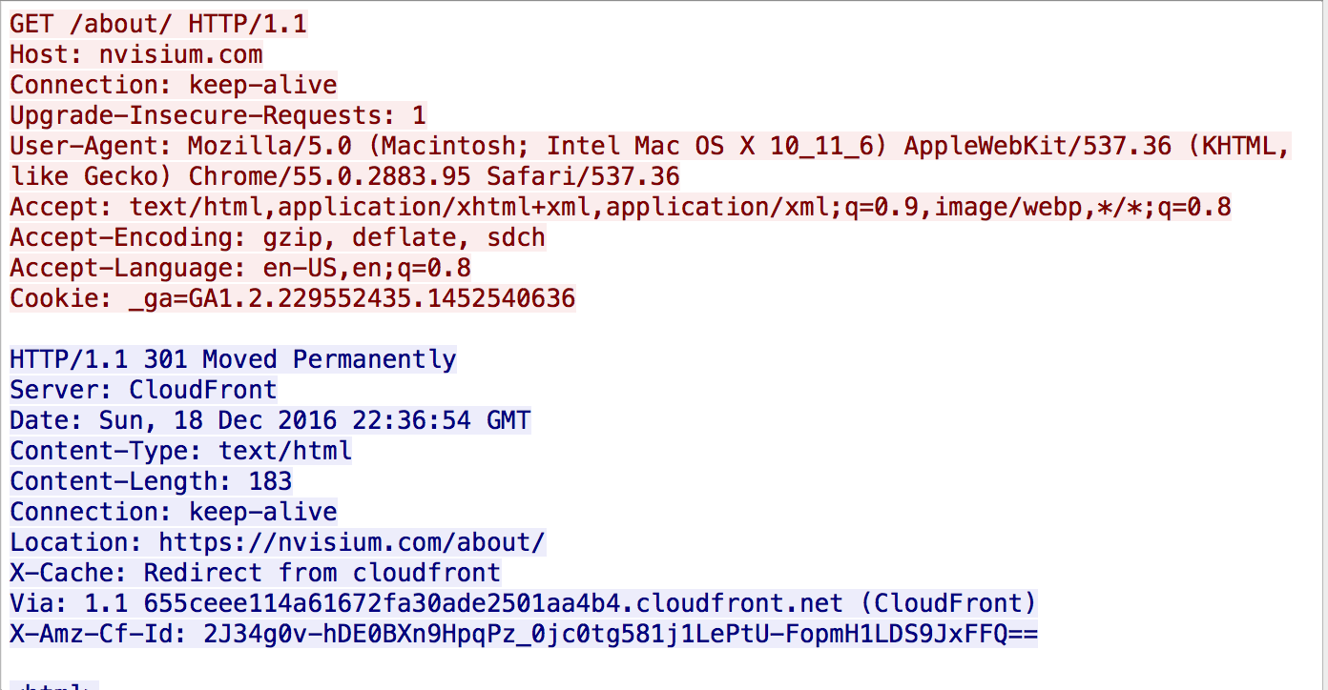
Turns this…

Slide 21
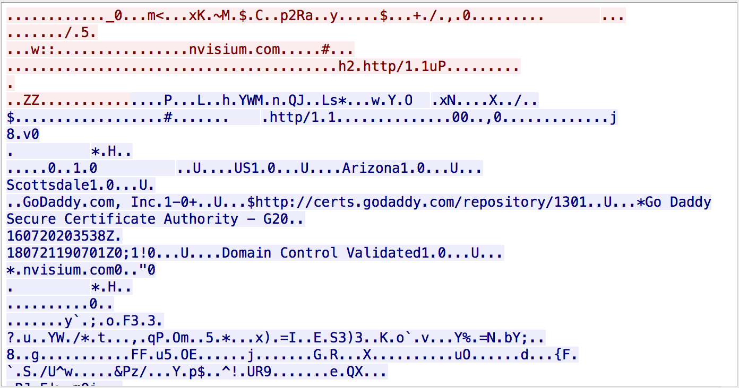
… into this:

Slide 22
TLS – Problems
Protocol issues (FREAK, POODLE, Lucky 13, CRIME, …)
Configuration issues (null cipher anyone?)
Certificate validity

Slide 23
Starting example
let url = URL(string: "https://nvisium.com")
let task = URLSession.shared.dataTask(with: url!) { (data, response, error) in
if error != nil {
print(error!)
dataSemaphore.signal()
} else {
if let usableData = data {
print(response!)
print(usableData)
dataSemaphore.signal()
}
}
}

Slide 24
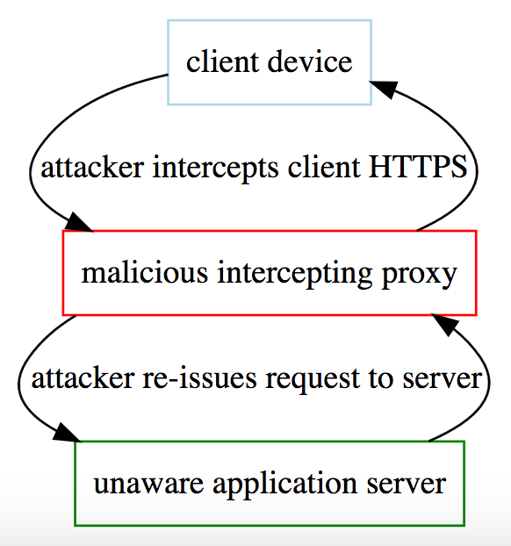
… what’s the problem?
We’re using HTTPS, right?

Slide 25
Fix? – subject checks
if challenge?.protectionSpace.authenticationMethod == NSURLAuthenticationMethodServerTrust
{
if challenge?.protectionSpace.host == "www.nvisium.com"
{
// ...
}
}

Slide 26
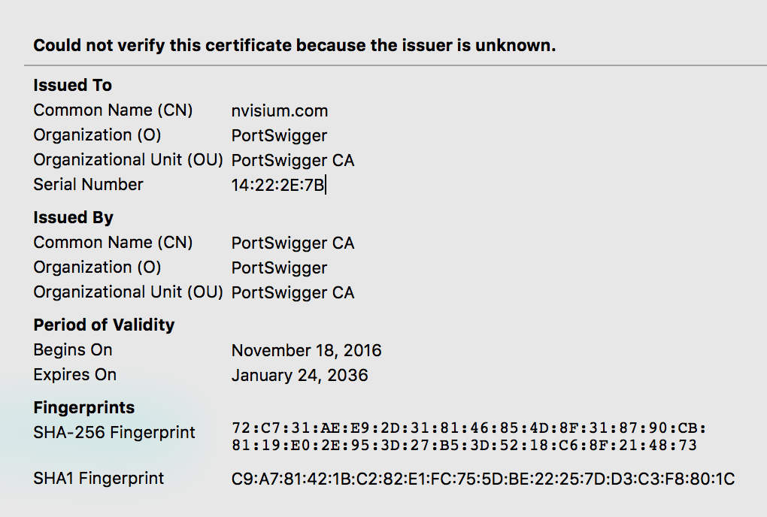
Only stops naive attackers…

Slide 27
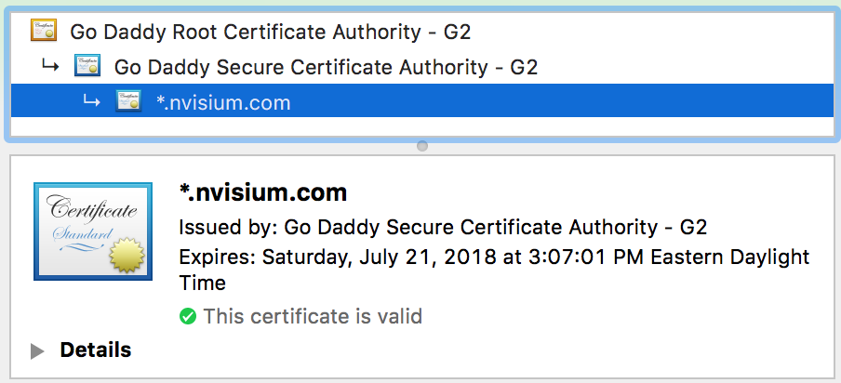
… well, clearly we need to check the chain

Slide 28
Checking the Certificate chain
Certificate[] certs = conn.getServerCertificates();
for (Certificate cert : certs) {
System.out.println("Certificate is: " + cert);
if(cert instanceof X509Certificate) {
try {
((X509Certificate) cert).checkValidity();
System.out.println("Certificate is active for current date");
} catch(CertificateExpiredException cee) {
System.out.println("Certificate is expired");
}
}
}

Slide 29
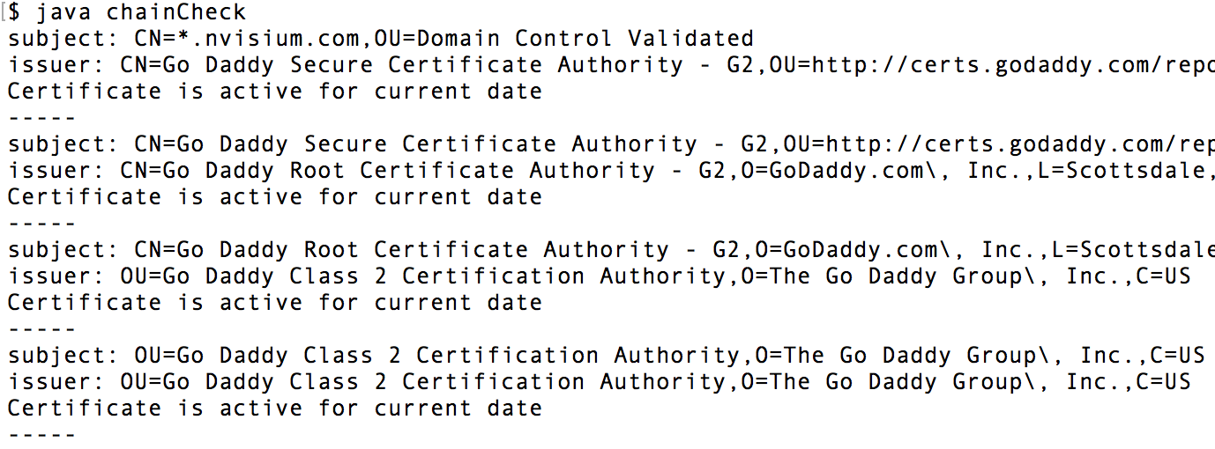
Checking the certificate chain

Slide 30
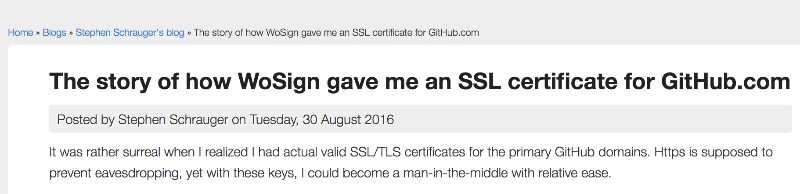
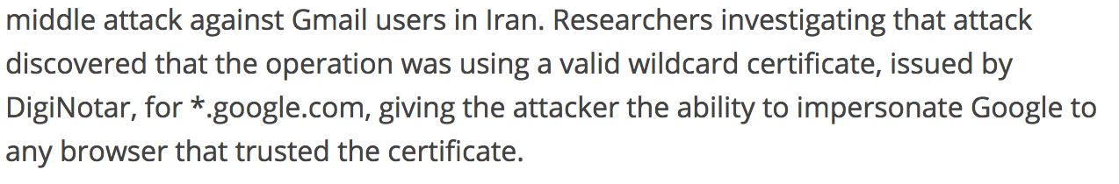
The problem…

Slide 31
Solution – pinning
Store something known about the cert
Public Key: a fingerprint of the cert (B7 CA 10 84 6A 7A 9D B3 33 B3 C8 B4 14 83 3F FD 9F CF C6 20)
Certificate: The entire certificate
Two main strategies:
Deploy the application with one of the above
Trust on First Use (ToFU)
Can also add rotation &c.

Slide 32
iOS with Swift? Use AlamoFire
Relatively easy, and pretty straight forward:
let serverTrustPolicy = ServerTrustPolicy.PinCertificates(
certificates:ServerTrustPolicy.certificatesInBundle(),
validateCertificateChain: true,
validateHost: true )

Slide 33
Android? OkHttp
Tunable, decent security out of the gate, and also easy to use:
public CertificatePinning() {
client = new OkHttpClient.Builder()
.certificatePinner(new CertificatePinner.Builder() .add("publicobject.com", "sha256/afwiKY3RxoMmLkuRW1l7QsPZTJPwDS2pdDROQjXw8ig=") .build()).build();
}

Slide 34
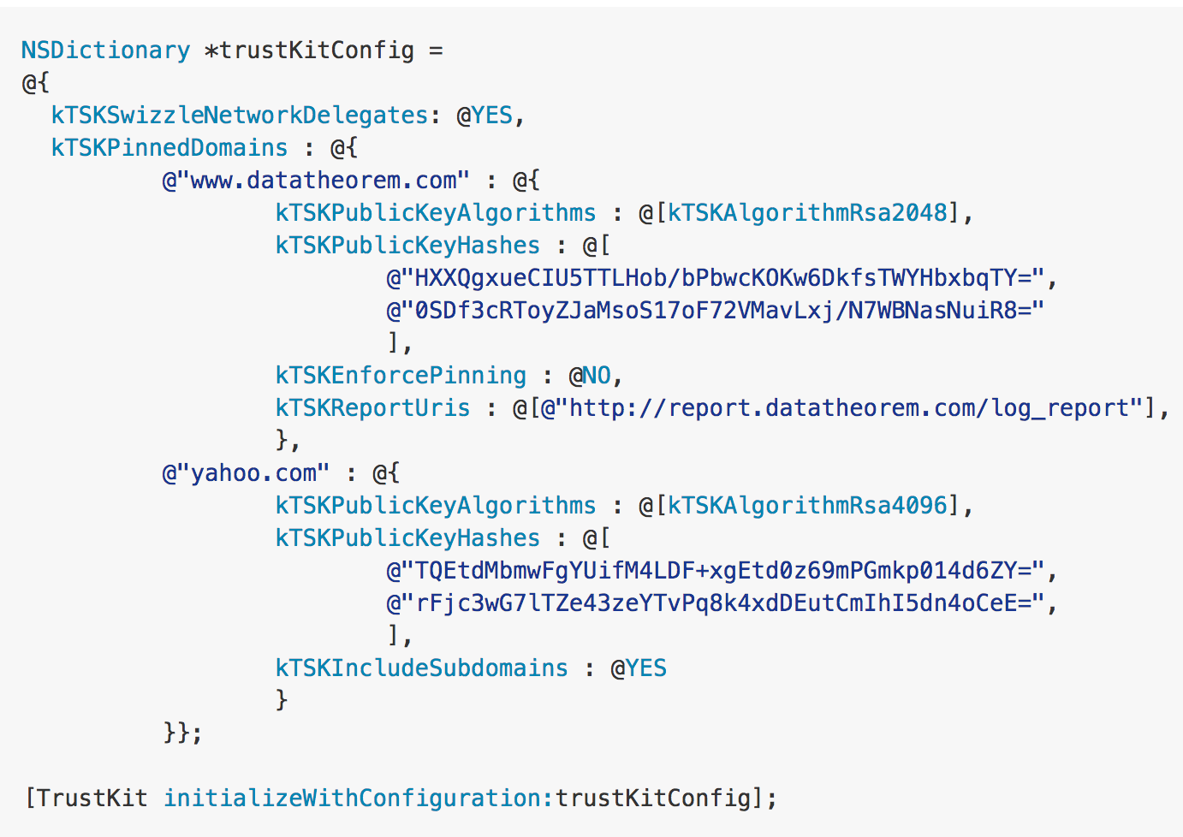
iOS with Objective C? use TrustKit
Declarative API, also works with Swift

Slide 35
Drawbacks
Definite deployment cost
Must either understand:
Expiry and rotation OR
Redistribution and deployment
Not a cure-all
Binary Patching
Missed domains
Referrer leakage
&c.

Slide 36
General Recommendations
Use TLS wherever possible
Use the most modern version possible
Currently 1.2
Store TLS information (probably the public key)
Understand your infrastructure
Deployment
Key expiry
Rotation challenges
Servers

Slide 37
Non-TLS Encryption & Hashing
… justice will convict the fashioners and witnesses of falsehoods
Clement, Miscellanies
Notes:
The difference between hashing & encryption, why encryption, types of hashing (e.g. hash vs hmac). Also, why to never use custom algorithms

Slide 38
In simplest terms…
Encryption:
encrypt(data, key)
decrypt(enciphered-data, key)
Hash:
hash(data)
no complementary function
Different algorithms for different purposes

Slide 39
Simple Encryption
Function:
let encrypt x k = (x + k) % 26
Key:
k = 13
Compliment:
let decrypt x k = (x - k) % 26
Result?
this is a test
guvf vf n grfg

Slide 40
And that’s important because…
Notes:
PIN example

Slide 41
Knowing when to use what algorithm

Slide 42
Hashing

Slide 43
Simple Hash: FNV1a

Slide 44
Cryptographic & Non-cryptographic

Slide 45
Combining Hashing & Encryption

Slide 46
Word of waning against bespoke

Slide 47
Drawbacks

Slide 48
Takeaways

Slide 49
Lifetime of Data
…those who search for gold, dig over much earth and find little
Clement, Miscellanies
Notes:
Passwords stored in memory, cached tokens on disk, and what to do about them

Slide 50
Mobile Registration
They would not know the name of justice if these things did not exist
Clement, Miscellanies
Notes:
Tokens tokens tokens tokens tokens; also, TouchID is not user auth.

Slide 51
Entropy Sources
Let us not conjecture at random about the most important things
Diogenes Laertius, Lives of the Philosophers
Notes:
All things are random, but some things are more random than others.

Slide 52
Take Aways
For fire will come and judge and convict all things
Hippolytus, Refutation of all Heresies

Slide 53
Take Aways
TLS: pin the public key or the certificate, use the latest version of TLS.
Data: know when to encrypt, hash, or both your data.
Data: make sure you know when & where data is being used.
Registration: make sure you know who your user is, and what device they’re on
Entropy: stuff is like random, until it’s not.

Slide 54
Thanks!
Questions?

