Slide 1
A Mobile Heraclitus Seminar
Understanding security via inscrutable philosophers
For philosophical people must be well versed in many things…

Slide 2
Overview
Your Brave Speaker
nVisium
What are we doing & why?
A Mobile Top 10 5
TLS Communications
Non-TLS Encryption & Hashing
Lifetime of data
Mobile Registration
Entropy Sources

Slide 3
Your Brave Speaker, Sextus Empiricus
Stefan Edwards (Github/Twitter: @lojikil)
Principal Security Consultant
Father (1 human, 1 doge), future husband, applied philosopher
Education: Dual majored CS & Philo
Interests
Computing: Programming Language Theory, LangSec, Secure environments, Discoverable Computing, Constructivist/Democratic/Accessible Computing
Philosophy: ethics, history of philosophy, absurdism/nihilism, political philosophy, Stoicism/Cynicism, Phenomenology

Slide 4
nVisium
Information Security
Penetration Testing (Web/Net/Mobile)
Adversarial Assessments
Training
Threat Modeling & Design Review
DFIR
Secure Development/Infrastructure
AWS/Cloud
Code Remediation

Slide 5

Note: Hearing Impaired

Slide 6
Heraclitus Seminar?
Famous talk by Heidegger & Fink
Approached Heraclitus’ work on Freiburg Phenomenological grounds
… and?

Slide 7
My Talks have themes
“On being Eeyore in InfoSec, or, how I learnt to hate everything & love Winnie the Pooh”
Everything is broken and we all die, but Winnie the Pooh is neat
“A Midsummer night’s Scheme: on Dancing for Oberon with Types”
Talk about LangSec, Types, Formal verification, and Shakespeare
“A Mobile Heraclitus Seminar”
This talk, on my Mobile Top 5

Slide 8
What are we doing and why?
Of this account which holds forever men prove uncomprehending, both before hearing it and when they have first heard it.
Heraclitus, as quoted by Sextus Empiricus in “Against the Mathematicians”

Slide 9
What are we doing?
Take away:
What the problems are.
What the attacks are.
What the (non-)solutions are.
And why we are bothering.

Slide 10
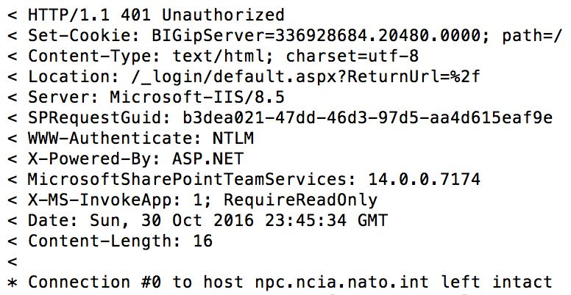
An Example – ad petitionem
Notes:
Here’s the background
I was looking around NATO, and one of the things I always do is look at the jobs page. It tells you a great deal about an organization (tech used, paradigms, &c &c &c).
Well, NATO linked to one of the sub organzations

Slide 11
An Example
From 1 request
BigIP F5 usage (BigIP cookie)
Specific version of SharePoint (14.0.0.7174), rough version of IIS (8.5)
Your Individual Request (SPRequestGuid)
Page is meant read from another App(X-MS-InvokeApp)
If we issued another request…
We could find internal DNS/NTLM/Host info

Slide 12
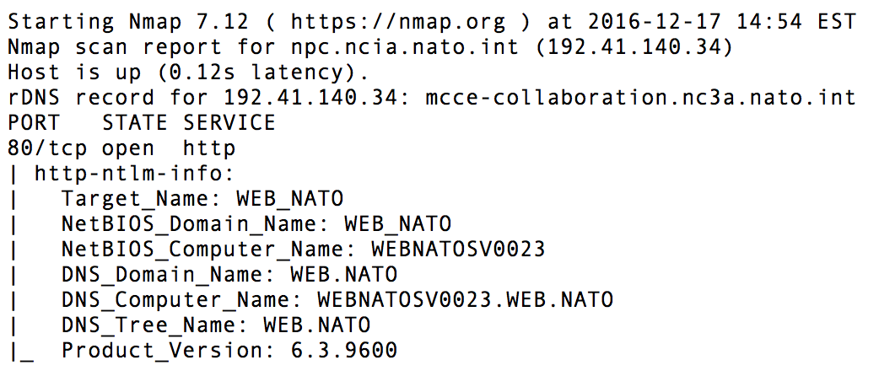
Not that anyone would issue such a request…

Slide 13
… and that’s the why
You have to be right all the time
Attackers only have to be right once

Slide 14
Attackers only have to be right once
2 HTTP Requests => great recon
Operating System Version
Host Names
Internal Domain Names
Technology Stack Information
No real attack has begun, just recon
Total time? < 5 minute, including silly browsing
Notes:
2 HTTP requests spread out over _days_
Who is really going to notice that level of recon?

Slide 15
A Mobile Top 10 5
For the sun will not overstep its boundaries, lest the Furies, ministers of justice, find it out.
Plutarch, On Exile

Slide 16
Top N, for N != 10
Top 5?
Top things seen in apps over and over
Mobile developer focused
Why not OWASP Mobile Top 10 (2014)?
Too server focused: M1, M5, M9
Client injection isn’t common or terribly dangerous (M7)
Maaaaaybe XSS in webviews, but… still not common
Binary protections is a vendor grab (M10)
And honestly not something a dev can fix anway
2016 is equally silly

Slide 17
Top N, for N != 10
TLS Communications
Data in transit
Non-TLS Encryption & Hashing
Data at rest
Lifetime of data
Where data lives
Mobile Registration
Knowing who owns data
Entropy Sources
How random is that data

Slide 18
TLS Communications
We step and do not step into the same rivers, we are and we are not.
Heraclitus, Homeric Questions
Notes:
TLS for all comms, TLS Version, Check things that matter (not name), Cert pinning, Public Key Pinning

Slide 19
TLS
Transport Layer Security
Derived from SSL v3
The “S” in https://…
Basically a collection of algorithms to secure data in transit

Slide 20
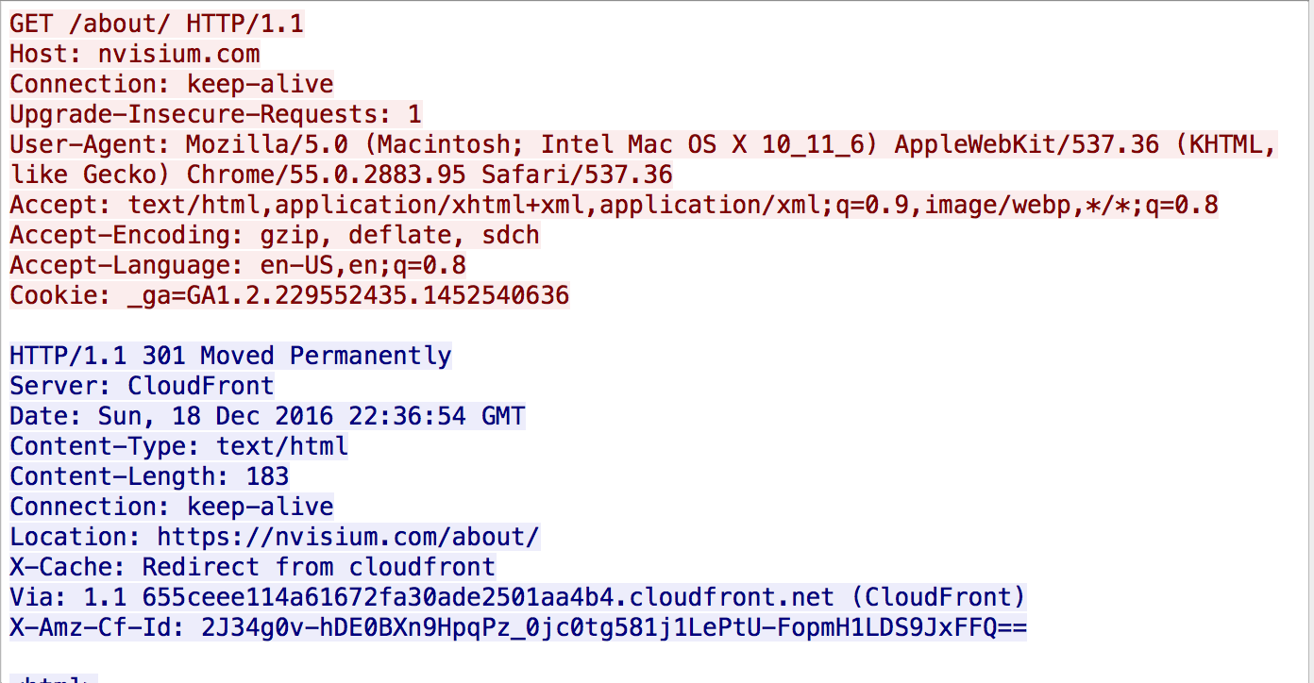
Turns this…

Slide 21
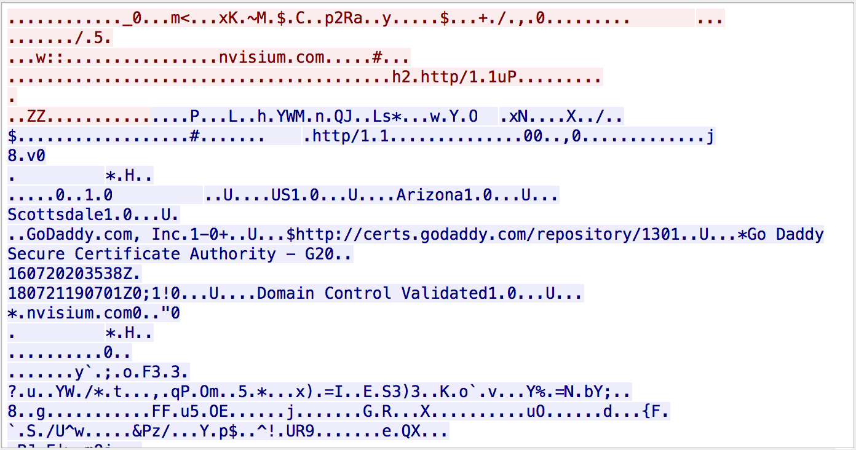
… into this:

Slide 22
TLS – Problems
Protocol issues (FREAK, POODLE, Lucky 13, CRIME, …)
Configuration issues (null cipher anyone?)
Certificate validity

Slide 23
Starting example
let url = URL(string: "https://nvisium.com")
let task = URLSession.shared.dataTask(with: url!) { (data, response, error) in
if error != nil {
print(error!)
dataSemaphore.signal()
} else {
if let usableData = data {
print(response!)
print(usableData)
dataSemaphore.signal()
}
}
}

Slide 24
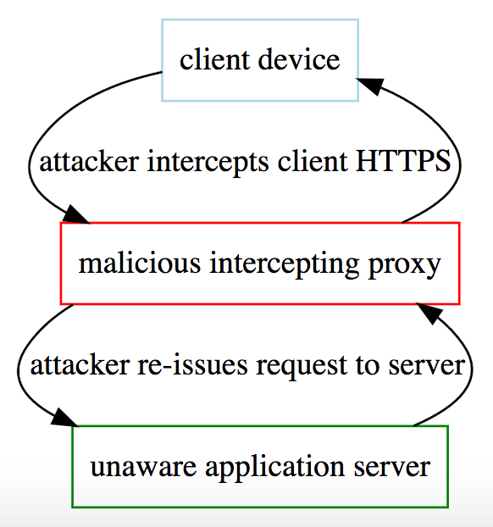
… what’s the problem?
We’re using HTTPS, right?

Slide 25
Fix? – subject checks
if challenge?.protectionSpace.authenticationMethod == NSURLAuthenticationMethodServerTrust
{
if challenge?.protectionSpace.host == "www.nvisium.com"
{
// ...
}
}

Slide 26
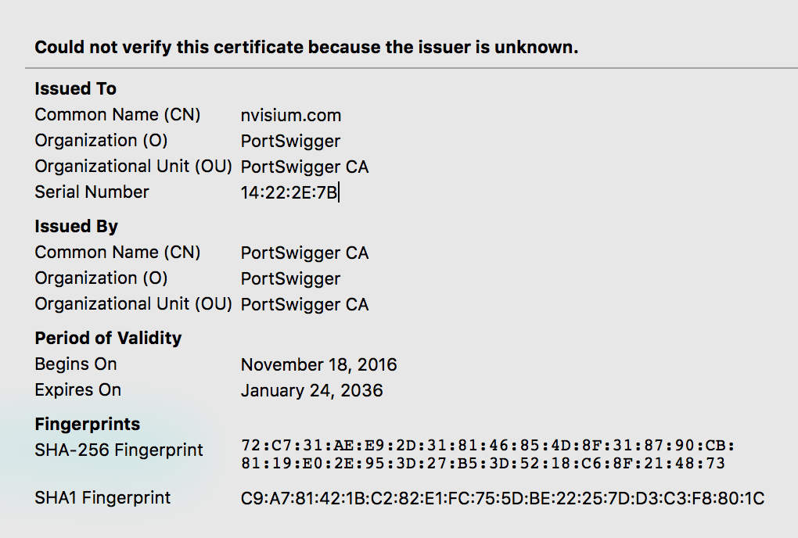
Only stops naive attackers…

Slide 27
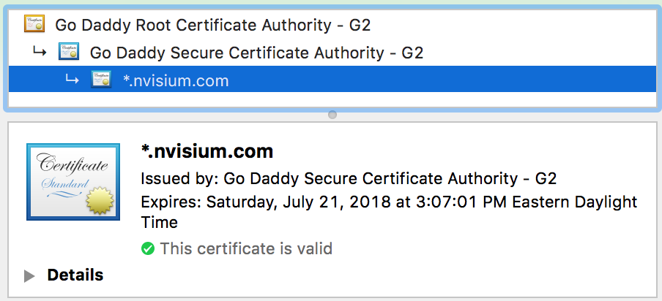
… well, clearly we need to check the chain

Slide 28
Checking the Certificate chain
Certificate[] certs = conn.getServerCertificates();
for (Certificate cert : certs) {
System.out.println("Certificate is: " + cert);
if(cert instanceof X509Certificate) {
try {
((X509Certificate) cert).checkValidity();
System.out.println("Certificate is active for current date");
} catch(CertificateExpiredException cee) {
System.out.println("Certificate is expired");
}
}
}

Slide 29
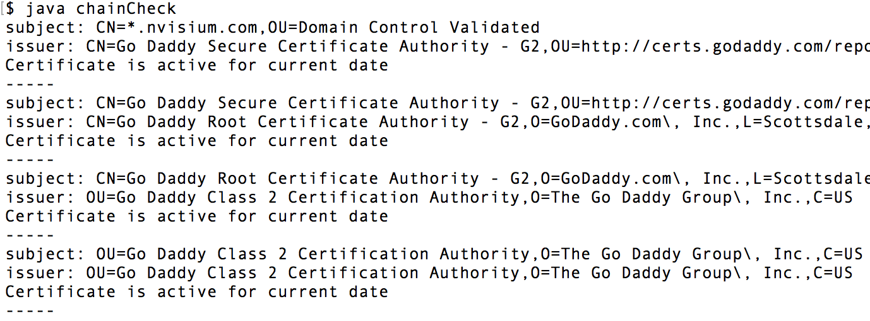
Checking the certificate chain

Slide 30
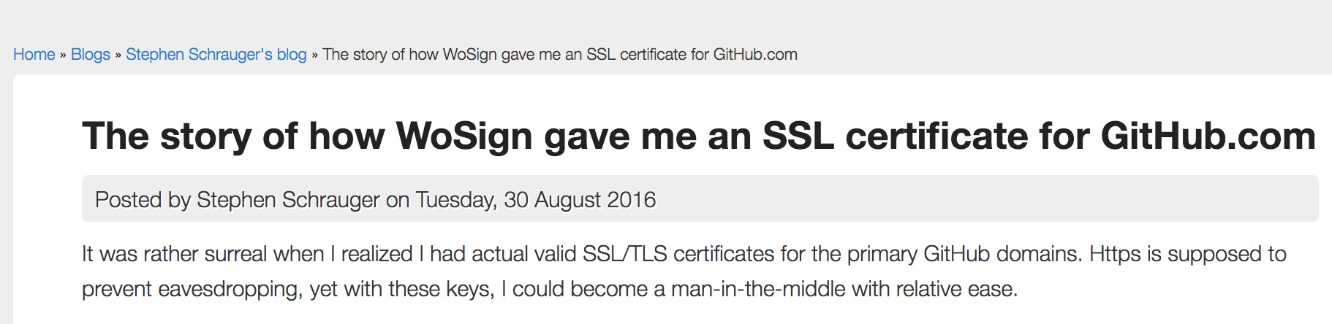
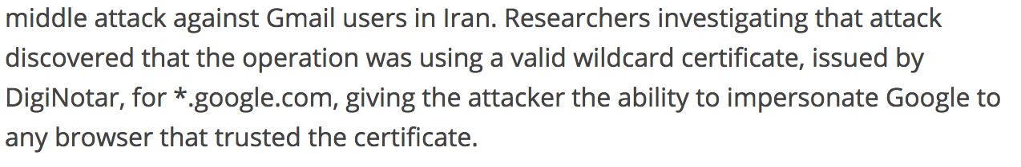
The problem…

Slide 31
Solution – pinning
Store something known about the cert
Public Key: a fingerprint of the cert (B7 CA 10 84 6A 7A 9D B3 33 B3 C8 B4 14 83 3F FD 9F CF C6 20)
Certificate: The entire certificate
Two main strategies:
Deploy the application with one of the above
Trust on First Use (ToFU)
Can also add rotation &c.

Slide 32
iOS with Swift? Use AlamoFire
Relatively easy, and pretty straight forward:
let serverTrustPolicy = ServerTrustPolicy.PinCertificates(
certificates:ServerTrustPolicy.certificatesInBundle(),
validateCertificateChain: true,
validateHost: true )

Slide 33
Android? OkHttp
Tunable, decent security out of the gate, and also easy to use:
public CertificatePinning() {
client = new OkHttpClient.Builder()
.certificatePinner(new CertificatePinner.Builder() .add("publicobject.com", "sha256/afwiKY3RxoMmLkuRW1l7QsPZTJPwDS2pdDROQjXw8ig=") .build()).build();
}

Slide 34
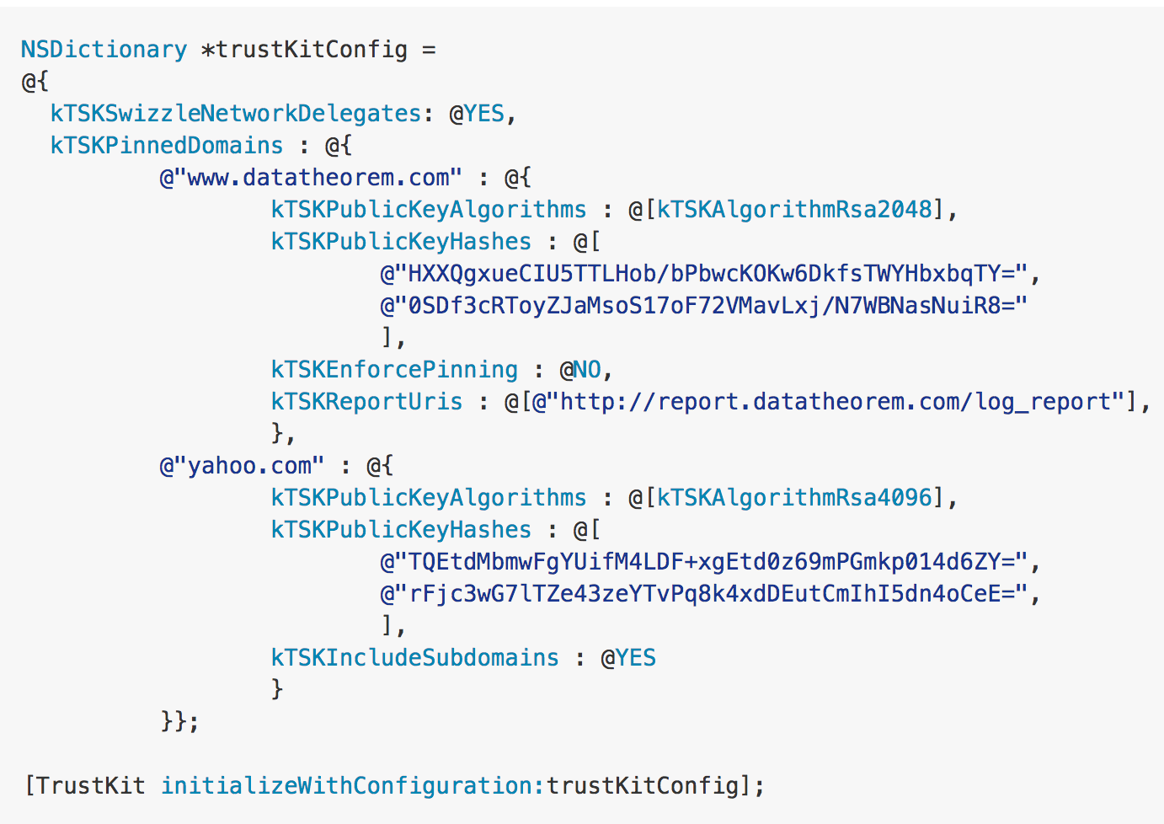
iOS with Objective C? use TrustKit
Declarative API, also works with Swift

Slide 35
Drawbacks
Definite deployment cost
Must either understand:
Expiry and rotation OR
Redistribution and deployment
Not a cure-all
Binary Patching
Missed domains
Referrer leakage
&c.

Slide 36
General Recommendations
Use TLS wherever possible
Use the most modern version possible
Currently 1.2
Store TLS information (probably the public key)
Understand your infrastructure
Deployment
Key expiry
Rotation challenges
Servers

Slide 37
Non-TLS Encryption & Hashing
… justice will convict the fashioners and witnesses of falsehoods
Clement, Miscellanies
Notes:
The difference between hashing & encryption, why encryption, types of hashing (e.g. hash vs hmac). Also, why to never use custom algorithms

Slide 38
In simplest terms…
Encryption:
encrypt(data, key)
decrypt(enciphered-data, key)
Hash:
hash(data)
no complimentary function
Different algorithms for different purposes

Slide 39
Simple Encryption
Function:
let encrypt x k = (x + k) % 26
Key:
k = 13
Compliment:
let decrypt x k = (x - k) % 26
Result?
this is a test
guvf vf n grfg

Slide 40
And that’s important because…
You can build an extremely strong cipher out of this
len(key) >= len(plain-text-data)
Security then relies on the key
Purely random
Never used more than once
Notes:
PIN example

Slide 41
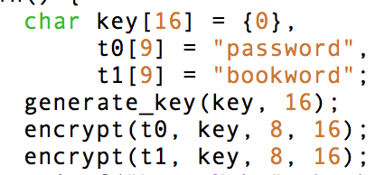
Situation
Client wants to store/transmit… something
Generates a “key”
Usually just a dictionary or something similar
Encrypts item

Slide 42
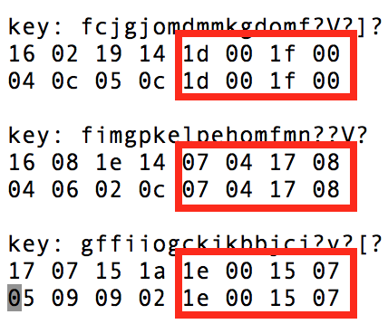
… non-solution
Notes:
I can’t tell what those _are_, but I can tell they are _the same_

Slide 43
Knowing when to use what algorithm
There are 3 hard problems in CS:
Naming things,
Cache invalidation,
Algorithm Selection,
and off-by-1 errors
Avoid writing crypto
The minute you’re modifying bits & bytes, you’re headed to trouble
As was I… I gave up fighting with Swift’s type system & patching things just to show you that demo cipher

Slide 44
If you have to encrypt something…
Use Standard Algorithms & secure modes
Transit: AES-256-GCM (Galois/Counter Mode)
Storage: AES-256-XTS (XEX-based tweaked-codebook mode with ciphertext stealing)
Yes, “XTS” really does expand into a 6 word sentence.
Avoid Modes CBC & ECB, Algorithms: DES, RC4
Use OS Services where possible
Much harder to crack KeyChain than your app

Slide 45
Hashing
“one way”
Used to check if data is the same
Kinda sorta
Two major classes:
Cryptographic
Non-cryptographic
Notes:
Let’s take a step back & talk about hashing

Slide 46
Simple Hash: FNV1a
uint64_t
fnv1a(char *key, uint32_t len)
{
uint64_t hash = 14695981039346656037;
uint32_t idx = 0;
for(; idx < len; idx++)
{
hash ^= key[idx];
hash *= 1099511628211;
}
return hash;
}

Slide 47
Simple Hash: FNV1a
FNV1a(“test”) == f9e6e6ef197c2b25
FNV1a(“this”) == 2587bcef32493841
FNV(“test“) == 8c093f7e9fccbf69
FNV(“this“) == 8c1a417e9fdb35c5

Slide 48
Cryptographic & Non-cryptographic
Non-Cryptographic: meant to be fast
Cryptographic: meant to be slow
Uses:
Non-cryptographic: Algorithms (like hash tables/dictionaries)
Cryptographic: file integrity
DO NOT use non-cryptographic hashes for secure use
in fact, sometimes don’t even use cryptographic ones alone

Slide 49
Encryption vs Hashing
Use Encryption when you’re sharing something new
Use hashing when you’re sharing something:
Both sides know
Both sides may know, but want to verify
One side may not know, but wishes to ensure is unmodified

Slide 50
Combining Hashing & Encryption
Encryption != Integrity
Plaintext: [1 1 0 1 …]
Ciphertext: [0 1 0 0 ...]
Attackers can flip bits in the cipher text...
The fix? Encrypt then HMAC:
Ciphertext: [0 1 0 0 ...]
HMAC: [1 1 1 0 ...]
Any modification in transit will fail the hash check

Slide 51
A word about password storage
Never Store passwords on the device.
If you must store passwords on the device, use keychain
If for some reason you cannot use the keychain…
You’re probably in trouble: pass the hash, key storage, &c &c

Slide 52
Drawbacks
Key management
Adequate strength
Complexity in:
Key selection
Algorithm selection
Ciphertext & Key storage & transmission…

Slide 53
Takeaways
Avoid encrypting anything manually
Use the KeyChain/KeyStore or the like instead
If you must, use standard algorithms with secure modes
Do not write custom algorithms

Slide 54
Lifetime of Data
…those who search for gold, dig over much earth and find little
Clement, Miscellanies
Notes:
Passwords stored in memory, cached tokens on disk, and what to do about them

Slide 55
Data lives…
On Screen
Backgrounded screenshots
In Memory
Variables prior to GC
On Disk
Potentially, depends on your reification of data

Slide 56
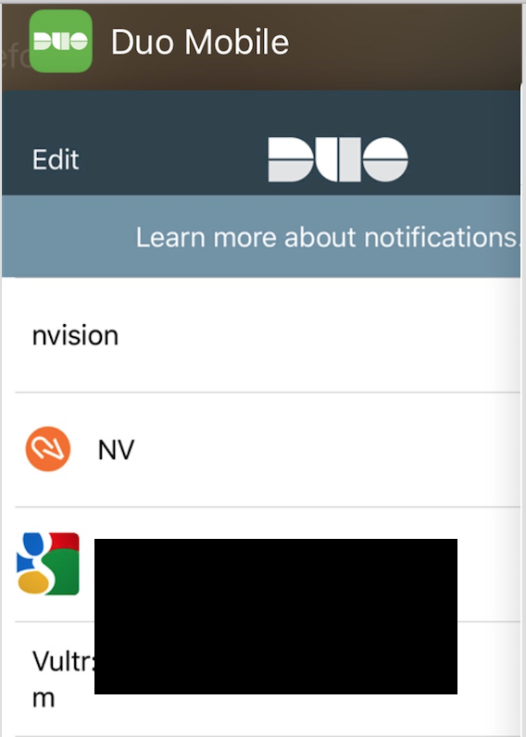
On Screen
Notes:
Screenshot from my DuoMobile page; an attacker with access to my file system would be able to see things (such as the email addresses released beneath the black boxes)

Slide 57
Side-channel
iOS/Android save screenshots
Can leak sensitive data
Best protection?
Just use your company’s logo as a screen blank on backgrounding
Another step:
Clear sensitive data on background

Slide 58
In Memory
Consider the following:
let username = userField.text!
let password = passField.text!
How long do these variables live in Memory? How long do the text fields last?

Slide 59
Cycript example
[#"<UITextField: 0x105199f60; frame = (25 34; 270 36); text = ''; clipsToBounds = YES; opaque = NO; autoresize = RM+BM; gestureRecognizers = <NSArray: 0x10119f000>; layer = <CALayer: 0x10519a3b0>>",#"<UITextField: 0x105b7a600; frame = (25 34; 270 36); text = ’SOMEACCOUNT@test.com'; clipsToBounds = YES; opaque = NO; autoresize = RM+BM; gestureRecognizers = <NSArray: 0x101293280>; layer = <CALayer: 0x1011cd560>>",#"<UITextField: 0x105372f20; frame = (25 34; 270 36); text = ''; clipsToBounds = YES; opaque = NO; autoresize = RM+BM; tag = 1; gestureRecognizers = <NSArray: 0x10518d0c0>; layer = <CALayer: 0x105373270>>",#"<UISearchBarTextField: 0x107f4fd50; frame = (8 8; 304 28); text = ''; clipsToBounds = YES; opaque = NO; gestureRecognizers = <NSArray: 0x1064d1570>; layer = <CALayer: 0x107f500d0>>",#"<UITextField: 0x1011effe0; frame = (25 34; 270 36); text = '!Password01'; clipsToBounds = YES; opaque = NO; autoresize = RM+BM; tag = 1; gestureRecognizers = <NSArray: 0x1053baeb0>; layer = <CALayer: 0x1011aa600>>"]

Slide 60
Attack Surface
Malicious App, jailbroken device, Operating System bug…
Part of why any app with truly sensitive operations (CC, &c.) should jailbreak detect.
If you’re not already, look at the “alternative” appstores for your app
... But what can you do about it?

Slide 61
Solution: lifecycle management
Know when & where data is used
Remove from memory ASAP
Store in secure location (KeyChain, &c.)
Never leave things in the open
Unless you have to

Slide 62
Lastly… ”disk”
When we say disk… we mean the FS
All sorts of obvious things:
Documents saved, images, logs...
And not so obvious
CFURL cache is usually the biggest & scariest

Slide 63
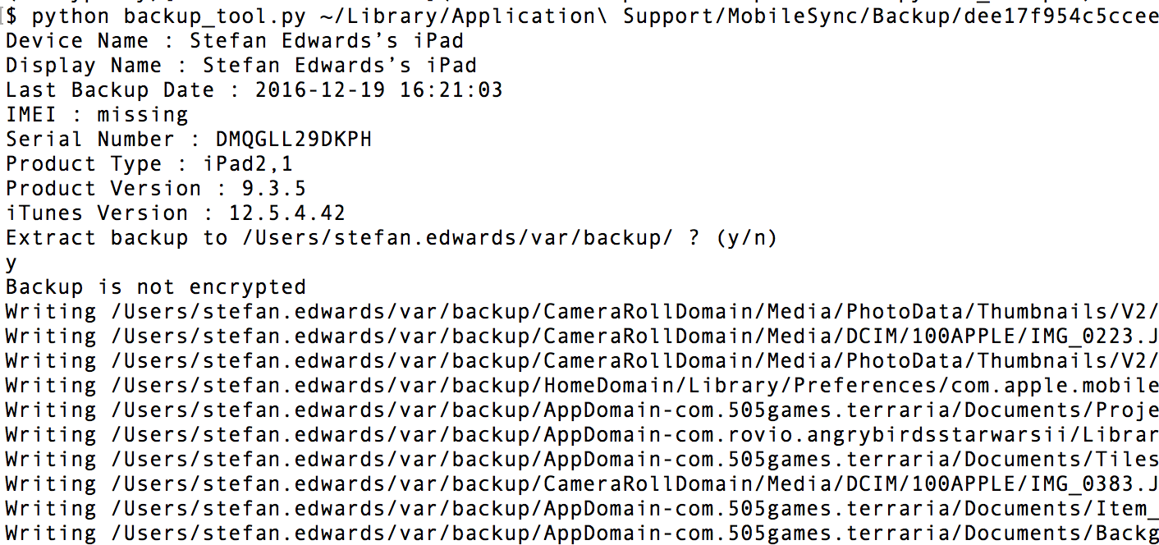
Attack Path

Slide 64
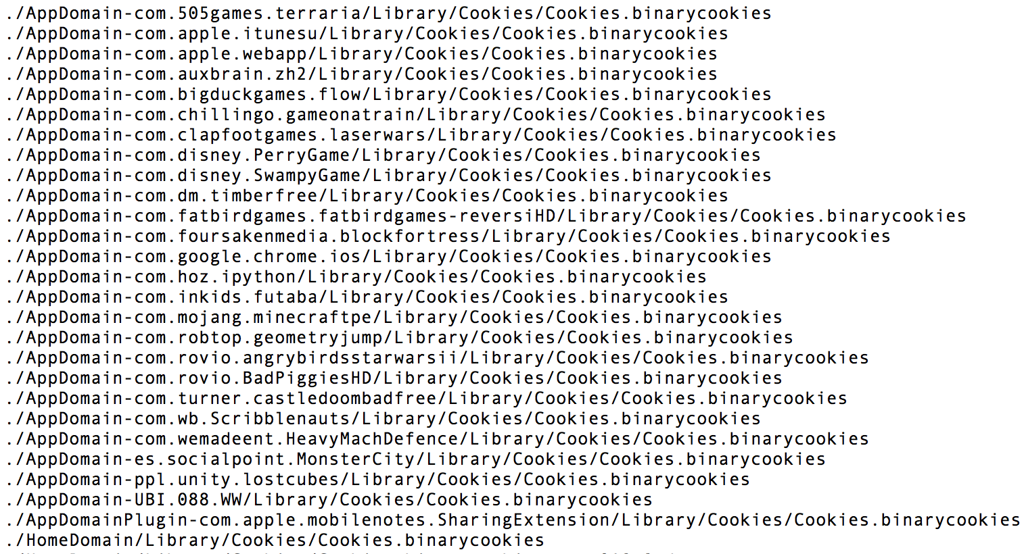
Storage Lifetime: cookies

Slide 65
Storage Lifetime: cookies

Slide 66
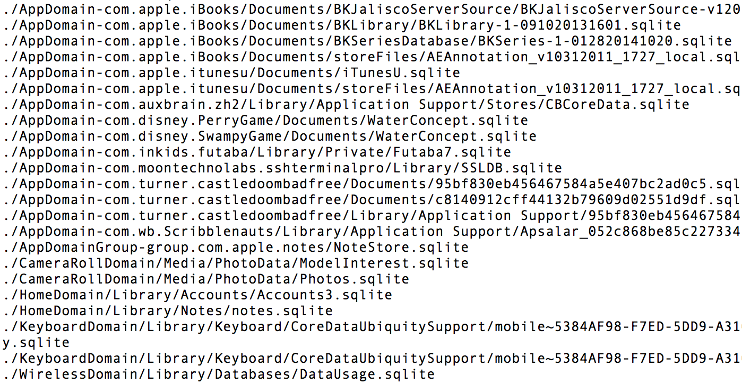
Storage Lifetime: cache

Slide 67
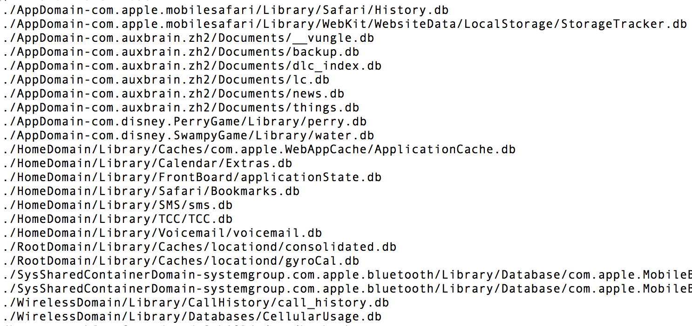
Storage Lifetime: cache

Slide 68
Backups
Attackers can access backups from victim’s device or computer
Easy to use tools to access
Anything stored in backups is accessible to an attacker
Once they’ve gathered it, they can replay it
Cookies
Tokens stored in caches
URLs exposed in cache…

Slide 69
Takeaways
Be aware of where data can leak, and what data that is
Whenever possible, do not store sensitive data inadvertanly
Make application cookies:
Live a reasonable amount of time
But not overly long
Completely revocable (such as on sign out)

Slide 70
Mobile Registration
They would not know the name of justice if these things did not exist
Clement, Miscellanies
Notes:
Tokens tokens tokens tokens tokens; also, TouchID is not user auth.

Slide 71
So…
A user signs up with our mobile app…
... And they don’t want to sign in all the time
What do we do?

Slide 72
Initial Sign up
User name / Password
Out of Band confirmation
Something only the user could know
User clicks link/app reads SMS…
Privacy concerns aside
And... Then what?
Avoid:
Annoying user
Overly verbose/difficult signup process

Slide 73
Cookies
Sign in once and…
Use overly long cookies?
Kinda like the above demo wherein we extracted cookies?

Slide 74
TouchID
We can use TouchID
Unlocks phone
Unlocks the keychain
And we know that’s the user who signed in because...
Actually we don’t.

Slide 75
Possible Fixes
A little less easy to fix…
Store a per device token
Something like a UUID, since the UDID is no longer around
Use that as part of any requests to the server
New device new token
Keep application cookies short-lived
Re-auth as needed to the sever
Always manually re-auth the user when sensitive operations needed
OOB

Slide 76
Entropy Sources
Let us not conjecture at random about the most important things
Diogenes Laertius, Lives of the Philosophers
Notes:
All things are random, but some things are more random than others.

Slide 77
This seems silly but…
Not all random things are equal
Here is a Pseudo-Random Number Generator (PRNG):
uint64_t
lcg(uint64_t mod, uint64_t a, uint64_t c, uint64_t seed) {
return ((a * seed) + c) % mod;
}

Slide 78
Linear Congruence
Creates lots of Random-looking data:
696741729
3061048176
1179345054
2307581784
2298185335
468838506
3374381503
2776561725
3036789030
3052269189

Slide 79
But, like encryption…
It matters what you use and where
Non-cryptographic PRNGs have small cycles (periods)
Use PRNGs for non sensitive operations, like Cache busting
Use csPRNGs for sensitive operations
Key generation
Unforgeable document references
&c.

Slide 80
Think about this:
Which one is an attacker going to find easer:
This: /documents/5791, /documents/493, /documents…
Or this: /documents/e71a83b6-23b8-4b50-8a9e-75df927074e4
Not to say you shouldn’t have access controls...
You should. Don’t use me as a scape goat to not implement them
But the search space makes this less feasible
A UUID is 128bit number (give or take)

Slide 81
Takeaways
For non-secure operations:
arc4random_uniform
rand(3)
&c.
For secure operations
Mersenne Twister (modified for secure use)
UUID (v4)
Blum-Blum-Shub
SecRandomCopyBytes (iOS)
A mix of JCA, BouncyCastle, & /dev/urandom (Android)
Never mix the two operations

Slide 82
Take Aways
For fire will come and judge and convict all things
Hippolytus, Refutation of all Heresies

Slide 83
Take Aways
TLS:
pin the public key or the certificate
use the latest version of TLS
Do not mix HTTP & HTTPS
Data:
know when to encrypt, hash, or both your data
Understand the cycle of your data, and try whenever possible to use OS primitives

Slide 84
Take Aways
Data:
make sure you know when & where data is being used
Understand the lifecycle of data within the application
Reduce that cycle as much as possible
Registration:
make sure you know who your user is, and what device they’re on
Entropy:
Randomness is surprisingly hard to get right
And it can burn you when it’s not.

Slide 85
Thanks!
Questions?

