Slide 1
Using You’re Types More Good
Or, how I convinced management to allow me to bore you for ~20 minutes with math.

Slide 2
Intro – Dafuq are you on about?
Types
What are they?
What can we do with them?
Modeling
Types are actually too sexy for Milan…

Slide 3
Types - a warning
Most people:
int foo;
Double bar;
Static or dynamic? Weak or Strong? Duck Typing?
Static (early binding) vs Dynamic (late binding)
Weak (implicit or simple type coercion) vs Strong (limited or no coercion)
Duck Typing vs Row Polymorphism (”Static Duck Typing”)…

Slide 4

NEWP
☣WARNING☣: talks contains Haskell, Hindley-Milner, and bitterants
Notes:
This talk uses Haskell for the examples, mostly because it was fun, but everything in here can be done in just about any language

Slide 5
Type Theory
A theory of types:
Basically logic: ∃X { a: X; f: (X → int); }
For those playing along at home, this is an existential type
A type describes:
Set of members
Shape of members
Context
And logical mapping of members
Gives us:
Correctness
Flow

Slide 6
Discussion note
Generally… Type Theory ≠ Type System
Type System is technically an application of Type Theory
… but I’m going to use it that way
You wanna fight about it?

Slide 7
Type Theory – a condensed history
Frege:
WHAT IF WE USED SET THEORY FOR THE BASIS OF MATH?! THAT SOLVES ALL OUR PROBLEMS!!
Russell:
lol, no (aka “Russell’s paradox”)
Or “that big jerkface Russell who ruined my naive set theory” -- Frege, probably
Worked with Whitehead on Principia Mathematica as a result
Also, people like Church and Per-Löf

Slide 8
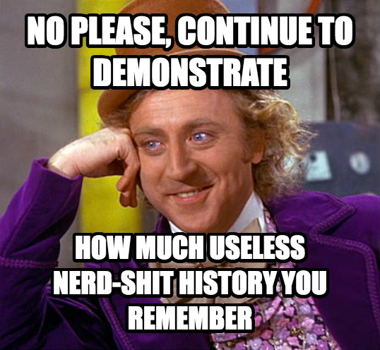
Notes:
For the longest time this was actually not overly applicable. It wasn’t really until the late 70’s early 80’s that we started to see real applications of Type systems, starting with Hindley-Milner, that his became useful.

Slide 9
Type Theory – descriptors
Integer types:
Set: {-∞, …, -2, -1, 0, 1, 2, ..., ∞}
Shape: (-|\+)?[0-9]+
Context: Numerics, ...
Logical Mapping: +, *, /, -, ...
Real types:
Set: Uncountable (read your Cantor!): {..., 0.9, 0.99, 0.999, 0.9999, ...}
Shape: (-|\+)?[0-9]+(\.[0-9]*)?
Context: Numerics, ...
Logical Mapping: +, *, /, ...

Slide 10
Types: Context Matters
data MyNum = Fnum Float | Inum Int
numsum :: MyNum -> MyNum -> MyNum
numsum (FlNum f) (FlNum h) = FlNum $ h + f
numsum (FlNum j) (INum i0) = FlNum $ j + (fromIntegral i0)
numsum (INum i1) (FlNum f3) = FlNum $ (fromIntegral i1) + f3
numsum (INum i2) (INum i3) = INum $ i2 + i3
-- Magic!
numsum (INum 4) (FlNum 10.0) -- FlNum 14.0
numsum (INum 6) (INum 10) -- INum 16

Slide 11
Types: Context Matters
We have:
Set: MyNum: {Z, R}
Shape of Members: INum, FlNum
Mapping: numsum
Context…?

Slide 12
Types: Context Matters
-- This is “well formed”:
numsum (INum 10) (FlNum 5)
-- But is this?
let y = numsum (INum 10) (INum 7) in
listIndex [1,2,3,4] y
-- listIndex :: [a] -> Int -> a

Slide 13
Types: Context Matters
No!
Fine by itself:
numSum (INum 10) (FlNum 5)
Wrong in context
listIndex :: [a] -> Int -> a
FlNum & INum are not Ints
FlNum doesn’t even map 1-1 onto Ints
And the compiler knows it

Slide 14


Slide 15
Let’s Solve a Problem… with MathTypes!
When rendering to a browser, several contexts in which we care about user strings:
HTML tags
HTML Attributes
JavaScript
URL parameters
…

Slide 16
Let’s Solve a Problem… with MathTypes!
Want:
Maximum support from Compiler
And I guess technically the runtime… if you’re a weirdo like that
I promise not to judge your... proclivities
Do not want:
Thinking

Slide 17
Let’s Solve a Problem… with MathTypes!
ESAPI model:
encodeForHTML, encodeForHTMLAttribute, encodeForUrl
This is… bad
Strings... Strings everywhere: encodeForHtml :: String → String → String
I have to remember where I’m using stuff?
And the compiler doesn’t tell me?
I’m not good with thinking...

Slide 18


Slide 19
Let’s Solve a Problem… with MathTypes!
Two different paths
Tag everything that isn’t yours
UnsafeString $ requestParameter “foo”
Tag everything that is yours:
renderHTMLAttribute :: String -> HTML
Notes:
The way I see it, there are two different paths here:
Tag everything that comes in from the user, all the various little alcoves and sources, and make sure we tag them
This is obviously pretty error prone… we’re going to miss something.
Or we can tag everything we *know* is ours, and assume anything that *isn’t* ours is unsafe.

Slide 20
Let’s Solve a Problem… with MathTypes!
data HTML = HTML [Char] deriving Show
returnToBrowser :: HTML -> IO ()
returnToBrowser x = -- Magic!
safeEncode :: [Char] -> HTML
safeEncode x = HTML $ safeEncode' x

Slide 21
Let’s Solve a Problem… with MathTypes!
-- This works:
returnToBrowser $ safeEncode $ getParameter “test”
-- This Fails _to compile_:
returnToBrowser $ getParameter “test”

Slide 22

Notes:
Again, what we’re looking for isn’t something that _works_, but rather something that in enforced by the compiler at compilation time.

Slide 23
Couldn’t we like… do that in Java?
Absolutely!
Python Too!
But it wouldn’t be static… unless you use PEP-484 & MyPy
The Point isn’t the language
Haskell was just fun
The point is the design

Slide 24
Types as Design
Codify our Design Choices
data File = ReadWriteFile Int | ReadOnlyFile Int
data AccessList = Admin [SecretData] | User [SensitiveButUnclassified]
Make the Compiler remind us
It’s easier than remembering, I swear
Notes:
That’s the key here… types aren’t just about getting the most efficient compilation, they’re about expressing programmer intent
If you’re attempting to design a File protocol, there may be specific API locations that you don’t want to have ReadWrite files passed to. So you would open a file ReadWrite, and let the compiler enforce what we’re actually doing.
If you’re designing a File

Slide 25
Let’s talk about modeling
Understanding Behavior of code
Preconditions
Post-conditions
Invariants
Basically, the specification of a program
What flows where, what modifies things, &c.
Whole industries exist around getting this right
JML, Spark, JOVIAL, &c &c &c &c.
And we still suck at it
Notes:
When we’re talking about modeling we’re talking about the behaviour of our code.

Slide 26
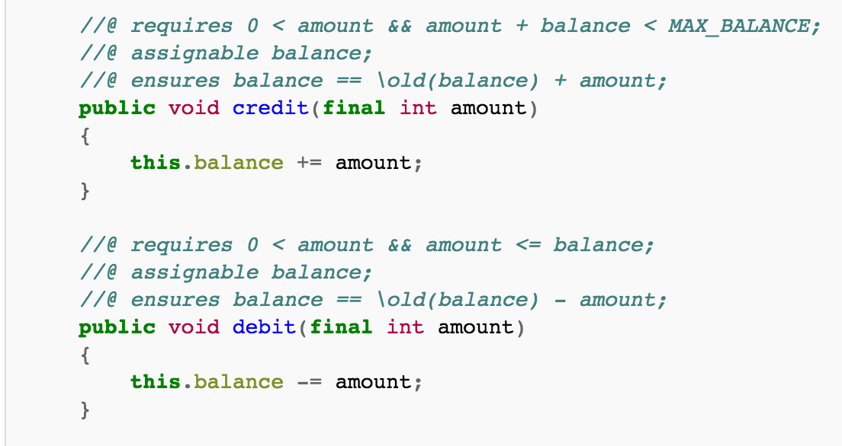
Here’s a model
Notes:
We’re building a specification of how this should operate… the JML annotations will tell us that anywhere this code is used, certain preconditions must be met that satisfy the specification, and it informs us as to what happens once the methods have been run.

Slide 27
… & this ties in with all that type shit... How?
More Advanced Type System => More Advanced Types
Despite all the magic & hype, Scala & Haskell are not the most advanced
Can we do this with types?

Slide 28
Mostly, yes…
requires 0 < amount
amount should be of type Nat (for Natural numbers)
assignable balance;
Monads! Specifically State monads, to track updates
If monads scare you, remember, they’re just like… space man isomorphic burritos... Or something.
balance < MAX_BALANCE
Not in Haskell specifically, but in Ada…
Betcha never thought you’d see Ada mentioned again...
amount <= balance
Not in Haskell specifically, but in Agda…
No, that’s not a misspelling, it’s called A-g-d-a

Slide 29
So what’s really going on here?
Types can:
Codify your Design
Alleviate whole classes of bugs
Help prove program correctness
Kill entire industries
God, I hope they kill the verification industry…
Soooooo... Why aren’t more people using them like this?

Slide 30
It’s fracking expensive to design shit
People are doing this
Lift (the framework), Yesod (Haskell web stack), Mirage (OCaml), &c &c.
Quant houses
Certain Shadowy Government agencies
But…
Design costs money up front
Thinking about types is like thinking about design/spec
… no one really thinks about their spec unless they have to.

Slide 31
Thanks!
Questions?
Ha, you’re all asleep
Not like I’d answer your questions anyway.

