Slide 1
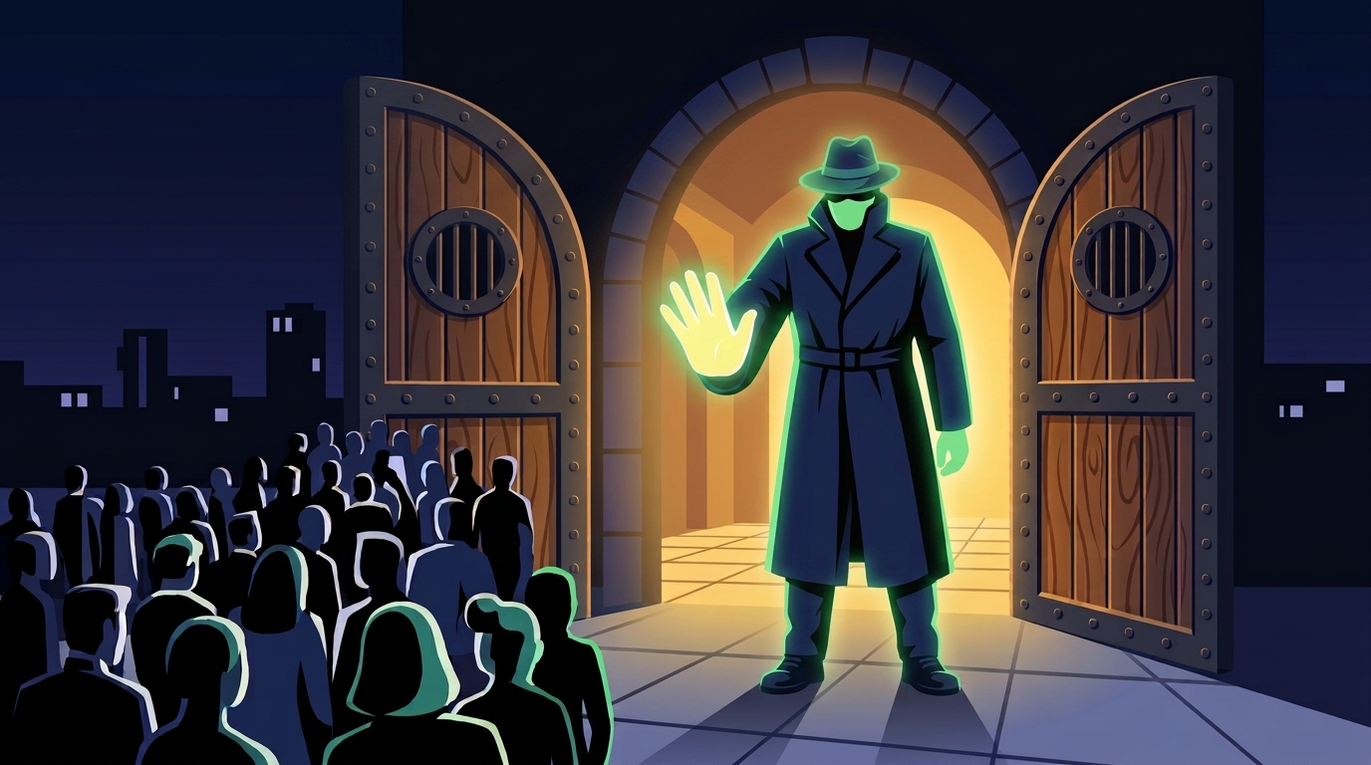
PROJECT BOUNCER
Cloud Engineering Capstone
Secure event ticketing platform
“Built for fair access. Engineered for resilience.”
Created by: Balint Lojt
1

Slide 2
Project goal
An AWS environment with security, automation, and cost control
3 AZ
HTTPS
3–6
4 layers
eu-central-1a / b / c
Route53 + ACM + ALB
ASG instance range
Terraform state separation
What Bouncer demonstrates
Design choices
• Public entry point with WAF and TLS termination
• Private EC2 app tier behind an Application Load Balancer
• PostgreSQL for ticket data and Redis for shared session / lockout state
• Infrastructure managed as separate Terraform layers
• Multi-AZ app tier; Single-AZ RDS for capstone cost control
• One shared NAT Gateway
• OIDC instead of long-lived AWS keys
• Full teardown for billable resources
2

Slide 3
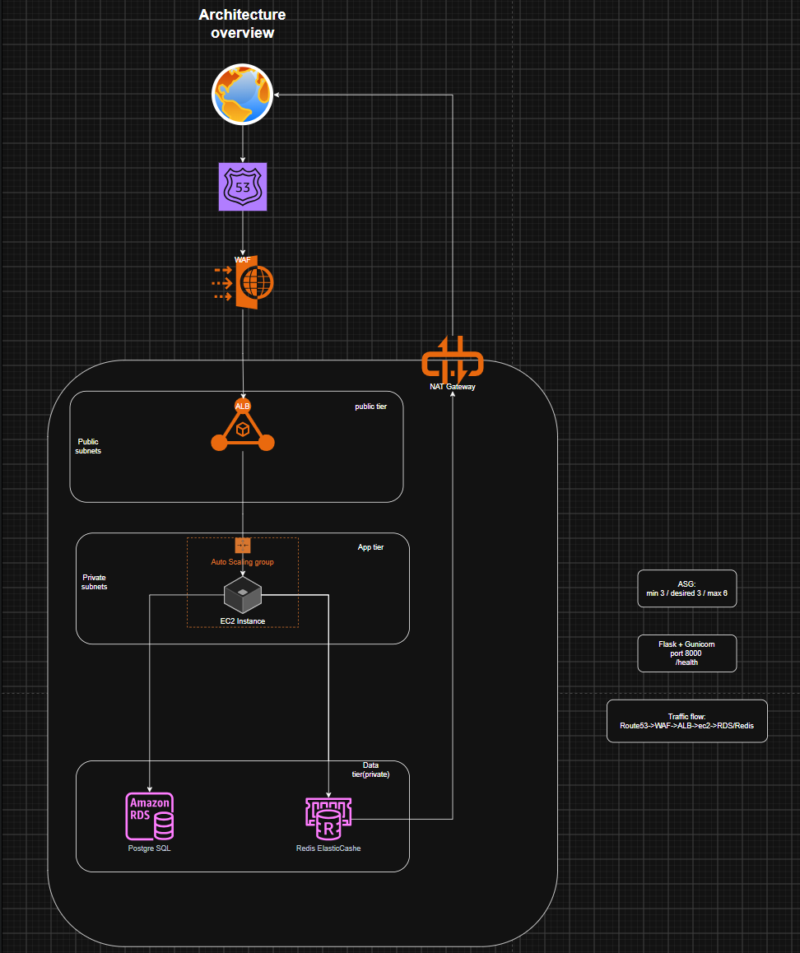
Architecture overview
Talk track
• Route 53 → WAF → ALB
• ALB sends traffic to EC2 instances in private subnets
• RDS stores users, events, and tickets
• Redis stores shared sessions, lockout counters, and rate limits
• NAT provides outbound internet access from private subnets
3

Slide 4
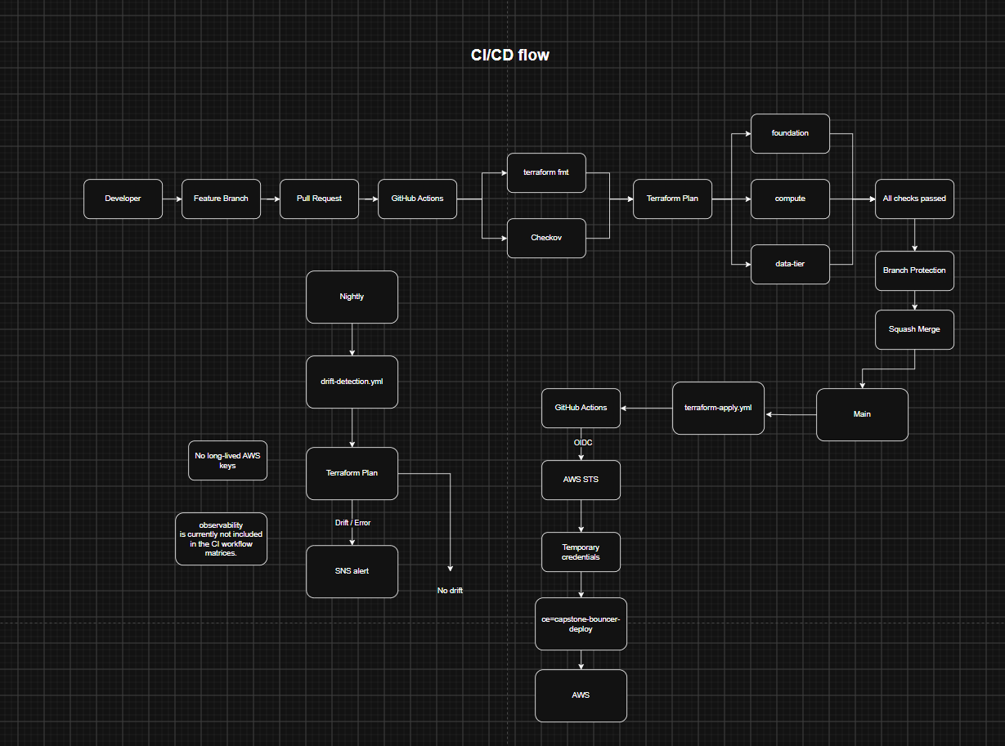
Delivery pipeline
What to point at
• Every PR: fmt + Checkov + Terraform plan
• Main: apply through GitHub OIDC
• AWS STS issues temporary credentials
• Required status: “All checks passed”
• Nightly: detailed-exitcode drift detection
4

Slide 5
Live demo
1
Public endpoint
app.projectbouncer.org
2
Application
Login → /me → /buy
3
Monitoring
CloudWatch dashboard + alarm state
4
CI/CD
GitHub Actions
5

Slide 6
Technical deep dive: security
Defense in depth across network, identity, application, and data layers
Network + identity
Application + data
• EC2 instances have no public IP and no SSH access
• SSM Session Manager is the management path
• IMDSv2 is required on EC2
• Security groups allow only tier-to-tier traffic
• GitHub Actions uses OIDC with temporary AWS credentials
• HTTPS with Secure, HttpOnly, SameSite=Lax cookies
• Passwords stored as bcrypt hashes
• Redis-backed 5-failure / 5-minute login lockout
• WAF rate limits /login and /buy
• DB UNIQUE(event_id, user_id) prevents duplicate tickets
• Checkov: 273/273 checks passing
6

Slide 7
Challenges & learning
The biggest lessons came from failures during real applies
IAM least privilege
NAT / EIP teardown
A clean Terraform plan did not prove the write path.
Real applies exposed missing AWS permissions.
A delete race left the EIP state stale.
Manual release + refresh-only recovered Terraform state.
Schema regression
Main lesson
A change removed the users table.
Fresh RDS creation then failed during app startup.
Test real create / destroy paths, not just syntax and plan output.
7

Slide 8
Future improvements
CI/CD fine-tune
Add Terratest
Add automated infrastructure integration tests.
Test that deployed resources actually behave as expected, not just that Terraform can plan.
Only run Terraform checks when Terraform code changes.
Avoid running Terraform tests for docs-only changes.
Build a proper frontend
Fix NGW EIP teardown race
Replace the basic/demo interface with a real website.
Make the application easier to demonstrate to a user.
Show the complete flow in the browser instead of relying mainly on curl/console demos.
Remove the current AWS-side deletion/release issue.
Make teardown fully reliable without the manual recovery step.
Main lesson
Least privilege is harder in practice than on paper.
Checkov forced tighter security.
IAM policy-size limits made permission design harder.
Test the real deployment path, not just the Terraform plan.
7

Slide 9
Results & impact
Evidence from the live environment
~$130.86
$150
3/3
273/273
steady-state monthly projection
monthly AWS Budget
healthy app targets
Checkov checks
Live verification
Business value
• HTTPS endpoint returns 200 on successful paths
• Authenticated /me works through Redis-backed sessions
• First ticket purchase returns 201; duplicate returns 409
• Application limiter returns 429; WAF returns 403 when its threshold is crossed
• Public users reach a secure ticketing service
• App capacity can scale from 3 to 6 instances
• Infrastructure changes are reviewed and automated
• Cost can be controlled by tearing down billable resources between sessions
8

Slide 10
Bouncer in one sentence
A ticketing platform that balances security, automation, observability, and cost control.
Questions?
9

