Slide 1
Interactive Digital Portfolio
CAPSTONE PROJECT
Presented By:
Bestha Arigela Lokesh - G.Pulla Reddy Engineering College
Computer Science and Business Systems

Slide 2
OUTLINE
Problem Statement (Should not include solution)
System Development Approach (Technology Used)
Algorithm & Deployment (Step by Step Procedure)
Result
Conclusion
Future Scope(Optional)
References

Slide 3
Problem Statement
In today’s digital era, traditional resumes alone are not enough to showcase skills and projects effectively. Many students and professionals lack a structured online presence to highlight their work. A digital portfolio provides an interactive and accessible platform to present achievements, skills, and experiences.

Slide 4
System Approach
Frontend Technologies:
HTML5 – Structure of the webpage
CSS3 – Styling and responsive layouts
JavaScript – Dynamic interactivity (cart, filtering, total calculation)
Design Approach:
Clean and user-friendly interface
Mobile-responsive design
Modular separation of HTML, CSS, and JS files

Slide 5
Algorithm & Deployment
Product Catalog Creation
Define product categories and details (image, price, description).
Frontend Design
Layout using HTML and CSS (grid & cards).
Interactive Features
Add-to-Cart, Remove-from-Cart functions in JavaScript.
Real-time total price calculation.
Product filtering by category.
Modal views for product details.
Testing
Cross-browser compatibility
Mobile responsiveness
Deployment
Host using GitHub Pages / Netlify for free and easy access.

Slide 6
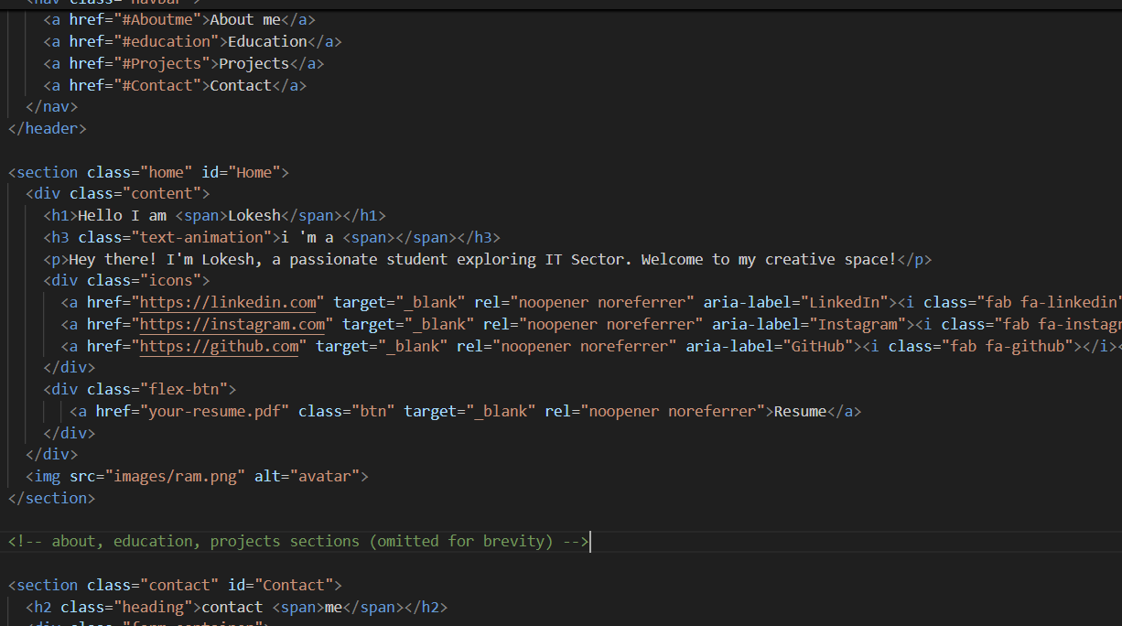
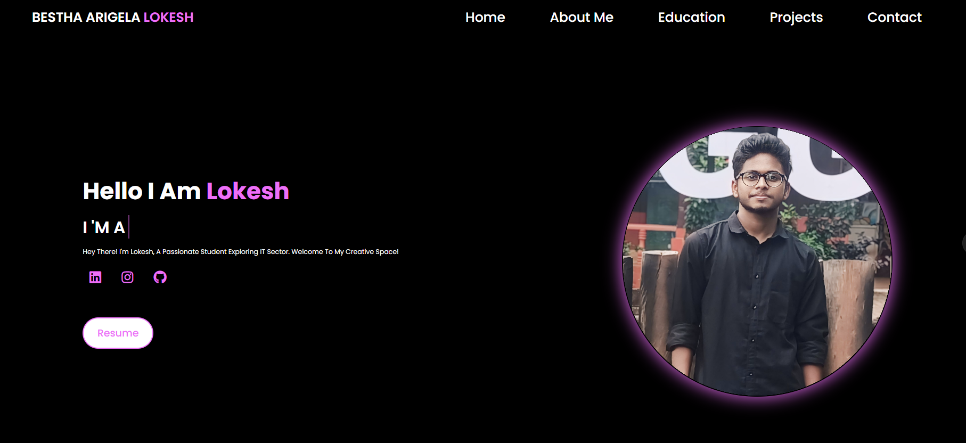
Result

Slide 7
Result
Attach your Github link
https://github.com/lok-01/Portfolio.git

Slide 8
Conclusion
Benefited to end users
Students (academic projects, resumes).
Job seekers (to share with recruiters).
Freelancers (to show clients).
Professionals (to highlight experience and achievements).

Slide 9
Future scope(Optional)
Navigation bar with smooth scrolling.
Project showcase with images/details.
Interactive elements (hover effects, animations).
Contact form (with validation).
Responsive design for all devices.

Slide 10
References
List and cite relevant sources, research papers, and articles that were instrumental in developing the proposed solution.
https://github.com/lok-01/Portfolio.git

Slide 11
THANK YOU

