Slide 1

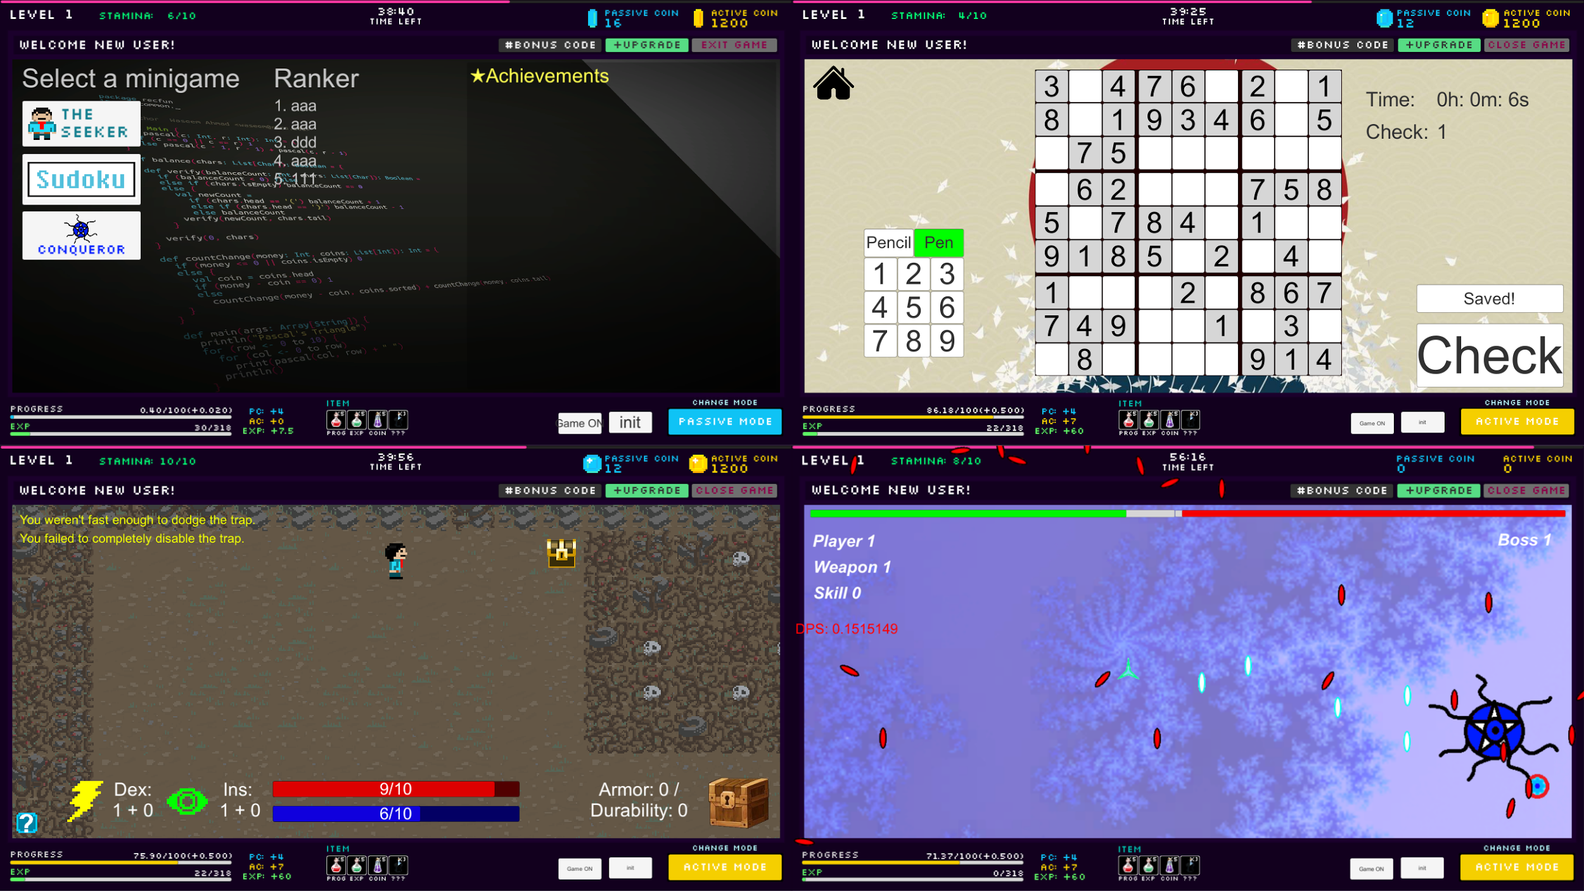
Gamification
Sponsor: WSU Intelligent Robot Learning Laboratory
Mentor: Chris Cain
Wai Fong, Wai Lok Cheng, Zachary Moore,
Sung Su Park, Casey Riehle
Overview & Motivation
Gameplay Screenshots
Game type: Mastermind
Gamification is the idea of designing a game for students to play that will reward them for the efforts they’ve put into their classes. It will track how much effort a student has put into their classes. Our team’s goal is to design and create a game that is enjoyable to a majority of students such that they’ll be motivated to put more effort in their classes.
The mastermind game is for people who like to exercise their brain through different difficulty puzzles to gain accomplishment from solving them.
Our team choose Sudoku to represent mastermind type game,where it will have 3 difficulty puzzle waiting to be solve. As the student progress into harder puzzles, the time spending on thinking for the solution will also be increased. The benefit of student solving harder puzzle is to encourage them to exercise their brain on finding solution and gaining better reward on the overall incremental progression.
Goals
Motivate students on their academic
Reward students in game based on their effort in class
Gather and statistics on how well the game works as an educational motivator
Require minimal work from the educator
Game type: Conqueror
The conqueror game is for people who enjoy a challenge and seek enjoyment from difficulty. It is a top down shooter that pits you against strong enemies. As your opponents get stronger, so do the rewards for victory. New weapons can be acquired and skills can be unlocked. These bonuses are essential for overcoming the enemies found later in the game. All bosses have unique mechanics that may require multiple attempts to defeat. This can provide a feeling of satisfaction and accomplishment that players may enjoy.
Background
Incremental Game
While there have been many games created for the sake of learning, nearly all of them are learning games rather than motivators. The fundamental aspect of this game we are creating is to provide students with a reward for when they show effort in their classes. This is measured by their class attendance, homework submissions, and lab submissions.
Incremental games have become a very widespread and popular genre over the past few years. They are very long lasting gameplay types and provides rewards in increments. This type of gameplay fits the needs for our overall game. It will be supported by our three other minigames to provide content for the player to do in order to level up and acquire rewards from the incremental.
All three games are connected together with the incremental game. The player can earn coins from the minigames and use the coins to boost their level up. Leveling up will unlock some new features in the minigames. By participating in class work, students have chances to get bonus code which can be used in the game to gain bonuses such as coins or items.
Stamina is what is used to play the minigames. If the player does not have enough stamina they will not be able to play. The player may gain stamina through work submissions and class attendances.
An active and passive mode is also included. The active mode is enabled for a set amount of time and provides a much faster experience gain. The passive mode provides player experience passively. It is very slow but runs continuously from the first launch of the game.
Game type: Seeker
The seeker game is for those who are interested in story and exploration based games. This game was designed with a story quest along with dungeon exploration. The player will play a character in the storyline. The main gameplay is to go into dungeons to explore for treasures which can be sold for upgrades in either the seeker game or for incremental progress. There are traps hidden within the dungeon which hinders the player’s progress. The player will have to increase their stats to disarm the traps or to dodge them.
Solution
To make all students enjoy the game, we made three mini games for different types of players: seeker, mastermind, and conqueror, with an incremental type game as the overarching genre. We used Unity3D as the development platform.
The Incremental game contain different mini-games, and each mini-game will represent its own genre element. Therefore each mini-game gathering specific genre statistics to help on the research to see how players tend to spend their time.
The game saves and loads game data using the EECS server via websockets where the data is stored using MongoDB database program. The assignment scores, attendance, etc. are read from CSV files and apply the appropriate rewards in the database.
Acknowledgments
We would like to thank the following people for their help and support:
Chris Cain, Alex Joens, WSU Intelligent Robot Learning Laboratory, and Behrooz Shirazi
Team Gamification

