Slide 1
COMP3222P SEMESTER PROJECT PRESENTATION
15005255D CHAN Chun Long 15004898D LAM Chun Ho
15005218D LOK Chun Wai

Slide 2
Introduction
User Login System
Using Factory Pattern - to create object without exposing the creation logic to the client and refer to newly created object using a common interface
To allow different users (Teacher, Student) to login into the system

Slide 3
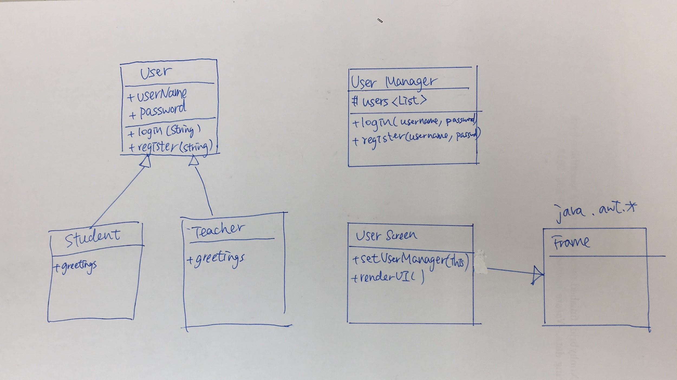
Class Diagram

Slide 4
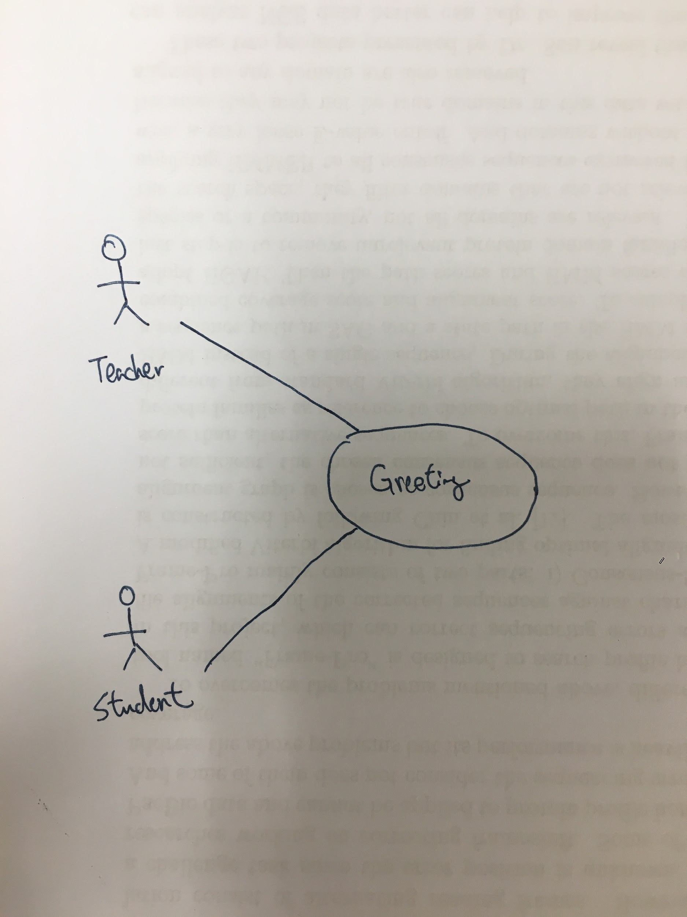
Use Case Diagram

Slide 5
Demo

