Slide 1

Tribhuvan University Institute Of Engineering Kathmandu Engineering College Kalimati, Kathmandu
Travel Perfect
Submitted By:
Abhishek Joshi (74004)
Bikesh Maharjan (74023)
Kabin Thapa (74031)
Lok Bahadur Chhetri (74035)
Date: 2076/08/16

Slide 2
Introduction
Naturally blessed mystical land of Himalayas, Nepal welcomes tourists from around the globe.
Having welcomed 1 million tourists in 2018, VisitNepal 2020 aims to double this number.
Realizing the extremely poor technology available for tourists to plan their trip, “Travel Perfect” strives to help them plan hassle free trip.
“Travel Perfect” is an android platform that helps the traveler to get the most out of their trip
“Travel Perfect” aims to uplift the socio-economic status of Nepali people and boost the GDP significantly.

Slide 3
Problem Statement
Information about routes and places of accommodation are lacking.
Interaction problem.
Expensive travel.
Security threat.
No information about volunteering activities.

Slide 4
Objectives
Finding travel destinations with accurate routes and geographical information.
Finding guides of similar age groups.
Getting involved in volunteering activities.
Providing opportunities for freelancing.

Slide 5
Scope and Application
Providing information free of cost.
Help users to get involved in volunteering activities.
Allow interested people to join as a freelance guide.
Gives reminder of the trip to users.
Provides information about prerequisites of the trip.

Slide 6
Application
It will guide travelers through the best available route.
It will provide opportunities for interested people to

Slide 7
Literature Review
Tourism generates USD 8.8 trillion annually and provides 319 million jobs in the world. ^{[1]}
Kathmandu is the 19th most popular travel destination.^{[2]}
Tourism industry generates 5% of Nepal’s GDP. ^{[1]}
Around 1 million visitors have visited Nepal in 2018.^{[3]}
There is no aggregate data that shows contribution of tourism related apps in Nepal’s GDP.

Slide 8
Methodology
Incremental model has been used to develop our project.
Required prototype is designed for implementation after analysis of requirement of user.
Required module is released after prototypes are tested, deployed and updated.

Slide 9
Process Model
The core product will display the places to visit by the use of GPS and map API.
The problems faced by tourists during their visits will be analyzed.
Designing the suitable problem and implement it as per user’s problem.
Prototype will be tested whether there is any error or not.
After repeating the process, the final product will be updated as per client’s review.

Slide 10
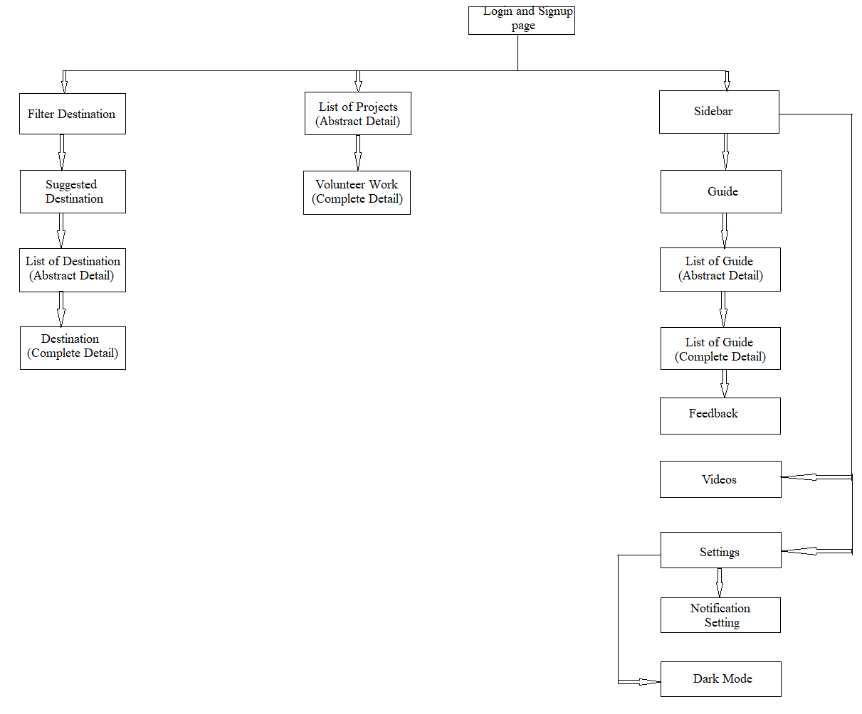
System Block Diagram

Slide 11
Expected Output
Provide the information about the trekking route via maps, photos and videos footages.
Travelers can choose the perfect travel companion from the available freelancer guides.
Travelers an choose to participate in a cause closer to their heart.
TRAVEL PERFECT aims to uplift the socio-economic status of Nepalese and boost the GDP significantly.
Community and national project gets financial and volunteering aids as well as international recognition.

Slide 12
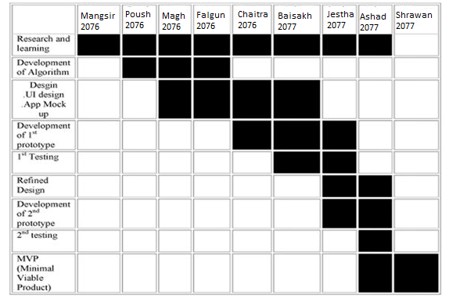
Time Schedule
Place the topics covered in your presentation

Slide 13
References
[1] World Travel and Tourism Council
[2] TripAdvisor.com
[3] The Himalayan Times, “Tourism Industry in Nepal” September 2019 [online]

