Slide 1
A Brief Exploration of Drawing Machines
Max Corbin
Local Maker, Hack-a-thon Winner, and General Mad Man

Slide 2
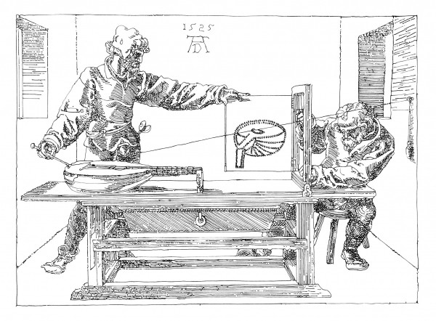
Older than you might think...
Drawing machines have been around for a very long time...
“Dürer’s Door”, Albrecht Dürer, 1525

Slide 3
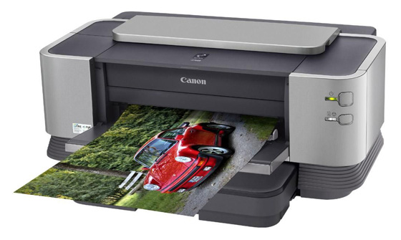
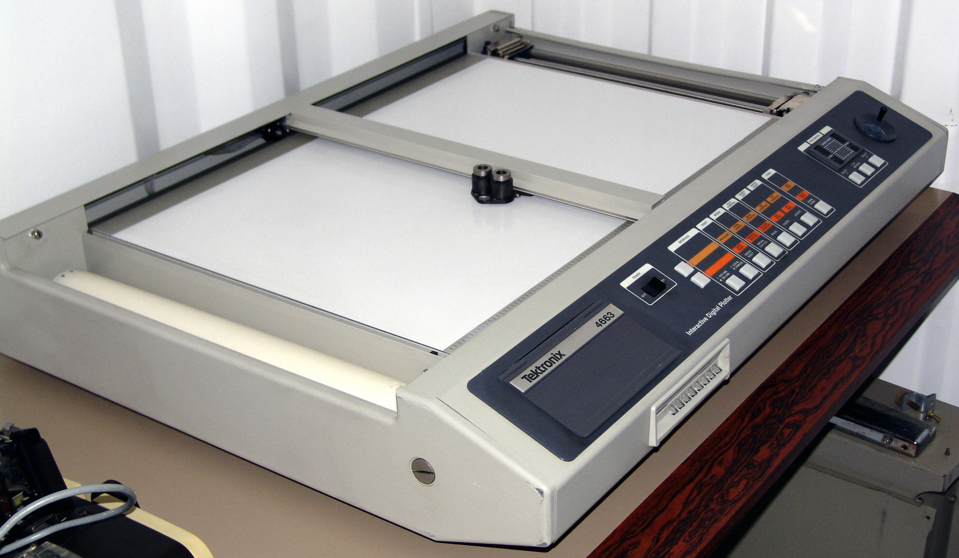
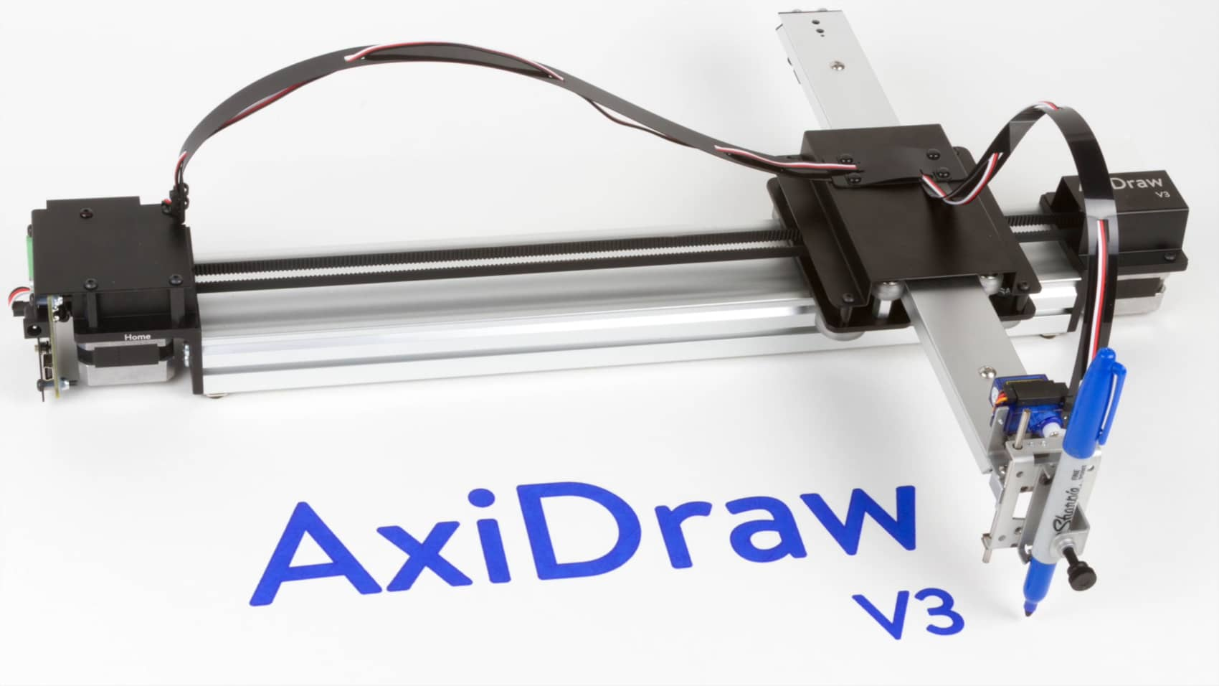
Focus is not the Typical “Drawing” Machines
These rely on X-Y
Cartesian coordinate
Systems. (Boring...)

Slide 4
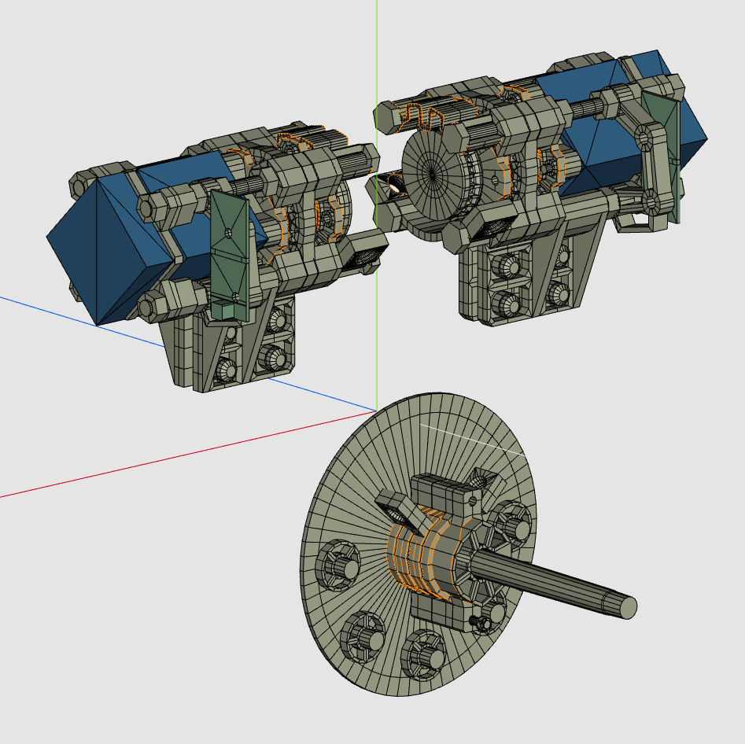
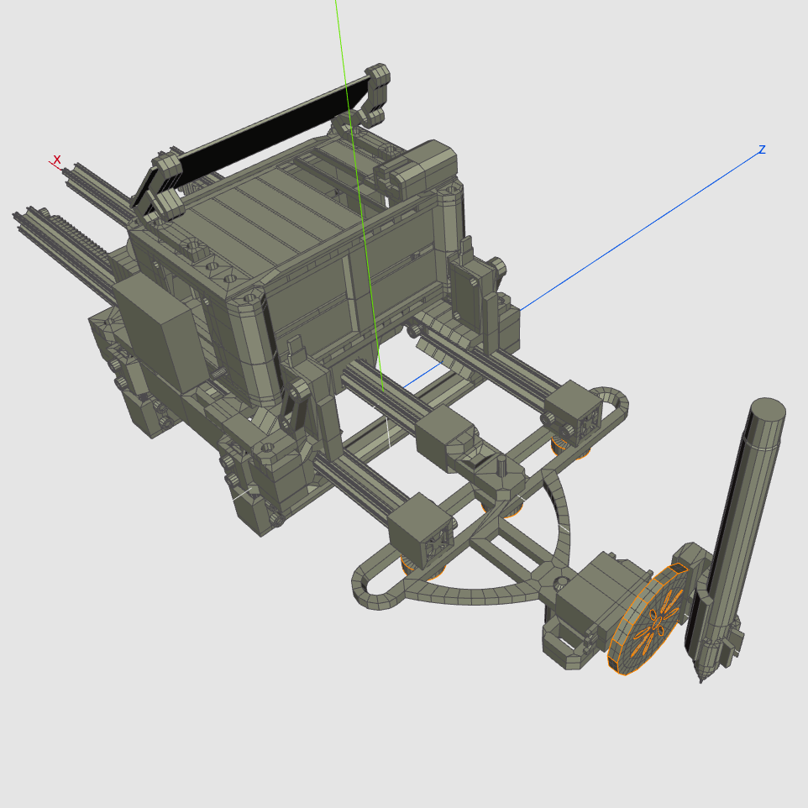
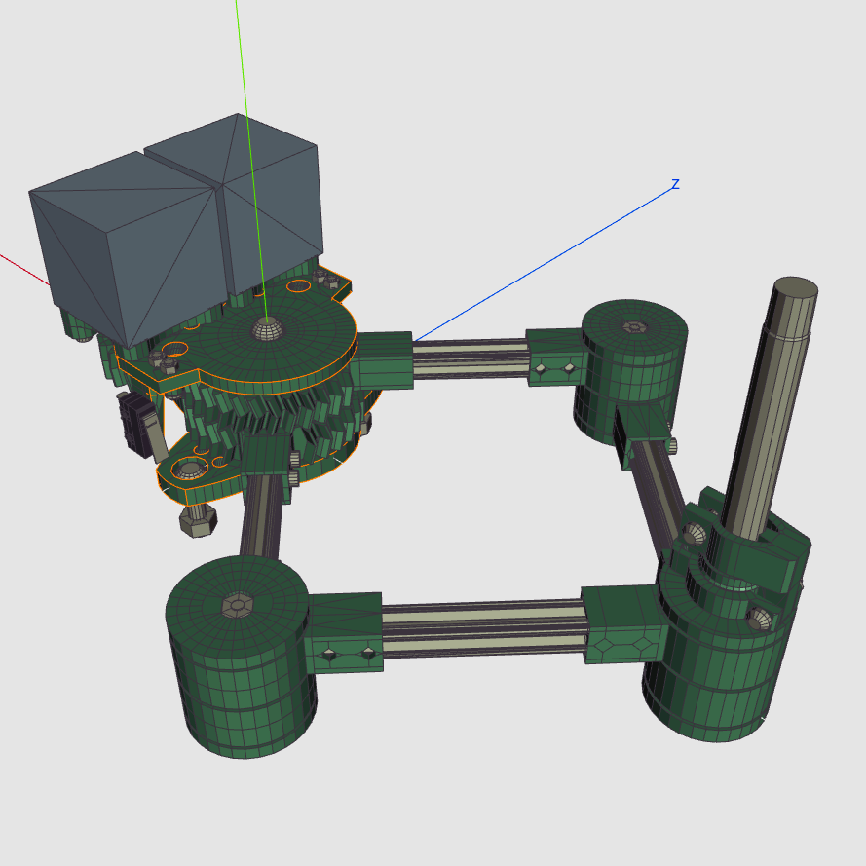
Of Machines More Unusual...
Discuss Three Machines in Particular:
Alexandria
Baalbeck
Exeter

Slide 5
Alexandria

Slide 6
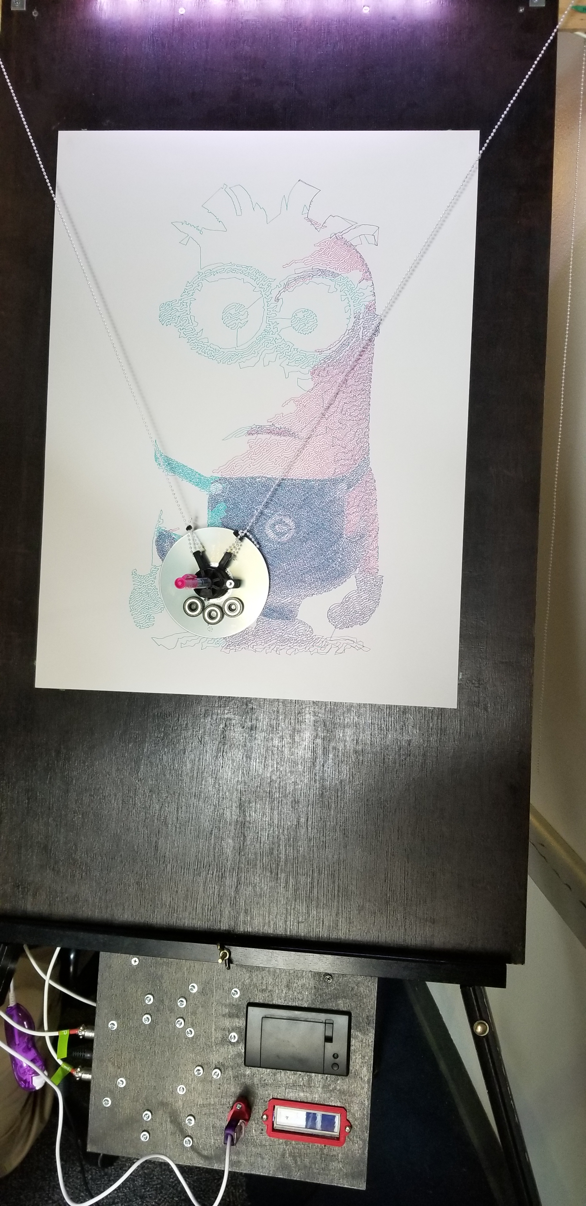
What is Alexandria?
Alexandria is a V-Plotter.
A pen hangs from two strings.
String length is varied to move the pen around.
Very simple mechanical design.

Slide 7
A Little History
Alexandria came about as a challenge to myself from some art students at M.I.C.A.
I was shown a machine called the “Polargraph Drawing Machine” and asked if I could make it better.
Alexandria was born as a result.

Slide 8
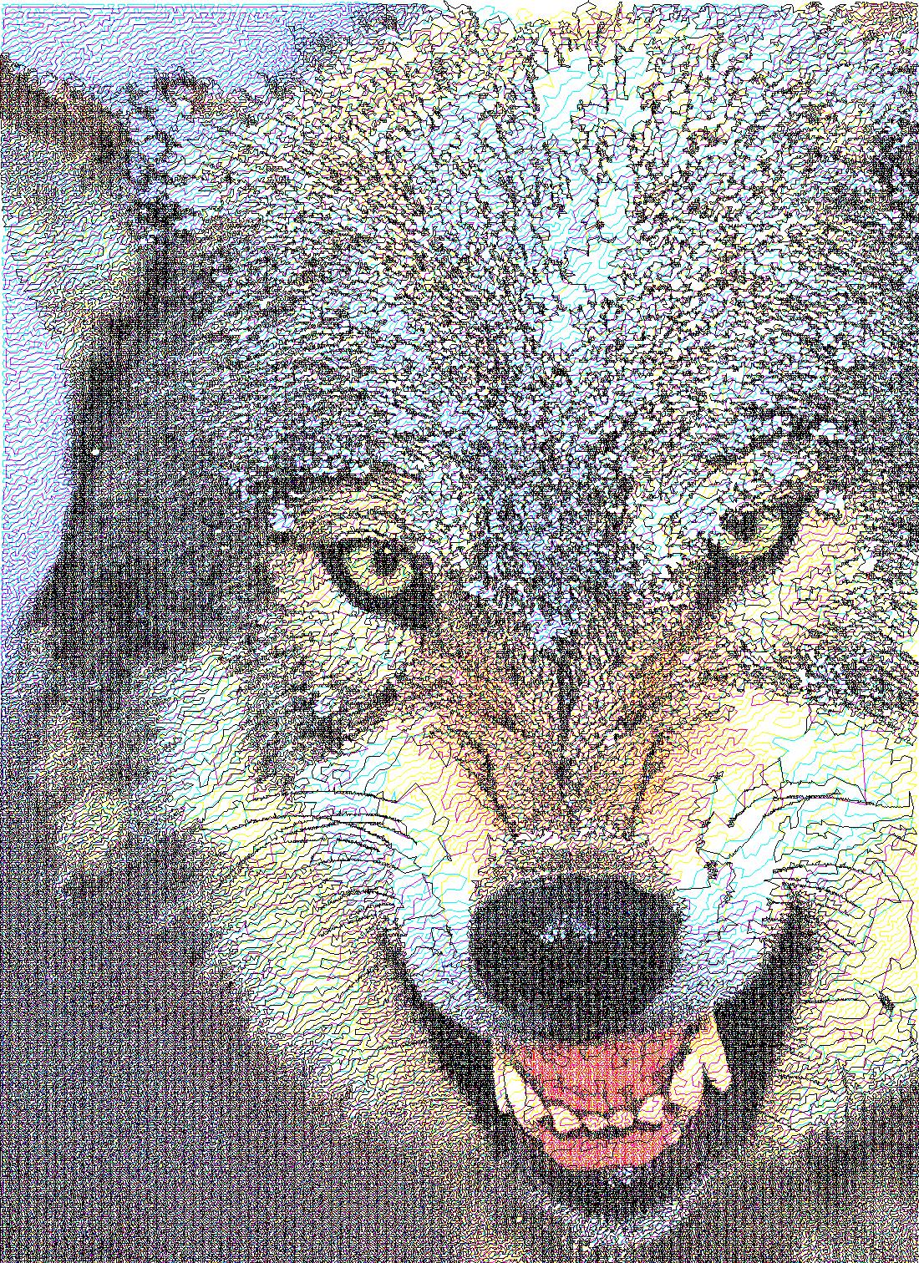
What Makes Alexandria Different?
Alexandria can do full color photographs.
No counterweights!
Very high resolution.
Alexandria cannot lift the pen!
  Each color is one line from beginning to end.

Slide 9
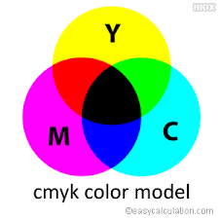
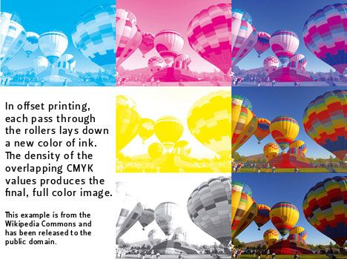
Photos via CMYK Color
Break image into:
  Cyan
  Magenta
  Yellow
  Black
Dither
Run TSP solver
  Traveling Salesman Problem

Slide 10
No Counterweights
Counterweights must be balanced to work correctly.
  Tension changes as a function of string length and position.
  Very common for weights to slip on polargraph machines.
Alexandria works around this problem by using a pinch wheel.
Pinch Wheel
Chain
Drive Wheel

Slide 11
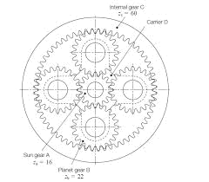
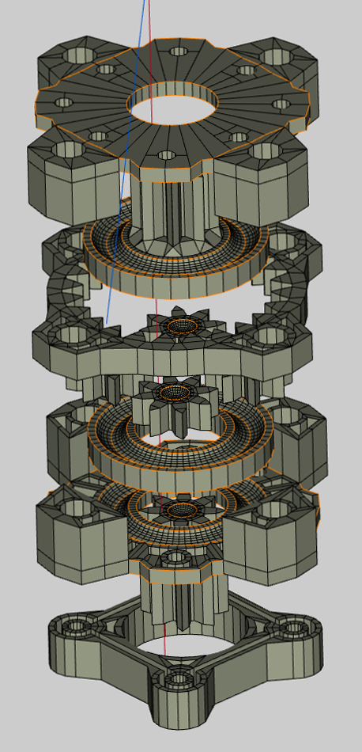
High Resolution
Alexandria uses a planetary gearbox to increase angular resolution.
4X improvement over regular stepper motors.
4X Torque improvement.
  The gondola can be heavy!

Slide 12
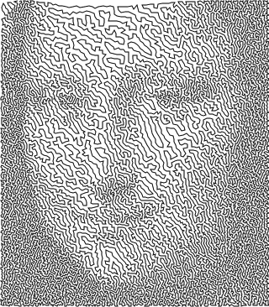
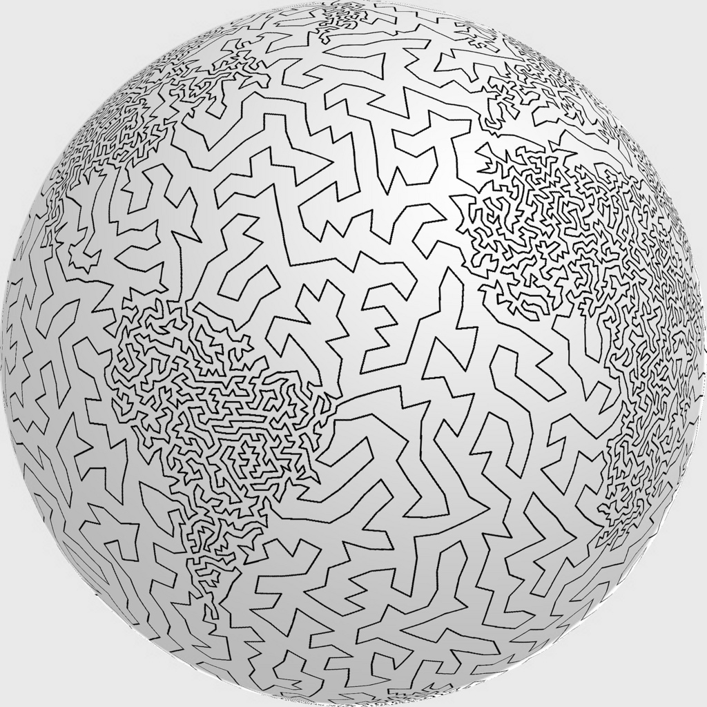
Can’t Lift the Pen?
Just how are those drawings possible?
TSP Art:
  http://www.cgl.uwaterloo.ca/csk/projects/tsp/
  https://wiki.evilmadscientist.com/TSP_art

Slide 13
The Math Behind Alexandria
h
R1
R2
x
h-x
h can be measured
y
But how to convert motors steps to actual length R??
This is left as an exercise for the reader.

Slide 14
Lessons Learned… A Useful Tip
Drawing a single, long, straight line may not end up being straight!
Break the lines into smaller segments.
  Bonis! The speed can vary along path.
Desired
Actual!

Slide 15
What Would I Have Done Different?
Improve the chain guides as the chain is slowly sawing through them…
Improve the pen holder on the gondola.
  It needs a quick release.
Better computer and user interface.
  Display the drawing as it progresses.
Alexandria is hard to transport...

Slide 16
Baalbeck

Slide 17
What is Baalbeck?
Baalbeck is a very unusual design.
Baalbeck uses two racks with pinions and a pivot in the center.
The pen can move left and right or swing about the pivot.

Slide 18
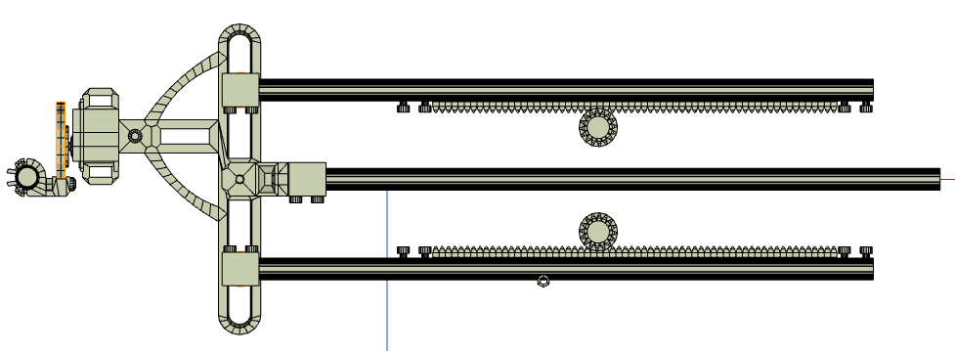
Baalbeck’s Main Mechanism
Pen
Upper pinion
Upper rack
Pivot
Lower pinion
Lower rack

Slide 19
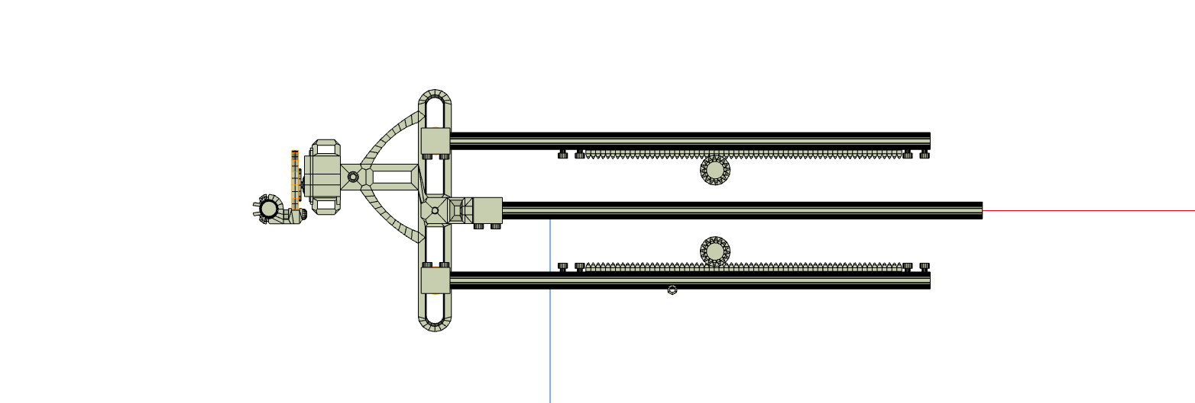
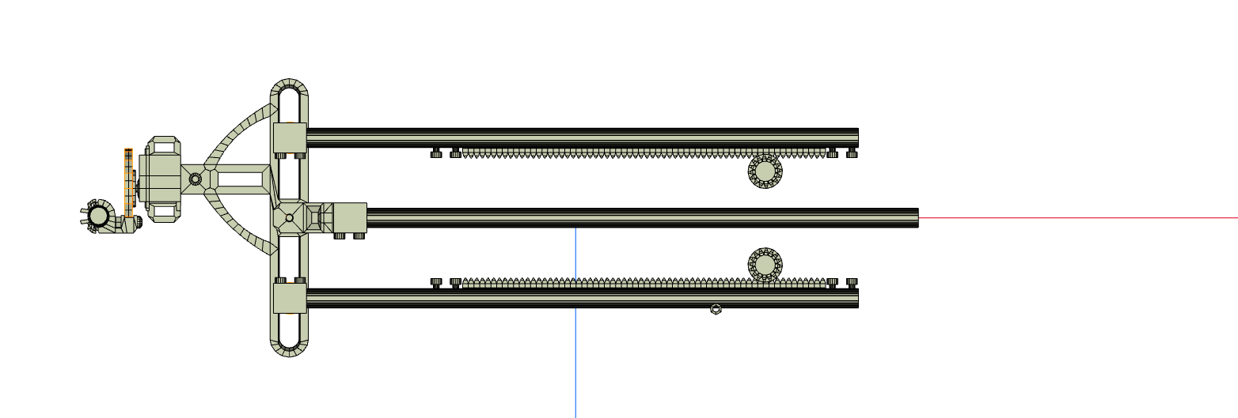
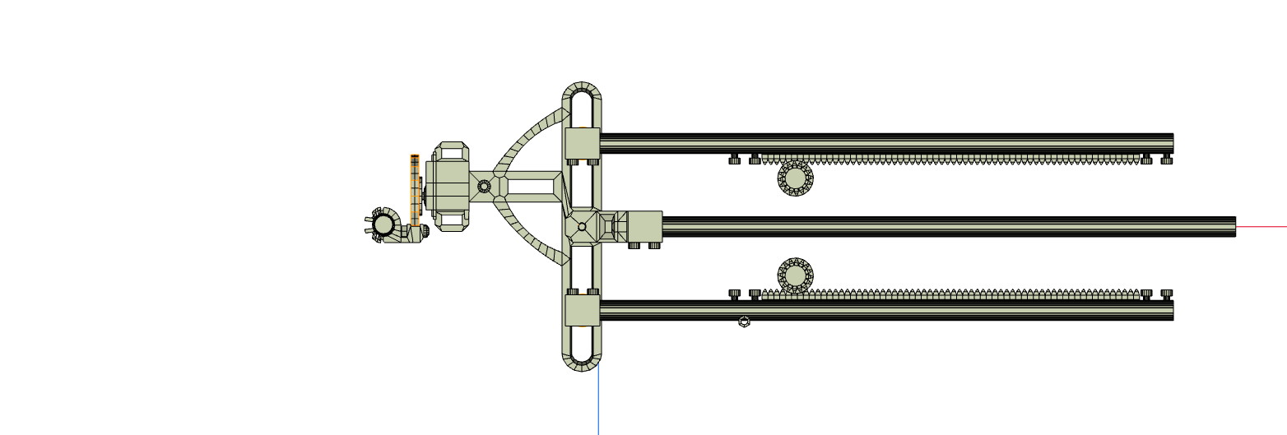
Baalbeck Horizontal Movement
The racks both move the same direction to achieve left/right movement.
The pinions rotate opposite directions to achieve this.
left
right

Slide 20
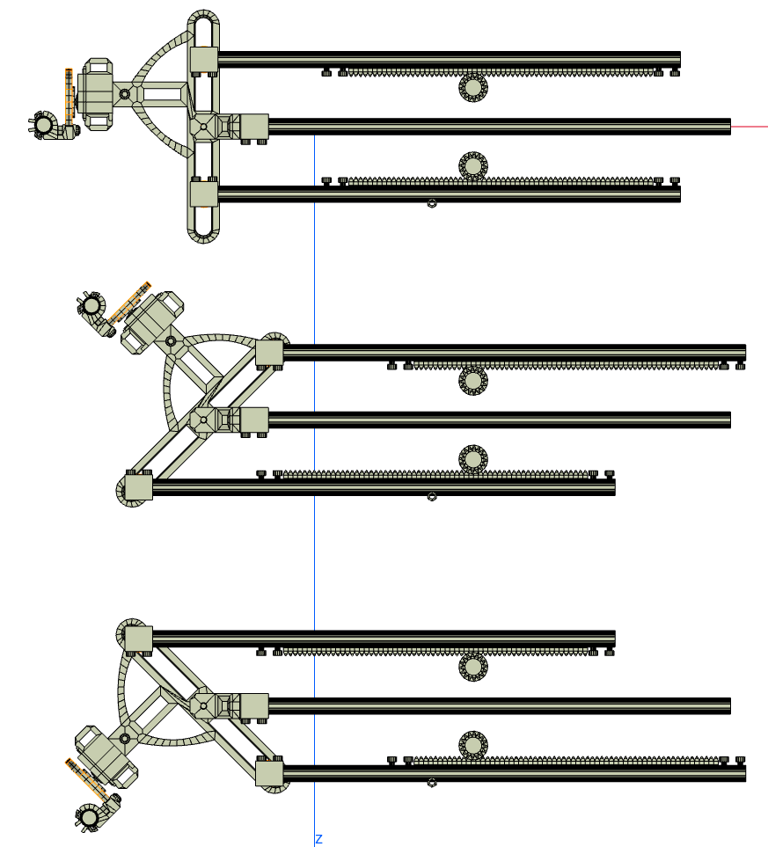
Baalbeck “Vertical” Movement
The pen rotates up/down around a pivot.
The rotation has a left/right movement that requires compensation.
  More math exercises for the reader.

Slide 21
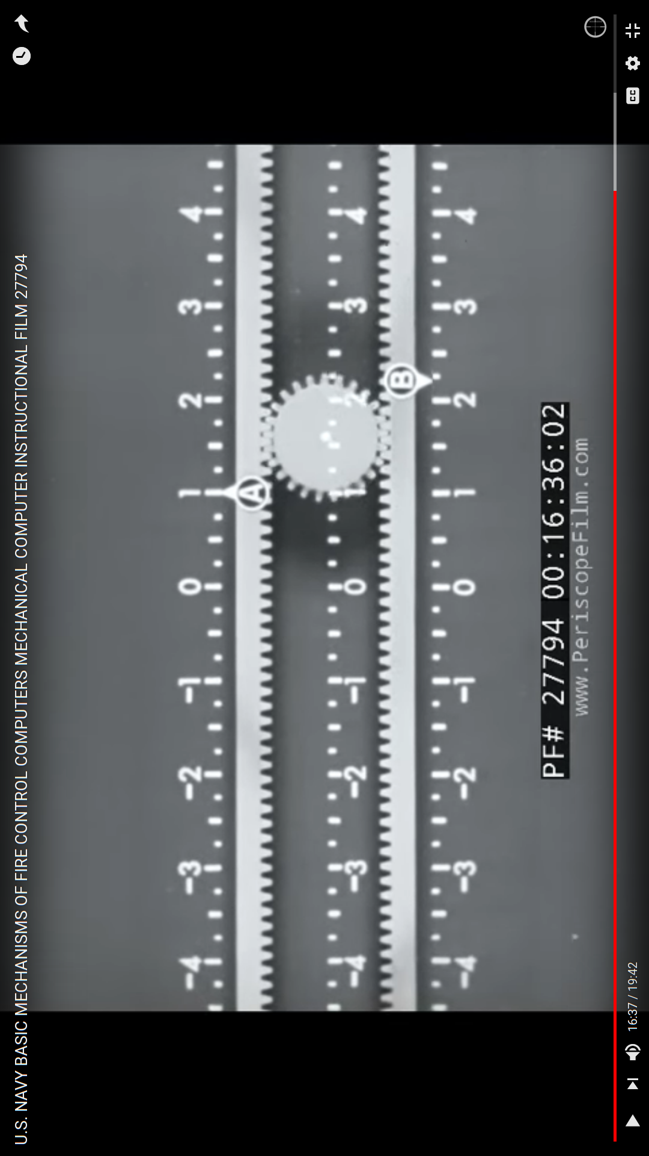
A New Idea?
Nope…
What is old is new again.
Found the same basic design in a Navy WWII mechanical computing video.
https://www.youtube.com/watch?v=gwf5mAlI7Ug

Slide 22
What Would I Have Done Different?
EVERYTHING!
The linear racks need smoother movement.
Expand range of motion.
Replace stepper motors with ones that support micro stepping.
Replace pivot with large disc.
Use herring-bone teeth on racks to hold disc.
Others...

Slide 23
Exeter

Slide 24
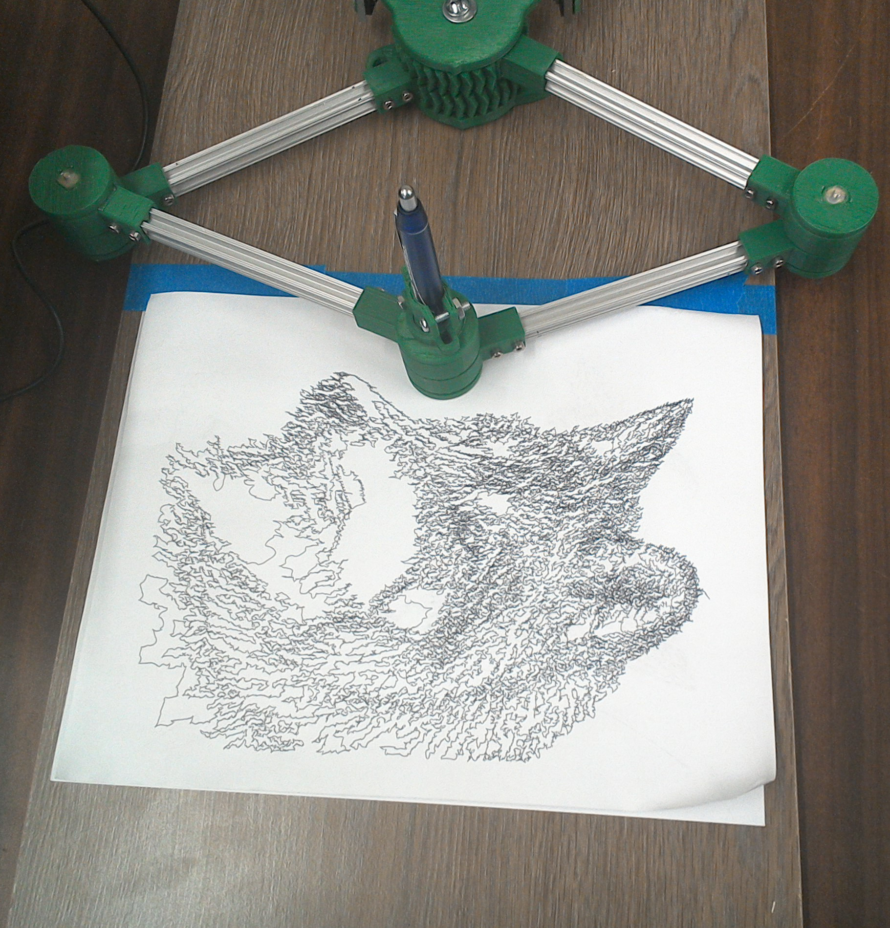
What is Exeter?
Exeter is a dual SCARA
  Selective
  Compliance
  Articulated
  Robot
  Arm

Slide 25
How Does Exeter Work?
Exeter can move a pen in/out or rotate about a pivot.
It is very much like Baalbeck in this regard.
It is very different from Baalbeck in how this is achieved.
Pen moves towards or away from the pivot when the arms rotate away or towards each other.
pivot
Pen swings with the arms if both arms rotate the same direction.
pivot

Slide 26
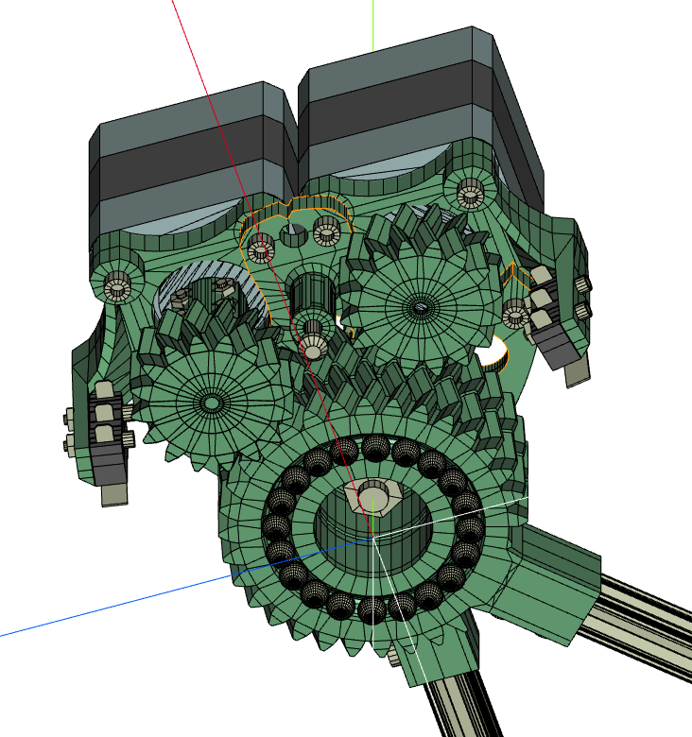
Lessons Learned… The Pivot
The pivot implements stacked herring-bone gears.
This caused a problem…
  Moving one gear causes the other to move!!!
  Caused by friction.

Slide 27
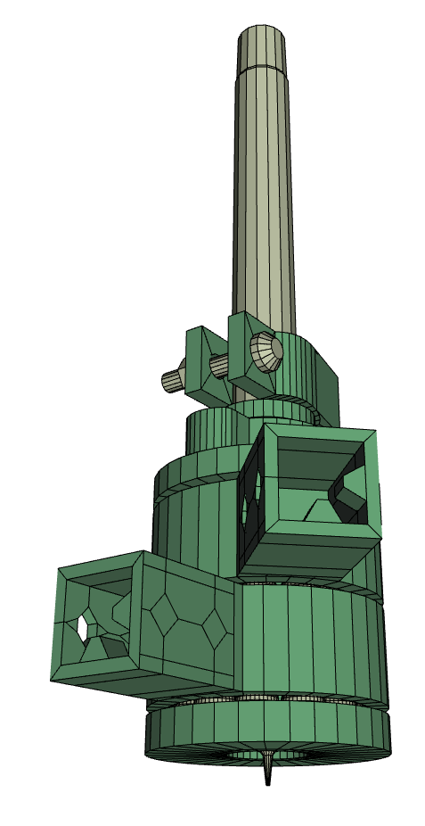
Lessons Learned… The Pen
The pen holder proves to be a particular challenge…
It works with any pen but is held halfway up the shaft!
Try writing holding a pen only at its mid point to experience the problem.
BAD

Slide 28
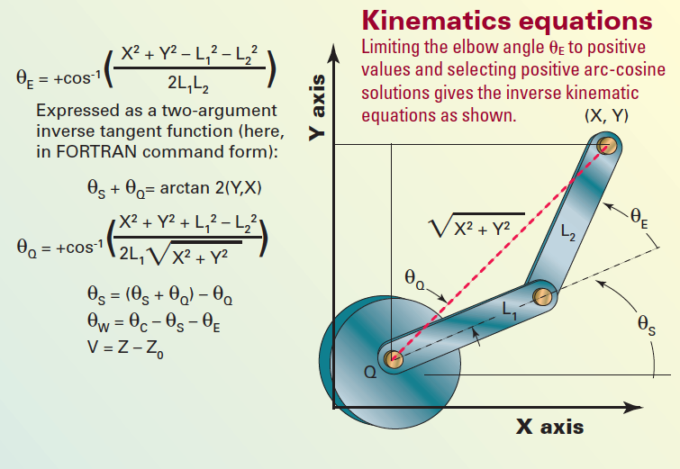
SCARA Arm Math
This is a well studied problem and it is easy to find references on-line

Slide 29
What Would I Have Done Different?
The pivot and pen holders need to be redesigned.
I would replace the limit switches with optical detectors.
“Homing” on this machine is scary.
  The arms moves very quickly.

