Slide 1
♻
CampusWasteGuide
AI-Powered Campus Waste Segregation Chatbot
1M1B – IBM SkillsBuild & AICTE | AI for Sustainability Virtual Internship | July–Sep 2026
SDG 4 · SDG 11 · SDG 12 · SDG 13
Submitted by: Bhagyashree Sushilkumar Lokapure
College: Indira Gandhi National Open University (IGNOU)
Notes:
Title slide. Fill in your name and college before submission.

Slide 2
SLIDE 2 | PROBLEM STATEMENT
Problem Statement
How might we use AI to guide campus users in correctly segregating waste so that campuses can become more sustainable and reduce landfill contribution?
Context & Evidence
• Campus waste bins are routinely contaminated — recyclables, compostables, and e-waste are mixed into general waste due to lack of awareness
• Bin labels are static and cannot answer ambiguous questions (e.g. "Is a coffee cup recyclable?")
• E-waste — batteries, chargers, pen drives — is discarded in general bins, causing environmental and health hazards
• No real-time, on-demand, accessible guidance exists for students and staff at the point of disposal
• Campus sustainability audits globally report 40–60% waste misclassification rates
Notes:
Problem statement slide. The core question follows the guideline format: How might we use AI to ___ so that ___ can become more sustainable?

Slide 3
SLIDE 3 | SDG ALIGNMENT & TARGET USERS
SDG Alignment & Target Users
SDG 12
Responsible Consumption
& Production
PRIMARY
SDG 11
Sustainable Cities
& Communities
Secondary
SDG 13
Climate Action
Secondary
SDG 4
Quality Education
Secondary
Target Users
🎓 Students — especially new intakes unfamiliar with campus waste systems
👩‍🏫 Lecturers & Administrative Staff — daily office waste generators
🏢 Canteen & Facility Workers — handle large volumes of mixed waste
🏫 Campus Sustainability Teams — seeking scalable awareness tools
Notes:
SDG mapping: primary SDG 12. Secondary: SDG 11, 13, 4. Target users are all campus stakeholders.

Slide 4
SLIDE 4 | DETAILED SOLUTION DESCRIPTION
Detailed Solution Description
What it does
CampusWasteGuide is a conversational AI chatbot that accepts a natural-language description of any waste item and instantly returns the correct disposal bin — from a verified 200-item campus waste knowledge base covering all 5 bin categories.
RAG Pipeline — 3 Stages
1 KNOWLEDGE BASE
knowledge_base.txt
200 items · 5 bins
Human-auditable
2 RETRIEVAL
Keyword substring
matching
Case-insensitive
3 GENERATION
Friendly bin-name
response or polite
fallback
→
→
Notes:
Detailed solution: RAG pipeline with knowledge_base.txt as the retrieval source. Pure Python, zero external dependencies.

Slide 5
SLIDE 5 | AI ELEMENTS & TOOLS USED
AI Elements & Tools Used
🔍 RAG
Retrieval-Augmented Generation — knowledge_base.txt is the retrieval corpus; no LLM hallucination possible
💬 Conversational AI
Natural-language input loop — free-text queries, no fixed command syntax required
🛠 IBM BOB
Used to design, code, analyse, and document the entire project — prompt engineering for knowledge base curation
⚙ Prompt Engineering
Knowledge base rules authored using structured prompt workflows — item classification logic designed via prompts
🐍 Python 3
waste_assistant.py — dynamic KB loader, regex parser, keyword matcher, interactive CLI loop
📄 Knowledge Base (200 items)
knowledge_base.txt — human-readable, auditable, zero-dependency corpus across 5 waste categories
Notes:
AI tools: RAG, conversational AI, IBM BOB, prompt engineering, Python. No paid API or internet required.

Slide 6
SLIDE 6 | WORKFLOW DIAGRAM & PROTOTYPE DEMO
Workflow Diagram & Prototype Demo
USER INPUT
Types item name
e.g. 'old banana peel'
NORMALISE
Lowercase + strip
parenthetical tags
RETRIEVE
Keyword match
against 200-item KB
MATCH?
→
→
→
Sample Output — CLI Demo
Yes → Bin name response
♻ Campus Waste Guide Assistant
Knowledge base loaded: 219 entries across 5 bins
What item are you disposing? banana peel
✅ Please dispose of that in the Green Compost Bin.
What item are you disposing? old laptop charger
✅ Please dispose of that in the Admin Office E-Waste Drop-off.
What item are you disposing? broken umbrella
✅ Please dispose of that in the Black General Waste.
What item are you disposing? sanitary pad
✅ Please dispose of that in the Red Sanitary Waste Bin.
No → Polite fallback
Notes:
Workflow diagram + actual CLI demo output showing all 5 bins being correctly identified.

Slide 7
SLIDE 7 | THE 5-BIN KNOWLEDGE BASE
Knowledge Base — 200 Items, 5 Bins
♻
BLUE
Recycling Bin
40 items
Bottles · Cans
Paper · Cardboard
Metal · Cartons
🌱
GREEN
Compost Bin
40 items
Food scraps
Fruit & veg
Garden waste
🗑
BLACK
General Waste
52 items
Wrappers · Foam
Broken items
Non-recyclables
🔋
E-WASTE
Admin Office
40 items
Devices · Cables
Bulbs · Batteries
Networking
🩺
RED
Sanitary Bin
28 items
Hygiene items
PPE · Diapers
Medical kits
200 items · 5 destinations · 0 ambiguity · Loaded dynamically from knowledge_base.txt at runtime
Notes:
Full 5-bin breakdown with item counts. Knowledge base is the single source of truth.

Slide 8
SLIDE 8 | RESPONSIBLE AI CONSIDERATIONS (MANDATORY)
Responsible AI Considerations
⚖ FAIRNESS
No bias in data or assumptions. All campus users — students, staff, canteen workers — receive identical, consistent guidance regardless of who asks.
🔍 TRANSPARENCY
All rules stored in human-readable knowledge_base.txt — any staff member can read, verify, and update them without technical knowledge.
🛡 ETHICS
No harmful, discriminatory, or misleading outputs. The chatbot only answers waste disposal questions. Fallback prevents incorrect guidance.
🔒 PRIVACY
Zero personal data collected. No login, no tracking, no analytics. Completely anonymous usage — no user profiling of any kind.
👁 HUMAN OVERSIGHT
Fallback response always directs uncertain users to physical bin labels — AI never fabricates an answer when unsure.
💡 EXPLAINABILITY
Every response names the exact bin — not just a colour. Users understand why, not just what. Rules are fully auditable.
Notes:
Mandatory Responsible AI section covering all 4 guideline requirements: Fairness, Transparency, Ethics, Privacy — plus Human Oversight and Explainability.

Slide 9
SLIDE 9 | EXPECTED IMPACT & DESIGN THINKING
Expected Impact & Design Thinking
What changes if this solution is implemented?
• Waste misclassification drops at the point of disposal — guidance is instant and always available
• Recyclable diversion from general waste increases — measurable sustainability impact
• E-waste reaches proper drop-off instead of landfill — reduces toxic contamination
• Students build long-term habits through repeated correct interactions
• Campus sustainability KPIs improve without costly infrastructure changes
Design Thinking Stages Applied
Empathize
Observed campus bin misuse daily
Define
Problem statement + user gaps
Ideate
RAG chatbot — no API needed
Prototype
CLI chatbot + 200-item KB
Test & Refine
Analysis script — 10/10 tests passed
Notes:
Impact statement and all 5 design thinking stages mapped to actual project activities.

Slide 10
Project Files & GitHub / Demo Links
Project Files Submitted
• knowledge_base.txt — 200-item waste segregation knowledge base (5 categories)
• waste_assistant.py — CLI chatbot loading KB dynamically via RAG pipeline
• analyse_knowledge_base.py — automated analysis & test script (10/10 tests passed)
• CampusWasteGuide_v2.pptx — visual presentation deck (12 slides)
• AGENTS.md — project documentation and conventions
Demo / Prototype / GitHub
GitHub Repository : https://github.com/lokapurebhagyashree/CampusWasteGuide
Live Demo : Run python waste_assistant.py locally (no internet required)
Prototype Folder : CampusWasteGuide\ (all files in workspace)
Notes:
Replace GitHub URL with your actual repo link before submission. Demo runs locally — no internet or API key needed.

Slide 11
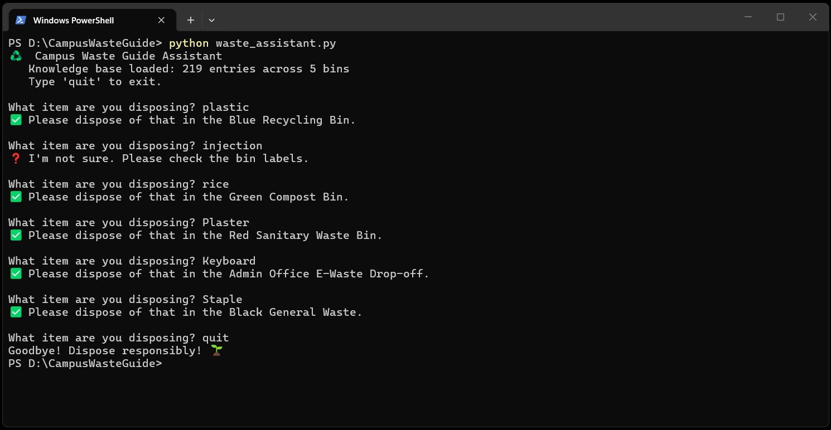
Screenshot

Slide 12
♻
Thank You
Ask it. Bin it. Do it right.
"You are not expected to solve the entire world's problem.
You are expected to think critically, apply AI responsibly,
design with purpose, and build for impact."
— 1M1B AI for Sustainability Internship Guidelines
Bhagyashree Sushilkumar Lokapure | Indira Gandhi National Open University (IGNOU)
1M1B – IBM SkillsBuild & AICTE | July–Sep 2026
Notes:
Closing slide. Fill in your name and college before submission.

