Slide 1
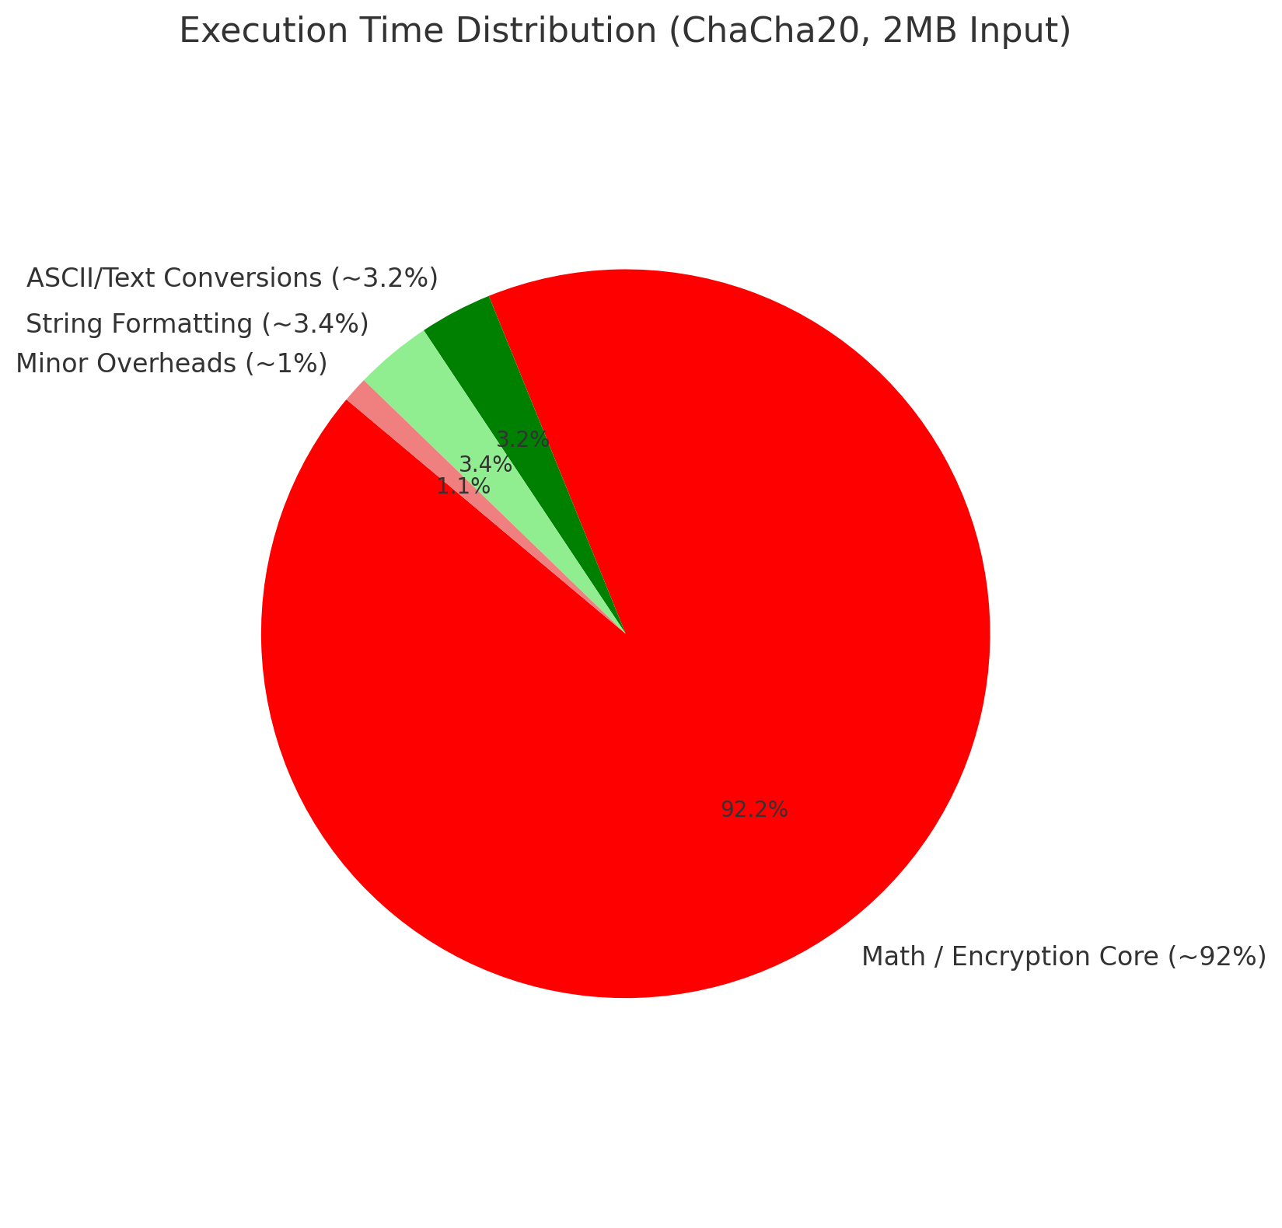
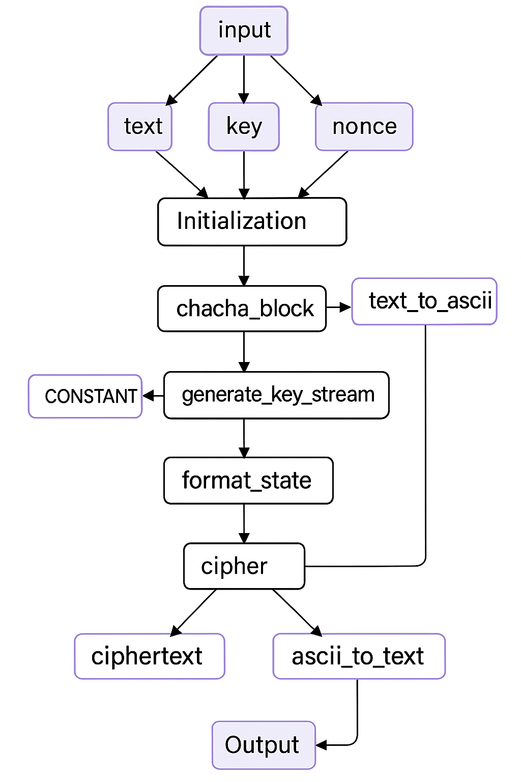
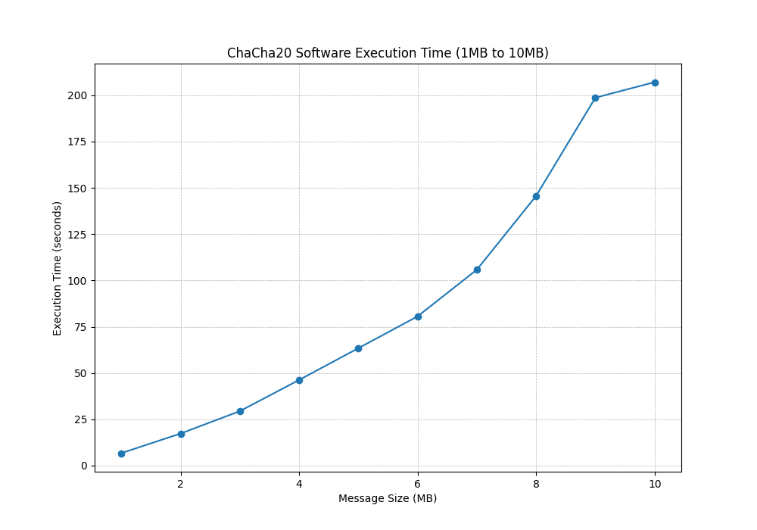
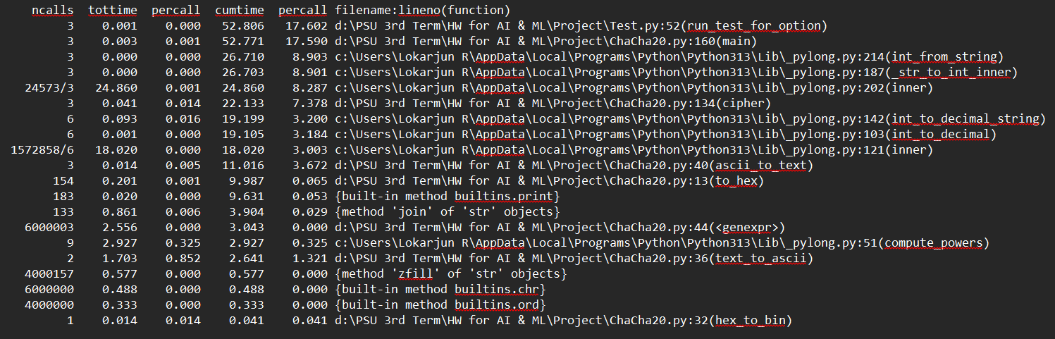
Cryptographic Algorithm (ChaCha20)
What are you trying to do? I.e., what AI/ML algorithm/workload did you pick?) I plan to implement a hardware-software co-design for the ChaCha20 stream cipher, a lightweight encryption algorithm commonly used in AI/ML edge applications for securing data streams.
It is a supportive cryptographic function integrated in AI/ML systems for privacy-preserving inference, secure model updates, or data transfer.
How have others implemented and/or accelerated this algorithm? ChaCha20 has been widely implemented in optimized C/C++ libraries such as OpenSSL and Libsodium for CPU/GPU platforms, and also as RTL-based IP cores for FPGAs and ASICs in secure low-power systems. Some hybrid approaches use embedded systems to combine software and hardware acceleration.
What are you doing differently/better/etc.? I am implementing and accelerating the ChaCha20 stream cipher algorithm using hardware-software co-design. The goal is to offload the core ChaCha20 block to a hardware accelerator written in SystemVerilog while retaining the control and ASCII/hex conversion logic in Python.
What have you accomplished so far? I have completed the Python reference implementation of ChaCha20, extracted and translated the core cryptographic block into SystemVerilog, built a cocotb testbench, and benchmarked the software-only implementation on large input sizes up to 10MB. I also generated visual data-flow diagrams and profiling reports to guide hardware mapping. I have also generated a input file of 2MB for my algorithm
What will you do next and what remains to be done until you can declare success? The next steps include completing hardware-software co-simulation, comparing performance between software and RTL execution, and finalizing documentation and benchmarks. Success will be defined by demonstrating correct, cycle-accurate behavior of the RTL block and performance improvement over the software baseline.

