Slide 1
Sweetviz
AC30 Vanessa

Slide 2
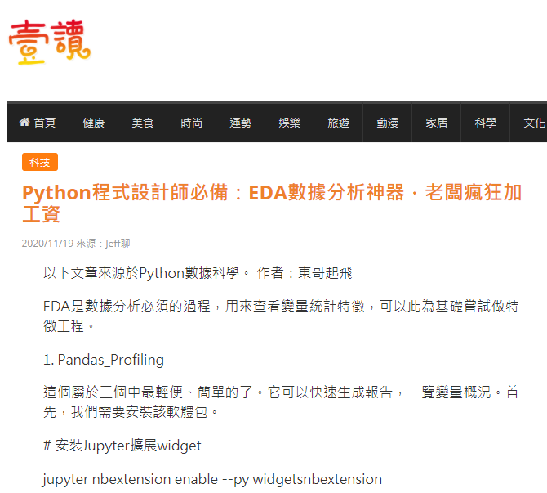
EDA 工具
1. Pandas_Profiling
2. Sweetviz
3. pandasGUI
比較：
  Pandas Profiling 適用於快速生成單個變量的分析。
  Sweetviz 適用於數據集之間和目標變量之間的分析。
  PandasGUI適用於具有手動拖放功能的深度分析。
https://read01.com/MJMMj0n.html#.YAPd6OgzaHu

Slide 3
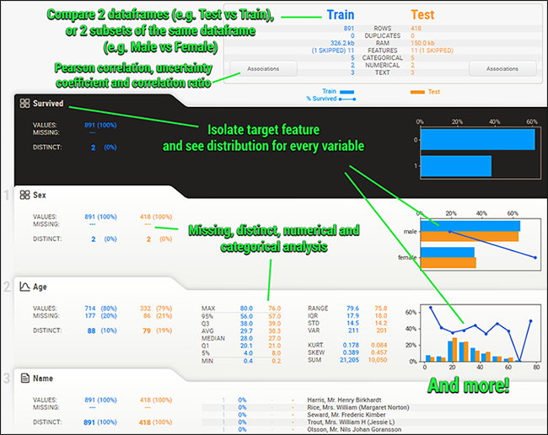
Sweetviz
快速完成你的資料集的EDA(探索性資料分析)和相關統計量的計算。
比較兩個不同資料集的特徵樣態或是。
比較兩個子資料集的特徵樣態。

Slide 4
安裝sweetviz
  pip install sweetviz
  conda install -c conda-forge sweetviz
在這次Demo，來自Kaggle的Titanic資料集。
  https://www.kaggle.com/c/titanic/data
前置作業，讀取資料
  train = pd.read_csv('./titanic/train.csv', index_col=0)
  test = pd.read_csv('./titanic/test.csv', index_col=0)

Slide 5
範例: Titanic旅客資料集=> 891筆旅客資料當作training data，309筆當作testing data。
Pclass:艙等、1,2,3代表成員的經濟社會地位1最高，3最低
Survived:是否生存 0代表NO，1代表YES
Name:乘客姓名
Sex:性別
Age:年齡
Sibsp:手足或配偶在船上的數量,兩部分組成，Sibling（兄弟姐妹，堂妹都合適），Spouse代表（丈夫或妻子）
Parch:雙親或子女在船上的數量,父母和孩子組成，若只跟保姆寫0
Ticket:車票號碼
Cabin:艙位號碼
Home.dest:住址(資料不完整)
PassengerId：乘客Id
Fare：乘客票價
Embarked：登船：C=Cherbourg，Q=Queenstown，S=Southampton

Slide 6
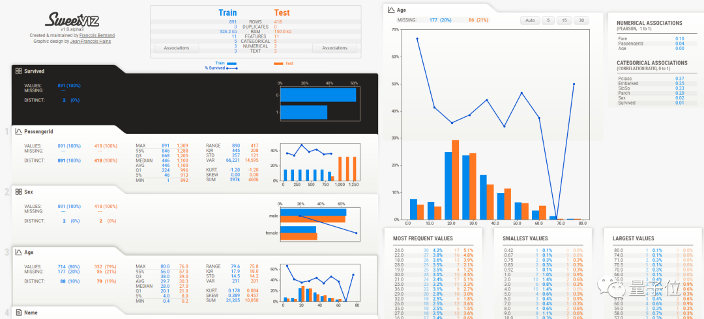
使用一行程式碼，生成一個數據報告的物件（其中，my_dataframe是pandas中的DataFrame，一種表格型資料結構）
用show一鍵輸出。（結果會以SWEETVIZ_REPORT.html網頁形式展示）

Slide 7

Features
Visualize and compare
  等橫向對比
Summary information:
  不僅根據Sex、Age等不同欄目縱向分析資料，每個欄目下還有
    眾數、
    最大值、
    最小值
automatically detects numerical, categorical and text features, with optional manual overrides:
所有輸入的數值、文字訊息都會被自動檢測，並進行資料分析、視覺化和對比，最後幫你進行資料總結。
。

Slide 8
3 main functions for creating reports
1.analyze(...):
2.compare(...)
3.compare_intra(...)

Slide 9
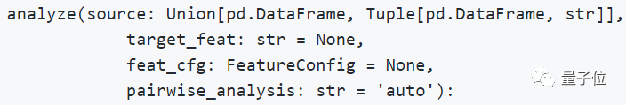
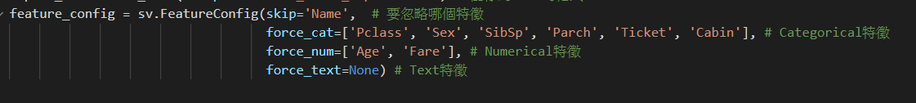
1. analyze()
analyze()丨資料分析
4個引數需要被設定。
source：分析來源物件(以pandas中的DataFrame資料結構、或是DataFrame中的某一類字串作為分析物件) 。
target_feat：需要被標記為目標物件的字串。
feat_cfg：需要被跳過、或是需要被強制轉換為某種資料型別的特徵。
pairwise_analysis：相關性和其他型別的資料關聯可能需要花費較長時間。如果超過了某個閾值，就需要設定這個引數為on或者off，以判斷是否需要分析資料相關性。

Slide 10
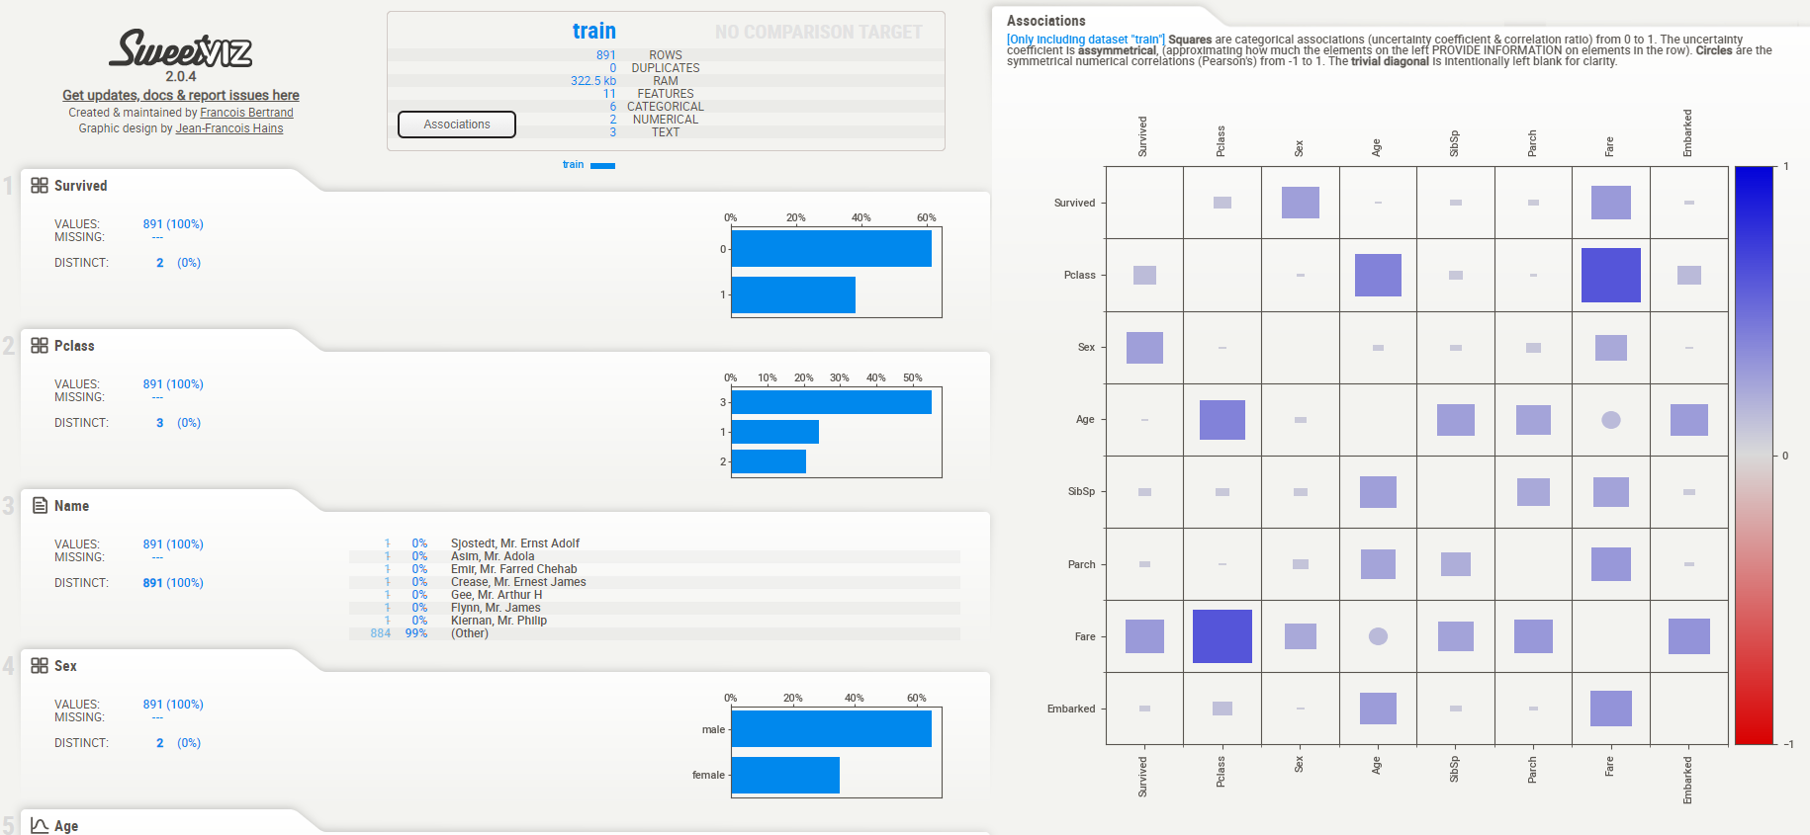

report_train = sv.analyze([train, 'train']) # 'train'是指會給這個資料集命名為train
report_train.show_html(filepath='Basic_train_report.html') # 儲存為html的格式

Slide 11
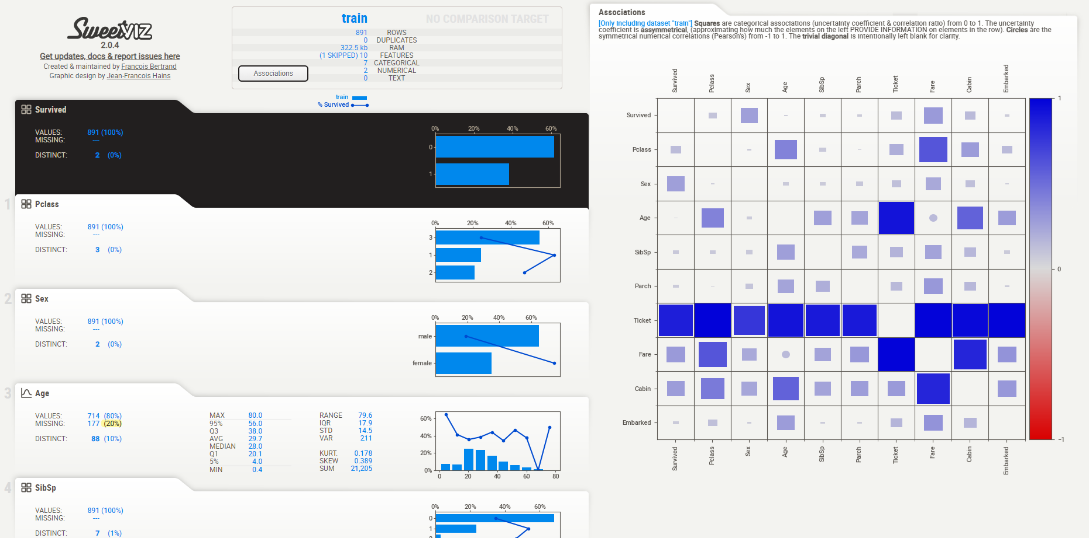
feature_config = sv.FeatureConfig(skip='Name', # 要忽略哪個特徵 force_cat=['Pclass', 'Sex', 'SibSp', 'Parch', 'Ticket', 'Cabin'], # Categorical特徵 force_num=['Age', 'Fare'], # Numerical特徵 force_text=None) # Text特徵 report_train_with_target = sv.analyze([train, 'train'], target_feat='Survived', # 加入特徵變數 feat_cfg=feature_config) report_train_with_target.show_html(filepath='Basic_train_report_with_target.html')

Slide 12
2. compare()
compare()丨兩個資料集比較
如果想要對兩個資料集進行對比分析，就使用這個比較函式。
例子中的my_dataframe和test_df是兩個資料集，分別被命名為訓練資料和測試資料。
除了這個被插入的資料集，剩餘的引數與analyze中的一致。

Slide 13
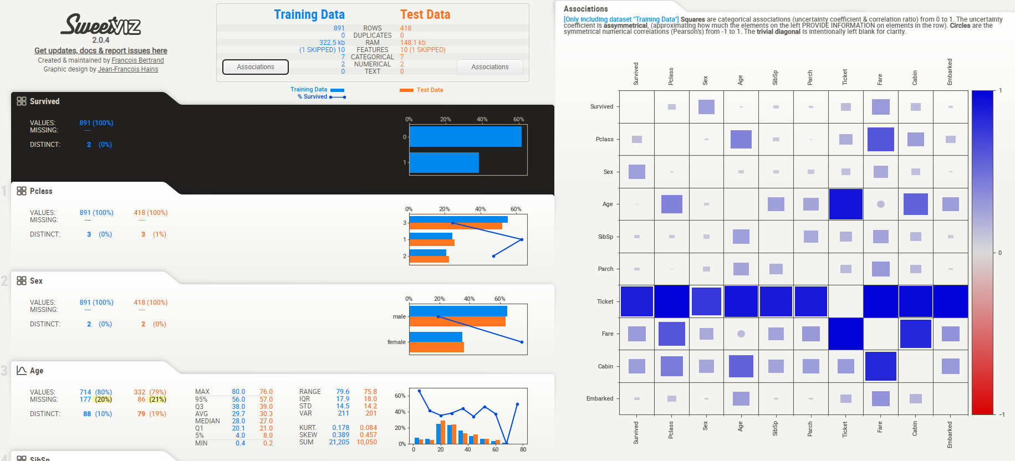

Slide 14
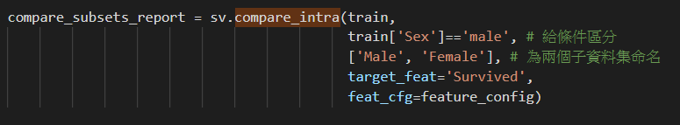
3. compare_intra()
同資料集中分為2個子集並進行比較
例如，如果需要比較“性別”欄目下的“男性”和“女性”，就可以採用這個函式。

Slide 15
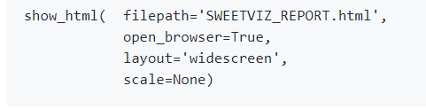
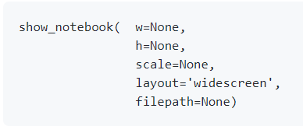
Show the report
show_html()
layout: Either 'widescreen' or 'vertical'. The widescreen layout displays details on the right side of the screen, as the mouse goes over each feature. The new (as of 2.0) vertical layout is more compact horizontally and enables expanding each detail area upon clicking.
scale: scale= 0.8 or None) to scale the entire report
open_browser: Enables the automatic opening of a web browser to show the report
filepath: An optional output HTML report.
show_notebook() (e.g. Jupyter, Google Colab, etc.).
w (width): w="100%" or pixels (w=900).
h (height): pixels (h=700) or "Full (h="Full").
scale:
layout: Same as for show_html, above.
scale: Same as for show_html, above.
filepath: An optional output HTML report.

Slide 16

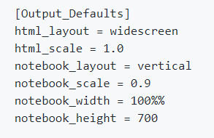
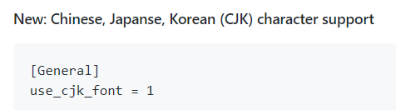
Customizing defaults: the Config file
sv.config_parser.read("Override.ini")
remove the Sweetviz logo from the top of the page
百分比要用%%

Slide 17
圖表內容說明
實際Demo
實現資料集視覺化、分析與比較

Slide 18
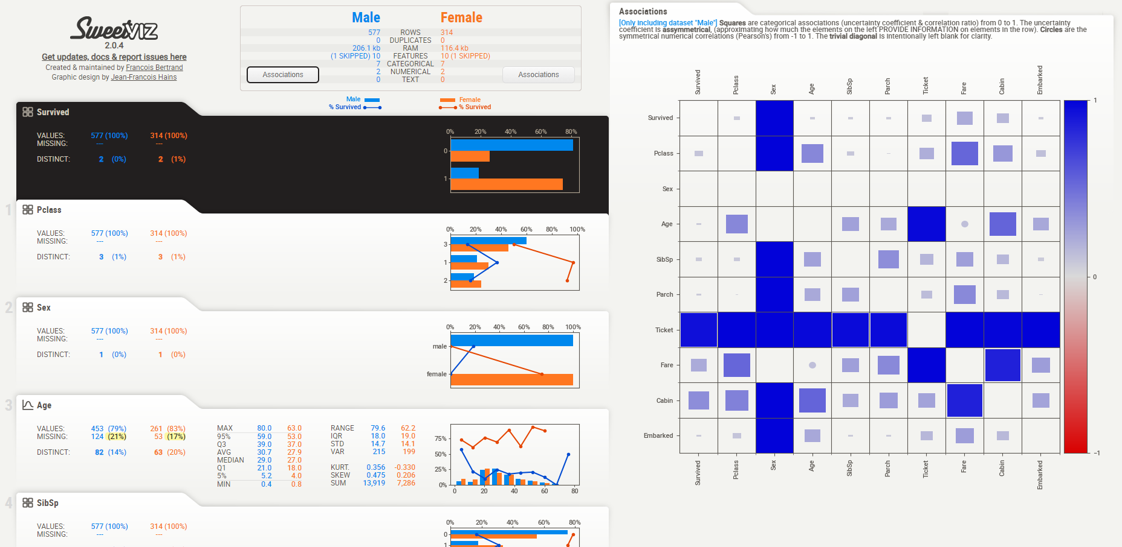

Slide 19
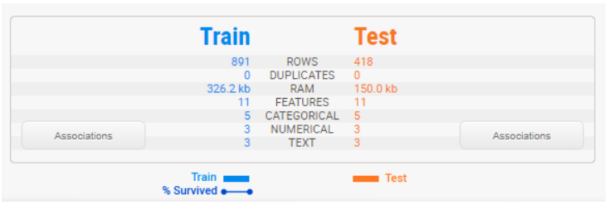
Summary display
1.訓練集是測試集約2倍
2.特徵值數量相同
3.測試集沒有提供survived target value
Sweetviz 會推估特徵適合的資料型態(numerical,category/Boolean,Text)

Slide 20
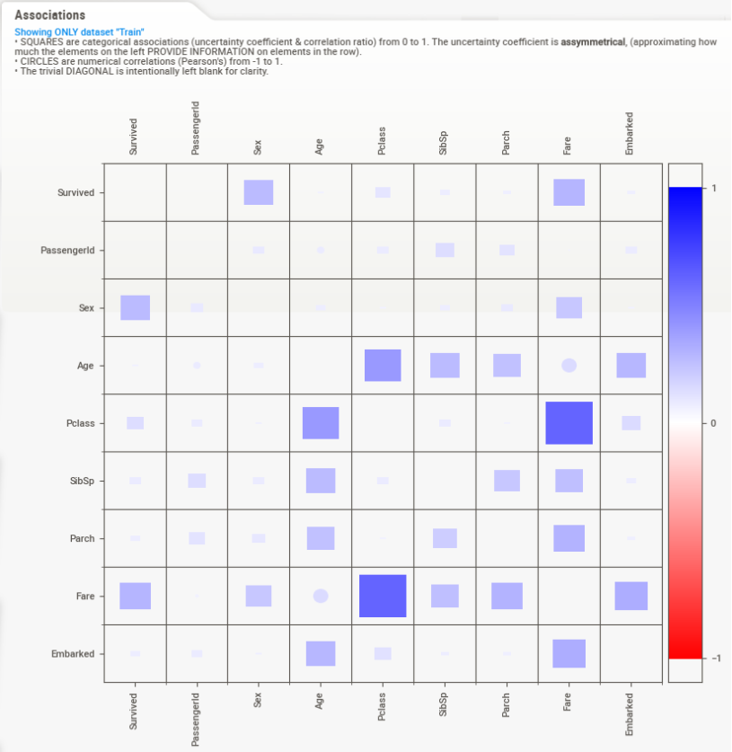
Associations
1. “Sex”, “Pclass” and “Fare”特徵 提供最多關於 “Survived 資訊.
一張圖表中，整合了數值化的相關係數(定量)和 未確定係數 (定性) and 相關係數 (for 定量-定性).
方塊:categorical-featured-related variables (相關性:0~1)
圓圈: 定量與定量特性的相關係數.(相關性:-1~1)

Slide 21
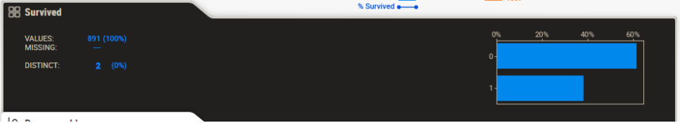
目標變數 Target variable
如果有指定 目標變數，會以黑色區塊顯示(要用chrome 才有)
IMPORTANT: 目前只能有numerical 和 boolean features可以當目標變數.
1.再訓練集中 Survived 沒有 缺漏值。
2.資料有可能只有兩種值。
3.圖形可以大致推估60%死亡率

Slide 22
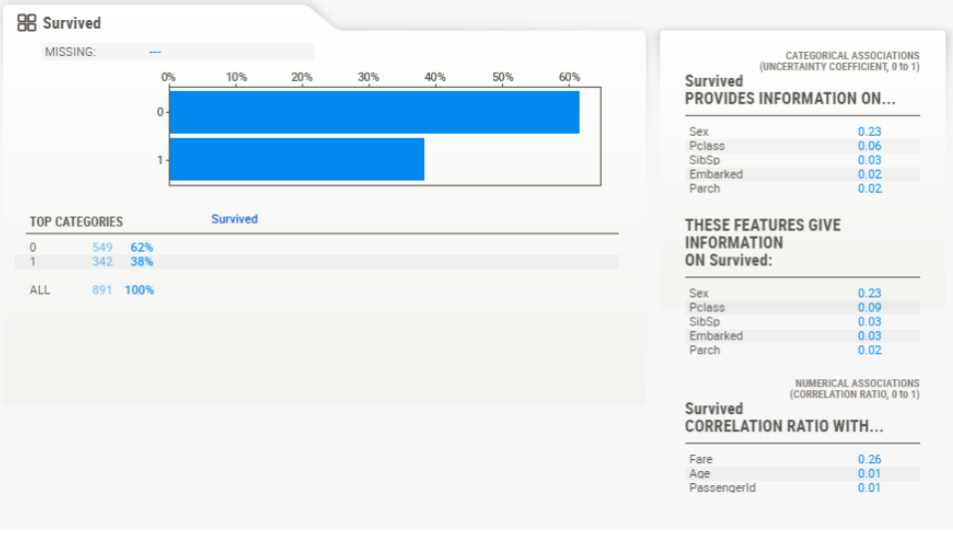
Detail area (categorical/boolean)
滑鼠點到特性區域，右側會顯示 Deteail.( a "widescreen" monitor is required )
顯示統計結果。Ex:與其他特性的相關係數

Slide 23
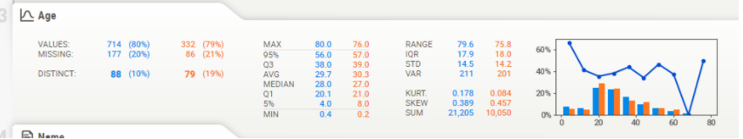
Numerical data
1.缺漏資料 (train :20% , test:21%，比例相當)
生存率相當一致(Test/train)
年紀小的生存率越高，可以推測 婦幼優先。

Slide 24
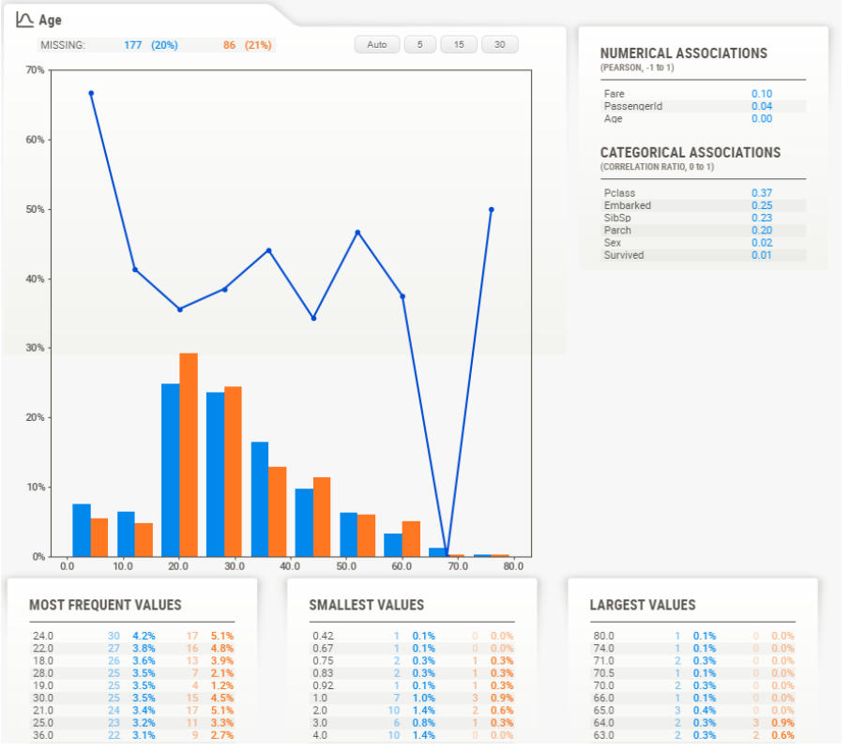
Numerical data –Detail area
定量資料會顯示更多資訊
上方顯示有幾種圖表分級方式

Slide 25
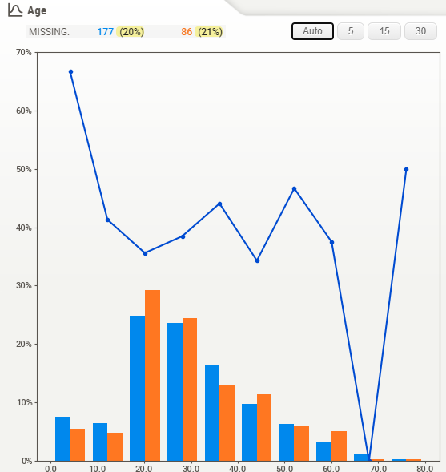
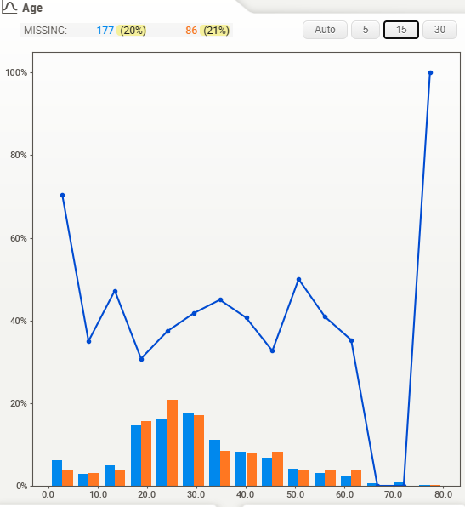
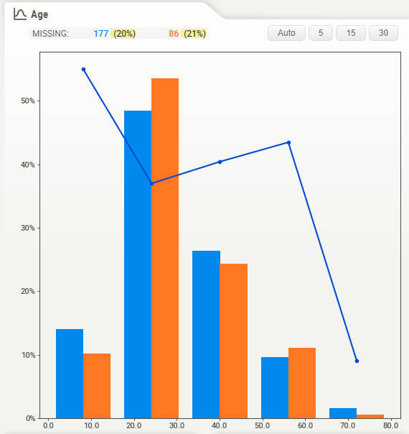
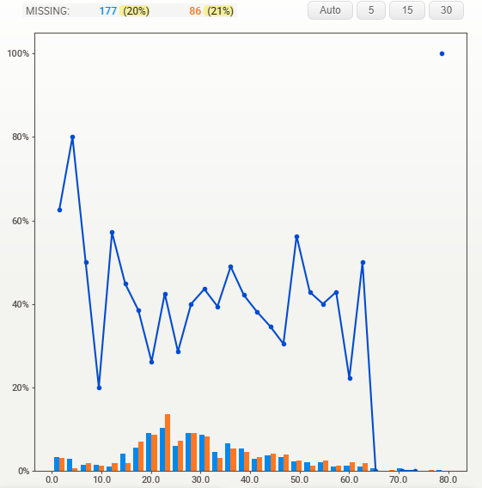
分級方式

Slide 26
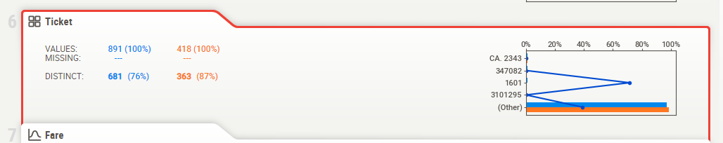
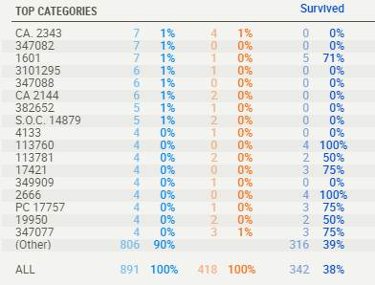
Text data
到目前為止，沒有 numerical 或 categorical特徵被誤判為Text
Text特徵 會顯示count (percentage)

Slide 27
FeatureConfig
也可以強制numerical 的資料，當作categorical 特徵進行分析
kwargs ➔
  Skip : (skipping columns)
  force_cat , force_tex, force_num : (forcing data types)
feature_config = sweetviz.FeatureConfig(skip="PassengerId", force_cat=["Ticket"])
my_report = sweetviz.compare([train, "Train"], [test, "Test"], "Survived", feature_config)

Slide 28
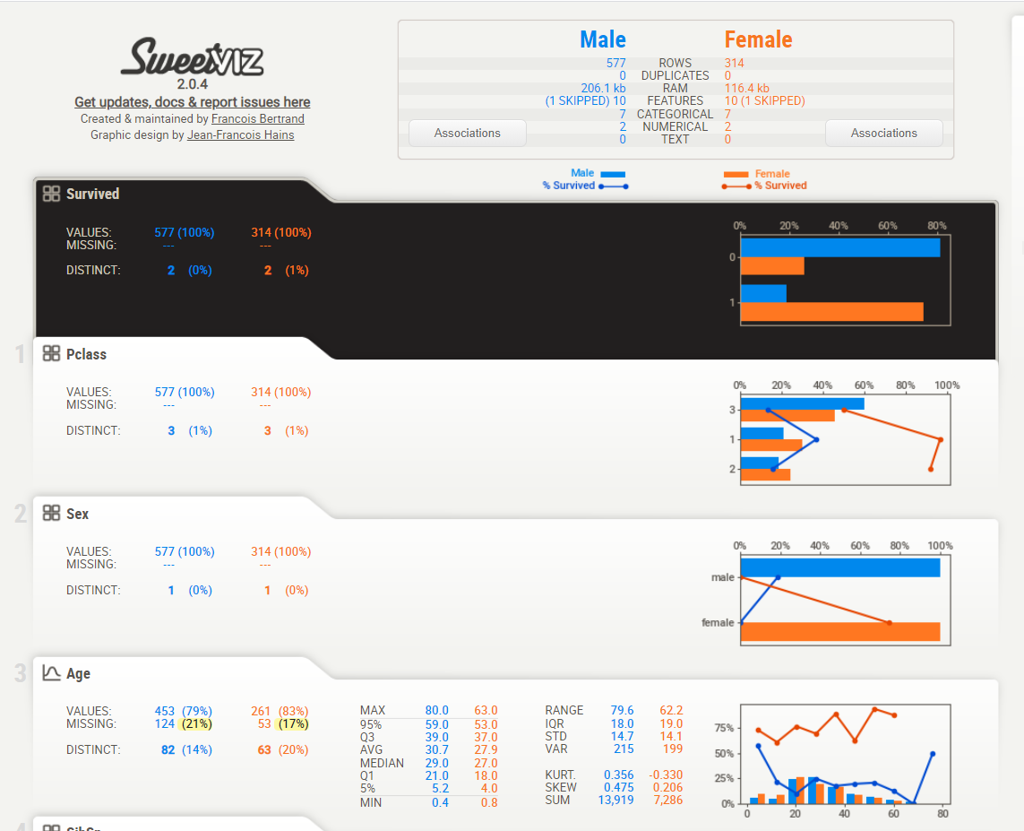
Comparing sub-populations (e.g. Male vs Female)
在同一個資料集中，也可以分析不同子群組的特
ex: 分析性別(sex)子群組的特徵)
1.提供分群判斷邏輯
2.提供子群組名稱
my_report = sweetviz.compare_intra(train,
train["Sex"] == 'male',
["Male", "Female"],
'Survived')

Slide 29
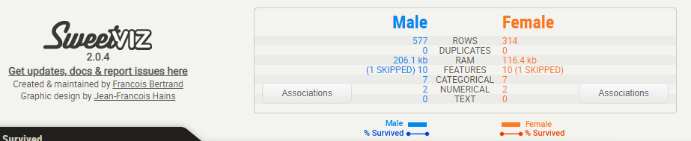
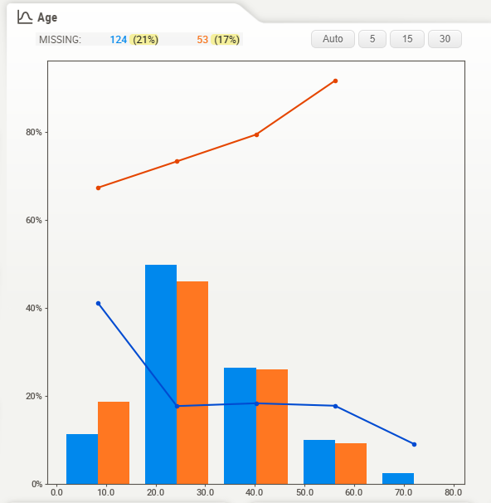

Slide 30
範例說明
Example report using the Titanic dataset
http://cooltiming.com/SWEETVIZ_REPORT.html

Slide 31
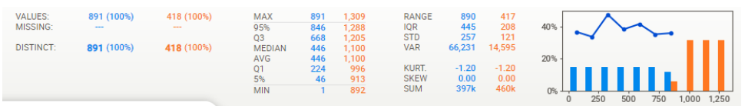
Putting it all together
PassengerId
ID 分布 and survivability 平坦 且 整齊。
No missing data

Slide 32
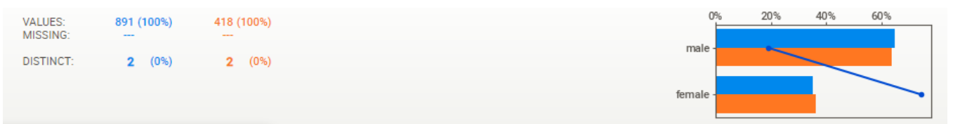
Sex
女性存活率很大的比率>男性
相關性而言,性別與票價之間有相關
Similar distribution between Train and Test
No missing data

Slide 33
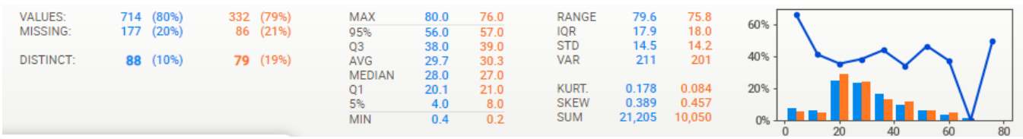
Age
20% missing data, 測試集與訓練集比率一致
Young-adult-centric population, but ages 0-70有較好的代表性
除了最年輕的年齡之外，其他存活率分布很平坦

Slide 34
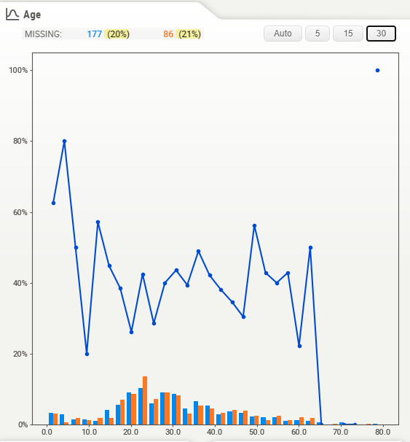
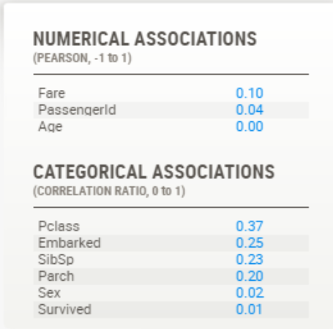
(圖一)Using 30 bins in the histogram in the detail window, you can see that this survivability spike is really for the youngest (about <= 5 years old), as at about 10 years old survivability is really low.
(圖二) Age seems related to SibSp, Pclass and Fare, and a bit more surprisingly to Embarked

Slide 35
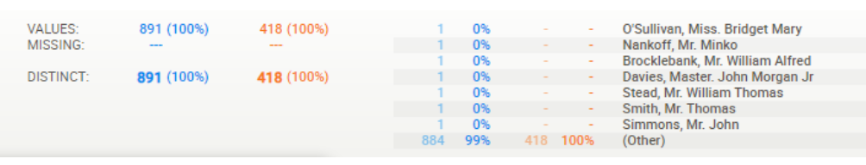
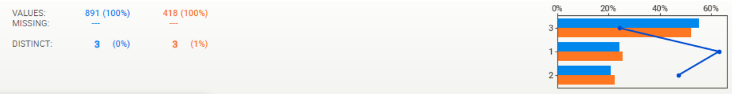
Name
  No missing data, data seems pretty clean
  All names are distinct, which is not surprising
Pclass
  Survivability closely follows class (first class most likely to survive, third class least likely)
  Similar distribution between Train and Test
  No missing data

Slide 36
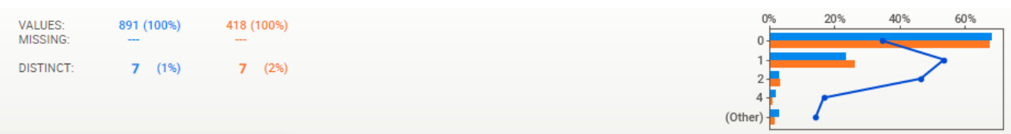
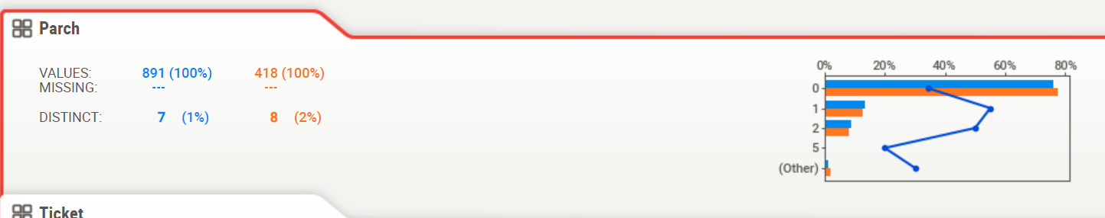
SibSp
  There seems to be a survival spike at 1 and to some degree 2, but there is a sharp drop-off at 3 and greater (若獨自一人，那麼其存活率比較低；但是如果親友太多的話，存活率也會很低)
  Similar distribution between Train and Test
  No missing data
Parch
  Similar distribution between Train and Test
  No missing data
雙親或子女在船上的數量,父母和孩子組成，若只跟保姆寫0

Slide 37
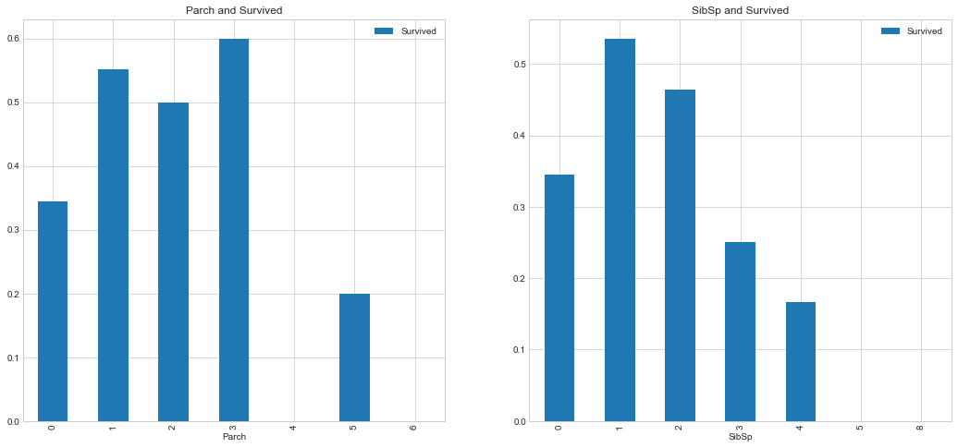
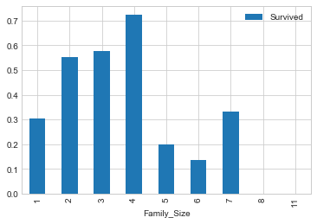
親友的人數和存活與否的關係 SibSp & Parch
fig,ax=plt.subplots(1,2,figsize=(18,8))
train_data[['Parch','Survived']].groupby(['Parch']).mean().plot.bar(ax=ax[0])
ax[0].set_title('Parch and Survived')
train_data[['SibSp','Survived']].groupby(['SibSp']).mean().plot.bar(ax=ax[1])
train_data['Family_Size'] = train_data['Parch'] + train_data['SibSp'] + 1
train_data[['Family_Size','Survived']].groupby(['Family_Size']).mean().plot.bar()
從圖表中可以看出，若獨自一人，那麼其存活率比較低；但是如果親友太多的話，存活率也會很低。

Slide 38
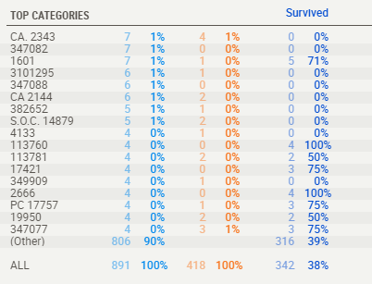
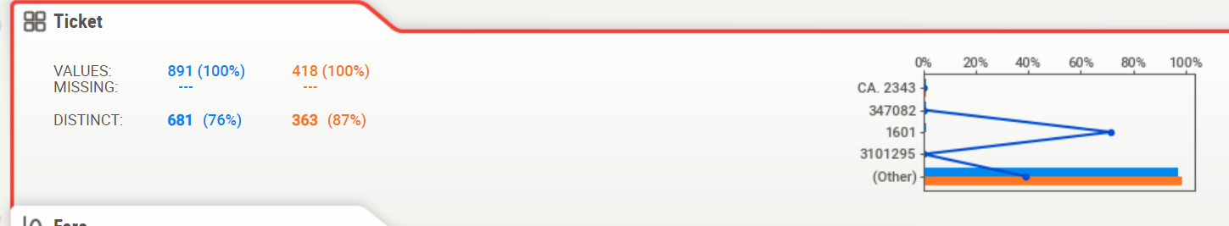
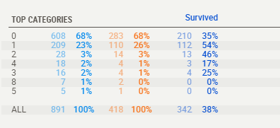
Ticket
  ~80% distinct values, so about 1 in 5 shared tickets on average
  The highest frequency ticket was 7, which is generally consistent with the maximum number of siblings (8)
  No missing data
siblings

Slide 39
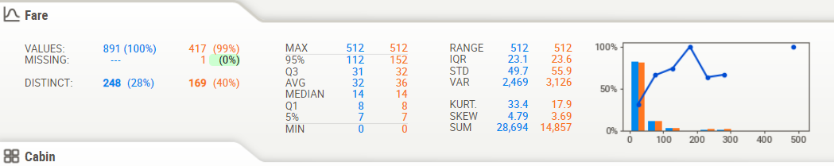
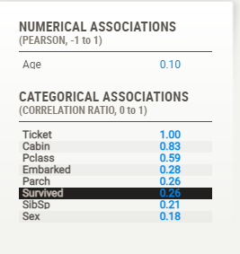
Fare
  As expected, and as with Pclass, the higher fares survived better (although sample size gets pretty thin at higher levels)
  A Correlation Ratio of 0.26 for "Survived" is relatively high so it would tend to support this theory
  About 30% distinct values feels a bit high as you would expect fewer set prices but looks like there is a lot of granularity so that's ok
  Only 1 missing record in the Test set, data pretty consistent between Train and Test

Slide 40
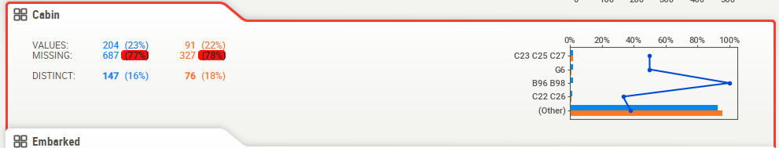
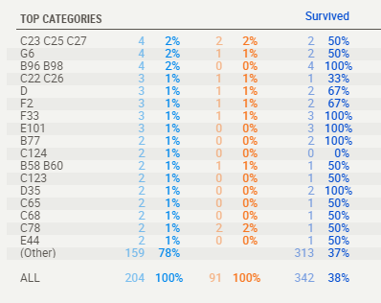
Cabin
A lot of missing data (up to 78%), but consistent between Train and Test
Maximum frequency is 4, which would make sense to have 4 people maximum in a cabin

Slide 41
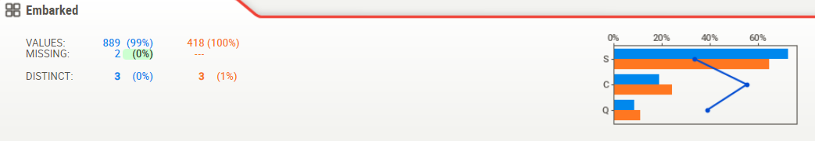
Embarked：登船倉：C=Cherbourg，Q=Queenstown，S=Southampton
3 distinct values (S, C, Q)
只有Train data兩筆缺漏值. Data seems pretty consistent between Train and Test
Survivability somewhat higher at C; could this be a location with richer people?
Either way, "Embarked" shows a Uncertainty Coefficient of only 0.03 for "Survived", so it may not be very significant

Slide 42
General analysis
Overall, most data is present and seems consistent and make sense; no major outliers or huge surprises
Test versus Training data
  Test has about 50% fewer rows
  Train and Test are very closely matched in the distribution of missing data
  Train and Test data values are very consistent across the board
Association/correlation analysis
  Sex, Fare and Pclass give the most information on Survived
  As expected, Fare and Pclass are highly correlated
  Age seems to tell us a good amount regarding Pclass, siblings and to some degree Fare, which would be somewhat expected. It seems to tell us a lot about "Embarked" which is a bit more surprising.
Missing data
  There is no significant missing data except for Age (~20%) and Cabin (~77%)

Slide 43
WIP 案例

