Slide 1
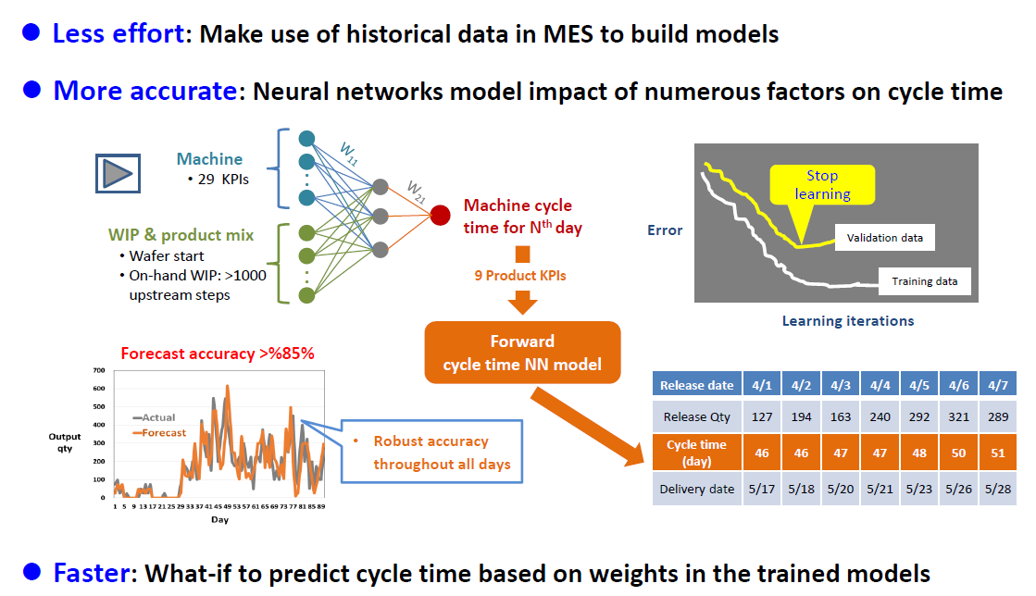

Slide 2
The Complete KPIs for each Machine Group
Type | Traditional 14 KPI |  | Extra 13 KPI
 | KPI | Description | KPI | Description
Machine | ↑Mean available rate(v) 機台可用率 ↓Mean process time(pt) 加工時間 ↑Mean number of machines(m) 機台數 ↑Mean percentage of usable machines(u) 路寬 ↓Mean sampling rate(s) 檢測率 ↓Mean tool wait time% for OHT (ow) 等待傳送時間比例 | (Run time+ Idle time)/Total time End process time－Start process time for a lot or a batch Number of machines for the machine group Released machines/# of machines Actually measured lots / Moved lots Tool wait time for OHT/ (Tool run time + wait time for OHT) | ↓Normalized STDEV of available rate(Dvn) 機台可用率變異 ↓COV of process times(Cpt) 加工時間變異 ↓Normalized COV of machine group loading(Cmgln) 機群內每日loading變異 ↓Normalized COV of machine ID loading(Cmiln) 機台間loading變異 ↓Backup percentage for other factory (↓) 支援它廠比率 ↑Backup percentage by other factory (bb) 它廠支援比率 ↓Mean of over capacity percentage(oc) 產能超載比率 | Deviation of available rate among hours ,normalized by available rate. To assess if non-available statuses are balanced Deviation/Mean of process time among lots Deviation/Mean of machine loading (arrival/AVL hours) among days, normalized by arrival rate. To measure if PM/ENG schedule is adequate Deviation/Mean of machine loading among machine IDs, normalized by arrival rate. To assess if scheduling is proper to balance loading among machines Move backup for other/Total move Move backup by other/Total move Arrival rate/Saturated move. To assess the impact of WIP unbalance
↑: The higher, the better ; ↓: The lower, the better

Slide 3
The Complete KPIs for each Machine Group (cont.)
Type | Traditional 13 KPI |  | Extra 14 KPI
 | KPI | Description | KPI | Description
Material | ↓Mean arrival rate(a) 來到量 ↑Mean lot size(ls) 批量 ↓Mean percentage of ENG lots(eng) 工程貨比例 ↓Mean percentage of hot lots(h) 急單比例 ↓Mean percentage of super hot lots(sh) 特級單比例 ↓Mean percentage of hold WIP(hw) Hold 貨比例 ↓Normalized Mean number of recipes(rn) 配方數 | Arrived WIP quantity per hour (pcs, = EOH+Move-BOH / Upstream Machine Move) Mean lot size of moved lots Move of engineering lots/Move of all lots Move of hot lots/Move of all lots Move of super hot lots/Move of all lots WIP of hold lots/WIP of all lots # of recipes processed by the machine group (weighted by move of individual recipes), normalized by arrival rate | ↓Normalized Intrinsic COV of arrival rate(Cain) 非派工到貨量變異 ↓Normalized Impact percentage of dispatching on Ca(idCan) 派工造成的到貨量變異 ↓Normalized STDEV of lot size(Dlsn) 批量變異 ↓Mean ratio for Q-time constraint(rw) 有卡Q-time貨的比例 ↑Mean limit for Q-time constraint(tw) 平均Q-time小時數 ↑Mean simplified percentage for recipes(sr) 配方簡化比例 | Deviation/Mean of arrival rate among hours if dispatching rule is even by upstream machines, normalized by arrival rate =(Intrinsic COV of arrival rate－Actual COV of arrival rate)/Actual COV of arrival rate, normalized by arrival rate. Deviation of lot size among lots, normalized by lot size Lots subject to q-time SPEC<24 hours/Total moved lots Mean SPEC hours for lots subject to Q-time SPEC <24 hours (# of recipes processed by the machine group－ #of recipes processed by machine IDs)/ # of recipes processed by the machine group. i.e., the reduced recipe change by dispatching rule
↑: The higher, the better ; ↓: The lower, the better

Slide 4


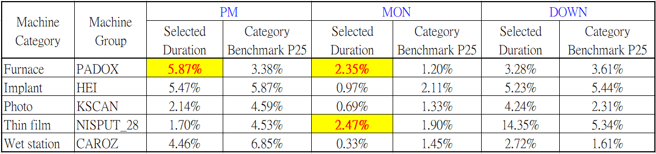
↑Mean available rate(v)
Daily mean available rate =
=
Breakdown benchmark for non-available rate
Notes:
As I highlighted before, we need an proactive and optimal PM schedule, rather than always postpone PM reactively
U Efficiency can accurately forecast the coming WIP of key machines, and the forecast accuracy is still over 90% for the 11th day.
On the base of robust forecast, every week, as the factory upload duration, planned date for execution, and the feasible time window for each PM or ENG item.
U Efficiency will refer to the upload data, and the forecast on arrival quantity of each day.
Then, the optimization algorithm will minimize the KPI “COV of machine group loading”
Finally, u Efficiency suggest the optimal date for each PM/ENG item. From now on, no more argue between manufacturing and module guys for postponing PM.
如同前面一再強調的，工廠應該有一套 proactive 且 optimal 的 PM/ENG schedule，而不是一昧被動地 postpone PM。
U Efficiency 對重點機台的每天 WIP 來到量預測，即使到第11天，預測準確率仍有 90%。
有了準確的預測能力，接下來，對每一個 machine group，user 只要每週上傳每一個 PM 及工程借機項目的執行時間、預計執行日期以及可以執行的區間。根據這些 constraint，u Efficiency 會再考量每天的 arrival 數量，建議每個 PM/ENG item 執行的最佳日期，目標是使 COV of machine loading 這個 KPI 最小化，也就是讓每天的 machine loading 儘量一樣。從此以後，製造部和工程部不會再為 postpone PM 爭的面紅耳赤。

Slide 5
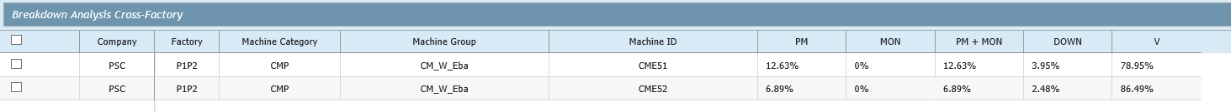
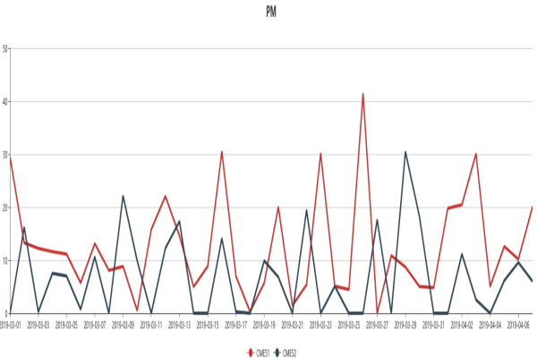
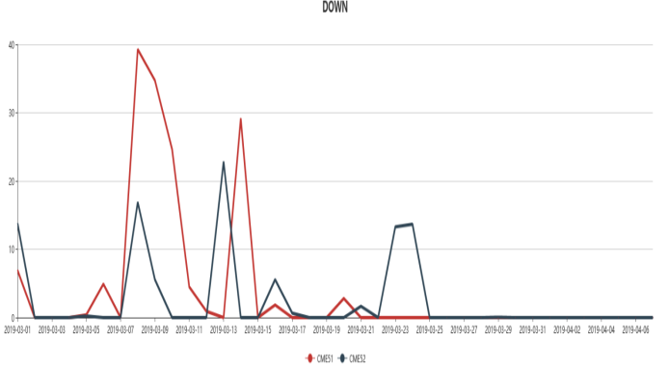
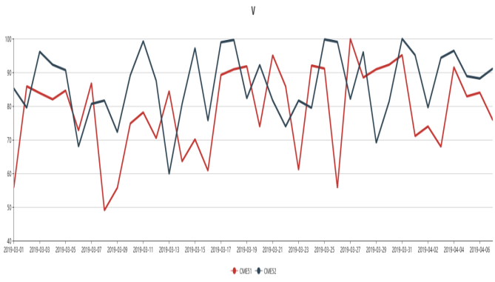
↑Mean available rate(v)
Breakdown benchmark for non-available rate (PSC)
Machine Category | Machine Group | PM + MON |  | DOWN
 |  | 2019/Feb. | Category Benchmark P25 | 2019/Feb. | Category Benchmark P25
Furnace | FK_LAZO(F) | 10.35% | 4.58% | 9.61% | 3.61%
CMP | CM_W_Eba | 9.84% | 7.21% | 8.93% | 6.11%
Thin film | DK_300 | 2.83% | 6.43% | 12.28% | 5.34%
Photo | PH_Immersion | 2.29% | 5.92% | 3.93% | 2.31%
Furnace | FN_SiN(A) | 11.87% | 4.58% | 3.88% | 3.61%
Breakdown Analysis Cross-Factory (PSC)
Notes:
As I highlighted before, we need an proactive and optimal PM schedule, rather than always postpone PM reactively
U Efficiency can accurately forecast the coming WIP of key machines, and the forecast accuracy is still over 90% for the 11th day.
On the base of robust forecast, every week, as the factory upload duration, planned date for execution, and the feasible time window for each PM or ENG item.
U Efficiency will refer to the upload data, and the forecast on arrival quantity of each day.
Then, the optimization algorithm will minimize the KPI “COV of machine group loading”
Finally, u Efficiency suggest the optimal date for each PM/ENG item. From now on, no more argue between manufacturing and module guys for postponing PM.
如同前面一再強調的，工廠應該有一套 proactive 且 optimal 的 PM/ENG schedule，而不是一昧被動地 postpone PM。
U Efficiency 對重點機台的每天 WIP 來到量預測，即使到第11天，預測準確率仍有 90%。
有了準確的預測能力，接下來，對每一個 machine group，user 只要每週上傳每一個 PM 及工程借機項目的執行時間、預計執行日期以及可以執行的區間。根據這些 constraint，u Efficiency 會再考量每天的 arrival 數量，建議每個 PM/ENG item 執行的最佳日期，目標是使 COV of machine loading 這個 KPI 最小化，也就是讓每天的 machine loading 儘量一樣。從此以後，製造部和工程部不會再為 postpone PM 爭的面紅耳赤。

Slide 6
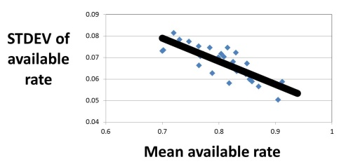
↓Normalized STDEV of available rate(Dvn)
To determine right timing for monitor to balance PM
Hour | 07:30 ~ 08:30 | 08:30 ~ 09:30 | 09:30 ~ 10:30 | 10:30 ~ 11:30 | 11:30 ~ 12:30 | 12:30 ~ 13:30 | 13:30 ~ 14:30 | 15:30 ~ 15:30 | 15:30 ~ 16:30 | 16:30 ~ 17:30 | 17:30 ~ 18:30 | 18:30 ~ 19:30 | 19:30 ~ 20:30 | 20:30 ~ 21:30 | 21:30 ~ 22:30 | 22:30 ~ 23:30 | 23:30 ~ 00:30 | 00:30 ~ 01:30 | 01:30 ~ 02:30 | 02:30 ~ 03:30 | 03:30 ~ 04:30 | 04:30 ~ 05:30 | 05:30 ~ 06:30 | 06:30 ~ 07:30
Available rate | 0.793 | 0.874 | 0.805 | 0.867 | 0.783 | 0.798 | 0.873 | 0.831 | 0.795 | 0.793 | 0.838 | 0.840 | 0.947 | 0.973 | 0.898 | 0.932 | 0.976 | 0.906 | 0.929 | 0.899 | 0.949 | 0.965 | 0.908 | 0.966
Standard deviation (Dv) = 0.066
Mean of the day= 0.881
Historical max of mean=0.938
Normalized standard deviation (Dvn) = 0.053
Right timing for monitor
Machine category | Machine group | PM |  |  |  | MON
 |  | Day | Night | Day-Night | Frequency (day) | Day | Night | Total | Frequency (day) | Timing for Monitor
Dry etch | ACE | 0.56% | 0.02% | 0.53% | 5.29 | 0.20% | 0.15% | 0.35% | 2.81 | Night
CMP | ACE_VIA | 0.47% | 0.02% | 0.45% | 9.22 | 0.12% | 0.01% | 0.13% | 1.08 | Night
Furnace | ALLOY | 0.0% | 0.0% | 0.0% | 15.25 | 0.84% | 0.04% | 0.88% | 1.54 | Day&night
CMP | CPO_F | 14.61% | 6.57% | 8.04% | 2.57 | 1.41% | 0.06% | 1.47% | 1.23 | Night
Wet station | CRB | 8.34% | 1.67% | 6.67% | 3.51 | 0.55% | 0.19 | 0.74% | 1.56 | Night
….. | ….. | ….. | ….. | ….. | ….. | ….. | ….. | ….. | ….. | …..
Thin film | HDP_P | 3.64% | 4.32% | -0.67% | 4.33 | 0.11% | 0.15% | 0.25% | 2.52 | Day
Furnace | HTO | 0.00% | 0.00% | 0.00% | 4.29 | 0.23% | 0.12% | 0.35% | 2.12 | Day&night
Implant | IHE | 22.43% | 24.03% | -1.60% | 2.95 | 1.06% | 1.04% | 2.10% | 1.38 | Day
Notes:
As I highlighted before, we need an proactive and optimal PM schedule, rather than always postpone PM reactively
U Efficiency can accurately forecast the coming WIP of key machines, and the forecast accuracy is still over 90% for the 11th day.
On the base of robust forecast, every week, as the factory upload duration, planned date for execution, and the feasible time window for each PM or ENG item.
U Efficiency will refer to the upload data, and the forecast on arrival quantity of each day.
Then, the optimization algorithm will minimize the KPI “COV of machine group loading”
Finally, u Efficiency suggest the optimal date for each PM/ENG item. From now on, no more argue between manufacturing and module guys for postponing PM.
如同前面一再強調的，工廠應該有一套 proactive 且 optimal 的 PM/ENG schedule，而不是一昧被動地 postpone PM。
U Efficiency 對重點機台的每天 WIP 來到量預測，即使到第11天，預測準確率仍有 90%。
有了準確的預測能力，接下來，對每一個 machine group，user 只要每週上傳每一個 PM 及工程借機項目的執行時間、預計執行日期以及可以執行的區間。根據這些 constraint，u Efficiency 會再考量每天的 arrival 數量，建議每個 PM/ENG item 執行的最佳日期，目標是使 COV of machine loading 這個 KPI 最小化，也就是讓每天的 machine loading 儘量一樣。從此以後，製造部和工程部不會再為 postpone PM 爭的面紅耳赤。

Slide 7
↓Mean process time(pt) ↓COV of process times(Cpt)
Machine type | Single processing machine | Batch processing machine
Definition for process time | for Move-out lots Duration between… First wafer was picked out from the POD & Last wafer was send back to the POD | for Move-out batches Duration between… First lot was picked out from the POD & Last lot was send back to the POD
Criteria lots for calculating mean and COV | Exclude recipe change Only for full lots. | Exclude recipe change No lot size or batch size restrict.
Notes:
As I highlighted before, we need an proactive and optimal PM schedule, rather than always postpone PM reactively
U Efficiency can accurately forecast the coming WIP of key machines, and the forecast accuracy is still over 90% for the 11th day.
On the base of robust forecast, every week, as the factory upload duration, planned date for execution, and the feasible time window for each PM or ENG item.
U Efficiency will refer to the upload data, and the forecast on arrival quantity of each day.
Then, the optimization algorithm will minimize the KPI “COV of machine group loading”
Finally, u Efficiency suggest the optimal date for each PM/ENG item. From now on, no more argue between manufacturing and module guys for postponing PM.
如同前面一再強調的，工廠應該有一套 proactive 且 optimal 的 PM/ENG schedule，而不是一昧被動地 postpone PM。
U Efficiency 對重點機台的每天 WIP 來到量預測，即使到第11天，預測準確率仍有 90%。
有了準確的預測能力，接下來，對每一個 machine group，user 只要每週上傳每一個 PM 及工程借機項目的執行時間、預計執行日期以及可以執行的區間。根據這些 constraint，u Efficiency 會再考量每天的 arrival 數量，建議每個 PM/ENG item 執行的最佳日期，目標是使 COV of machine loading 這個 KPI 最小化，也就是讓每天的 machine loading 儘量一樣。從此以後，製造部和工程部不會再為 postpone PM 爭的面紅耳赤。

Slide 8
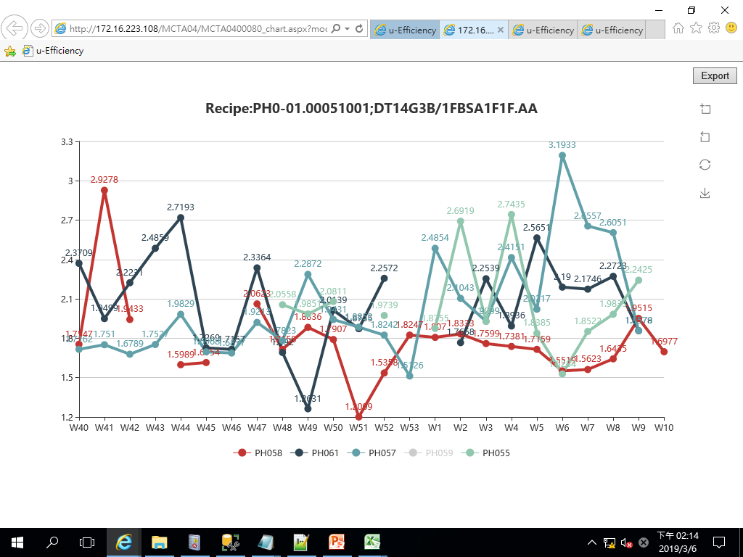
↓COV of process times(Cpt)
PH_DUVArF
2/25-3/3
Machine difference by recipe
Tool recipe trend chart
Longer process time
Recipe ID |  | PH0-01.00051001; DT14G3B/1FBSA1F1F.AA |  |  | PH0-01.00051004; DT14G3B/2BBSA1F1G.AA |  |  | PH0-01.00050027; DT14G3B/1CDSASPSP.AA |  |  | PH0-01.00051002; DT14G3B/RGBSA1F1F.AA
Moved lots |  | 160 |  |  | 123 |  |  | 119 |  |  | 114
Machine ID | Mean COV | Mean | STDEV | COV | Mean | STDEV | COV | Mean | STDEV | COV | Mean | STDEV | COV
PH061 | 0.239 | 1.958 | 0.529 | 0.270 | 1.694 | 0.536 | 0.316 |  |  |  | 1.900 | 0.483 | 0.254
PH057 | 0.1891 | 2.114 | 0.456 | 0.216 | 1.753 | 0.340 | 0.194 |  |  |  | 1.896 | 0.482 | 0.254
PH055 | 0.1549 | 1.883 | 0.282 | 0.150 | 1.840 | 0.090 | 0.049 |  |  |  | 1.636 | 0.211 | 0.129
PH058 | 0.1546 | 1.842 | 0.403 | 0.219 | 1.882 | 0.334 | 0.178 |  |  |  | 1.828 | 0.132 | 0.072
PH059 | 0.1465
PH054 | 0.1694 |  |  |  |  |  |  | 1.434 | 0.372 | 0.259
PH053 | 0.1813 |  |  |  |  |  |  | 1.241 | 0.341 | 0.275
PH057 trend up
PH058 trend down
Notes:
As I highlighted before, we need an proactive and optimal PM schedule, rather than always postpone PM reactively
U Efficiency can accurately forecast the coming WIP of key machines, and the forecast accuracy is still over 90% for the 11th day.
On the base of robust forecast, every week, as the factory upload duration, planned date for execution, and the feasible time window for each PM or ENG item.
U Efficiency will refer to the upload data, and the forecast on arrival quantity of each day.
Then, the optimization algorithm will minimize the KPI “COV of machine group loading”
Finally, u Efficiency suggest the optimal date for each PM/ENG item. From now on, no more argue between manufacturing and module guys for postponing PM.
如同前面一再強調的，工廠應該有一套 proactive 且 optimal 的 PM/ENG schedule，而不是一昧被動地 postpone PM。
U Efficiency 對重點機台的每天 WIP 來到量預測，即使到第11天，預測準確率仍有 90%。
有了準確的預測能力，接下來，對每一個 machine group，user 只要每週上傳每一個 PM 及工程借機項目的執行時間、預計執行日期以及可以執行的區間。根據這些 constraint，u Efficiency 會再考量每天的 arrival 數量，建議每個 PM/ENG item 執行的最佳日期，目標是使 COV of machine loading 這個 KPI 最小化，也就是讓每天的 machine loading 儘量一樣。從此以後，製造部和工程部不會再為 postpone PM 爭的面紅耳赤。

Slide 9
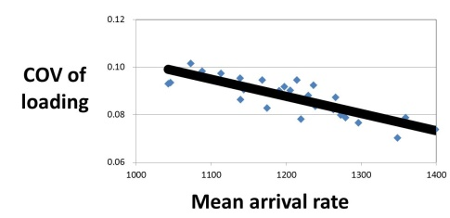
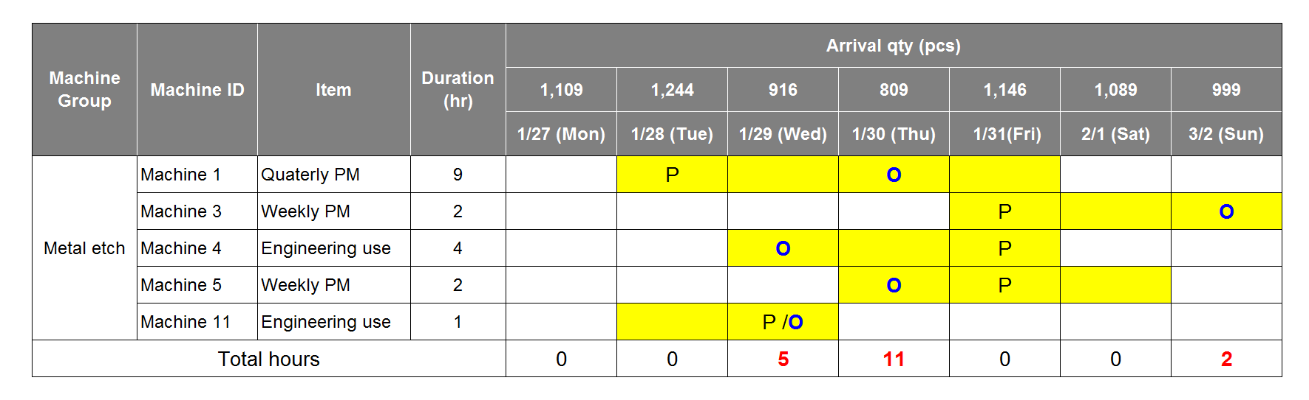
↓Normalized COV of machine group loading(Cmgln)
Optimal PM/ENG schedule to sync with fluctuant coming WIP
Day | Mon | Tue | Wed | Thu | Fri | Sat | Sun
Arrival pcs (A) | 1109 | 1244 | 916 | 809 | 1146 | 1089 | 999
Available hours (B) | 103 | 109 | 98 | 89 | 114 | 116 | 109
Loading/hour (A/B) | 10.8 | 11.4 | 9.3 | 9.1 | 10.1 | 9.4 | 9.2
Standard deviation of loading= 0.89
Mean loading of the week= 9.9
COV of loading= 0.090 (Cmgl)
Mean arrival of the week=1045
Historical max of arrival =1395
Normalized COV of loading (Cmgln) = 0.075
Cmgl
Original :0.09 →Optimal : 0.06
Window
for execution
Original plan
Optimal
Optimal PM/ENG schedule
Min Cmgl
s.t.
PM/ENG item A duration=10 hours
PM/ENG item A =between 1/28~1/31
Max duration/day= 12 hours
…
Forecast arrival rate`
Notes:
As I highlighted before, we need an proactive and optimal PM schedule, rather than always postpone PM reactively
U Efficiency can accurately forecast the coming WIP of key machines, and the forecast accuracy is still over 90% for the 11th day.
On the base of robust forecast, every week, as the factory upload duration, planned date for execution, and the feasible time window for each PM or ENG item.
U Efficiency will refer to the upload data, and the forecast on arrival quantity of each day.
Then, the optimization algorithm will minimize the KPI “COV of machine group loading”
Finally, u Efficiency suggest the optimal date for each PM/ENG item. From now on, no more argue between manufacturing and module guys for postponing PM.
如同前面一再強調的，工廠應該有一套 proactive 且 optimal 的 PM/ENG schedule，而不是一昧被動地 postpone PM。
U Efficiency 對重點機台的每天 WIP 來到量預測，即使到第11天，預測準確率仍有 90%。
有了準確的預測能力，接下來，對每一個 machine group，user 只要每週上傳每一個 PM 及工程借機項目的執行時間、預計執行日期以及可以執行的區間。根據這些 constraint，u Efficiency 會再考量每天的 arrival 數量，建議每個 PM/ENG item 執行的最佳日期，目標是使 COV of machine loading 這個 KPI 最小化，也就是讓每天的 machine loading 儘量一樣。從此以後，製造部和工程部不會再為 postpone PM 爭的面紅耳赤。

Slide 10

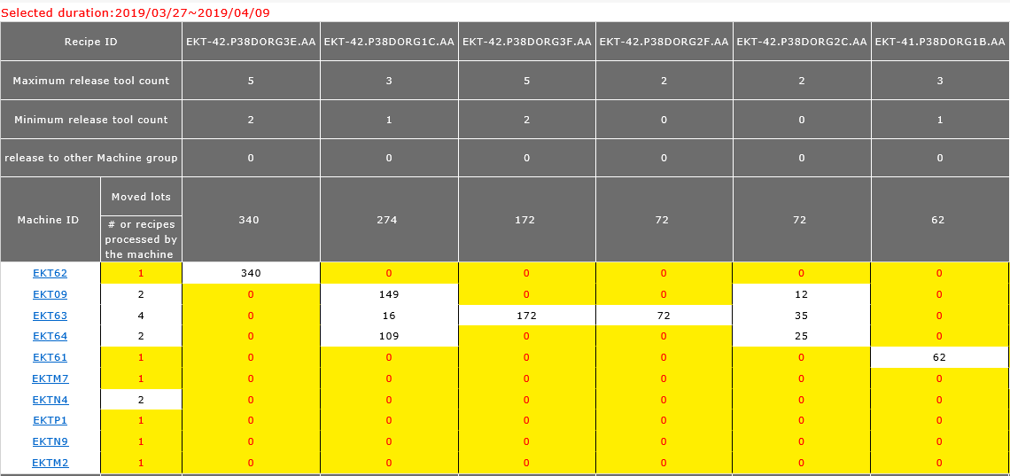
↑Mean percentage of usable machines(u)
Daily mean % of usable machines =
Breakdown benchmark for % of usable machines
EK_RG_SDRM
Notes:
As I highlighted before, we need an proactive and optimal PM schedule, rather than always postpone PM reactively
U Efficiency can accurately forecast the coming WIP of key machines, and the forecast accuracy is still over 90% for the 11th day.
On the base of robust forecast, every week, as the factory upload duration, planned date for execution, and the feasible time window for each PM or ENG item.
U Efficiency will refer to the upload data, and the forecast on arrival quantity of each day.
Then, the optimization algorithm will minimize the KPI “COV of machine group loading”
Finally, u Efficiency suggest the optimal date for each PM/ENG item. From now on, no more argue between manufacturing and module guys for postponing PM.
如同前面一再強調的，工廠應該有一套 proactive 且 optimal 的 PM/ENG schedule，而不是一昧被動地 postpone PM。
U Efficiency 對重點機台的每天 WIP 來到量預測，即使到第11天，預測準確率仍有 90%。
有了準確的預測能力，接下來，對每一個 machine group，user 只要每週上傳每一個 PM 及工程借機項目的執行時間、預計執行日期以及可以執行的區間。根據這些 constraint，u Efficiency 會再考量每天的 arrival 數量，建議每個 PM/ENG item 執行的最佳日期，目標是使 COV of machine loading 這個 KPI 最小化，也就是讓每天的 machine loading 儘量一樣。從此以後，製造部和工程部不會再為 postpone PM 爭的面紅耳赤。

Slide 11
↑Mean percentage of usable machines(u)
Daily mean % of usable machines =
Breakdown benchmark for % of usable machines
Tech | Before |  | After |  | Impact% to △ % of All Factory
 | % usable machines | Move% | % usable machines | Move% | % usable machines | Move%
bkhTV0t4RHdSZF | 0.3431 | 21.62% | 0.3023 | 22.32% | -1.61% | -0.24%
cldobmNESjNnM3 | 0.7723 | 5.14% | 0.8122 | 6.26% | 0.37% | 0.42%
eUViREhJYmR2bll4 | 0.6676 | 0.34% | 0.6890 | 0.51% | 0.01% | 0.03%
K016YUpJU2J6RWV | 0.8123 | 38.22% | 0.8321 | 61.48% | 1.38% | 10.35%
RmwyWlYxSlc4eD | 0.3421 | 33.82% | 0.3968 | 8.18% | 3.38% | 8.80%
U1U0dzhGR2Vve | 0.5289 | 0.85% | 0.4412 | 1.27% | -0.14% | -0.01%
All factory | 0.5468 | 100.00% | 0.6713 | 100.00%
△ u of MG |  |  | 22.77% |  | 3.40% | 19.36%
No 1. killer
Contributor
△ u by change on u of tech
△ u by change of product mix
Notes:
As I highlighted before, we need an proactive and optimal PM schedule, rather than always postpone PM reactively
U Efficiency can accurately forecast the coming WIP of key machines, and the forecast accuracy is still over 90% for the 11th day.
On the base of robust forecast, every week, as the factory upload duration, planned date for execution, and the feasible time window for each PM or ENG item.
U Efficiency will refer to the upload data, and the forecast on arrival quantity of each day.
Then, the optimization algorithm will minimize the KPI “COV of machine group loading”
Finally, u Efficiency suggest the optimal date for each PM/ENG item. From now on, no more argue between manufacturing and module guys for postponing PM.
如同前面一再強調的，工廠應該有一套 proactive 且 optimal 的 PM/ENG schedule，而不是一昧被動地 postpone PM。
U Efficiency 對重點機台的每天 WIP 來到量預測，即使到第11天，預測準確率仍有 90%。
有了準確的預測能力，接下來，對每一個 machine group，user 只要每週上傳每一個 PM 及工程借機項目的執行時間、預計執行日期以及可以執行的區間。根據這些 constraint，u Efficiency 會再考量每天的 arrival 數量，建議每個 PM/ENG item 執行的最佳日期，目標是使 COV of machine loading 這個 KPI 最小化，也就是讓每天的 machine loading 儘量一樣。從此以後，製造部和工程部不會再為 postpone PM 爭的面紅耳赤。

Slide 12
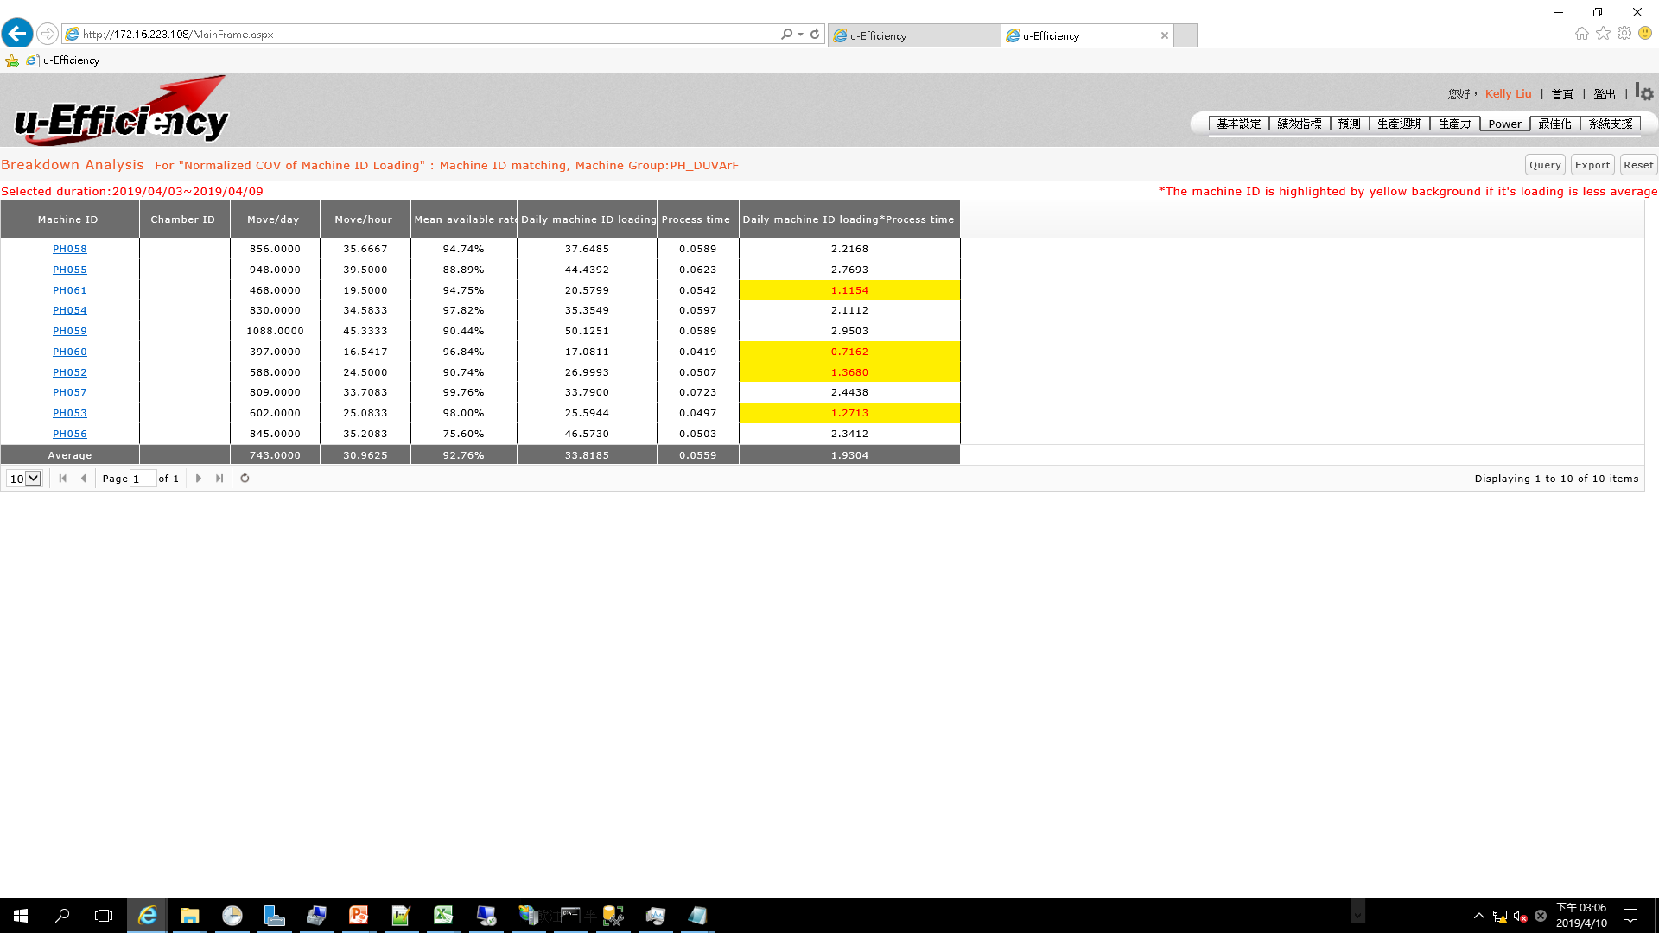
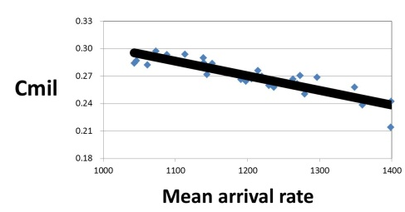
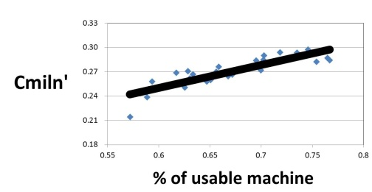
↓Normalized COV of machine ID loading(Cmiln)
PH_DUVArF
Standard deviation of loading= 79.4
Mean loading of the week= 282
COV of loading= 0.28 (Cmil)
Mean arrival of the week=1045
Historical max of arrival =1395
Normalized COV of loading’ = 0.21 (Cmiln’)
Cmiln’=0.21
% of usable machines of the week=0.631
Historical max of % of usable machines=0.767
Normalized COV of loading = 0.25 (Cmiln)
Notes:
As I highlighted before, we need an proactive and optimal PM schedule, rather than always postpone PM reactively
U Efficiency can accurately forecast the coming WIP of key machines, and the forecast accuracy is still over 90% for the 11th day.
On the base of robust forecast, every week, as the factory upload duration, planned date for execution, and the feasible time window for each PM or ENG item.
U Efficiency will refer to the upload data, and the forecast on arrival quantity of each day.
Then, the optimization algorithm will minimize the KPI “COV of machine group loading”
Finally, u Efficiency suggest the optimal date for each PM/ENG item. From now on, no more argue between manufacturing and module guys for postponing PM.
如同前面一再強調的，工廠應該有一套 proactive 且 optimal 的 PM/ENG schedule，而不是一昧被動地 postpone PM。
U Efficiency 對重點機台的每天 WIP 來到量預測，即使到第11天，預測準確率仍有 90%。
有了準確的預測能力，接下來，對每一個 machine group，user 只要每週上傳每一個 PM 及工程借機項目的執行時間、預計執行日期以及可以執行的區間。根據這些 constraint，u Efficiency 會再考量每天的 arrival 數量，建議每個 PM/ENG item 執行的最佳日期，目標是使 COV of machine loading 這個 KPI 最小化，也就是讓每天的 machine loading 儘量一樣。從此以後，製造部和工程部不會再為 postpone PM 爭的面紅耳赤。

Slide 13


↓Mean sampling rate(s)
Daily mean sampling rate =
=
Breakdown benchmark for sampling rate
Tech | Before |  | After |  | Impact% to △ % of All Factory
 | Sampling rate | Move% | Sampling rate | Move% | Sampling rate | Move%
bkhTV0t4RHdSZFI4a | 0.7811 | 21.62% | 0.5532 | 22.32% | -6.99% | 0.05%
cldobmNESjNnM3RD | 0.7825 | 5.14% | 0.7022 | 6.26% | -0.59% | 0.08%
eUViREhJYmR2bll4RZ | 0.6676 | 0.34% | 0.6890 | 0.51% | 0.01% | -0.01%
K016YUpJU2J6RWVL | 0.5423 | 38.22% | 0.6088 | 61.48% | 3.61% | -3.44%
RmwyWlYxSlc4eDUw | 0.8322 | 33.82% | 0.7892 | 8.18% | -2.06% | -2.98%
 | 0.5289 | 0.85% | 0.7623 | 1.27% | 0.28% | -0.07%
All factory | 0.7046 | 100.00% | 0.6193 | 100.00%
△s of all factory |  |  | -12.11% |  | -5.74% | -5.36%
No 1. contributor
No 1. killer
Sampling guideline of a leading semiconductor company
Sampling rate | Cpk | Rework Rate (RR) | Defect Rate (DR)
20% | Cpk≧2.00 | RR<0.24% | DR<0.24%
25% | 1.83≤Cpk<2.00 | 0.24%≦RR<0.39% | 0.24%≦DR<0.39%
33% | 1.67≤Cpk<1.83 | 0.39%≦RR<0.63% | 0.39%≦DR<0.63%
50% | 1.50≤Cpk<1.67 | 0.63%≦RR<1.00% | 0.63%≦DR<1.00%
100% | Cpk<1.50 | RR≧1.00% | DR≧1.00%
Notes:
As I highlighted before, we need an proactive and optimal PM schedule, rather than always postpone PM reactively
U Efficiency can accurately forecast the coming WIP of key machines, and the forecast accuracy is still over 90% for the 11th day.
On the base of robust forecast, every week, as the factory upload duration, planned date for execution, and the feasible time window for each PM or ENG item.
U Efficiency will refer to the upload data, and the forecast on arrival quantity of each day.
Then, the optimization algorithm will minimize the KPI “COV of machine group loading”
Finally, u Efficiency suggest the optimal date for each PM/ENG item. From now on, no more argue between manufacturing and module guys for postponing PM.
如同前面一再強調的，工廠應該有一套 proactive 且 optimal 的 PM/ENG schedule，而不是一昧被動地 postpone PM。
U Efficiency 對重點機台的每天 WIP 來到量預測，即使到第11天，預測準確率仍有 90%。
有了準確的預測能力，接下來，對每一個 machine group，user 只要每週上傳每一個 PM 及工程借機項目的執行時間、預計執行日期以及可以執行的區間。根據這些 constraint，u Efficiency 會再考量每天的 arrival 數量，建議每個 PM/ENG item 執行的最佳日期，目標是使 COV of machine loading 這個 KPI 最小化，也就是讓每天的 machine loading 儘量一樣。從此以後，製造部和工程部不會再為 postpone PM 爭的面紅耳赤。

Slide 14
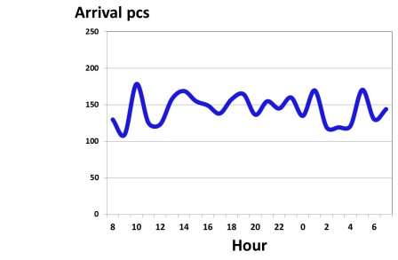
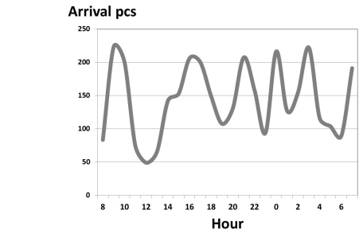
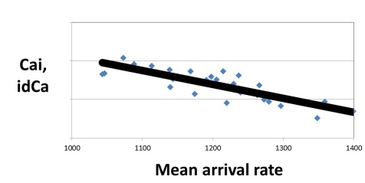
↓Normalized Intrinsic COV of arrival rate(Cain) ↓Normalized Impact percentage of dispatching on Ca(idCan)
Even dispatch
by upstream
Uneven dispatch
by upstream
Hour | Type | 07:30 ~ 08:30 | 08:30 ~ 09:30 | 09:30 ~ 10:30 | 10:30 ~ 11:30 | 11:30 ~ 12:30 | 12:30 ~ 13:30 | 13:30 ~ 14:30 | 15:30 ~ 15:30 | 15:30 ~ 16:30 | 16:30 ~ 17:30 | 17:30 ~ 18:30 | 18:30 ~ 19:30 | 19:30 ~ 20:30 | 20:30 ~ 21:30 | 21:30 ~ 22:30 | 22:30 ~ 23:30 | 23:30 ~ 00:30 | 00:30 ~ 01:30 | 01:30 ~ 02:30 | 02:30 ~ 03:30 | 03:30 ~ 04:30 | 04:30 ~ 05:30 | 05:30 ~ 06:30 | 06:30 ~ 07:30
Upstream | Move out pcs | 120 | 80 | 120 | 80 | 120 | 80 | 120 | 80 | 120 | 80 | 120 | 80 | 120 | 80 | 120 | 80 | 120 | 80 | 120 | 80 | 120 | 80 | 120 | 80
Downstream 1 | Arrival pcs | 120 | 80 | 120 | 80 | 0 | 0 | 0 | 0 | 120 | 80 | 120 | 80 | 0 | 0 | 0 | 0 | 120 | 80 | 120 | 80 | 0 | 0 | 0 | 0
Downstream 2 |  | 0 | 0 | 0 | 0 | 120 | 80 | 120 | 80 | 0 | 0 | 0 | 0 | 120 | 80 | 120 | 80 | 0 | 0 | 0 | 0 | 120 | 80 | 120 | 80
COV (STDEV/Mean) of move out of upstream =0.20=Intrinsic COV of arrival rate(Cai) of downstream
COV of arrival of downstream (Ca) =1.06
Impact percentage of dispatching on Ca(idCa) =(1.06-0.20)/0.20=4.30
Normalized intrinsic COV of arrival rate(Cain)=0.16
Normalized impact percentage of dispatching on Ca(idCan) = 2.92
Notes:
As I highlighted before, we need an proactive and optimal PM schedule, rather than always postpone PM reactively
U Efficiency can accurately forecast the coming WIP of key machines, and the forecast accuracy is still over 90% for the 11th day.
On the base of robust forecast, every week, as the factory upload duration, planned date for execution, and the feasible time window for each PM or ENG item.
U Efficiency will refer to the upload data, and the forecast on arrival quantity of each day.
Then, the optimization algorithm will minimize the KPI “COV of machine group loading”
Finally, u Efficiency suggest the optimal date for each PM/ENG item. From now on, no more argue between manufacturing and module guys for postponing PM.
如同前面一再強調的，工廠應該有一套 proactive 且 optimal 的 PM/ENG schedule，而不是一昧被動地 postpone PM。
U Efficiency 對重點機台的每天 WIP 來到量預測，即使到第11天，預測準確率仍有 90%。
有了準確的預測能力，接下來，對每一個 machine group，user 只要每週上傳每一個 PM 及工程借機項目的執行時間、預計執行日期以及可以執行的區間。根據這些 constraint，u Efficiency 會再考量每天的 arrival 數量，建議每個 PM/ENG item 執行的最佳日期，目標是使 COV of machine loading 這個 KPI 最小化，也就是讓每天的 machine loading 儘量一樣。從此以後，製造部和工程部不會再為 postpone PM 爭的面紅耳赤。

Slide 15

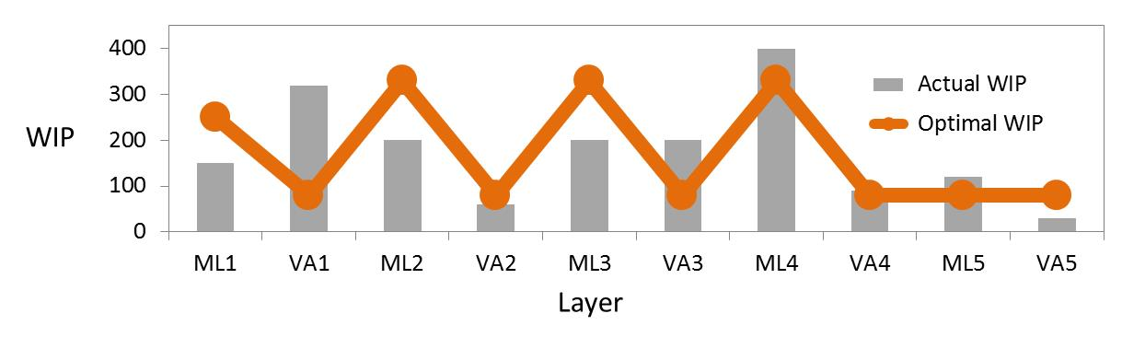

↓Normalized Impact percentage of dispatching on Ca(idCan)
Optimal WIP profile to sustain WIP linearity & prevent bottleneck from starvation
Determine linear WIP profile
Priority quadrant for a machine
Bottleneck
Safety WIP
Optimal WIP | Layer | Step
.. | .. | ..
250 | ML2 | 120
80 | ML2 | 125
80 | VA2 | 135
250 | ML3 | 140
80 | ML3 | 145
80 | VA3 | 155
250 | ML4 | 160
.. | .. | ..
Current layer Next layer | WIP ≧Optimal | WIP <Optimal
WIP <Optimal | First 15 lots | 2nd 20 lots
WIP ≧Optimal | 3rd 20 lots | Last 15 lots
Non-bottleneck
Actual WIP
Daily update
by u-Efficiency
Real-time update
by dispatching system
Optimal WIP profile
for each Tech
First
Last
Notes:
If WIP profile is linear, the arrival variation will be smooth. And it can prevent bottleneck from starvation.
U Efficiency allocates safety WIP of bottleneck and actual WIP of non-bottleneck to corresponding layers evenly. And defines the optimal WIP for each layer.
U Efficiency daily uploads optimal WIP of each tech to dispatching system at user side, If the WIP of a layer is higher than optimal level, and the WIP of next layer is lower than optimal level, highest priority is given to the layer. On the contrary, if the WIP of current layer is lower than optimal level, and the WIP of next layer is higher than optimal level, lowest priority is given to the layer.
Finally, for each machine group, dispatching system will categorize all queuing lots into the 4 priority quadrants.
如果 WIP 的 profile 夠 linear，機台的 WIP 來到變異就會很小，而且可以避免 bottleneck WIP 不足。
U Efficiency 將 bottleneck 的 safety WIP 及 non-bottleneck 的實際 WIP 均勻分配到對應的 layer，最後訂出每個 layer 的 optimal WIP。
U Efficiency 每天更新每個 tech 的 optimal WIP profile，user 可以於派工系統中制定對應的 rule。如果某個 layer 的 WIP 高於 optimal，但是下一個 layer 的 WIP 低於 optimal level, 必須列為最高 priority。相反的，如果某個 layer 的 WIP 低於 optimal，而下一個 layer 的 WIP 高於 optimal level, 就將它列為最低 priority。
最後，派工系統可以針對每個機群，將所有 queueing lots 歸類為這 4 個 priority 象限。

Slide 16
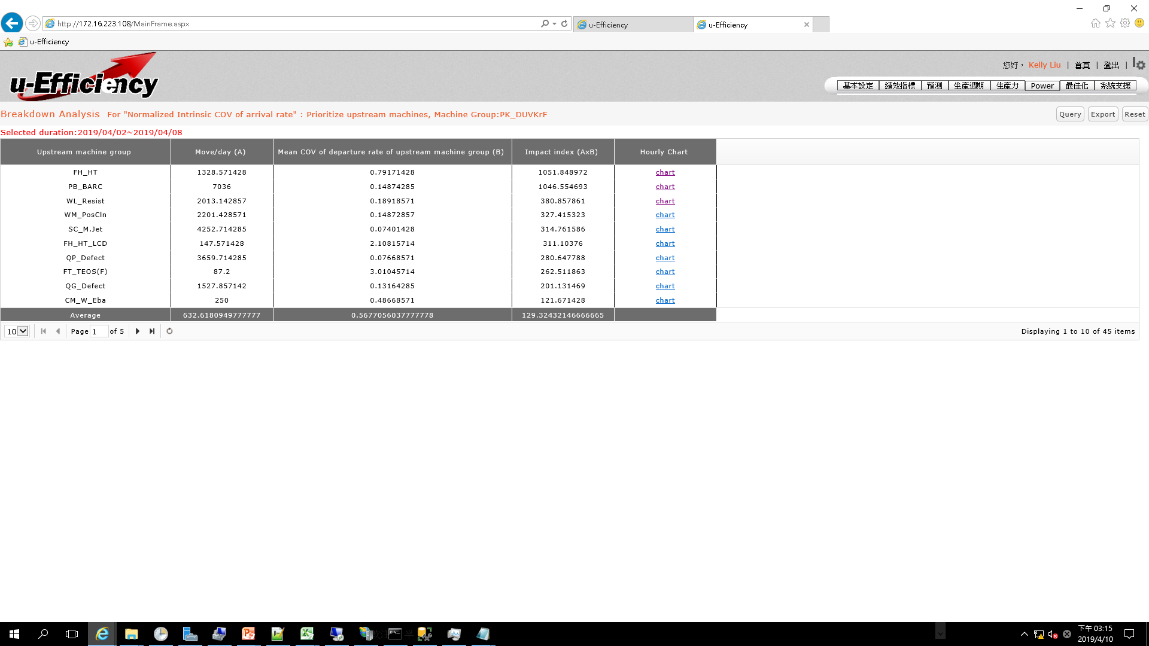
↓Normalized Impact percentage of dispatching on Ca(idCan)
Identify the machines that hurt optimal WIP profile
Breakdown Analysis For KPI “Impact of dispatching on COV of Arrival Rate”
Down stream machine Group: PK_DUVArF
Upstream killer for arrival fluctuation of the downstream
Notes:
In order to improve KPI effectively, u-Efficiency provides KPI breakdown analysis to identify the root causes for poor KPI performance.
Take the machine for instance, the KPI impact of dispatching on COV of arrival rate is actually influenced by upstream machines. Thus, u-Efficiency can identify the true killers that need to dispatch WIP more evenly, and smooth arrival variation for downstream machines.
要如何有效改善 KPI 呢? u-Efficiency 提供了 KPI breakdown 分析功能，協助找到真正的原因。
舉例來說，這一個機台的 WIP 來到變異太高， 真正的破壞者是它的上游特定機台。u-Efficiency 能找到最大的元兇，進而由 user 去修改它的派工法則。

Slide 17
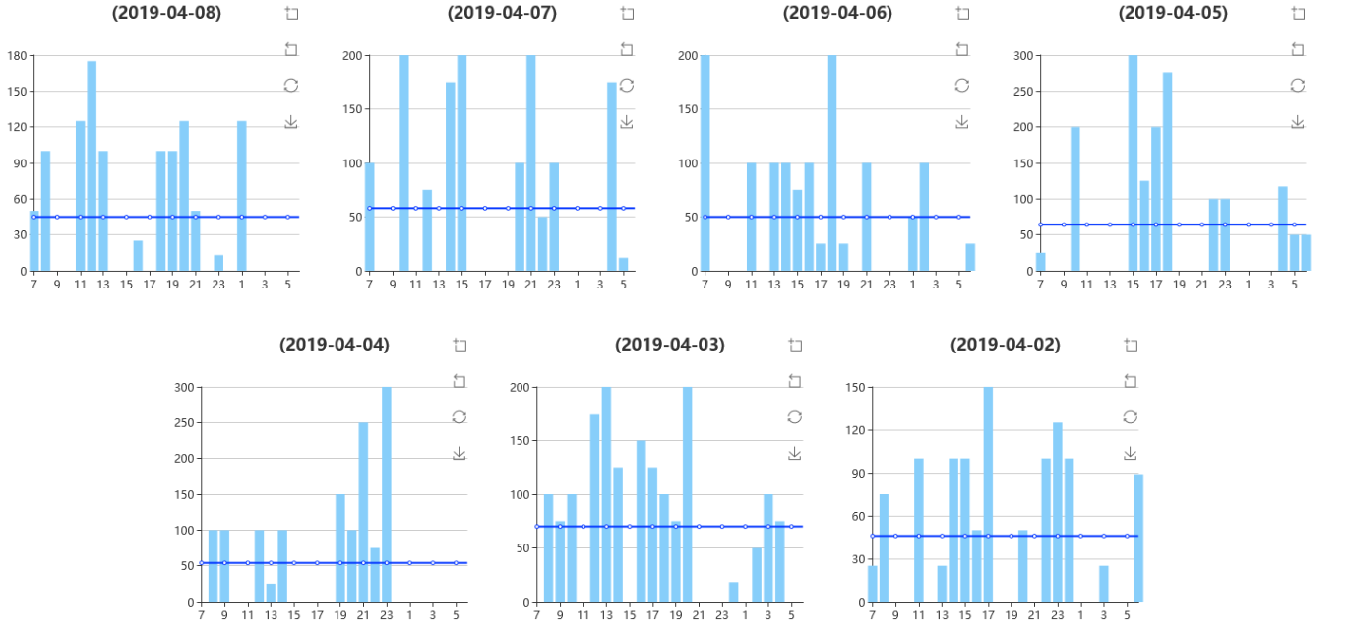
↓Normalized Impact percentage of dispatching on Ca(idCan)
Identify the machines that hurt optimal WIP profile
PH_HT ➔ PK_DUVArF
Notes:
In order to improve KPI effectively, u-Efficiency provides KPI breakdown analysis to identify the root causes for poor KPI performance.
Take the machine for instance, the KPI impact of dispatching on COV of arrival rate is actually influenced by upstream machines. Thus, u-Efficiency can identify the true killers that need to dispatch WIP more evenly, and smooth arrival variation for downstream machines.
要如何有效改善 KPI 呢? u-Efficiency 提供了 KPI breakdown 分析功能，協助找到真正的原因。
舉例來說，這一個機台的 WIP 來到變異太高， 真正的破壞者是它的上游特定機台。u-Efficiency 能找到最大的元兇，進而由 user 去修改它的派工法則。

Slide 18
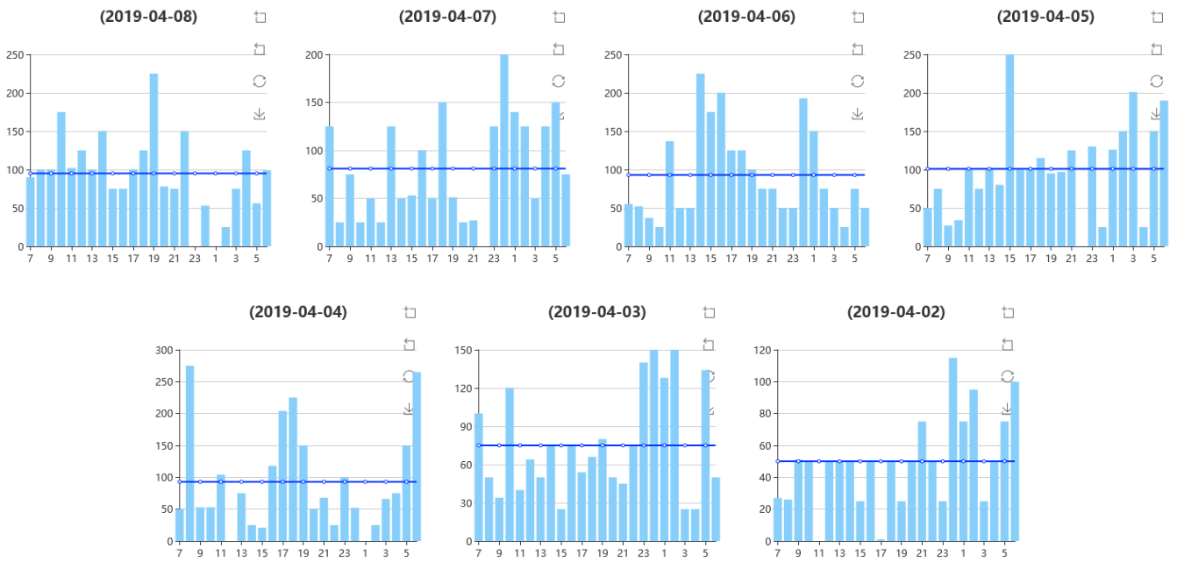
↓Normalized Impact percentage of dispatching on Ca(idCan)
Identify the machines that hurt optimal WIP profile
WL_Resist ➔ PK_DUVArF
Notes:
In order to improve KPI effectively, u-Efficiency provides KPI breakdown analysis to identify the root causes for poor KPI performance.
Take the machine for instance, the KPI impact of dispatching on COV of arrival rate is actually influenced by upstream machines. Thus, u-Efficiency can identify the true killers that need to dispatch WIP more evenly, and smooth arrival variation for downstream machines.
要如何有效改善 KPI 呢? u-Efficiency 提供了 KPI breakdown 分析功能，協助找到真正的原因。
舉例來說，這一個機台的 WIP 來到變異太高， 真正的破壞者是它的上游特定機台。u-Efficiency 能找到最大的元兇，進而由 user 去修改它的派工法則。

Slide 19



↓Mean ratio for Q-time constraint(rw) ↑Mean limit for Q-time constraint(tw)
Example | rw | tw
 | (20% + 80%) ÷ 100% = 1 | (6×20% + 12×80%) ÷ 100% = 10.8 hrs
 | (20% + 30%) ÷ 100% = 0.5 | (6×20% + 12×30%) ÷ 50% = 9.6 hrs
 | 22.67 hrs < 24 hrs rw of MG_B, C, D = 1 | µ Q-time of MG_B, C, D = 68 hrs ÷ 3 steps = 22.67 hrs
Ignore Q-time ≥ 24 hrs
MG: Machine group
Notes:
As I highlighted before, we need an proactive and optimal PM schedule, rather than always postpone PM reactively
U Efficiency can accurately forecast the coming WIP of key machines, and the forecast accuracy is still over 90% for the 11th day.
On the base of robust forecast, every week, as the factory upload duration, planned date for execution, and the feasible time window for each PM or ENG item.
U Efficiency will refer to the upload data, and the forecast on arrival quantity of each day.
Then, the optimization algorithm will minimize the KPI “COV of machine group loading”
Finally, u Efficiency suggest the optimal date for each PM/ENG item. From now on, no more argue between manufacturing and module guys for postponing PM.
如同前面一再強調的，工廠應該有一套 proactive 且 optimal 的 PM/ENG schedule，而不是一昧被動地 postpone PM。
U Efficiency 對重點機台的每天 WIP 來到量預測，即使到第11天，預測準確率仍有 90%。
有了準確的預測能力，接下來，對每一個 machine group，user 只要每週上傳每一個 PM 及工程借機項目的執行時間、預計執行日期以及可以執行的區間。根據這些 constraint，u Efficiency 會再考量每天的 arrival 數量，建議每個 PM/ENG item 執行的最佳日期，目標是使 COV of machine loading 這個 KPI 最小化，也就是讓每天的 machine loading 儘量一樣。從此以後，製造部和工程部不會再為 postpone PM 爭的面紅耳赤。

Slide 20
↑Mean limit for Q-time constraint(tw)
Breakdown benchmark for limit for Q-time constraint
Tech | Before |  | After |  | Impact% to △ % of All Factory
 | Limit for Q-time (hour) | Move% | Limit for Q-time (hour) | Move% | Limit for Q-time (hour) | Move%
bkhTV0t4RHdSZFI | 3.4665 | 21.62% | 3.5175 | 22.32% | 0.14% | -0.27%
cldobmNESjNnM3RD | 11.7375 | 5.14% | 10.5330 | 6.26% | -0.79% | 0.38%
eUViREhJYmR2bll4RT | 10.0140 | 0.34% | 10.3350 | 0.51% | 0.01% | 0.03%
K016YUpJU2J6RWV | 12.1845 | 38.22% | 10.8495 | 61.48% | -6.50% | 8.83%
RmwyWlYxSlc4eDU | 5.1315 | 33.82% | 5.9520 | 8.18% | 3.54% | 6.10%
U1U0dzhGR2VveGlIT | 7.9335 | 0.85% | 6.6180 | 1.27% | -0.14% | 0.00%
All factory | 7.8471 | 100.00% | 8.7367 | 100.00%
△tw of all factory |  |  | 11.34% |  | -3.74% | 15.08%
No 1. killer
No 1. contributor
△tw by change on tw of tech
△ tw by change of product mix
Notes:
As I highlighted before, we need an proactive and optimal PM schedule, rather than always postpone PM reactively
U Efficiency can accurately forecast the coming WIP of key machines, and the forecast accuracy is still over 90% for the 11th day.
On the base of robust forecast, every week, as the factory upload duration, planned date for execution, and the feasible time window for each PM or ENG item.
U Efficiency will refer to the upload data, and the forecast on arrival quantity of each day.
Then, the optimization algorithm will minimize the KPI “COV of machine group loading”
Finally, u Efficiency suggest the optimal date for each PM/ENG item. From now on, no more argue between manufacturing and module guys for postponing PM.
如同前面一再強調的，工廠應該有一套 proactive 且 optimal 的 PM/ENG schedule，而不是一昧被動地 postpone PM。
U Efficiency 對重點機台的每天 WIP 來到量預測，即使到第11天，預測準確率仍有 90%。
有了準確的預測能力，接下來，對每一個 machine group，user 只要每週上傳每一個 PM 及工程借機項目的執行時間、預計執行日期以及可以執行的區間。根據這些 constraint，u Efficiency 會再考量每天的 arrival 數量，建議每個 PM/ENG item 執行的最佳日期，目標是使 COV of machine loading 這個 KPI 最小化，也就是讓每天的 machine loading 儘量一樣。從此以後，製造部和工程部不會再為 postpone PM 爭的面紅耳赤。

Slide 21
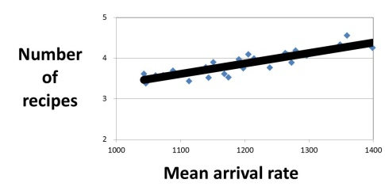
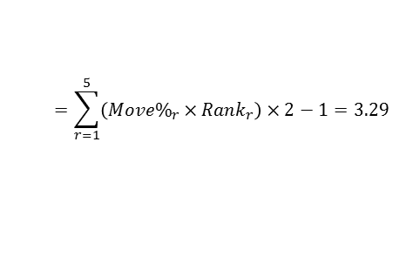
↓Normalized Mean number of recipes(rn) ↑Mean simplified percentage for recipes(sr)
Recipe | Machine ID A |  |  | Machine ID B |  |  | Machine ID C |  |  | Machine group
 | Moved pcs | Move% | Rank | Moved pcs | Move% | Rank | Moved pcs | Move% | Rank | Moved pcs | Move% | Rank
Recipe 1 | 86 | 24% | 3 | 193 | 52% | 1 | 119 | 34% | 2 | 398 | 37% | 1
Recipe 2 | 0 | 0% | 5 | 64 | 17% | 3 | 0 | 0% | 4 | 64 | 6% | 5
Recipe 3 | 151 | 42% | 1 | 115 | 31% | 2 | 78 | 22% | 3 | 344 | 32% | 2
Recipe 4 | 89 | 25% | 2 | 0 | 0% | 4 | 0 | 0% | 4 | 89 | 8% | 4
Recipe 5 | 31 | 9% | 4 | 0 | 0% | 4 | 152 | 44% | 1 | 183 | 17% | 3
Number of reipes | 2.98 |  |  | 2.31 |  |  | 2.58 |  |  | 3.29
Number of recipe for machine group (r)
Mean number of recipes for machine ID =2.62
Simplified % for recipes =1-(2.62/3.29)=0.204
Normalized number of recipes for machine group (rn) = 4.58
Notes:
As I highlighted before, we need an proactive and optimal PM schedule, rather than always postpone PM reactively
U Efficiency can accurately forecast the coming WIP of key machines, and the forecast accuracy is still over 90% for the 11th day.
On the base of robust forecast, every week, as the factory upload duration, planned date for execution, and the feasible time window for each PM or ENG item.
U Efficiency will refer to the upload data, and the forecast on arrival quantity of each day.
Then, the optimization algorithm will minimize the KPI “COV of machine group loading”
Finally, u Efficiency suggest the optimal date for each PM/ENG item. From now on, no more argue between manufacturing and module guys for postponing PM.
如同前面一再強調的，工廠應該有一套 proactive 且 optimal 的 PM/ENG schedule，而不是一昧被動地 postpone PM。
U Efficiency 對重點機台的每天 WIP 來到量預測，即使到第11天，預測準確率仍有 90%。
有了準確的預測能力，接下來，對每一個 machine group，user 只要每週上傳每一個 PM 及工程借機項目的執行時間、預計執行日期以及可以執行的區間。根據這些 constraint，u Efficiency 會再考量每天的 arrival 數量，建議每個 PM/ENG item 執行的最佳日期，目標是使 COV of machine loading 這個 KPI 最小化，也就是讓每天的 machine loading 儘量一樣。從此以後，製造部和工程部不會再為 postpone PM 爭的面紅耳赤。

Slide 22
↑Mean simplified percentage for recipes(sr)
No 1 & 2 killer
Breakdown benchmark for same recipe rate
Shift | A_Day |  |  | B_Day |  |  | A_Night |  |  | B_Night
Machine ID | Moved lots | Lots with same recipes | Same recipe% | Moved lots | Lots with same recipes | Same recipe% | Moved lots | Lots with same recipes | Same recipe% | Moved lots | Lots with same recipes | Same recipe%
All | 287 | 185 | 64.5% | 287 | 180 | 62.7% | 280 | 167 | 59.6% | 280 | 155 | 55.4%
SPF01 | 30 | 15 | 50.0% | 30 | 14 | 46.7% | 28 | 14 | 50.0% | 28 | 14 | 50.0%
SPF02 | 21 | 21 | 100.0% | 21 | 20 | 95.2% | 1 | 1 | 100.0% | 1 | 1 | 100.0%
SPF03 | 40 | 36 | 90.0% | 40 | 36 | 90.0% | 41 | 24 | 58.5% | 41 | 23 | 56.1%
SPF04 | 29 | 25 | 86.2% | 29 | 25 | 86.2% | 25 | 21 | 84.0% | 25 | 19 | 76.0%
SPF05 | 35 | 12 | 34.3% | 35 | 11 | 31.4% | 41 | 10 | 24.4% | 41 | 7 | 17.1%
SPF06 | 24 | 8 | 33.3% | 24 | 7 | 29.2% | 31 | 9 | 29.0% | 31 | 7 | 22.6%
Notes:
As I highlighted before, we need an proactive and optimal PM schedule, rather than always postpone PM reactively
U Efficiency can accurately forecast the coming WIP of key machines, and the forecast accuracy is still over 90% for the 11th day.
On the base of robust forecast, every week, as the factory upload duration, planned date for execution, and the feasible time window for each PM or ENG item.
U Efficiency will refer to the upload data, and the forecast on arrival quantity of each day.
Then, the optimization algorithm will minimize the KPI “COV of machine group loading”
Finally, u Efficiency suggest the optimal date for each PM/ENG item. From now on, no more argue between manufacturing and module guys for postponing PM.
如同前面一再強調的，工廠應該有一套 proactive 且 optimal 的 PM/ENG schedule，而不是一昧被動地 postpone PM。
U Efficiency 對重點機台的每天 WIP 來到量預測，即使到第11天，預測準確率仍有 90%。
有了準確的預測能力，接下來，對每一個 machine group，user 只要每週上傳每一個 PM 及工程借機項目的執行時間、預計執行日期以及可以執行的區間。根據這些 constraint，u Efficiency 會再考量每天的 arrival 數量，建議每個 PM/ENG item 執行的最佳日期，目標是使 COV of machine loading 這個 KPI 最小化，也就是讓每天的 machine loading 儘量一樣。從此以後，製造部和工程部不會再為 postpone PM 爭的面紅耳赤。

Slide 23
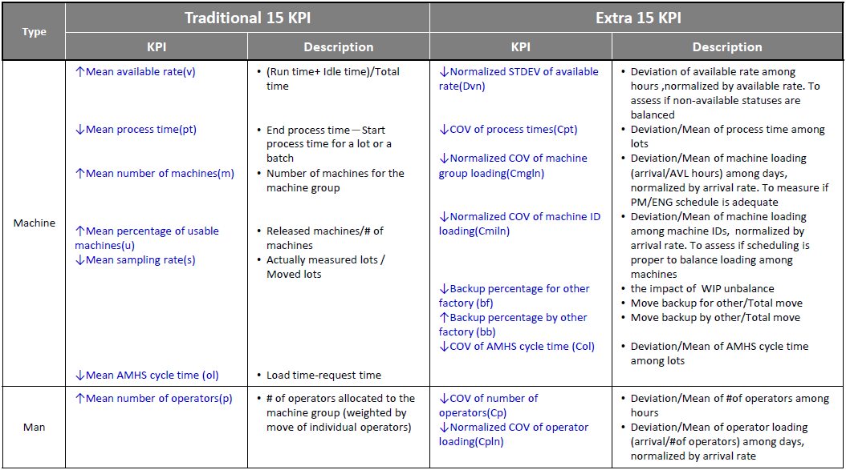
Machine Group KPI
等待時間
等待時間變異
人機比

Slide 24
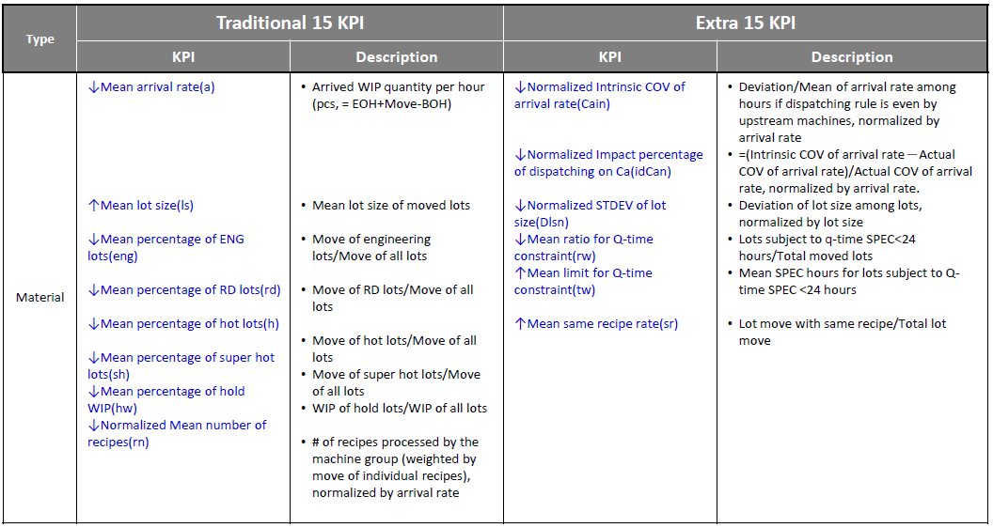
Machine Group KPI (cont.)
RD Lot 比例

