Slide 1

SHRI G. S. INSTITUTE OF TECHNOLOGY & SCIENCE, INDORE Department of Computer Engineering
Session June 2019 – December 2020
Topic:- AI in Agriculture
Guided By:
Mrs.Sonika Shrivastava
Submitted By:
Harish Lohare(0801CS173D06)
Lokendra Singh (0801CS161039)
Hemant Sawle (0801CS161027)

Slide 2
Artificial Intelligence
in Agriculture

Slide 3
INTRODUCTION
As we know India is agrarian country and agriculture
sector contributes around 55 % of Indian GDP.
Despite the contribution we are still way behind then
many developed countries.
But the advancement of technology and program like
digital India have the potential to transform the
agriculture, And Artificial intelligence can be a key
technology in solving these problems.

Slide 4
IMPORTANCE OF APPLICATION
The global population is expected to reach 10 billion people by 2050, which means double agricultural production in order to meet food demands which is about 70% increase in food production.
Farm enterprises require new and innovative technologies
to face and overcome these challenges.
To understand it in more detail, let’s dive deeper.

Slide 5
PROBLEM FACED IN AGRICULTURE
Weather Forecasting
Irrigation
Crop Health Monitoring

Slide 6
HOW AI CAN SOLVE THESE PROBLEM
Weather Forecasting
Data is collected from various means such as radar system, anemometers, through satellite etc.
Data is fed into an algorithm that uses deep learning techniques and make predictions based on past data.
By comparing predictions with outcomes, the model is able to learn simulation and improve result by greater accuracy.

Slide 7
IRRIGATION
To make the schedule of irrigation, smart devices senses the data of environment like humidity and temperature of soil.
This information is stored on cloud, then with help of AI, data is diagnosed and monitored.
After then it provide appropriate schedule of irrigation to the farmers.

Slide 8
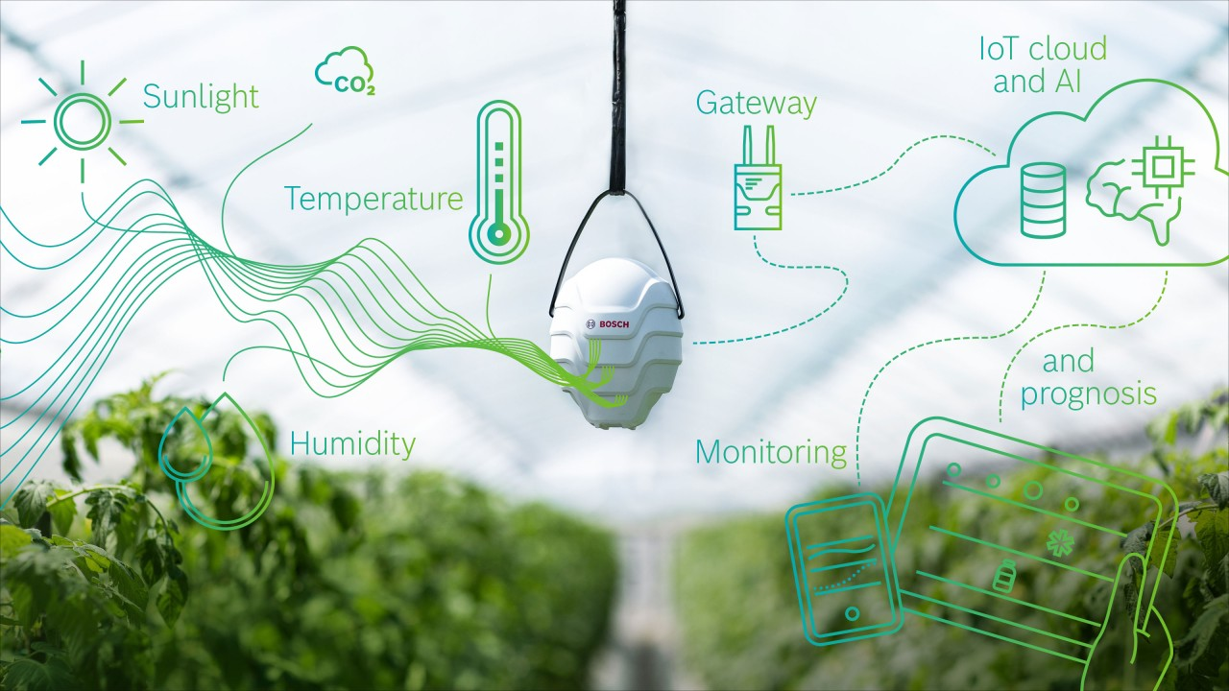
Visual Representation

Slide 9
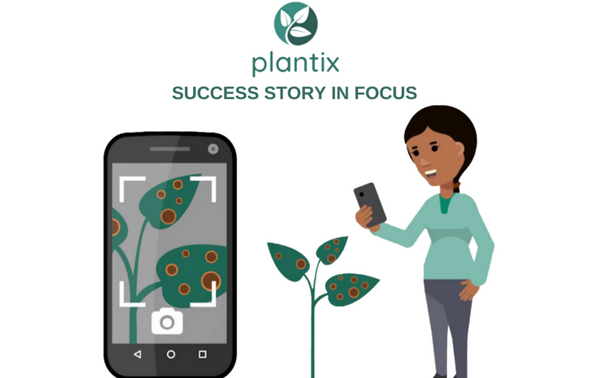
Crop Health Monitoring
There is “plantix app” that uses images to detect plant diseases, a smart phone collects image which is matched with a server image and then a diagnosis of the plant and soil health is provided.
It uses computer vision and deep learning algorithms to process data captured by smart phone.

Slide 10
WORKING OF ALGORITHM:
Image acquisition is the very first step that requires capturing an image with the
help of a digital camera.
Preprocessing of input image to improve the quality of image and to remove the
desired distortion from the image. Clipping of the leaf image is performed to get
the interested image region and then image smoothing is done using the
smoothing filter. To increase the contrast Image enhancement is also done.
Mostly green colored pixels, in this step, are masked. In this, we computed a
threshold value that is used for these pixels. Then in the following way mostly
green pixels are masked: if pixel intensity of the green component is less than the
pre-computed threshold value, then zero value is assigned to the red, green and
blue components of the this pixel.
In the infected clusters, inside the boundaries, remove the masked cells.
Obtain the useful segments to classify the leaf diseases. Segment the components
using genetic algorithm.

Slide 11
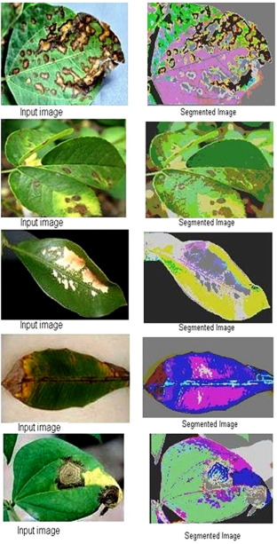
Fig. 1 shows the original images which are followed by output segmented images.

Slide 12
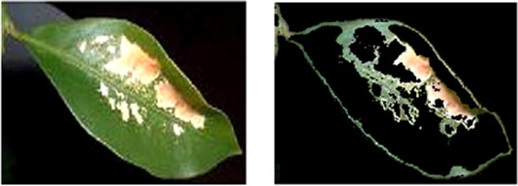
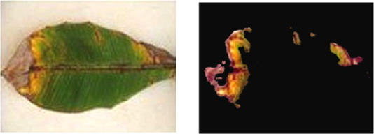
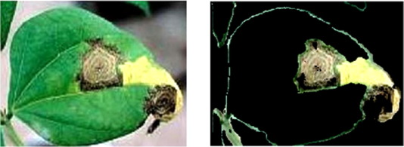
Fig. 1 Input and output image of banana leaf and output diseases is early scorch disease.
Fig. 2. Input and output image of lemon leaf and output diseases is sun burn disease.
Fig 3. Input and output image of beans leaf and output diseases is fungal disease

Slide 13
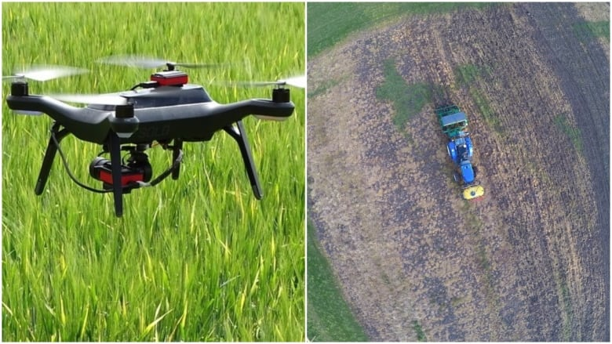
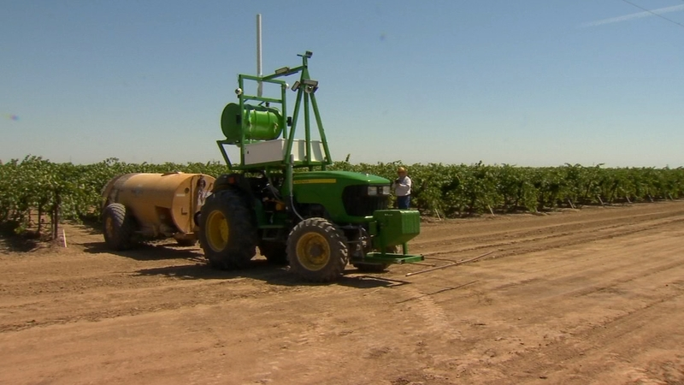
Various Tools used in AI
Spraying Drone
DriverLess tractor

Slide 14
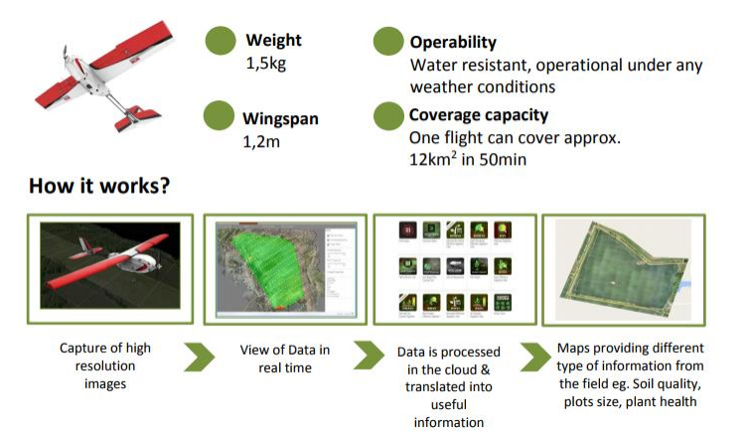
Various Tools used in AI
Drone Working

Slide 15
Challenges In AI Adoption
in Agriculture
AI systems also need a lot of data to train machines
and to make precise predictions. In case of vast
agricultural land, though spatial data can be gathered
easily, temporal data is hard to get.
Lack of infrastructure.

Slide 16
Conclusion
AI can be appropriate and efficacious in agriculture
sector as it optimizes the resource use and efficiency.
It solves the scarcity of resources and labor to a large
extent. Adoption of AI is quite useful in agriculture.
Artificial intelligence can be technological revolution and
boom in agriculture to feed the increasing human
population of world.
Artificial Intelligence will complement and challenge to
make right decision by farmers.

Slide 17
REFERENCES
V. Dharmaraj* and C. Vijayanand “Crop health monitoring ” International Journal of Current Microbiology and Applied Sciences ISSN: 2319-7706 Volume 7 Number 12 (2018) , pp 2130.
https://www.agritechtommorow.com
https://plantix.net/en/

Slide 18
Thanking You

