Slide 1
ORGANISATION DATABASE SERVER
Factory_1
Factory_2
Factory_3
Factory_4
DB
DB
DB
DB
Factory_5
Head_office
Factory_6
DB
DB
DB
DB
DB
DB
DB
DB
DB
DB
DB
DB
DB

Slide 2
Factory_1 DATABASE
DB
Machines
Prod_dept
Pur_dept
TB1
TB2
TB3
Sales_dept
Quality_dept
TB4
TB5
TB1
TB..
TB..
TB..

Slide 3
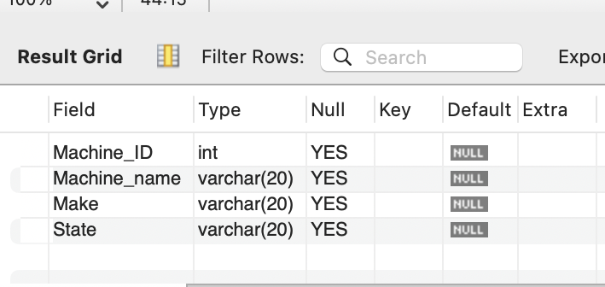
TABLES
MACHINES
Structure of the table
TB1
Col_name
Machine_ID | Machine_name | Make | Country
int | Var_char(20) | Var_char(20) | Var_char(20)
Data type
Content of the table
Machine_ID | Machine_name | Make | Country
1001 | Drilling_machine | Mahine_tools | India
1002 | Milling_machine | Private_mech | China
1003 | Shaping_machine | Shaping_trend | South_africa
1004 | Testing_machine | Pioneer_test | India

Slide 4
Data types
Numeric:
Tiny Int → +ve ex: age
Int → -ve to +ve
Big Int → -ve to +ve
Decimal → -ve to +ve (ex: salary :: Exact value)
Float → -ve to +ve ( ex: Temperature, sensor readings:: approximate values)
Date& Time:
DATE → YYYY-MM-DD
TIME→ HH:MM:SS
DATE&TIME→
YYYY-MM-DD HH:MM:SS
String:
Char → Char(6) (ex: Hero_ _ )
Varchar → Varchar(20) (ex: Hero)
BLOB → useful for images
Text → plane text like statements

