Slide 1
THE WHO
Team Members:
Vitaly Theriault
Namitha Logishetty
Lokesh Yadav Ramanaboina
Sachin Krishna Nelakonda
Target Market: Generations X,Y,Z.
Value Proposition:
1. It is most useful for ‘hearing impaired’ people.
2. Transcripted data will be a key for organisations.
3. Small fee to transcribe discord meetings for multiple users.

Slide 2
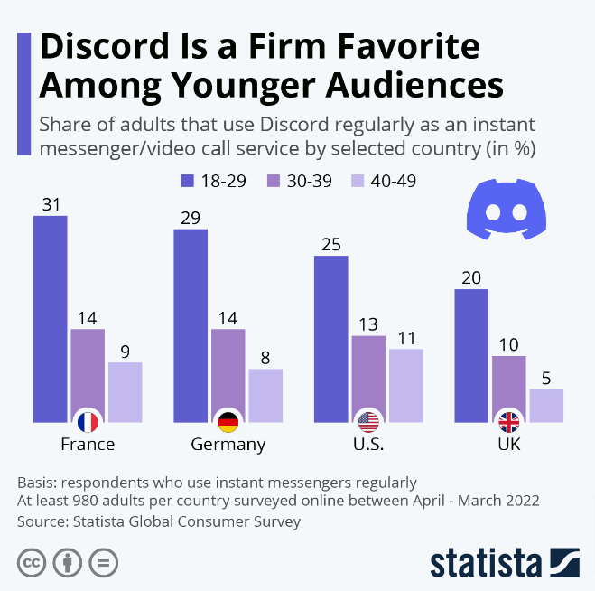
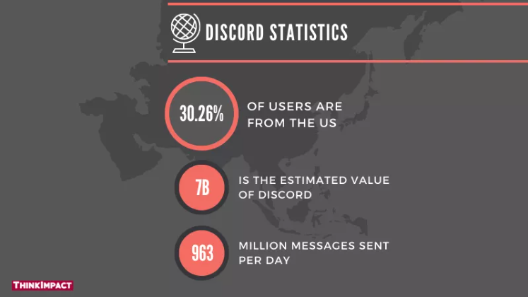
Discord Users Charts :
Source (1st pic ): https://onehourprofessor.com/how-to-make-money-on-discord/
(2nd pic) : https://www.thinkimpact.com/discord-statistics/

Slide 3
Key Winning Features and Capabilities
Transcription Per User: This Application will generate transcripts for each user. This can be particularly useful in group meetings for multiple users.
Speaker Identification: This Application identifies the user transcripts based on the user id and the Timestamps during the meeting.
Multilingual support: Google Speech-to-Text API supports a wide range of languages, including English, Spanish, French, German, and many others. This can be especially helpful for global teams and multi-lingual meetings.

Slide 4
Key Winning Features and Capabilities
The bot can recognize the speech input from users through the microphone and convert it to text format.
This Application is easy to Integrate to Any Discord Server as the bot will listen to the voice events and perform speech to text services easily.

Slide 5
Justifications
The current Market Needs an cost effective Application which will transcribe the meetings in Discord with easy setup.
Accessibility: By using Speech to text Services in Discord, users with hearing impairments will able to participate in the meeting and can communicate effectively
Reduce Manual Effort: This Application reduces human manual note taking process as they can go through the transcription generated rather than listening the Entire Audio.

Slide 6
Justifications
Google Speech-to-Text API is known for its high accuracy with 95% in speech-to-text transcription, which can help ensure that meeting content is accurately transcribed, that means the Word Error Rate (WER) of the Google API is 5%.
Inclusivity: Speech-to-text transcription can help ensure that all meeting participants are included in the conversation, regardless of their language, accent.

Slide 7

Plan for the implementation phase
Create a discord bot
Set up the voice channel
Build the bot
Add up code to capture Audio per user from the Voice channel using Discord API
Send audio to Google speech-Text ApI
Receive Transcript
Test and deploy
your bot

Slide 8
Thank You
Questions

