Slide 1
Understanding Cache Memory: Working Principles and Applications
TECHNICAL PRESENTATION
CSA1220-Computer Architecture
GUIDED BY
DR S RADHIKA
BY
G LOKESH YADAV
192411061

Slide 2
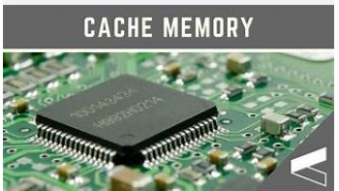
Introduction to CACHE MEMORY
Cache memory is a small, high-speed memory located close to the CPU.
It stores frequently used data and instructions.
It helps the CPU access data much faster than RAM.
Main purpose: Reduce memory access time and improve system performance.

Slide 3
Problem identification
Modern CPUs execute billions of instructions per second.
RAM is much slower than the CPU.
This speed difference creates a memory bottleneck.
The CPU wastes time waiting for data from RAM.

Slide 4
Problem anALYSIS
Component | Access Time
CPU Registers | ~1 ns
L1 Cache | ~1 ns
L2 Cache | 3–5 ns
L3 Cache | 10–20 ns
RAM | 50–100 ns
Analysis:
CPU is much faster than RAM.
Cache memory bridges this speed gap.

Slide 5
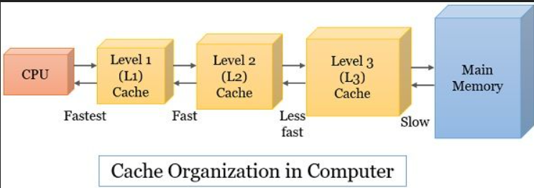
TYPES OF CACHE MEMORY
L1 Cache L3 Cache
Fastest cache Largest cache
Smallest size (32–128 KB) Shared among CPU cores
Built inside each CPU core Size ranges from 4 MB to 64 MB or more
L2 Cache
Larger than L1
Slightly slower
Usually 256 KB–2 MB

Slide 6
WORKING OF CACHE MEMORY
Check Cache
Check Cache
Cache Hit
Data sent to CPU
YES
Fetch data from RAM
NO
Store in Cache
Send to CPU

Slide 7
ADVANTAGES
Faster data access
Improves CPU performance
Reduces execution time
Decreases RAM access
Saves power
Enhances multitasking

Slide 8
APPLICATIONS
Personal computers
Gaming systems
Smartphones
Servers
Artificial Intelligence
Cloud computing
Embedded systems

Slide 9
conclusion
Cache memory solves the CPU–RAM speed mismatch.
Improves processing speed.
Reduces execution time.
Essential in modern processors.

Slide 10
THANK YOU

