Slide 1
Looking for translocation signals across mitogenomes
Lokesh Venkatesh
Lab meeting: 19-03-25

Slide 2
Introduction
Specific Aims
Methodology
Results
Future Work
Mitochondrial Genomes
Interested in looking at a ‘signal’ that is common across translocation events in the evolution of the mitochondrial genome, whether from a molecular or a biophysical basis
We are only considering intra-mitogenome translocations and not mitochondria-nucleus translocations in this workflow
Divided all mitogenomes available on the NCBI database into three broad datasets: fungi-protists, plants, and animals
Using only the animal dataset to refine the workflow for two reasons:
  Animal mitochondrial genomes have nearly identical gene content
  Except for a small region of regulatory DNA around the TSS, there are little to no non-coding regions in between the genes

Slide 3
Introduction
Specific Aims
Methodology
Results
Future Work
Workflow
Start with a dataset of available mitochondrial genomes, and an ordered list of their genes starting from the Transcription Start Site (TSS).
Using a custom-distance metric, arrange these genomes in an order that is supposed to be how each of them actually originated over the course of evolution.
Identify ‘breakpoints’, which are disruptions in the order of genes when comparing two adjacent genomes in his order. Those are the locations at which our target sequences are.
Obtain the sequences in those regions with some leeway on either side.
Construct the vectors for these sequences and carry out further analysis.

Slide 4
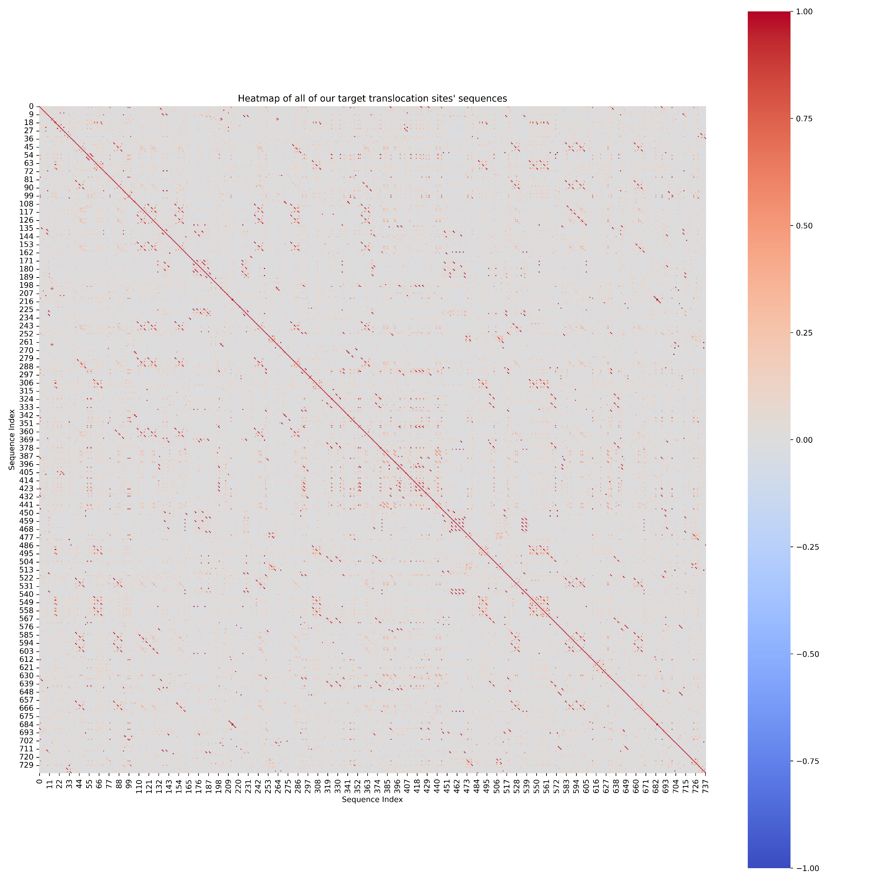
Introduction
Specific Aims
Methodology
Results
Future Work

Slide 5
Introduction
Specific Aims
Methodology
Results
Future Work
Distance metric
Levenshtein-Distance Score (a DP, edit-based metric)
Double-cut and Join Model (a graph-based metric)

Slide 6
Introduction
Specific Aims
Methodology
Results
Future Work
Target-sequence lengths
Regions between gene sequences are at most around 10 bases long, barring the TSS-regulatory region.
Smallest known translocation in mitochondrial genomes (one such example) is between two adjacent TRNAs genes coding for Isoleucine (TrnI) and Glutamine (TrnQ) seen in lizards and closely-related species
It made sense to take around 20-30 base pairs on either side since the TRNA genes are usually about 60 bases long.
Any longer of a sequence may bring in unwanted motifs (‘noise’)
Short target sequence lengths result in further problems (elaborated further on the next slide)
Boore, J.L. (1999) Animal mitochondrial genomes. Nucleic Acids Res., 27, 1767–1780.
Macey,J.R., Larson,A., Ananjeva,N.B. and Papenfuss,T. (1997) Evolutionary shifts in three major structural features of the mitochondrial genome among iguanian lizards. J. Mol. Evol., 44, 660–674.

Slide 7
Introduction
Specific Aims
Methodology
Results
Future Work
Constructing motif vectors for these obtained sequences
For a sequence length of 60 bases, if we were to construct a 5-mer vector of length 512 for this sequence, we would end up with only about 512-60+1 non-zero entries in this vector
Most of the whole vectors will therefore have a high correlation with each other owing to multiple entries being zeroes.
Assigning a cutoff before performing a correlation is very dicey, since none of the motifs are expected to be ‘abundant’ in any way since they do not correspond to any functional regulation.
Therefore, using motif distributions to extrapolate and obtain ‘unknown’ motifs becomes even more trickier
One more problem is, if the unknown protein(s) chopped up the motif right in the middle, then we would never be able to detect it post-translocation. Things become further complicated if the sequences evolutionarily diverge over time.

Slide 8
Introduction
Specific Aims
Methodology
Results
Future Work
A molecular signal-hypothesis vs. a biophysical explanation
Below is a ChatGPT-ed list of possible ways in which translocations could potentially take place in the human nuclear genome. The molecular-signal hypothesis is that the proteins involved in some of these pathways will show up as their corresponding binding sites when we analyse the motif vectors obtained.
(Link to .md file)
The biophysical explanation is that the motifs will simply be AT-rich and therefore be more prone to being chopped up
What’s next would then be to obtain the matrices on the ~15K-ish animal genomes and analyse them for these two broad possibilities.
If there does exist a signal of sorts, then the next step would be to look for whether this signal is present in the other two datasets

