Slide 1

Credit Card Fraud Detection
Submitted By
Lokesh Singh & Shubham Gupta
Course – PG-DBDA
PRN- (240320525007 & 240320525011)
CDAC, Noida

Slide 2
INTRODUCTION
'Fraud' in credit card transactions is unauthorized and unwanted usage of an account by someone other than the owner of that account. Necessary prevention measures can be taken to stop this abuse and the behaviour of such fraudulent practices can be studied to minimize it and protect against similar occurrences in the future.In other words, Credit Card Fraud can be defined as a case where a person uses someone else’s credit card for personal reasons while the owner and the card issuing authorities are unaware of the fact that the card is being used.
Fraud detection involves monitoring the activities of populations of users in order to estimate, perceive or avoid objectionable behaviour, which consist of fraud, intrusion, and defaulting.

Slide 3
Main challenges involved in credit card fraud detection are:
Enormous Data is processed every day and the model build must be fast enough to respond to the scam in time.
Imbalanced Data i.e most of the transactions are not fraudulent which makes it really hard for detecting the fraudulent ones.
Data availability as the data is mostly private.
Misclassified Data can be another major issue, as not every fraudulent transaction is caught and reported.
Adaptive techniques used against the model by the scammers.

Slide 4
How to tackle these challenges?
The model used must be simple and fast enough to detect the anomaly and classify it as a fraudulent transaction as quickly as possible.
Imbalance can be dealt with by properly using some methods which we will talk about in the next paragraph
For protecting the privacy of the user the dimensionality of the data can be reduced.

Slide 5
Overview
Problem statement:
The increasing prevalence of credit card fraud in the digital era necessitates the development of robust and efficient fraud detection systems. This project aims to develop a machine-learning model to detect credit card fraud. The model will be trained on a dataset of historical credit card transactions and evaluated on a holdout dataset of unseen transactions.

Slide 6
Project Goal:
The main aim of this project is the detection of fraudulent credit card transactions, as it is essential to figure out the fraudulent transactions so that customers do not get charged for the purchase of products that they did not buy.

Slide 7

Machine Learning in Fraud Detection
Machine Learning Technologies
Machine learning plays a crucial role in fraud detection by analyzing patterns, anomalies, and trends in transaction data to identify potential fraud. Algorithms learn from historical data to make accurate predictions in real-time.

Slide 8
Data Description
The dataset was retrieved from an open-source website, Kaggle.com. It contains data on transactions made in 2013 by European credit card users in two days only. The dataset consists of 31 attributes and 284,807 rows.
Twenty-eight attributes are numeric variables that, due to the confidentiality and privacy of the customers.
Time: which contains the elapsed seconds between the first and other transactions of each Attribute.
Amount : Which is the amount of each transaction
Class : which contains binary variables where 1 is a case of fraudulent transaction, and 0 is not as case of fraudulent transaction.
Dataset : https://www.kaggle.com/datasets/mlg-ulb/creditcardfraud

Slide 9
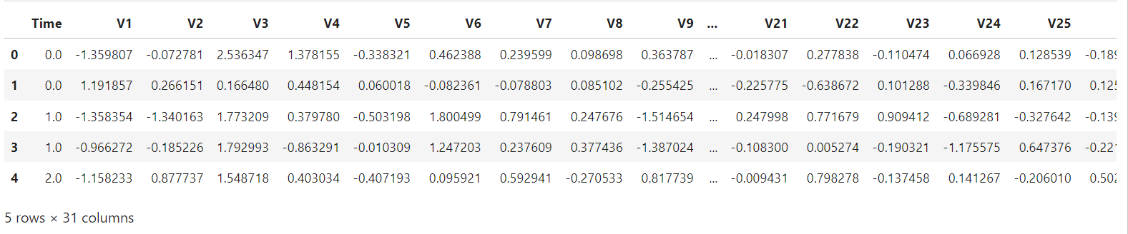
Lets take a Look at Dataset

Slide 10
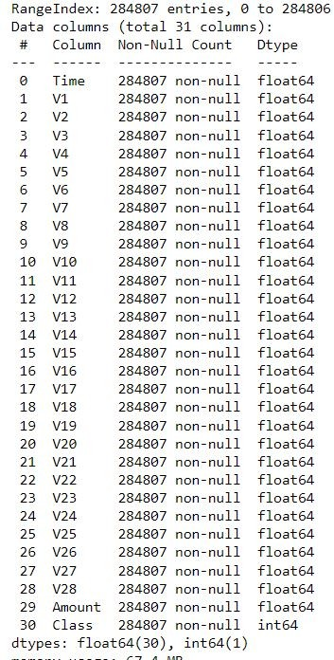
Data Information

Slide 11
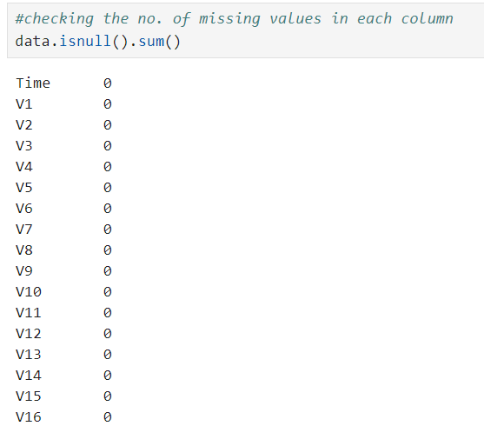
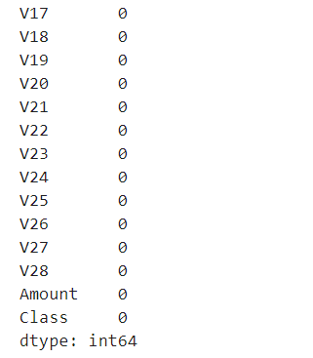
Checking no of missing values in each colum:

Slide 12
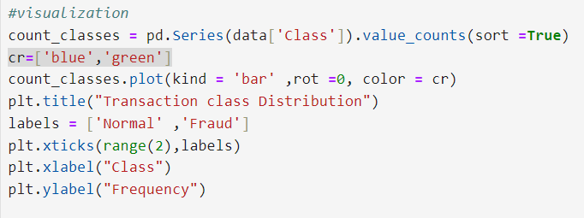
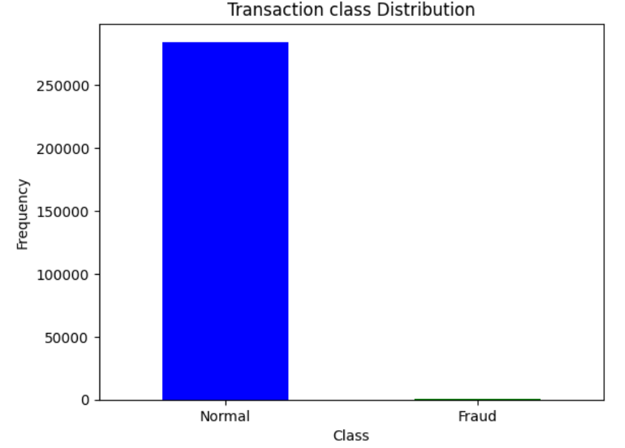
Exploratory Data Analysis visualization of normal transcation and fraud transcation through bar graph-Imbalanced Data
Notes:
I

Slide 13
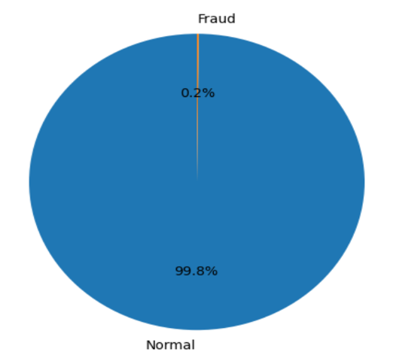
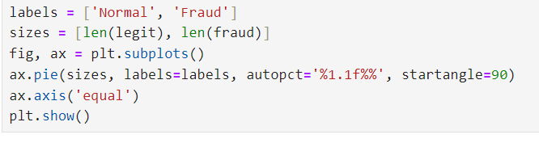
visualization of normal transcation and fraud transcation through Pie chart: Imbalanced Data

Slide 14
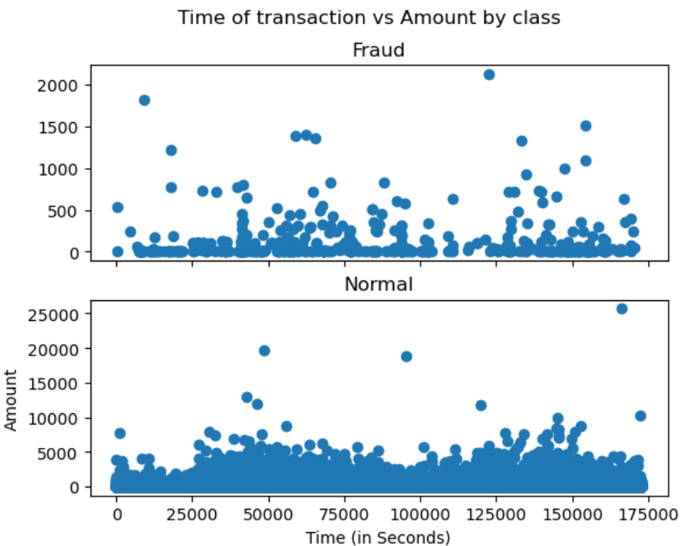
We Will check Do fraudulent transactions occur more often during certain time frame

Slide 15
Imbalanced Data:
As you see we got the imbalanced data in the above slides now lets know what is imbalanced data and how to tackle it..
Datasets where the distribution of observations in the target class is uneven. In other words, one class label has a significantly higher number of observations, while the other has a notably lower count.
Problem with Handling Imbalanced Data for Classification
Algorithms may get biased towards the majority class and thus tend to predict output as the majority class.
Minority class observations look like noise to the model and are ignored by the model.
Imbalanced dataset gives misleading accuracy score.

Slide 16
Class Imbalance Handling in Machine Learning:
Using Random Under-Sampling
When observations from the majority class are eliminated until the majority and minority classes are balanced, this is known as undersampling.
Undersampling has advantages when working with large datasets, especially ones with millions of rows, but there is a risk that important information will be lost during the removal process.

Slide 17
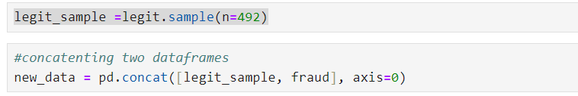
Data Sampling
under-sampling
Build a sample dataset containg similar distribution of normal transction and fraudlent Transactions
Number of fraudulent transactions = 492 & Legit Transactions = 284315

Slide 18
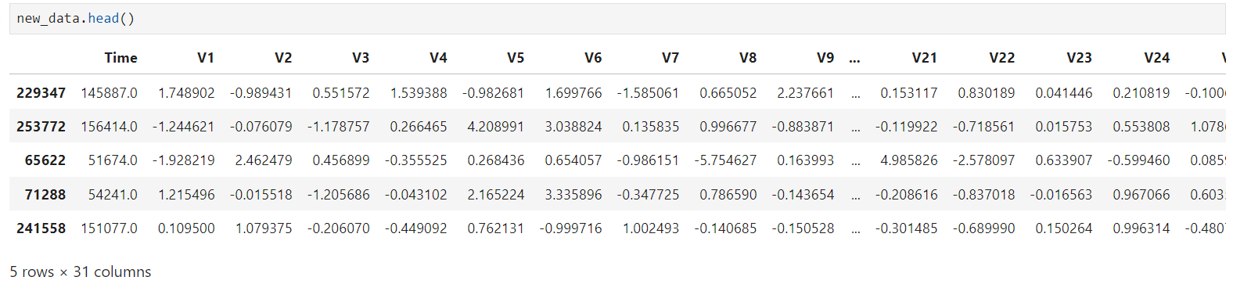
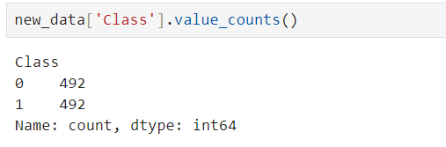
Balanced Dataset

Slide 19
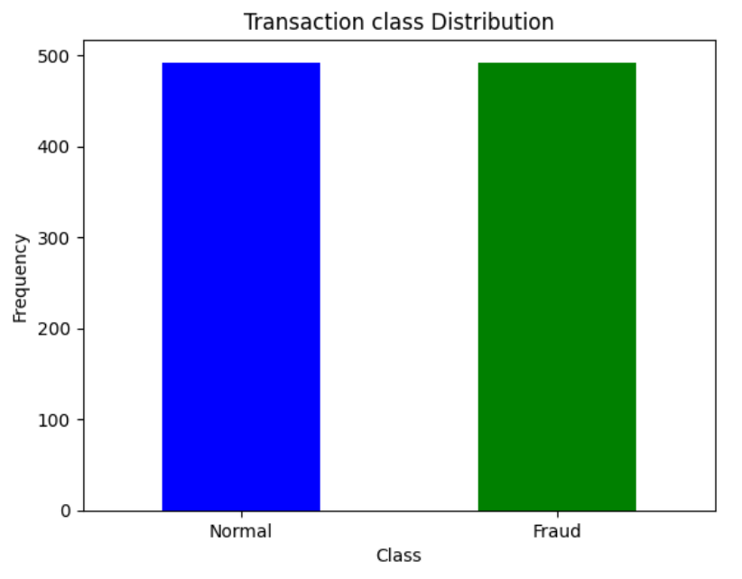
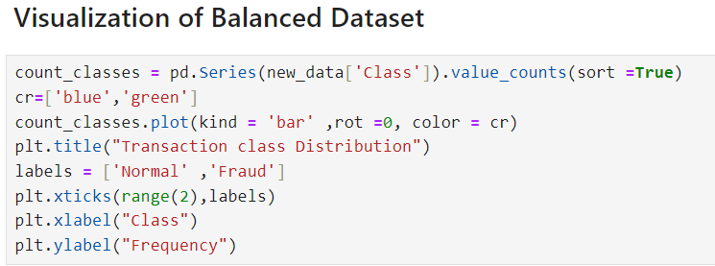

Slide 20
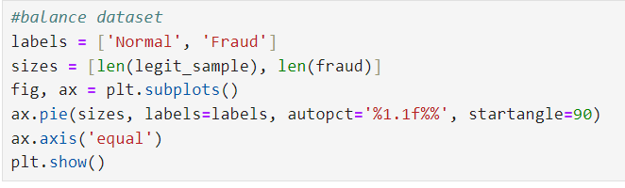
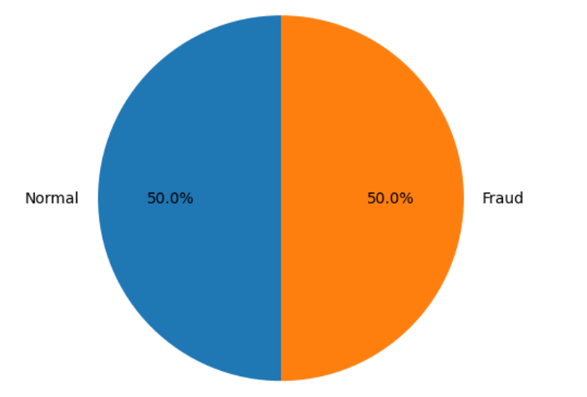

Slide 21
Train And Test Dataset
TRAIN DATASET:
The training data is the biggest (in -size) subset of the original dataset, which is used to train or fit the machine learning model. Firstly, the training data is fed to the ML algorithms, which lets them learn how to make predictions for the given task.
The training data varies depending on whether we are using Supervised Learning or Unsupervised Learning Algorithms.

Slide 22
TEST DATASET:
Once we train the model with the training dataset, it's time to test the model with the test dataset. This dataset evaluates the performance of the model and ensures that the model can generalize well with the new or unseen dataset.
The test dataset is another subset of original data, which is independent of the training dataset.
Test data is a well-organized dataset that contains data for each type of scenario for a given problem that the model would be facing when used in the real world. Usually, the test dataset is approximately 20-25% of the total original data for an ML project.

Slide 23
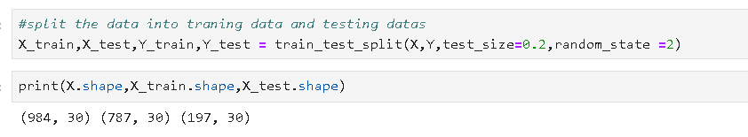
Train And Test Dataset

Slide 24
Machine Learning Techniques Used
Algorithm | Description
Logistic Regression | Statistical model that predicts the probability of a binary outcome.
Random Forest | Ensemble learning method that uses multiple decision trees for classification.
KNN | uses proximity to make predictions and classifications about a data point's grouping
SVM | to classify data, perform regression, and detect outliers

Slide 25
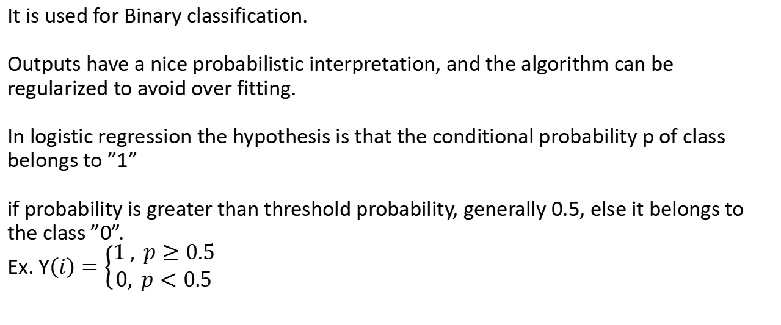
It is used for Binary classification. Outputs have a nice probabilistic interpretation, and the algorithm can be regularized to avoid over fitting. In logistic regression the hypothesis is that the conditional probability p of class belongs to ”1” if probability is greater than threshold probability, generally 0.5, else it belongs to the class ”0”. Ex. Y$\left(i\right)=\left\{\begin{aligned}1 , p≥0.5 \\ &0, p<0.5\end{aligned}\right.$
Logistic Regression

Slide 26
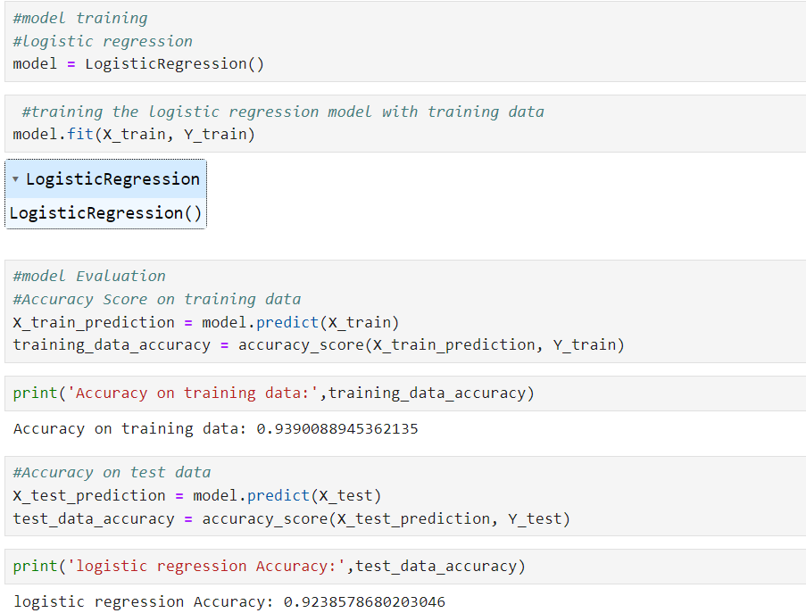

Slide 27
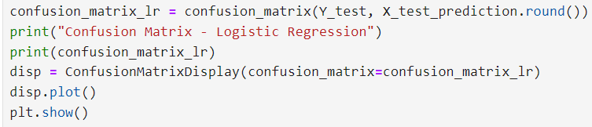
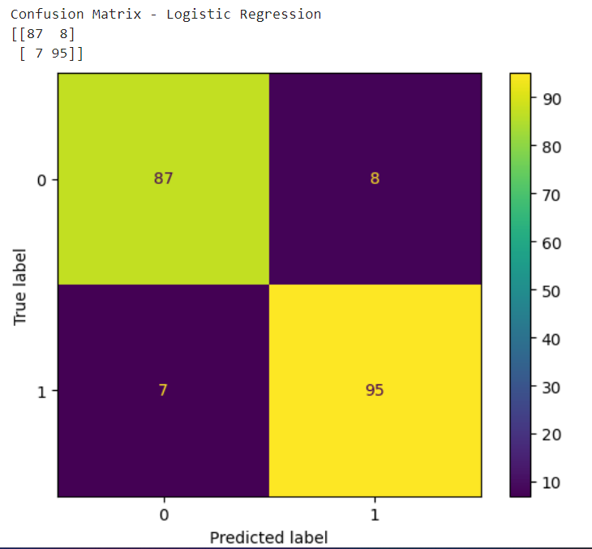

Slide 28
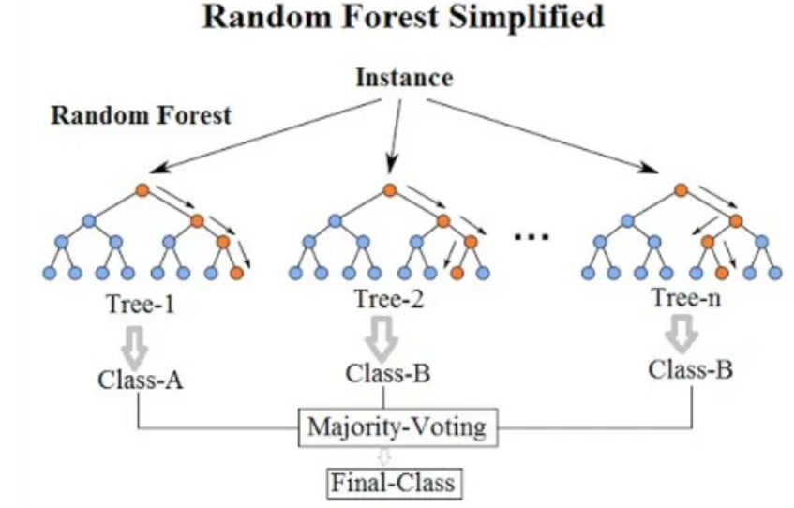
Random Forest
Random Forest is a Supervised Learning Algorithm that is essentially an Ensemble of randomly created Uncorrelated Decision Trees using the Bagging Process.
Random Forest can be used in Classification as well as in Regression.
For this discussion, we will limit ourselves to Classification only

Slide 29
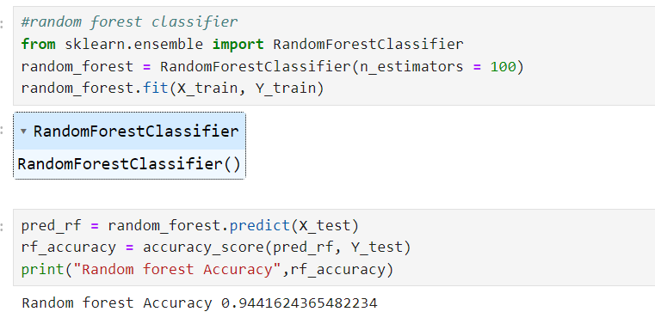

Slide 30
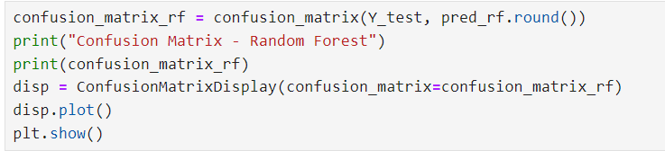
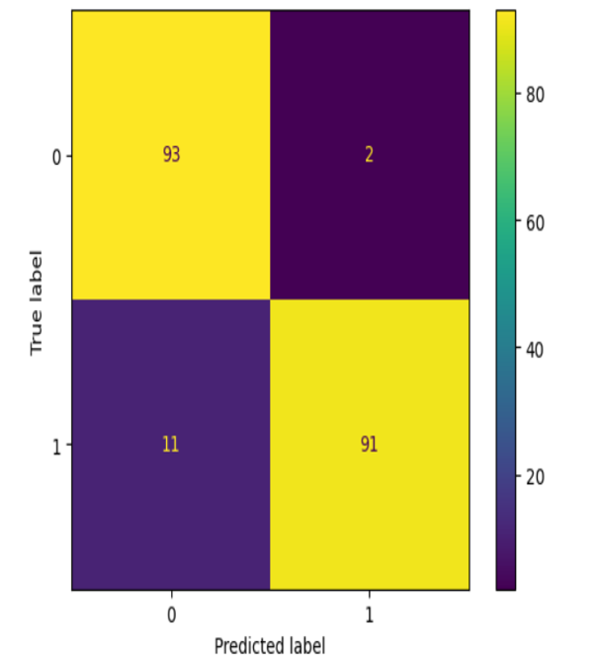

Slide 31
KNN
The k-nearest neighbors (KNN) algorithm is a non-parametric, supervised learning classifier, which uses proximity to make classifications or predictions about the grouping of an individual data point. It is one of the popular and simplest classification and regression classifiers used in machine learning today.
The KNN algorithm can be used for either regression or classification problems, it is typically used as a classification algorithm

Slide 32
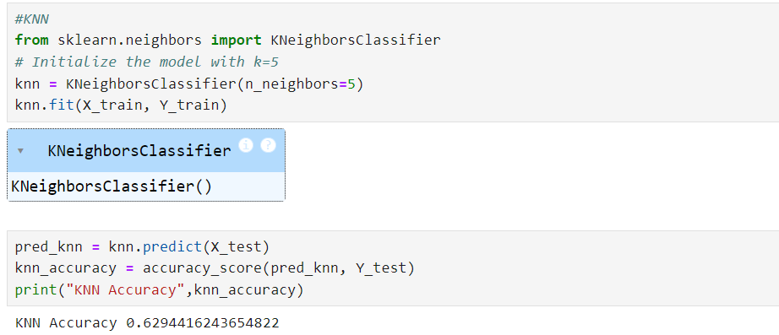

Slide 33
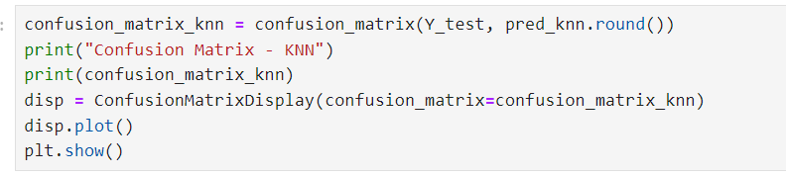
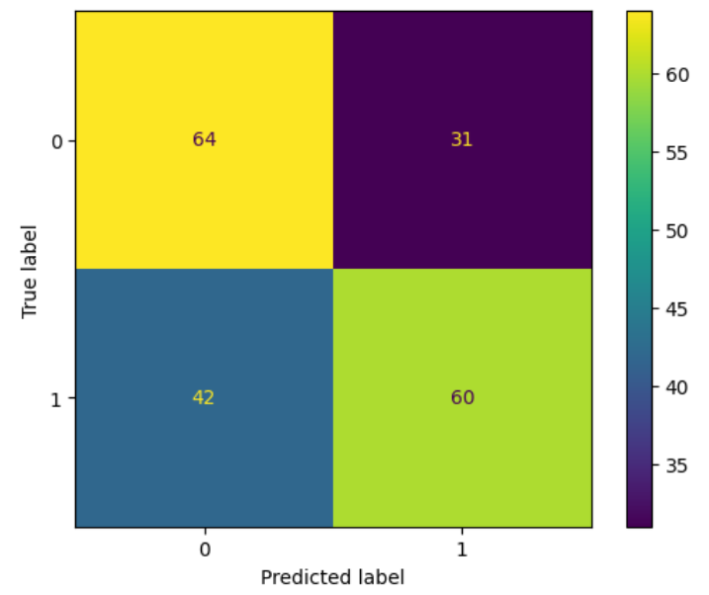

Slide 34
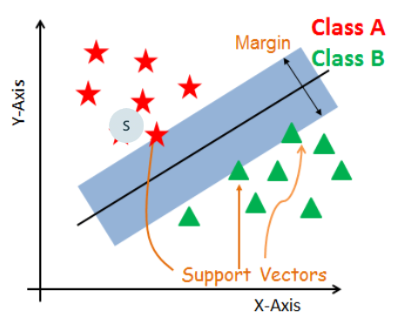
SVM
A support vector machine (SVM) is a algorithm that classifies data by finding an optimal line or hyperplane that maximizes the distance between each class in an N-dimensional space.
SVMs are commonly used within classification problems. They distinguish between two classes by finding the optimal hyperplane that maximizes the margin between the closest data points of opposite classes

Slide 35
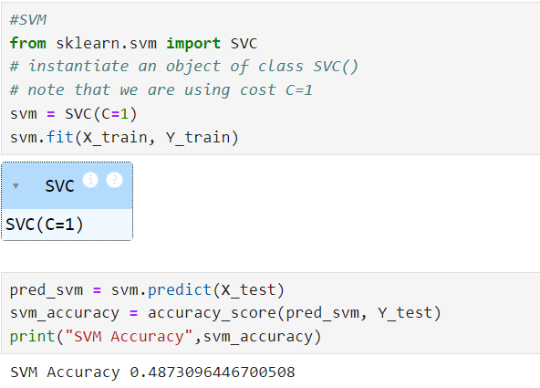

Slide 36
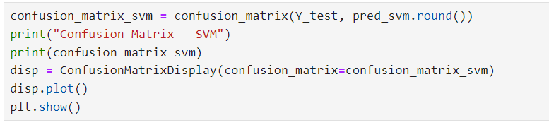
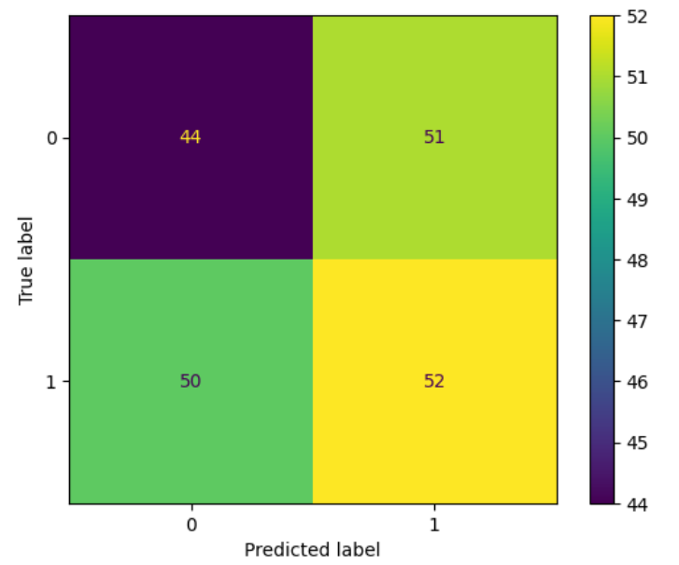

Slide 37
Evaluation Result
Algorithm | Accuracy | Precision | Recall | F1-Score
Logistic Regression | 93.40% | 94.94% | 92.15% | 93.53%
Random Forest | 92.89% | 95.83% | 90.15% | 92.92%
KNN | 62.94% | 65.93% | 58.82% | 62.17%
SVM | 48.73% | 50.48% | 50.98% | 50.73%

Slide 38
Thank You

