Slide 1

Singular Value Decomposition Applications

Slide 2

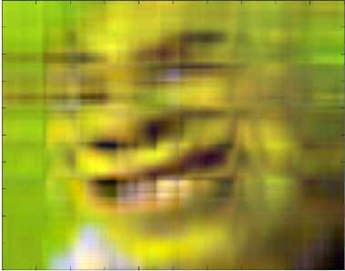
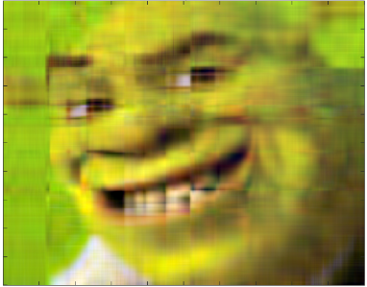



Singular Value Decomposition
Image Compression
$$A= σ_{1}u_{1}{v^{T}}_{1}+σ_{2}u_{2}{v^{T}}_{2}+…σ_{r}u_{r}{v^{T}}_{r}+σ_{r+1}u_{r+1}{v^{T}}_{r+1}+…σ_{n}u_{n}{v^{T}}_{n}$$
$$A≈ σ_{1}u_{1}{v^{T}}_{1}+σ_{2}u_{2}{v^{T}}_{2}+…σ_{r}u_{r}{v^{T}}_{r}+0$$
Total Saving: Original A requires $m×n$ storage , reduced to $r×(m+n+1)$
Original
Rank 5
Rank 10
Rank 25
Rank 50

Slide 3
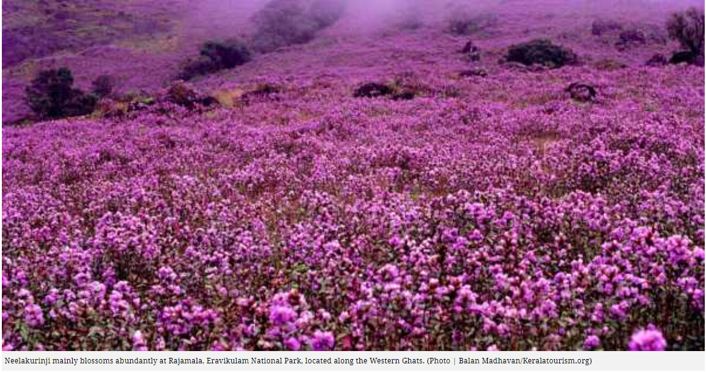
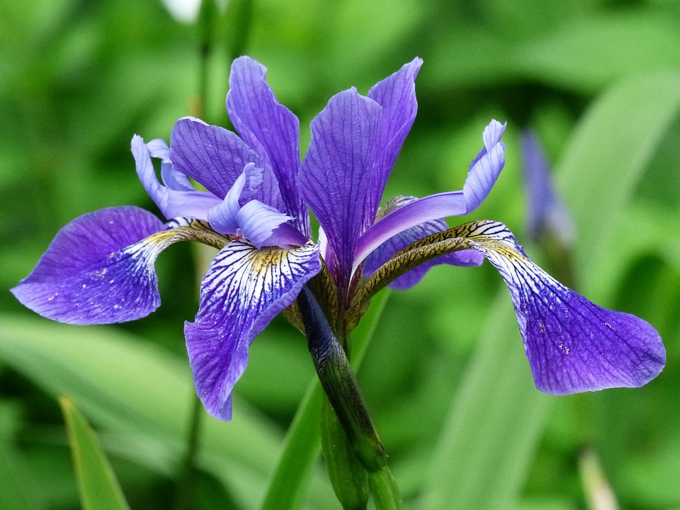
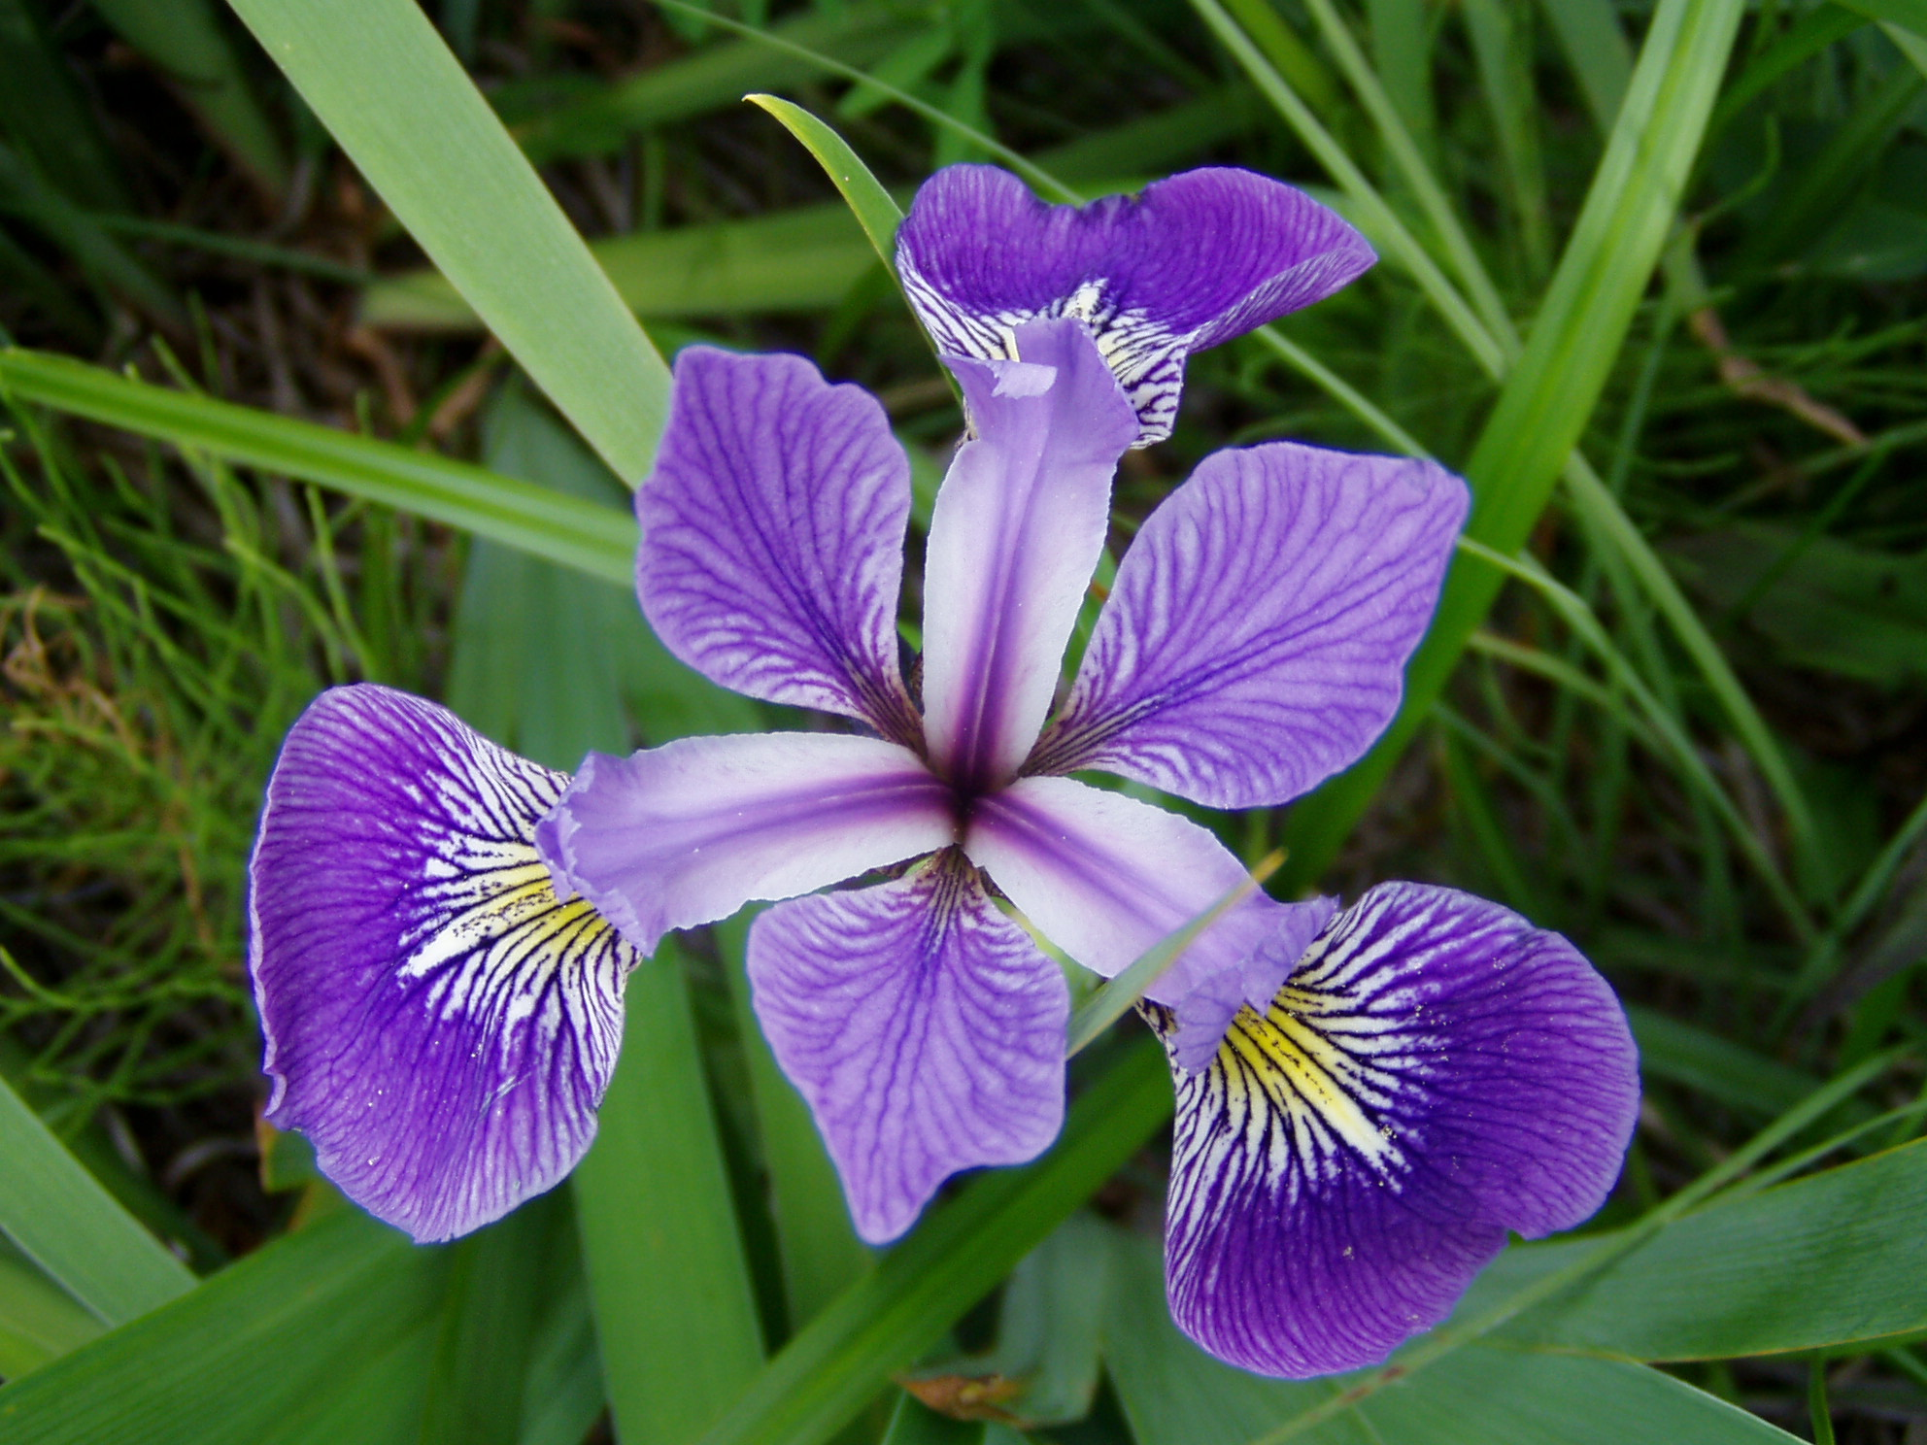
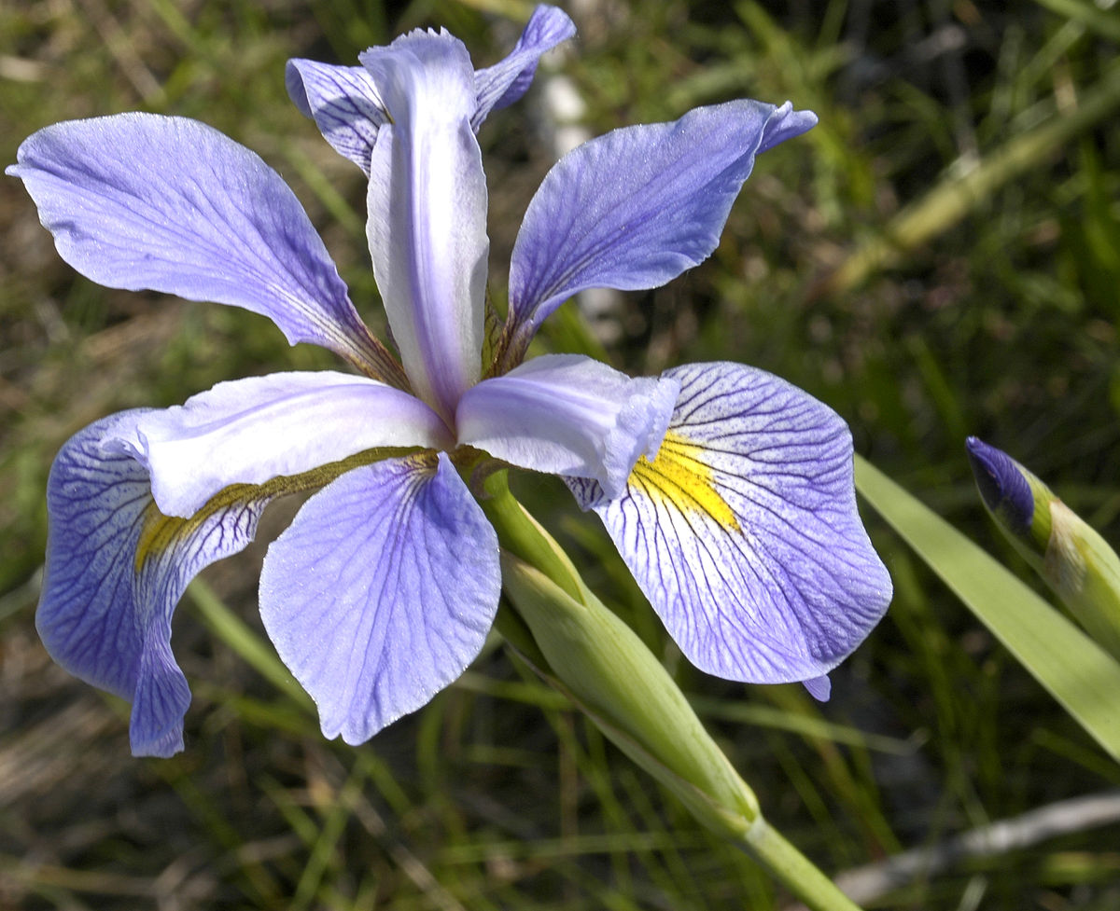
Singular Value Decomposition
Fischer Iris Dataset
Imagine you are in a valley of Iris flowers.
You observe that there are some difference between the flowers shapes
sepal length
sepal width
petal length
petal width
How do you classify them?
DataSource: https://archive.ics.uci.edu/ml/machine-learning-databases/iris/

Slide 4





Singular Value Decomposition
Fischer Iris Dataset
$$X$$
$$y$$
$$50$$
$$150$$
$$50$$
$$50$$
DataSource: https://archive.ics.uci.edu/ml/machine-learning-databases/iris/
This Photo by Unknown Author is licensed under CC BY-SA

Slide 5
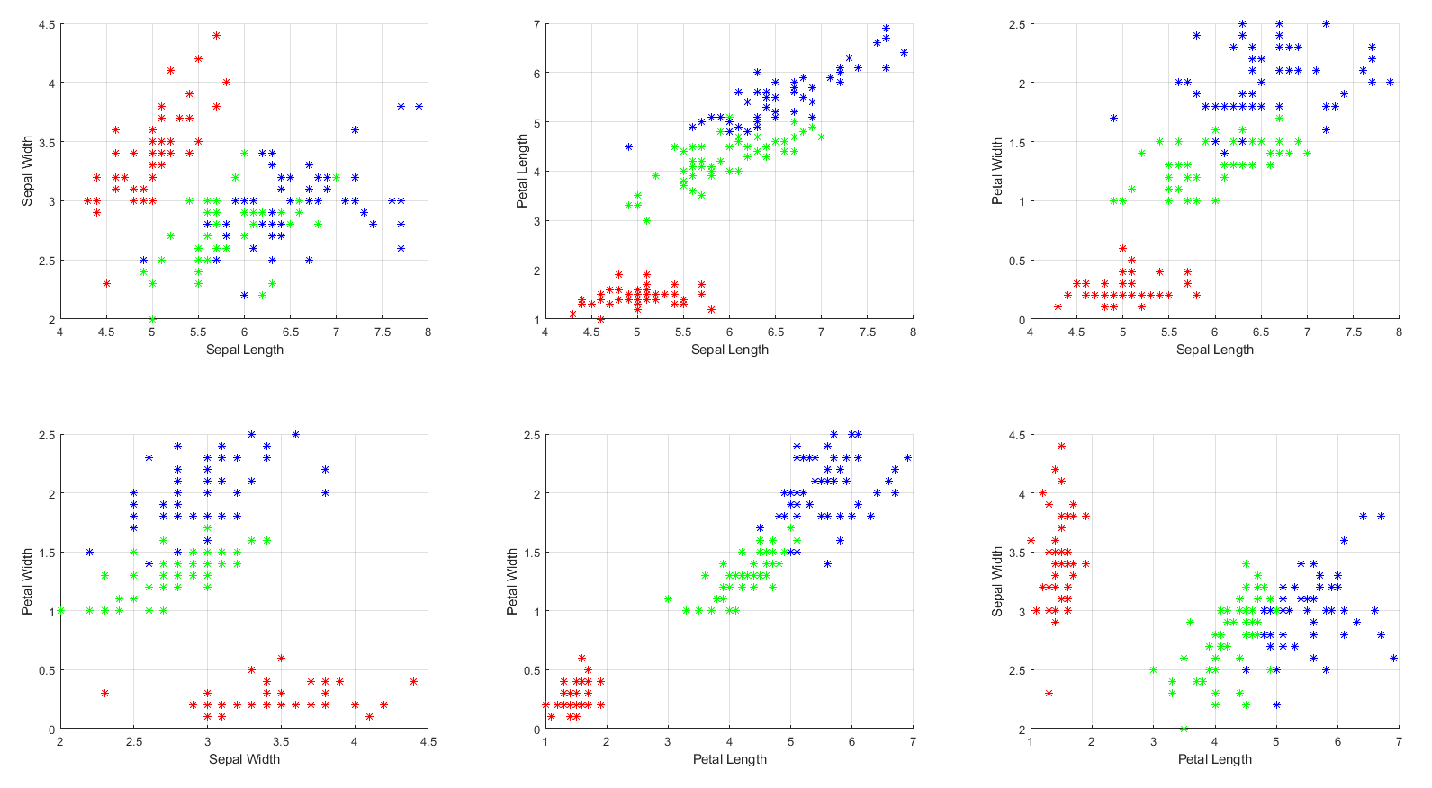
Singular Value Decomposition
PCA
Data is of 4 dimensions: Sepal Length, Sepal Width, Petal Length, Petal Width . Aim is to reduce to 2 dimensions, using PCA
*https://en.wikipedia.org/wiki/File:Iris_versicolor_3.jpg **https://en.wikipedia.org/wiki/File:Kosaciec_szczecinkowaty_Iris_setosa.jpg ***https://en.wikipedia.org/wiki/File:Iris_virginica.jpg
This Photo by Unknown Author is licensed under CC BY-SA

Slide 6
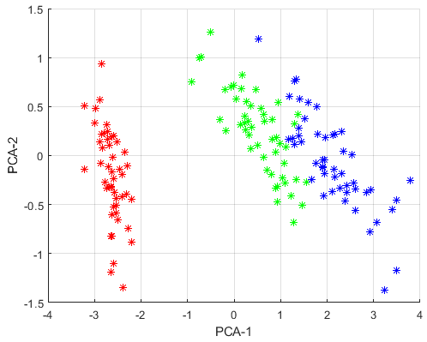

Singular Value Decomposition
Principal Component Analysis (PCA)
Algorithm:
Create $X$ formed by using the m-measurements of n-variables
Subtract mean for each measurement type.
Find the SVD of $X$
To find the reduced dimensional representation of the given data we dominant left singular vectors
Since $\hat{U}$ is orthonormal set of range of $X$, using the first 2 singular vectors we can get the 2d reduced data.
The reduced dimensional representation enables one to use clustering algorithms efficiently to group the data.
DataSource: https://archive.ics.uci.edu/ml/machine-learning-databases/iris/
This Photo by Unknown Author is licensed under CC BY-SA

