Slide 1

S7 PROJECT FINAL REVIEW
Adaptive Multi-Agent AI Tutoring System for Personalized Programming Education
CodePath: a tutor that helps beginners think, not copy
Guided by
Ms. Anju Sukumar
Kataru Reddy Eswar AM.SC.U4CSE23126
Bharath Bommineni AM.SC.U4CSE23112
Chimmili Lokesh AM.SC.U4CSE23114
Ramisetti Gowtham Tej AM.SC.U4CSE23144
Notes:
Opening (presenter 1). Good morning. We are presenting our final-year project, an adaptive multi-agent AI tutor for beginner programmers, called CodePath. Our guide is Ms. Anju Sukumar. In one line: when a beginner is stuck, our tutor gives only the help they need at that moment, like a teacher sitting beside them, and never the full answer.

Slide 2
Outline
01
Introduction
09
Results and Analysis
02
Problem Definition
10
Discussion and Limitations
03
Objectives
11
Conclusion
04
Literature Review
12
Future Work
05
Research Gap
13
Project Time Line
06
Datasets, Platforms, and Implementation Tools
14
Team Contribution
07
Proposed Methodology
15
Reference
08
Evaluation Setup and Criteria
16
Appendix A: Code and Demo
Adaptive Multi-Agent AI Tutoring System for Personalized Programming Education
Notes:
This is the flow of our talk. We start with why the problem matters, then the literature and the gap, then our six-agent method, how we evaluated it, the results, and what comes next. The demo details are in the appendix.

Slide 3
Introduction: Background and Motivation
Today: AI tools give the answer
A good teacher does more
Write a full solution in seconds
Same help for every learner, with no memory of how they are doing
Beginners copy instead of thinking: a 2024 study of a ChatGPT tutor reported over-reliance
Notices where the student is stuck
Gives only the next step, not the answer
Asks the student to explain their thinking
Chooses what to practise next
vs
Our aim: an AI tutor that behaves like a teacher sitting beside the student
SDG
4
UN SDG 4: Quality Education. Target 4.4: more youth and adults with relevant skills for employment. Programming is one of those skills; our tutor helps beginners build it themselves.
Adaptive Multi-Agent AI Tutoring System for Personalized Programming Education
Notes:
AI assistants like ChatGPT can write a beginner's whole program in seconds. That is convenient, but it gives everyone the same help and the learner does not build their own reasoning. A 2024 classroom study of a ChatGPT-based tutor, PyTutor, found exactly this risk of over-reliance. A good human teacher behaves differently: they notice where you are stuck, give just the next step, ask you to explain, and choose your next exercise. Our aim is a tutor that does what that teacher does. This links to UN Sustainable Development Goal 4, Quality Education, target 4.4: building skills for employment.

Slide 4
Problem Definition
Problem statement: after every learner action, decide what went wrong, how much the learner knows, and whether and how much to help, without ever giving the full solution.
Input
Output
Learner action: Run, Submit, Ask for a hint, or a question
The exact version of the code
Learner history: attempts, hints, answers
CodePath
6 cooperating AI agents
Diagnosis with evidence
Estimate of the learner's state
Help decision: wait, offer or show, and how much
One checked hint, never a solution
Reflection question, and the next problem
Learners: help that keeps them thinking
Teachers: see who needs support
Institution: untrusted code runs safely
Adaptive Multi-Agent AI Tutoring System for Personalized Programming Education
Notes:
Our problem in one sentence: after every action the learner takes, the tutor must decide what went wrong, how much the learner already knows, and whether and how much to help, and it must never hand over the full solution. The input is the learner's action, the exact code, and their history. The output is a diagnosis, a learner-state estimate, a help decision, at most one checked hint, a reflection question and the next problem. Three groups benefit: learners, teachers, and the institution, which needs untrusted student code to run safely.

Slide 5
Objectives
O1
O2
O3
O4
O5
Multi-agent tutor
Learner state
Similar learners
Scaffolding algorithm
Evaluation
Six collaborating agents in one learning cycle, not a single chatbot
Estimate knowledge, confidence, confusion, overload and progress
Find what helped in similar situations, using cosine similarity
DSDA chooses how much help from state, hint history and time
Verify on programming problems and real tutoring scenarios
Guiding rule Help like a teacher: never the full solution, and more help only when the learner asks for it
Adaptive Multi-Agent AI Tutoring System for Personalized Programming Education
Notes:
We set five objectives in our proposal. O1, build the tutor as six collaborating agents instead of one chatbot. O2, keep a live estimate of each learner's knowledge, confidence, confusion, overload and progress. O3, find what helped similar learners using cosine similarity. O4, design the scoring algorithm, DSDA, that decides how much help to give. O5, evaluate it. Above all of these sits one rule: help like a teacher, never the full solution, and more help only when the learner asks.

Slide 6
Literature Review
Paper (Year) | Key contribution | Demerit / gap | Dataset | Evaluation metrics
Corbett & Anderson (1995) Knowledge tracing | Probability each skill is learned; drives mastery learning | Hand-built rule model for every domain | ACT Programming Tutor students | Prediction of test performance
Piech et al. (2015) Deep Knowledge Tracing | LSTM predicts the next answer | Only predicts; does not choose help; hard to interpret | ASSISTments, Khan Academy, simulated | AUC, 5-fold cross-validation
Liffiton et al. (2023) CodeHelp | LLM help with guardrails: no solutions | No per-learner model of how much to help | 52 students, 12 weeks | Usage patterns, perceptions
Kazemitabaar et al. (2024) CodeAid | LLM assistant that avoids code solutions | No learner model or similar-learner retrieval | 700 students, about 8,000 uses | Logs, surveys, interviews
Yang et al. (2024) PyTutor | ChatGPT tutor with structured hints for beginners | Over-reliance risk; hints include coding solutions | 35 vs 36 students, 11 weeks | Engagement, completion, success
Ma et al. (2024) RAGMan | Course-specific RAG tutors for an intro course | Retrieves course content only; self-reported | 455 students, intro course | Usage, accuracy, perceptions
Schmucker et al. (2024) Ruffle&Riley | Two LLM agents (student and professor) teach a lesson | No significant learning gain vs reading; not code | 200 participants, biology | Engagement, learning gain
Wang et al. (2025) TRAVER | Knowledge tracing + turn-by-turn verifier for coding tutors | Simulated students; no decision on how much help | Simulated coding tasks (DICT) | Task success rate
Adaptive Multi-Agent AI Tutoring System for Personalized Programming Education
Notes:
Our report reviews thirteen works; this table shows the eight closest to our project, the same systems we compare in the research gap. Knowledge tracing and Deep Knowledge Tracing model what a learner knows, but they only predict; they do not decide how to help. CodeHelp and CodeAid stop the AI from giving solutions, but they have no learner model that decides how much help each student needs. PyTutor helped weak students, but its authors saw over-reliance, and its hints include coding solutions. RAGMan retrieves course material, not what helped similar learners. Ruffle&Riley uses two LLM agents, but learning was not better than reading, which reminds us that engagement is not learning. TRAVER combines knowledge tracing with a verifier, but was tested only with simulated students.

Slide 7
Research Gap
System | Learner model | Decides how much help | Withholds solutions | Learns from similar learners | Multiple agents | Programming practice
Knowledge tracing | ✓ | ✓ | – | – | – | ✓
CodeHelp | – | – | ✓ | – | – | ✓
CodeAid | – | – | ✓ | – | – | ✓
PyTutor | – | – | ✗ | – | – | ✓
RAGMan | – | – | – | Course content | – | ✓
Ruffle&Riley | – | – | – | – | ✓ | ✗
TRAVER | ✓ | – | – | – | – | Simulated
CodePath (ours) | ✓ | ✓ | ✓ | ✓ | ✓ | ✓
✓ reported ✗ not provided – not reported in the paper
Gap: no reviewed system combines a learner-state model, a decision on how much help to give, learning from similar learners, and reflection with planning, for live programming practice.
Adaptive Multi-Agent AI Tutoring System for Personalized Programming Education
Notes:
This matrix is the gap in one picture. Each row is a related system, each column a capability. Tick means the paper reports it, cross means it does not provide it, dash means the paper does not mention it. Guardrail tools like CodeHelp and CodeAid withhold solutions but have no learner model; knowledge tracing and TRAVER model the learner but do not decide how much help to give in a live programming session. No reviewed system combines all of these; CodePath is designed to fill exactly that gap.

Slide 8
Datasets, Platforms, and Implementation Tools
No model is trained, so no training dataset is needed. The agents work from our problem set and each learner's activity.
Dataset
Platforms and Tools
Python problem set
Part | What we used
Platform | Web app for learners and teachers
Frontend | React, TypeScript, code editor
Backend | Python, FastAPI
AI agents | LangGraph (six rule-based agents)
Database | PostgreSQL
Similar-learner search | ChromaDB
Running student code | Docker sandbox
Testing | pytest, Vitest, Playwright
Hardware | Laptop (Apple M2, 8 GB), no GPU
1
496 practice problems in 17 topics
Easy, medium and hard problems
Test cases check every answer: a few are shown, the rest are hidden
A short lesson for every technique
2
Learner activity
Recorded as each student uses the tutor
Code attempts, test results, hints and answers
Adaptive Multi-Agent AI Tutoring System for Personalized Programming Education
Notes:
An important point for the panel: we do not train any model, so we need no training dataset. Our agents follow explicit rules. The data they work from is, first, our Python problem set: 496 practice problems in 17 topics, easy, medium and hard, each checked by test cases. A few test cases are shown to the learner; the rest stay hidden for grading. Second, the learner's own activity, recorded as they use the tutor: their code attempts, test results, hints and answers. On the right are the tools: a web app built with React and TypeScript, a Python FastAPI backend, LangGraph to run the six agents, PostgreSQL as the database, ChromaDB to find similar learners, and a Docker sandbox so student code runs safely. Everything ran on one laptop with no GPU. If asked: there are 15,717 test cases in all, 1,000 visible and 14,717 hidden. An importer for the IBM CodeNet dataset is built and tested, but the full archive was not imported in this phase.

Slide 9
Proposed Methodology: System Architecture
Learner or teacher
FastAPI backend
logins and requests
PostgreSQL
learner history and progress
Web application
React, TypeScript
Code editor
Tutor pane
Lessons, practice
Progress, profile
Teacher dashboard
Tutoring service
one learner action at a time
LangGraph learning cycle
six AI agents (next slide)
ChromaDB
finds similar past situations
student code
Code runner
runs student code safely in a Docker sandbox
Student code never runs inside the server
Language model (optional)
only rewords hints; off by default
Adaptive Multi-Agent AI Tutoring System for Personalized Programming Education
Notes:
This is the architecture. The learner or teacher uses our web application, built with React. It talks to our FastAPI backend, which handles logins and requests. Each learner's actions are handled one at a time, in order, and every submission or hint request starts the LangGraph learning cycle with our six agents. The agents keep the learner's history and progress in PostgreSQL, and ChromaDB finds similar past situations. Student code never runs inside the server: it goes to a separate code runner that starts a locked-down Docker sandbox for every run. A language model is optional and can only reword hints; it is off by default, so the tutor works fully without any paid AI model.

Slide 10
Proposed Methodology: The Six-Agent Learning Cycle
Learner: Submit or Hint
waits for the learner's next action, then the cycle runs again
Tutor responds, then waits
1
2
3
4
5
6
Diagnostic
Learner State
Similar-Learner Retrieval
Adaptive Scaffolding (DSDA)
Reflection
Learning Planner
What went wrong, with evidence
How much the learner knows now
What helped similar learners
Whether and how much to help
Asks the learner to explain
What to practise next
Novelty: what is new in our approach
Dynamic Scaffolding Decision Algorithm
Hybrid experience retrieval
Adaptive difficulty progression
Cyclic graph orchestration
Decides how much help to give, one step at a time; never the full solution
Uses what helped learners in similar situations; stays quiet when evidence is weak
Technique by technique, easy to medium to hard, then the next topic
The agents run as a cycle that waits for the learner; every hint is checked first
Adaptive Multi-Agent AI Tutoring System for Personalized Programming Education
Notes:
This is the heart of the project. Every time the learner submits code or asks for a hint, six agents run in order. Pressing Run only executes the code on the visible examples; it does not start the agents. One, the Diagnostic agent finds what went wrong, with evidence. Two, the Learner State agent updates how much the learner knows. Three, Retrieval looks at what helped similar learners. Four, DSDA decides whether to help and how much, then writes and checks the hint. Five, Reflection asks the learner to explain. Six, the Planner picks what to practise next. Then the cycle pauses until the learner acts again; nothing runs on its own. Our four novel contributions are at the bottom: the DSDA algorithm, which decides how much help to give; hybrid experience retrieval, which uses what helped similar learners and stays quiet when the evidence is weak; adaptive difficulty progression; and the cyclic agent workflow, which waits for the learner and checks every hint before it is shown.

Slide 11
Proposed Approach: How Each Agent Works
Agent | Input | How it decides (rules) | Output
1 Diagnostic | Test results and the code | Reads the code's structure and the error message; matches known beginner mistakes | What went wrong and where, e.g. the loop stops one value early on line 3
2 Learner State | This attempt and past attempts | Knowledge tracing: each attempt updates how well the topic is known; also looks for signs of confusion | How well the topic is known, confused or not, or “unknown”
3 Retrieval | The learner's current situation | Compares it with past situations; answers only when there are enough close matches | The kind of help that worked before, or “no reliable match”
4 DSDA | All of the above + hints already given | Need for help → help level → a new kind of hint → timing; then checks the hint | Wait, offer or show one hint (L0 to L4); never a solution
5 Reflection | The issue + the learner's answer | Builds a question from the learner's own code; reads the answer for key ideas | A question, and a kind reply to the answer
6 Planner | What the learner knows, techniques, difficulty | Each technique easy, then medium, then hard; then the next topic | The next problem with its reason, and the route ahead
Adaptive Multi-Agent AI Tutoring System for Personalized Programming Education
Notes:
Here is how each agent works: input, rule, output. The Diagnostic agent reads the test results, the code's structure and the error message, and matches them to known beginner mistakes; for example, it finds that the loop stops one value early on line 3. The Learner State agent uses knowledge tracing, a standard method from our literature review: every attempt updates how well the learner knows the topic. It also looks for signs of confusion, and says unknown when there is no evidence. Retrieval compares the situation with past ones and answers only when there are enough close matches. DSDA decides how much help is needed, picks a help level and a new kind of hint, decides the timing, and checks the hint before it is shown. Reflection builds its question from the learner's own code and replies to their answer. The Planner moves technique by technique, from easy to hard, then to the next topic.

Slide 12
Proposed Approach: Dynamic Scaffolding Decision Algorithm
Support score
The help ladder
1
Combines what we know: how well the topic is known, confusion, repeated mistakes, hints that did not help, time. Unknown values are left out, not guessed.
L4
Help level
2
L3
Higher score, more help: L0 to L4. A new mistake starts at L2 or lower, and help rises one level at a time.
L2
L1
Strategy
L0
3
The next unused kind of hint for this mistake, so a hint never repeats
Try yourself (offer only)
Guiding question
Targeted hint
Step-by-step outline
Example on a different task
Timing
Worked example: second wrong submission with the same bug → medium score → L2 targeted hint → offered, not pushed, because a hint was already shown
4
Asked: show the hint. Not asked: a first nudge on a new mistake can come by itself; after that, help is only offered.
Adaptive Multi-Agent AI Tutoring System for Personalized Programming Education
Notes:
DSDA is our main algorithm. Step 1: a support score that combines everything we know about the learner: how well they know the topic, how confused they are, repeated mistakes, hints that did not help, and time. Anything unknown is left out instead of guessed. Step 2: the score maps to a help level from L0 to L4. A higher score means more help, but a new mistake starts at L2 or lower, and help rises only one level at a time. Step 3: the next unused kind of hint for that mistake, so hints never repeat. Step 4: timing. If the learner asked, we show the hint. If not, the first nudge on a new mistake can come by itself, but after that more help is only offered. Worked example from our tests: on the second wrong submission with the same bug, the score is in the middle band, so level 2, a targeted hint, and it is offered, not pushed. If asked for the exact figures: the score was 0.472, and the bands are below 0.2, 0.4, 0.6 and 0.8 for levels 0 to 3.

Slide 13
Proposed Approach: Rules Instead of Training
We do not train a model. Each agent follows clear rules that we designed, so every decision can be explained.
 | A trained AI model | Our rule-based agents
Needs a large training dataset | Yes | No
Needs training time and a GPU | Yes | No
Explains why it chose a hint | Often hard | Yes: a reason is shown with each hint
Changing how it behaves | Retrain the model | Edit one settings file
Learns from data by itself | Yes | Not yet: planned future work
Because nothing is trained, the tutor works from the very first learner
Adaptive Multi-Agent AI Tutoring System for Personalized Programming Education
Notes:
A key point for the panel: we do not train a model. Each agent follows clear rules that we designed. Compared with a trained model, we need no large dataset, no training time and no GPU, and every hint comes with a reason the learner can see. To change the tutor's behaviour we edit one settings file instead of retraining. The trade-off is that the rules do not yet learn from data by themselves; fitting them to real learner data is in our future work. Because nothing is trained, the tutor works from the very first learner. If asked: all rule values are in one versioned settings file, policy.yaml, and they are starting values chosen by design, not tuned on data.

Slide 14
Evaluation Setup and Criteria
How we tested
Criterion | What we check | Pass when
Correct software | All automated tests | Every test passes
No repeated hints | Asking again on the same code | A new hint each time
Help grows slowly | Help level after each hint | One level at a time
Not pushed | More help when not asked | Only offered
Specific hints | Each hint and the learner's code | Names their code
No full solution | Every hint level, and asking for it | Never shown
Valid problems | Model answer and starter code | Answer passes, starter fails
Accessible | Automatic accessibility scan | No violations
Learning gain | Test before and after, real learners | Planned next phase
1
Automated tests
Backend, browser, unit and sandbox tests
2
Agent audit
9 realistic tutoring scenarios run through all six agents
3
Problem check
Every problem run against its own tests
4
Real system
Real database and sandbox; no paid AI model
Compared with
Our earlier version, and the reviewed systems
Adaptive Multi-Agent AI Tutoring System for Personalized Programming Education
Notes:
How we evaluated. On the left: we ran four automated test suites, backend, browser, unit and sandbox; an agent audit that drives nine realistic tutoring scenarios through all six agents; and a check that runs every practice problem against its own tests. Everything ran on the real system, with the real database and sandbox and no paid AI model, so every hint used the built-in wording. We compare against our own earlier version and the reviewed systems. On the right are our criteria in plain words: every test passes; asking again gives a new hint; help grows one level at a time; more help is only offered when the learner has not asked; every hint names the learner's own code; the full solution is never shown; every problem's model answer passes and its starter code fails; and the automatic accessibility scan finds no violations. Learning gain needs a test before and after with real learners, so it is planned for the next phase.

Slide 15
Results and Analysis: Key Results
✓
All tests passed
✓
Every problem verified
✓
Hints never repeat
Every backend, browser, unit and sandbox test passed on the final system.
Each problem's model answer passes its tests, and the starter code fails them.
Asking again on the same code gave a different hint every time.
✓
Help grows step by step
✓
Hints fit the learner
✓
Solution stays hidden
Help rose one level at a time. After the first hint, more help was offered, not pushed.
Every hint named something from the learner's own code. None was generic advice.
No hint level gives the full solution, even when the learner asks for it.
Not measured yet: whether students learn more with CodePath. This needs a study with real learners, our next phase.
Adaptive Multi-Agent AI Tutoring System for Personalized Programming Education
Notes:
Our results in plain words. All automated tests passed on the final system. Every practice problem was verified: its model answer passes and its starter code fails. In the agent audit, asking again on the same code gave a different hint every time; help rose one level at a time, and after the first hint more help was only offered; every hint named something from the learner's own code; and no hint level ever gives the full solution, even when the learner asks for it. What we have not measured yet is learning gain: that needs a study with real students, which is our next phase. If asked for the figures: 551 backend, 59 browser, 21 unit and 39 sandbox tests passed; all 37 audit checks passed; all 496 problems were verified; four hint requests on unchanged code gave four different hints; and all 17 hints in the audit named the learner's code.

Slide 16
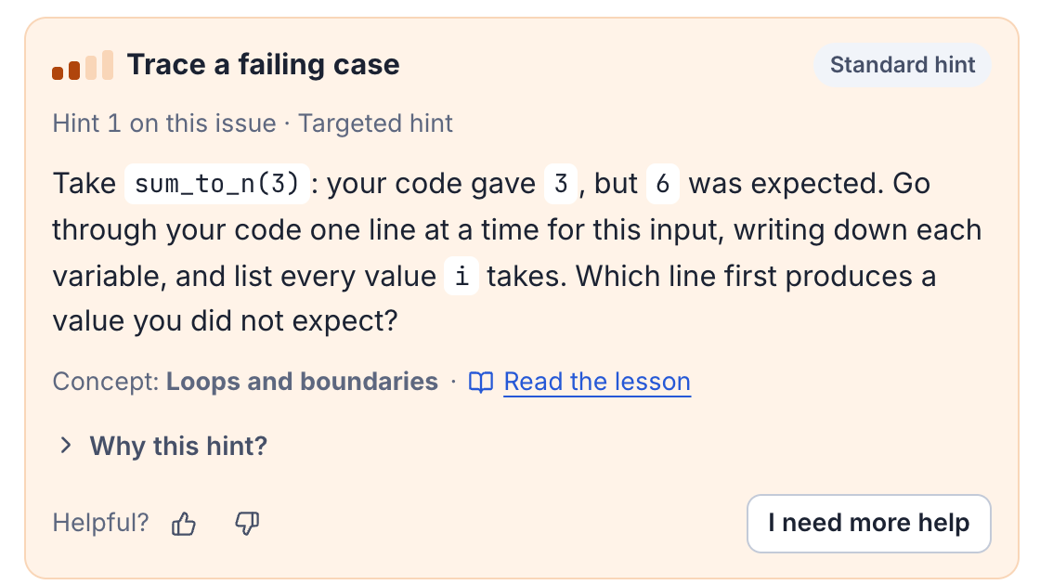
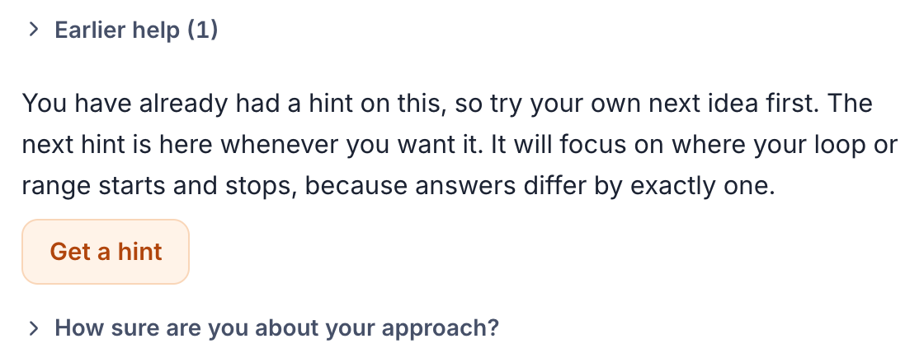
Results and Analysis: Visual Outputs (1/2)
Problem: Sum from 1 to N. The learner's loop uses range(1, n), so it misses the last value.
1
2
Second wrong submission: the next hint is offered, not shown. The learner tries their own idea first; one click shows it.
First wrong submission: one targeted hint, built from the learner's own call, values and loop variable. It names the concept and links to the lesson.
Adaptive Multi-Agent AI Tutoring System for Personalized Programming Education
Notes:
Here is the tutor in action on the problem Sum from 1 to N; the student's loop misses the last value. Screen one: after the first wrong submission the tutor gives one targeted hint. Notice it quotes the student's own call, sum_to_n(3), the values 3 and 6, and the loop variable i. It does not give the fix. Screen two: the student submits again without asking for help. Instead of pushing a bigger hint, the tutor only offers it, so the student tries their own idea first. That is the teacher-like behaviour we wanted.

Slide 17
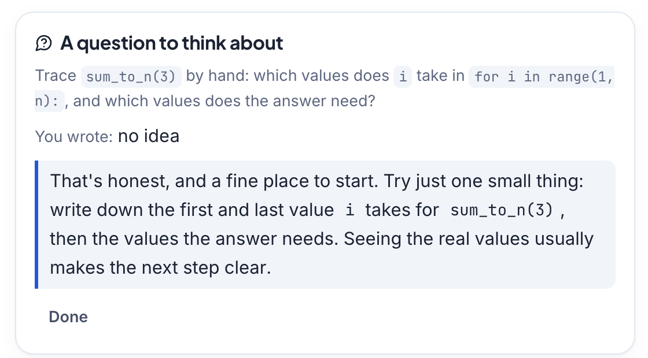
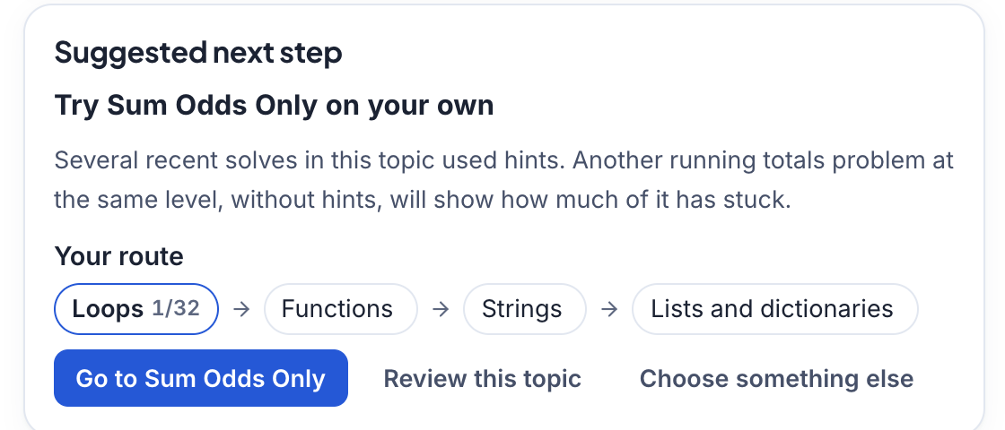
Results and Analysis: Visual Outputs (2/2)
3
4
After solving: a hint was used, so the planner suggests one more problem of the same technique, on their own, and shows the route ahead.
Reflection: a question about the learner's own loop. The learner wrote “no idea”; the tutor replied kindly with one small thing to try.
Adaptive Multi-Agent AI Tutoring System for Personalized Programming Education
Notes:
Screen three: after three failed attempts the Reflection agent asks the student to trace their own loop by hand. The student answered no idea; the tutor did not judge, it replied with one small concrete step. Screen four: after solving with a hint, the Planner suggests one more problem of the same technique without hints, and shows the route ahead: Loops, then Functions, Strings, and Lists and dictionaries.

Slide 18
Results and Analysis: Comparison
Behaviour | Before (our earlier version) | After (final system)
Repeated hint requests | The same hint again | A different hint every time
Wrong answers without asking | Help climbed automatically | Help offered; shown only when asked
Reflection | Fixed questions; answers ignored | About the learner's code; replies; changes the plan
Planning | By difficulty only | Technique by technique, with a route
Specific hints | Half were generic advice | Every hint names the learner's code
Compared with the state of the art
Among the reviewed works, only CodePath combines:
✓ Learner-state model
✓ Decision on how much help
✓ Solutions withheld, hints checked
✓ Learning from similar learners
✓ Reflection and planning
✓ Live programming practice
Adaptive Multi-Agent AI Tutoring System for Personalized Programming Education
Notes:
We compare in two ways. Left, against our own earlier version: before the agent fixes, asking again gave the same hint; now each request gives a different one. Help no longer climbs automatically; reflection answers now get a reply and change the plan; planning follows techniques; and every hint now names the learner's own code, where before half were generic. If asked: before, five hint requests gave one distinct hint and 8 of 16 hints named the learner's code; after, four requests gave four different hints and all 17 named it. Right, against the state of the art: among the works we reviewed, CodePath is the only system that combines all six capabilities.

Slide 19
Discussion and Limitations
Discussion
Limitations
CodePath coordinates multiple agents to provide guidance without directly giving complete solutions.
Diagnosis uses learner code, execution results, tests and previous attempts as evidence.
Learner-state tracking and retrieval help adapt the hint level to current understanding.
Scaffolding and reflection encourage retries, reasoning and independent problem-solving.
The workflow links diagnosis, hints and next-step planning in a continuous feedback loop.
Learning gains have not yet been established through controlled studies with real learners.
Learner-state estimates can be uncertain when attempt history or evidence is limited.
Hint correctness, clarity, usefulness and solution-leakage prevention need broader expert evaluation.
Retrieval quality depends on knowledge-base coverage, relevance and freshness.
Sandbox runs and multi-agent orchestration can increase latency and compute cost.
Current validation is mainly technical testing; learning outcomes and long-term retention remain unevaluated.
Adaptive Multi-Agent AI Tutoring System for Personalized Programming Education
Notes:
Discussion. CodePath coordinates several agents to guide the learner without handing over complete solutions. The diagnosis is based on evidence: the learner's code, the run results, the tests and previous attempts. Tracking the learner's state, together with retrieval, lets the tutor adapt the hint level to what the learner understands now. Scaffolding and reflection encourage the learner to retry, reason and solve problems independently, and the workflow links diagnosis, hints and next-step planning in one continuous feedback loop. Limitations, stated honestly. We have not yet shown learning gains in a controlled study with real learners. Learner-state estimates are uncertain when there is little history. Hint quality and leak prevention need broader expert evaluation. Retrieval is only as good as its knowledge base. Running code in a sandbox and coordinating several agents adds time and compute cost. And our validation so far is mainly technical testing; learning outcomes and long-term retention are not yet evaluated.

Slide 20
Conclusion
We built CodePath, a tutor for beginner Python programmers on the CSMASF framework
Six rule-based agents decide when and how much to help, and never give the full answer
Verified by automated tests, an agent audit of realistic tutoring scenarios, and a check of every practice problem
Objective | Status | Evidence
O1 Multi-agent tutor | Achieved | Six agents in order; pipeline tests
O2 Learner state | Achieved | Estimates with evidence; audit
O3 Similar learners | Achieved* | *mechanism works; needs real data
O4 DSDA algorithm | Achieved | Worked example reproduced; tests
O5 Evaluation | Partly | Software verified; learner study next
CodePath gives a beginner only the help they need: one step at a time, never the answer
Adaptive Multi-Agent AI Tutoring System for Personalized Programming Education
Notes:
To conclude: we built CodePath on the CSMASF framework. Six rule-based agents decide when and how much to help, and never give the answer. It is verified by automated tests across four suites, an agent audit of realistic tutoring scenarios, and a check of every practice problem; if asked, that is 670 tests, 37 audit checks and 496 problems. Objective-wise: O1, O2 and O4 are achieved; O3 is achieved as a mechanism but needs real learner data to be useful; O5 is partly achieved, because the software is verified but the learning study is the next phase.

Slide 21
Future Work
1
Learner study
2
Real LLM evaluation
3
Learn the rule values
Pilot with 30+ students: pre and post test, learning gain, effect size
Measure leak rate, rejected hints and response time with a real model
Fit knowledge tracing and DSDA weights to real data; compare Deep Knowledge Tracing
4
CodeNet offline study
5
Deployment
6
More languages
Import attempt sequences and replay them through the agents
Linux server, independent security review, scale to many users
JavaScript next, then Java or C++
Adaptive Multi-Agent AI Tutoring System for Personalized Programming Education
Notes:
Next steps. First and most important, a study with at least 30 students, with a pre-test and post-test to measure learning gain. Second, evaluate with a real LLM for leak rate and response time. Third, learn the rule values from real data and compare with Deep Knowledge Tracing. Fourth, an offline study on CodeNet. Fifth, deployment hardening on a Linux server with a security review. Sixth, more programming languages.

Slide 22
Project Time Line
Phase I
25–26 Oct 2026
9 Nov 2026
Nov 2026
Idea, objectives and literature survey
Agents, DSDA v2.1, sandbox, curriculum
Full CSMASF implementation
Final review
1
2
3
4
5
6
7
17 Sep 2026
4 Nov 2026
10 Nov 2026
Repository and interface started
LangGraph anti-leak verifier, assessments
Agent audit, final tests, report
Dates from the project's commit history
Adaptive Multi-Agent AI Tutoring System for Personalized Programming Education
Notes:
Our timeline, taken from our commit history. Phase one was the proposal with the problem, objectives and a nine-paper survey. Development began on 17 September. On 25 and 26 October we built the agent baseline, DSDA version 2.1, the sandbox hardening and the curriculum. On 4 November we added the LangGraph anti-leak verifier and assessments. On 9 November the full CSMASF implementation, and on 10 November the agent audit, final testing and the report.

Slide 23
Team Contribution
Bommineni Bharath
Chimmili Lokesh
Kataru Reddy Eswar
Ramisetti Gowtham Tej
AM.SC.U4CSE23112
AM.SC.U4CSE23114
AM.SC.U4CSE23126
AM.SC.U4CSE23144
• System architecture and agent workflow design
• FastAPI API integration and backend coordination
• End-to-end integration, debugging and final review
• Adaptive hint/scaffolding and reflection workflow
• Sandbox execution and safety checks
• Test automation, documentation and demo preparation
• Retrieval pipeline and learner-context handling
• Database / knowledge-store integration
• Backend tests, validation and reliability checks
• Frontend development: React, TypeScript and code editor
• UI–backend interaction and learner workflow screens
• Browser testing and interface refinements
Adaptive Multi-Agent AI Tutoring System for Personalized Programming Education
Notes:
Each of us introduces our own part. Bharath: system architecture and agent workflow design, FastAPI integration and backend coordination, and end-to-end integration, debugging and final review. Lokesh: the adaptive hint, scaffolding and reflection workflow, sandbox execution and safety checks, and test automation, documentation and demo preparation. Eswar: the retrieval pipeline and learner-context handling, database and knowledge-store integration, and backend tests, validation and reliability checks. Gowtham Tej: frontend development in React and TypeScript with the code editor, the screens that connect the learner to the backend, and browser testing and interface refinements.

Slide 24
Reference
[1] A. T. Corbett and J. R. Anderson, “Knowledge tracing,” User Model. User-Adapt. Interact., vol. 4, no. 4, 1995.
[2] C. Piech et al., “Deep knowledge tracing,” NIPS 28, 2015.
[3] V. Rus, N. B. Niraula, R. Banjade, “DeepTutor,” Proc. AAAI, vol. 29, 2015.
[4] V. Aleven et al., “Help helps, but only so much,” Int. J. Artif. Intell. Educ., vol. 26, 2016.
[5] R. Puri et al., “Project CodeNet,” arXiv:2105.12655, 2021.
[6] M. Liffiton et al., “CodeHelp,” arXiv:2308.06921, 2023.
[7] M. Kazemitabaar et al., “CodeAid,” Proc. CHI ’24, 2024.
[8] A. C. M. Yang et al., “Enhancing Python learning with PyTutor,” Comput. Educ. Artif. Intell., vol. 7, 2024.
[9] I. Ma, A. Krone Martins, C. V. Lopes, “Integrating AI tutors in a programming course,” arXiv:2407.15718, 2024.
[10] R. Schmucker et al., “Ruffle&Riley,” arXiv:2404.17460, 2024.
[11] Y. Zhan et al., “CoderAgent,” Proc. IJCAI-25, 2025.
[12] J. Wang et al., “Training turn-by-turn verifiers for dialogue tutoring agents,” Findings of ACL 2025.
[13] G. Pitts, A. P. Hridi, A. B. Lekshmi Narayanan, “A survey of LLM-based applications in programming education,” HCI+NLP 2025.
Adaptive Multi-Agent AI Tutoring System for Personalized Programming Education
Notes:
These are the thirteen works we reviewed. Full citations with DOIs are in our project report.

Slide 25
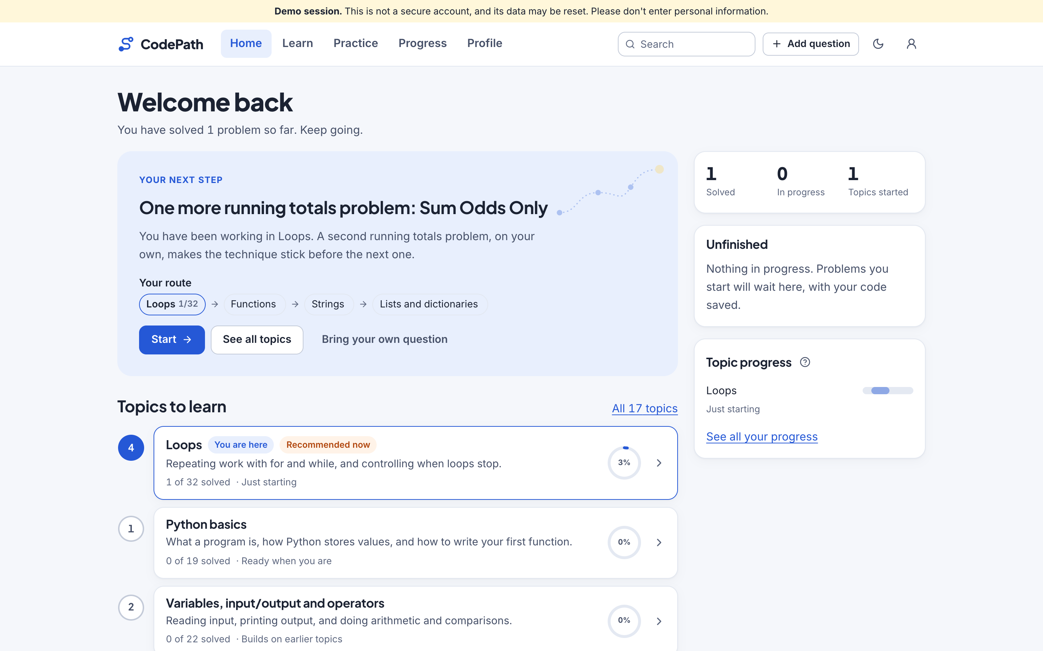
Appendix A: Code and Demo
Repository
github.com/lokesh12125/AdaptiveAITutor
Branch: Trellis Commit: [after final commit]
Run the demo
./scripts/setup.sh
./scripts/dev.sh
Open 127.0.0.1:5173
“Try as a learner” or “Try as a teacher”
Demo flow
Wrong code → one hint → submit again → help offered
Reflection reply → solve → next step and route
Teacher dashboard
Learner home: next step and route through the course
Adaptive Multi-Agent AI Tutoring System for Personalized Programming Education
Notes:
Our code is on GitHub at the address shown. Two commands start everything, then open the browser and press Try as a learner. For the live demo: submit the off-by-one code, show the single hint, submit again to show the offer, answer the reflection, solve, and show the plan and route, then the teacher dashboard.

Slide 26
Thank You
Questions are welcome
CodePath: a tutor that helps beginners think, not copy
Notes:
Thank you. We are happy to take questions, and we can show the live demo.

