Slide 1

A Project Report on
ONLINE FEEDBACK SYSTEM
In partial fulfillment for the award of “Diploma In Computer Engineering”
Offered By
Department Of Computer Engineering Government Polytechnic Anakapalle, Viskhapatnam.
By
K.SURYA NARAYANA RAJU | (15173-CM-028)
G.MOHAN KRISHNA | (15173-CM-022)
B.SATYAVANI | (15173-CM-007)
M.PRIYA MOUNIKA | (15173-CM-035)
T.NAGA LAKSHMI SUDHA | (15173-CM-414)
A.POTHU RAJU | (15173-CM-002)
B.DIVYA DURGA | (15173-CM-014)
N.K.S.S.PRIYANKA | (15173-CM-040)
S.NIRMALA | (15173-CM-049)
S.NAGA LAKSHMI | (15014-CM-042)
T.DILEEP KUMAR | (15173-CM-053)

Slide 2
DEPARTMENT OF TECHNICAL EDUCATION
GOVT.POLYTECHNIC ANAKAPALLI CERTIFICATE
This is to certify that this is the bonafide project work entitled “ONLINE FEEDBACK SYSTEM” by students of 6th semester DCME during the period of 2015-2018 in the partial fulfillment of the requirement for the award of Diploma in Computer Engineering.
K.SURYA NARAYANA RAJU | (15173-CM-028)
G.MOHAN KRISHNA | (15173-CM-022)
B.SATYAVANI | (15173-CM-007)
M.PRIYA MOUNIKA | (15173-CM-035)
T.NAGA LAKSHMI SUDHA | (15173-CM-414)
A.POTHURAJU | (15173-CM-002)
B.DIVYA DURGA | (15173-CM-014)
N.K.S.S.PRIYANKA | (15173-CM-040)
S.NIRMALA | (15173-CM-049)
S.NAGA LAKSHMI | (15014-CM-042)
T.DILEEP KUMAR | (15173-CM-053)
Project Guide | Head of CME Department
External Examiner
2

Slide 3
ACKNOWLEDGEMENT
The satisfaction that accompanies that the successful completion of any task would be incomplete without the mention of people whose ceaseless cooperation made it possible, whose constant guidance and encouragement crown all efforts with success.
We am grateful to our project guide Ch.Sarojini and A.Sravanthi, for the inspiration and constructive suggestions that helpful us in the preparation of this project.
This project is a result of the hard work & sincere effort put by many hands. We render my sincere thanks to our Lecturers for giving me this opportunity to do our project work in Government Polytechnic, Anakapalli, Visakhapatnam.
We express our sincere thanks to Head of the Computer Engineering Department Sri G. Govinda Naidu Garu, whose supervision, valuable guidance & help enabled me to complete this project.
We also wish to express our sincere thanks to our Principal Sri. B.K. Surya Prakash Garu, who have directly or indirectly lend us a helping hand in completion of our Diploma.
We’re grateful to all our friends for their friendly co-operation throughout our study period in the College.
3

Slide 4
Table of Contents
S.NO | Title | Page No.
1 | Abstract | 5
2 | Introduction | 6
3 | Feasibility Study | 7
4 | Software And Hardware Specifications | 9
5 | Languages Used | 10
6 | System Design | 13
7 | Instruction Manual | 20
8 | Flow Chart | 21
9 | Code | 24
10 | Test Cases | 33
11 | Output Screens | 35
12 | Conclusion | 46
13 | Bibliography | 47
4

Slide 5
Abstract
The purpose of Online Feedback System is to automate the existing manual system by the help of computerized equipments and full-fledged computer software. Fulfilling their requirements, so that valuable data/information can be stored for a longer period with easy accessing and manipulation of the same. The required software and hardware are easily available and easy to work with.
Online Feedback System, as described above, can lead to error free, secure, reliable and fast management system. It can assist the user to concentrate on their other activities rather to concentrate on the record keeping. Thus it will help organization in better utilization of resources. The organization can maintain computerized records without redundant entries. That means that one need not be distracted by information that is not relevant, while being able to reach the information.
The aim is to automate its existing manual system by the help of computerized equipments and full-fledged computer software, fulfilling their requirements, so that their valuable data/information can be stored for a longer period with easy accessing and manipulation of the same. Basically the project describes how to manage for good performance and better services for the clients.
“Online Feedback System” is generally used by two kinds of users Student, Admin. The application should evaluate the answers given by the students based on the feedback (which will be given by a no. 1 - 10) and grade has to be generated to all the staff members. Admin can view overall grades obtained to the lecturers.
“By using this online system we make it better and quick way.”
There are 2 Modules in this Online Feedback System
1) Admin:-
The Admin can add or delete or modify or view the staff members and creates feedback pattern by selecting scheme and semester/year and enable and see the results.
2) Student:-
The Student can give the feedback based on their present year/semester.
5

Slide 6
INTRODUCTION
Purpose:
Aim is to provide fast and quick online feedback about the college lecturers by the student on time by just login from their valid account. By using this technology we can give feedback in online system as fast as compare to the existing paper feedback system. The student can give feedback in online system provided by college staff. The existing system carries more time to do a piece of work for this reason the online system feedback is implemented. In this project security is also maintain that is the result of feedback is only visible to authentic user. This feedback report was checked by the Admin. He can view grades and view the grades obtained to the lecturers.
Scope:
The scope of Online Feedback System is as follows:
• The Faculty Feedback portal provides an easier and quicker way to give rating to the colleges staffs.
• Student can rate their faculty members according to their teaching style, knowledge, discipline and punctuality at any time from any place.
• Through this site data of faculty members and student were managed in quite a simple manner.
Features:
Simple
Easy to use
Reliable and accurate
No wastage of Papers
Simple Interface
Languages Used:
HTML
CSS
PHP
MY SQL
BOOTSTRAP
6

Slide 7
EXISTING SYSTEM
Coming to the existing system the feedback is done by manual process. In the existing system students can give feedback about the lecturers by using paper and pen. After giving feedback by every student Papers are collected by the Administrator and calculate the overall grade for each lecturer. After that those all grade report is viewed by Admin. Hence estimating the performance of lecturers and giving counseling to college staff. So, the existing system is carries more time to do a piece of work for this reason. The online system feedback is implemented. This is the major advantage of the existing system for giving feedback about the Lecturers and viewing report of lecturers.
Here we aimed to design online web application for issuing the feedback about the lecturers by students, this is named as Online Feedback System. Online feedback System to provide feedback in an easy and quick manner to the college lecturers. The Online Student Feedback System is a management information system for education establishments to manage student data. Student Feedback Systems provide capabilities for selecting particular subject for feedback and generate the report automatically, build student details, student-related data needs in a college. Student can give feedback in online system without wasting his time in writing. This system is designed to be simple to use, simple to understand and easy to implement and configure to fit.
DISADVANTAGES OF CURRENT SYSTEM
X The current system is very time consuming.
X It is very difficult to analyze the Feedback manually.
X To take Exam of more candidates a lot of paper is required but no need of Paper in case of Online System.
X Results are not precise as calculation and evaluations are done manually.
X The chances of date modifying are more in current system as compared to proposed system.
X Result processing takes more time as it is done manually.
X A lot of time wastage is done in evaluating every individual paper.
PROPOSED SYSTEM
7

Slide 8
CHARACTERSTIC OF THE PROPOSED SYSTEM
1) Accurate result can be obtained.
2) This system makes Selection process more effective
3) To increase efficiency proposed system is depend on classification method.
4) Proposed system is used to reduce confusion at the time of processing feedback average.
8

Slide 9
SOFTWARE AND HARDWARE SPECIFICATIONS
Software Requirements:-
Operating System | : Window XP or Higher
User interface | : HTML, CSS
Back End | : PHP
Database | : My SQL
Browsers : | Mozilla Firefox , Google Chrome (recommended),or Any
Web Servers | : : Xampp , Wampp, or Any
Documentation Tool | : MS - Office
Hardware Requirements:-
Processor | : Standard processor with a speed of 1.6 GHz or more
RAM | : 256 MB RAM or more
Hard Disk | : 20 GB or more
Monitor | : Standard color monitor
Keyboard | : Standard keyboard
Mouse | : Standard mouse
Network Cables | : Straight cable wires
Network Switch | : 10 port Switch or Higher | 9

Slide 10
 | SYSTEM DESIGN Database Tables 1) faculty
 | S.No | Name | ^{T}yp^{e} | Description
 | 1 | scheme | Varchar(4) | Stores the scheme of the Syllabus
 | 2 | subcode | Varchar(7) | Stores the subject code
 | 3 | subname | Varchar(20) | Stores the subject name
 | 4 | Subfaculty | Varchar(20) | Stores the name of the faculty
 | 5 | dept | Varchar(10) | Stores the dept of the Staff
 | 2) login
 | S.No | Name | ^{T}yp^{e} | Description
 | 1 | Id | Varchar(20) | Stores the id of the Staff
 | 2 | Name | Varchar(20) | Stores the name of the Staff
 | 3 | Password | Varchar(20) | Stores the password of the staff
 | 4 | Status | Tinyint(1) | Stores the status of the staff login.
 | 3) list
 | S.No | Name | ^{T}yp^{e} | Description
 | 1 | Pin | varchar(15) | Stores the pin number of student
 | 2 | Date | Date | Stores the date of feedback taken
 | 3 | Scheme | varchar(5) | Stores the scheme of syllabus
 | 4 | Year | varchar(9) | Stores the semester of student
 | 10

Slide 11
4) student
s.no | Name | Typ^{e} | Description
1 | Sno | Int(3) | Stores serial number of student
2 | pin | Varchar(15) | Stores the pin of the student
3 | name | Varchar(35) | Stores the name of the student
4 | sheme | Varchar(5) | Stores the scheme of the student syllabus
5 | sem | Varchar(9) | Stores the semester of the student
5) enable
s.no | Name | ^{T}yp^{e} | Description
1 | Date | Date | Stores the date of feedback enabled
 | Scheme | Varchar(4) | Stores the scheme of student
3 | Year | Varchar(6) | Stores the year/sem of student
4 | status | tinyint | Stores the status of feedback whether it is enabled or not
11

Slide 12
 | 6) result
 | S.No | Name | ^{T}yp^{e} | Description
 | 1 | sno | float | Stores the serial number of issue
 | 2 | issue | Varchar(60) | Stores the issue
 | 3 | A | Int(2) | Stores value of the issue
 | 4 | B | Int(2) | Stores value of the issue
 | 5 | C | Int(2) | Stores value of the issue
 | 6 | D | Int(2) | Stores value of the issue
 | 7 | E | Int(2) | Stores value of the issue
 | 8 | F | Int(2) | Stores value of the issue
 | 9 | G | Int(2) | Stores value of the issue
 | 10 | H | Int(2) | Stores value of the issue
 | 11 | I | Int(2) | Stores value of the issue
 | 12 | J | Int(2) | Stores value of the issue
 | 13 | Date | date | Stores date of the that day
 | 14 | Scheme | Varchar(5) | Stores Scheme of the syllabus
 | 15 | Year | Varchar(9) | Stores year of the feedback form
 | 16 | Dept | Varchar(5) | Stores dept of the feedback form
 | 17 | total | Varchar(3) | Stores total score of the that column
 | 7) student form
 | S.No | Name | ^{T}yp^{e} | Description
 | 1 | sno | Float | Stores the serial number of issue
 | 2 | issue | Varchar(60) | Stores value of the issue
 | 3 | A | Int(2) | Stores value of the issue
 | 4 | B | Int(2) | Stores value of the issue
 | 5 | C | Int(2) | Stores value of the issue
 | 6 | D | Int(2) | Stores value of the issue
 | 7 | E | Int(2) | Stores value of the issue
 | 8 | F | Int(2) | Stores value of the issue
 | 9 | G | Int(2) | Stores value of the issue
 | 10 | H | Int(2) | Stores value of the issue
 | 11 | I | Int(2) | Stores value of the issue
 | 12 | J | Int(2) | Stores value of the issue
 | 12

Slide 13
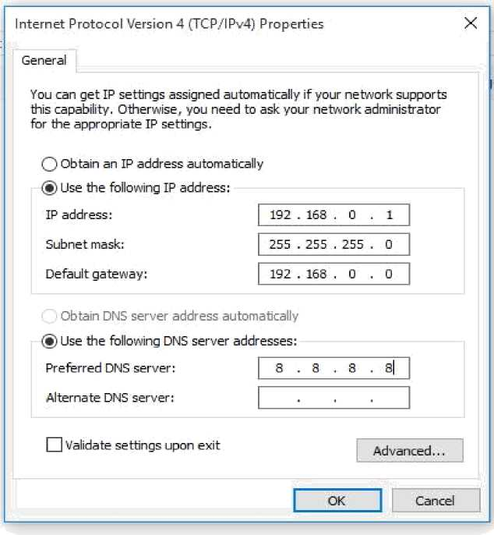
Instruction Manual
Connecting pc’s into network:
1. Connect the systems to the network switch / router.
2. Set up the IP addresses for each system.
3. To configure the IP addresses follow these Steps:
' Open the Network and Sharing Center ' Click on change adapter settings option.
' Open the properties of the Local Area Connection.
' Edit the Internet Protocol Version 4(TCP/ IPv4 ) options.
' Set the IP address of your system and the Default Gateway of the Switch / router.
Example:-
4. Now Copy the Project folder in the Xampp/htdocs folder in a selected Server system.
5. Now ON the Xampp- PHP & Mysql in the Server system.
6. Enter the server system’s IP address in the Browser off the Client System to access the localhost of the Server.
7. Type the IP address and the Project folder name in the Address bar.
13

Slide 14
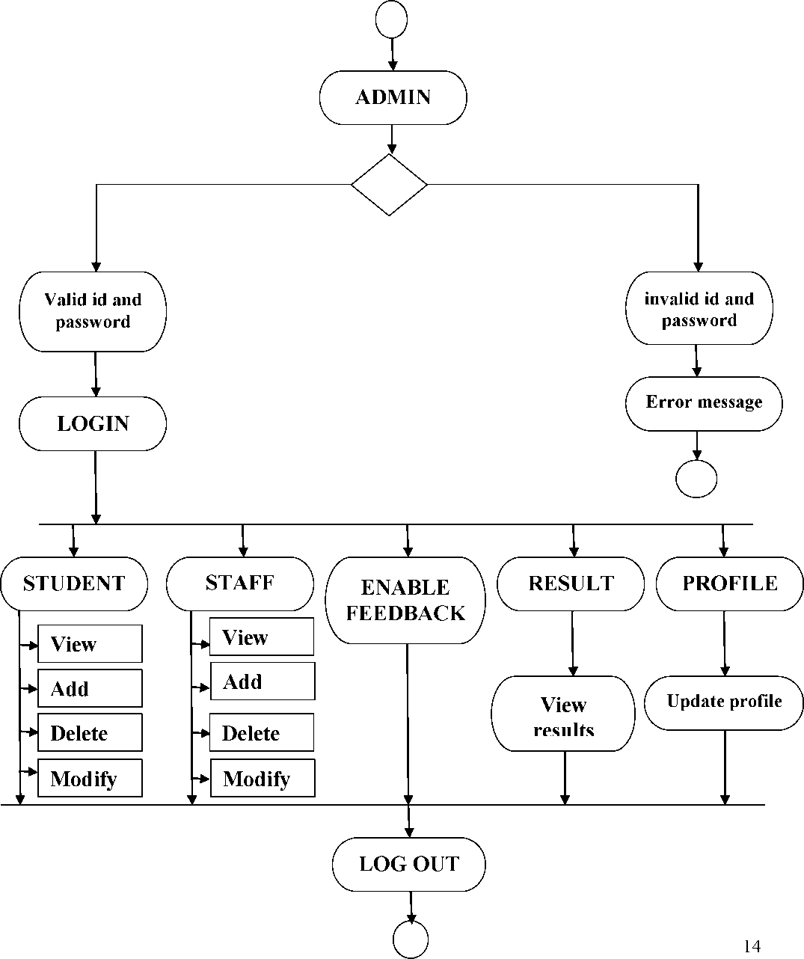
FLOW CHART Admin flow chart

Slide 15
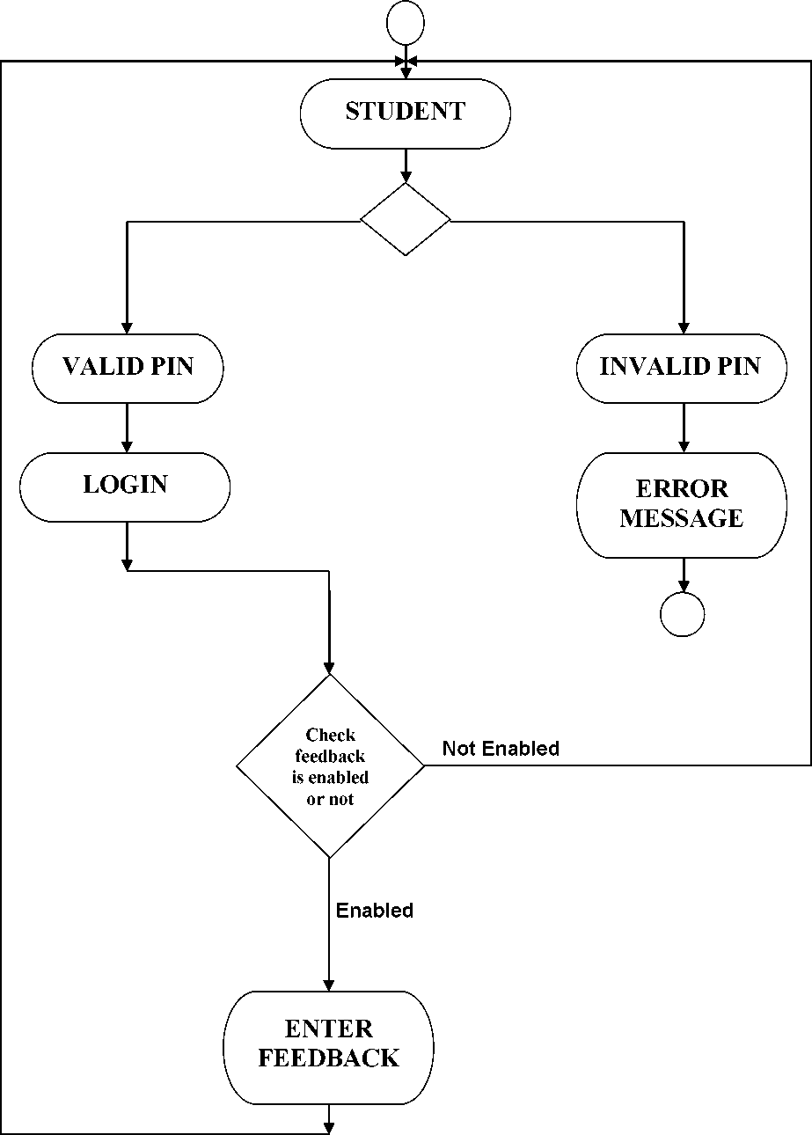
Student flow chart
15

Slide 16
CODE
1) selection.php
<?php
$c= mysql_connect("localhost","root")or die("not connected
db".mysql_error());
mysql_select_db("feedback",$c);
//session_start();
$sscheme=$_SESSION['scheme'];
$sdept=$_SESSION['sem'];
$branch=$_SESSION['dept'];
$p= $_SESSION['pin'];
//echo $sscheme;
//echo $sdept;
//echo $branch;
if(isset($_POST['sub']))
{
$value=$_POST ['t'];
$y=MYSQL_QUERY("SELECT date FROM enable where scheme='$sscheme' && year='$sdept' && status=1 ",$c) OR DIE(MYSQL_ERROR());
$d=mysql_fetch_array($y);
//echo $d[0];
$i=mysql_query("insert into list
values('$p','$d[0]','$sscheme','$sdept')",$c)OR DIE(MYSQL_ERROR()); if($d[0]=="")
{
echo "<script language='javascript' type='text/javascript'>"; echo "alert('FEEDBACK DISABLED');"; echo "</script>";
}
else
{
$issue=array();
$issue[0]="Has the faculty covered entire syallbus";
$issue[1]="Has the faculty covered relevant topics beyond syallbus" $issue[2]="Effectiveness of faculty in terms of"; $issue[3]="Command on Subject";
$issue[4]="Communication Skills";
$issue[5]="use of Visual/ Teaching aids ";
$issue[6]="Accessibility outside the class";
$issue[7]="Punctuality in taking classes";
$issue[8]="Overall rating of the faculty";
16

Slide 17
$x=MYSQL_QUERY("SELECT count(*) FROM result where scheme='$sscheme' && year='$sdept' && dept='$branch' ",$c) OR DIE(MYSQL_ERROR());
$ro=mysql_fetch_array($x);
$i=0; $j=0; $te=0;
$sn=1;
$j0=0;$j1=1;$j2=2;$j3=3;$j4=4;$j5=5;$j6=6;$j7=7;$j8=8;$j9=9;
if($ro[0]==0)
{
// echo "c"; for($i=0;$i<9;$i++)
{
if($sn==3)
{
mysql_query("insert into result
values($sn,'$issue[$te]',NULL,NULL,NULL,NULL,NULL,NULL,NULL,NULL, NULL,NULL,'$d[0]','$sscheme','$sdept','$branch',1)",$c)or die(mysql_error());
$sn++;
$te++;
continue;
}
else
{
mysql_query("insert into result
values($sn,'$issue[$te]',$value[$j0],$value[$j1],$value[$j2],$value[$j3],$value[$j4 ],$value[$j5],$value[$j6],$value[$j7],$value[$j8],$value[$j9],'$d[0]','$sscheme','$ sdept','$branch',1)",$c)or die(mysql_error());
$j0=$j0+10;$j1=$j1+10;$j2=$j2+10;$j3=$j3+10;$j4=$j4+10;$j5=$j5+10;$j6=$j6+
10;$j7=$j7+10;$j8=$j8+10;$j9=$j9+10;
$te++;
$sn++;
}
}
}
else
{
// echo "xcxc";
$tot= mysql_query("select total from result where scheme='$sscheme' && year='$sdept' && dept='$branch' ",$c) OR DIE(MYSQL_ERROR());
$ro=mysql_fetch_array($tot);
//echo $ro; $av=$ro[0]; $av++;
$x=mysql_query("select * from result",$c); 17
$i=0;

Slide 18
$j=0 $te=0; $sn=1;
$c= mysql_connect("localhost","root")or die("not connected db".mysql_error()); mysql_select_db("feedback",$c);
$j0=0;$j1=1;$j2=2;$j3=3;$j4=4;$j5=5;$j6=6;$j7=7;$j8=8;$j9=9;
$total=$av;
while($old=mysql_fetch_assoc($x))
{ $sn=$old['sno'];
if($old['sno']==3)
{ //echo "if";echo $old['sno'];
//echo "if";echo $old['sno'];
mysql_query("update result set total=$total, a=NULL,b=NULL,c=NULL,d=NULL,e=NULL,f=NULL,g=NULL,h=NULL,i=N ULL,j=NULL where scheme='$sscheme' && year='$sdept' && dept='$branch' && sno=$sn ",$c)OR DIE(MYSQL_ERROR());
continue;
}
$a=(($old['a']*($av-1))+$value[$j0])/$av;
//echo $a."<br>";
//echo $old['a']."<br>";
// echo $value[$j0]."<br>"; $b=(($old['b']*($av-1))+$value[$j1])/$av; $c1=(($old['c']*($av-1))+$value[$j2])/$av; $d=(($old['d']*($av-1))+$value[$j3])/$av; $e=(($old['e']*($av-1))+$value[$j4])/$av; $i=(($old['i']*($av-1))+$value[$j8])/$av; $f=(($old['f]*($av-1))+$value[$j5])/$av; $g=(($old['g']*($av-1))+$value[$j6])/$av; $h=(($old['h']*($av-1))+$value[$j7])/$av; $j=(($old['j']*($av-1))+$value[$j9])/$av; $j0=$j0+10;$j1=$j1+10;$j2=$j2+10;$j3=$j3+10;$j4=$j4+10;$j5=$j5+10;$j 6=$j6+10;$j7=$j7+10;$j8=$j8+10;$j9=$j9+10;
mysql_query("update result set total=$total, a=$a,b=$b,c=$c1,d=$d,e=$e,f=$f,g=$g,h=$h,i=$i,j=$j where scheme='$sscheme' && year='$sdept' && dept='$branch' && sno=$sn ",$c)OR DIE(MYSQL_ERROR());
}
}
echo "<script>";
echo "window.location.href='/feedback/slogin.php' ";
echo"</script>";
header("location:/feedback/slogin.php");
}
}
?>
18

Slide 19
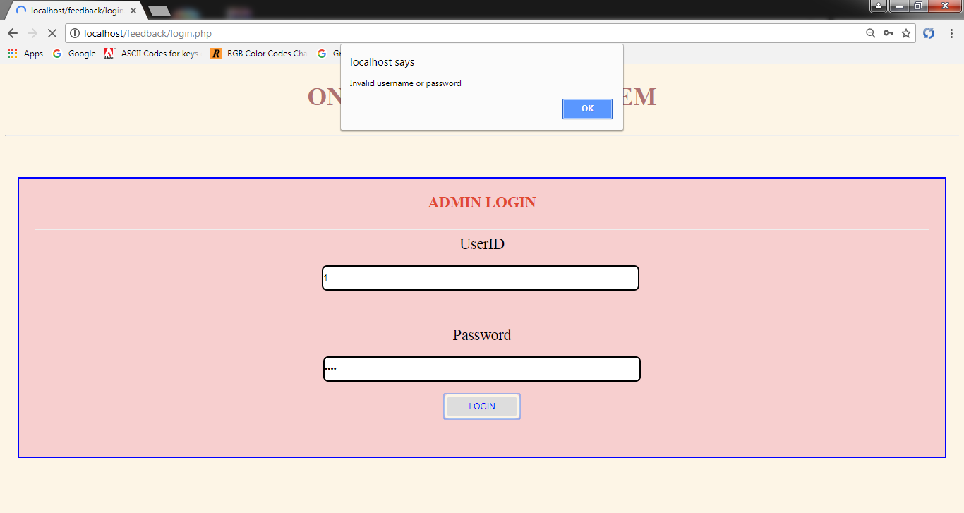
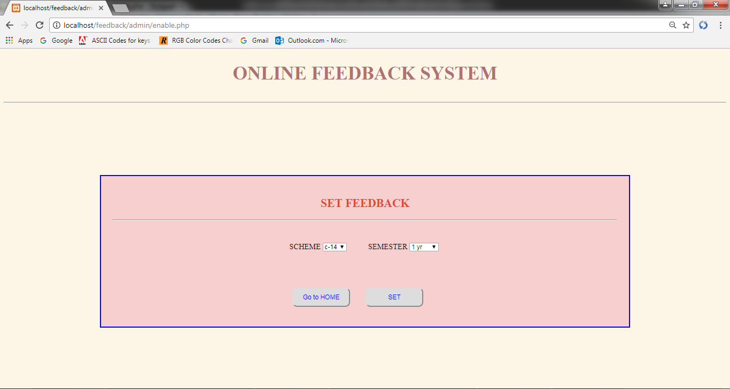
TEST CASES
Login with incorrect username when a user assign an invalid user name an error will be occur and they not enter into web site.
2) Admin Setting feedback by selecting scheme and year/semester.
19

Slide 20
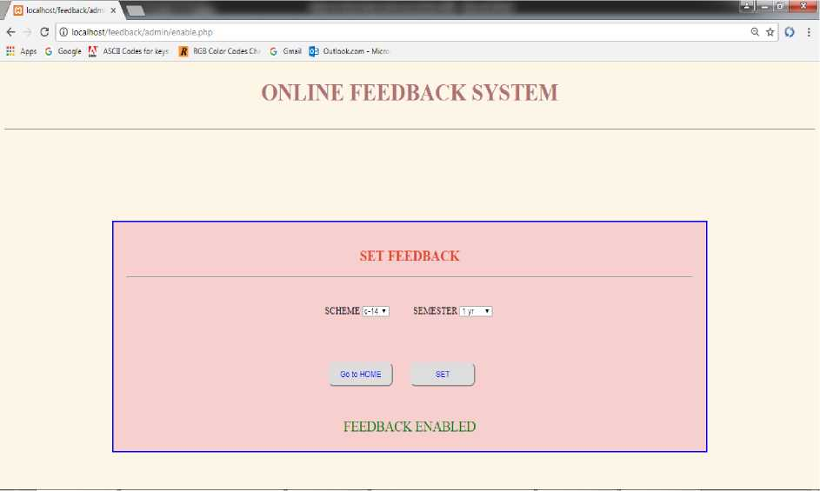
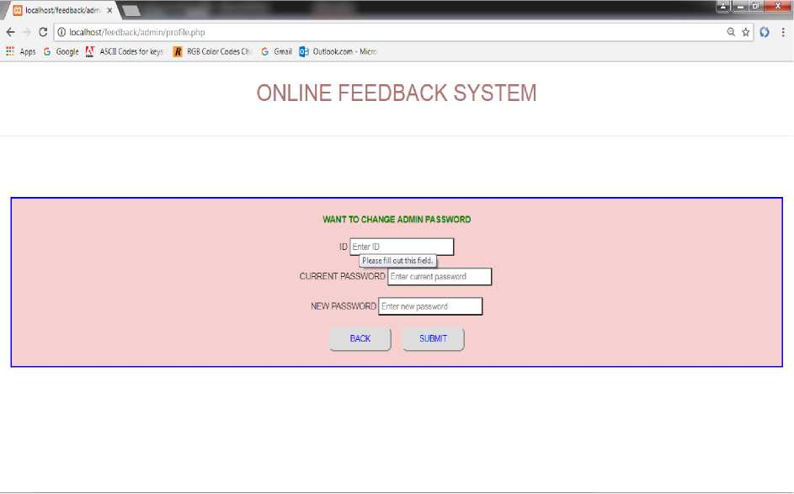
3) If Admin sets feedback.
4) If admin wants to change password.
20

Slide 21
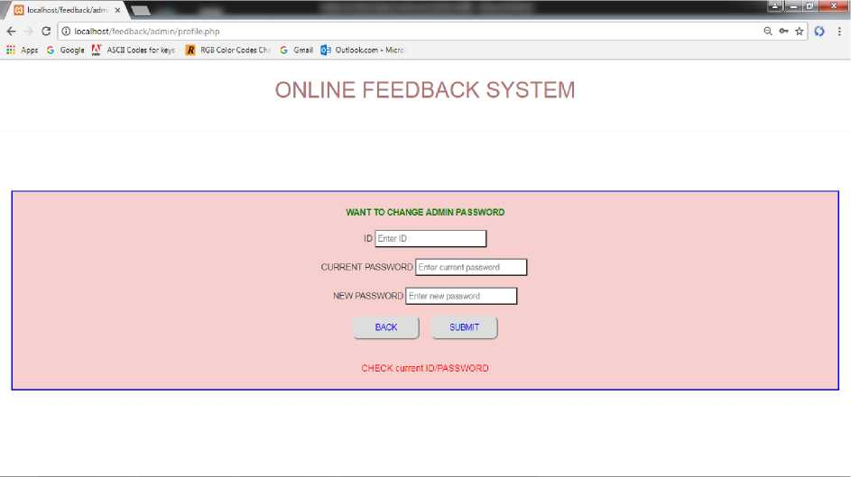
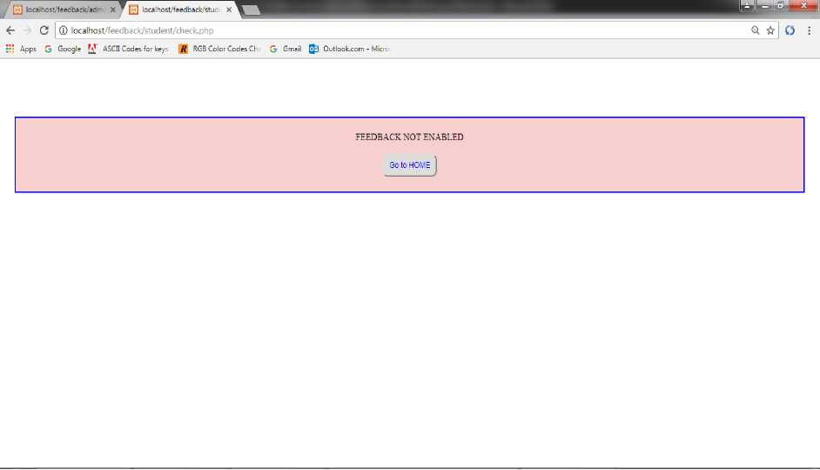
5) Login with Incorrect Password: : when a user assign an invalid password an error will be occur and they not able to change the user password.
6) If student enters incorrect pin or if the pin assigned student feedback is not enabled at that time.
21

Slide 22
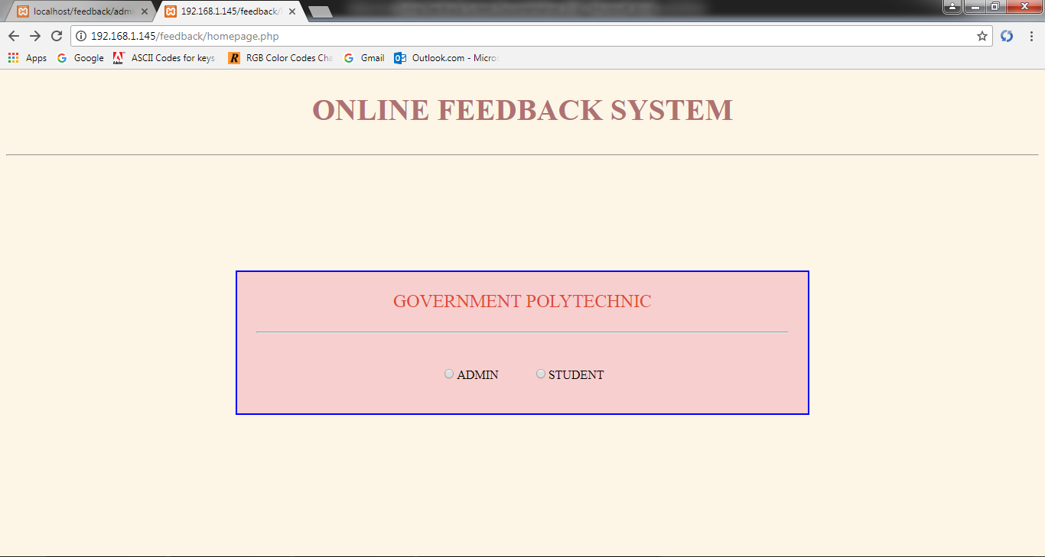
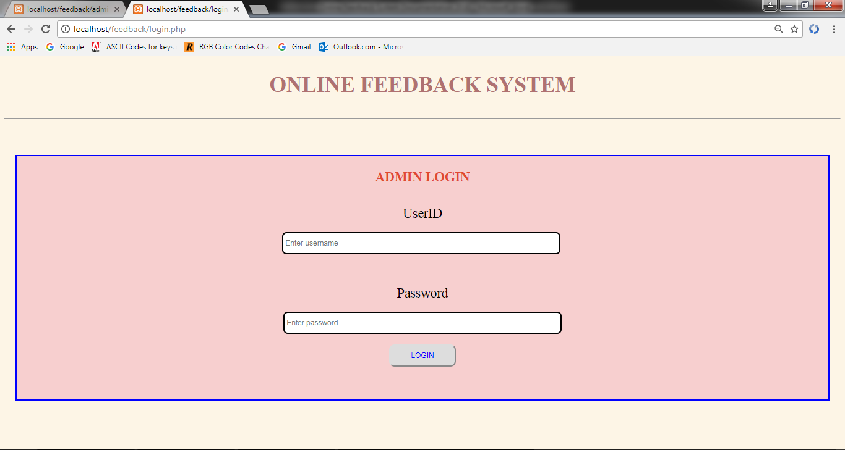
Output Screens
Home Page:
Admin Login:
22

Slide 23
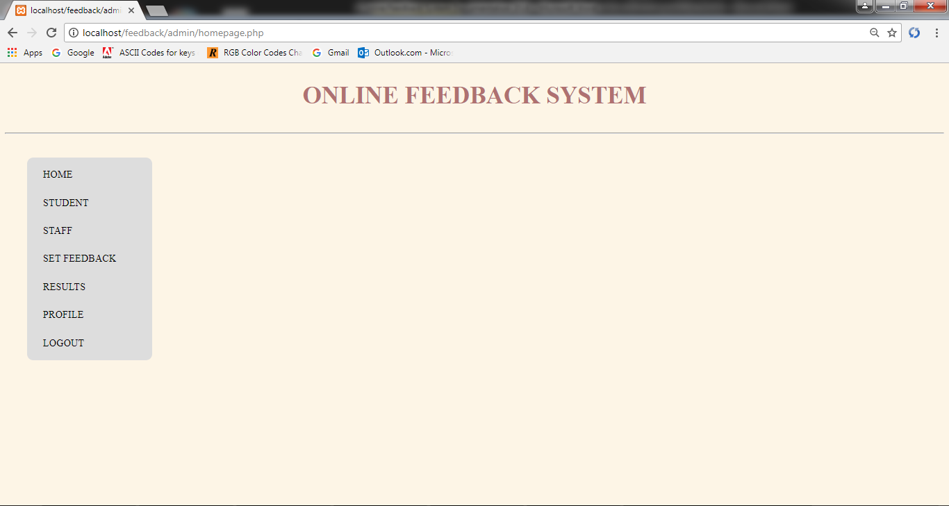
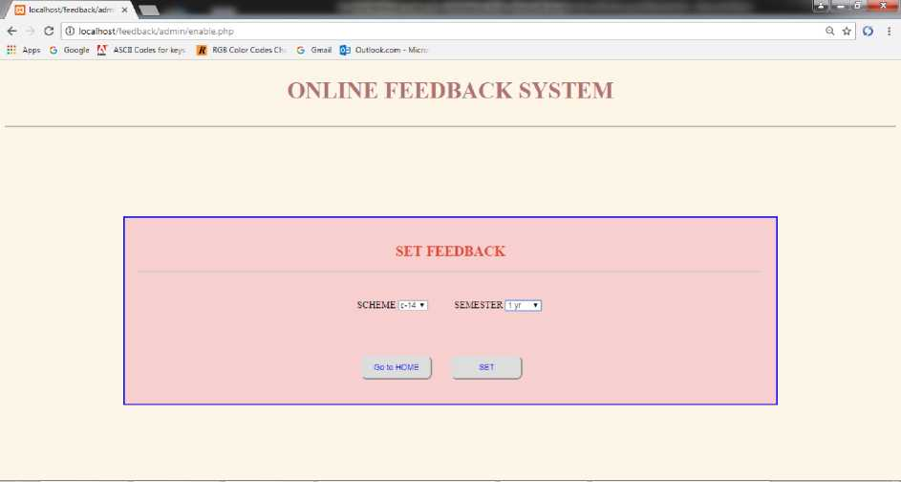
Admin Home Page:
Admin setting feedback:

Slide 24
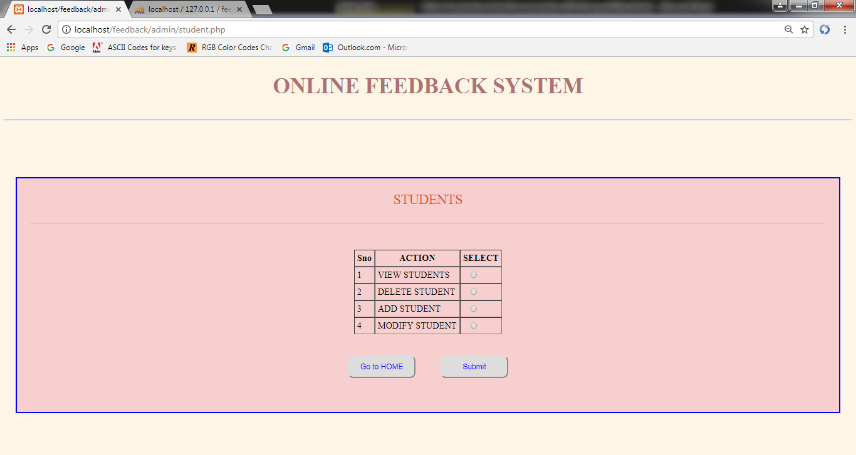
Admin actions on students:
Admin actions on staff members :

Slide 25
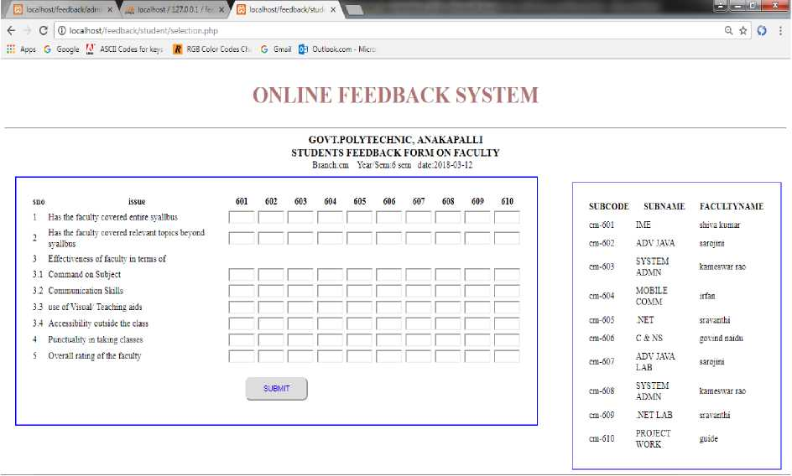
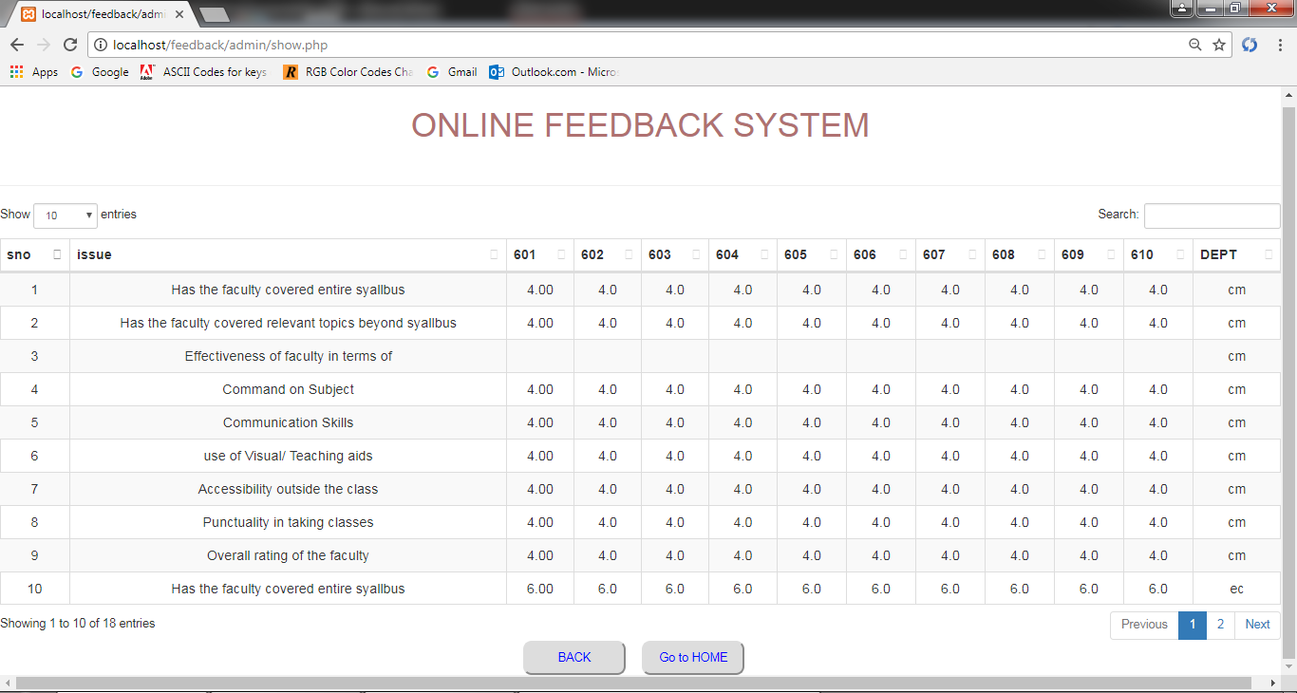
Student Feedback Form:
Displaying Feedback Result:
►

Slide 26
CONCLUSION
The project “Online Feedback System” is designed in order reduce the burden of maintaining bulk of records of all the students feedback details of who study in an educational institution. Inserting, retrieving and updating the feedback details of a student are easy when it is compared to the manual feedback and storing. Maintaining the project is also easy which can is easily understandable. Maintaining the details in the database is manageable. This Website provides facility to conduct online feedback in a Network. It saves time as it allows number of students to give the exam at a time and displays the results as the test gets over, so no need to wait for the result. It is automatically generated by the server. The Administrator has the privileges to enable feedback. Student can login and give the feedback with his specific pin.

Slide 27
BIBLIOGRAPHY
Reference Websites:
w3schools.com
tutorialspoint.com
google.com
php.com
bootstrap.com
Reference Books:
• The Complete Reference Php (Steven Holzer)
• HTML5 FOR WEB DESIGNERS (Jeremy Keith)
• HTML5 Solutions (Essential Techniques for HTML5 Developers)
• HTML5 for complete web designing (Essential Techniques for HTML5 Developers).

