Slide 1
CP 330 · EDGE AI
PCB Manufacturing Defect Detection
Using Edge AI
[Potturi Lakshmi Sri Sai Lokesh] · [Kalaiyarasan V] · Rohith V · Naman Thakur

Slide 2
MOTIVATION
Why Automate PCB Inspection?
Human Error
Slow Throughput
High Cost
Manual inspection misses ~15% of defects due to fatigue and subjectivity
Traditional QA bottlenecks production lines; automated systems run 24/7
Late-stage defect detection costs 10× more to fix than early detection
Solution: A real-time Edge AI pipeline — compact model + quantization + hardware deployment

Slide 3
SYSTEM OVERVIEW
End-to-End Edge AI Pipeline
1
2
3
4
5
6
PCB Dataset
Preprocessing
Model Training
Optimization
Export
Deployment
Images + XML
Annotations
YOLO Labels
70/20/10 Split
YOLOv8S
70 epochs @1024
Pruning 30%
+ Quantization
TFLite
OpenVINO
ESP32 Conveyor
+ IP Webcam
5 Defect Classes Detected:
missing hole
mouse bite
open circuit
short
spurious copper
Dataset: DeepPCB — Pascal VOC XML → YOLO format conversion

Slide 4
DATASET
Dataset Preparation
Dataset Statistics
Data Augmentation
Source:
DeepPCB (Publicly Available)
HSV Jitter:
H=0.015 S=0.7 V=0.4
Annotation:
Pascal VOC XML → YOLO TXT
Rotation:
±10°
Train Split:
70%
Translation:
0.1
Val Split:
20%
Scale:
0.5
Test Split:
10%
Flip (H/V):
50% probability each
Random Seed:
42 (reproducible)
Mosaic:
Enabled (1.0)
Input Resolution:
1024 × 1024 px
MixUp:
0.2
📷 [Insert: Sample PCB image with annotated bounding boxes]

Slide 5
MODEL
YOLOv8S Architecture
Input
1024×1024×3
CSPDarknet
Backbone (C2f)
PAN-FPN
Neck
Decoupled
Head ×3
5-Class
Output
~11M
1024²
32
70
Parameters
Input Size
Stride
Epochs
YOLOv8S
vs 800² baseline
max feature map
final training
Baseline: YOLOv8n (50 epochs, 800px) → Final: YOLOv8S (70 epochs, 1024px) — Higher resolution critical for small PCB defects

Slide 6
OPTIMIZATION
Model Optimization Techniques
✂ Pruning
30%
Type: L1 Unstructured Target: All Conv2d layers Sparsity: 30% Framework: torch.nn.utils.prune
Format
Size
Speed
Conv sparsity
float32
~41 MB
Baseline
float16
~22 MB
1.5× faster
OpenVINO
~44 MB
Intel HW accel
50% size reduction (FP16)
Key Edge AI concept applied: Post-Training Quantization (PTQ) — no retraining required, compatible with Ultralytics export

Slide 7
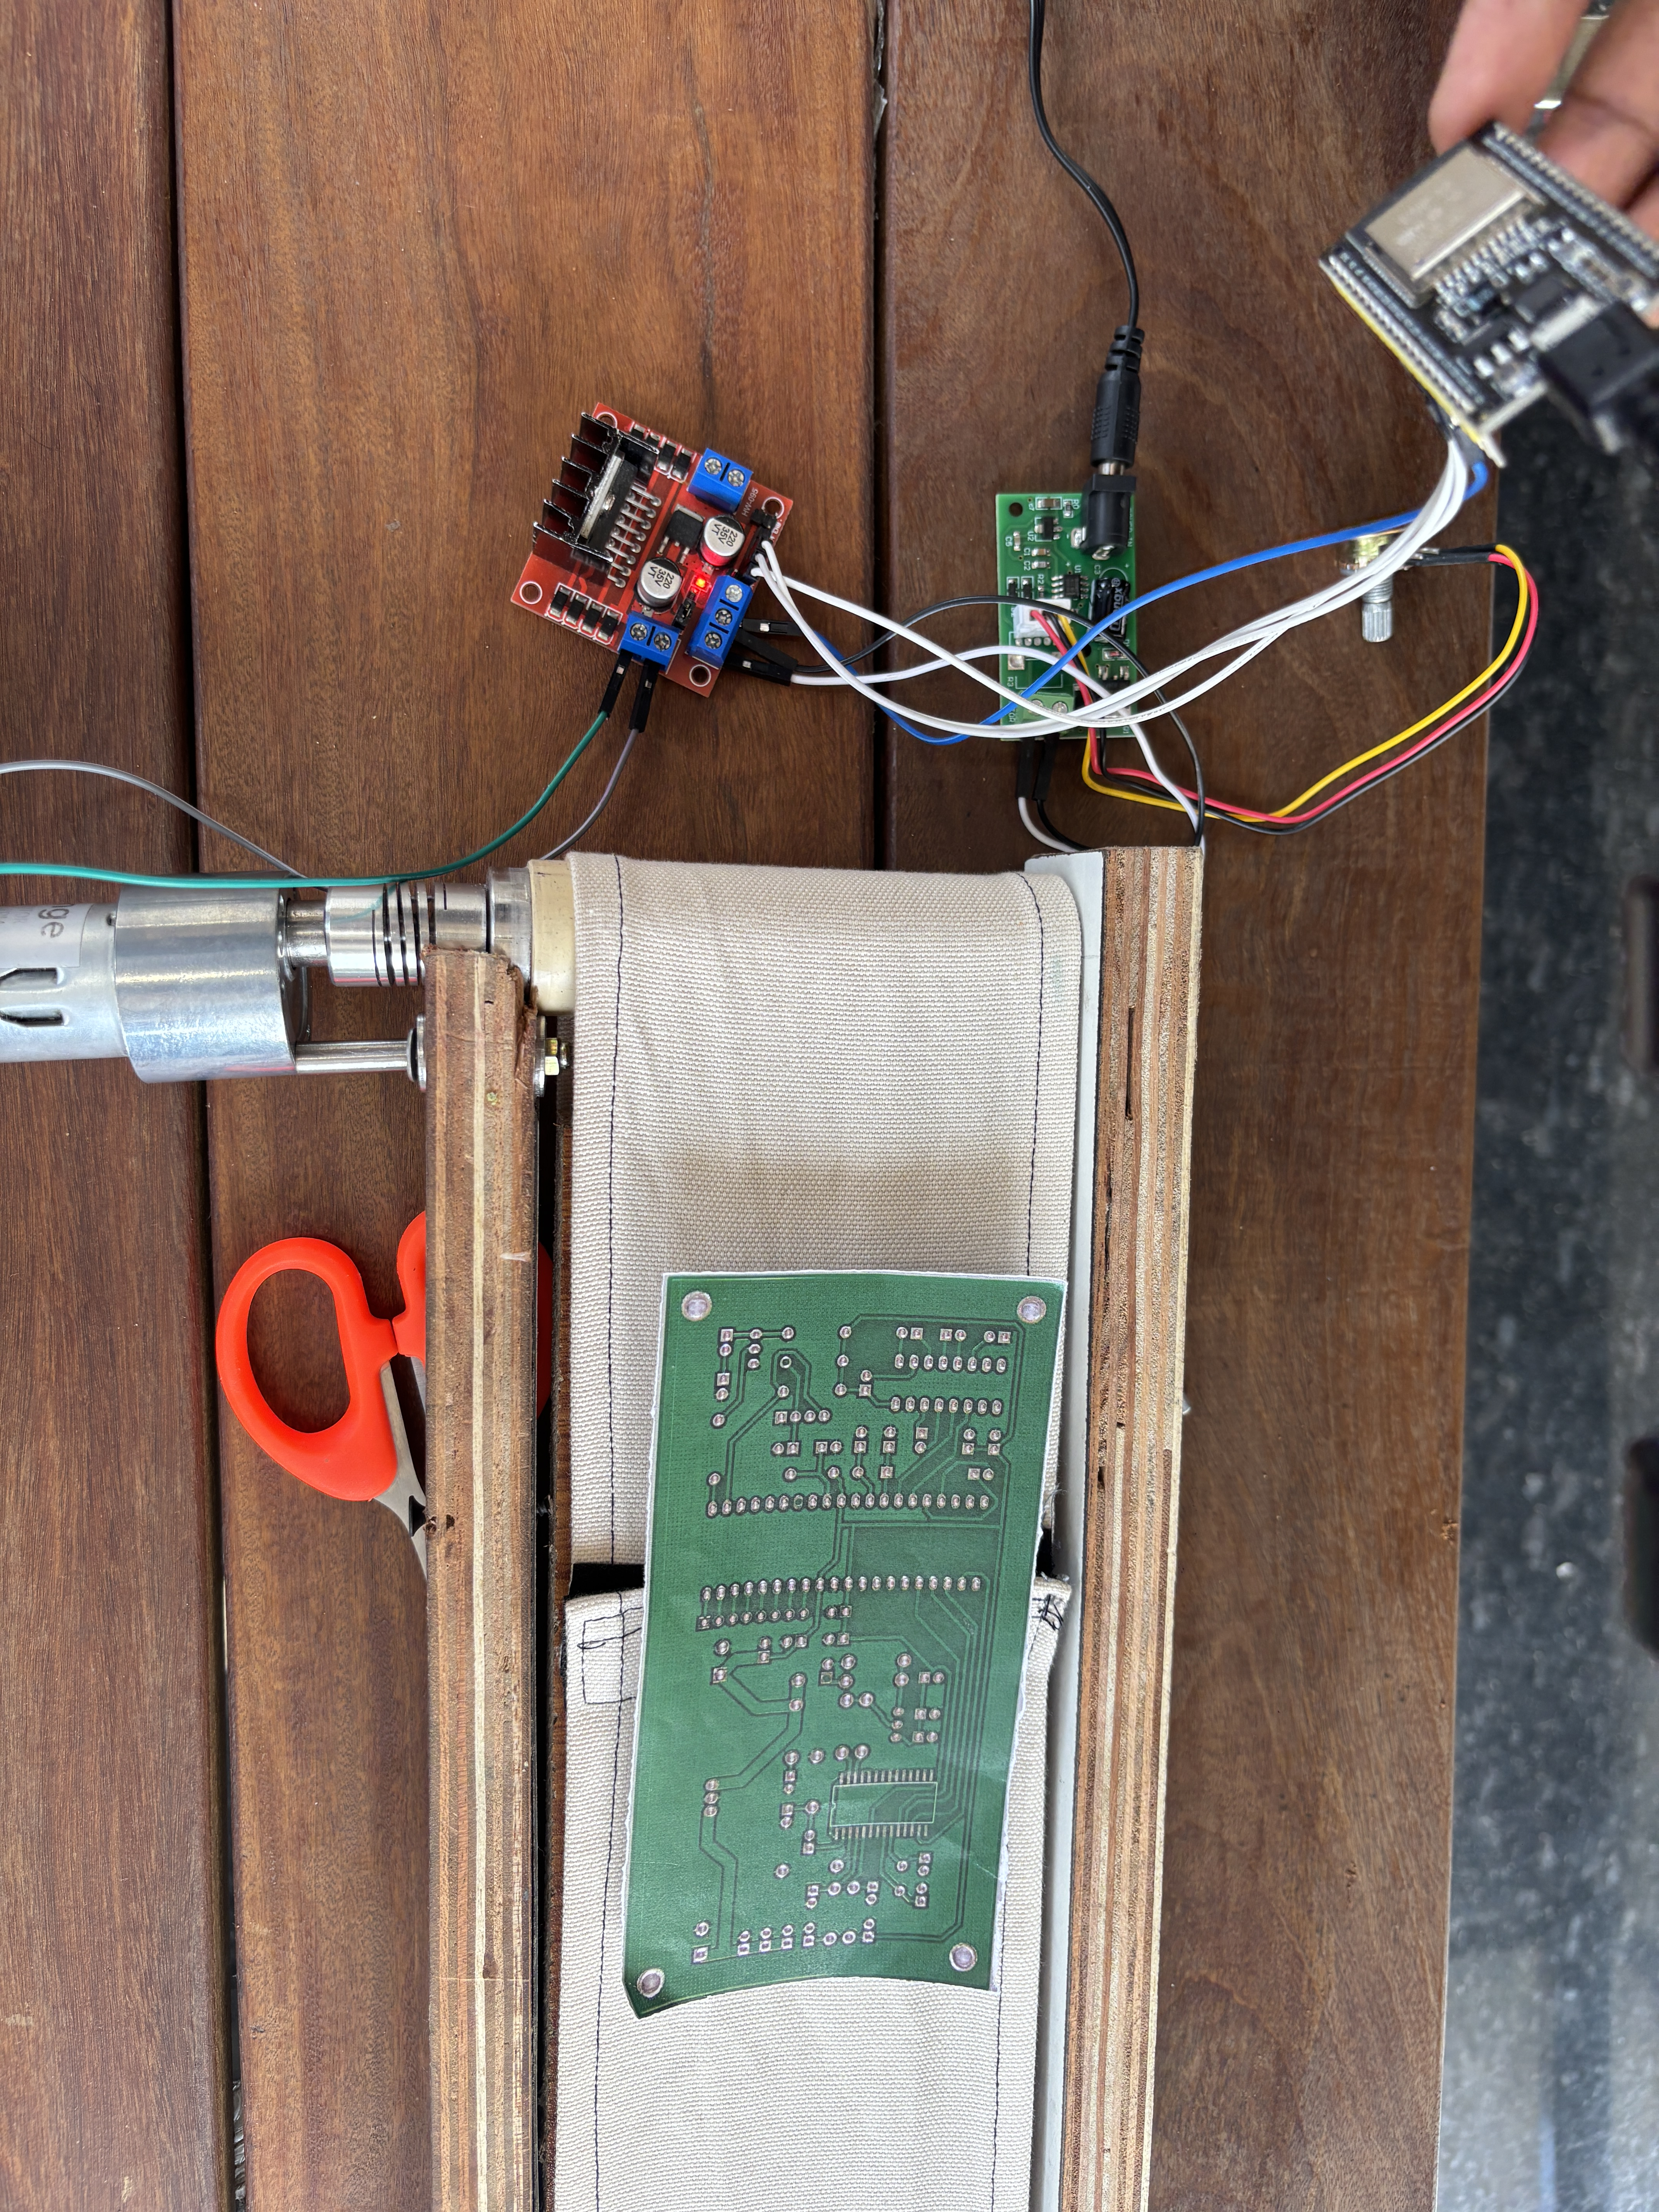
HARDWARE
Physical Conveyor System
Motor:
12V DC Johnson Geared Motor
Driver:
L298N H-Bridge IC
Controller:
ESP32 Dev Module
Speed Ctrl:
12V rotary potentiometer
Power:
12V DC adapter
Camera:
IP Webcam (mobile) over Wi-Fi
ESP32 runs conveyor for 2 sec per trigger → PCB moves to inspection point → Camera captures frame → AI inference

Slide 8
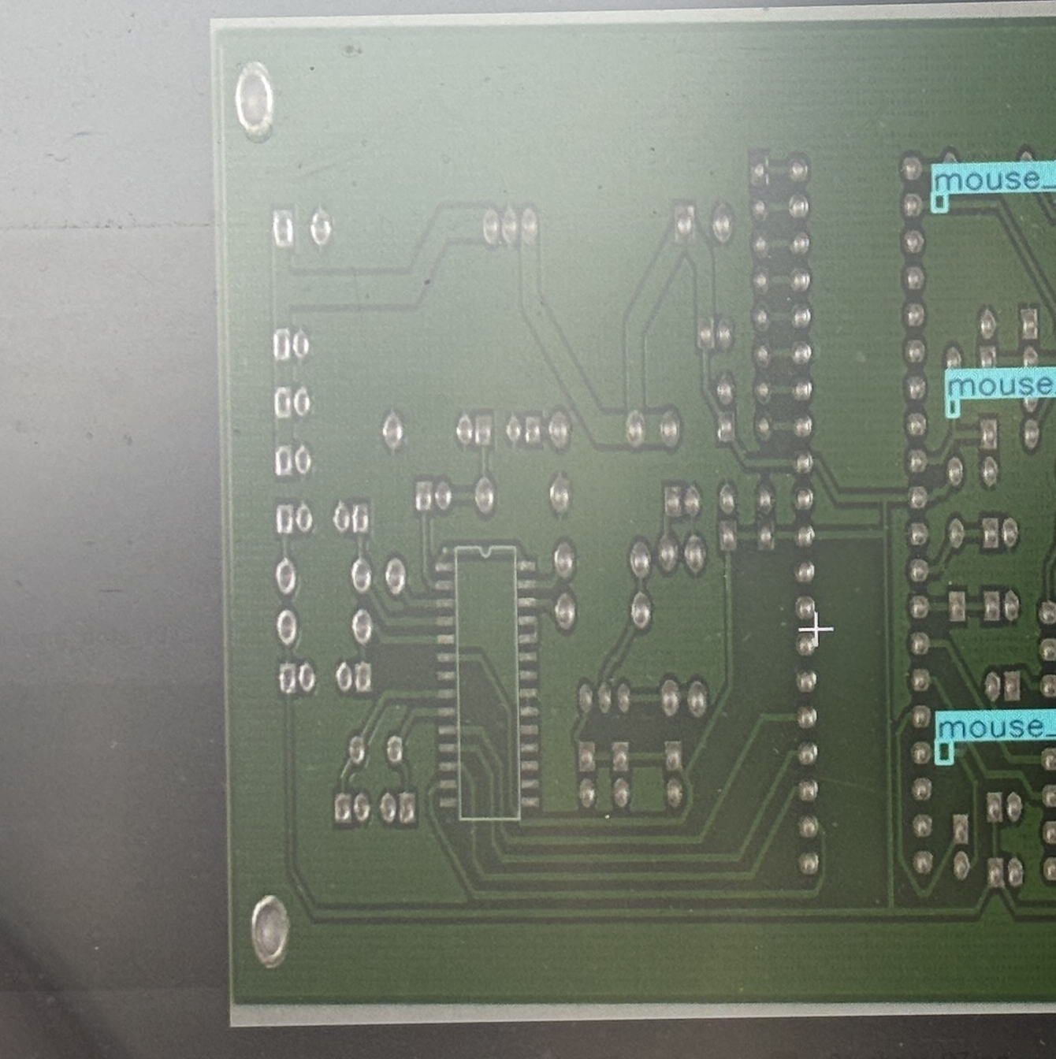
DEPLOYMENT
Inference Pipeline — run.py
1
Load Model
YOLO('best_float32.tflite')
Sample Output
Inspection Time: 1:02:01
Status: DEFECTS FOUND: 2
Waiting 5 seconds for next PCB...
2
Capture Frame
HTTP GET → IP Webcam URL
3
Run Inference
conf=0.4, verbose=False
📷 [Insert detection output screenshot]
4
Process Results
Draw boxes
5
Display & Wait
Show in notebook, wait 5s
Deployed Models:
best_float32.tflite

Slide 9
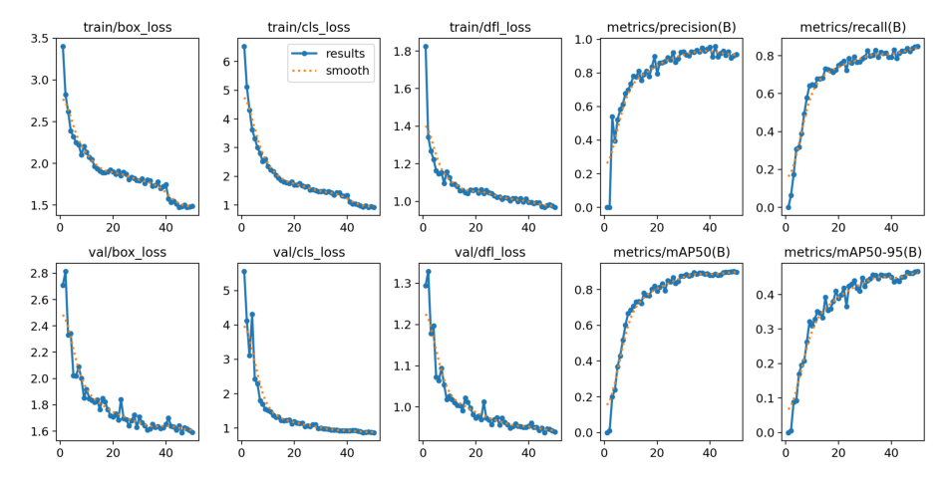
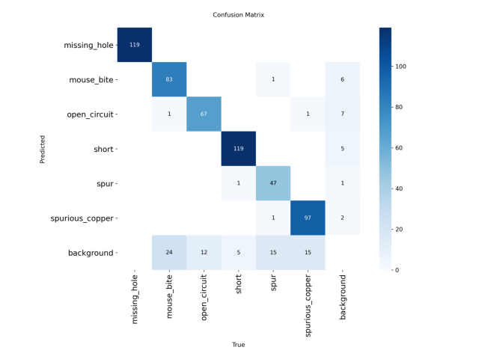
RESULTS
Experimental Results
Model Comparison
Model | Input | Epochs | Notes
YOLOv8n | 800×800 | 50 | Baseline
YOLOv8S | 1024×1024 | 70 | Final — higher mAP
YOLOv8S + Pruning | 1024×1024 | 70 | 30% sparse, ≈ same mAP
Quantization Trade-offs
Format | Size | Speed Gain | Accuracy
float32 | ~41 MB | 1× | Full
float16 | ~22 MB | ~1.5× | Negligible drop
OpenVINO | ~44 MB | - | Full

Slide 10
CONCLUSION
Conclusions & Future Work
✅ Key Achievements
🚀 Future Work
YOLOv8S at 1024×1024 outperforms YOLOv8n baseline for fine-grained PCB defect detection
QAT
Quantization Aware Training for better INT8 accuracy
30% L1 pruning maintained accuracy while reducing computational footprint
KD
Knowledge Distillation from YOLOv8L → YOLOv8n / YOLOv8s
OpenVINO export enables hardware-accelerated inference on Intel edge platforms
NAS
Neural Architecture Search for PCB-specific backbone
Physical ESP32 + L298N conveyor system successfully simulated industrial PCB inspection
Deploy
RPi / Intel NCS2 fully embedded inference

Slide 11
Thank You!
GitHub: https://github.com/lokesh23p/PCB-Manufacturing-defect-detection/tree/main

