Slide 1
BLACK FRIDAY SALES PREDICTION
BY
NAME-C.K.M.GANESAN
REGNO-18BCE1266

Slide 2
ABOUT THE PROBLEM
A retail company “ABC Private Limited” wants to understand the customer purchase behaviour (specifically, purchase amount) against various products of different categories. They have shared purchase summary of various customers for selected high volume products from last month.The data set also contains customer demographics (age, gender, marital status, city_type, stay_in_current_city), product details (product_id and product category) and Total purchase_amount from last month.
This is a regression problem. The dataset has 550,069 rows and 12 columns.
Problem: Predict purchase amount
The model performance will be evaluated on the basis of the prediction of the purchase amount for the test data (test.csv), which contains similar data-points as train except for their purchase amount.

Slide 3
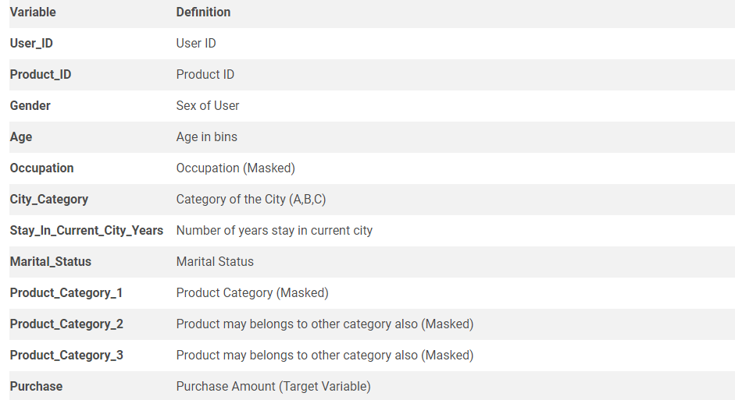
STRUCTURE OF DATASET

Slide 4
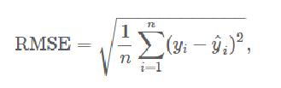
METRICS TESTED FOR A SUBMISSION –USED BY SOLUTION CHECKER
The system on its end has the actual purchase amount for the test dataset, against which my predictions will be evaluated. Submissions are scored on the root mean squared error (RMSE). RMSE is very common and is a suitable general-purpose error metric. Compared to the Mean Absolute Error, RMSE punishes large errors:
Where y hat is the predicted value and y is the original value.

Slide 5

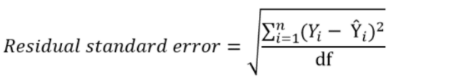
OTHER METRICS
R-squared (R2), which is the proportion of variation in the outcome that is explained by the predictor variables. In multiple regression models, R2 corresponds to the squared correlation between the observed outcome values and the predicted values by the model. The Higher the R-squared, the better the mode
l
Residual Standard Error (RSE), also known as the model sigma, is a variant of the RMSE adjusted for the number of predictors in the model. The lower the RSE, the better the model. In practice, the difference between RMSE and RSE is very small, particularly for large multivariate data.

Slide 6
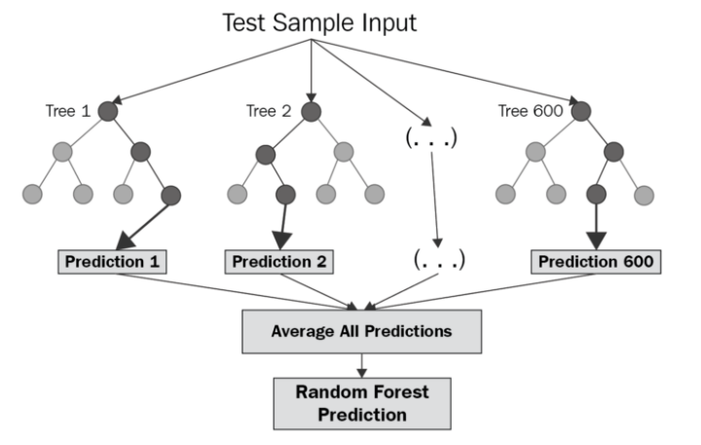
ALGORITHMS USED FOR BUILDING THE MODEL
Random forests or random decision forests are an ensemble learning method for classification, regression and other tasks that operate by constructing a multitude of decision trees at training time and outputting the class that is the mode of the classes (classification) or mean prediction (regression) of the individual trees. Random decision forests correct for decision trees' habit of overfitting to their training set

Slide 7
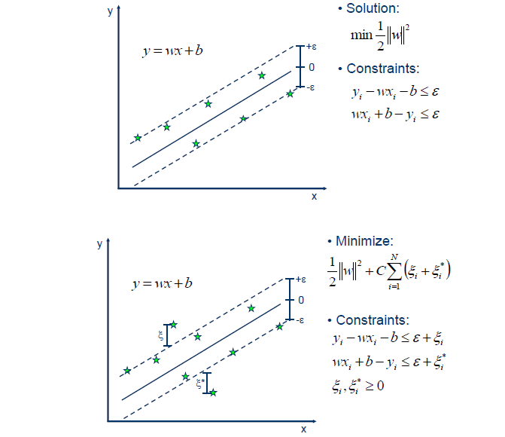
Support-vector machines (SVMs, also support-vector networks) are supervised learning models with associated learning algorithms that analyze data used for classification and regression analysis. The Support Vector Regression (SVR) uses the same principles as the SVM for classification, with only a few minor differences. First of all, because output is a real number it becomes very difficult to predict the information at hand, which has infinite possibilities. In the case of regression, a margin of tolerance (epsilon) is set in approximation to the SVM which would have already requested from the problem. But besides this fact, there is also a more complicated reason, the algorithm is more complicated therefore to be taken in consideration. However, the main idea is always the same: to minimize error, individualizing the hyperplane which maximizes the margin, keeping in mind that part of the error is tolerated

Slide 8
DATA PREPARATION
Data collection:- The datasets used in the project are taken from the website which had this problem statement
Dealing with missing values:-First let’s take a look at the missing values. If number of observations with missing values are much lower than the total number of observations, then there’s not much loss of information by dropping them
Data Exploration:-The relationship between each of the features and how features are dependent to the final result are calculated using the data visualization options such as ggplot etc and each of the characteristics are analysed before using them to build the model

Slide 9
Data Preprocessing
Many real world data is dirty and needs to be cleaned before used in code. The process of cleaning a dataset is called Data Preprocessing.
Preprocessing of data includes below steps :
1. Taking care of missing data:-Check for null values – if null values are dound they are replaced by columns mean value.
2. Catgorical Data:- Categorical data is non numeric data which belongs to specific set of categories. Like the City column the dataset. These are converted into numerical labels
3. Splitting data into training and test data sets :- When the dataset is presented to us to do machine learning stuff we need some data as part of training and some to test the model after the learning stage is done.In this project a whole dataset is alloted for training and values for testing are given seperately.
4. Feature scaling:- Feature scaling is needed when different features has different ranges, for example Age and Purchase Column.They have very different ranges but when we training a model, which is basically trying to fit some line(in linear regression) then the error is trying to be minimized,to minimize the error the euclidian distance is minimized using some algorithm(gradient descent )

Slide 10
DESCRIPTIVE ANALYSIS
The data given is fully explored using various tools available and the following are the main conclusions drawn
1.Purchase amount is higher whenever there is a lot of products of second categories are brought
2.The purchase amount on an average is higher among married people especially women
3.Product category 3 is bought majorly among the 0-17 year age group
4.There is a pattern noted between city b people and category 2 products.Among the cities these people use this product a lot.
5.A majority amount of sales are made by men of the age group 26-35

Slide 11
THANK YOU

