Slide 1
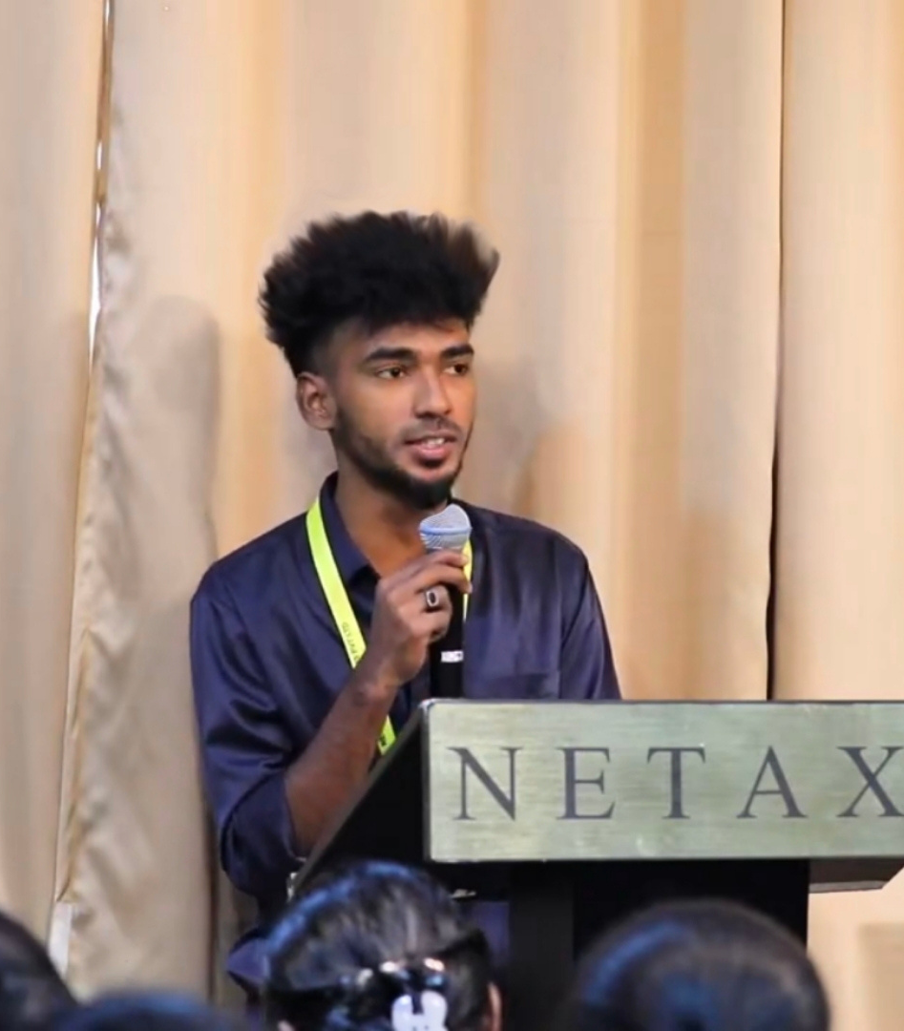
Hi, I'm Lokesh S.v
Full Stack Developer
EMAIL ME

Slide 2
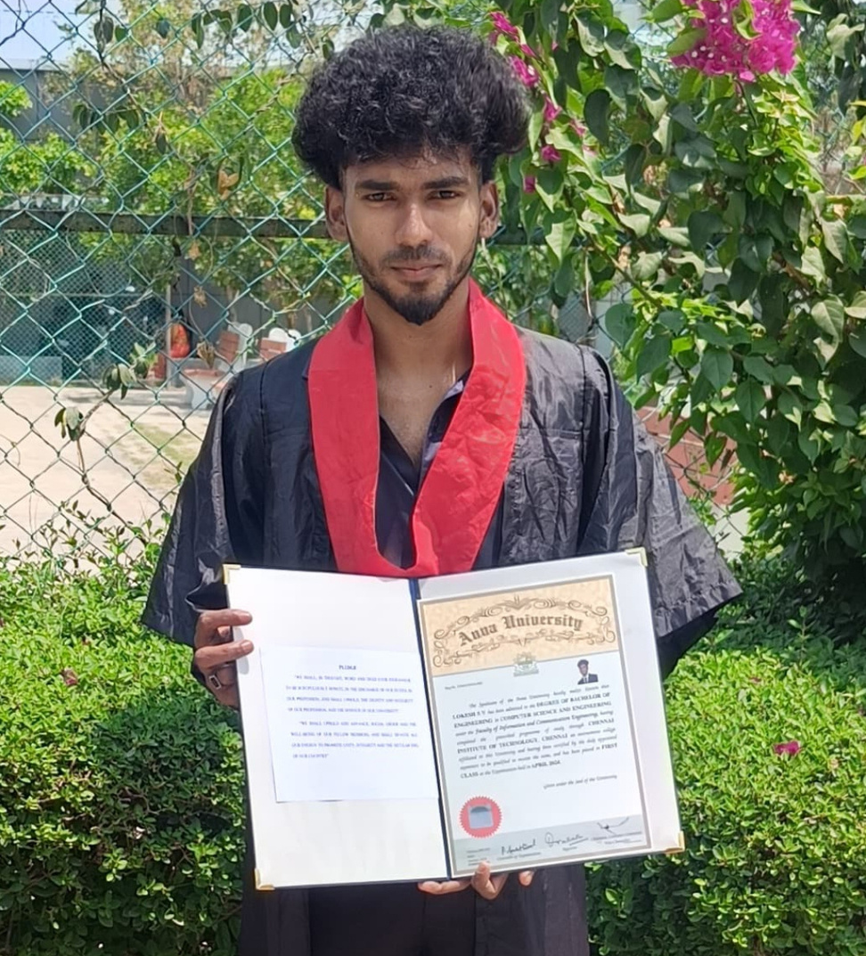
Who Am I?
A passionate and results-driven Full-Stack Developer with a focus on building robust and scalable web applications.
I specialize in developing end-to-end web solutions using:
Laravel/ PHP (Backend)
AngularJS JavaScript / Bootstrap / jQuery (Frontend)
MySQL/ Laragon (Database)

Slide 3
E-commerce Web Application
Goal:
Create a complete and responsive e-commerce web platform using Laravel.
Purpose:
Offer users a seamless shopping experience with product browsing, cart management, and secure ordering. Provide an admin interface to manage the store efficiently.
Stack Used:
Laravel (PHP Framework), MySQL (Database), Bootstrap & HTML/CSS (UI), AngularJS/jQuery (Frontend Interactivity)

Slide 4
Key Features
Secure User Registration/Login with Laravel Breeze
Product Listing by Categories
Cart and Wishlist Management
Order Placement and History Tracking
Admin Dashboard for Products, Categories, and Orders

Slide 5
User Experience
Browse categorized products on a responsive interface
View product details including images and price
Add items to cart and wishlist
Checkout securely and track orders
View complete order history and statuses

Slide 6
Admin Dashboard Features
Admin authentication with restricted access
Add/Edit/Delete product details with images
Manage product categories dynamically
View all user orders and update their statuses
(Optional) Visual Dashboard with sales analytics

Slide 7
Database Schema Overview
Admin Dashboard Features
Core Tables:
users - Authentication and role details
products - Product data (name, price, stock, image)
categories - Product categorization
carts - Items added to the user's cart
wishlists - Saved products
orders - Purchase history per user
order_items - Products linked to each order
Foreign key constraints maintain data consistency

Slide 8
Workflow Structure
User Workflow:
1. Register/Login
2. Browse Products
3. Add to Cart
4. Add to Wishlist
4. Checkout
5. Place Order
Admin Workflow:
1. Admin Login
2. Manage Products
3. Manage Categories
4. View and Process Orders

Slide 9
Technologies Used
Backend: Laravel 11 / PHP (MVC Architecture)
Frontend:Blade,Bootstrap5,HTML/CSS/AngularJS/jQuery /Modern JS
Database: MySQL / Laragon
Authentication: Laravel Breeze
Image Management: Local storage/public uploads

Slide 10




Grow with me.
Let's improve your processes together.
PHONE
+91 7810081636
EMAIL
svalokesh.gmail.com
SOCIAL

