Slide 1
Tittle : Cross Site Scripting Domain : Vulnweb.com Subdomain : testasp.vulnweb.com Steps to reproduce:
Step 1: Visit http://testasp.vulnweb.com/
Step 2: On the top menu you will find a search option.
Step 3: Click on it and you will be prompted with the Search box.
Step 4: You can intercept the request in Burp Suite
Step 5: Now you can find different payloads for XSS.
Step 6: Send the request to the intruder and paste all the payloads.
Step 7: Try to find a successful payload for XSS.
Step 8: prepare a report for it.
Impact : XSS can have huge implications for a web application and its users. User accounts can be hijacked, credentials could be stolen, sensitive data could be exfiltrated, and lastly, access to your client computers can be obtained
Mitigation: if you want to prevent your website to be vulnerable of cross site scripting then content security policy (CSP) is a browser mechanism that aims to mitigate the impact of cross-site scripting and some other vulnerabilities.

Slide 2
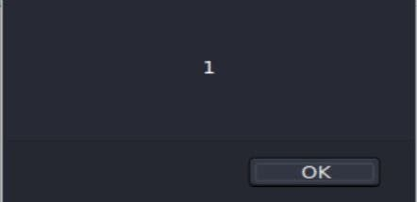
POC including screenshot/screen recording is included in the report
Image 1

Slide 3
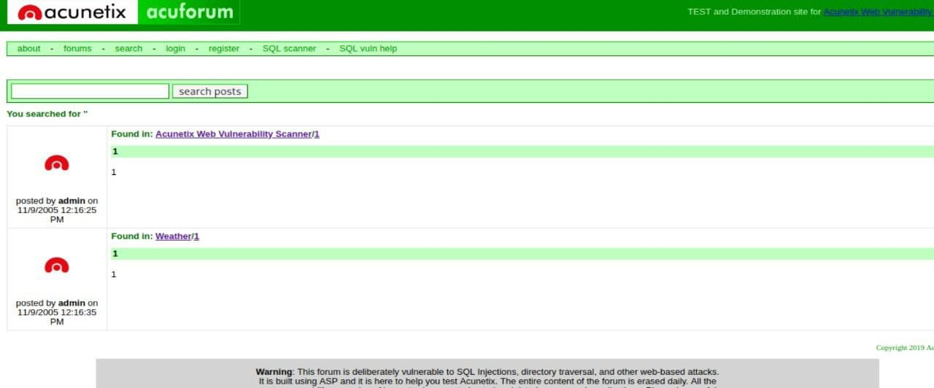
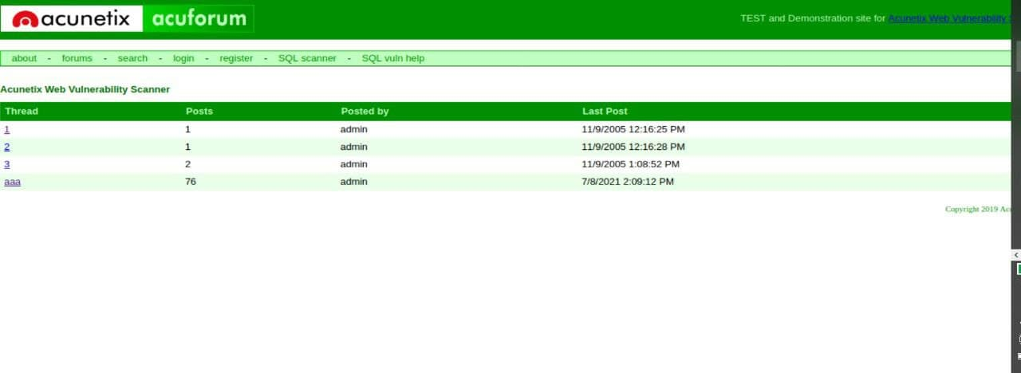
Image 2
Image 3

