Slide 1

FAKE NEWS DETECTION
PHASE-4

Slide 2
INTODUCTION
Imagine a scenario where a false news story spreads rapidly on social media, claiming that a particular medication is a cure for a deadly disease. People start hoarding the medication, causing scarcity and preventing those who need it from accessing it. This example scenario shows one of the several real-world risks of fake news.
Detecting fake news using machine learning techniques would mean having an automatic detection system that looks at a piece of text (tweets, news articles, a WhatsApp message) and determine how likely it looks like a piece of false news.

Slide 3
Table of Contents
What Is Fake News Detection Using Machine Learning Project?
Advantages And Disadvantages Of Fake News Detection Using Machine Learning
Top 5 Machine Learning Algorithms For Fake News Detection
Top 5 Fake News Detection Project Datasets
Fake News Detection Real-World Use Cases/Applications
Top 3 Fake News Detection Projects on GitHub
Build A Fake News Detection Project In Python With Source Code - A Step-by-Step Approach
Boost Your Career With Fake News Detection Project By ProjectPro
FAQs

Slide 4
Top 5 Fake News Detection
FakeNewsNet: Dataset of Political and Gossip Tweets
Fake News Corpus
FakeHealth
Constraint COVID-19 Fake News Dataset
FNC-1 (Fake News Challenge Stage 1)

Slide 5
FakeNewsNet: Dataset of Political and Gossip Tweets
This dataset uses the Twitter official API to fetch tweets from Twitter users, including metadata and social context. But to begin with, they provide a sizeable amount of clean data that can be readily used to test models.
Fake News Corpus
This open-source dataset comprises millions of news articles scraped from a curated list of 1001 domains. The dataset includes over 9,400,000 articles from over 700 domains scraped from multiple domains, such as NYTimes and WebHose English News Articles.

Slide 6
FakeHealth
FakeHealth is collected to address Fake Health News detection challenges from sources like news content, reviews, and social media. As proposed in the paper, "Ginger Cannot Cure Cancer: Battling Fake Health News with a Comprehensive Data Repository," the data can be fetched from Twitter using the Twitter API and the IDs provided in the GitHub repository- EnyanDai/FakeHealth.
Constraint COVID-19 Fake News Dataset
This dataset contains social media posts related to COVID-19 and vaccinations from various popular platforms. The posts are annotated as real and fake news, and the dataset can be better understood in its paper 'Fighting an Infodemic: COVID-19 Fake News Dataset' and the data, as well as the proposed baseline benchmark using attention models and heuristic-based post-processing

Slide 7
FNC-1 (Fake News Challenge Stage 1)
FNC-1 was designed as a stance detection dataset containing 75,385 labeled headline and article pairs. The pairs are either agree, disagree, discuss, or unrelated. Moreover, the baseline estimates the stance of a text from a news article relative to a headline. Specifically, the text may agree, disagree, discuss, or be unrelated to the headline. The FNC-1 dataset and the proposed baseline both take advantage of this.

Slide 8
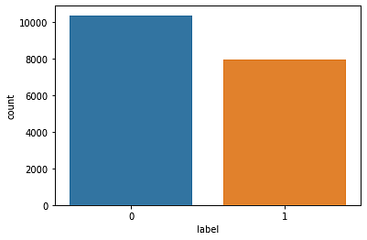
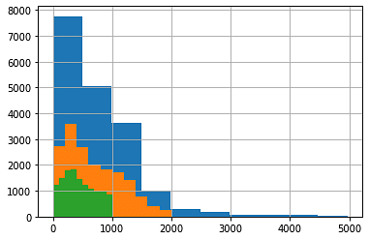

Slide 9
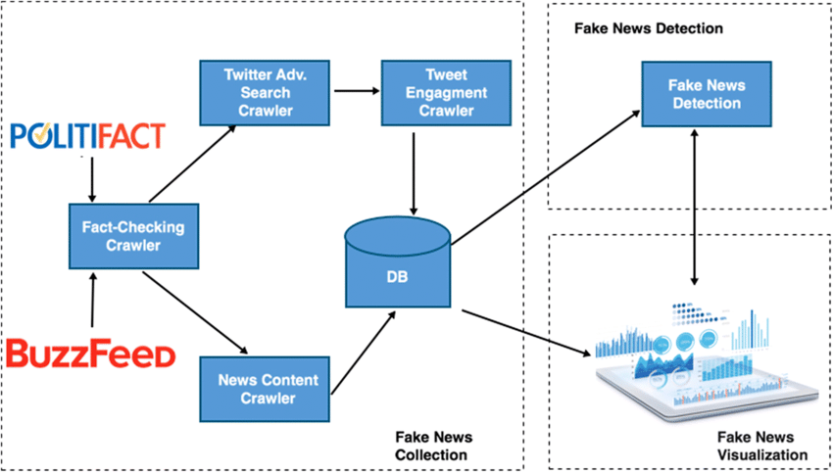

Slide 10
METHODOLOGY
The aim of this research is to create a fake news detection model utilising three machine learning techniques. Because the focus is on model building in machine learning using jupyter notebook, this isn't continually developing new usual package systems. Machine learning normally necessitates a significant amount of time for model training and testing, as well as a large volume of high-quality dataset. In other words, if the model yields predictable results, such as the prediction of fake and actual news, we might consider
it to be fairly accurate.

Slide 11
❖ Data Administration
This section collects a body of knowledge (dataset), which could be a collection of report articles, stories, news, or blog postings. Once the dataset has been collected, nltk is used to identify a collection of written or spoken material stored on a computer and used to discover how language is utilised: the data is investigated to obtain a better understanding of its structure, which means stopwords are deleted.
❖Data Exploration
The charting of graphs according to the fake and true news anticipated by the machine learning algorithm is the major focus of the information exploration section. Word clouds are created, which are essentially visual image ways for conveying text information in which the magnitude of each word represents its frequency or importance.

Slide 12
❖ Model Training
The machine learning model can then be trained after the data has been adequately analysed and controlled. During the Model Training phase, many methodologies are considered, and a learning problem that is a prediction task is determined. Whatever possibilities are available within the training data set are then investigated.
❖ Model Assessment
The output of the model generated is measured in many ways while evaluating it. The model's correctness is graded using performance measures such as F1 score, precision, recall, and accuracy rate, which are based on the confusion matrix report.

Slide 13
CONCLUSION & FUTURE SCOPE
Spreading false information has always had a harmful influence on society. When it comes to distinguishing between false and genuine news, there is still a lot of ambiguity in our culture. Fake news is a false alarm for anybody since it constantly misleads the audience, leaving them perplexed and unable to respond appropriately. They see their daily lives with their own eyes. So, this is when our research can be used to anticipate whether a given piece of news is false or not! People will be more conscious of fake news propagation if they consider the philosophy of our research report. This system was completed in the final year, but it will undoubtedly benefit from more enhancements in the near future, such as the use of a flask.

Slide 14
Disadvantages Of Detecting Fake News Using ML
Bias
Limited Accuracy
Limited Domain Knowledge
Privacy Concerns
Maintenance
REFERENCES
1. https://www.researchgate.net/figure /Pseudocode-for-KNNclassification_fig7_260397165
2. https://www.analyticsvidhya.com/b log/2017/09/common-machinelearning-algorithms/

