Slide 1
Software Testing

Slide 2
Introduction
Software Testing
Computer programs are designed and developed by human beings and hence are prone to errors.
Unchecked, they can lead to a lot of problems, including social implications.
Testing the software becomes an essential part of the software development lifecycle.
Carrying out the testing activities for projects has to be practiced with proper planning and must be implemented correctly.

Slide 3
Basic Questions on Testing
Why to test?
testing becomes absolutely essential to make sure the software works properly and does the work that it is meant to perform.
What to test?
Any working product which forms part of the software application has to be tested. Both data and programs must be tested.
How often to test?
When a program (source code) is modified or newly developed, it has to be tested.
Who tests?
Programmer, Tester and Customer

Slide 4
Software Development Lifecycle (SDLC)
Inception
Requirements
Design
Coding
Testing
Release
Maintenance

Slide 5
Requirements
User Requirements Specification (URS)
This document will describe in detail about what is expected out of the software product from the user's perspective.
The wordings of this document will be in the same tone that of a user
Software Requirements Specification (SRS)
A team of business analysts, who are having a very good domain or functional expertise, will go to the clients place and get to know the activities that are to be automated and prepare a document based on URS and it is called as SRS

Slide 6
Design
High Level Design (HLD)
List of modules and a brief description of each module.
Brief functionality of each module.
Interface relationship among modules
Dependencies between modules (if exists, B exists etc.)
Database tables identified along with key element.
Overall architecture diagrams along with technology details.
Low Level Design (LLD)
Details functional logic of the module, in pseudo code.
Database tables, with all elements, including their type and size
All interface details with complete API references (both requests and responses)
All dependency issues
Error message Listings
Complete input and outputs for a module.

Slide 7
Coding
Converting the pseudo code into a programming language in the specified platform
Guidelines to be followed for the naming convention of procedures, variables, commenting methods etc
By compiling and correcting the errors, all syntax error and removed.

Slide 8
Testing Levels
Unit Testing
Programs will be tested at unit level
The same developer will do the test
Integration Testing
When all the individual program units are tested in the unit testing phase and all units are clear of any known bugs, the interfaces between those modules will be tested
Ensure that data flows from one piece to another piece
System Testing
After all the interfaces are tested between multiple modules, the whole set of software is tested to establish that all modules work together correctly as an application.
Put all pieces together and test
Acceptance Testing
The client will test it, in their place, in a near-real-time or simulated environment.

Slide 9
Release to Production and Warranty Period
When the clients to the acceptance testing and finds no problems, then they will accept the software and now they have to start using the software in their real office.
Bug Fixes during the warranty period – we cannot charge the customer for this
Go Live Process means the product is used in live servers

Slide 10
Maintenance Phase
Bug fixing
Upgrade
Enhancement
After some time, the software may become obsolete and will reach a point that it cannot be used. At that time, it will be replaced by another software which is superior to that. This is the end of the software
We do not use FoxPro or Windows 3.1 now as they are gone!

Slide 11
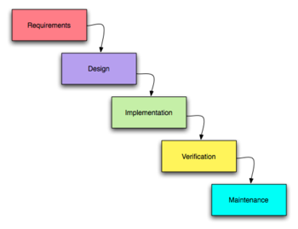
Development Models
Water Fall Model – do one phase at a time for all requirements given by customer

Slide 12
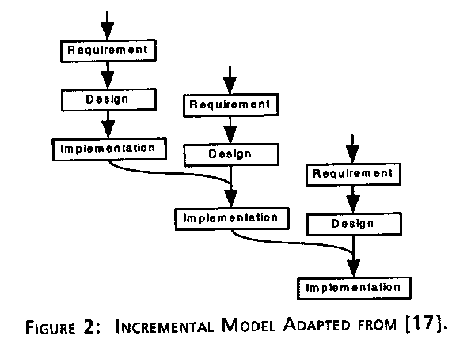
Development Models
Incremental Model – take smaller set of requirements and build slowly

Slide 13
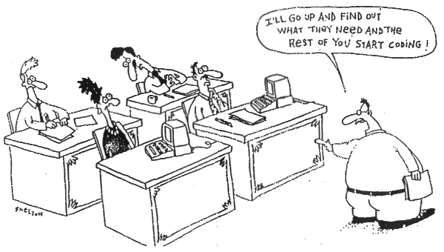
Development Models
Extreme Programming Model – take only one piece and develop!

Slide 14
Testing Vs Debugging
Testing is focused on identifying the problems in the product
Done by Tester
Need not know the source code
Debugging is to make sure that the bugs are removed or fixed
Done by Developer
Need to know the source Code

Slide 15
System Testing Process
Plan
Create master test plan (MTP) – done by test manager or test lead
Create Detailed Test Plan (what to test) – by testers – this will contain test scenarios also known as test conditions
Create Detailed Test Cases (DTC) – how to test – by testers
Execute
Regress and Analyze

Slide 16
Random Testing
Use a random number generator to generate test cases
Derive estimates for the reliability of the software using some probabilistic analysis
Coverage is a problem

Slide 17
Types of Testing
Functional (Black box) vs. Structural (White box) testing
Functional testing: Generating test cases based on the functionality of the software
Structural testing: Generating test cases based on the structure of the program
Black box testing and white box testing are synonyms for functional and structural testing, respectively.
In black box testing the internal structure of the program is hidden from the testing process
In white box testing internal structure of the program is taken into account
Module vs. Integration testing
Module testing: Testing the modules of a program in isolation
Integration testing: Testing an integrated set of modules

Slide 18
Functional Testing, Black-Box Testing
Functional testing:
identify the the functions which software is expected to perform
create test data which will check whether these functions are performed by the software
no consideration is given how the program performs these functions, program is treated as a black-box: black-box testing
need an oracle: oracle states precisely what the outcome of a program execution will be for a particular test case. This may not always be possible, oracle may give a range of plausible values
A systematic approach to functional testing: requirements based testing
driving test cases automatically from a formal specification of the functional requirements

Slide 19
Structural Testing, White-Box Testing
Structural Testing
the test data is derived from the structure of the software
white-box testing: the internal structure of the software is taken into account to derive the test cases
One of the basic questions in testing:
when should we stop adding new test cases to our test set?
Coverage metrics are used to address this question

Slide 20
Integration Testing
Integration testing: Integrated collection of modules tested as a group or partial system
Integration plan specifies the order in which to combine modules into partial systems
Different approaches to integration testing
Bottom-up
Top-down
Big-bang
Sandwich

Slide 21
Thank you

