Slide 1

Digital portfolio
DIGITAL PORTFOLIO
STUDENT NAME: lokesh.b
REGISTER NO AND NMID: 32324u09036 & Astvu32332324u09036
DEPARTMENT: Bca
College:voorhees college & Thiruvalluvar University

Slide 2
Project title digital portfolio
Project Title Digital portfolio Student digital portfolio Using html,css and javascript…

Slide 3
Agenda
AGENDA: 1.Problem Statement
2.Project Overview 3.End Users 4.Tools and Technologies 5.Portfolio design and Layout6 6.Features and Functionality 7.Results and Screenshots 8.Conclusion
9.Github Link

Slide 4
Problem statement
PROBLEM STATEMENT
Many students and beginnersin web developmentstruggle to
showcase their skills effectively. A personal portfolio website
provides a professional way to display projects,share contact
Details, and demonstrate technical abilities.

Slide 5
Project overview
PROJECT OVERVIEW
This project is a responsive personal portfolio website
built with HTML, CSS, and JavaScript. It includes
sections such as Home, About, Projects, and Contact.
The website is mobile-friendly and highlights both
design and functionality

Slide 6
End User
End Users
Students who want to showcase academic or personal
projects
Recruiters and employers reviewing candidate skills Anyone interested in the student’s journey and projects

Slide 7
Tool and technologyies
Tools and Technologies
• HTML5 – for structuring content • CSS3 – for styling and responsive layout
• JavaScript (ES6) – for interactivity (menu toggle, smooth scrolling) • GitHub – for version control and hosting

Slide 8
Portfolio design and layout
PORTFOLIO DESIGN AND LAYOUT
• Header & Navbar: Sticky navigation with toggle menu for mobile • Hero Section: Introduction with name and tagline • About Section: Profile image and student background • Projects Section: Grid of project cards
• Contact Section: Email and phone details

Slide 9
Featured and Functionality
FEATURES AND FUNCTIONALITY
• Responsive design (desktop & mobile) Interactive navigation menu • Project showcase with hover effects
• Contact section with clickable email/phone links

Slide 10
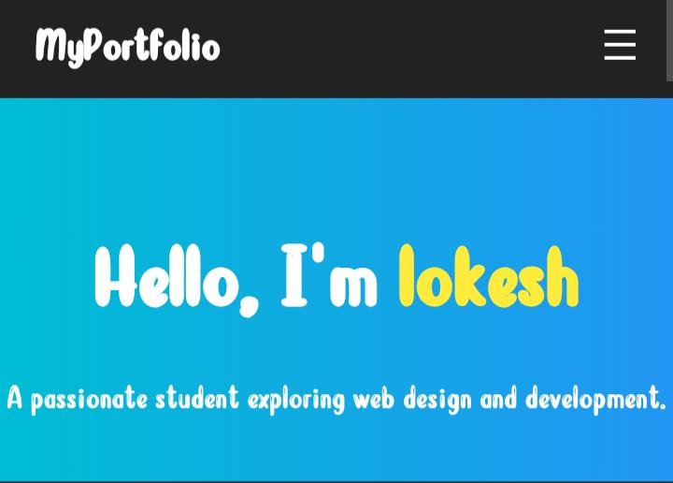
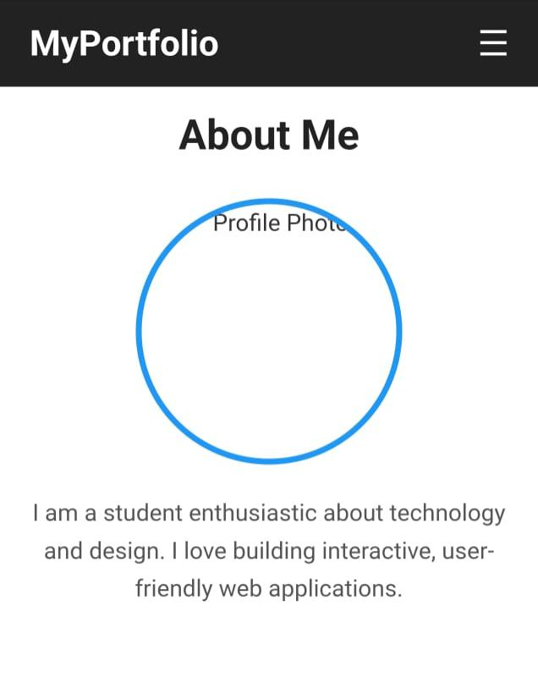
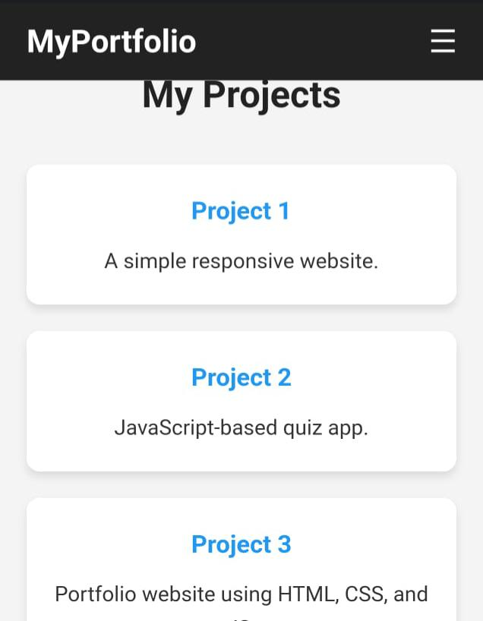
Screen shot sample sample

Slide 11
Conclusion
CONCLUSION
The portfolio website provides a professional platform
To highlight skills and projects. It demonstrates the
Use of fundamental web technologies and serves as a
foundation for more advanced web development.

