Slide 1

Student Counseling System
By: Lokesh Kumar Saini

Slide 2
INTRODUCTION
1)This project is used to manage student counselling system.
2) We have three different types of users in this project that are:
a)Admin b)Mentor c)Student
3) All of them have respective permissions to access the information.

Slide 3
Technology Used
Back End Technologies:
1) Python
2) Django(framework)
Front End Technologies:
1) Bootstrap
2) CSS
3) HTML

Slide 4
Working Model
HOME
HOME
LOGIN
SIGNUP
Student/ Mentor
Registered in respective Groups
Admin Dashboard
Student Dashboard
Mentor Dashboard
LOGOUT

Slide 5
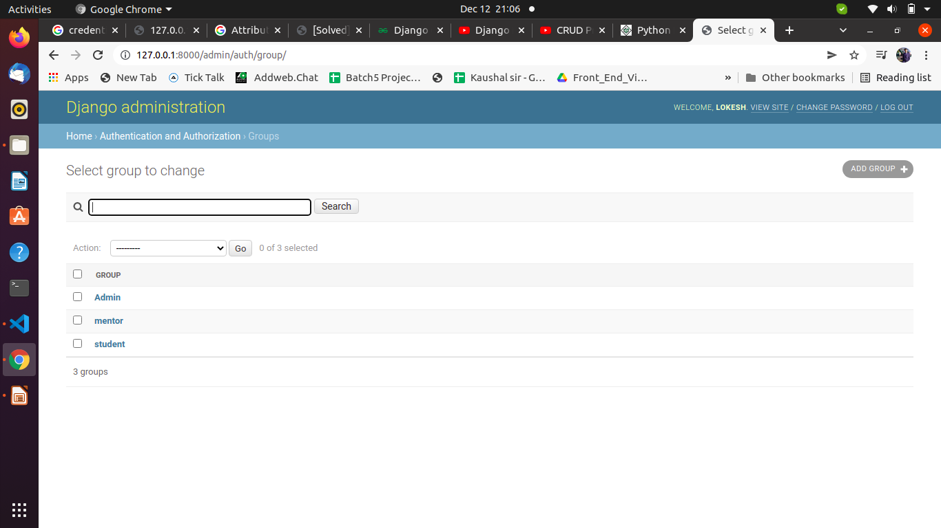
MODELS
a)Student Group
1)Can apply for the courses.
2)Can’t update,delete and add courses.
b)Mentor Group
1)Can add,delete,update courses
2)Can see their followers (students)
c)Admin Group
1)Have all the permissions to access the panel.

Slide 6
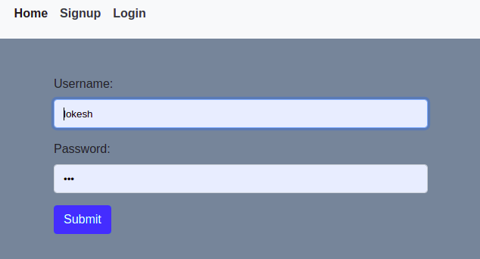
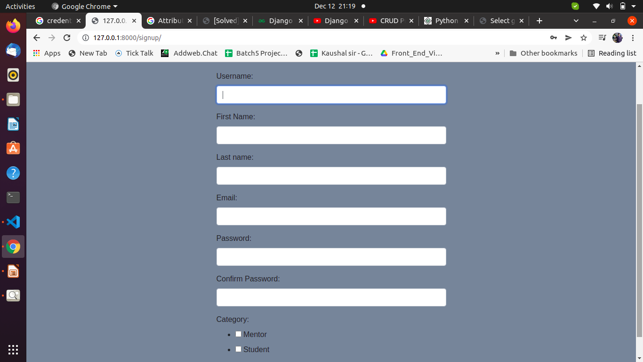
LOGIN AND SIGNUP FORMS
Login Form with validations
Signup Form with Category Choice and Validations

Slide 7
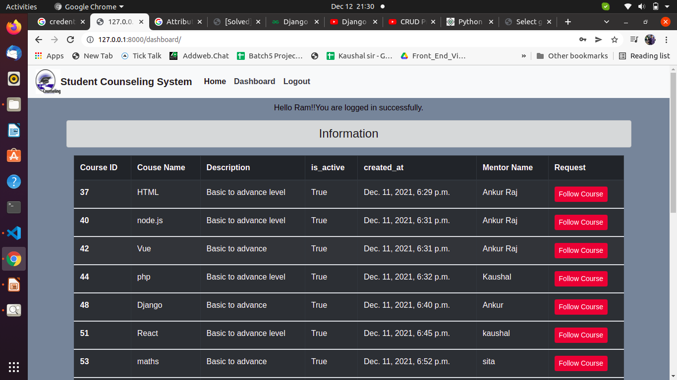
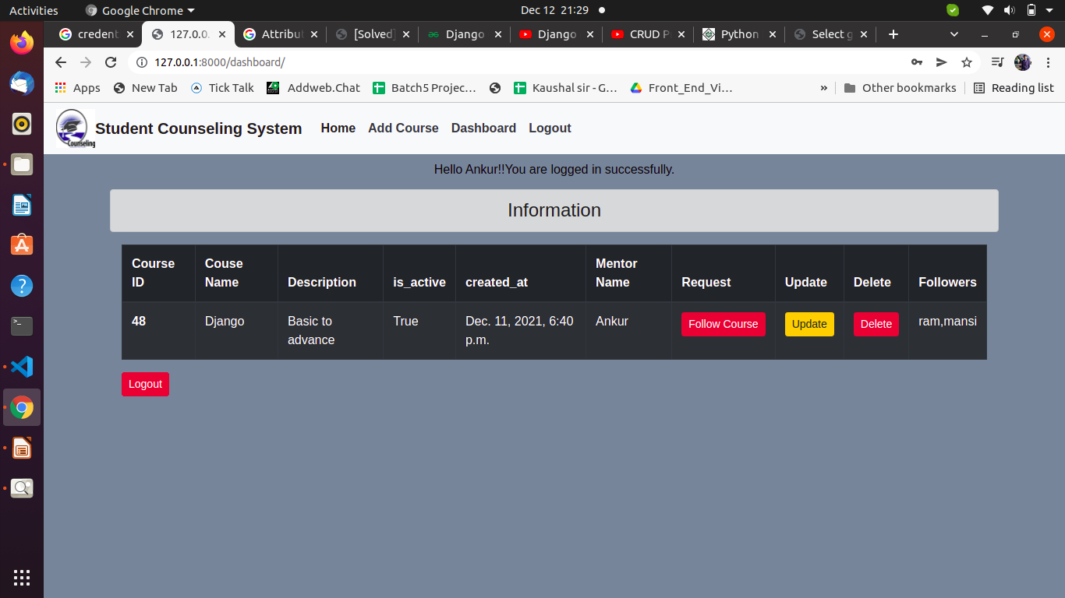
DASHBOARDS
1) Student Dashboard
2) Mentor Dashboard

Slide 8
References
Links:
1.https://docs.djangoproject.com/en/3.2/topics/auth/default/
2.https://developer.mozilla.org/en-US/docs/Learn/Server-side/Django/Introduction
3.https://docs.djangoproject.com/en/4.0/
4.https://getbootstrap.com/docs/4.0/utilities/colors/
5.https://stackoverflow.com/questions/629551/how-to-query-as-group-by-in-django

Slide 9
Thank You!!

