Slide 1
Paint
By A.Lokesh
1601-12-733-105
Under the guidance of
VIMALA MANOHARA RUTH

Slide 2
Paint With Graphics
user friendly painting program
colour palette
Tool bar
study of figures and their geometrical parameters
Focus- creation and analysis
Java platform

Slide 3
OBJECTIVES
To design a user friendly application and to make it more efficient.
To display the graphical representation of various 2 dimensional structures.

Slide 4
SYSTEM REQUIREMENTS
HARDWARE REQUIREMENTS
Processor: Pentium IV 2.4GHz processor
Memory: 512 MB
SOFTWARE REQUIREMENTS
Operating System: Windows 7
Programming Language Java
Java version: jdk 1.6.0_45

Slide 5
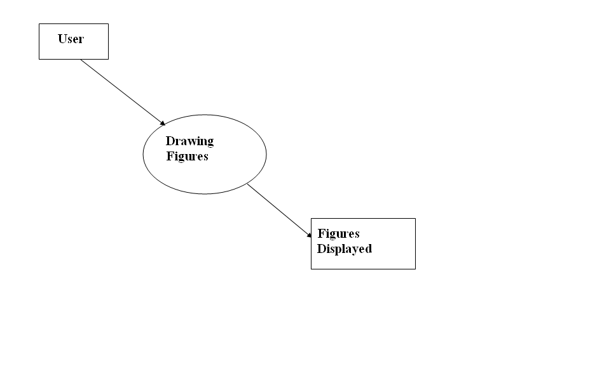
DFD LEVEL- 0

Slide 6
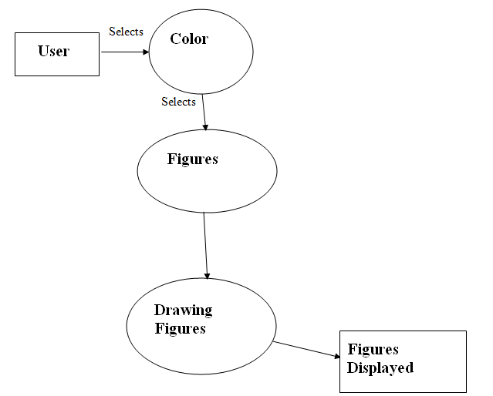
DFD LEVEL1

Slide 7
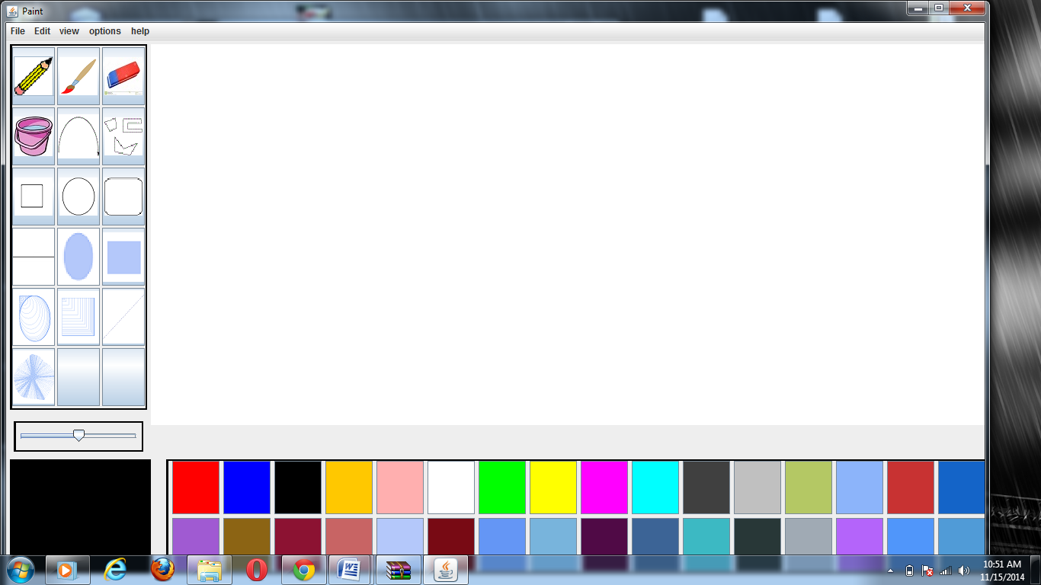

Slide 8
GUI Components
Here, Jbuttons in the tool bar are used to select from multiple tools and Combo Boxes to select foreground and background colors as well as to select the tool size.
JMenus were used for the top menu bar with dialog boxes.

Slide 9
GUI Layout
BorderLayout with a GridLayout is used to organize the toolbar, menubar and canvas to draw on.
Dialog Boxes were used to provide the user information in the program.

Slide 10
MouseListener and MouseMotionListener
The dragged method was used to provide the paint on the canvas. They enabled the graphic context to function on the canvas to display the user drawing input.
Event is performed by defining abstract methods of mouse Listener interface .methods like clicked,pressed etc

Slide 11
ButtonListener (ActionListener)
In order for the user to select different tools, I set an integer value for each tool and switched it when the user clicked a different button to change the event source.
It is implemented to indicate that an action is going to be performed when a Jbutton is clicked

Slide 12
Adjustment Listener
Usage of Jscrollpane controls the thickness of the tools like paint brush.

Slide 13
Tool Bar
List of Tools 6.polygon
1. Pencil 7.Round rectangle
2. brush 8. Rectangle
3. line 9. Oval
4. eraser 10.arc
5. Spray Can

Slide 14
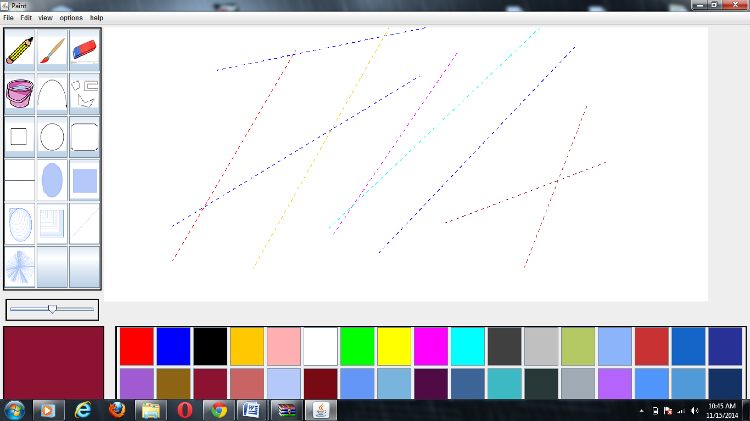

DRAWING USING PENCIL

Slide 15
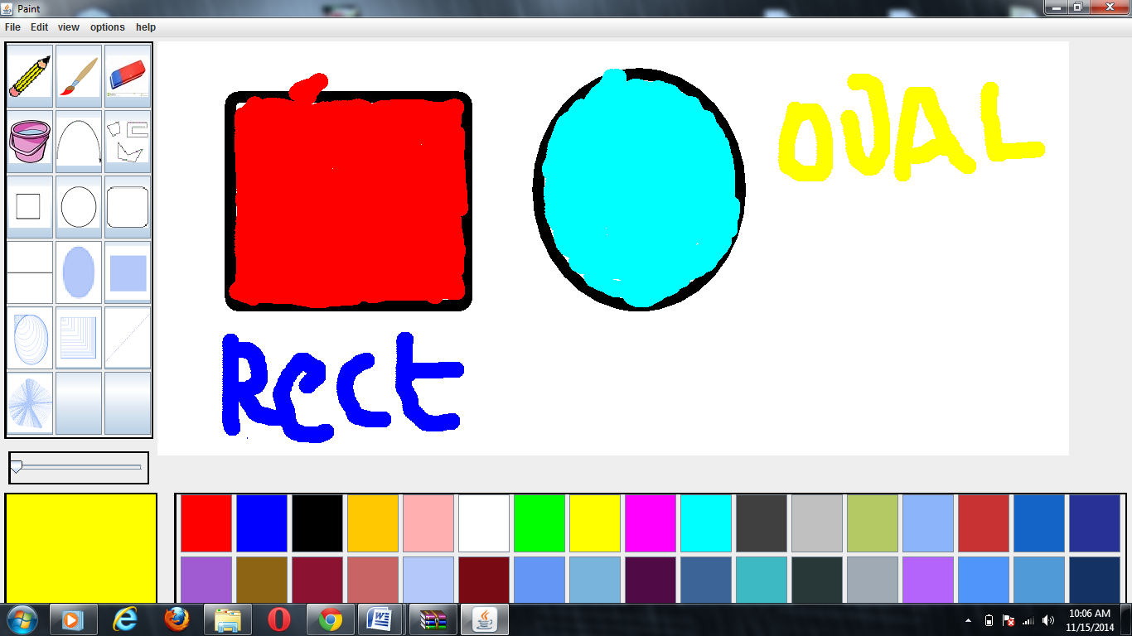
DRAWING USING BRUSH

Slide 16
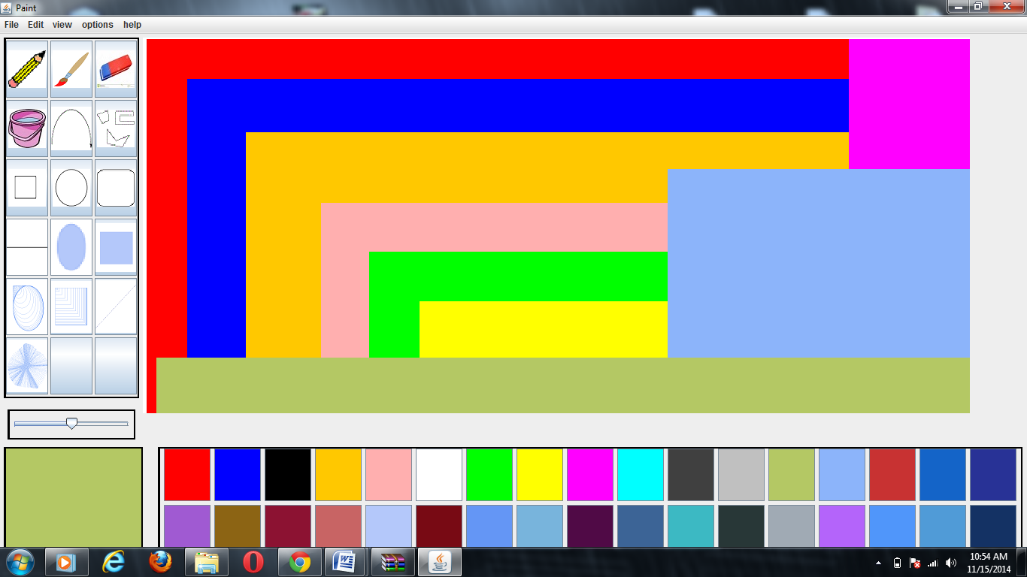
BY SELECTING PAINT BUCKET BUTTON BACKGROUND GETS CHANGED

Slide 17
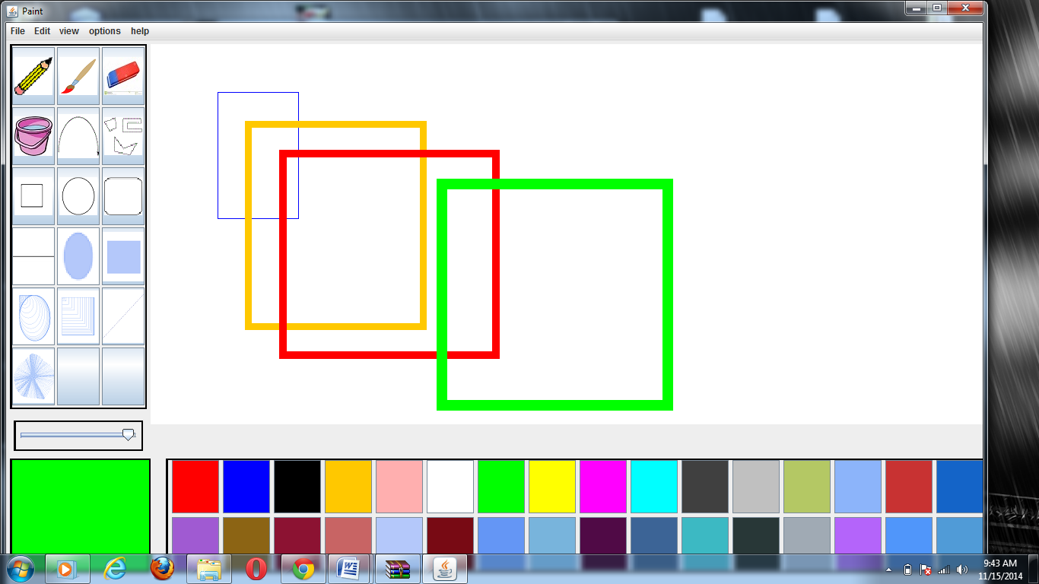
DRAWING RECTANLES

Slide 18
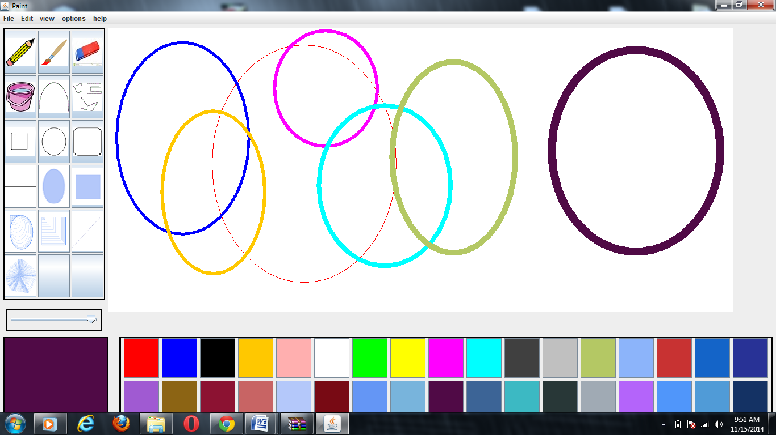
DRAWING OVALS

Slide 19
DRAWING ROUND RECTANGLES

Slide 20
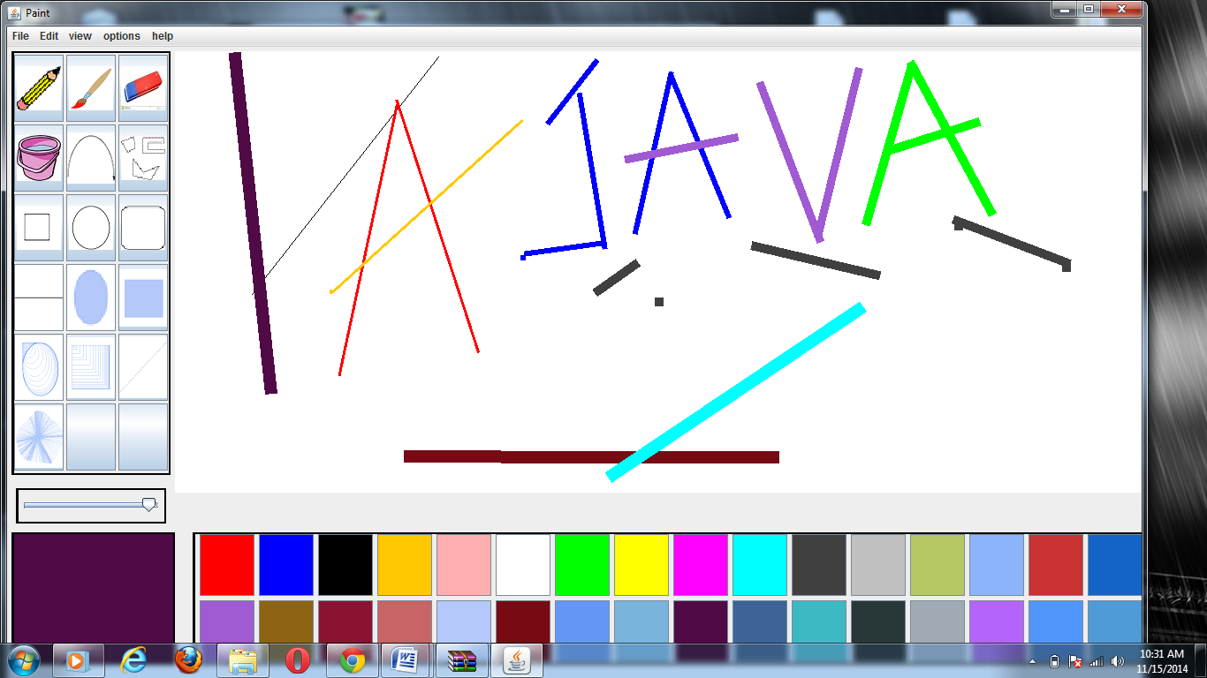
DRAWING USING LINES

Slide 21
Lessons Learned
I learned the vast possibilities Java provides. The object oriented aspect of Java makes it flexible to create applications, animations, games.

Slide 22
REFERENCES
[1] Herbert Schildt, The Complete Reference JAVA, Tata McGraw-Hill Edition,2007
[2] http://www.javaranch.com/

Slide 23
Thank you


