Slide 1
Most Popular components in syncfusion
- By Lokesh bala

Slide 2
Popular components
Data Grid
Charts
List View
Schedular
Diagram
PDF Viewer
Excel Library

Slide 3
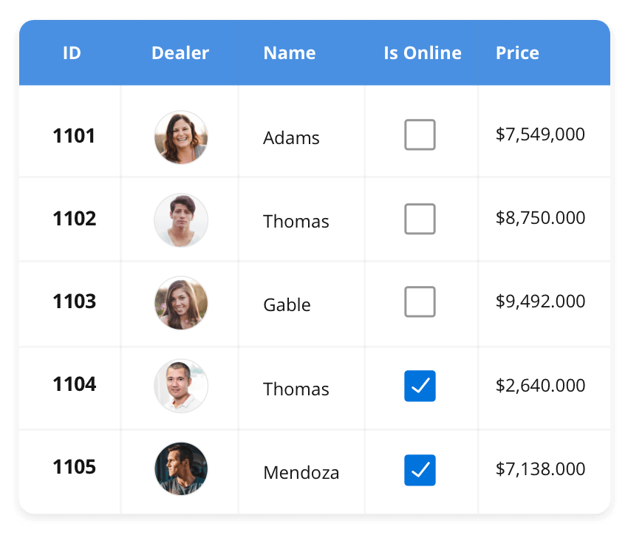



Data grid
The DataGrid control is a high-performance grid component that helps display and manipulate large amounts of data in a tabular format. Its rich feature set includes functionalities like data binding, sorting, grouping, editing, filtering, swiping, dragging, resizing, loading more items, pull-to-refresh, and exporting to Excel and PDF file formats.
Javascript
Angular
React
Vue
Blazor
ASP.NET MVC
ASP.NET CORE
WinForms
.NET MAUI
Xamarin
Xamarin
Flutter
UWP
Javascript
.NET MAUI

Slide 4
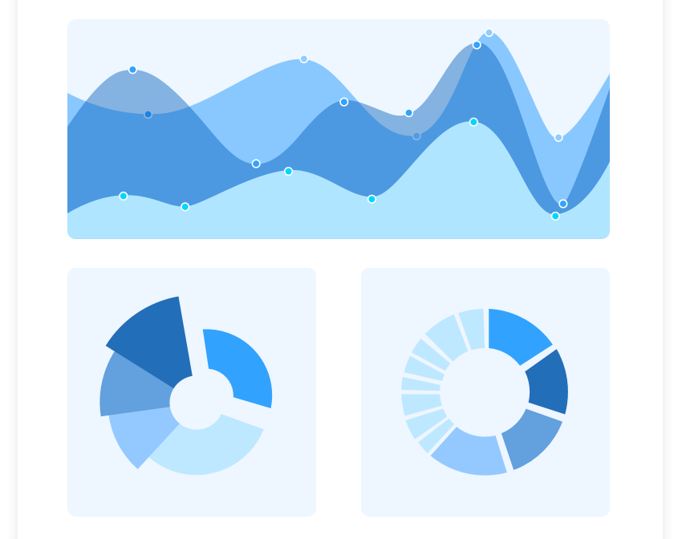
charts
The Charts control can plot a wide range of chart types, ranging from line charts to specialized financial charts. Its rich feature set includes functionalities like data binding, multiple axes, legends, animation, data labels, annotations, trackballs, tooltips, and zooming.
Javascript
Angular
React
Vue
Blazor
ASP.NET MVC
ASP.NET CORE
WinForms
.NET MAUI
Xamarin
Xamarin
Flutter
UWP
Javascript
.NET MAUI

Slide 5
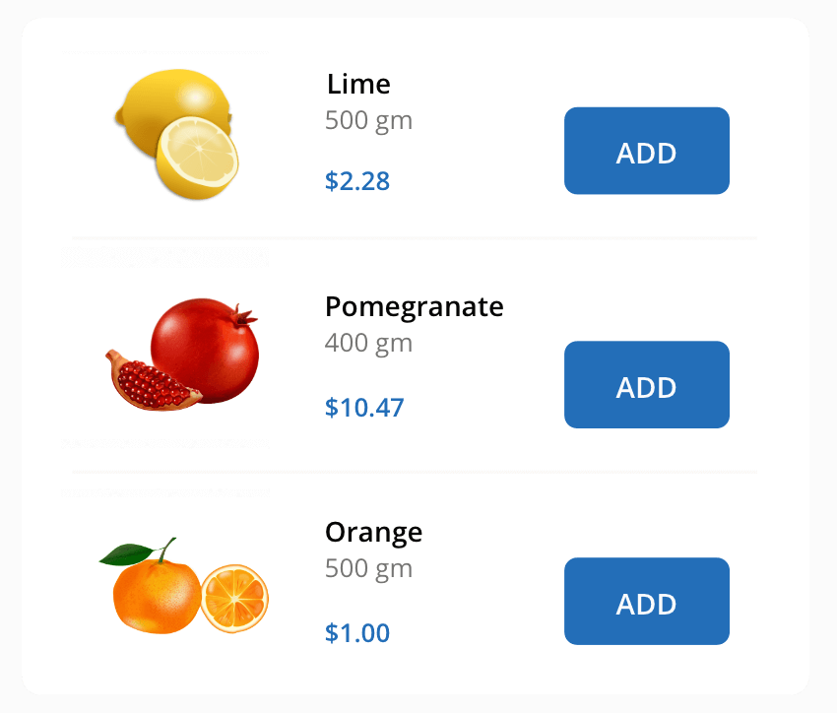
List view
The ListView renders a set of data items with UI views or custom templates. It has many features like grouping, sorting, filtering, paging, swiping, multiple selection, drag and drop, and different layout types. The ListView control has been optimized to work with large amounts of data.
Javascript
Angular
React
Vue
Blazor
ASP.NET MVC
ASP.NET CORE
WinForms
.NET MAUI
Xamarin
Xamarin
Flutter
UWP
Javascript
.NET MAUI

