Slide 1

Data 603: Big Data Processing
Data integration and Predictive analysis on Motor Vehicle Collision in NYC
Professor : Najam Hassan
By :
Mohammed Abdul Rasheed Khan
Suhana sheik
Dixith Kumar Bandari
Lokesh Chava

Slide 2
Introduction
We see many deaths related to accidents in day-to-day life.
To understand the factors of these accidents we will delve deeper into the data collected in the New York city.
There are three different datasets: crashes, vehicles and persons in Data.gov
We will merge these datasets and look at meaningful insights of these datasets.
We will visualize many scenarios such as when most of the accidents occur, what are the factors causing these accidents, at what time a greater number of accidents occur, and reasons for the accidents and fatalities causes in accidents.
This data will be helpful for the city’s traffic polices to avoid accidents and take necessary measures to avoid accidents and reduce deaths.

Slide 3
Objectives
The purpose of this project is to apply big data analytics on the dataset of New York state motor vehicle collisions.
The aim is to provide a more comprehensive and dynamic framework for evaluating the collisions and their time frames with all the details about the crash, location vulnerabilities and estimating damages.
Integrate the data from different datasets like collisions, vehicles and persons.
Perform Data Integration, Predictive Analysis, Visualization, Reports stating the recommendation to the Government to avoid further incidents and the locations to focus on.

Slide 4
Dataset Overview
Data Source: https://catalog.data.gov/dataset/motor-vehicle-collisions-crashes/resource/b5a431d2-4832-43a6-9334-86b62bdb033f.
The data set is fetched from “data.gov” which is a legitimate United states government website.
The data access is set to public and has different kinds of Datasets collected directly from the government organizations and private organizations functioning under the US government.
The data set has been updated lastly in September, 2023 and has over 2 million rows of data.

Slide 5
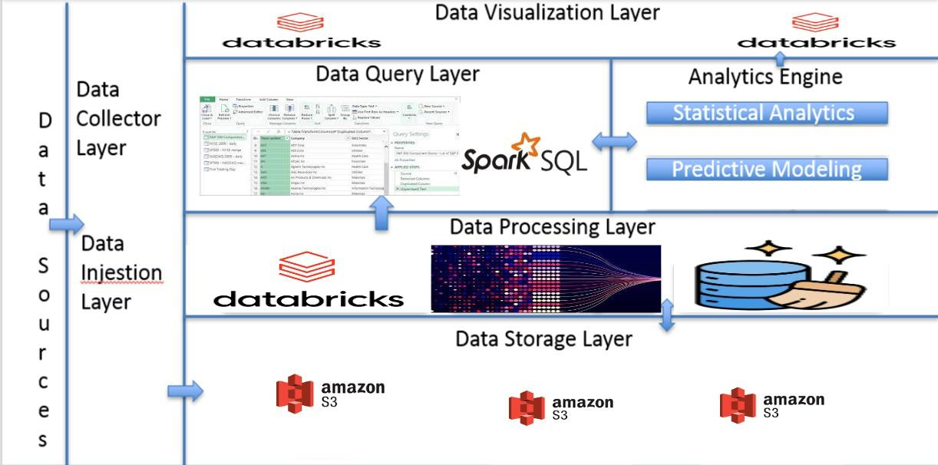
Tools and Technologies

Slide 6
Implementation of cloud storage using amazon S3 database.
Imputation of data sets into data bricks platform for data Pre - processing and integration.
Apache spark session is used for data stimulation integration of datasets into a single data frame.
Pandas, Seaborn and Sklearn Python packages are used for analysis and visualization of data.
Databricks dashboards created to generate reports with meaningful insights from the analyzed data.

Slide 7
Insights and Recommendations
In most of the crash's road occupants are main reason for the incidents followed by Bicyclists.
Friday is the most accident occurring day among all days.
10PM to 12PM is the most accident happening time zone.
Male stands as the primary culprit for crashes influenced by distractions, drugs, alcohol and aggressive driving
Crashes with vehicle defects includes Accelerator defective as the primary reason followed Breaks defective
Human factors include emotional influence, illness and hormonal imbalance
Second part collision factors are right of the way, other vehicles using headphones mostly committed by the female group.

Slide 8
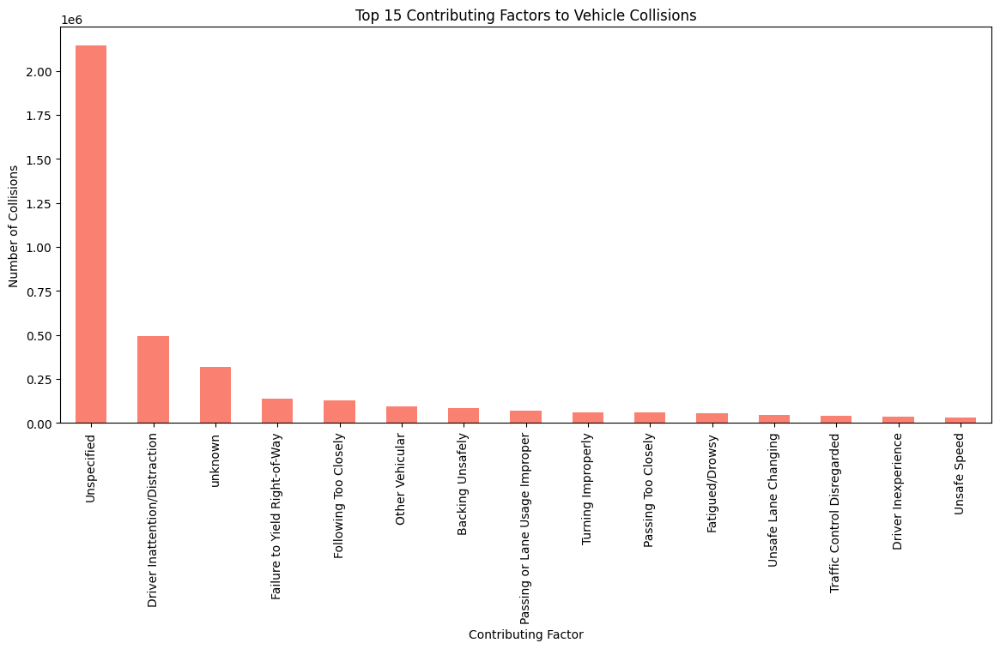
Top vehicle models includes sedan, SUV and passenger vehicles
Motorist persists more injuries at 72.8%, followed by pedestrians at 18.4% and cyclists at 8.8%
Top zip codes are 11207, 11101, 11236
2020 has all time low accidents with a stable count of crashes from 2021 till date and 2016 to 2019 being the most accident happen period.

Slide 9
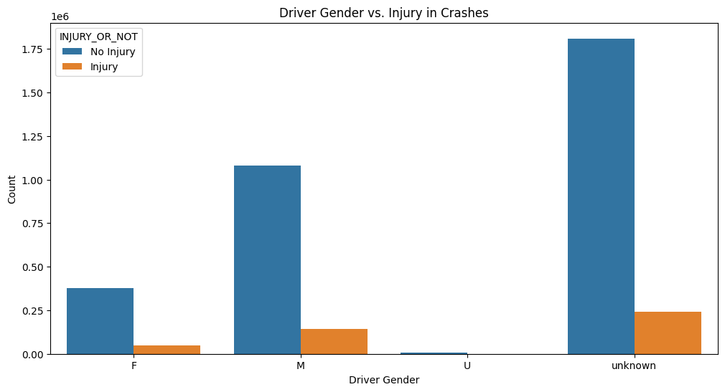
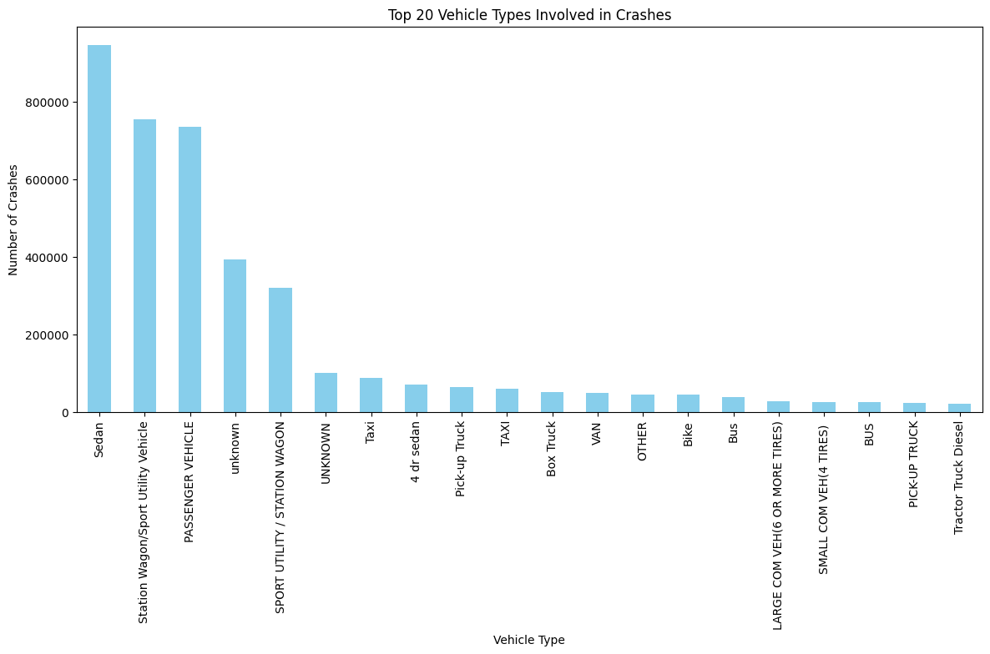
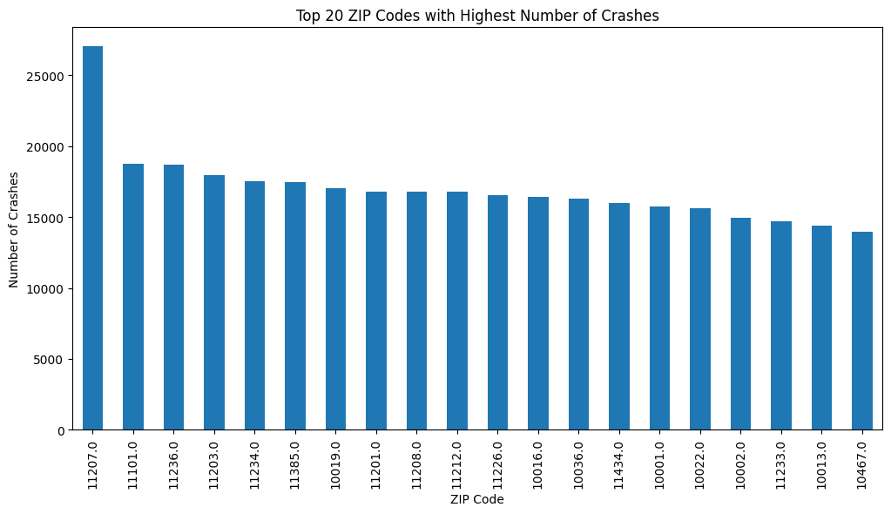
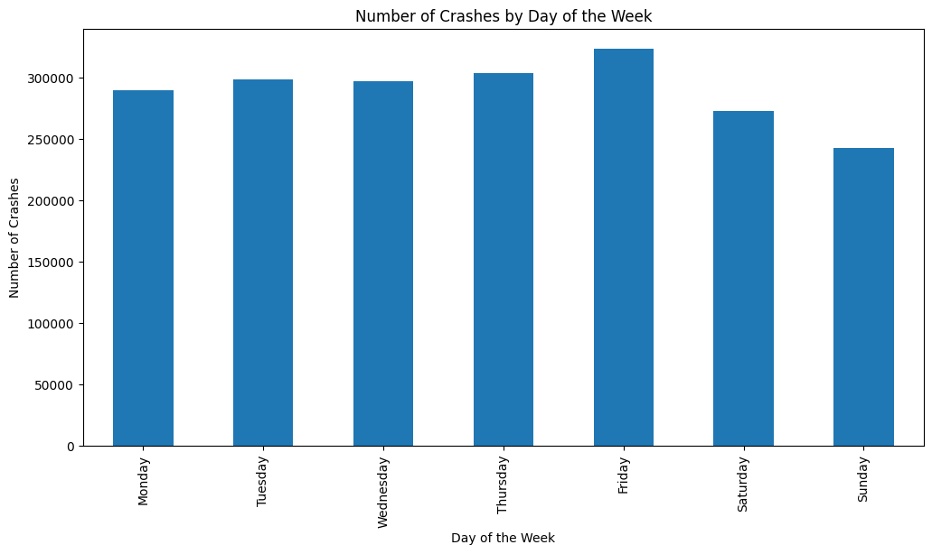

Slide 10
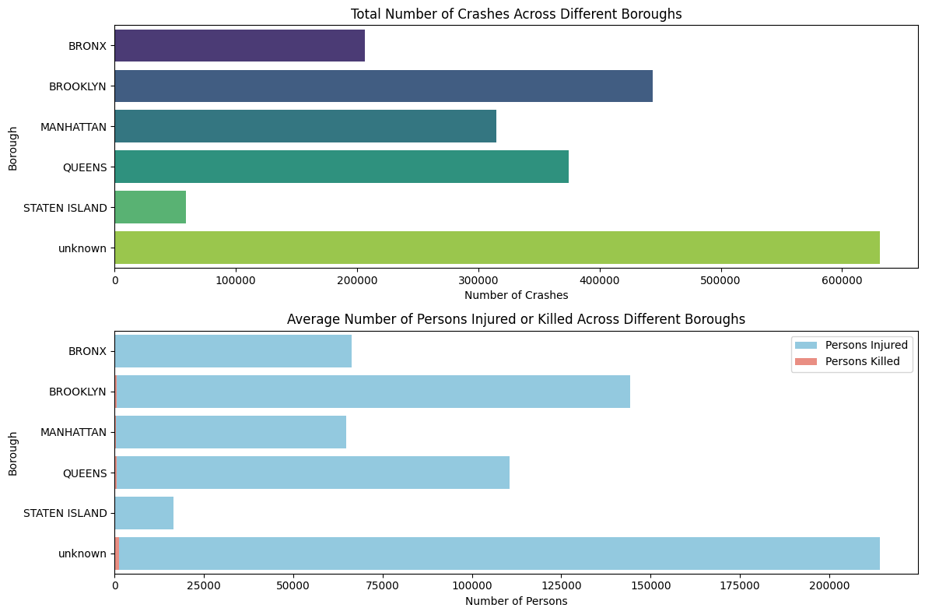
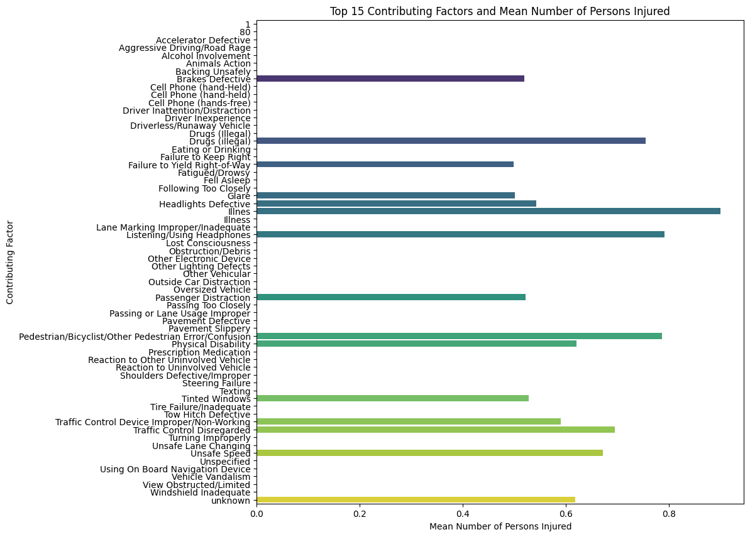

Slide 11
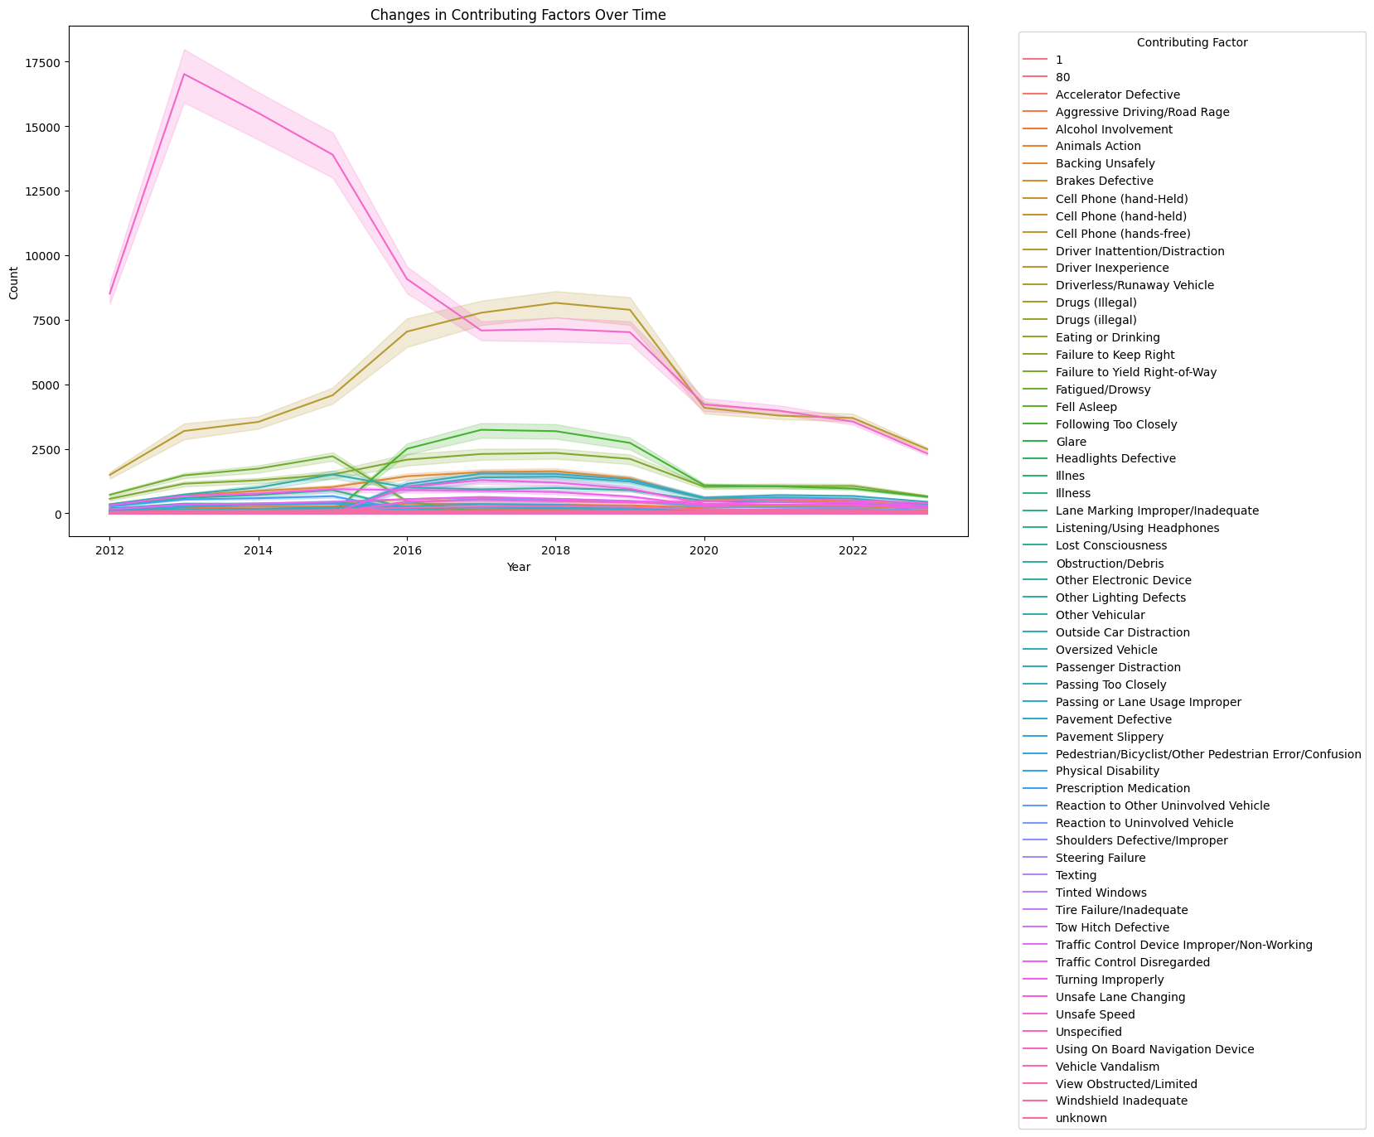
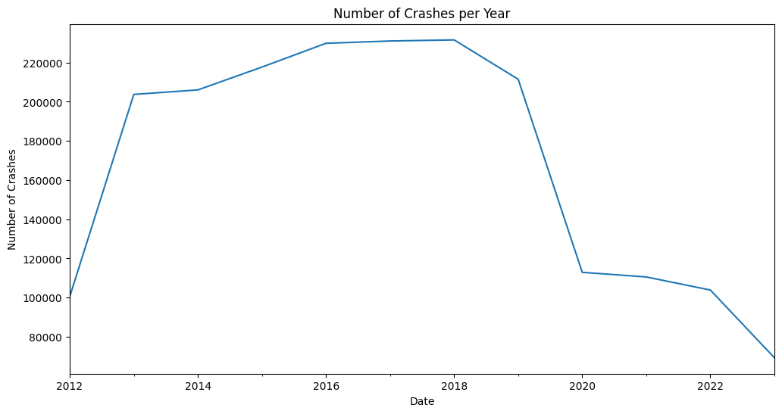
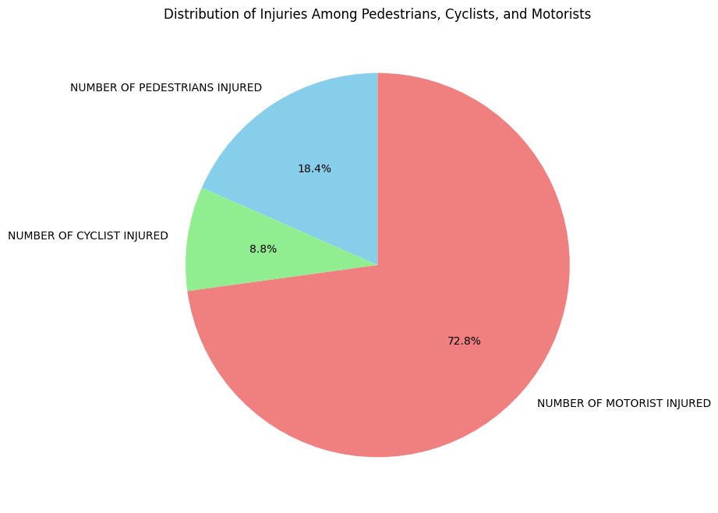

Slide 12

Future Opportunities
Advanced Analytics for Prediction
Integration with Autonomous Vehicles
Real-Time Data Analysis
Infrastructure Planning
Improved Emergency Response
Behavioral Analysis

Slide 13

Challenges
Data Quality and Standardization
Handling Big Data
Privacy Concerns
Interoperability
Ethical Considerations
Cybersecurity Risks

Slide 14
References
Motor vehicle collisions - Crashes - Comma separated Values file - catalog. (n.d.). https://catalog.data.gov/dataset/motor-vehicle-collisions-crashes/resource/b5a431d2-4832-43a6-9334-86b62bdb033f
Data 603 class work and reference materials.

Slide 15


